Slide 1
Plan and Deploy My Site for
Microsoft SharePoint Server 2010
OSP318
Chris Gideon
Senior PFE

Slide 2
Agenda
My Site Overview
Planning Considerations
  Architecture
  Users and Permissions
  User profiles
  Features
  Policies
Scalability/Performance

Slide 3
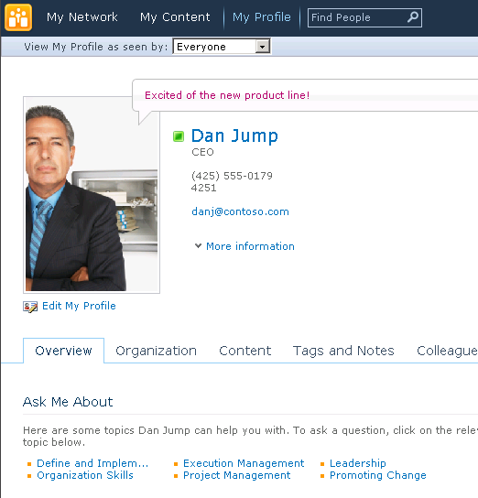
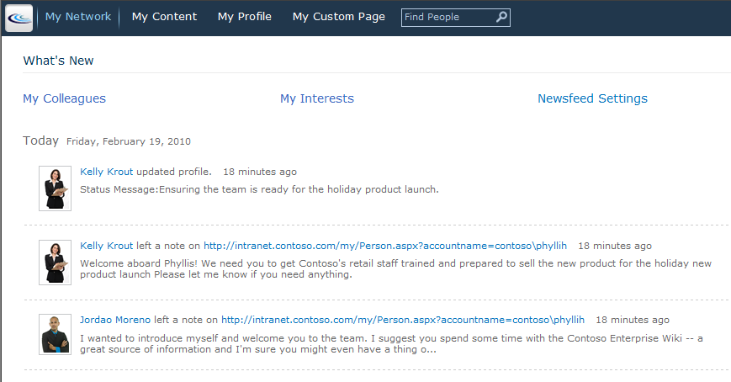
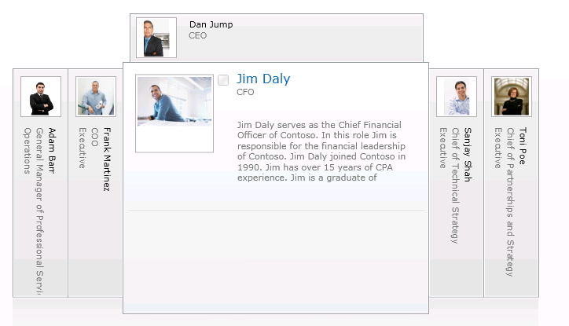
People Data
User Profiles
Personal Content
Social Data
  Tags, Comments, & Rating
  Activity Feed
Organization Browser
Manage Colleagues & Memberships
Office Business Card

Slide 4

Social Feedback
Feedback = Social Tags, Notes and Ratings
  Helps categorize, annotate, promote and help retrieval of relevant links
  Applies to any URL, inside or outside of SharePoint with bookmarklet
  Primary mechanism for promoting documents and web pages to the newsfeed
At the very basic level it is a 3-tuple
  Person, URI, Feedback

Slide 5
Profile Store Databases
Social Data Database
  Tags
  Comments
  Bookmarks
  Ratings
User Profile Database
  Profile
  Activity Feed
Sync Database
  Staging data
User Profile Service
Social Data
Profiles
Sync
Profile Service
Instance
Profile
Synchronization
Service
Instance

Slide 6
Tagging
Documents through Managed Metadata
Social through I like it or Tags & Notes
Controlled via the Social Data Maintenance Job
  Runs Hourly
Presented through Tags & Notes on My Site
Items are written to the Social DB

Slide 7
Tag Profile
Each Tag has a profile
Follow this Tag in my newsfeed
  Shows in My Interests
Add to “Ask me about” in My Profile
View people who are following this tag
  People Search
FAST Search
  Doesn’t Index Social Tags
  “There are no available items tagged with”

Slide 8
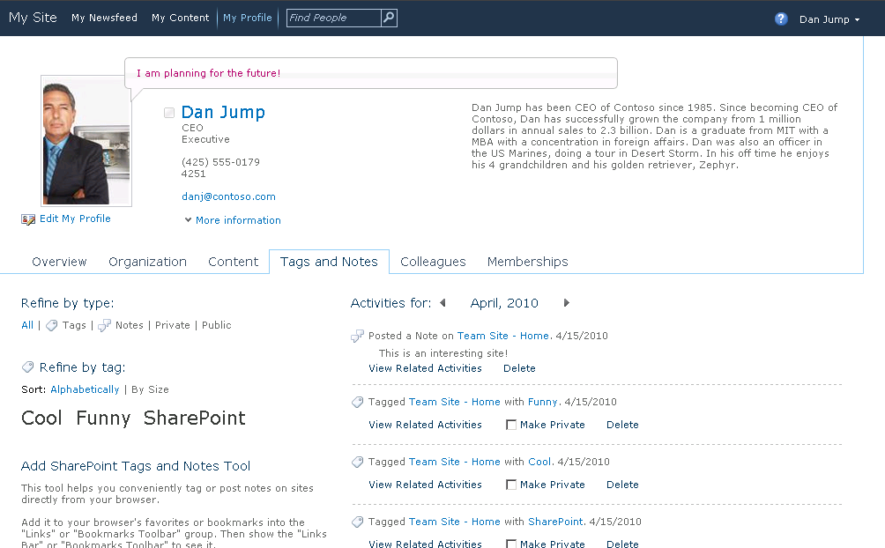
Social Networking
Tracking Colleagues
  Better, more readable “newsfeed”
  Tracking colleagues for
  Extensible for third parties
Email notifications
  Note board
  Colleague addition
  Keywords suggestions
Profile Updates
  Alerts to update profile
  Status message

Slide 9
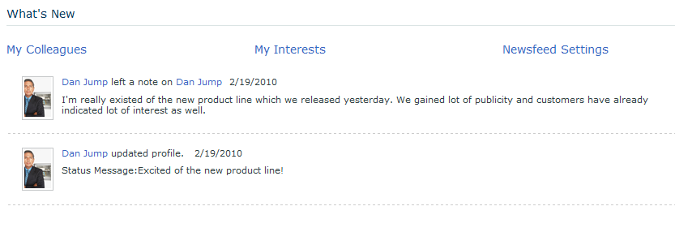

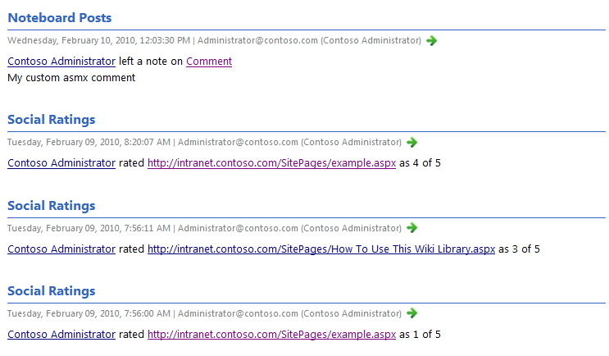
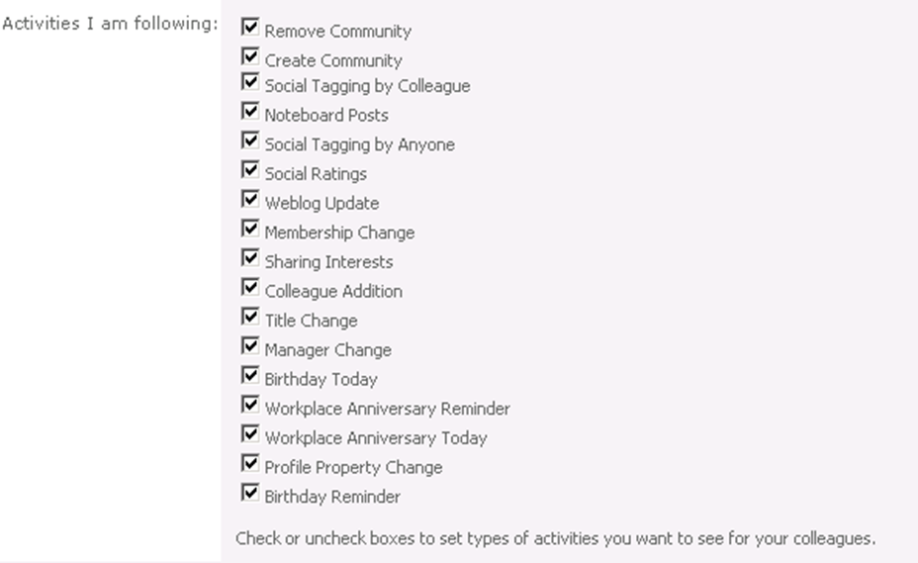
Activity feeds

Slide 10
Activity Feeds
Extensible Enterprise Activity Feed
  Web part
  Atom 2.0 feed
Two types
  Consolidated – activities from everything I track
  Published – my activities

Slide 11

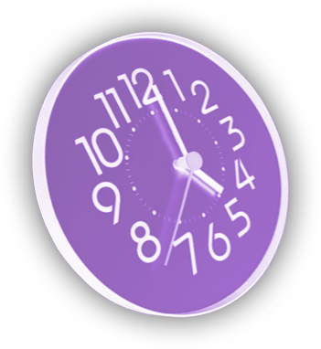








Activity feed architecture
User actions in SharePoint or any other application can be collected to activity feeds and published to colleagues
User feed depends on interests defined in the profile page – Custom applications and types shown here as options
Activity Feed
Activity Feed - User profile DB
Activity Timer Job
Custom Timer Job
Custom Timer Job
Custom Timer Job
Profile and social gatherers
Custom gatherer
Social database
Change log - User profile DB

Slide 12
Activity Feeds
Activity Feed timer job
  Hourly
Surfaced in People Search
  Requires a crawl
Activity Feed Cleanup Job
  Every 14 Days
  Compliance Warning

Slide 13
Email Updates
Dependent on the User Profile Change Job
  Hourly
Activity Feed Timer Job displays Colleagues on the Newsfeed
  Hourly
No Opt out of being tracked
Can be turned off
  HKEY_CURRENT_USER\Software\Microsoft\Office\14.0\Common\Portal\ColleagueImport\Enabled

Slide 14
Ratings
3 Timer Jobs
  Social Data Maintenance
  Activity Feed
  Social Ratings Sync
    Replicates to Content DB
  Can be disabled but Farm wide

Slide 15
My Site
Features and Administration
demo

Slide 16
Planning Considerations
What would be a logical architecture design?
What users are allowed and with what permissions?
What user profile information will be used and from what source(s)?
What features will be enabled?
What policies will be used to protect information in the public profile?

Slide 17
Trusted My Site Host Locations
Multiple Server Farms or UPAs
  e.g. Geographic deployment
  Users can create multiple My Site
Trusted My Site Host Locations
  Users have single My Site
  Redirects users to the correct My Site

Slide 18
Multilingual Implications
Personal sites in different languages but the My site host is in a single language
Partial support for MUI: Some UI elements will show up in preferred language: ribbons, tabs, site action menus.
Only the language (default) of the My Site Host is used for discovering the language phonetic on people search.
Not all of the attributes in the profile can be translated

Slide 19
User Profile Service
Collects user information from directory services and adds properties from BCS
Synchronization Planning Tips
  Start with the user profile default properties.
  Identify directory services connections.
  Consider line-of-business applications.
  Directory services create users (rows). Biz system data adds properties (columns).

Slide 20
User Profile Import/Export
User Profile Service
New in 2010
Active Directory
LDAP
  Novell eDirectory
  SunOne
  IBM Tivoli
BCS (Import only)
Profiles
Sync
Profile
Synchronization
Service
Instance
Active
Directory
LDAP
Business Connectivity
Service
http://technet.microsoft.com/en-us/library/ff182925.aspx

Slide 21
Profile Sync Overview
FIM
Metaverse
AD1
11
3
7
AD
MA
MSS
MA
AD2
1
8
9
ADn
2
4
5
12
13
Profiles
AD Import
MSS Import
AD Sync
MSS Export
Confirming Import
MSS Post Processing
MSS Sync
AD Export
Confirming Import
BDC Import
BDC Sync
MSS Export
Confirming Import
MSS Post Processing
BCS
10
6
14
HR
Sales
LOBn

Slide 22
Self-Service
BCS doesn’t support write back for Profile properties.
No support for External FIM today
Using the version of FIM we shipped as part of MSS isn’t supported for anything other than AD, Sun, IBM, and Novell.
LDIF MA configuration is serviceable workaround for other LDAP providers

Slide 23
Claims Implications
Audiences only property-based
Profile mapping to a claims user is a manual process
  SPS-ClaimID property to the attribute that uniquely identifies the user and then start a full profile synchronization.
Custom code for People Picker
Outlook Social connector is Windows only.

Slide 24
Policies
Which properties should be mandatory?
  Account name, department..etc.
Which properties should be visible to everyone?
  Non-sensitive information
Which properties can be changed by users?
  Phone number, preferred name..etc.

Slide 25
Policies and Privacy Settings
Policies
  Enabled, Required, Optional, Disabled
  User Override
  Replicable
Privacy and Visibility
  Everyone
  My Colleagues
  My Team
  My Manager
  Only Me

Slide 26
Planning for Privacy
Social tagging may be culturally disruptive
Need to plan and decide
  Who can social tag/bookmark?
    Define an acceptable use policy
  What happens when the employee leaves?
  Security trimming of tags ON or OFF
    Pluggable architecture allows definition of rules and back ends
    Define how to handle non-SharePoint and external sites
    Only Indexed sites can be trimmed out-of-the-box
  Activity feed repercussions

Slide 27
Planning for Privacy
You will need to proactively plan for privacy
Key stakeholders are HR, Legal, IT and Business Drivers
Top Issues for My Site deployment
  Picture usage
  Activity feed
  Custom Fields

Slide 28
Scale
Database Capacity
  2M user profiles with social features
  600 million tags/notes
Active users create 4.5 tags and 1.8 comments per month
  2 million users: 10% Active users: 200,000
  In 2 years, total number of tags and notes:
  200,000 x 2 x 12 x (4.5 + 1.8) = 30.24 million
Throughput
  200K users/600K groups takes 1W to full sync
  # of groups is larger factor than # of users
  Tags/Notes are not synced – do not affect numbers

Slide 29
Planning for Scale
Can be very large datasets
  Enterprise metadata generates tags
Estimating the amount is not trivial
  Use a model
  Make assumptions
  Track usage and reapply
Need to scale UP, not OUT
  Keep managed metadata, profile and search services together

Slide 30
Sync Throughput Planning Factors
# of groups
Size of groups
# of users
Users | Groups | Largest Group | Duration* (Full Sync)
50K | 0 | NA | 2.5 hrs
50K | 12K | 50 | 5 hours
180K | 45K | 1000 | 33 hrs
200K | 600K | 200K | 250 hrs
Expect a 50% improvement with December CU
* Directory Service Only

Slide 31
New Guidance
Export to Directory Services Only (AD, LDAP)
Sync on a dedicated SQL box
  Lots of memory, up to 4500 IOPS
Global deployments
  UPRE
Updates for Dec CU & SP1
  UPA reliability/perf
Complex filters for the connections: Create them in FIM, edit them in FIM Only

Slide 32
Summary
My Sites are Improved
Social Features Require Planning
Geographically Distributed Organizations
Plan Technology and “People Policies”
Plan for Scalability & Performance

Slide 33





Resources
  Connect. Share. Discuss.
http://northamerica.msteched.com
Learning
  Sessions On-Demand & Community
  Microsoft Certification & Training Resources
www.microsoft.com/teched
www.microsoft.com/learning
  Resources for IT Professionals
  Resources for Developers
http://microsoft.com/technet
http://microsoft.com/msdn

Slide 34












Complete an evaluation on CommNet and
enter to win!

Slide 35


Slide 36

© 2011 Microsoft Corporation. All rights reserved. Microsoft, Windows, Windows Vista and other product names are or may be registered trademarks and/or trademarks in the U.S. and/or other countries.
The information herein is for informational purposes only and represents the current view of Microsoft Corporation as of the date of this presentation. Because Microsoft must respond to changing market conditions, it should not be interpreted to be a commitment
on the part of Microsoft, and Microsoft cannot guarantee the accuracy of any information provided after the date of this presentation. MICROSOFT MAKES NO WARRANTIES, EXPRESS, IMPLIED OR STATUTORY, AS TO THE INFORMATION IN THIS PRESENTATION.

