Slide 1

Lessons from Hackwarts Vol 1:
Defence Against the Dark Arts 2011
SIM 302
Andy Malone MVP, MCT
Senior Instructor
Andrew.malone@quality-training.co.uk

Slide 2


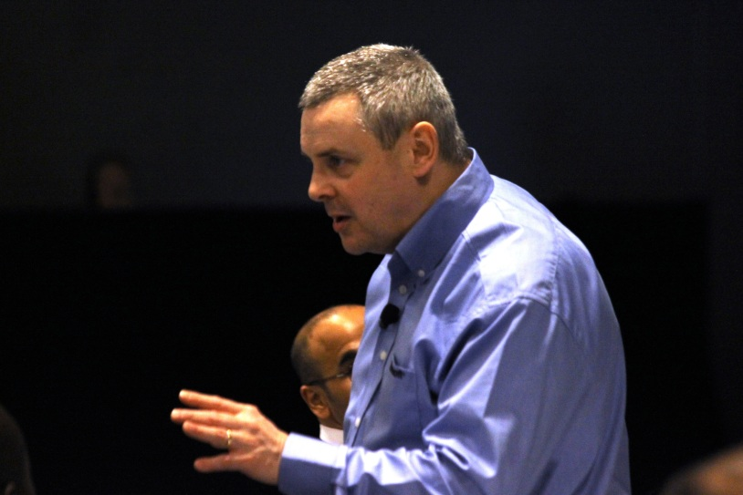
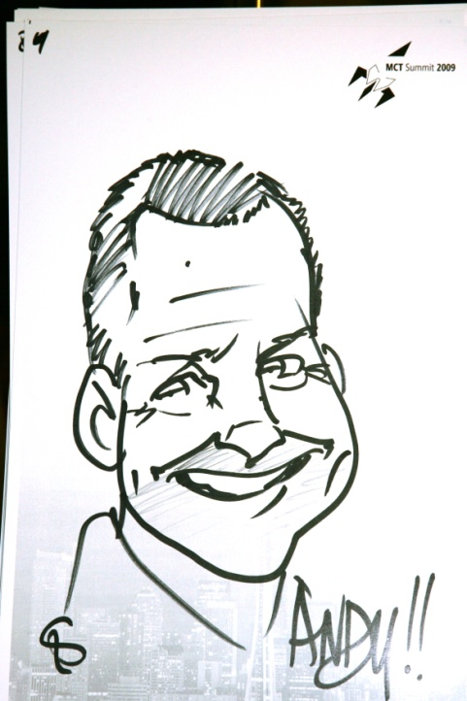
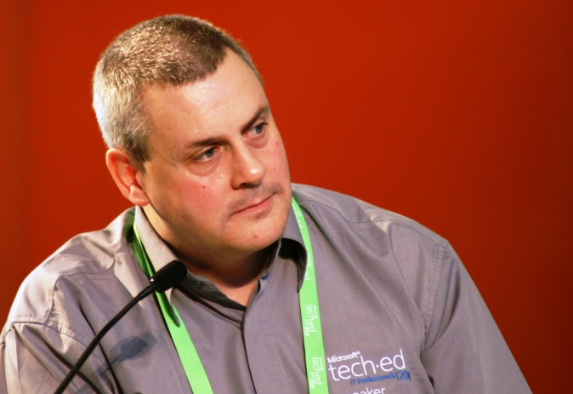
Andy Malone (UK)
Microsoft Certified Trainer MCT (16 Years)
Worldwide Security and Systems Consultant
Microsoft Most Valuable Professional MVP
Enterprise Security (5 Years)
International Event Speaker
Winner Microsoft Speaker Idol 2006

Slide 3
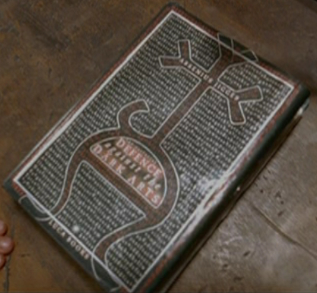
Coming up in this Session
Lesson 1: Understanding The Changing World
Lesson 2: Learn Why Security Fails
Lesson 3: The Rise of the Socio
Technical Society
Lesson 4: The Good Guy’s Wear Black! –
From Cybercrime to Cyber-warfare
Lesson 5: Defending against Advanced Persistent Threats (APTs)
Lesson 6: Defence Against the Dark Arts
Conclusions

Slide 4
Lesson 1:
Understand the Changing World…

Slide 5

The Changing World
The evolution of cloud computing
Increased mobile population
Increase in organized crime
Increased reliance on technology
Problematic border control
Technological advances
Increase in insider threat
Breakup of traditional workforce to home based
Focus on cost reduction!
Evolution of cyber-warfare

Slide 6
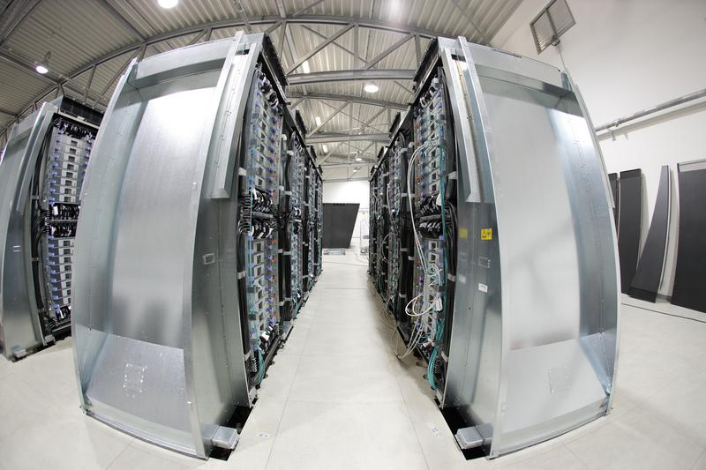
Lesson 1: The Changing World
Life in a cloud!

Slide 7
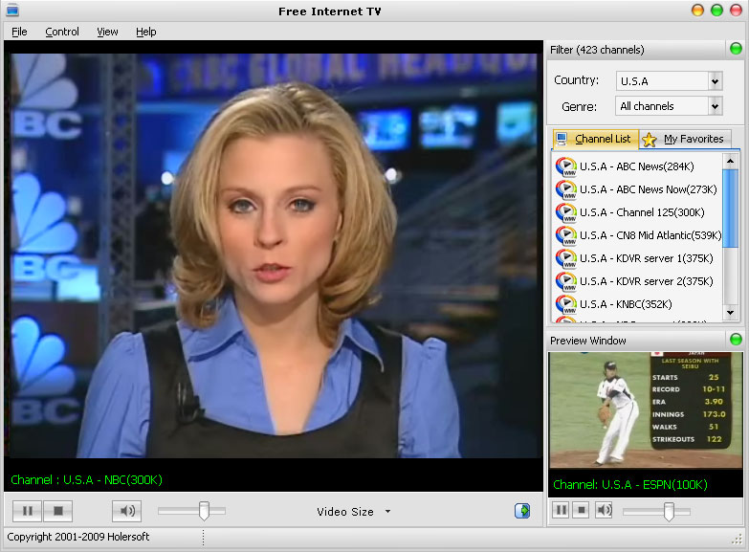
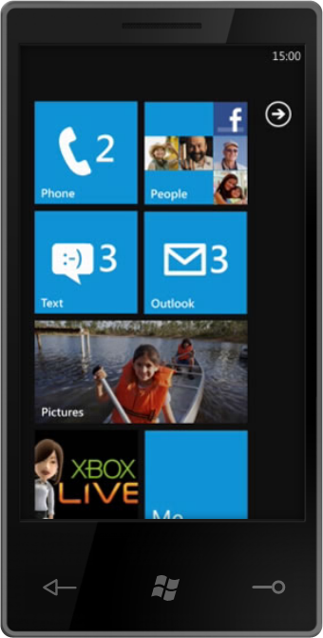
I Want It All and I Want It Now!

Slide 8
Lesson 2:
Understand Why Security Fails…

Slide 9
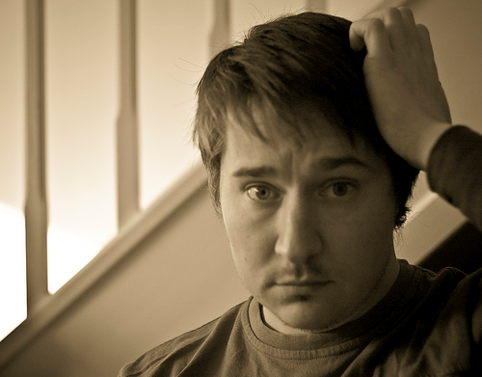
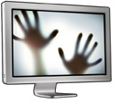
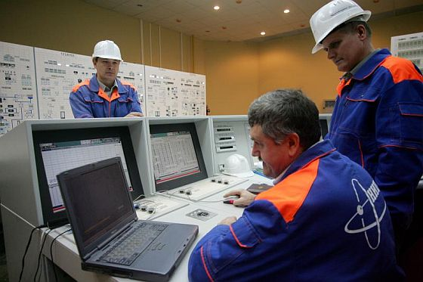
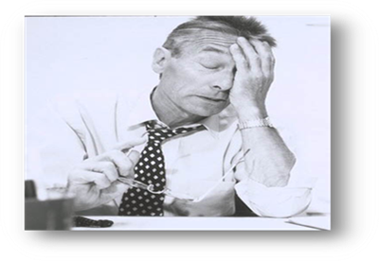
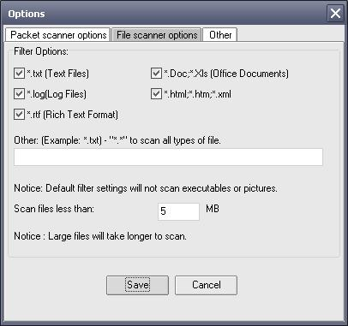
Why Security Fails “The 5 U’s!”
Unprepared
Uninformed
Unaware
Untrained
Unused

Slide 10
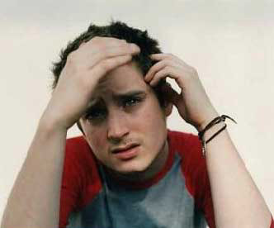
Security…I just Don’t get it!
Failure to Understand how Security Tools & devices actually Work!
Failure to Understand Emerging Technologies e.g. Cloud etc.
Inadequate Training
Failure in Management to Understand “Security Value” to Overall Business
Security Often Seen as a Needless Expense
Source: Dreamtime

Slide 11
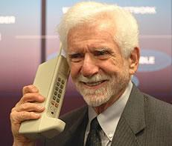
Hey Old Timer!
Failure to understand current trends
E-mail/Texting…Huh? that’s so 90s
Massive growth in social networking
  Facebook 600m users!
Mobile phone apps – massive market
Next gen high speed
protocol developments
Geo location services (creepy)
Near Field Communication (NFC)

Slide 12
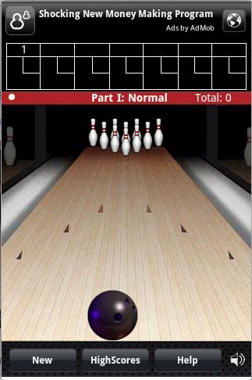
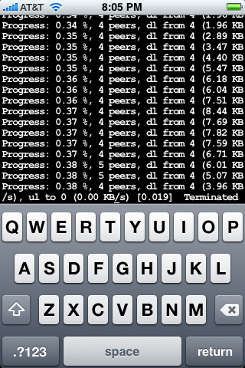
Failure to Understand Current Security Trends
Spear Phishing attack
Mobile malware
Follow the money
Mobile banking, eWallets
Follow the money
Proliferation of devices
Data centricity
Nothing forgotten,
everything searchable
Importance of Identity
Government comeback
DroidDream malware
iPhone/Privacy

Slide 13
Lesson 3:
The Rise of the Socio
Technical Society…

Slide 14

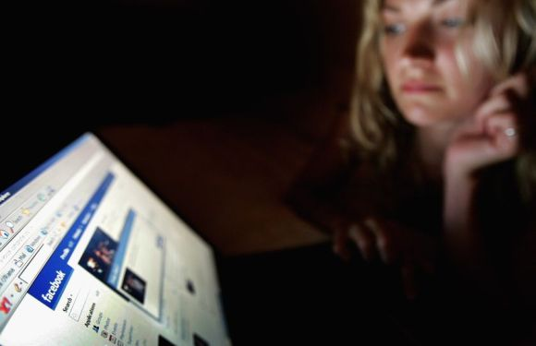
Lesson 3: The Rise of the Socio
Technical Society
The interaction between society's complex infrastructures and human behaviour

Slide 15
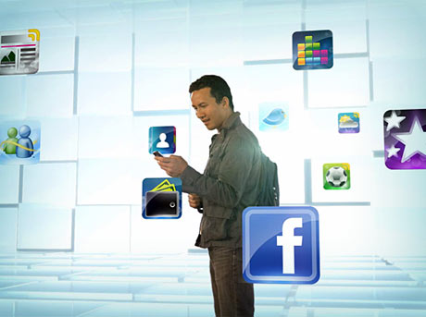
The Rise of the Socio Technical Society
For the first time in Human history, social networks have fundamentally changed the way the human
being interacts
Evolved social systems are changing
to complex socio technical systems
In the past we would only pass information to “close friends”, with technologies like Facebook this has become blurred
Result = less control and less privacy

Slide 16
What is “Privacy”?
The enforcement/maintenance and control over their personal information (PII)
Control over PII” means companies respect customer’s information by
  Being transparent about how PII is gathered and used
  Allowing customers to direct how we use their PII
  Limiting use of PII
  Providing a means by which customers can update their PII to ensure accuracy
  Striving to keep PII secure
  Working to ensure customers can access their data
Common privacy regulations e.g., customers comply with while using
Microsoft Online
  HIPAA, GLBA, FERPA, Mass 201, PIPEDA, and the EU Data Protection Directive along
  with the EU Model Clauses and security requirements in EU national privacy laws

Slide 17
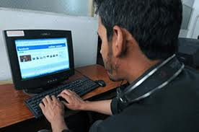

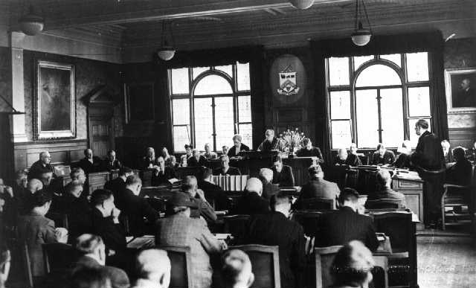
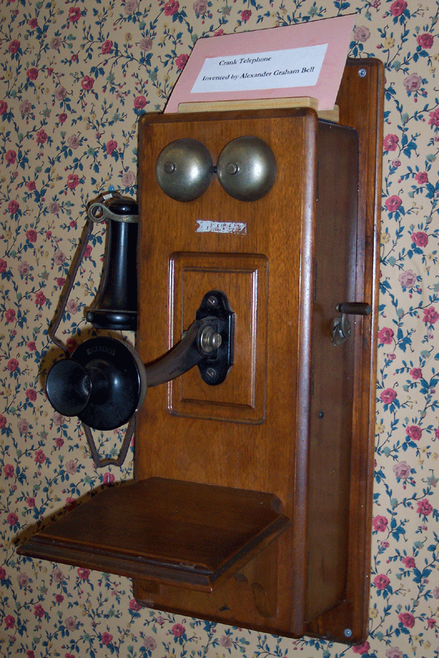
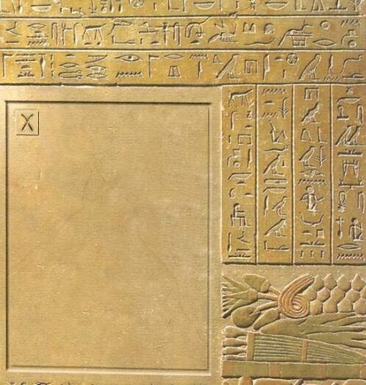
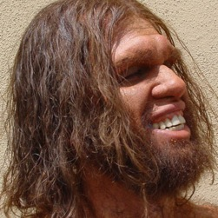
The Rise of the Socio Technical Society
Loss of
information control
Socio isolation
Socio
interactivity
Communicate
Learn
Gatherer/hunter

Slide 18
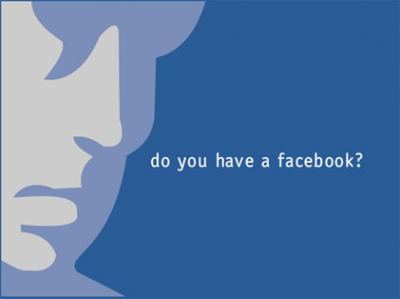
Threats in the Socio Technical Society
STS Security is difficult to define
let alone manage
New STS crimes are evolving
at a frightening pace
    Cyber stalking
    Cyber bullying
    ID theft
    Fraud
Nobody really understands what security is!
Nobody really knows how the security
tools work
Security focus is often too much on the “distant” attack – hacking, etc.

Slide 19
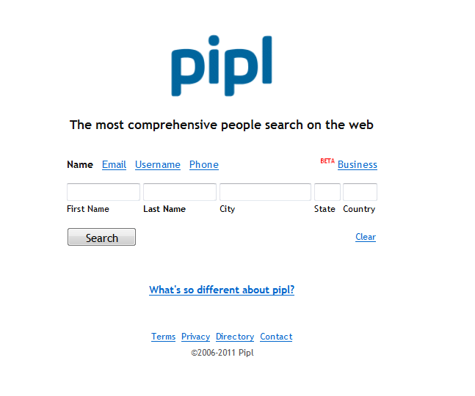
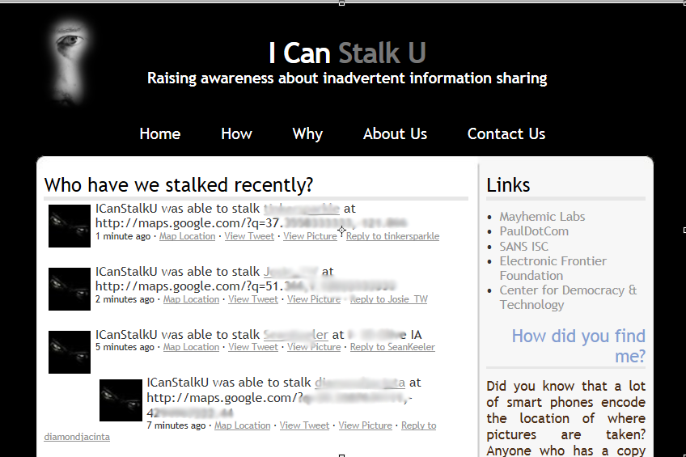
Welcome to Creepyville…

Slide 20
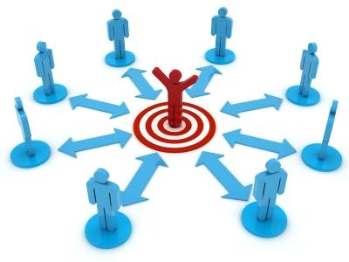
Data in the Socio Technical Society
Moore's Law rule is becoming blurred
Almost everything we do produces data
Data is like nuclear waste, it’s cheap
and thus NEVER depreciates, stays around forever!
STS has allowed personal security to be breached because of a fundamental lack of understanding or control
“Normal” security mechanisms fail because of these changes in human behaviour and interactivity

Slide 21
Lesson 4: Cyberwarfare…
When the Good Guy’s Wear Black!

Slide 22
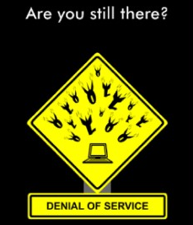
Think About This
What if the Internet went away
  For a day
  A week
  A month
No e-mails
No BlackBerry’s
(Er sorry, Windows Phones)
No eCommerce
Virtual business services of all sorts, accounting, payroll, and even
sales would come to a halt, as would many companies

Slide 23
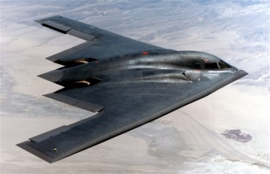
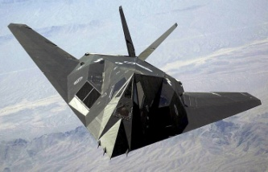


War versus Cyberwar!
What does a stealth bomber cost?
$1.5 to $2 billion
What does a stealth fighter cost?
$80 to $120 million
What does an cruise missile cost?
$1 to $2 million
What does a cyber weapon cost?
$300 to $50,000

Slide 24
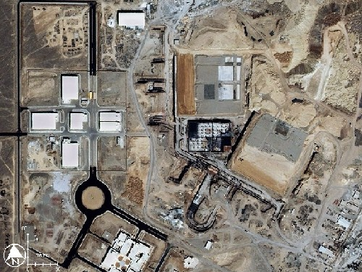
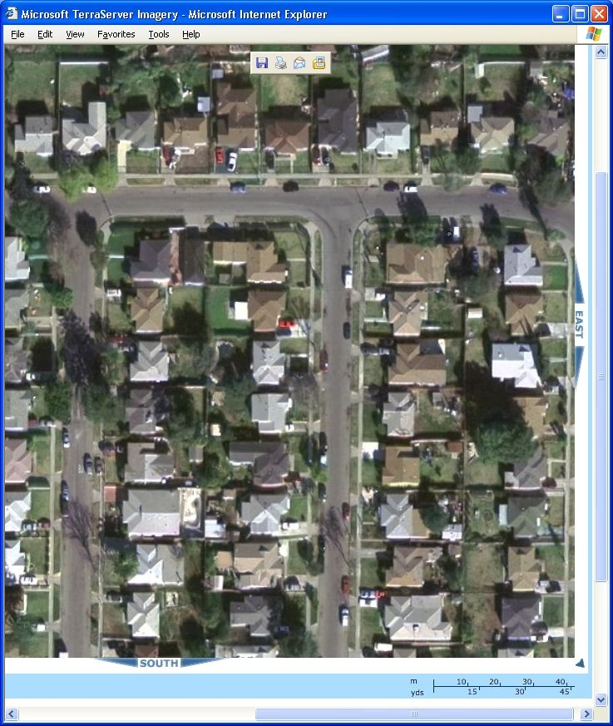
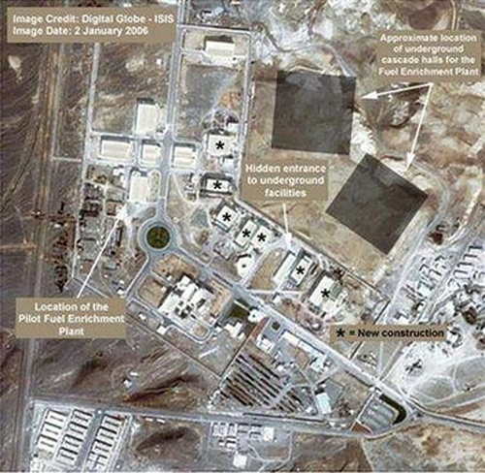
Find the Weapons of Mass Disruption!
Nuclear Weapons Facility
Cyber Weapons Facility
Where’s the Cyber Weapons Facility?

Slide 25
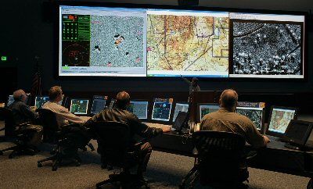
Cyber-Warfare
Why!
The Internet is vulnerable
to attack
High return on investment
Inadequacy of
cyber Defences
Plausible deniability
Participation of
non-state actors

Slide 26
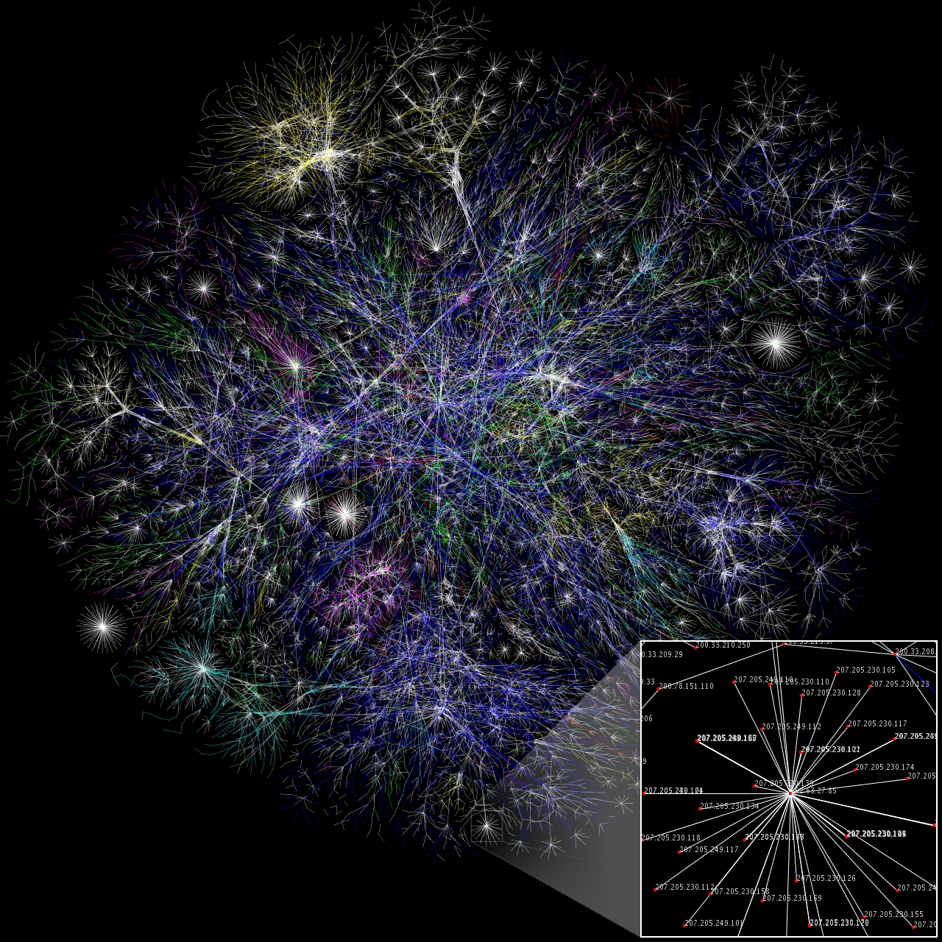
The Internet is Vulnerable to Attack
Imperfect design
  Hackers can read, delete, and modify information on or traveling between computers
  Common vulnerabilities
  and exposures (CVE)
  Database grows daily
  Difficult to guard all holes into your network

Slide 27
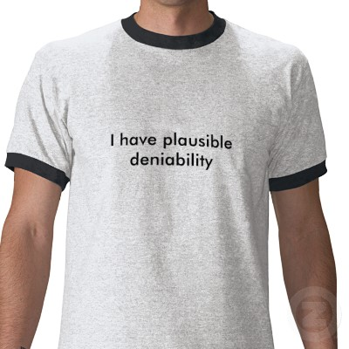
Plausible Deniability
Maze-like architecture of Internet
  Investigations often find
  only hacked box
Smart hackers route
attacks through
Multiple routes/servers
  Poor diplomatic relations
  No law enforcement cooperation
The problem of the last
hop, retaliation

Slide 28
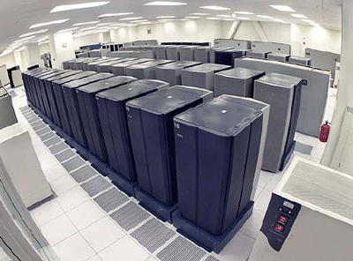
Cyber Warfare Tactics
Espionage
Propaganda
Denial-of-Service (DoS)
Data modification
Infrastructure manipulation

Slide 29
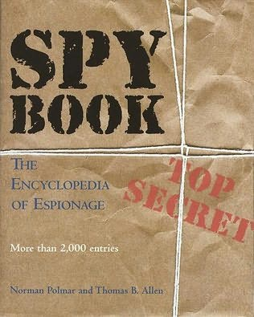
(1) The New Espionage
Universal media and intelligence gathering
  Binoculars, satellites, mass media, NMAP?
  Territorial sovereignty not violated
  Metadata and reading between the lines
  Picture taking, not physical invasion… right?
  If indefensible, normally
  not espionage!

Slide 30



Top Tip: Counter-Surveillance Techniques
Check for mysterious holes or spots on objects in the room, such as books, cases, folders, electronic goods, conduits, alarm systems, soft furnishings, etc.
Do any objects look out of place? Are any objects alien to the type of room that you’re in? Is the object meant to be there? Something could be concealed in that object
With respect to flooring, ceilings, walls and furniture, are any panels lose or have been tampered with?
Are you getting interference on any TVs, radios, phones or wireless networks? This might indicate a nearby electronic device
Check cables for computers, TVs, video systems, networks, etc. for Keyloggers, tampering or splicing

Slide 31
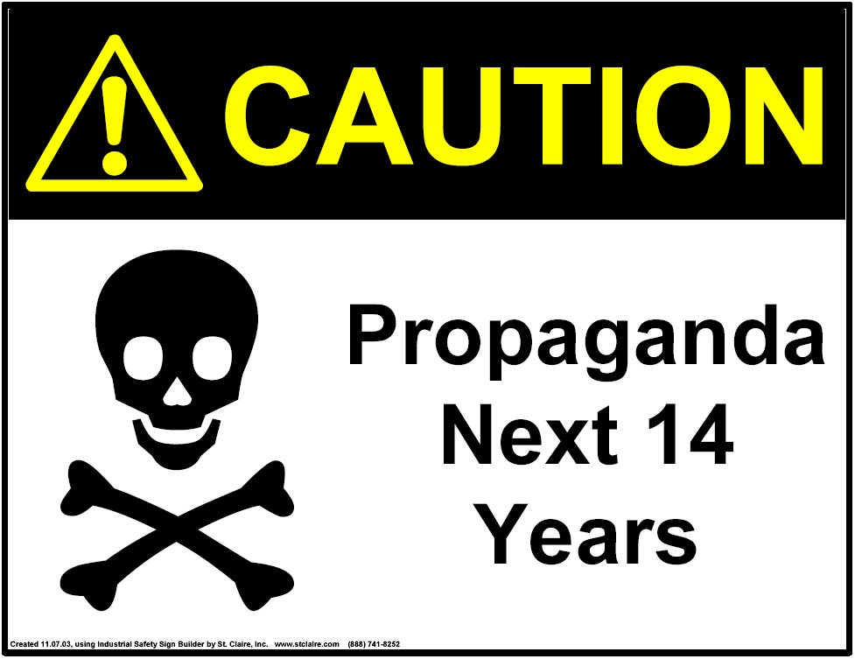
(2) Propaganda
Easy, cheap, quick,
safe, powerful
  Audience is the world
  Drop behind enemy lines
  Does not need to be true
Recruitment, fund
raising, hacktivism
  Censored information replaced
  in seconds
Tech expanding rapidly (multimedia, Skype, etc.)
Appearance of technical prowess!

Slide 32
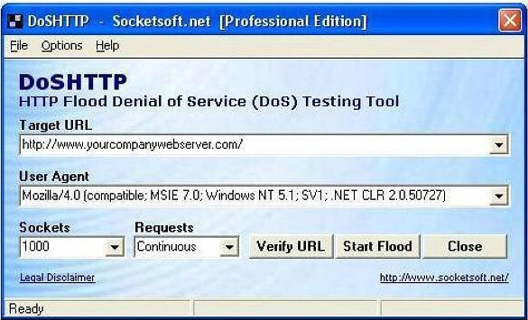
(3) Denial of Service (DoS)
Simple strategy
  Deny computer resource to legitimate users
  Most common: flood target with bogus data so it cannot respond to real requests for services/info
Other DoS attacks
  Physical destruction of hardware
  Electromagnetic interference designed to destroy unshielded electronics via current or
  voltage surges

Slide 33

(4) Data Modification
The Holy Grail of Hacks
  Control weapons, command
  and control (C2) systems and
  you control everything!
Extremely dangerous
  Legitimate users (human or machine) may make important decisions based on maliciously altered information
Website defacement
  “Electronic graffiti” can carry propaganda or disinformation

Slide 34
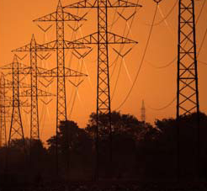

(5) Infrastructure Manipulation
Critical infrastructures connecting to Net
SCADA: Supervisory Control and Data Acquisition; refers to industrial control systems: computer systems that monitor and control industrial, infrastructure,
or facility-based processes
SCADA security may not be robust
Electricity especially important
Infrastructure in private hands
Seized hard drives: Microstran,
AutoCAD, etc.
White House briefed on certain 0-days

Slide 35
Lesson 5: Defending against
(APT) Advanced Persistent Threats…

Slide 36
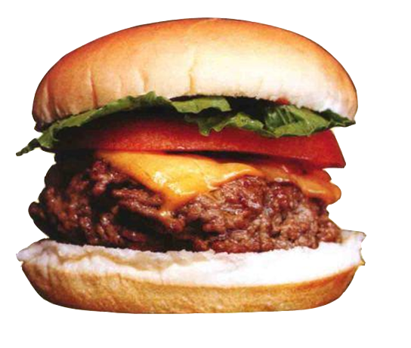
Advanced Persistent Threat: What’s that?
The APT as a group of sophisticated, determined and coordinated attackers that have been systematically compromising U.S. Government and Commercial networks for years. The vast majority of APT activity initially observed by Mandiant has been linked to Asia
APT is a term coined by the U.S. Air Force in 2006

Slide 37

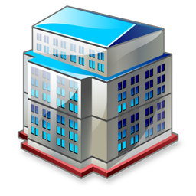

Advanced Persistent Threats
Internet malware infections
Drive-by downloads
E-mail attachments
File sharing
Pirated software
and keygen
Spear Phishing
DNS and Routing Mods
Physical malware infections
Infected USB memory sticks
Infected CDs and DVDs
Infected memory cards
Infected appliances
Backdoor IT equipment
External exploitation
Professional hacking
Mass vulnerability exploits
Co-location host
exploitation
Cloud provider penetration
Rogue Wi-Fi penetration
Smartphone bridging
Insider threat
Rogue employee
Malicious sub-contractor
Social engineering expert
Funded placement
Criminal break-in
Dual-use software installation
Trusted connections
Stolen VPN credentials
Hijacked roaming hosts
B2B connection tapping
Partner system breaches
Externally hosted
system breaches
Grey market
network equipment

Slide 38
APT Delivery Systems
Worms – software that spreads on own with
harmful consequences
Virus – malware attached to other software
(e.g., e-mail attachment)
Trojan horse – software that appears to be positive but have harmful effects
Logic bomb – software planted to activate at a later date/time with harmful consequences
Advanced Persistent Threats (APTs) is a term coined by the U.S. Air Force in 2006

Slide 39
APTs Objectives
Political
  Includes suppression of their own population for stability
Economic
  Theft of IP, to gain competitive advantage
Technical
  Obtain source code for further exploit development
Military
  Identifying weaknesses that allow inferior military forces
  to defeat superior military forces

Slide 40
APT’s: Understand Targeting and Exploitation Cycle
Step 1
Reconnaissance
Step 2
Initial intrusion into the network
Step 3
Establish a backdoor into
the network
Step 4
Obtain user credentials
Step 7
Maintain persistence
Step 6
Privilege escalation /lateral movement /data exfiltration
Step 5
Install various utilities

Slide 41
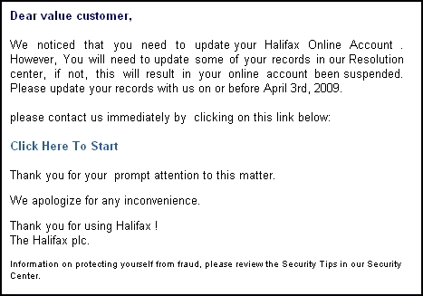
Reconnaissance
In multiple cases, example company Mandiant identified a number of public website pages from which a victim’s contact information was extracted and subsequently used in targeted social engineering messages

Slide 42
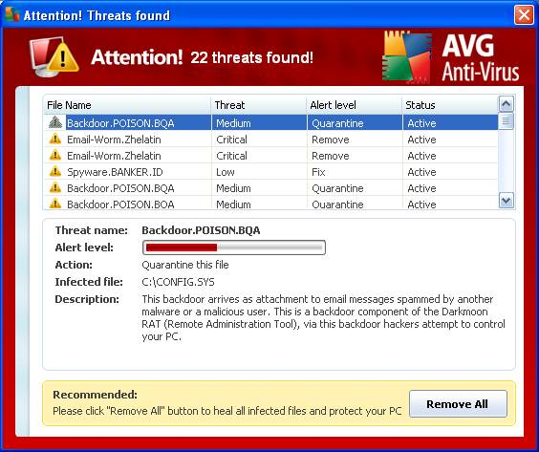
Initial Intrusion into the Network
Most malware attacks
  Have no icons
  No description or company name
  Unsigned Microsoft images
  Most Live in Windows Directory
  or System32, Update,
  Typically are Packed, Compressed
  or Encrypted (UP0 Signature)
  Many Include Strange URLs in Strings
  Many have open TCP/IP Endpoints
  (ET phone home)
  Most Host suspicious services or DLLs

Slide 43
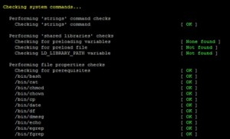
Establish a Backdoor into the Network
Attempt to obtain domain administrative credentials… transfer the credentials out of the network
The attackers then established a
stronger foothold in the environment
by moving laterally through the network
and installing multiple backdoors with different configurations
The malware is installed with system level privileges through the use of process injection, registry modification
or scheduled services

Slide 44
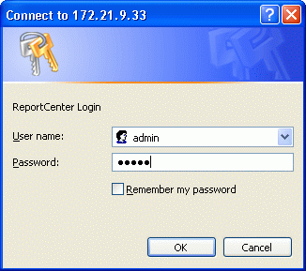
Obtain User Credentials
The attackers often target domain controllers to
obtain user accounts and corresponding password hashes en-masse
The attackers also obtain
local credentials from compromised systems
The APT intruders access approximately 40 systems
on a victim network using compromised credentials

Slide 45
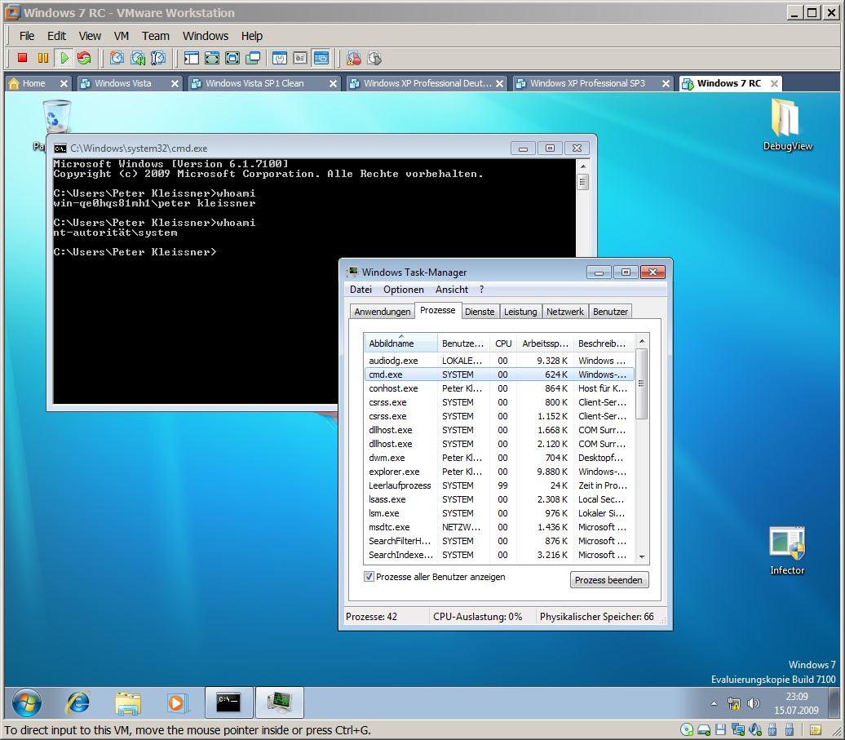
Privilege Escalation/Lateral Movement/
Data Exfiltration
Once a secure foothold has
been established
  Exfiltration data such as e-mails and attachments, or files residing on user workstations or project file servers
  The data is usually compressed and
  put into a password protected RAR or Microsoft Cabinet File
  They often use “Staging Servers” to aggregate the data they intend to steal
  They then delete the compressed files they exfiltrated from the “Staging Servers”

Slide 46
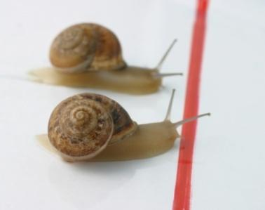
Maintain Persistence

Slide 47
Top Tip: Malware – Know What to Look For!
Typical malware characteristics
  Malware is continually updated
  Usually have no icons, description or company name
  Live in the Windows Directory or System32, Update
  Malware uses encryption and obfuscation techniques of its network traffic
  The attackers’ malware uses built-in Microsoft libraries
  The attackers’ malware uses legitimate user credentials so they can better blend in with typical user activity
  Do not listen for inbound connections
  Often include Strange URLs in Strings
  Has open TCP/IP Endpoints
  Host suspicious services or DLLs

Slide 48
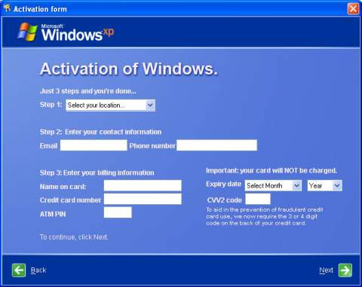
Top Tip: How to Get Rid of Malware
Disconnect from network
Identify malicious processes and drivers
End suspend and terminate identified processes
Identify and delete malware and auto starts
Delete malware files
Reboot and repeat

Slide 49
Cyberwarfare: Three Real World Examples

Slide 50
1) Google (2009 – 2010)
Highly sophisticated and targeted attack originating from China that resulted in the theft of intellectual property
At least twenty other large companies have also been targeted
Suggestions that primary goal was to access Gmail accounts of Chinese human rights activists
Discovered accounts of dozens of U.S., China, and Europe-based Gmail users who are advocates of human rights in China appear to have been routinely accessed by third parties
These attacks and surveillance have uncovered attempts over the past year to further limit free speech on the web – have led us to conclude that we should review the feasibility of it’s business operations in China
http://googleblog.blogspot.com/2010/01/new-approach-to-china.html

Slide 51

Thanks to Dreamtime

Slide 52

2) The Stuxnet Worm
Very complex Windows-specific computer worm that infects computers and connected
industrial control equipment (PLCs)
First known worm to attack
industrial infrastructure
Spreads through USB thumb drives
as well as network connections
Utilizes four “zero-day” exploits
Uses stolen valid security certificates

Slide 53




(2) The Stuxnet Worm
Thanks to BBC.co.uk

Slide 54

(3) Estonia (April 2007)
Sometimes referred to as
“Web War 1”
Followed Estonia relocating
the Bronze Soldier of Talinn,
a Russian monument
Sophisticated and large set of denial of service (DoS) attacks on Estonian parliament, banks, ministries, newspapers, other web sites
Severe effect on above institutions
for approximately three weeks

Slide 55
Tools of the Trade
demo

Slide 56
Lesson 6:
Defence Against the Dark Arts…

Slide 57

First Understand the Difficulties in Defense
Most networks have many entry points to internet
Encryption is not a silver bullet
Difficult to trace attacks
Many from robot networks (botnets)
of compromised PCs
Internet created for convenience, not security
Internet technology does not support easy defense
Unknown capabilities of other nations, criminal gangs/groups
Little deterrence exists
Defenders have to defend against many possible attacks, but attackers only have to find one hole

Slide 58
Difficulties in Defense
Internet created in an environment of intellectual freedom, mostly under private (not government) control
  Efforts to change – e.g., “Kill Switch” bill (2010) in Congress giving government power to take over parts of internet in national emergency
  Other countries can more easily mount Defense (e.g., fewer entry points, government can already control networks)
Military cyber-capabilities are significantly focused on offense, not Defense

Slide 59

Use Risk Management Techniques?
Ensures good
management practice
Process steps that
enable improvement in decision making
A logical and
systematic approach
Identifying opportunities
Avoiding or
minimising losses
Identify and
Analyze Exposures
Monitor
Results
Examine Risk
Management
Techniques
Risk
Management
Implement
Techniques
Select Risk
Management
Technique

Slide 60

Security Planning is Everything…
Conduct regular business
risk analysis
Adopt security policies
Design and implement an in-depth security solution
Ensure physical security
Understand firewall rules
Service packs/patching/anti virus
Deploy intrusion prevention
system (IPS)
Secure mobile devices/laptops

Slide 61

Adopt a Multi-Layered Defense
Strategy: Employ a risk-based, multi-dimensional approach to safeguarding services and data
Security Management
Threat and Vulnerability Management, Monitoring and Response
Data
Access Control and Monitoring, File/Data Integrity
User
Account Management, Training and Awareness, Screening
Application
Secure Engineering (SDL), Access Control and Monitoring,
Anti-Malware
Host
Access Control and Monitoring, Anti-Malware,
Patch and Configuration Management
Internal Network
Dual-factor Authorization, Intrusion Detection, Vulnerability Scanning
Network Perimeter
Edge Routers, Firewalls, Intrusion Detection, Vulnerability Scanning
Facility
Physical Controls, Video Surveillance, Access Control

Slide 62
Review
Lesson 1: Understanding The Changing World
Lesson 2: Learn Why Security Fails
Lesson 3: The Rise of the Socio
Technical Society
Lesson 4: The Good Guy’s Wear Black! –
From Cybercrime to Cyber-warfare
Lesson 5: Defending against Advanced Persistent Threats (APTs)
Lesson 6: Defence Against the Dark Arts
Conclusions

Slide 63
My Other Sessions…
Required Slide
Speakers, please list the Breakout Sessions, Interactive Discussions, Labs, Demo Stations and Certification Exam that relate to your session. Also indicate when they can find you staffing in the TLC.
SIM 301 Monty WiFion and the Quest for the Holy Grail of Network Security!
SIM 302 Lessons from Hackwarts Vol 1: Defense against the Dark Arts 2011
SIM 327 Rethinking Cyber Threats: Experts Panel
Find Me Later At…

Slide 64
Andy Malone (UK)
Thanks For Listening & Enjoy TechEd!
E: andrew.malone@quality-training.co.uk
Twitter: AndyMalone
LinkedIn: Andy Malone (UK)

Slide 65

Trustworthy Computing
Safety and Security Center
http://www.microsoft.com/security
Security Development Lifecycle
http://www.microsoft.com/sdl
Security Intelligence Report
http://www.microsoft.com/sir
End to End Trust
http://www.microsoft.com/endtoendtrust

Slide 66





Resources
  Connect. Share. Discuss.
http://northamerica.msteched.com
Learning
  Sessions On-Demand & Community
  Microsoft Certification & Training Resources
www.microsoft.com/teched
www.microsoft.com/learning
  Resources for IT Professionals
  Resources for Developers
http://microsoft.com/technet
http://microsoft.com/msdn

Slide 67












Complete an evaluation on CommNet and
enter to win!

Slide 68


