Slide 1

Optimizing FIM 2010
SIM315
Arshad Ahmad, Lead Program Manager
Mark Wahl, Architect
Microsoft

Slide 2
Topics
Approaches to optimization
  Service partitioning and workflow hosts
  Query performance and search scopes
  FIM Service database performance
  Improving initial load performance
Resources

Slide 3
Service Partitioning

Slide 4
Issues
Service Partitioning
Authorization workflows stuck after machine failure
Thousands of active workflows
FIM Service requests time out
  Portal interaction latency increases when FIM MA running
  Administrative tasks take longer when FIM MA running

Slide 5
Under the covers
Service Partitioning
Workflows are run by workflow hosts in a FIM Service
Workflows are automatically load balanced between each of the FIM Service machines
FIM Service machines are grouped into service partition
Requests submitted to a partition are only processed on FIM Service instances that belong to that partition
  Request object includes name of the service partition

Slide 6



Under the covers
Service Partitioning
Partition: Admin
Admin Portal
FIM Service 1
Sync Service
Admin
Partition: User
Request 1
Authz workflow
Partition: User
Owner: Service 3
Authz workflow
Partition: User
Owner: Service2
Request 2
Authz workflow
Partition: User
Owner: None
User Portal
FIM Service 2
FIM Service DB
Users
FIM Service 3

Slide 7
Under the covers
Service Partitioning
Only a single FIM Service machine can execute a workflow instance at a time
  The FIM Service workflow host uses the service name to lock the workflow
  FIM Service machine within the partition is identified by its service name

Slide 8
Recommendation #1
Service Partitioning
Analyze the workflow load
  Observe portal response time when FIM MA is running
    Using SQL profiler
    Using IIS log
  Look at the total number of active workflow instances
  Compare workflow instances generated from various sources

Slide 9
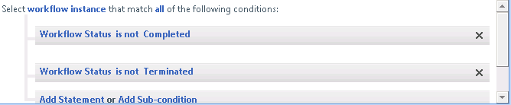
How To
Find Active Workflows
Administration->All Resources->Workflow Instance
Search for active workflow instances
Count at the bottom of the page

Slide 10

Recommendation #2
Service Partitioning
At scale, separate workloads (User, Administrative, Sync) by using service partitioning
  One for administrative updates and for use with Sync
  One service partition for users
    User service partition does not have to compete for workflow host resources with Sync and administrative tasks (policy updates)
Adjust timeouts for administrative partition to allow longer running operations

Slide 11
Recommendation #3
Service Partitioning
If a machine fails within a service partition, start a new FIM Service machine with the same service machine name to allow pending workflows to complete
Partition:User
Request
Workflow1
Partition: 2
Owner: Service2
Sync
FIM Service 2
FIM Service 3
SQL Cluster
FIM Service 2

Slide 12
How To
Set a partition name
Specify the service partition name in the FIM Service configuration file Microsoft.ResourceManagementService.exe.config
  <resourceManagementService externalHostName="FIMServerOne" servicePartitionName="User" serviceName="User1"/>
  Note: the name of your service partition defaults to the external host name of the computer when FIM Service was installed

Slide 13
Workflow Hosts

Slide 14
Issues
Workflow Hosts
Workflows consuming excessive system resources

Slide 15
Under the covers
Workflow Hosts
Resource Management Service
(WCF Endpoint)
Request Dispatcher
FIM Service

Slide 16
Under the covers
Workflow Hosts
Resource Management Service
(WCF Endpoint)
Request Dispatcher
Host Activator
Shared AuthN
WF Host
Workflow Service Host
(WorkflowDefinitionId = 1)
…
Shared
WF Host
Workflow Service Host
(WorkflowDefinitionId = 2)
FIM Service

Slide 17

Under the covers
Workflow Hosts
FIM Service
InstanceState
(persisted)
Create WF
Instance Load
Start WF
Instance UnLoad
Persistence
Workflow Instance
Scheduler
(Workflow Definition,
Workflow Instance)
Request
Dispatcher
Workflow Instance Runtime
WF7
WF6
WF5
Queue
WF4
Queue
WF1
Queue
Workflow Runtime Services
Workflow
Instance (active)
Workflow
Host
Workflow
Definition (active)
{Workflow Control
Message Mgr}
FIM Service DB

Slide 18
Recommendation #4
Workflow Hosts
Understand impact of creating numerous AuthZ workflows with approval activities
When designing policies, avoid workflows with custom receive activities

Slide 19
Search and Search Scopes

Slide 20
Issues
Search and Search Scopes
Portal responsiveness
  End user searches are slow for certain types of searches
  End user searches are slow for custom search scopes
  End user experiencing long response time for ordinary actions
SQL server experiencing heavy load
  FIM Service experiencing high response times to queries

Slide 21
Under the Covers
Search and Search Scopes
XPath Query
FIM Portal
/Person[Contains (DisplayName, ‘Arshad’)]
FIM Service
Web Service
Object Model Mapping
Request Dispatcher
Map to ObjectType and
ObjectTypeKeys
Workflow Host
Data Access
SQLQuery
exec [fim].ExecuteQuery @sql=N'WITH CandidateList(ObjectKey, ObjectTypeKey)
AS
( SELECT…
SQL Server
Resources

Slide 22
Under the Covers
Search and Search Scopes
/Person[Contains(DisplayName,’’Arshad’’)]
  SQL query components that are derived from the user’s search:
SELECT
valueOfProposition0.ObjectKey,valueOfProposition0.ObjectTypeKey
FROM
[fim].ObjectValueString AS valueOfProposition0
WHERE
(((valueOfProposition0.ObjectTypeKey = 24) /*Person*/)
AND
(valueOfProposition0.AttributeKey = 66) /*DisplayName*/
AND
(CONTAINS(valueOfProposition0.ValueString,N''"Arshad*"'')))
AND…

Slide 23
Under the Covers
Search and Search Scopes
SQL query components derived from rights verification
Determine if Read MPRs allow the values to be read by the requesting user
  Access to the attributes in the query
  Access to the attributes returned from the search

Slide 24
Under the Covers
Search and Search Scopes
Target Object Type | Attributed Searched | Generated XPath | SQL Query Size
/Person | DisplayName | /Person[Contains(DisplayName,’’Arshad’’)] | ~700 Lines
/Person | DisplayName, AccountName | /Person[(Contains(DisplayName,’’Arshad’’) or (Contains(AccountName,’’Arshad’’) ) ] | ~1000 Lines
/Person | DisplayName, AccountName, JobTitle, Email | /Person[(contains(DisplayName,’’Arshad’’) or (contains(AccountName,’’Arshad’’) or (starts-with(JobTitle,’’Manager’’) ) or (contains(Email,’’Arshad’’) )] | ~1200 Lines

Slide 25
Recommendation #5
Search and Search Scopes
Tune search scopes
  Number of resources within the scope
  Number of attributes
  Type of attribute -Full text indexed fields

Slide 26
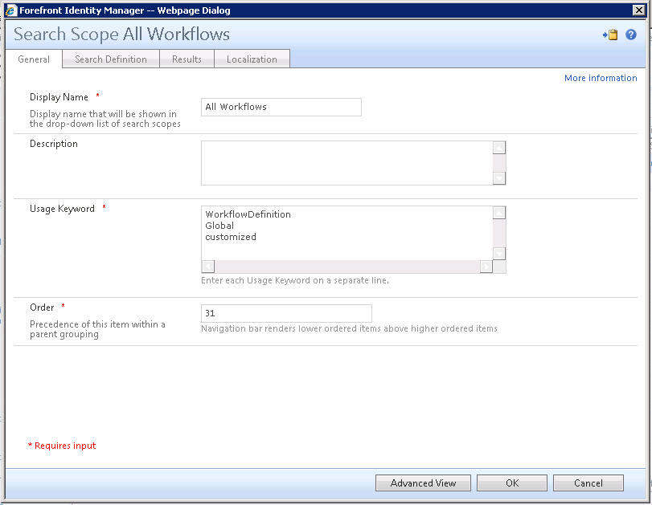
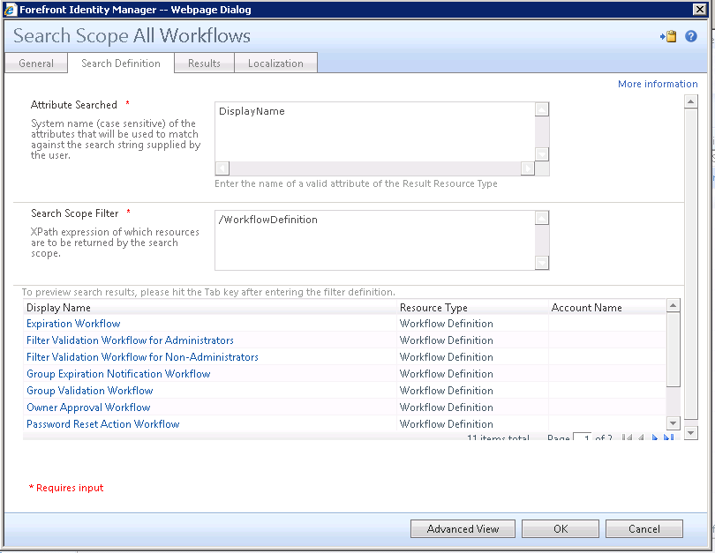
How To
Set Search Scopes
Administration->Search Scopes
MSIT FACTOID
Scope | XPath
My FIM Security Groups | /Group[(Type='Security' or Type='MailEnabledSecurity') and Owner='%LoginID%' and AGManaged='false']
All FIM Distribution Groups | /Group[Type='Distribution' and AGManaged='false']

Slide 27
Recommendation #6
Search and Search Scopes
Identify queries that are slow
  Full text search- “Contains”, “Starts with”
  Object search- searching on the object type
Ensure SharePoint indexing does not trigger unnecessary queries
Use SQL Profiler…

Slide 28
Demo
Using SQL Management Studio Profiler

Slide 29
System Objects- Database Bloat

Slide 30
Issues
System Objects
Excessive growth in SQL database and log file
Both search and update requests time out
FIM MA performance declines when exporting data into FIM Service

Slide 31
Under the covers
System Objects
ALL FIM Service resources are stored in a single table
System objects created when requests are submitted and as a result of policy evaluation
  “Request”, “WorkflowInstance”, “Approval”, “GateRegistration”, “ApprovalResponse”.…

Slide 32
Under the covers
System Objects- Example
User makes a request to join a group – one WS-T Update
Object Type | Number | Display Name
Requests | 5 | “Update to Group”, “Create Approval”, "Create ApprovalResponse”, "Update to Approval”, "Update to Approval”
Workflow Instance | 1 | "Owner Approval Workflow"
Approval | 1 | “Update to Group”
Approval Response | 1 | "Update to Group"
FIM Service creates as many as ~142 rows in the tables for changes to attribute values
  E.g., request state changes

Slide 33
Under the covers
System Objects- Requests
SQL Server
FIM Service DB
FIM Service DB
Config Migration
FIM Service
Request Object
Request Object
CreateRequest
Config Upgrade
Create
Request
Policy Application
Portal
Policy Application
Password
Create
Register
Reset
System Event Request
Exchange Mail Listener
Workflow Host
Custom
SQL Agent (FIM_TemporalEventsJob)
Temporal
Set Correction
SQL Agent (FIM_TemporalEventsJob)
Set Correction
Temporal
Collateral
Workflow
Join Group
Leave Group
Add member
Remove member
Workflow Instance
Synchronization
Service
Export
MSIT FACTOID
Exchange
Outlook
On avg. 1,000,000 request objects with 60,000 requests created per day

Slide 34
Recommendation #7
System Objects
  Avoid creating new sets containing internal system objects
FIM Service has a SQL Agent job to delete expired system objects
  FIM_DeleteExpiredSystemObjectsJob
  The default expiration date is the request complete date + expirationTime (default 30 days)
  Don’t turn this job off
Consider different tuning settings for the FIM Service and Sync databases

Slide 35
Initial Load

Slide 36
Issues
Initial Load
FIM MA total/large exports into the FIM Service database
  First install of FIM Service
  Sync rule change
  Sync watermark change, from restoration of a FIM Sync database backup

Slide 37
Under the Covers
Initial Load
FIM Sync Service
FIM MA
FIM Service
Web Service
Request Dispatcher
Workflow Host
Data Access
SQL Server
Resource DB
SQL Broker

Slide 38
Recommendation #8
Initial Load
Turn off SQL Server full-text indexing during initial load
Use the minimum amount of policy configuration policy possible during initial load
  Remove unneeded Sets and disable unneeded MPRs during initial load
  Use Run-on-policy-update after completion of initial load
Ensure adequate space for log files
  Use simple recovery mode instead of full recovery mode
  Pre-size data and log files

Slide 39
Recommendation #9
Search Scopes
FIM on TechNet
FIM on MSDN
FIM Script Box
FIM Wiki
FIM Forum

Slide 40
Thanks for attending!

Slide 41
Related Content
Required Slide
Speakers, please list the Breakout Sessions, Interactive Discussions, Labs, Demo Stations and Certification Exam that relate to your session. Also indicate when they can find you staffing in the TLC.
SIM315 Optimizing FIM (Thursday)
SIM332 Technical Overview (Tuesday)
SIM358 Preparing Identities for the Cloud with FIM (Tuesday)
SIM375-INT Chalk Talk with the Product Team (Tuesday)
SIM395-HOL FIM Overview
SIM399-HOL Managing Claims AuthN using FIM 2010
Forefront Identity Manager demos in the exhibition hall

Slide 42
Track Resources
Don’t forget to visit the Cloud Power area within the TLC (Blue Section) to see product demos and speak with experts about the Server & Cloud Platform solutions that help drive your business forward.
You can also find the latest information about our products at the following links:
Cloud Power - http://www.microsoft.com/cloud/
Private Cloud - http://www.microsoft.com/privatecloud/
Windows Server - http://www.microsoft.com/windowsserver/
Windows Azure - http://www.microsoft.com/windowsazure/
Microsoft System Center - http://www.microsoft.com/systemcenter/
Microsoft Forefront - http://www.microsoft.com/forefront/

Slide 43





Resources
  Connect. Share. Discuss.
http://northamerica.msteched.com
Learning
  Sessions On-Demand & Community
  Microsoft Certification & Training Resources
www.microsoft.com/teched
www.microsoft.com/learning
  Resources for IT Professionals
  Resources for Developers
http://microsoft.com/technet
http://microsoft.com/msdn

Slide 44












Complete an evaluation on CommNet and
enter to win!

Slide 45


Slide 46

© 2011 Microsoft Corporation. All rights reserved. Microsoft, Windows, Windows Vista and other product names are or may be registered trademarks and/or trademarks in the U.S. and/or other countries.
The information herein is for informational purposes only and represents the current view of Microsoft Corporation as of the date of this presentation. Because Microsoft must respond to changing market conditions, it should not be interpreted to be a commitment
on the part of Microsoft, and Microsoft cannot guarantee the accuracy of any information provided after the date of this presentation. MICROSOFT MAKES NO WARRANTIES, EXPRESS, IMPLIED OR STATUTORY, AS TO THE INFORMATION IN THIS PRESENTATION.

