Slide 2


Developer's View on Single Sign-On for Applications Using Windows Azure
SIM322
Vittorio Bertocci
Principal Technical Evangelist
Microsoft
Notes:
Signing users in and granting them access is a core function of almost every cloud-based application. In this session we show you how to simplify your user experience by enabling users to sign in with an existing account such as a Windows Live ID, Google, Yahoo, Facebook or on-premises Active Directory account, implement access control and make secure connections between applications. Learn how the AppFabric Access Control Service, Windows Identity Foundation, and Active Directory Federation Services use a cloud-based identity architecture to help you to take advantage of the shift toward the cloud while still fully leveraging your on-premises investments.
How to simplify your approach enabling access to applications across on-premises and cloud

Slide 3
Claims Will Get the Job Done
Notes:
The session will explore many different scenarios and show multiple products & services in actions; however those will just be proof points of a simple fact, claims-based identity is the identity and access control strategy which will yield the best results for your on-premises, cloud and hybrid solutions.

Slide 4



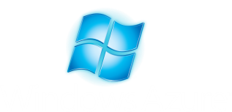


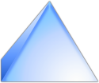
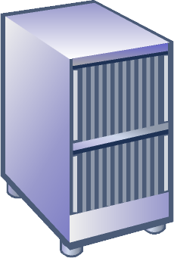
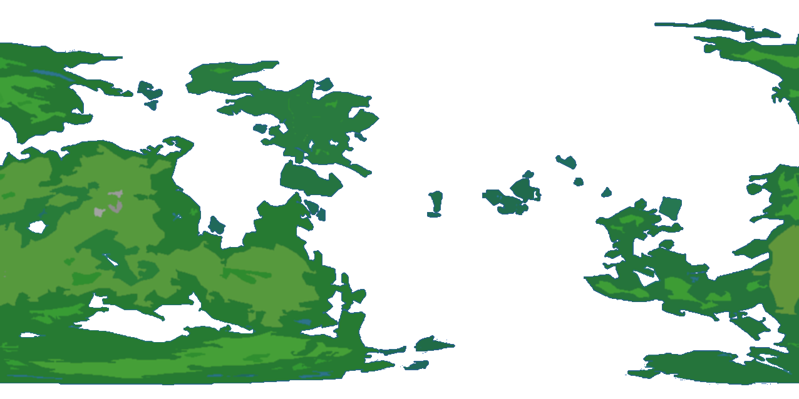







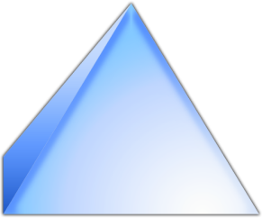











Scenarios
Notes:
Here there’s a list of cloud scenarios we consider of interest in term of how identity is handled.
<click> our baseline is the classic on premises scenario.
<click> you have a data center, <click> a population of internal users and <click> some authentication infrastructure, such as Active Directory, maintaining their accounts.
<click> applications targeting such environment will follow the current intranet practices.
<click> We will then introduce Windows Azure in the picture and observe how things change when the application moves to the cloud; we'll consider this both from the architecture and products usage perspectives.
<click> Then we'll move to consider what happens when the application is exposed to multiple business partners, and the implications on authentication and relationships management.
<click> However business partners represent an important but tiny fraction of all the possible population <click> you an cater to if you target the internet users.
<click> live id, Google, Facebook and yahoo! have hundreds of millions of users; the authentication requirements in those conditions are completely different than the business case, although as we will see the solutions may end up being surprisingly similar.
<click> Finally, the mobile scenario is of great importance and again apparently a completely different problem space. Using claims-based identity makes it very easy to progressively accommodate all those different scenarios.
Without further ado, let’s get started.

Slide 5



On-Premises Applications

Slide 6
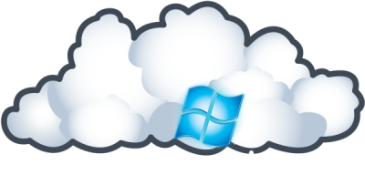
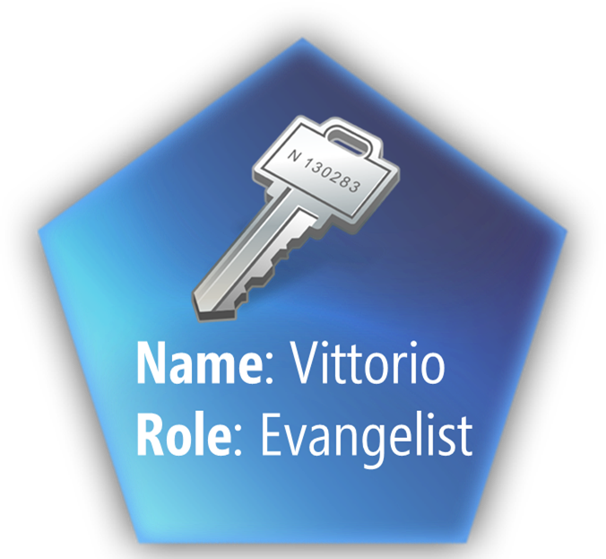

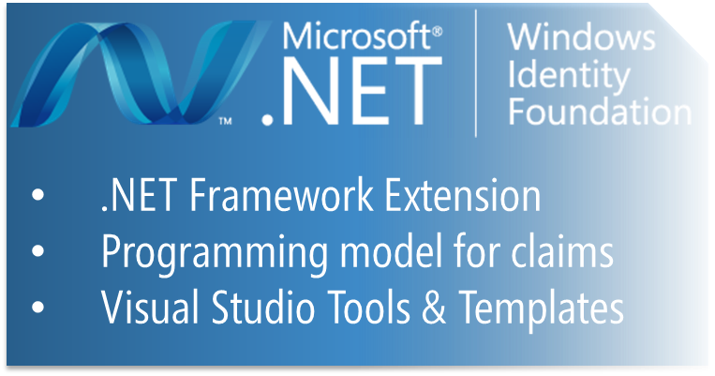


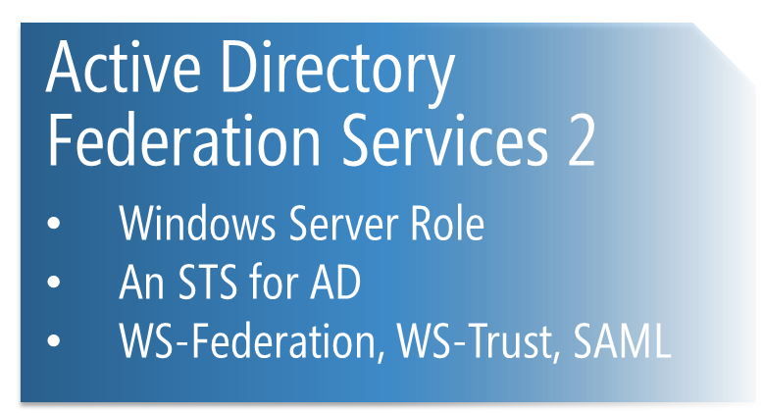
Managing Access for a Windows Azure Application

Slide 7
Basic Use of WIF with a Web Role
demo

Slide 8

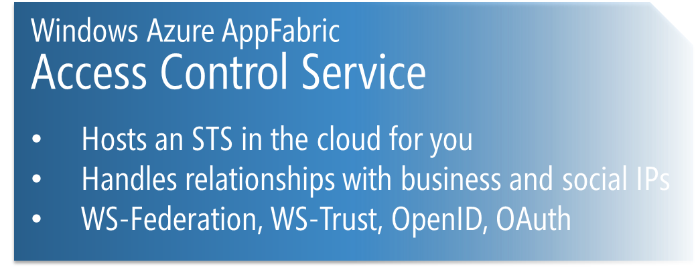
Authenticating Users from Business Partners

Slide 9
Using ACS for
Managing Relationships,
Home Realm Discovery and Token Normalization
demo
Notes:
See 2nd demo at http://bit.ly/cNdEcM

Slide 10



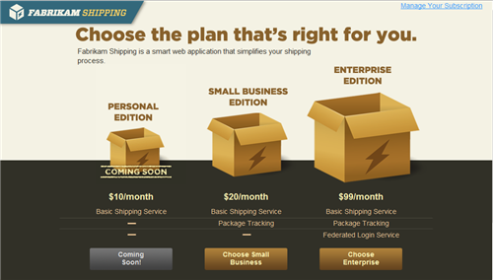

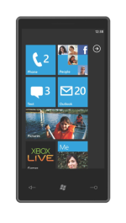
Authenticating Users from Web and Social Providers

Slide 11
FabrikamShipping:
Automating Customer Sign-up from Social Providers via ACS
demo
Notes:
See 3rd demo at http://bit.ly/cNdEcM

Slide 12
Claims Will Get the Job Done
Notes:
The session will explore many different scenarios and show multiple products & services in actions; however those will just be proof points of a simple fact, claims-based identity is the identity and access control strategy which will yield the best results for your on-premises, cloud and hybrid solutions.

Slide 13




Windows Azure Platform

Slide 14

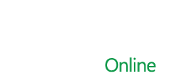

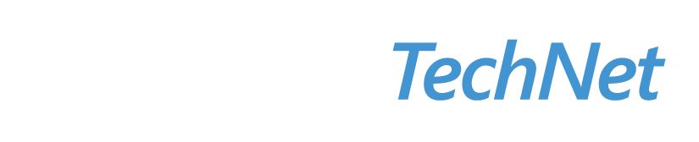

Resources
  Connect. Share. Discuss.
http://northamerica.msteched.com
Learning
  Sessions On-Demand & Community
  Microsoft Certification & Training Resources
www.microsoft.com/teched
www.microsoft.com/learning
  Resources for IT Professionals
  Resources for Developers
http://microsoft.com/technet
http://microsoft.com/msdn

Slide 15












Required Slide
Complete an evaluation on CommNet and
enter to win!

Slide 16
MS Tag Placeholder Slide
Required Slide
Your MS Tag will be inserted here during the final scrub.
Notes:
New for TechEd 2011, we will be working with Microsoft Tag (http://tag.microsoft.com/overview.aspx) to create unique Tags for every session at the event. Your session Tag will appear on both the room signage and at the end of your presentation. With your session Tag, attendees will be able to scan as they enter the room to retrieve session details, view speaker bios, and engage in discussions; or scan at the end of the presentation to evaluate your session and download materials. We’re excited to integrate Microsoft Tag across the My TechEd mobile experience this year.

Slide 17

© 2011 Microsoft Corporation. All rights reserved. Microsoft, Windows, Windows Vista and other product names are or may be registered trademarks and/or trademarks in the U.S. and/or other countries.
The information herein is for informational purposes only and represents the current view of Microsoft Corporation as of the date of this presentation. Because Microsoft must respond to changing market conditions, it should not be interpreted to be a commitment
on the part of Microsoft, and Microsoft cannot guarantee the accuracy of any information provided after the date of this presentation. MICROSOFT MAKES NO WARRANTIES, EXPRESS, IMPLIED OR STATUTORY, AS TO THE INFORMATION IN THIS PRESENTATION.

