Slide 1

User Identity and Authentication for Desktop and Phone Applications
SIM323
Caleb Baker
Senior Program Manager
Microsoft

Slide 2
Agenda
  Using federated identity in client apps
    Windows Presentation Foundation
    Silverlight
    Windows Phone 7
  Identity design decisions for client apps

Slide 3





Rich Client Application

Slide 4
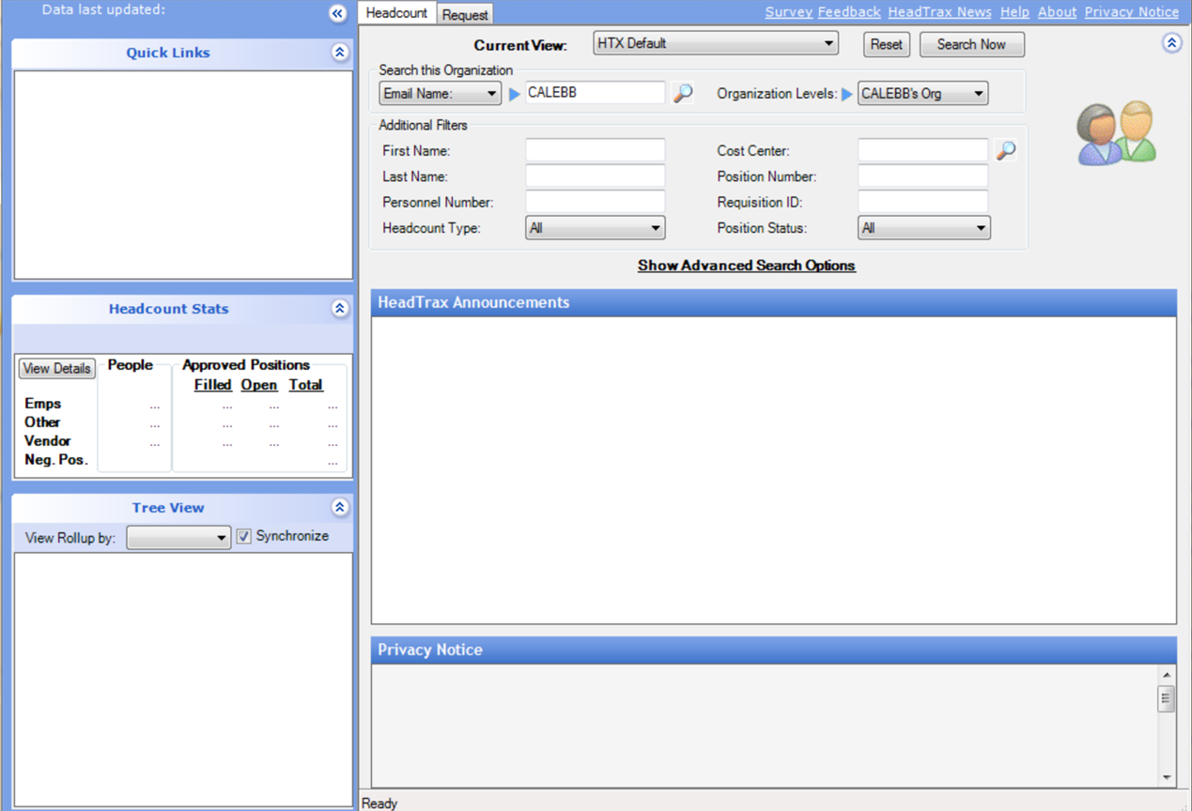

Slide 5
Rich Client Application On Premise
Active Directory
Windows Auth
Windows Auth

Slide 6

Cloud Pic

Slide 7

Rich Client Application in the Cloud
Active Directory
?
Windows Auth

Slide 8
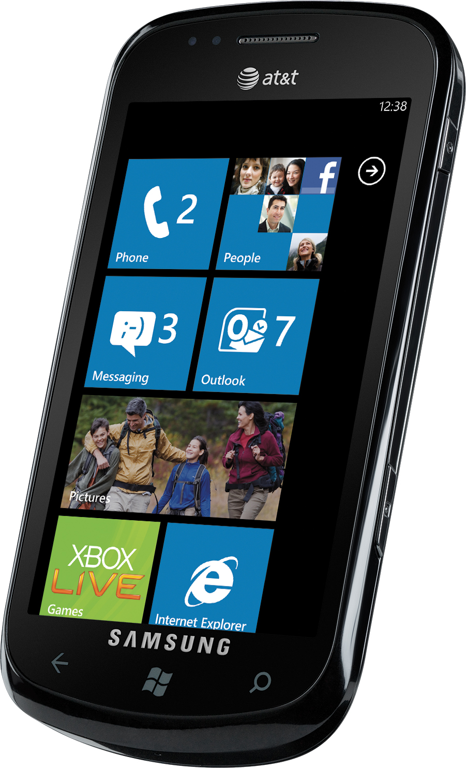
Mobile Pic

Slide 9
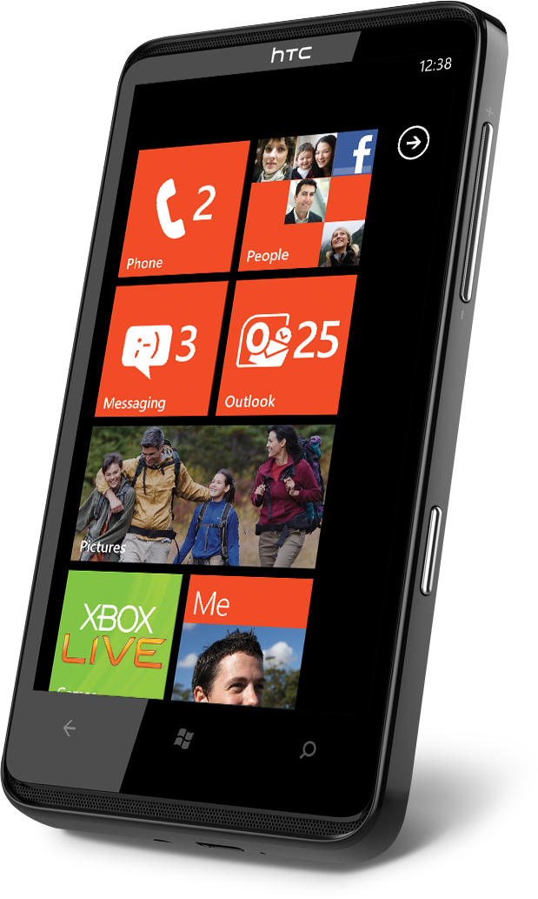
Rich Client Application with Mobile
Active Directory
?
?

Slide 10

Social

Slide 11



Rich Client Application and Social
Active Directory
?
?
?
?
?
?

Slide 12
Tools
Claims
Token
Security Token Service ( STS )
Relying Party ( RP )
Windows Identity Foundation ( WIF )
Active Directory Federation Server v2 ( AD FS )
AppFabric Access Control Service ( ACS )

Slide 13
Authentication Flow
Application
AD FS 2.0
Service
Username / Password
SAML
Authenticate
Customer List

Slide 14
WPF Client
demo

Slide 15
Authentication Flow
Application
AD FS 2.0
Service
Username / Password
<ws2007HttpBinding>
  <binding name="ws2007HttpBindingConfiguration">
    <security mode="TransportWithMessageCredential">
      <message clientCredentialType="UserName“ establishSecurityContext="False"/>
    </security>
  </binding>
</ws2007HttpBinding>
SAML
Authenticate
Customer List

Slide 16
Username Binding
<ws2007HttpBinding>
  <binding name="ws2007HttpBindingConfiguration">
    <security mode="TransportWithMessageCredential">
      <message clientCredentialType="UserName“ establishSecurityContext="False"/>
    </security>
  </binding>
</ws2007HttpBinding>

Slide 17
Username Binding
<ws2007HttpBinding>
  <binding name="ws2007HttpBindingConfiguration">
    <security mode="TransportWithMessageCredential">
      <message clientCredentialType="UserName“ establishSecurityContext="False"/>
    </security>
  </binding>
</ws2007HttpBinding>

Slide 18
Username Binding
<ws2007HttpBinding>
  <binding name="ws2007HttpBindingConfiguration">
    <security mode="TransportWithMessageCredential">
      <message clientCredentialType="UserName“ establishSecurityContext="False"/>
    </security>
  </binding>
</ws2007HttpBinding>

Slide 19
AD FS Endpoints
https://[server]/adfs/services/trust/13/usernamemixed
https://[server]/adfs/services/trust/13/windowstransport

Slide 20
Authentication Flow
Application
AD FS 2.0
Service
Username / Password
<customBinding>
<binding name="customBinding0">
<security authenticationMode="IssuedTokenOverTransport"
messageSecurityVersion="WSSecurity11WSTrust13WSSecureConversation13WSSecurityPolicy12BasicSecurityProfile10">
<issuedTokenParameters keyType="SymmetricKey" >
<issuer address="https://localhost/PatientListService_STS/Service.svc/IWSTrust13" />
<issuerMetadata address="https://localhost/PatientListService_STS/Service.svc/mex" />
</issuedTokenParameters>
</security>
…
</customBinding>
SAML
Authenticate
Customer List

Slide 21

Service Binding
<customBinding>
<binding name="customBinding0">
<security authenticationMode="IssuedTokenOverTransport"
messageSecurityVersion="WSSecurity11WSTrust13WSSecureConversation13WSSecurityPolicy12BasicSecurityProfile10">
<issuedTokenParameters keyType="SymmetricKey" >
<issuer address="https://localhost/PatientListService_STS/Service.svc/IWSTrust13" />
<issuerMetadata address="https://localhost/PatientListService_STS/Service.svc/mex" />
</issuedTokenParameters>
</security>
</customBinding>

Slide 22
Service Binding
<customBinding>
<binding name="customBinding0">
<security authenticationMode="IssuedTokenOverTransport"
messageSecurityVersion="WSSecurity11WSTrust13WSSecureConversation13WSSecurityPolicy12BasicSecurityProfile10">
<issuedTokenParameters keyType="SymmetricKey" >
<issuer address="https://localhost/PatientListService_STS/Service.svc/IWSTrust13" />
<issuerMetadata address="https://localhost/PatientListService_STS/Service.svc/mex" />
</issuedTokenParameters>
</security>
</customBinding>

Slide 23
Service Binding
<customBinding>
<binding name="customBinding0">
<security authenticationMode="IssuedTokenOverTransport"
messageSecurityVersion="WSSecurity11WSTrust13WSSecureConversation13WSSecurityPolicy12BasicSecurityProfile10">
<issuedTokenParameters keyType="SymmetricKey" >
<issuer address="https://localhost/PatientListService_STS/Service.svc/IWSTrust13" />
<issuerMetadata address="https://localhost/PatientListService_STS/Service.svc/mex" />
</issuedTokenParameters>
</security>
</customBinding>

Slide 24
Service Binding
<customBinding>
<binding name="customBinding0">
<security authenticationMode="IssuedTokenOverTransport"
messageSecurityVersion="WSSecurity11WSTrust13WSSecureConversation13WSSecurityPolicy12BasicSecurityProfile10">
<issuedTokenParameters keyType="SymmetricKey" >
<issuer address="https://localhost/PatientListService_STS/Service.svc/IWSTrust13" />
<issuerMetadata address="https://localhost/PatientListService_STS/Service.svc/mex" />
</issuedTokenParameters>
</security>
</customBinding>

Slide 25
Review
Active Directory with AD FS
WPF

Slide 26

How to get user identity in the app?

Slide 27
How an App uses User Identity
Personalize app for the user
Customize for user role

Slide 28
Where to get the User Identity?
Is it the service?
Is the identity provider?

Slide 29
Getting The Display Token
Application
AD FS 2.0
Service
Username / Password
SAML
Authenticate
Customer List

Slide 30
Showing User Identity
demo

Slide 31
Review
Active Directory with AD FS
Welcome Frank!

Slide 32

Perform Authorization at the Service
Don’t trust app code to enforce
security for the service

Slide 33
Moving to Silverlight
Easy deployment
Broader reach

Slide 34
Silverlight App
demo

Slide 35
Review
Active Directory with AD FS
Silverlight
WPF

Slide 36
Enabling Windows Phone 7
Active Directory with AD FS

Slide 37
Windows Phone 7
demo

Slide 38
Review
Active Directory with AD FS
Silverlight
WPF

Slide 39
Disable Formatting
private string DisableFormatting(string input)
{
StringBuilder output = new StringBuilder();
XmlReaderSettings rs = new XmlReaderSettings();
rs.IgnoreComments = true;
rs.IgnoreWhitespace = true;
using (XmlReader reader = XmlReader.Create(new StringReader(input),rs))
{
XmlWriterSettings ws = new XmlWriterSettings();
ws.OmitXmlDeclaration = true;
ws.NewLineHandling = NewLineHandling.Replace;
ws.NewLineChars = "";
using (XmlWriter writer = XmlWriter.Create(output, ws))
{
writer.WriteNode(reader, true);
}
}
return output.ToString();
}

Slide 40

Balance Between Usability And Security
Typing passwords in is
harder on smaller form factor.
Saving user credential
on device is dangerous.

Slide 41

Using Longer Lived Tokens
Pro: limits risk
Con: token is hard to revoke
Increase token lifetime to 8-10 hrs
Set-ADFSRelyingPartyTrust -TargetName "RP name" -TokenLifeTime 600
Set AD FS token lifetime

Slide 42



Using Multiple Identity Providers
(AD FS 2.0 )
Access
Control
Service

Slide 43
Sign In Using a Web Browser
Broader support across identity providers
User enters credentials at the identity provider
Lighter weight to implement

Slide 44
Simple Web Token (SWT)
http://.../claims/emailaddress=calebb@live.com&
http://.../claims/identityprovider=FaceBook&
Audience=http://localhost:32075/&
ExpiresOn=1302285961&
Issuer=https://contoso.accesscontrol.windows.net/&
HMACSHA256=X...DGzVepvditIP33IIq753JCz99ENY=

Slide 45
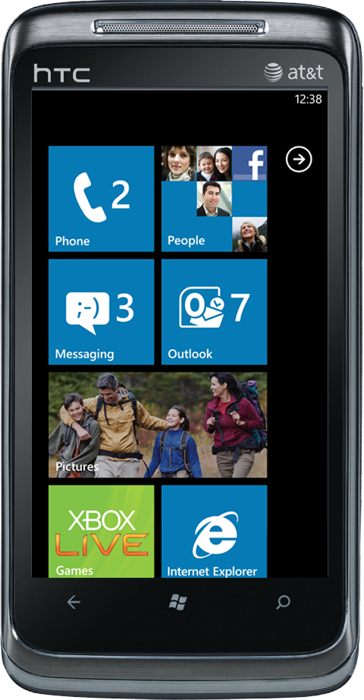
Sign in Flow
Application
IdP
ACS
Service
GET feed of Configured IdPs
JSON Feed
<html>
<javascript>
Notify( SWT )
<javascript>
</html>
Get IdP
OAuth

Slide 46
ACS with WP7
demo

Slide 47
Review
(AD FS 2.0 )

Slide 48
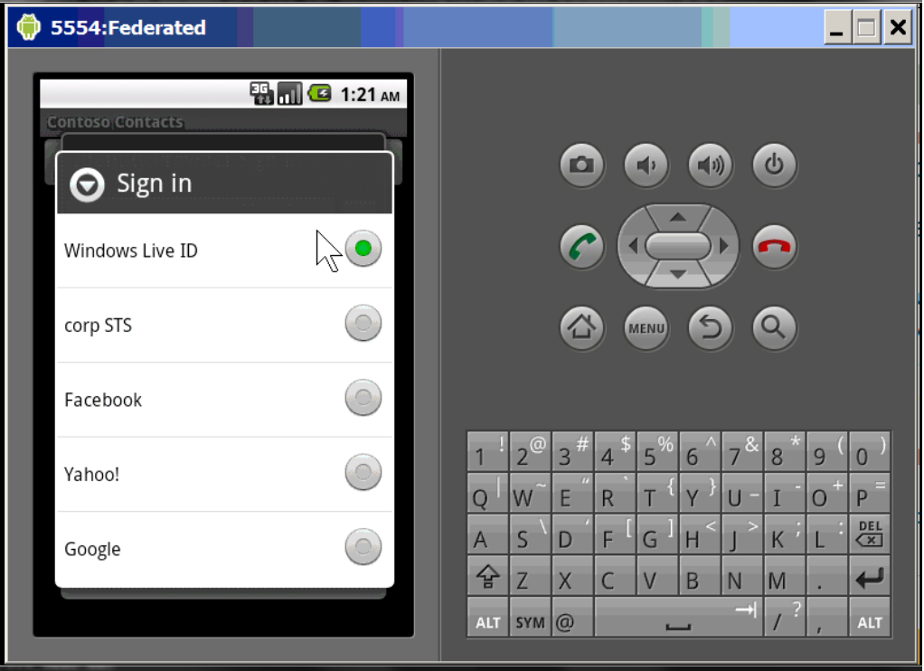
Android

Slide 49
Considerations when using Web Browser
App doesn’t get user credentials. Or does it…?
Not a consistent model for sign out
Need mobile friendly sign in page

Slide 50
In Review
  Using federated identity in client apps
    Windows Presentation Foundation
    Silverlight
    Windows Phone 7
  Identity design decisions for client apps

Slide 51

Resources
ACS samples on CodePlex
  http://acs.codeplex.com/wikipage?title=Samples&referringTitle=Home
Identity Developer Training Kit
  http://go.microsoft.com/fwlink/?LinkId=148795
Windows Azure Toolkit for Windows Phone 7 v1.2
  http://watoolkitwp7.codeplex.com/

Slide 52
Track Resources
Don’t forget to visit the Cloud Power area within the TLC (Blue Section) to see product demos and speak with experts about the Server & Cloud Platform solutions that help drive your business forward.
You can also find the latest information about our products at the following links:
Cloud Power - http://www.microsoft.com/cloud/
Private Cloud - http://www.microsoft.com/privatecloud/
Windows Server - http://www.microsoft.com/windowsserver/
Windows Azure - http://www.microsoft.com/windowsazure/
Microsoft System Center - http://www.microsoft.com/systemcenter/
Microsoft Forefront - http://www.microsoft.com/forefront/

Slide 53





Resources
  Connect. Share. Discuss.
http://northamerica.msteched.com
Learning
  Sessions On-Demand & Community
  Microsoft Certification & Training Resources
www.microsoft.com/teched
www.microsoft.com/learning
  Resources for IT Professionals
  Resources for Developers
http://microsoft.com/technet
http://microsoft.com/msdn

Slide 54












Complete an evaluation on CommNet and
enter to win!

Slide 55


Slide 56

© 2011 Microsoft Corporation. All rights reserved. Microsoft, Windows, Windows Vista and other product names are or may be registered trademarks and/or trademarks in the U.S. and/or other countries.
The information herein is for informational purposes only and represents the current view of Microsoft Corporation as of the date of this presentation. Because Microsoft must respond to changing market conditions, it should not be interpreted to be a commitment
on the part of Microsoft, and Microsoft cannot guarantee the accuracy of any information provided after the date of this presentation. MICROSOFT MAKES NO WARRANTIES, EXPRESS, IMPLIED OR STATUTORY, AS TO THE INFORMATION IN THIS PRESENTATION.

