Slide 1

Rethinking Cyber Threats:
Experts Panel
SIM327
Panelists: Andy Malone, Laura Chappell, Marcus Murray, Paula Januszkiewicz
Moderator: Jimmy Kuo

Slide 2
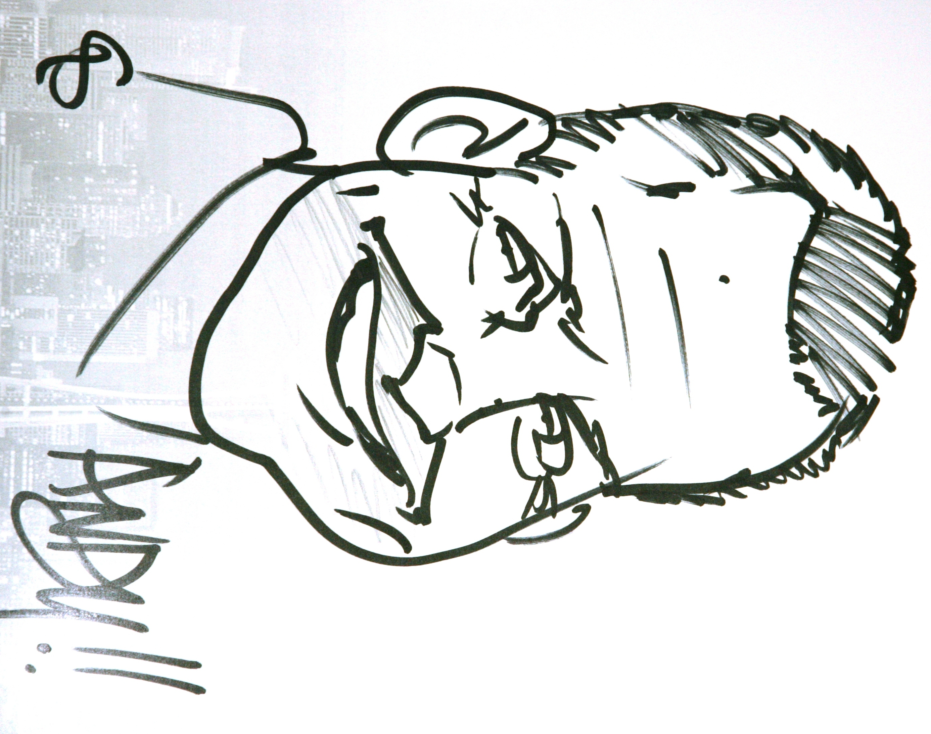
Panelist
Andy Malone
CEO & Senior Technologist
Quality Training (UK) Ltd., & Dive Deeper Events
Andy Malone is the CEO of Quality Training Ltd and founder of both the Dive Deeper Technology and Cybercrime Security events. Based in Scotland, Andy is a popular international event speaker and technology evangelist with over 15 years experience. Andy continues to work with the Microsoft product teams to create and deliver ground breaking material on Windows 7, Server 2008 R2 and beyond.
Andy’s blog: http://blogs.quality-training.co.uk/blog

Slide 3
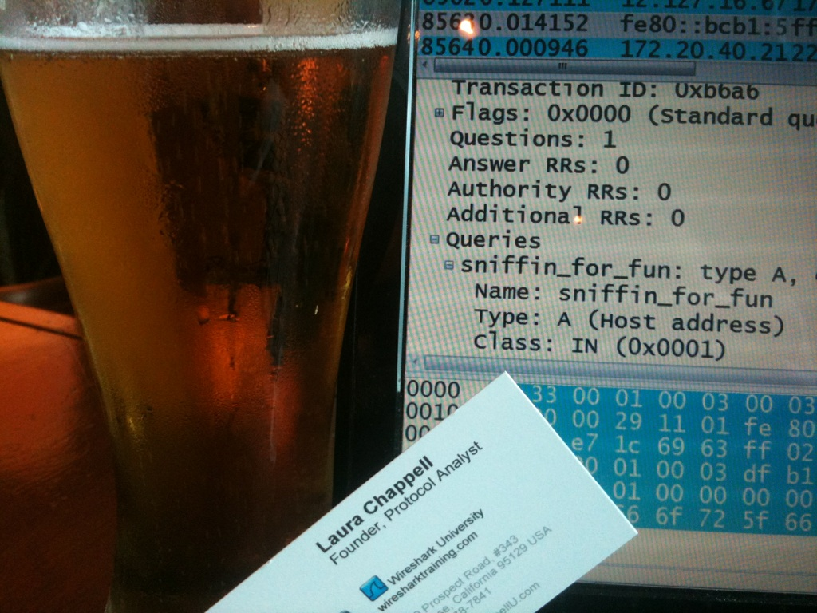
Panelist
Laura Chappell
Founder, Chappell/Wireshark University
Laura Chappell is the Founder of Wireshark University and Chappell University and a highly-energetic speaker. Ms. Chappell is the author of the best-selling "Wireshark Network Analysis" book and several other industry titles on network communications, analysis and security. Nicknamed “Glenda, the Good Witch,” Laura has presented to thousands of State, Federal and international law enforcement officers, judicial members, engineers, network administrators, technicians and developers.

Slide 4

Panelist
Marcus Murray
Security Team Manager, Truesec
Marcus Murray is the Security Team Manager at Truesec. In addition to his work designing secure infrastructures and implementing security functions, he and his team also perform security assessments for a variety of clients, including banks, military organizations, and other large corporations. He is frequently engaged as keynote speaker for Security Events and his focus is often security threats, vulnerabilities, and awareness, and how to implement countermeasures that work in the real world. Marcus is a member of the Truesec Expert Team, an independent elite-team of Security and infrastructure consultants operating all over the world.

Slide 5
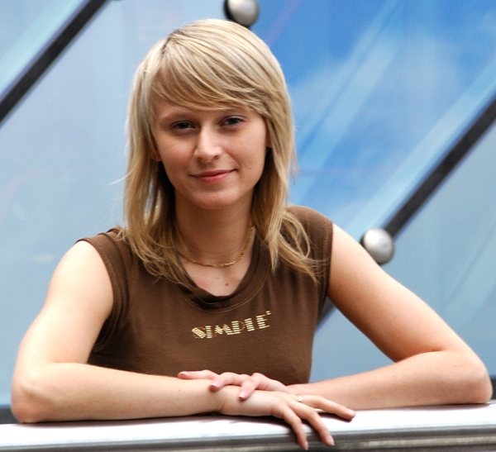
Panelist
Paula Januszkiewicz
IT Security Auditor, CEO, CQURE
Paula Januszkiewicz is the IT Security Auditor, Enterprise Security MVP, trainer (MCT) and Microsoft Security Trusted Advisor. The trainings she conducts usually cover Security, Virtualization and Windows operating system topics. Paula is passionate about sharing her knowledge with others. She conducted many IT security audits and penetration tests. She drives her own company CQURE. Paula is the leader of the Women in Technology group in Poland and organizes Warsaw Girl Geek Dinners. In private, she enjoys researching new technologies and describes them on her blog http://blogs.technet.com/plwit

Slide 6

Panelist
Jimmy Kuo
Principal Architect, MMPC, Microsoft Corporation
Chengi Jimmy Kuo is the principal architect for the Microsoft Malware Protection Center (MMPC), where he assesses the impact of computer viruses on customers and how best to protect the data that people and organizations store on computer systems. Jimmy directs Microsoft’s worldwide anti-malware engineering team, assessing the types of computing activities that put people and organizations at high risk and
then establishing procedures, test methodologies and updates to address threats.

Slide 7
Panelist
Andy Malone
CEO & Senior Technologist
Quality Training (UK) Ltd., & Dive Deeper Events
Andy Malone is the CEO of Quality Training Ltd and founder of both the Dive Deeper Technology and Cybercrime Security events. Based in Scotland, Andy is a popular international event speaker and technology evangelist with over 15 years experience. Andy continues to work with the Microsoft product teams to create and deliver ground breaking material on Windows 7, Server 2008 R2 and beyond.
Andy’s blog: http://blogs.quality-training.co.uk/blog

Slide 8
Panelist
Laura Chappell
Founder, Chappell/Wireshark University
Laura Chappell is the Founder of Wireshark University and Chappell University and a highly-energetic speaker. Ms. Chappell is the author of the best-selling "Wireshark Network Analysis" book and several other industry titles on network communications, analysis and security. Nicknamed “Glenda, the Good Witch,” Laura has presented to thousands of State, Federal and international law enforcement officers, judicial members, engineers, network administrators, technicians and developers.

Slide 9
Panelist
Marcus Murray
Security Team Manager, Truesec
Marcus Murray is the Security Team Manager at Truesec. In addition to his work designing secure infrastructures and implementing security functions, he and his team also perform security assessments for a variety of clients, including banks, military organizations, and other large corporations. He is frequently engaged as keynote speaker for Security Events and his focus is often security threats, vulnerabilities, and awareness, and how to implement countermeasures that work in the real world. Marcus is a member of the Truesec Expert Team, an independent elite-team of Security and infrastructure consultants operating all over the world.

Slide 10
Panelist
Paula Januszkiewicz
IT Security Auditor, CEO, CQURE
Paula Januszkiewicz is the IT Security Auditor, Enterprise Security MVP, trainer (MCT) and Microsoft Security Trusted Advisor. The trainings she conducts usually cover Security, Virtualization and Windows operating system topics. Paula is passionate about sharing her knowledge with others. She conducted many IT security audits and penetration tests. She drives her own company CQURE. Paula is the leader of the Women in Technology group in Poland and organizes Warsaw Girl Geek Dinners. In private, she enjoys researching new technologies and describes them on her blog http://blogs.technet.com/plwit

Slide 11
Panelist
Jimmy Kuo
Principal Architect, MMPC, Microsoft Corporation
Chengi Jimmy Kuo is the principal architect for the Microsoft Malware Protection Center (MMPC), where he assesses the impact of computer viruses on customers and how best to protect the data that people and organizations store on computer systems. Jimmy directs Microsoft’s worldwide anti-malware engineering team, assessing the types of computing activities that put people and organizations at high risk and
then establishing procedures, test methodologies and updates to address threats.

Slide 12
Panelist
Andy Malone
CEO & Senior Technologist
Quality Training (UK) Ltd., & Dive Deeper Events
Andy Malone is the CEO of Quality Training Ltd and founder of both the Dive Deeper Technology and Cybercrime Security events. Based in Scotland, Andy is a popular international event speaker and technology evangelist with over 15 years experience. Andy continues to work with the Microsoft product teams to create and deliver ground breaking material on Windows 7, Server 2008 R2 and beyond.
Andy’s blog: http://blogs.quality-training.co.uk/blog

Slide 13
Panelist
Laura Chappell
Founder, Chappell/Wireshark University
Laura Chappell is the Founder of Wireshark University and Chappell University and a highly-energetic speaker. Ms. Chappell is the author of the best-selling "Wireshark Network Analysis" book and several other industry titles on network communications, analysis and security. Nicknamed “Glenda, the Good Witch,” Laura has presented to thousands of State, Federal and international law enforcement officers, judicial members, engineers, network administrators, technicians and developers.

Slide 14
Panelist
Marcus Murray
Security Team Manager, Truesec
Marcus Murray is the Security Team Manager at Truesec. In addition to his work designing secure infrastructures and implementing security functions, he and his team also perform security assessments for a variety of clients, including banks, military organizations, and other large corporations. He is frequently engaged as keynote speaker for Security Events and his focus is often security threats, vulnerabilities, and awareness, and how to implement countermeasures that work in the real world. Marcus is a member of the Truesec Expert Team, an independent elite-team of Security and infrastructure consultants operating all over the world.

Slide 15
Panelist
Paula Januszkiewicz
IT Security Auditor, CEO, CQURE
Paula Januszkiewicz is the IT Security Auditor, Enterprise Security MVP, trainer (MCT) and Microsoft Security Trusted Advisor. The trainings she conducts usually cover Security, Virtualization and Windows operating system topics. Paula is passionate about sharing her knowledge with others. She conducted many IT security audits and penetration tests. She drives her own company CQURE. Paula is the leader of the Women in Technology group in Poland and organizes Warsaw Girl Geek Dinners. In private, she enjoys researching new technologies and describes them on her blog http://blogs.technet.com/plwit

Slide 16
Panelist
Jimmy Kuo
Principal Architect, MMPC, Microsoft Corporation
Chengi Jimmy Kuo is the principal architect for the Microsoft Malware Protection Center (MMPC), where he assesses the impact of computer viruses on customers and how best to protect the data that people and organizations store on computer systems. Jimmy directs Microsoft’s worldwide anti-malware engineering team, assessing the types of computing activities that put people and organizations at high risk and
then establishing procedures, test methodologies and updates to address threats.

Slide 17
Panelist
Andy Malone
CEO & Senior Technologist
Quality Training (UK) Ltd., & Dive Deeper Events
Andy Malone is the CEO of Quality Training Ltd and founder of both the Dive Deeper Technology and Cybercrime Security events. Based in Scotland, Andy is a popular international event speaker and technology evangelist with over 15 years experience. Andy continues to work with the Microsoft product teams to create and deliver ground breaking material on Windows 7, Server 2008 R2 and beyond.
Andy’s blog: http://blogs.quality-training.co.uk/blog

Slide 18
Panelist
Laura Chappell
Founder, Chappell/Wireshark University
Laura Chappell is the Founder of Wireshark University and Chappell University and a highly-energetic speaker. Ms. Chappell is the author of the best-selling "Wireshark Network Analysis" book and several other industry titles on network communications, analysis and security. Nicknamed “Glenda, the Good Witch,” Laura has presented to thousands of State, Federal and international law enforcement officers, judicial members, engineers, network administrators, technicians and developers.

Slide 19
Panelist
Marcus Murray
Security Team Manager, Truesec
Marcus Murray is the Security Team Manager at Truesec. In addition to his work designing secure infrastructures and implementing security functions, he and his team also perform security assessments for a variety of clients, including banks, military organizations, and other large corporations. He is frequently engaged as keynote speaker for Security Events and his focus is often security threats, vulnerabilities, and awareness, and how to implement countermeasures that work in the real world. Marcus is a member of the Truesec Expert Team, an independent elite-team of Security and infrastructure consultants operating all over the world.

Slide 20
Panelist
Paula Januszkiewicz
IT Security Auditor, CEO, CQURE
Paula Januszkiewicz is the IT Security Auditor, Enterprise Security MVP, trainer (MCT) and Microsoft Security Trusted Advisor. The trainings she conducts usually cover Security, Virtualization and Windows operating system topics. Paula is passionate about sharing her knowledge with others. She conducted many IT security audits and penetration tests. She drives her own company CQURE. Paula is the leader of the Women in Technology group in Poland and organizes Warsaw Girl Geek Dinners. In private, she enjoys researching new technologies and describes them on her blog http://blogs.technet.com/plwit

Slide 21
Panelist
Jimmy Kuo
Principal Architect, MMPC, Microsoft Corporation
Chengi Jimmy Kuo is the principal architect for the Microsoft Malware Protection Center (MMPC), where he assesses the impact of computer viruses on customers and how best to protect the data that people and organizations store on computer systems. Jimmy directs Microsoft’s worldwide anti-malware engineering team, assessing the types of computing activities that put people and organizations at high risk and
then establishing procedures, test methodologies and updates to address threats.

Slide 22
Rethinking Cyber Threats:
Experts Panel
SIM327
Panelists: Andy Malone, Laura Chappell, Marcus Murray, Paula Januszkiewicz
Moderator: Jimmy Kuo

Slide 23
Ripped from the headlines…

Slide 24
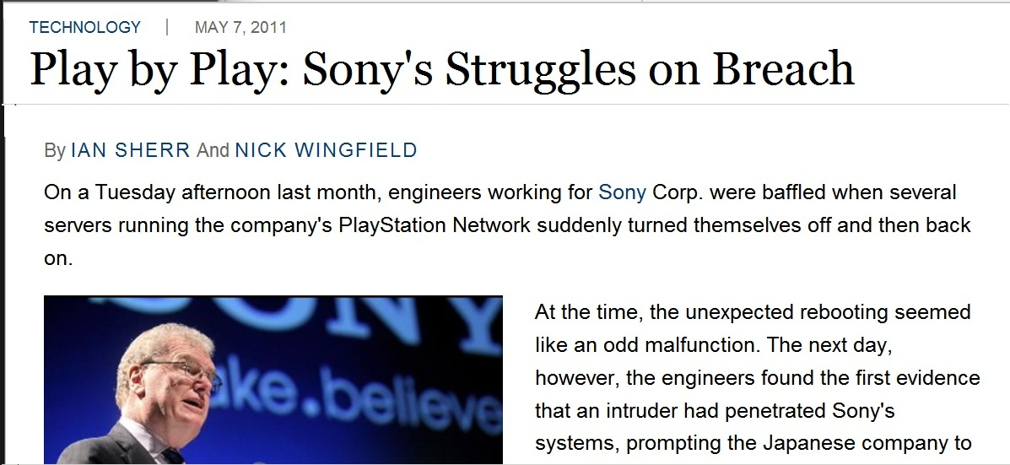
http://online.wsj.com/article/SB10001424052748704810504576307322759299038.html

Slide 25
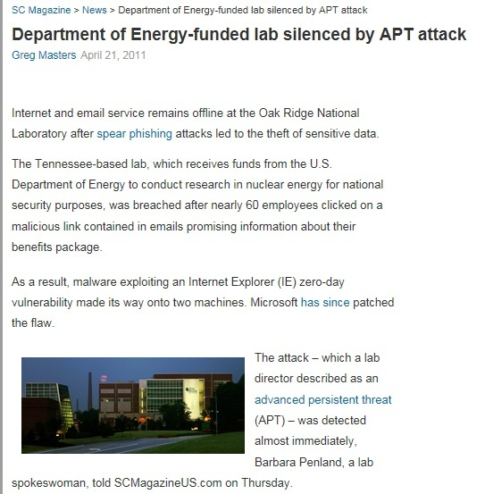
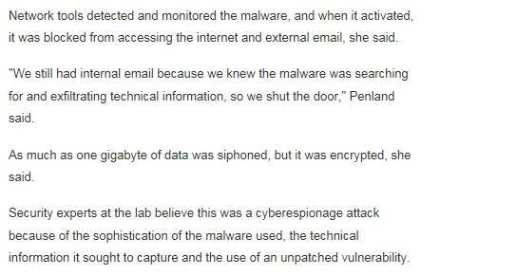
http://www.scmagazineus.com/department-of-energy-funded-lab-silenced-by-apt-attack/article/201144/

Slide 26

Trustworthy Computing
Safety and Security Center
http://www.microsoft.com/security
Security Development Lifecycle
http://www.microsoft.com/sdl
Security Intelligence Report
http://www.microsoft.com/sir
End to End Trust
http://www.microsoft.com/endtoendtrust

Slide 27





Resources
  Connect. Share. Discuss.
http://northamerica.msteched.com
Learning
  Sessions On-Demand & Community
  Microsoft Certification & Training Resources
www.microsoft.com/teched
www.microsoft.com/learning
  Resources for IT Professionals
  Resources for Developers
http://microsoft.com/technet
http://microsoft.com/msdn

Slide 28












Complete an evaluation on CommNet and
enter to win!

Slide 29


Slide 30
© 2011 Microsoft Corporation. All rights reserved. Microsoft, Windows, Windows Vista and other product names are or may be registered trademarks and/or trademarks in the U.S. and/or other countries.
The information herein is for informational purposes only and represents the current view of Microsoft Corporation as of the date of this presentation. Because Microsoft must respond to changing market conditions, it should not be interpreted to be a commitment
on the part of Microsoft, and Microsoft cannot guarantee the accuracy of any information provided after the date of this presentation. MICROSOFT MAKES NO WARRANTIES, EXPRESS, IMPLIED OR STATUTORY, AS TO THE INFORMATION IN THIS PRESENTATION.

