Slide 2

Centralized Management of Anti-Malware/
Anti-Spam Using Microsoft Forefront
Protection Server Management Console
SIM333
Mitchell Hall
Senior Program Manager
Microsoft Corporation

Slide 3
Agenda
Overview
Multi-node Management Options
Forefront Protection Server Management Console 2010
    Demo
Forefront Protection Server Script Kit
    Demo
Summary

Slide 4
Overview
Forefront Protection 2010 for Exchange Server (FPE)
  Provides Antimalware, Antispam and Filtering protection on Exchange 2007 and Exchange 2010 deployments
  Released November 2009, current rollup: RU2
Forefront Protection 2010 for SharePoint (FPSP)
  Provides Antimalware and Filtering protection on SharePoint 2007 and SharePoint 2010
  Released April 2010, current rollup: RU1
Both products have built-in standalone management capabilities
  Comprehensive UI
  PowerShell support provides scriptability
Centralized Multi-Node Management
  To enable management of FPE and FPSP in the organization

Slide 5
Multi-node Management for Forefront Protection Servers
Forefront Protection Server Management Console 2010 (FPSMC)
  Multi-server management of FPE and FPSP in a single web-based interface.
  Free download– see http:\\Microsoft.com\Forefront
  Released December 2010
Forefront Protection Server Script Kit (FPSSK)
  Scripts for discovery, configuration, deployment, and reporting on FPE and FPSP
  Free download – see http:\\Microsoft.com\Forefront
  Released August 4, 2010.

Slide 6
Forefront Protection Server Management Console 2010 (FPSMC)
Centralized Multi-node Management Console
for FPE/FPSP servers

Slide 7



FPSMC Capabilities
Simplified Management
Visibility & Control
Enterprise Ready
Manage FPE 2010 and FPSP 2010
Server Discovery and Grouping
FPSMC agent deployment
Deploy policies to custom-defined groups of servers
Manage cross-domain and non-domain server from one console
Firewall friendly communication channel
Signature Redistribution for 32-bit and 64-bit engines
Visibility into incidents across FPE, FPSP
Real-time monitoring for security events
User friendly Dashboard view
Real-time and historical reports
Web-based interface for easier access
License distribution and activation
Centralized Quarantine
Enterprise ready scalability
Support for SQL scenarios
Business continuity for critical functionality
Manage FPE on Clusters (Exchange 2007 and Exchange 2010)
Built on Microsoft Infrastructure
Windows Server 2008 R2
Hyper-V
WCF
Active Directory
SQL Server 2008
IE 7.0 and IE 8.0; IE 9 support in progress
Microsoft Confidential

Slide 8







Management Console Overview
Remote Access over HTTP
FPE Servers
Add servers to FPSMC and deploy Agent
Upload policy to FPSMC and create jobs
Run jobs to deploy policy
Retrieve Quarantine and stats periodically
Data is stored in SQL Server
Remote access of FPSMC for management
If Backup is deployed, servers and redistribution jobs replicated across SQL ; Backup erver provides signature redistribution only.
2
6
1
FPSP Servers
3
Communication over WCF
4
Active-Active configuration
Data access via Stored Procedures
5
7
Continuous SQL Replication
Enterprise SQL
Enterprise SQL
Primary FPSMC
Backup FPSMC

Slide 9
Installing FPSMC
Installs on Windows Server 2008 R2
Prerequisites
  SQL 2008 or higher Enterprise Edition or SQL 2008 Express will be installed by FSPMC
  MS Chart Control for .Net 3.5 – must be installed separately by Admin
  Windows Additional Components ( e.g. IIS)
2 deployment options
  Standalone
    Will install SQL Server 2008 R2 Express by default
    Support both Express and Enterprise versions of Microsoft SQL Server
    Cannot be used to connect to a Backup server
  Primary/Secondary
    Primary is identical to the Standalone server; Requires SQL enterprise
    Backup requires primary to be already deployed
    Primary and Secondary deployments cannot be on the same server

Slide 10
Access to the Console
Web access for the UI
  http://<FPSMCserver>/FPSMConsole
  HTTPS must be enabled by the Admin
Initial Access is limited to the Installation Admin
  Other users must be added via the console
Access limited to Administrators
  Local Admin, Domain Admin, Exchange Admin, Enterprise Admin

Slide 11
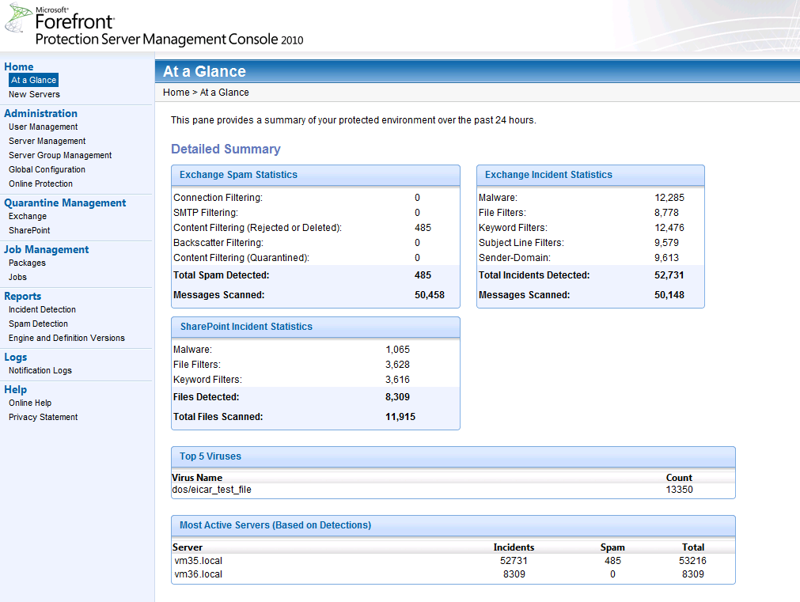
FPSMC Home Page
Side Navigation bar provides quick access to desired functionality
At-a-glance provides 24-hour activity snapshot
  Stats broken out by Exchange and SharePoint
  Top 5 viruses
  Most active servers
Highlighted navigation and ‘breadcrumb bar’ for current location

Slide 12
Server Management
FPSMC can manage domain joined servers and non-domain joined servers
  E.g. Edge servers, Perimeter SharePoint deployments
Automatic discovery of FPE and FPSP servers within AD
  Displayed under “New Servers”
  Must be added to FPSMC to be managed
Non-domain joined servers can be manually added
  Need to enter FQDN
Servers can be managed as groups
Agent must be deployed in order to manage servers
  Status will be displayed

Slide 13
Forefront Protection Management Console
  At a glance
  User Management
  Server Management
  Global Configuration
  Online Protection
demo

Slide 14
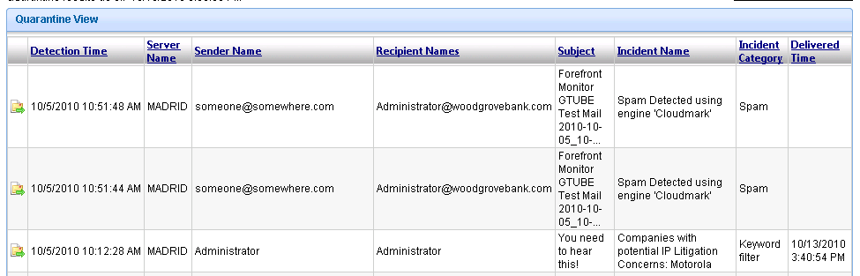
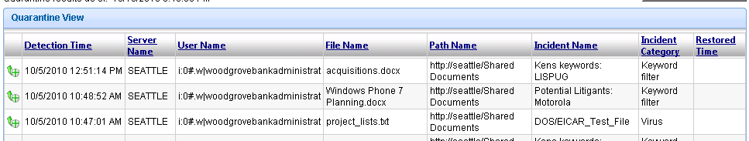
Quarantine Management
Centralized management
Configurable retrieval period and polling interval
  Defaults to retrieving 5 days of records and polling every 15 min
Broken out by Exchange and SharePoint
  Enables deliver/restore of false positives directly from console
  Results can be filtered for quicker recovery

Slide 15
Job Management
4 types of jobs
  Deployment job (Policy)
  Signature Redistribution Job
  Scheduled Report Job
  Product Activation Job
Jobs can be scheduled or run on demand
Jobs can be scoped to target a specific set of servers
  Configured by the Administrator

Slide 16
Forefront Protection Management Console
  Quarantine Management
  Job Management
demo

Slide 17
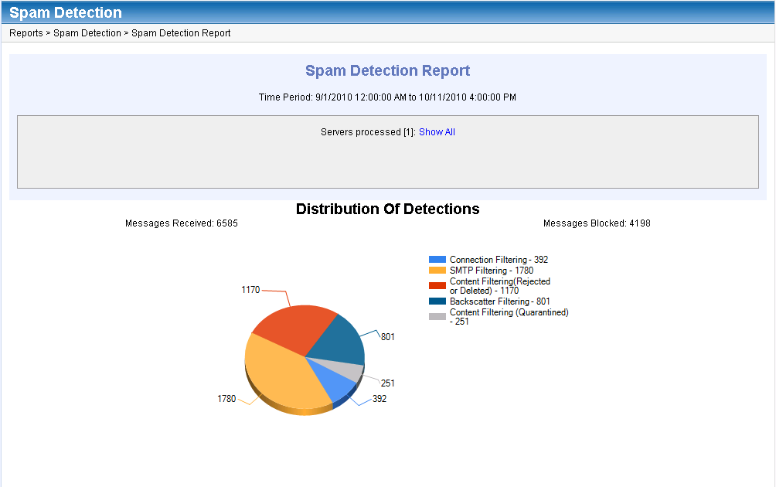
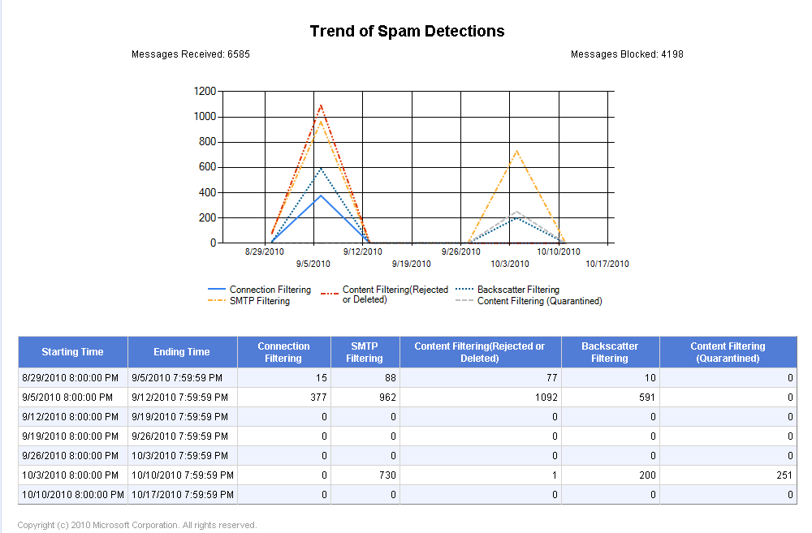
Reporting
  New Server, Incident Detection, Spam Detection, Engine and Definition Version
On-demand
  Report scoped based on date range and desired servers
  Report includes distribution of
  detections, trending and raw data
Scheduled
  Delivered via email

Slide 18
Forefront Protection Management Console
  Reporting
demo

Slide 19
Migrating from FSSMC to FPSMC
FSSMC Migration to FPSMC not supported
  FSSMC is 32-bit only; FPSMC is 64-bit only
  FSSMC only supports SQL 2005; FPSMC requires SQL 2008
FPSMC and FSSMC must both be deployed to manage a mixed deployment
  FPSMC to manage FPE/FPSP
  FSSMC to manage FSE/FSSP/Antigen

Slide 20
Forefront Protection Server Script Kit (FPSSK)

Slide 21
FPSSK Overview
Management of FPE and FPSP servers using scripts
Solution based 100% on PowerShell features
  Based on PowerShell v2.0 remoting
  Leveraged in-market FPE/FPSP PowerShell cmdlets
  No new compiled code
  Easily customizable and extensible
FPSSK complements FPSMC functionality
  Enables some features not included in FPSMC e.g. policy compliance

Slide 22
FPSSK Overview
Provides examples of the following functionality:
  Compare server configuration files
  Discover new servers
  Export / Import server configurations
  Remotely run reports

Slide 23
Forefront Protection Script Kit
demo

Slide 24
Summary
Forefront Protection Server Management Console 2010
  Provides multi-server management for all FPE and FPSP deployments in the organization
    Management of jobs on the target server
    Centralized Quarantine Management
    On-demand and email reports
  Available as a free download at http:\\Microsoft.com\Forefront
Forefront Protection Server Script Kit
  Provides scripting management solution
  Base set of scripts that can be extended to meet customer need
  Complements FPSMC

Slide 25

Related Content
Required Slide
Speakers, please list the Breakout Sessions, Interactive Discussions, Labs, Demo Stations and Certification Exam that relate to your session. Also indicate when they can find you staffing in the TLC.
SIM326 Microsoft Forefront End-to-End Protection for Information Workers
  Thursday May 19 @ 4:30
For more information on Forefront Products please visit:
http:\\Microsoft.com\Forefront
Come to the Exchange area for more information on the Forefront products

Slide 26
Track Resources
Don’t forget to visit the Cloud Power area within the TLC (Blue Section) to see product demos and speak with experts about the Server & Cloud Platform solutions that help drive your business forward.
You can also find the latest information about our products at the following links:
Cloud Power - http://www.microsoft.com/cloud/
Private Cloud - http://www.microsoft.com/privatecloud/
Windows Server - http://www.microsoft.com/windowsserver/
Windows Azure - http://www.microsoft.com/windowsazure/
Microsoft System Center - http://www.microsoft.com/systemcenter/
Microsoft Forefront - http://www.microsoft.com/forefront/

Slide 27





Resources
  Connect. Share. Discuss.
http://northamerica.msteched.com
Learning
  Sessions On-Demand & Community
  Microsoft Certification & Training Resources
www.microsoft.com/teched
www.microsoft.com/learning
  Resources for IT Professionals
  Resources for Developers
http://microsoft.com/technet
http://microsoft.com/msdn

Slide 28












Complete an evaluation on CommNet and
enter to win!

Slide 29

Notes:
New for TechEd 2011, we will be working with Microsoft Tag (http://tag.microsoft.com/overview.aspx) to create unique Tags for every session at the event. Your session Tag will appear on both the room signage and at the end of your presentation. With your session Tag, attendees will be able to scan as they enter the room to retrieve session details, view speaker bios, and engage in discussions; or scan at the end of the presentation to evaluate your session and download materials. We’re excited to integrate Microsoft Tag across the My TechEd mobile experience this year.

Slide 30

© 2011 Microsoft Corporation. All rights reserved. Microsoft, Windows, Windows Vista and other product names are or may be registered trademarks and/or trademarks in the U.S. and/or other countries.
The information herein is for informational purposes only and represents the current view of Microsoft Corporation as of the date of this presentation. Because Microsoft must respond to changing market conditions, it should not be interpreted to be a commitment
on the part of Microsoft, and Microsoft cannot guarantee the accuracy of any information provided after the date of this presentation. MICROSOFT MAKES NO WARRANTIES, EXPRESS, IMPLIED OR STATUTORY, AS TO THE INFORMATION IN THIS PRESENTATION.

