Slide 2

Microsoft System Center Integration,
Automation, Process and Compliance:
Orchestrator and Service Manager
SIM335
Adam Hall and Sean Christensen
Senior Technical Product Managers
Server and Cloud

Slide 3
Session Objectives and Takeaways
Objectives:
  You understand the capability pillars of Service Manager and Orchestrator
  You can effectively describe the differences between the products and the benefits each brings to your organization
Key Takeaways:
  Orchestrator and Service Manager are complimentary
  Together they provide a market leading IT Process and Automation capability

Slide 4
Where are we today?

Slide 5
NetApp
Opalis and Service Manager
Alex Jauch
Demo

Slide 6
Demo: Rapid Provisioning
Rapid Provisioning via Opalis
Integrated with SCSM and SCVMM
Part of Hyper-V Fast Track Submission
Uses OIP from OnCommand 3.0
See it Live at Booth 1001

Slide 7
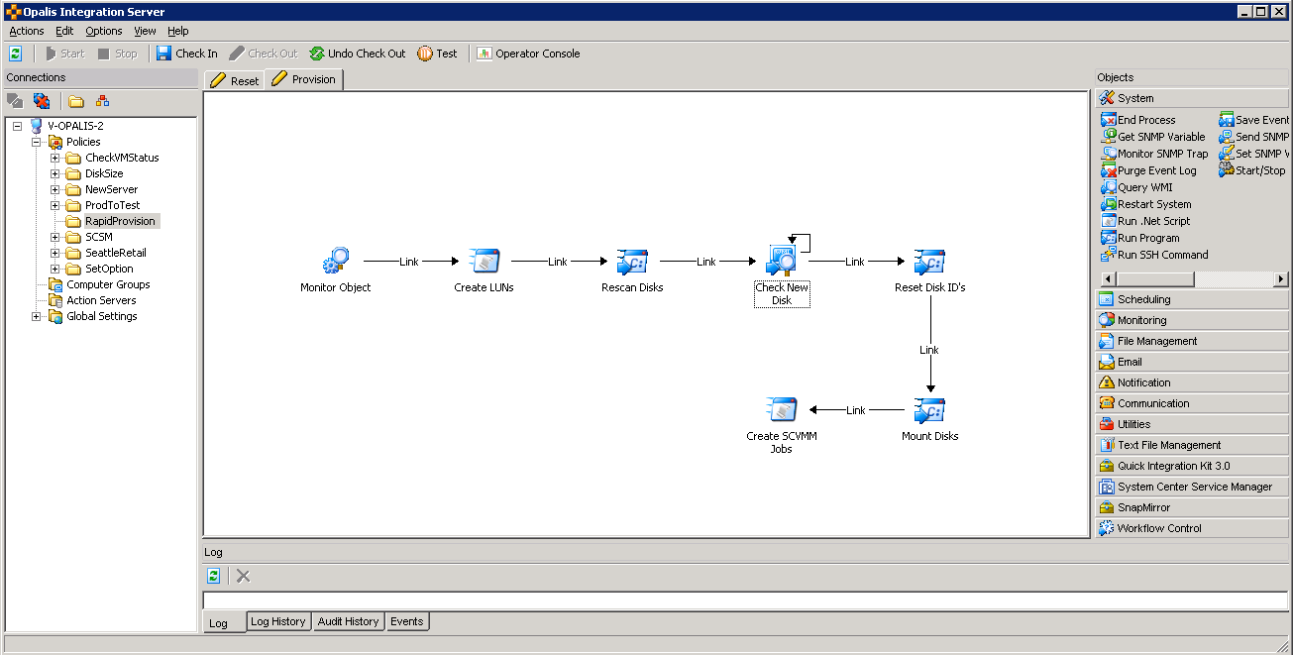
Prototype Workflow

Slide 8
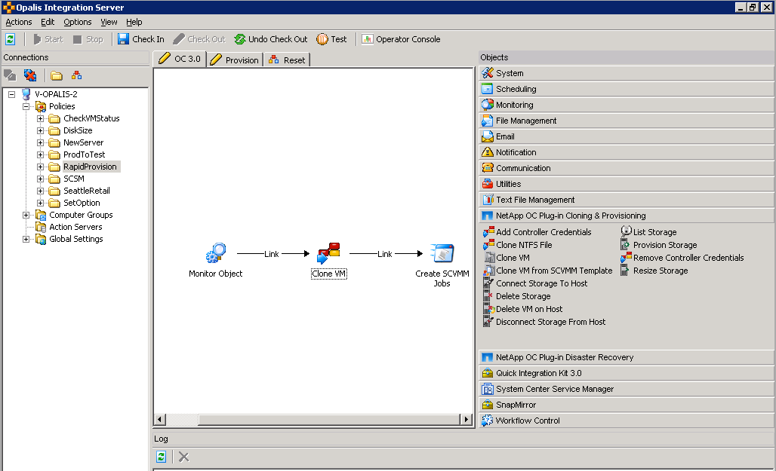
Fast Track Provisioning Workflow

Slide 9
Looking ahead to System Center 2012

Slide 10
Contrasting Orchestrator and Service Manager
Orchestrator 2012 | Service Manager 2012
Integration across all the technology solutions | Connector framework to Microsoft applications and other System Center solutions
Orchestration of system level processes | Knowledge capture and process management
Automation of technology based standard operational procedures | Service Management best practices
Runbook execution | Automation of service management processes

Slide 11

System Center Orchestrator

Slide 12
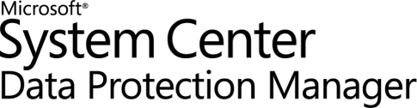

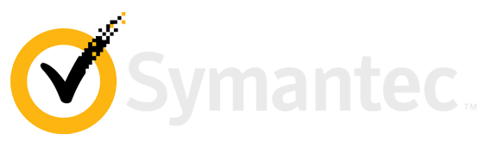
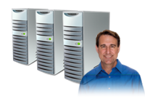
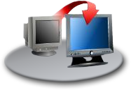


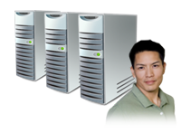



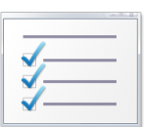


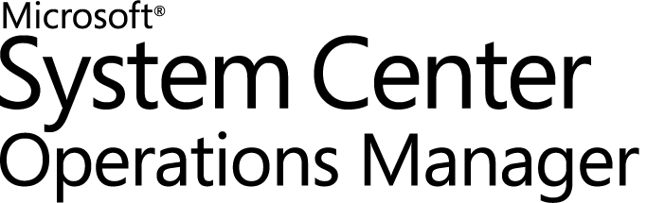
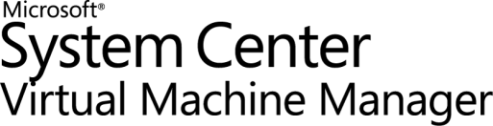

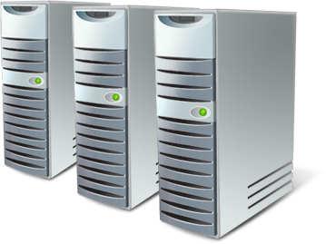


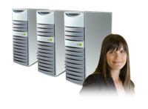

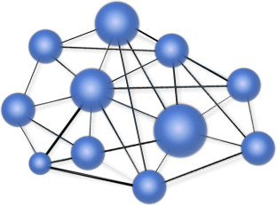



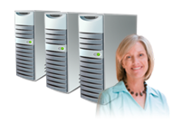
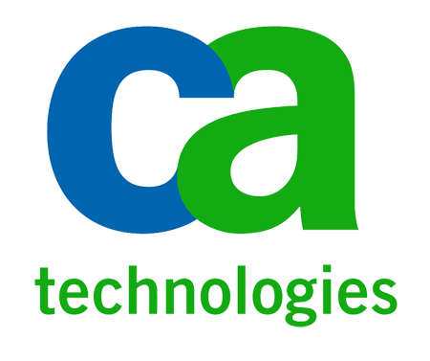

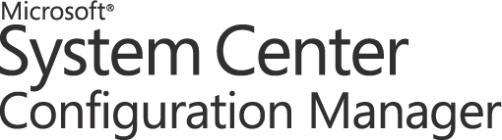
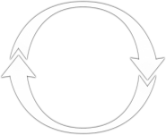
Orchestrator brings it all together!
Service Management
Configuration
Monitoring
Provisioning
Protection
Service Manager
Automation
Integration
HP Service Manager Software
Make your IT service desk enterprise strength
.
Orchestration
OpenView Operations
Notes:
You can break down the core capabilities required to manage a Datacenter into 5 key areas. And in all likelihood, you will have a range of solutions in your datacenter from a variety of vendors.
The System Center suite provides solutions to all of these areas, and with the addition of Opalis to the suite we also provide the mechanism to integrate to the 3rd party solutions. This is an investment that we are committed to and will continue to maintain as part of Orchestrator.
There are 3 words we associate with Opalis/Orchestrator. The first is Integration.
Bringing all of the components of your datacenter together and being able to communicate and execute across all the different moving parts is the first step. This brings us to Orchestration.
Once you have integrated your datacenter and can reference it is a single entity, then you can start to map out how to co-ordinate all the different parts to work together.
And then you can automate all of this to deliver consistent and repeatable results.

Slide 13
Opalis Concepts
Activities
  Intelligent tasks that perform defined actions
Integration Packs
  The way Opalis integrates to and executes activities against other systems and solutions
Databus
  The mechanism Opalis uses to publish and consume information between
  activities as the runbook executes
Runbooks
  System level workflows that execute a series of linked activities to complete
  a defined set of actions

Slide 14
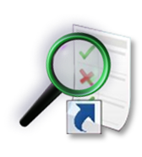
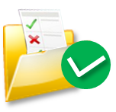

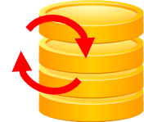

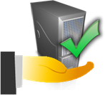
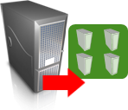

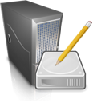

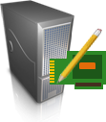
Automating Across Datacenter IT Silos
Event Mgmt
Monitor
for request
Application Service Management
VM Lifecycle Management
Incident
Response
Service Desk
Initiate
Change
Update
CMDB
Close
Request
Change & Compliance
Provisioning
Asset/CMDB
Create
Deployment
Configuration
Clone
VM
Associate
Server to Service
Virtual
Security
Storage
Create
Disk
Connect
Disk to VM
Server
Create
Server
Network
Join
Network
Notes:
As you all will be aware, there are many different silos within an IT environment. The diagram we have here is representative of what a lot of customers have in their technology organizations. With Opalis, we are able to integrate and automate across these silos.
If we take an example of VM lifecycle, you can see an example of a runbook and how it cuts across these silos to provide the complete process required to deploy out a new virtual machine.

Slide 15
System Center Service Manager

Slide 16
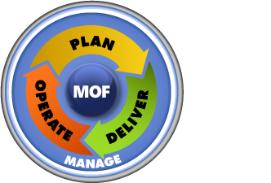
Achieving IT as a Service Objectives
MOF®
Automation
ITaaS Objectives
Standardization
Reduce Costs
Increase Service Levels
Faster Time to Delivery
Provide More Data
More Transparency
Compliance
ITIL®
Self-service
COBIT®
Compliance
Process Design
Implementation

Slide 17
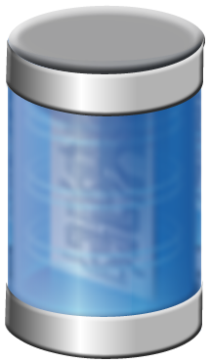






Service Manager Enables Controlled Automation
IT Data
Warehouse
Configuration Management DB
Work Items
Configuration Items
Knowledge
Automation Services
Centralized Data Storage
Integration

Slide 18
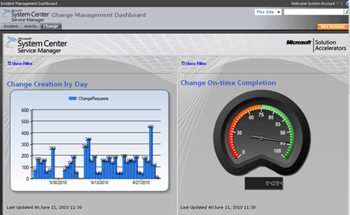
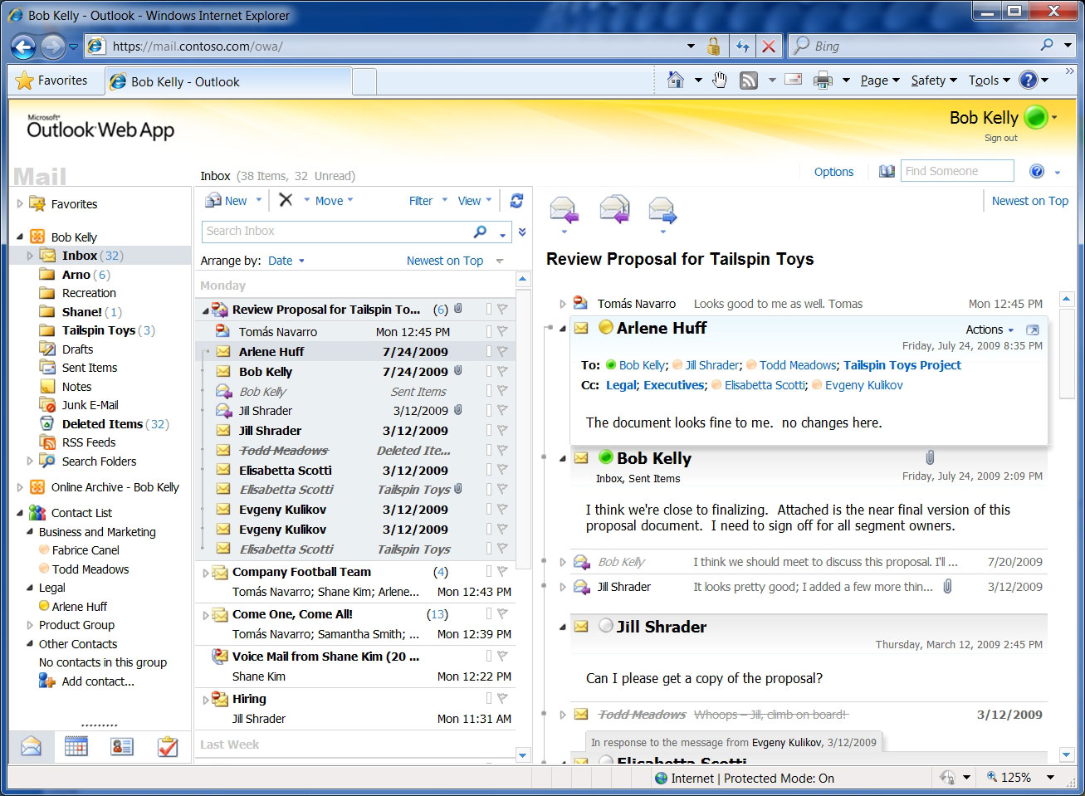
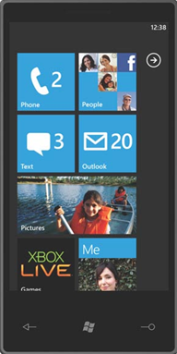
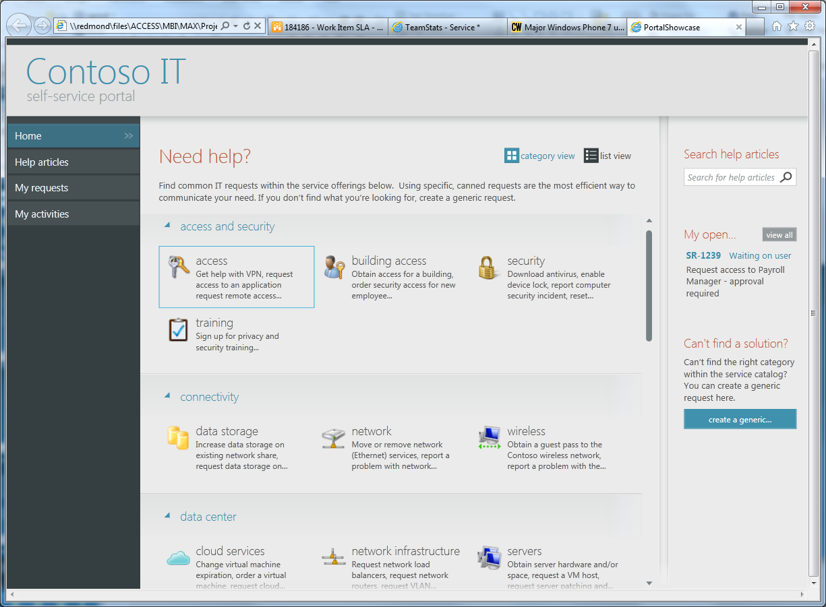
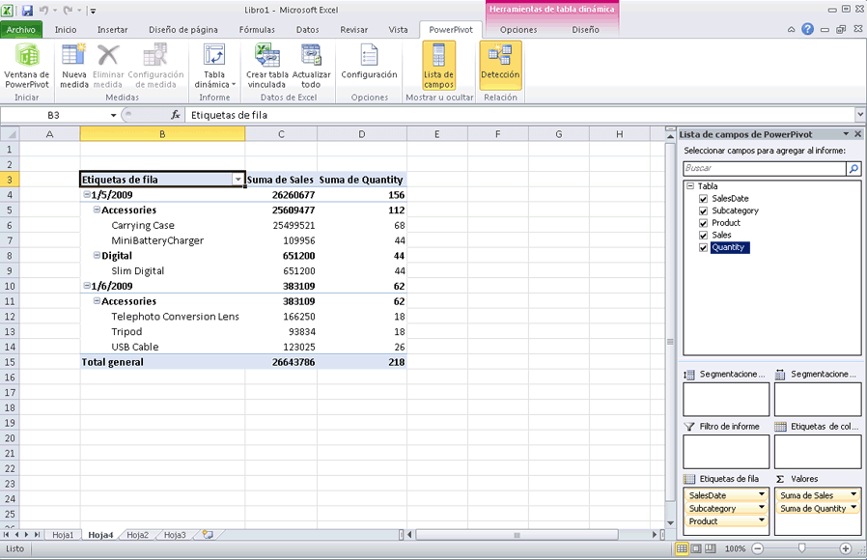
Service Manager Enables Self-Service
Reports &
Dashboards
E-Mail &
Other Clients
Portal
Excel

Slide 19
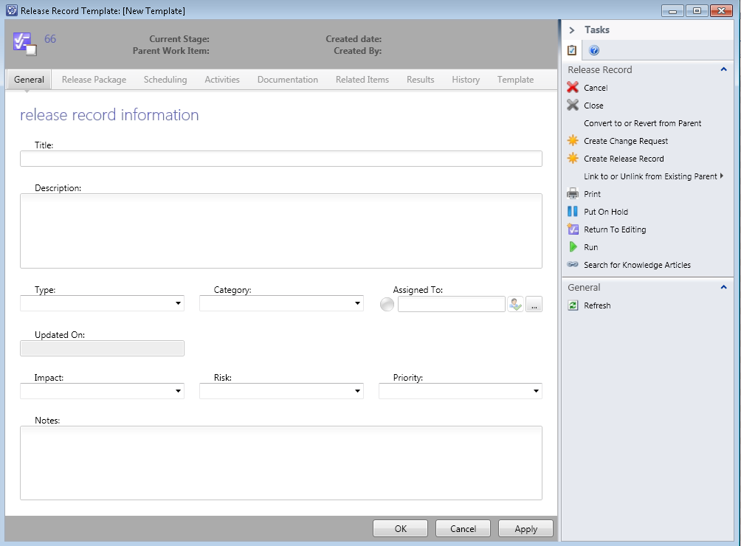
Service Manager Enables Standardization
Business Process Defined in Templates
CMDB Data Standardization
  Common Model
  Reconciliation of Data
Service Catalog

Slide 20

Service Manager Enables Compliance
Compliance is embedded in process, standards, self-service, and automation
Compliance library maps legalese to actionable IT control activities
Compliance is continuously and automatically evaluated in real time
Bob Lemur

Slide 21
Orchestrator and Service Manager
System Center 2012!
Demo

Slide 22
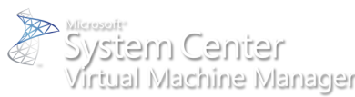









System Center Roadmap
Available Now
Coming Soon
  1H CY10
  2H CY10
  1H CY11
  2H CY11
Beta
RTM
Beta
2007 R3
Beta2
RTM
Beta2
6.3
Beta
RTM
Acquired
Beta
Beta
RTM
Beta
2010
IT GRC
Beta & RTM
2010
Beta & RTM
Beta & RTM
Beta
RC
RC
RTW
System Center
Codename “Concero”
Beta & RTM
GA
GA
Notes:
22
© 2008 Microsoft Corporation. All rights reserved. Microsoft, Windows, Windows Vista and other product names are or may be registered trademarks and/or trademarks in the U.S. and/or other countries.
The information herein is for informational purposes only and represents the current view of Microsoft Corporation as of the date of this presentation. Because Microsoft must respond to changing market conditions, it should not be interpreted to be a commitment on the part of Microsoft, and Microsoft cannot guarantee the accuracy of any information provided after the date of this presentation.
MICROSOFT MAKES NO WARRANTIES, EXPRESS, IMPLIED OR STATUTORY, AS TO THE INFORMATION IN THIS PRESENTATION.

Slide 23
Community Evaluation Program
Guided evaluation of Management & Security Products
  Access to evaluation bits and VHDs
  Access to product group at Virtual Chalk Talks
Community of Participants
  Share feedback on product and documentation
  Share best practices and experiences
Learn more about programs at
  http://msft.it/cep
  Or email mscep@microsoft.com with your interest

Slide 24
Adam: adhall@microsoft.com @Adman_NZ
Sean: sechrist@microsoft.com @SeanC_MSFT
Close, Q & A

Slide 25

Service Manager Related Content
Required Slide
Speakers, please list the Breakout Sessions, Interactive Discussions, Labs, Demo Stations and Certification Exam that relate to your session. Also indicate when they can find you staffing in the TLC.
Breakout Sessions
  SIM 208 - Management in the Datacenter
  SIM 209 - Microsoft System Center Service Manager - A Deep Dive on How to Automate ITIL or MOF
  SIM 210 - Sneak Peak at Microsoft System Center Service Manager 2012
  SIM 335 - Automation - Service Manager & Orchestrator - Better Together
  SIM 340 - Extending Microsoft System Center Service Manager - Modeling your Business Process
  SIM 362 - Monitoring IT as a Service with Microsoft System Center
  SIM??? - Taking the Next Step in IT GRC
Interactive Sessions
  SIM 372INT - How to Deploy and Configure Microsoft System Center Service Manager
  SIM 373INT - Stump The Microsoft System Center Service Manager team
  SIM383INT - Managing the Datacenter: Ask a Panel of Experts
Hands-on Labs
  SIM371-HOL Building a Microsoft System Center Service Manager Test Lab - Hall B1
  SIM372-HOL Incident and Change Management in Microsoft System Center Service Manager 2010 - Hall B1
  SIM373-HOL Microsoft System Center Service Manager 2010 Data Warehouse and Reporting - Hall B1
  SIM374-HOL IT Governance, Risk and Compliance Configuration in Microsoft System Center Service Manager 2010 - Hall B1
Product Demo Stations TLC – SIM – station 21
Find Me Later At…TLC station 21 or @SeanC_MSFT

Slide 26
Track Resources
Don’t forget to visit the Cloud Power area within the TLC (Blue Section) to see product demos and speak with experts about the Server & Cloud Platform solutions that help drive your business forward.
You can also find the latest information about our products at the following links:
Cloud Power - http://www.microsoft.com/cloud/
Private Cloud - http://www.microsoft.com/privatecloud/
Windows Server - http://www.microsoft.com/windowsserver/
Windows Azure - http://www.microsoft.com/windowsazure/
Microsoft System Center - http://www.microsoft.com/systemcenter/
Microsoft Forefront - http://www.microsoft.com/forefront/

Slide 27





Resources
  Connect. Share. Discuss.
http://northamerica.msteched.com
Learning
  Sessions On-Demand & Community
  Microsoft Certification & Training Resources
www.microsoft.com/teched
www.microsoft.com/learning
  Resources for IT Professionals
  Resources for Developers
http://microsoft.com/technet
http://microsoft.com/msdn

Slide 28












Complete an evaluation on CommNet and
enter to win!

Slide 29

Notes:
New for TechEd 2011, we will be working with Microsoft Tag (http://tag.microsoft.com/overview.aspx) to create unique Tags for every session at the event. Your session Tag will appear on both the room signage and at the end of your presentation. With your session Tag, attendees will be able to scan as they enter the room to retrieve session details, view speaker bios, and engage in discussions; or scan at the end of the presentation to evaluate your session and download materials. We’re excited to integrate Microsoft Tag across the My TechEd mobile experience this year.

Slide 30

© 2011 Microsoft Corporation. All rights reserved. Microsoft, Windows, Windows Vista and other product names are or may be registered trademarks and/or trademarks in the U.S. and/or other countries.
The information herein is for informational purposes only and represents the current view of Microsoft Corporation as of the date of this presentation. Because Microsoft must respond to changing market conditions, it should not be interpreted to be a commitment
on the part of Microsoft, and Microsoft cannot guarantee the accuracy of any information provided after the date of this presentation. MICROSOFT MAKES NO WARRANTIES, EXPRESS, IMPLIED OR STATUTORY, AS TO THE INFORMATION IN THIS PRESENTATION.

