Slide 1

Opalis and the Internal
Microsoft Adoption Story
SIM338
Charlie Satterfield (Microsoft MPSD)
Adam Hall (Microsoft Orchestrator)

Slide 2
Topics To Be Covered Today
Real World Scenarios: Opalis at Microsoft
    Administration
    VMM & Role Provisioning
    SR Fulfillment / IR Remediation
Management Platforms and Service Delivery (MPSD) Operations Using Opalis
Lessons Learned
Q&A

Slide 3






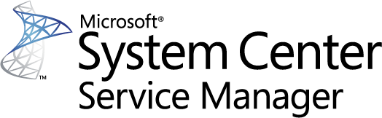

How is Microsoft using Opalis?
Administration
VMM & Role Provisioning
SR Fulfillment /
IR Remediation

Slide 4



Who is using Opalis at Microsoft?

Slide 5


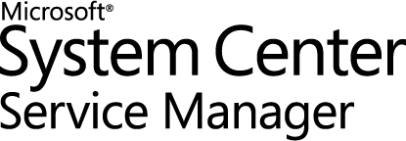







MPSD Operations Overview
Client Management
Datacenter Monitoring & Management
280,000 Desktops Managed at Microsoft
6,500 Clients Managed at Energizer
5,000 Clients Managed at XL
600+ Clients in the Microsoft Store
Over 4,500 servers managed for large online properties
Mgmt & Monitoring for online services
Outside-In Monitoring
Protection Services

Slide 6
Operational Readiness
SC Agents installed on all servers
Administration

Slide 7

Operational Readiness Using Opalis
Readiness Goal > 95% Agent Coverage
Before:
After with Opalis:
Identify unhealthy machines using AD (Automated)
Install agents (Semi-automated)
Triage issues (Manual)
Remediate known failures (Manual)
Escalate issues via email (Manual)
Identify unhealthy machines using AD (Automated)
Create Change Requests in ServiceMgr (Automated)
Install agents (Automated)
Update Change Log in ServiceMgr (Automated)
Remediate known failures (Automated)
Escalate issues in ServiceMgr (Automated)
Close Change Request (Automated)
Issues:
Benefits:
Manual hand offs between teams
No auditing or approval tracking
No automatic remediation for failures
Manual escalations of failures in email
Automated handoffs between teams
Rich auditing and approval
Automated remediation of known issues
Automated escalation of failures in ServiceMgr

Slide 8


Operational Readiness Using Opalis
Domain 3
Domain 2
Domain 1

Slide 9
Operational Readiness Using Opalis
Domain 3
Domain 2
Domain 1
Identify unhealthy machines using AD (Automated)
  Query AD
1a
1a
1a

Slide 10
Operational Readiness Using Opalis
Domain 3
Domain 2
Domain 1
Identify unhealthy machines using AD (Automated)
  Query AD
  Gather machine data
1b
1b
1b

Slide 11
Operational Readiness Using Opalis
Domain 3
Domain 2
Domain 1
Identify unhealthy machines using AD (Automated)
  Query AD
  Gather machine data
Create Change Requests in Service Manager (Automated)
2

Slide 12
Operational Readiness Using Opalis
Domain 3
Domain 2
Domain 1
Identify unhealthy machines using AD (Automated)
  Query AD
  Gather machine data
Create Change Requests in Service Manager (Automated)
Install agents (Automated)
3
3
3

Slide 13
Operational Readiness Using Opalis
Domain 3
Domain 2
Domain 1
Identify unhealthy machines using AD (Automated)
  Query AD
  Gather machine data
Create Change Requests in Service Manager (Automated)
Install agents (Automated)
Update Change Log in Service Manager (Automated)
4

Slide 14
Operational Readiness Using Opalis
Domain 3
Domain 2
Domain 1
Identify unhealthy machines using AD (Automated)
  Query AD
  Gather machine data
Create Change Requests in Service Manager (Automated)
Install agents (Automated)
Update Change Log in Service Manager (Automated)
Remediate known failures (Automated)
5
5
5

Slide 15
Operational Readiness Using Opalis
Domain 3
Domain 2
Domain 1
Identify unhealthy machines using AD (Automated)
  Query AD
  Gather machine data
Create Change Requests in Service Manager (Automated)
Install agents (Automated)
Update Change Log in Service Manager (Automated)
Remediate known failures (Automated)
Escalate issues in Service Manager (Automated)
6

Slide 16
Operational Readiness Using Opalis
Domain 3
Domain 2
Domain 1
Identify unhealthy machines using AD (Automated)
  Query AD
  Gather machine data
Create Change Requests in Service Manager (Automated)
Install agents (Automated)
Update Change Log in Service Manager (Automated)
Remediate known failures (Automated)
Escalate issues in Service Manager (Automated)
Close Change Request in Service Manager (Automated)
7

Slide 17
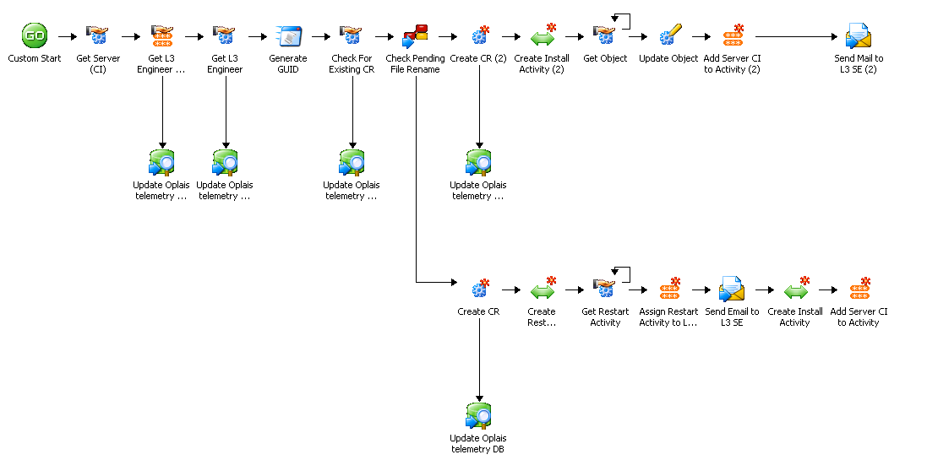

Slide 18
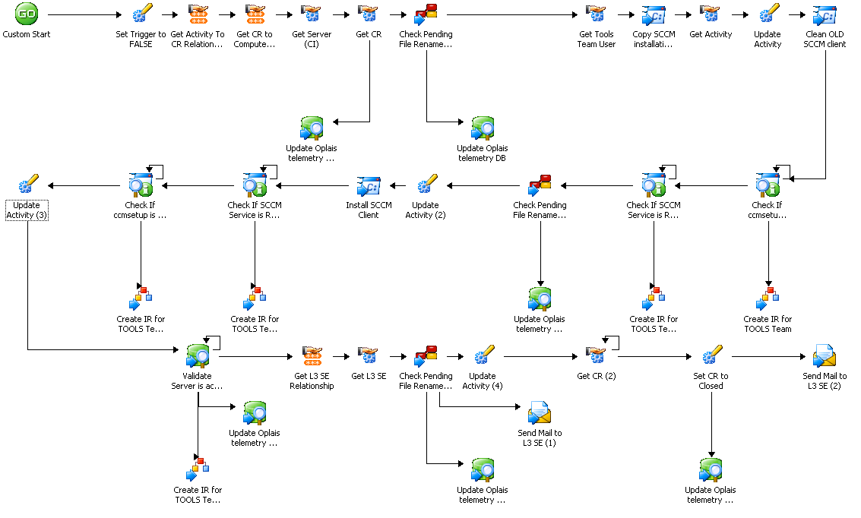

Slide 19
Desktop Patch Tuesday Process
Preparing and distributing software update packages
Administration

Slide 20
Solution Overview – Desktop Patch Process
Business Challenge
Solution
Results/Goals
Patching process:
Manual monthly process
Four part process
No auditing and quality control
Resource and time intensive
Multiple teams involved
Hand-offs are expensive
Process repeated across customers
Goal of Opalis automation:
Automate process
Streamline 4 part process
Provide auditing and quality control
Save time and resources
Orchestrate actions across teams
Standardize across customers
Windows PowerShell

Slide 21
Desktop Patch Tuesday Process
Planning and Assessment
Document business requirements
  Scale to 280,000+ desktops
  Support multiple customer environments
  Orchestrate process, people, and technology
Develop functional spec and update patch process flow
Evaluate functional requirements against Opalis 6.3 ConfigMgr IP objects
Work with Opalis PG to fill the gaps

Slide 22
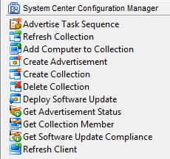
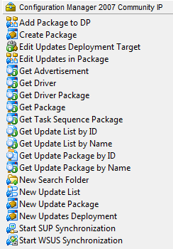
Configuration Manager IP Comparison
Opalis 6.3 ConfigMgr IP
ConfigMgr 2007 Community IP

Slide 23

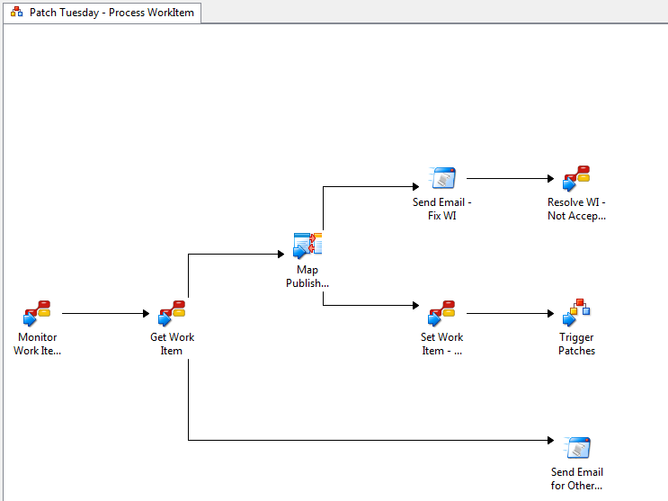
Automated Patch Process
Opalis Action Server
Policy Execution
Opalis Database
Query TFS for patch work item
1
Team Foundation Server
(TFS)
Work Items
Microsoft IT
ConfigMgr 07 Central Site
280,000 Clients Managed
1
Worldwide Primary/Secondary Sites

Slide 24
Automated Patch Process
Opalis Action Server
Policy Execution
Query TFS for patch work item
Validate TFS work item for quality
Opalis Database
2
Team Foundation Server
(TFS)
Work Items
Microsoft IT
ConfigMgr 07 Central Site
280,000 Clients Managed
2
Worldwide Primary/Secondary Sites

Slide 25
Automated Patch Process
Opalis Action Server
Policy Execution
Query TFS for patch work item
Validated TFS work item for quality
Update new work item to “Approved”
Opalis Database
3
Team Foundation Server
(TFS)
Work Items
Microsoft IT
ConfigMgr 07 Central Site
280,000 Clients Managed
3
Worldwide Primary/Secondary Sites

Slide 26
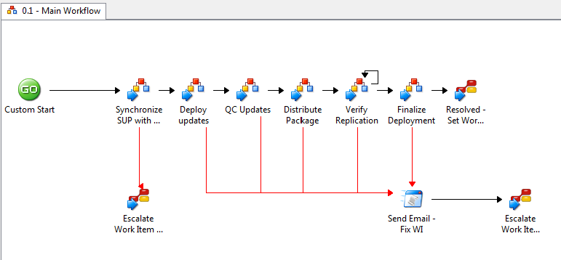
Automated Patch Process
Opalis Action Server
Policy Execution
Query TFS for patch work item
Validate TFS work item for quality
Update new work item to “Approved”
Synchronize server with SUP
Opalis Database
Team Foundation Server
(TFS)
Work Items
4
Microsoft IT
ConfigMgr 07 Central Site
280,000 Clients Managed
4
Worldwide Primary/Secondary Sites

Slide 27
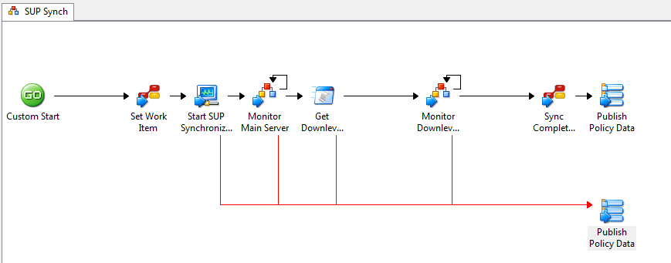
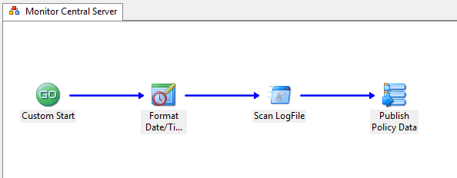
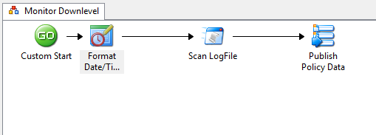
Automated Patch Process
Synchronize SUP
Monitor Main Server Sync
Monitor Down-level Server Sync

Slide 28
Automated Patch Process
Opalis Action Server
Policy Execution
Query TFS for patch work item
Validate TFS work item for quality
Update new work item to “Approved”
Synchronize server with SUP
Create update package and deployment
Opalis Database
Team Foundation Server
(TFS)
Work Items
5
Microsoft IT
ConfigMgr 07 Central Site
280,000 Clients Managed
5
Worldwide Primary/Secondary Sites

Slide 29
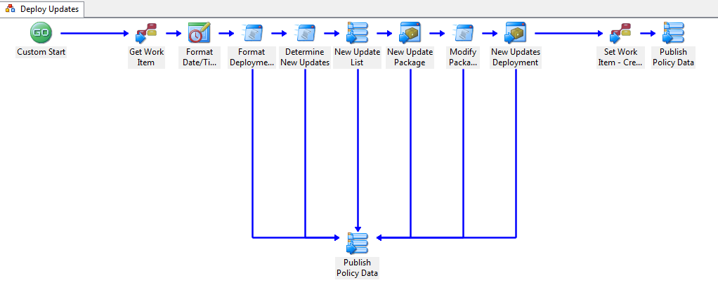
Automated Patch Process
Create update package and deployment

Slide 30
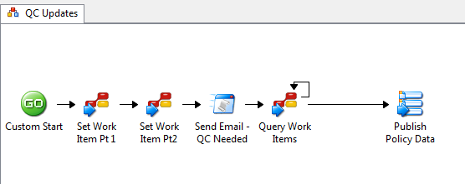
Automated Patch Process
Opalis Action Server
Policy Execution
Query TFS for patch work item
Validate TFS work item for quality
Update new work item to “Approved”
Synchronize server with SUP
Create update package and deployment
Update work item to “Waiting for QC”
Opalis Database
6
Team Foundation Server
(TFS)
Work Items
Microsoft IT
ConfigMgr 07 Central Site
280,000 Clients Managed
6
Worldwide Primary/Secondary Sites

Slide 31


Automated Patch Process
Opalis Action Server
Policy Execution
Query TFS for patch work item
Validate TFS work item for quality
Update new work item to “Approved”
Synchronize server with SUP
Create update package and deployment
Update work item to “Waiting for QC”
Validate package (manual)
Opalis Database
Team Foundation Server
(TFS)
Work Items
Microsoft IT
ConfigMgr 07 Central Site
280,000 Clients Managed
7
Worldwide Primary/Secondary Sites

Slide 32
Automated Patch Process
Opalis Action Server
Policy Execution
Query TFS for patch work item
Validate TFS work item for quality
Update new work item to “Approved”
Synchronize server with SUP
Create update package and deployment
Update work item to “Waiting for QC”
Validate package (manual)
Update TFS work item (manual)
Opalis Database
Team Foundation Server
(TFS)
Work Items
8
Microsoft IT
ConfigMgr 07 Central Site
280,000 Clients Managed
Worldwide Primary/Secondary Sites

Slide 33
Automated Patch Process
Opalis Action Server
Policy Execution
Query TFS for patch work item
Validate TFS work item for quality
Update new work item to “Approved”
Synchronize server with SUP
Create update package and deployment
Update work item to “Waiting for QC”
Validate package (manual)
Update TFS work item (manual)
Query TFS for validated work items
Opalis Database
9
Team Foundation Server
(TFS)
Work Items
Microsoft IT
ConfigMgr 07 Central Site
280,000 Clients Managed
9
Worldwide Primary/Secondary Sites

Slide 34
Automated Patch Process
Opalis Action Server
Policy Execution
Query TFS for patch work item
Validate TFS work item for quality
Update new work item to “Approved”
Synchronize server with SUP
Create update package and deployment
Update work item to “Waiting for QC”
Validate package (manual)
Update TFS work item (manual)
Query TFS for validated work items
Distribute package
Opalis Database
Team Foundation Server
(TFS)
Work Items
10
Microsoft IT
ConfigMgr 07 Central Site
280,000 Clients Managed
10
Worldwide Primary/Secondary Sites

Slide 35
Automated Patch Process
Opalis Action Server
Policy Execution
Query TFS for patch work item
Validate TFS work item for quality
Update new work item to “Approved”
Synchronize server with SUP
Create update package and deployment
Update work item to “Waiting for QC”
Validate package (manual)
Update TFS work item (manual)
Query TFS for validated work items
Distribute package
Monitor replication
Opalis Database
Team Foundation Server
(TFS)
Work Items
11
Microsoft IT
ConfigMgr 07 Central Site
280,000 Clients Managed
11
Worldwide Primary/Secondary Sites

Slide 36
Automated Patch Process
Opalis Action Server
Policy Execution
Query TFS for patch work item
Validate TFS work item for quality
Update new work item to “Approved”
Synchronize server with SUP
Create update package and deployment
Update work item to “Waiting for QC”
Validate package (manual)
Update TFS work item (manual)
Query TFS for validated work items
Distribute package
Monitor replication
Close TFS work item
Opalis Database
12
Team Foundation Server
(TFS)
Work Items
Microsoft IT
ConfigMgr 07 Central Site
280,000 Clients Managed
12
Worldwide Primary/Secondary Sites

Slide 37
ConfigMgr Role Deployment
Deploying new ConfigMgr Secondary Sites and Distribution Points
VMM & Role Provisioning

Slide 38
Solution Overview – Role Deployment
Business Challenge
Solution
Results/Goals
ConfigMgr Role deployments:
Manual process
Legacy site retirement
Resource / Time Intensive
Sequencing / Timing required
No auditing
Multiple teams involved
Hand-offs are expensive
Required across customers
Automated process
Retires legacy sites
Saves time / requires fewer resources
Ensures correct sequencing
Provides rich auditing
Automates hand offs
Repeatable across all customers
PowerShell

Slide 39
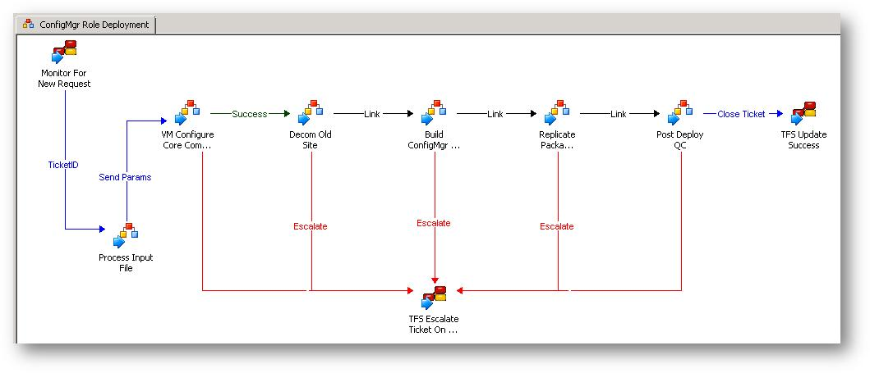
ConfigMgr Role Deployment

Slide 40
ConfigMgr Role Deployment
Monitor TFS
1

Slide 41
ConfigMgr Role Deployment
Monitor TFS
Process Input Data
2

Slide 42
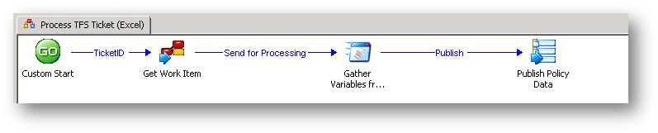
ConfigMgr Role Deployment
Monitor TFS
Process Input Data
2

Slide 43
ConfigMgr Role Deployment
Monitor TFS
Process Input Data
2

Slide 44
ConfigMgr Role Deployment
Monitor TFS
Process Input Data
2

Slide 45
ConfigMgr Role Deployment
Monitor TFS
Process Input Data
2

Slide 46
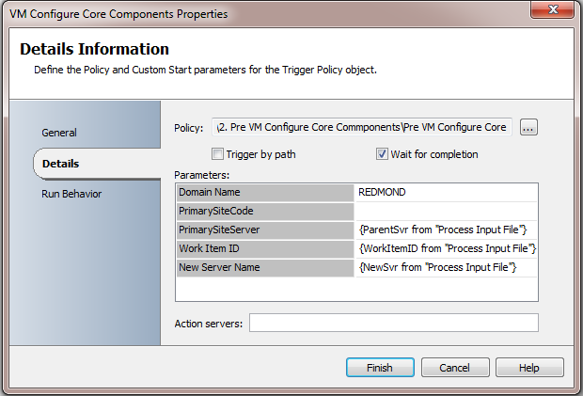
ConfigMgr Role Deployment
Monitor TFS
Process Input Data
Configure Pre-reqs
3

Slide 47
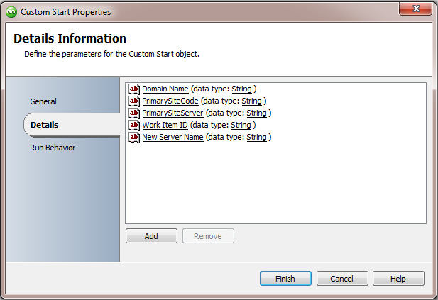
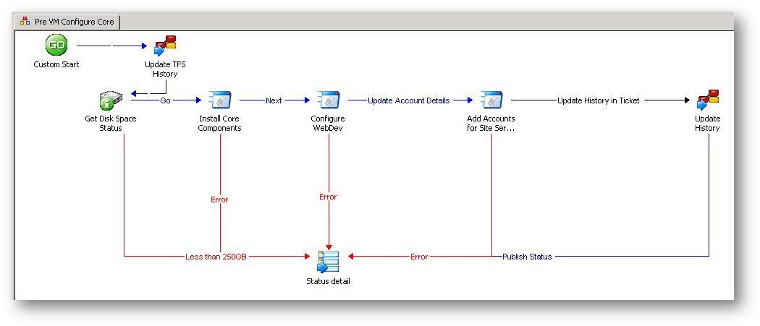
ConfigMgr Role Deployment
Monitor TFS
Process Input Data
Configure Pre-reqs
3

Slide 48
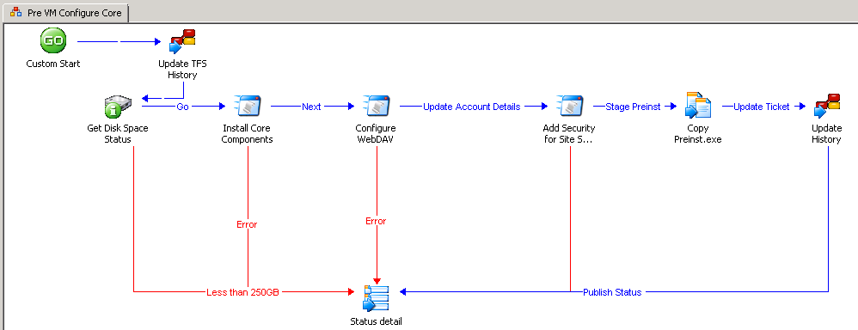
ConfigMgr Role Deployment
Monitor TFS
Process Input Data
Configure Pre-reqs
3

Slide 49
ConfigMgr Role Deployment
Monitor TFS
Process Input Data
Configure Pre-reqs
3

Slide 50
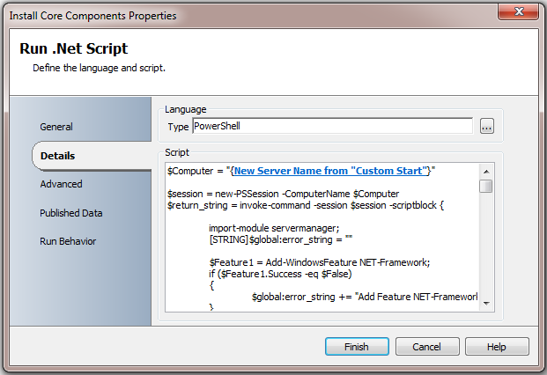
ConfigMgr Role Deployment
Monitor TFS
Process Input Data
Configure Pre-reqs
3

Slide 51
ConfigMgr Role Deployment
Monitor TFS
Process Input Data
Configure Pre-reqs
3

Slide 52
ConfigMgr Role Deployment
Monitor TFS
Process Input Data
Configure Pre-reqs
3

Slide 53
ConfigMgr Role Deployment
Monitor TFS
Process Input Data
Configure Pre-reqs
3

Slide 54
ConfigMgr Role Deployment
Monitor TFS
Process Input Data
Configure Pre-reqs
3

Slide 55
Monitor TFS
Process Input Data
Configure Pre-reqs

Slide 56
ConfigMgr Role Deployment
Monitor TFS
Process Input Data
Configure Pre-reqs
Decom old site
4

Slide 57
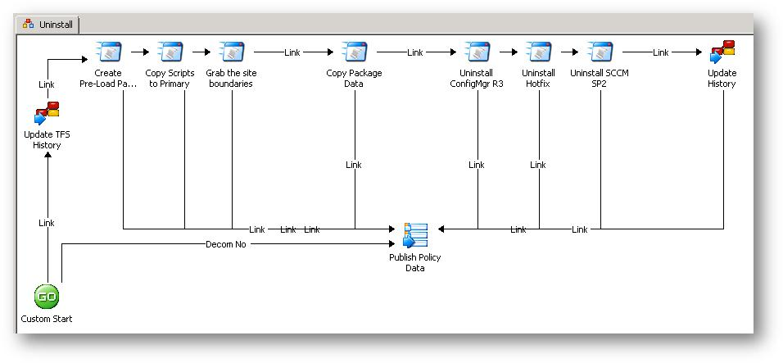
ConfigMgr Role Deployment
Monitor TFS
Process Input Data
Configure Pre-reqs
Decom old site
4

Slide 58
ConfigMgr Role Deployment
Monitor TFS
Process Input Data
Configure Pre-reqs
Decom old site
4

Slide 59
ConfigMgr Role Deployment
Monitor TFS
Process Input Data
Configure Pre-reqs
Decom old site
4

Slide 60
ConfigMgr Role Deployment
Monitor TFS
Process Input Data
Configure Pre-reqs
Decom old site
4

Slide 61
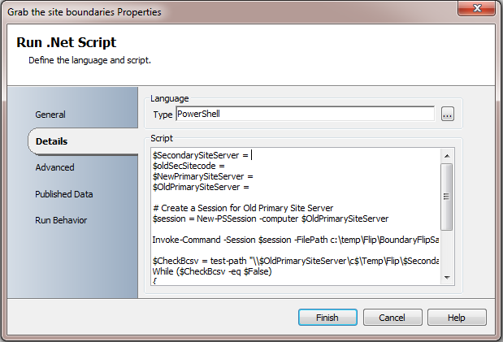
ConfigMgr Role Deployment
Monitor TFS
Process Input Data
Configure Pre-reqs
Decom old site
4

Slide 62
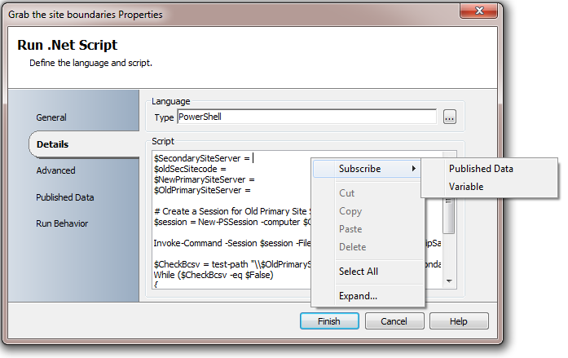
ConfigMgr Role Deployment
Monitor TFS
Process Input Data
Configure Pre-reqs
Decom old site
4

Slide 63
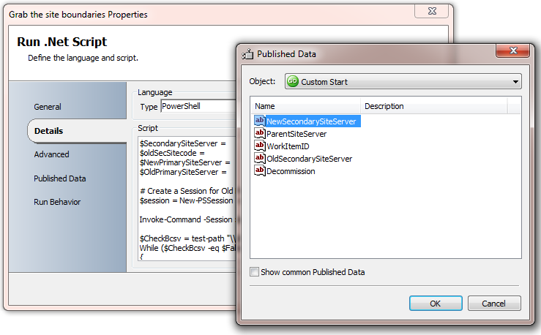
ConfigMgr Role Deployment
Monitor TFS
Process Input Data
Configure Pre-reqs
Decom old site
4

Slide 64
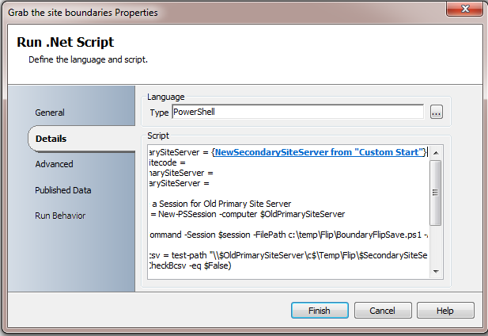
ConfigMgr Role Deployment
Monitor TFS
Process Input Data
Configure Pre-reqs
Decom old site
4

Slide 65
ConfigMgr Role Deployment
Monitor TFS
Process Input Data
Configure Pre-reqs
Decom old site
4

Slide 66
ConfigMgr Role Deployment
Monitor TFS
Process Input Data
Configure Pre-reqs
Decom old site
4

Slide 67
ConfigMgr Role Deployment
Monitor TFS
Process Input Data
Configure Pre-reqs
Decom old site
4

Slide 68
ConfigMgr Role Deployment
Monitor TFS
Process Input Data
Configure Pre-reqs
Decom old site
4

Slide 69
ConfigMgr Role Deployment
Monitor TFS
Process Input Data
Configure Pre-reqs
Decom old site
4

Slide 70
ConfigMgr Role Deployment
Monitor TFS
Process Input Data
Configure Pre-reqs
Decom old site

Slide 71
ConfigMgr Role Deployment
Monitor TFS
Process Input Data
Configure Pre-reqs
Decom old site
Install ConfigMgr
5

Slide 72
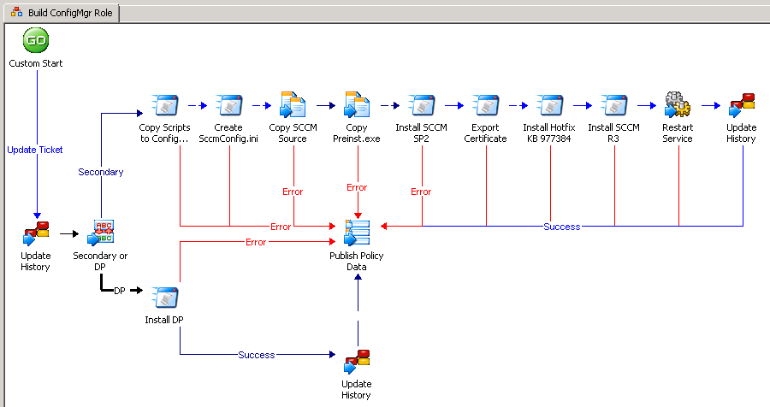
ConfigMgr Role Deployment
Monitor TFS
Process Input Data
Configure Pre-reqs
Decom old site
Install ConfigMgr

Slide 73
ConfigMgr Role Deployment
Monitor TFS
Process Input Data
Configure Pre-reqs
Decom old site
Install ConfigMgr

Slide 74
ConfigMgr Role Deployment
Monitor TFS
Process Input Data
Configure Pre-reqs
Decom old site
Install ConfigMgr

Slide 75
ConfigMgr Role Deployment
Monitor TFS
Process Input Data
Configure Pre-reqs
Decom old site
Install ConfigMgr

Slide 76
ConfigMgr Role Deployment
Monitor TFS
Process Input Data
Configure Pre-reqs
Decom old site
Install ConfigMgr

Slide 77
ConfigMgr Role Deployment
Monitor TFS
Process Input Data
Configure Pre-reqs
Decom old site
Install ConfigMgr

Slide 78
ConfigMgr Role Deployment
Monitor TFS
Process Input Data
Configure Pre-reqs
Decom old site
Install ConfigMgr
Replicate Packages
6

Slide 79
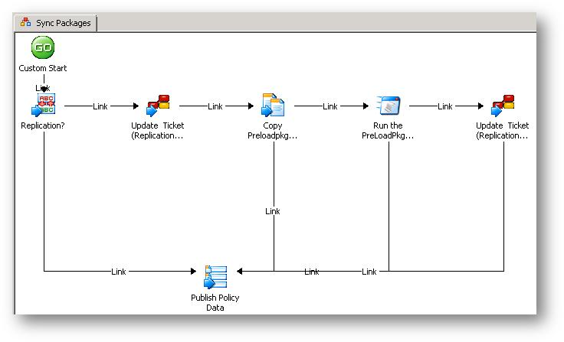
ConfigMgr Role Deployment
Monitor TFS
Process Input Data
Configure Pre-reqs
Decom old site
Install ConfigMgr
Replicate Packages
6

Slide 80
ConfigMgr Role Deployment
Monitor TFS
Process Input Data
Configure Pre-reqs
Decom old site
Install ConfigMgr
Replicate Packages
6

Slide 81
ConfigMgr Role Deployment
Monitor TFS
Process Input Data
Configure Pre-reqs
Decom old site
Install ConfigMgr
Replicate Packages
6

Slide 82
ConfigMgr Role Deployment
Monitor TFS
Process Input Data
Configure Pre-reqs
Decom old site
Install ConfigMgr
Replicate Packages
6

Slide 83
ConfigMgr Role Deployment
Monitor TFS
Process Input Data
Configure Pre-reqs
Decom old site
Install ConfigMgr
Replicate Packages
6

Slide 84
ConfigMgr Role Deployment
Monitor TFS
Process Input Data
Configure Pre-reqs
Decom old site
Install ConfigMgr
Replicate Packages
6

Slide 85
ConfigMgr Role Deployment
Monitor TFS
Process Input Data
Configure Pre-reqs
Decom old site
Install ConfigMgr
Replicate Packages
Test Deployment
7

Slide 86
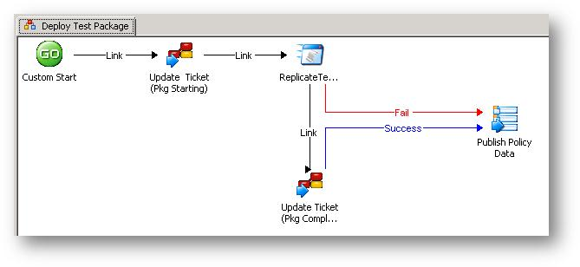
ConfigMgr Role Deployment
Monitor TFS
Process Input Data
Configure Pre-reqs
Decom old site
Install ConfigMgr
Replicate Packages
Test Deployment
7

Slide 87
ConfigMgr Role Deployment
Monitor TFS
Process Input Data
Configure Pre-reqs
Decom old site
Install ConfigMgr
Replicate Packages
Test Deployment
7

Slide 88
ConfigMgr Role Deployment
Monitor TFS
Process Input Data
Configure Pre-reqs
Decom old site
Install ConfigMgr
Replicate Packages
Test Deployment
7

Slide 89
ConfigMgr Role Deployment
Monitor TFS
Process Input Data
Configure Pre-reqs
Decom old site
Install ConfigMgr
Replicate Packages
Test Deployment

Slide 90
ConfigMgr Role Deployment
Monitor TFS
Process Input Data
Configure Pre-reqs
Decom old site
Install ConfigMgr
Replicate Packages
Test Deployment
7

Slide 91
ConfigMgr Role Deployment
Monitor TFS
Process Input Data
Configure Pre-reqs
Decom old site
Install ConfigMgr
Replicate Packages
Test Deployment
Update TFS
8

Slide 92
Service Request (SR) Fulfillment
User account password resets
SR Fulfillment / IR Remediation

Slide 93
Xbox LIVE Service Request (SR) Fulfillment
Business Challenge
Solution
Results/Goals
Service requests are not automated
Service response is labor intensive and manual through emails regardless of request type
Use Opalis to automate the typical SR’s including:
  Password resets
  Account unlocks
  Log file extraction from production servers
  Gamertag history
Eliminate Manual SR Fulfillment
Improve tracking of request and completion
Reduced costs

Slide 94
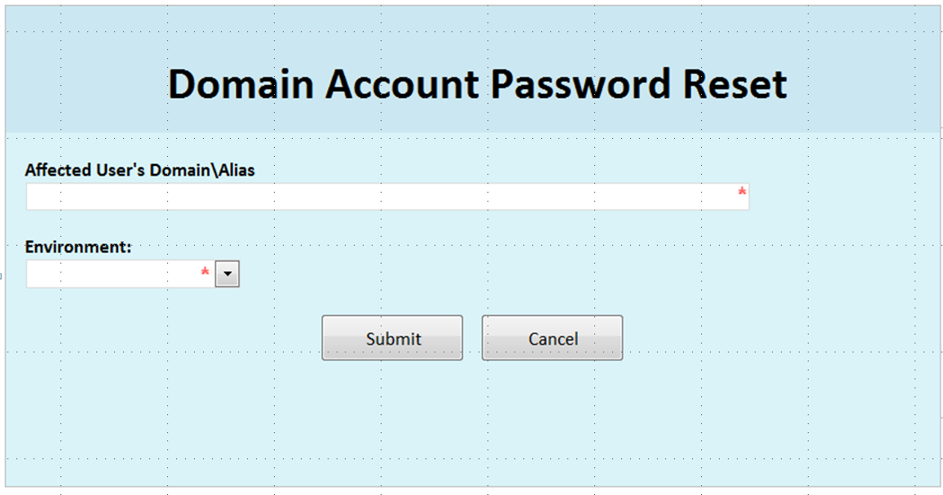
Xbox LIVE SE Password Reset

Slide 95
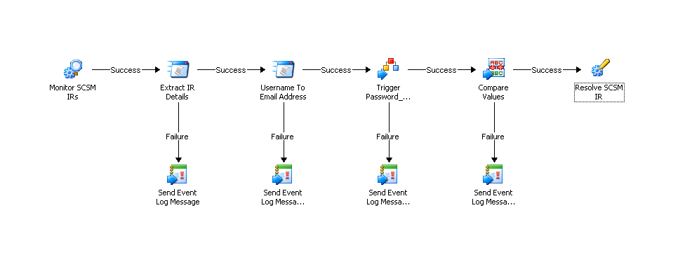
Xbox LIVE SE Password Reset
Monitor Service Manager IRs
1

Slide 96
Xbox LIVE SE Password Reset
Monitor Service Manager IRs
Extract IR Details
2

Slide 97
Xbox LIVE SE Password Reset
Monitor Service Manager IRs
Extract IR Details
Resolve username to email address
3

Slide 98
Xbox LIVE SE Password Reset
Monitor Service Manager IRs
Extract IR Details
Resolve username to email address
Trigger password reset
4

Slide 99
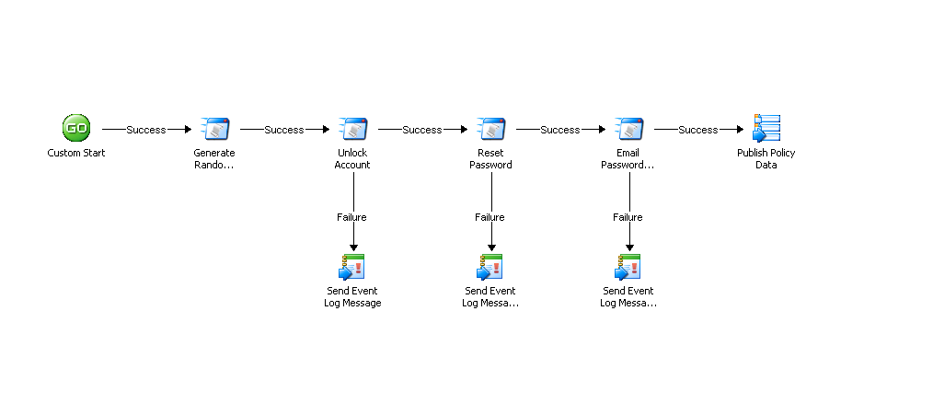
Xbox LIVE SE Password Reset
Monitor Service Manager IRs
Extract IR Details
Resolve username to email address
Trigger password reset
Generate random password
5

Slide 100
Xbox LIVE SE Password Reset
Monitor Service Manager IRs
Extract IR Details
Resolve username to email address
Trigger password reset
Generate random password
Unlock frozen accounts
6

Slide 101
Xbox LIVE SE Password Reset
Monitor Service Manager IRs
Extract IR Details
Resolve username to email address
Trigger password reset
Generate random password
Unlock frozen accounts
Reset password
7

Slide 102
Xbox LIVE SE Password Reset
Monitor Service Manager IRs
Extract IR Details
Resolve username to email address
Trigger password reset
Generate random password
Unlock frozen accounts
Reset password
Email password
8

Slide 103
Xbox LIVE SE Password Reset
Monitor Service Manager IRs
Extract IR Details
Resolve username to email address
Trigger password reset
Generate random password
Unlock frozen accounts
Reset password
Email password
Determine success
9

Slide 104
Xbox LIVE SE Password Reset
Monitor Service Manager IRs
Extract IR Details
Resolve username to email address
Trigger password reset
Generate random password
Unlock frozen accounts
Reset password
Email password
Determine success
Resolve Service Manager IR
10

Slide 105
MPSD operations using Opalis

Slide 106

Opalis Value for MPSD
Simplify IT Automation with a Common platform
Leverage existing automation in workflows
Integrate tasks across core applications
  OpsMgr, ConfigMgr, ServiceMgr
Commoditize IT
  Coordinate SR fulfillment
  Coordinate Tier 1 & 2 issue remediation
  Initiate Tier 3 escalations

Slide 107

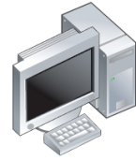






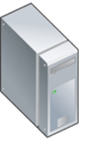


Opalis Architecture
11
Policy
Designer
Operator Console
Client
Management
Server
GUI
Data Store
Action Servers
(Design, manage, report)
(Store process logic)
(Run processes)

Slide 108
Planning Opalis Architecture in MPSD
Datacenter Latency Map
Approach
  Understand your network distances and limitations
  Map out the required infrastructure based on results of latency tests
200ms
100ms
50ms
30ms

Slide 109
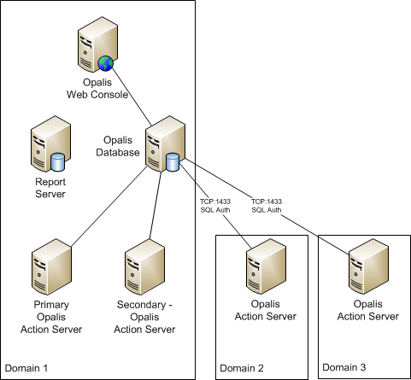
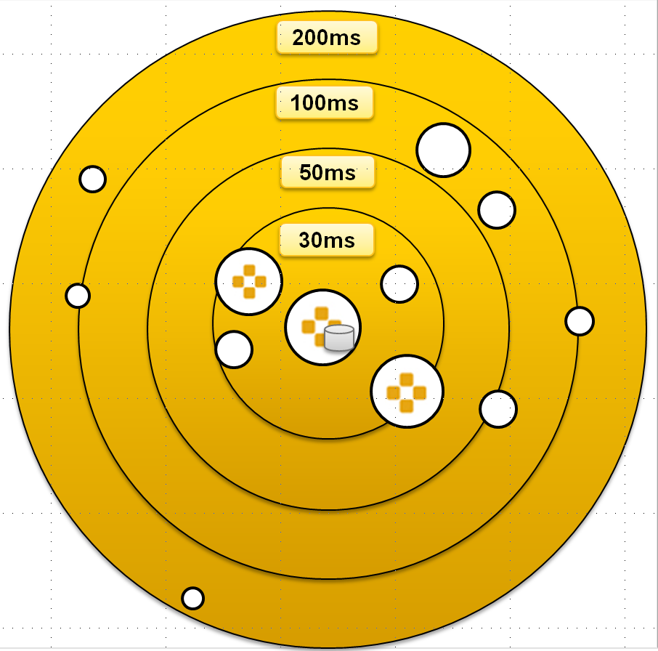
Planning Opalis Architecture in MPSD
Datacenter Opalis Arch.
Approach
  Understand your network distances and limitations
  Map out the required infrastructure based on results of latency tests
Datacenter Latency Map

Slide 110

Planning Opalis Architecture in MPSD
Desktop Mgmt Latency Map
500ms
Approach
  Understand your network distances and limitations
  Map out the required infrastructure based on results of latency tests
200ms
100ms
50ms
30ms

Slide 111
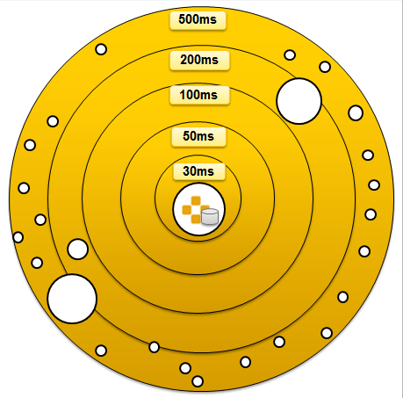
Planning Opalis Architecture in MPSD
Desktop Mgmt Opalis Arch.
Approach
  Understand your network distances and limitations
  Map out the required infrastructure based on results of latency tests
Opalis Management Service (DB)
Primary Action Server
Reporting Server
Web Console
Opalis Action Server
Desktop Mgmt Latency Map
MPSD Desktop Mgmt Goal:
Test the reach limits of Opalis

Slide 112
Architecture Validation
Determine the ability of Opalis to successfully execute tasks on servers in high and low latency scenarios
Develop reach runbook
  Execute a network ping
    >100ms in latency from Action servers
    <100ms in latency from Action servers
  Check service status

Slide 113

Architecture Validation: Reach Runbook
Initiate Process
1

Slide 114
Architecture Validation: Reach Runbook
Initiate Process
Validate SQL Table exists
2

Slide 115
Architecture Validation: Reach Runbook
Initiate Process
Validate SQL Table exists
Get server list
3

Slide 116
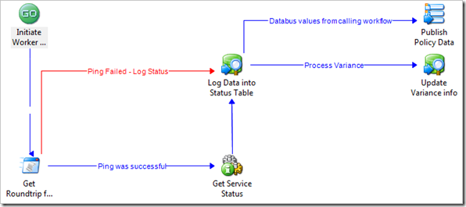
Architecture Validation: Reach Runbook
Initiate Process
Validate SQL Table exists
Get server list
Ping target server
4

Slide 117
Architecture Validation: Reach Runbook
Initiate Process
Validate SQL Table exists
Get server list
Ping target server
Check service status
5

Slide 118
Architecture Validation: Reach Runbook
Initiate Process
Validate SQL Table exists
Get server list
Ping target server
Check service status
Update SQL with results
6

Slide 119
Architecture Validation: Reach Runbook
Initiate Process
Validate SQL Table exists
Get server list
Ping target server
Check service status
Update SQL with results
Record variance
7

Slide 120
Architecture Validation: Results
  http://blogs.technet.com/b/jbritt
No direct correlation between latency and failure rates
  Largest failure rates occurred in both high and low latency
Packet loss, not latency contributed to runbook failures

Slide 121
MPSD Lessons Learned
Design and paper test business processes
  Automated, error prone processes make mistakes more quickly
Break down policies into smaller components
  Easier to maintain and reuse, improves scalability
Build initial framework to ensure consistency and quality
  Development environment & processes
Provide base training for engineers
  Opalis policy design best practices
  PowerShell, C# basics for creating custom IPs

Slide 122
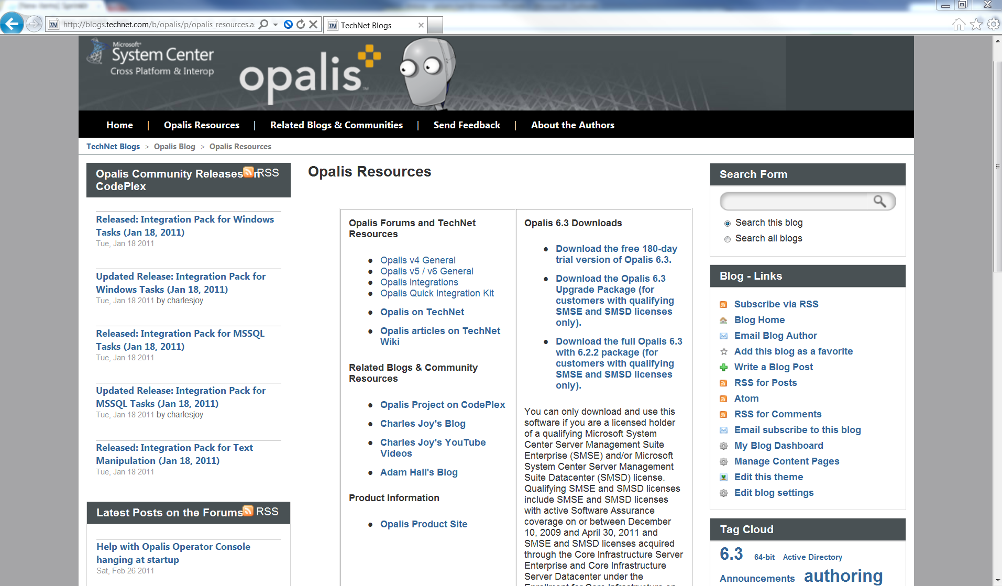
Getting Started
http://msft.it/opalisresources
http://msft.it/opalis
http://msft.it/opalisblog
http://msft.it/opalistechnet
http://msft.it/CharlesJoy
  http://msft.it/adamhall
  http://opalis.codeplex.com
  http://blogs.technet.com/b/jbritt

Slide 123
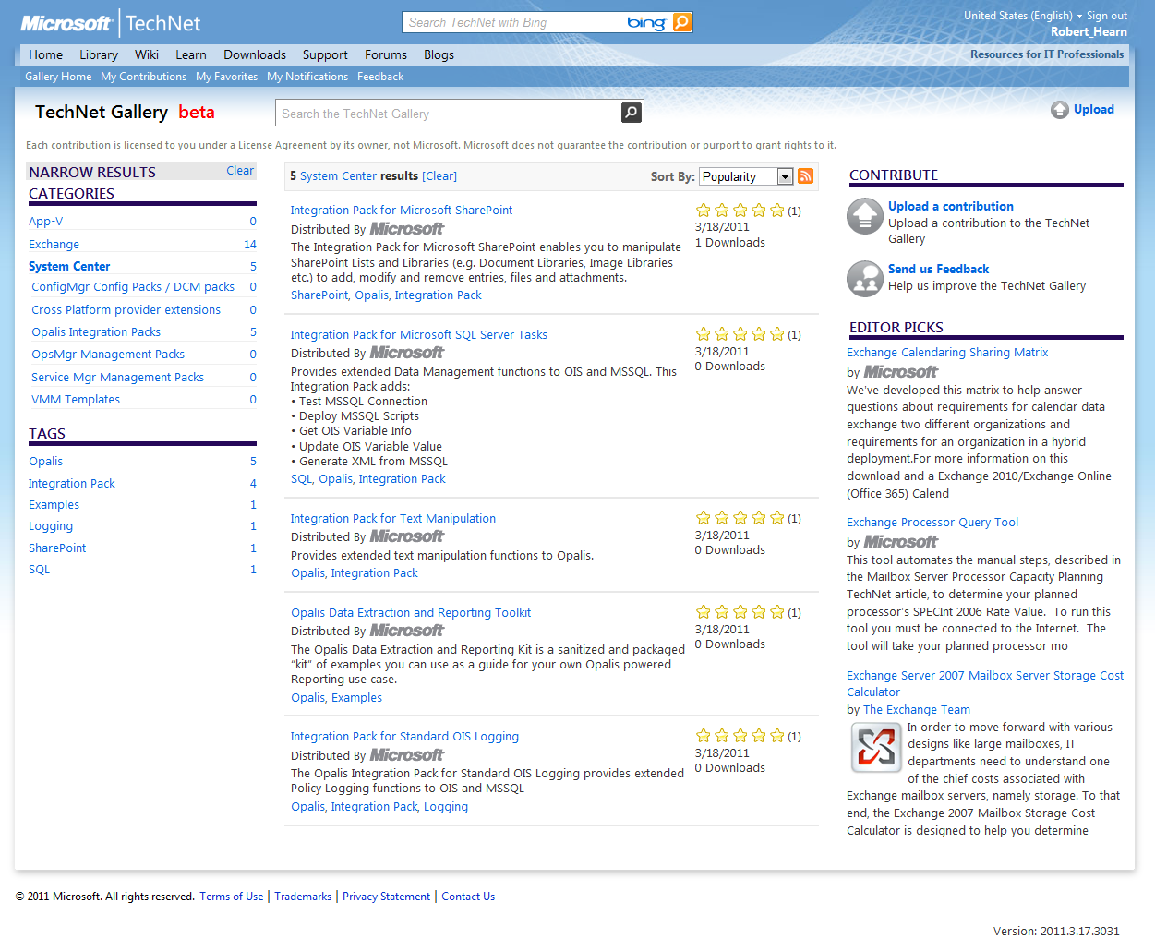
Announcing the TechNet Gallery!
A central place to find community content for System Center
Easy to share & download
See ratings of download & author, Q&A, and more!
http://gallery.technet.microsoft.com/

Slide 124
Appendix

Slide 125
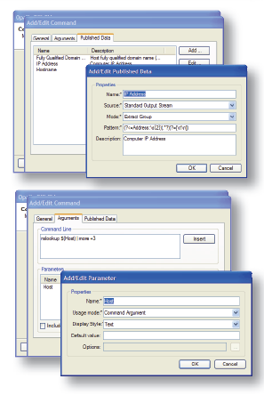
No IP? No Problem!
Quickly Develop Integrations
  Simple APIs that are easy to learn and use
  Integration details are encapsulated
  Easy wizard-driven approach to building integrations with data center tools that provide a command-line interface
QIK is a Software Development Kit (SDK)
  Programming Interface for Microsoft .NET 2.0 (C#, VB)
  Programming Interface for Java SE5+
  API documentation, C# examples, FAQs
  Integration Packs for running QIK objects
  Wizard for packaging Integration Packs
  Wizard for creating integrations with command line based solutions

Slide 126
Track Resources
Don’t forget to visit the Cloud Power area within the TLC (Blue Section) to see product demos and speak with experts about the Server & Cloud Platform solutions that help drive your business forward.
You can also find the latest information about our products at the following links:
Cloud Power - http://www.microsoft.com/cloud/
Private Cloud - http://www.microsoft.com/privatecloud/
Windows Server - http://www.microsoft.com/windowsserver/
Windows Azure - http://www.microsoft.com/windowsazure/
Microsoft System Center - http://www.microsoft.com/systemcenter/
Microsoft Forefront - http://www.microsoft.com/forefront/

Slide 127





Resources
  Connect. Share. Discuss.
http://northamerica.msteched.com
Learning
  Sessions On-Demand & Community
  Microsoft Certification & Training Resources
www.microsoft.com/teched
www.microsoft.com/learning
  Resources for IT Professionals
  Resources for Developers
http://microsoft.com/technet
http://microsoft.com/msdn

Slide 128












Complete an evaluation on CommNet and
enter to win!

Slide 129


Slide 130

© 2011 Microsoft Corporation. All rights reserved. Microsoft, Windows, Windows Vista and other product names are or may be registered trademarks and/or trademarks in the U.S. and/or other countries.
The information herein is for informational purposes only and represents the current view of Microsoft Corporation as of the date of this presentation. Because Microsoft must respond to changing market conditions, it should not be interpreted to be a commitment
on the part of Microsoft, and Microsoft cannot guarantee the accuracy of any information provided after the date of this presentation. MICROSOFT MAKES NO WARRANTIES, EXPRESS, IMPLIED OR STATUTORY, AS TO THE INFORMATION IN THIS PRESENTATION.

