Slide 2

Microsoft System Center
Advisor Technical Overview
SIM349
Sachin Agrawal
Senior Program Manager
Microsoft Corporation

Slide 3
Session Objectives and Takeaways
Session Objective(s):
  Provide a quick overview of System Center Advisor
  Drill into Advisor architecture
  Show demos of the Advisor RC
  Outline pricing and licensing
Key Takeaways:
  System Center Advisor is the connection between your servers and Microsoft Customer Support
  You can try it for free at www.SystemCenterAdvisor.com

Slide 4





Customer Challenges
  Improving server performance
  Quickly resolving server issues
  Reducing server downtime
Properly configuring and maintaining servers to improve performance and reduce downtime
  Incorrect configuration of servers often causes performance and availability issues
  The right knowledge is hard to find and often out of date
  Time lag between discovering issue and resolving
  Difficult to find solutions and patches that can help resolve issue
  Service outages expensive and painful
  Today’s management products are often focused on detecting outages rather than preventing them

Slide 5
Advisor Overview
Sachin Agrawal
demo

Slide 6


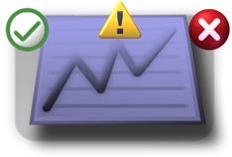
System Center Advisor Customer Benefits
Proactively avoid problems
Help resolve issues faster
Help reduce downtime
Increase awareness and proactively avoid problems with server deployments through ongoing assessment and alerting of configuration from a cloud service
Resolve issues faster by providing Microsoft or internal support staff current and historical views into configuration to get up to date solutions for issues
Help reduce downtime and improve performance of servers through proactive scanning for known configuration issues and comparison with best practices.
System Center Advisor is a cloud service that proactively scans a customer’s server environment to help them gain insight into server configuration problems, resolve issues faster with support staff, and reduce server downtime, all with the security features to meet customer needs.

Slide 7



System Center Advisor Features
  Alerts for unpatched, misconfigured, unsupported configurations
  Ongoing assessment of server configuration, with weekly summary email
  Assess and understand configurations from virtually anywhere
Proactively avoid problems
  Access current and historical configuration data
  Share server configuration data with internal or Microsoft support staff
  Instant access to guidance and forums related to identified issues
Help resolve
issues faster
  SQL Server knowledge & Windows Server knowledge
  Comparison with best practices
  Access centralized data of a deployment’s configurations
Help reduce
downtime

Slide 8
Advisor Feature Overview
demo

Slide 9
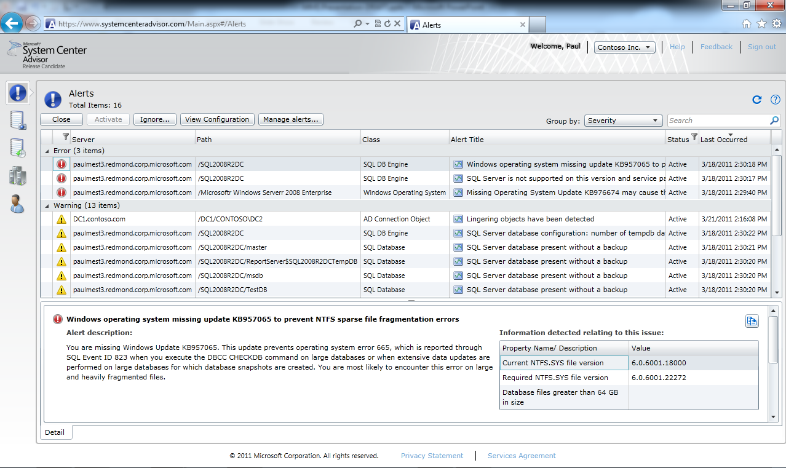
Proactive Knowledge
Advisor alerts customers when SQL and Windows Server roles are:
Unpatched
  Beyond Microsoft Update
  Best practices based on support cases
  What we wish customers would deploy
Misconfigured
  Can be simple or complex
  Not aligned to best practices gathered from customer support cases
At risk of data loss
  Event log errors that according to customer support cases often cause downtime
  Point you to articles with solutions “as if you were calling Microsoft support”
Unsupported
  Highlight unsupported configurations
  A real-time monitoring product (like System Center Operations Manager) will continue to be the recommended alerting solution when server roles are:
  Unavailable
  Underperforming
  Causing LOB downtime / business impact

Slide 10
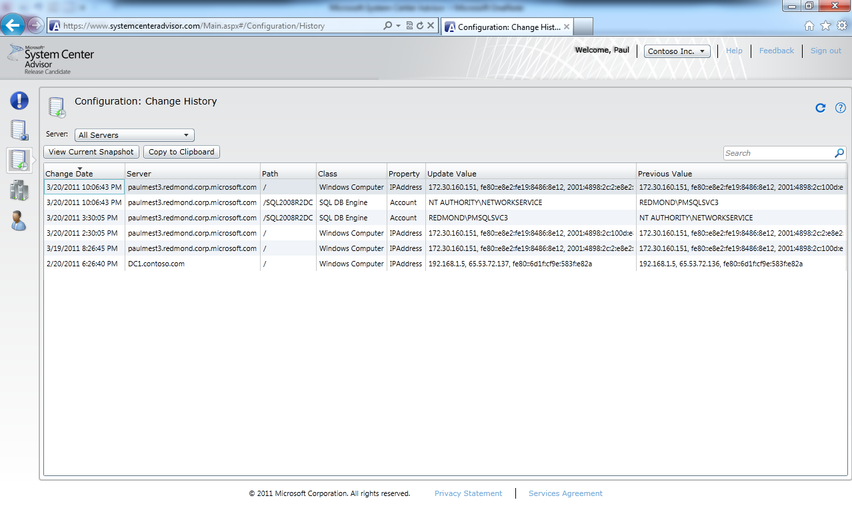
Recent and Historical Context
Advisor provides context with historical data:
Configuration Snapshot
  latest information about my server, instance,
  or database
Configuration History
  Basic OS properties (server name, OS version, IP address, et al)
  Basic SQL properties (sys.configurations, sys.databases, SERVERPROPERTY_EX, et al)
This is not an all-inclusive configuration manifest. We started with the main points that Customer Support Services (CSS) needs to diagnose problems. The type of data collected will continually expand based on CSS and customer feedback (e.g. usefulness, collection overhead, data size, data sensitivity).

Slide 11











Advisor Architecture
Advisor Cloud Service
  Uploaded data is analyzed
  Alerts and recommendations added to customer portal
Analysis &
Aggregation
End User
Web Site
Web Portal
  Review alerts and solutions
  Review configuration
Collected
Data
Knowledge
& Content
Microsoft Customer
Support Services and Product Teams
Daily upload from customer
  Alerts
  Configuration
Periodic download to customer
  Updated rules
  New configuration points
  Agents are installed on each server and run continuously
  Internet connected servers upload data daily
  Agents in private networks can route through an internet connected gateway
  Collected data is written to a file for customer visibility
Private Network
Legend
Agent
Gateway
Customer Datacenter
Agent & Gateway

Slide 12
Onboarding and Deployment
demo

Slide 13
Advisor and Your Management Solution
Advisor analyses uploaded configuration data from your servers
  Provides view into current configuration
  Tracks and publishes historical view of changes
  Alerts administrator through portal and weekly summary email
  Not a real-time monitoring solution
Advisor leverages Operations Manager 2007 R2 Agent and Management Pack technology
  Advisor agent does not require but works side by side with OpsMgr
Reusing Operations Manager technology will enable…
  Future better-together scenarios with Microsoft’s management platform investments (e.g. Operations Manager, Configuration Manager, Service Manager)
  Minimize duplication of data collection

Slide 14
Server Impact and Data Collected
Low overhead
  Agent CPU: < 1% average, occasional spikes
  Agent Memory: < 75 MB
  Gateway Upload: ~100KB/server/day
Server management data only
  Diagnostic data (configuration settings, error logs)
  Utilization (CPU, IO, Available Memory, etc.)
  Workload throughput (transactions/day, GB served/day)
  No customer data or custom workload data

Slide 15
Data Privacy & Handling Sensitive Data
Complete Privacy Statement available
Advisor only has visibility into servers with Agents deployed on them
Uploads are archived on-premises (5 days by default) for audit trail and to enable you to inspect the data
Upload time is configurable; you can stop uploading at any time
You can close your account and request to remove data from Advisor servers
Your organization controls what non-Microsoft party will have access to your individual organization’s data
Microsoft will not use this data for sales/licensing validation

Slide 16
Roadmap and Licensing
Beta Release in Nov 2010
  SQL Server content
RC release in March 2011
  http://www.SystemCenterAdvisor.com
  Available to all customers in US*
  Additional SQL content & Windows Server content
RTW release is TBD
  Target: H2 CY11
  Available as a benefit of Software Assurance for supported server workloads
* Additional market support to be announced later in CY11

Slide 17


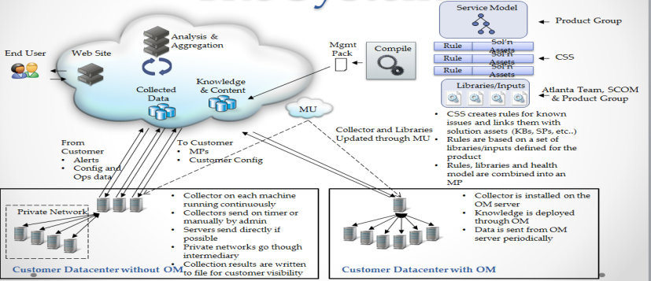
Summary of Advisor – Original Pitch
Give you “up to date” Microsoft knowledge to help you prevent problems and react to critical situations in the form of an automated system
A Microsoft engineer “checklist”
        Missing updates
        “Configuration” Advice
        Critical Events
        Support Polices
Update the checklist with new advice regularly
Now automate it, store it in the cloud, and share data with CSS
rules
+configuration history!
Customer experiences

Slide 18
Next Steps
Just want to test Advisor?
  Sign up on www.SystemCenterAdvisor.com
Want to guide the future of Advisor?
  We’re looking for external customers for our TAP program. Please send nominations to: AtlTAPnm@microsoft.com
  Requirements
    U.S.-based organization with Windows Servers physically located in U.S.
    Willing to deploy the Advisor agent on production systems
    Will commit time from DBA and/or IT Admin to provide detailed feedback on rules and functionality

Slide 19
In Review: Session Objectives and Takeaways
Session Objective(s):
  Provide a quick overview of System Center Advisor
  Drill into Advisor architecture
  Show demos of the Advisor RC
  Outline pricing and licensing
Key Takeaways:
  System Center Advisor is the connection between your servers and Microsoft Customer Support
  You can try it for free at www.SystemCenterAdvisor.com

Slide 20
We may have answers… ;-)
Questions?

Slide 21
Appendix

Slide 22
Track Resources
Don’t forget to visit the Cloud Power area within the TLC (Blue Section) to see product demos and speak with experts about the Server & Cloud Platform solutions that help drive your business forward.
You can also find the latest information about our products at the following links:
Cloud Power - http://www.microsoft.com/cloud/
Private Cloud - http://www.microsoft.com/privatecloud/
Windows Server - http://www.microsoft.com/windowsserver/
Windows Azure - http://www.microsoft.com/windowsazure/
Microsoft System Center - http://www.microsoft.com/systemcenter/
Microsoft Forefront - http://www.microsoft.com/forefront/

Slide 23





Resources
  Connect. Share. Discuss.
http://northamerica.msteched.com
Learning
  Sessions On-Demand & Community
  Microsoft Certification & Training Resources
www.microsoft.com/teched
www.microsoft.com/learning
  Resources for IT Professionals
  Resources for Developers
http://microsoft.com/technet
http://microsoft.com/msdn

Slide 24












Complete an evaluation on CommNet and
enter to win!

Slide 25

Notes:
New for TechEd 2011, we will be working with Microsoft Tag (http://tag.microsoft.com/overview.aspx) to create unique Tags for every session at the event. Your session Tag will appear on both the room signage and at the end of your presentation. With your session Tag, attendees will be able to scan as they enter the room to retrieve session details, view speaker bios, and engage in discussions; or scan at the end of the presentation to evaluate your session and download materials. We’re excited to integrate Microsoft Tag across the My TechEd mobile experience this year.

Slide 26

© 2011 Microsoft Corporation. All rights reserved. Microsoft, Windows, Windows Vista and other product names are or may be registered trademarks and/or trademarks in the U.S. and/or other countries.
The information herein is for informational purposes only and represents the current view of Microsoft Corporation as of the date of this presentation. Because Microsoft must respond to changing market conditions, it should not be interpreted to be a commitment
on the part of Microsoft, and Microsoft cannot guarantee the accuracy of any information provided after the date of this presentation. MICROSOFT MAKES NO WARRANTIES, EXPRESS, IMPLIED OR STATUTORY, AS TO THE INFORMATION IN THIS PRESENTATION.

