Slide 1

Microsoft System Center and Private +
Public Cloud: Better Together
SIM350
Kenon Owens and Brjann Brekkan
Technical Product Managers
Management and Security
Microsoft Corporation

Slide 2
Session Objectives and Takeaways
Session Objective(s):
  Get an overview of how System Center solutions are used to help drive customer adoption of our cloud services
  Understand how System Center solutions today are used to monitor Windows Azure based services
  Learn about Better Together scenarios between Windows Azure and upcoming System Center solutions
Key Takeaways
  System Center Provides Solutions for Private and Public Clouds
  You need the entire suite working together

Slide 3


What is the cloud?
Delivering IT as a Standardized Service
Customer datacenter
Partner datacenter
Microsoft datacenter

Slide 4




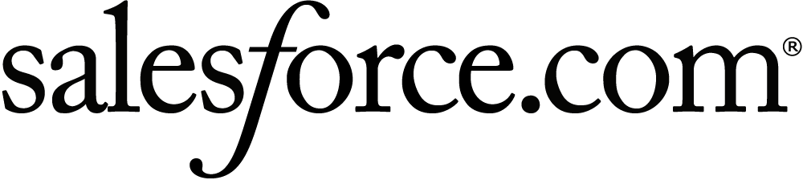
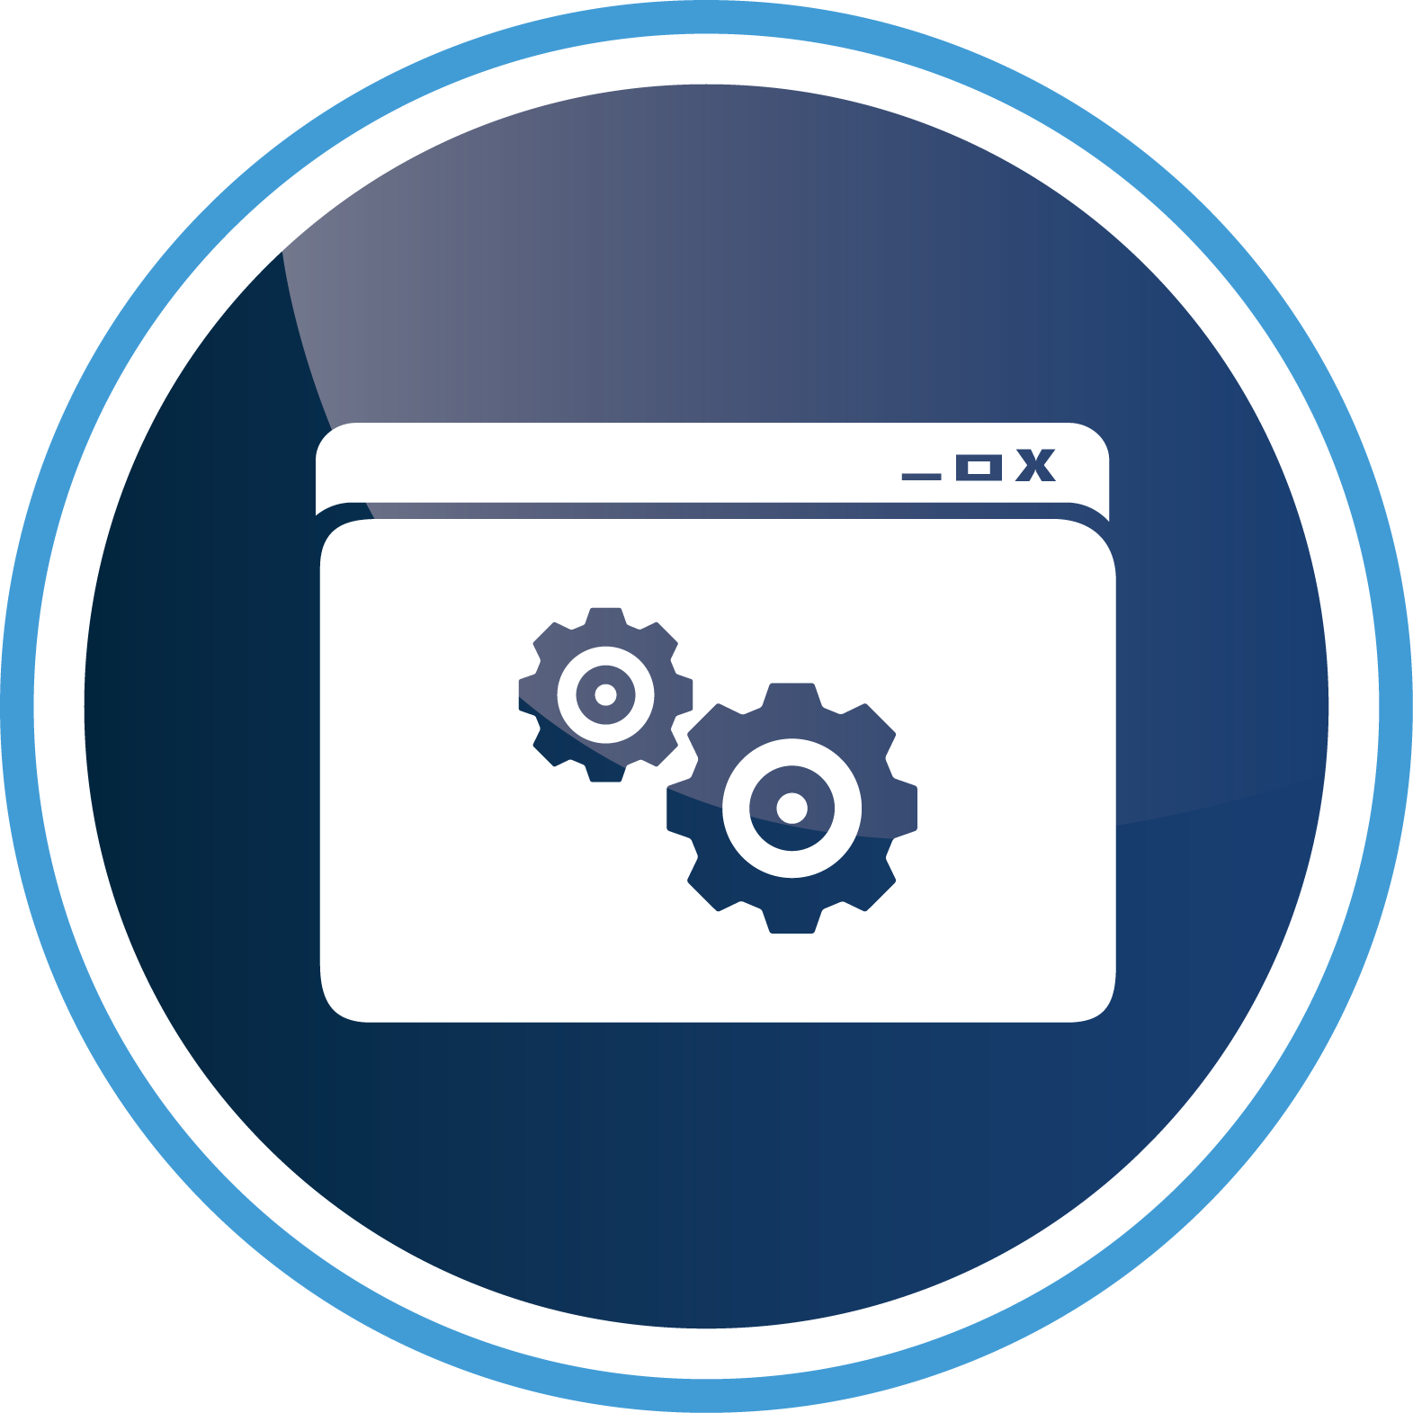



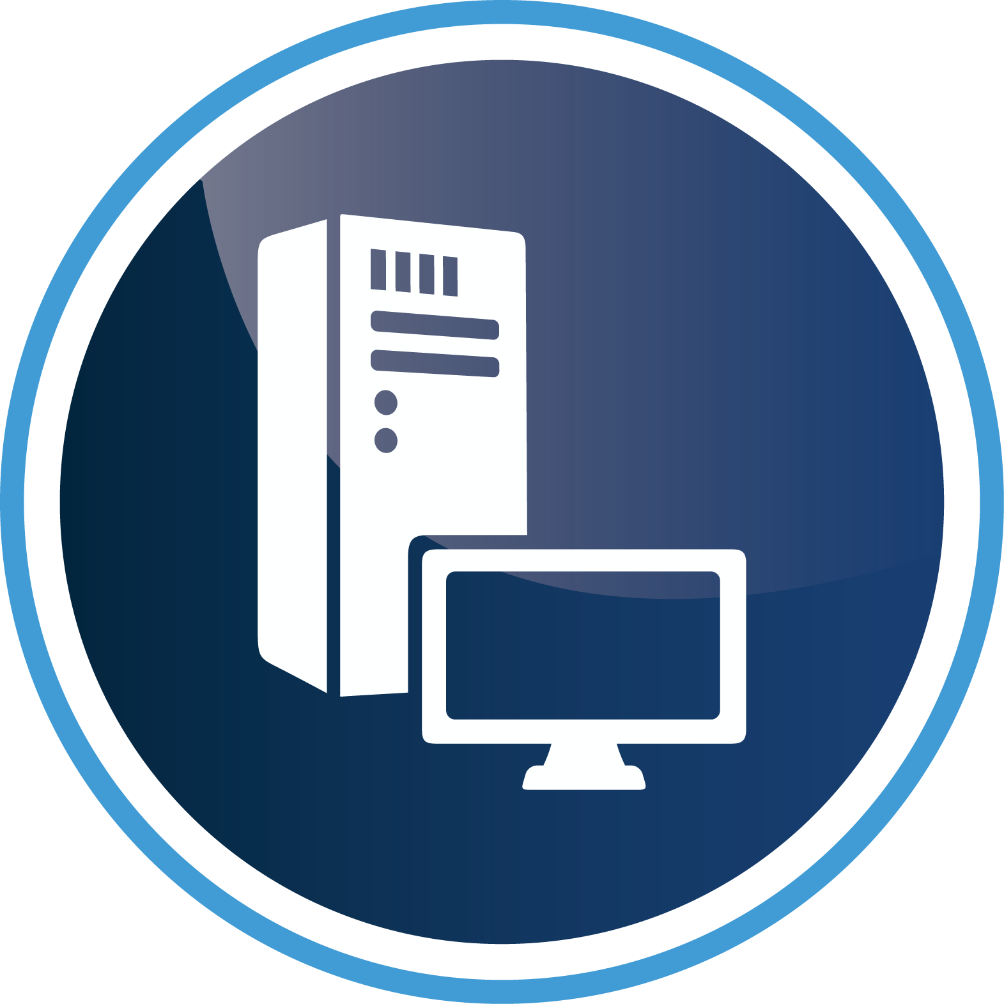

Delivering IT as a Service
SaaS
PaaS
IT as a SERVICE
IaaS
Customer
Service Providers
Global Providers

Slide 5


Delivering IT as a Service
SaaS
PaaS
IaaS
Customer
Service Providers
Global Providers

Slide 6


Application Owner
“Service Consumer”
Datacenter Admin
“Service Provider”

Slide 7


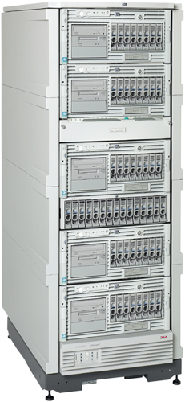

Consuming and Delivering IT as a Service
IT Tools
PaaS
Deploy
Configure
Self Service
Portal
Process &
Automation
Migrate
Service
Model
IaaS
Application Owner
Inventory
Monitor
Virtual
Audit
Physical
Business Requirements
IT Process
IT Tools
IT Infra

Slide 8






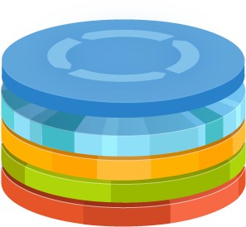



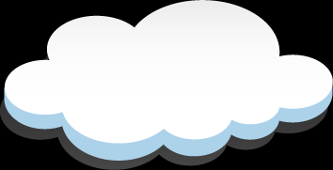



IT as a Service
Identity
Provisioning
Monitoring
Protection
Database
Application
Data

Slide 9
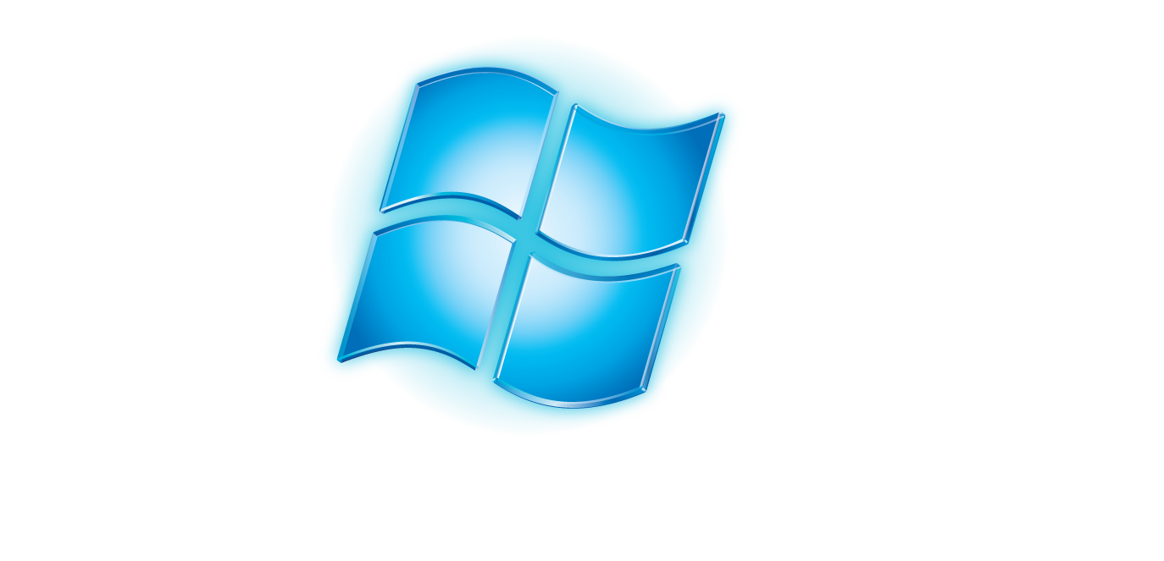

Setting the Stage for the Cloud
Internal Datacenter
Service Provider
Database
Application
Data
Hoster

Slide 10
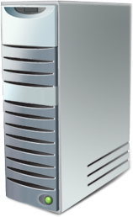
7 – Customer Cloud Deployment Scenarios
Internal Datacenter
Service Provider
Service 2
Service 5
Service 1
Service 7
Service 6
Service 3
Service 4
Hoster

Slide 11
Types of Cloud Services
Services Taxonomy
(On-Premises)
Infrastructure
(as a Service)
Platform
(as a Service)
Software
(as a Service)
Applications
Applications
You manage
Applications
Applications
Data
Data
Data
Data
Common Identity
Leveraging on-premises Active Directory
Federating based on industry standards
Provisioning objects to services where needed
Enabling cloud identity providers
You manage
Runtime
Runtime
Runtime
Runtime
Middleware
Middleware
Middleware
Middleware
Other Manages
You manage
Other Manages
O/S
O/S
O/S
O/S
Virtualization
Virtualization
Other Manages
Virtualization
Virtualization
Servers
Servers
Servers
Servers
Storage
Storage
Storage
Storage
Networking
Networking
Networking
Networking

Slide 12

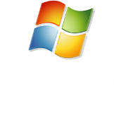

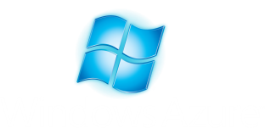


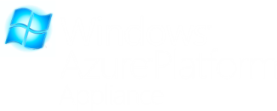

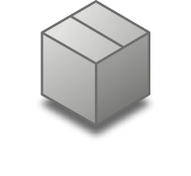
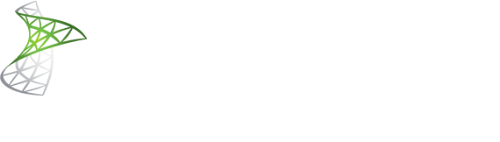
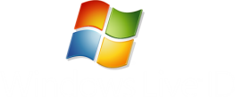


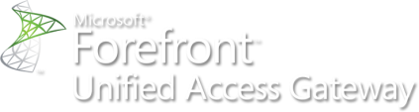

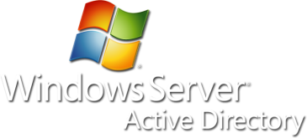

Microsoft Identity Components
SaaS
PaaS
AppFabric Access Control service
Public Cloud
OAUTH
WS-Trust, SAML
AD Federation Services
Private Cloud
SAML
Partners
Claims based applications
AD Certificate Services
AD Rights Management Services
User
On-Premises

Slide 13
Demo - Identity in the Cloud
Internal Datacenter
Service Provider
Service 5
Hoster

Slide 14
Process Automation in the Cloud

Slide 15
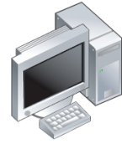








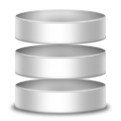







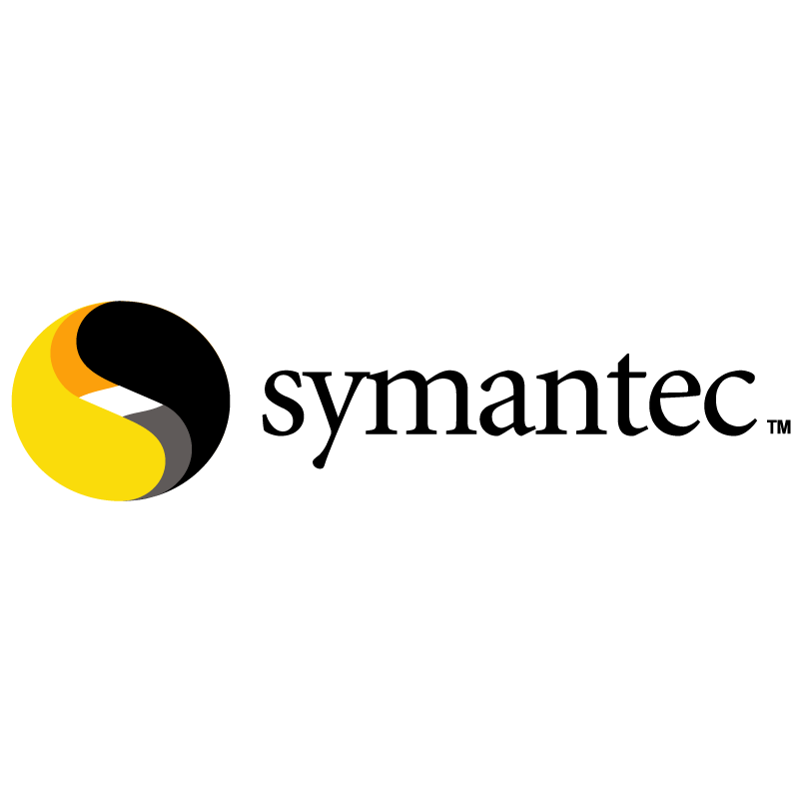
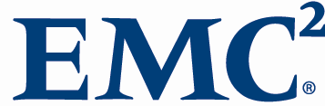
Essential to Moving to Cloud
Opalis Components
11
Asset - CMDB
Incident Mgmt
Workflow
Designer
Operator’s
Console
Backup
Config mgmt
Event mgmt
Change & Compliance
Network
Provisioning
Security
Server/Service Management
(physical + virtual)
Service Desk
GUI
Data Store
Action Servers
Storage
(Design, manage, report)
(Store process logic)
(Run processes)
Virtual
Process Catalogs
Automation Platform
Integration Packs

Slide 16
IT Service Management in the Cloud

Slide 17
Types of Cloud Services
Services Taxonomy
(On-Premises)
Infrastructure
(as a Service)
Platform
(as a Service)
Software
(as a Service)
Applications
Applications
You manage
Applications
Applications
Data
Data
Data
Data
IT Service Management
“It Just Works”
Proactive more than Reactive
Building compliance into services
Managing for Capacity, Availability & Continuity
You manage
Runtime
Runtime
Runtime
Runtime
Middleware
Middleware
Middleware
Middleware
Other Manages
You manage
Other Manages
O/S
O/S
O/S
O/S
Virtualization
Virtualization
Other Manages
Virtualization
Virtualization
Servers
Servers
Servers
Servers
Storage
Storage
Storage
Storage
Networking
Networking
Networking
Networking

Slide 18
IT Service Management in the Cloud
Pay no Attention to the Man Behind the Curtain
As you move up the Stack, what you are responsible for lessens – Trust in others increases
Windows Azure in reality has very little controls in it and visibility from an ITSM perspective is limited
IaaS Solutions mean from an App POV, you don’t worry about the infrastructure
  Datacenter Administrator handles the Infrastructure and abstracts from the Application Owner
  Application Owner worries relies on SLA

Slide 19
Provisioning in the Cloud

Slide 20



Private Clouds in VMM 2012
Private Cloud
  Abstraction that enables opaque usage model for service and VM management
  Pre-defined Logical Networks, Load Balancers, VIP Templates, Storage Classifications,
  Library Paths
Capacity and Capability: Fabric
  Compute: Logical grouping of hosts or clusters in host groups
  Storage: Storage Classifications, Pools, Providers and Arrays
  Network: Logical Networks, IP/MAC Address Pools, Load Balancers, VIP Templates
Delegation - User Role
  Profile, Scope and Members
  Types: Administrators/Fabric Managers, Delegated Administrators and Cloud Consumers
  Quota: Defines per-user limits on compute, memory, storage, number of VMs
  Sharing: Cloud consumers can share resources like VMs, services, templates, profiles
  with each other

Slide 21




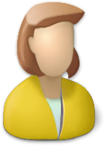


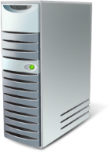
User Roles and Scope in VMM 2012
VMM Admin
Delegated Admin
Read-only Admin
Self-Service User

Slide 22




System Center Concero
Customer
Microsoft
Services
  Windows Azure
VMM 2012
VMM 2012
Fabric
VMM 2012
  Hyper-V, VMware, Xen
  Hyper-V, VMware, Xen
  Hyper-V, VMware, Xen
Concero 1.0
Customer Problems Addressed
Bring multiple clouds under IT management processes
Visibility and control into services deployed in multiple clouds
Self-Service agility for service owners
Azure – PaaS Public Cloud
IT Pro experience for Azure
RBAC using on-premise domain credentials
Single view for multiple Azure subscriptions
VMM – IaaS Private Clouds
Manage services across multiple VMM servers
Web based – self service experience

Slide 23
Demo – Cloud Management
Internal Datacenter
Service Provider
Service 5
Service 1
Hoster

Slide 24
Monitoring in the Cloud

Slide 25
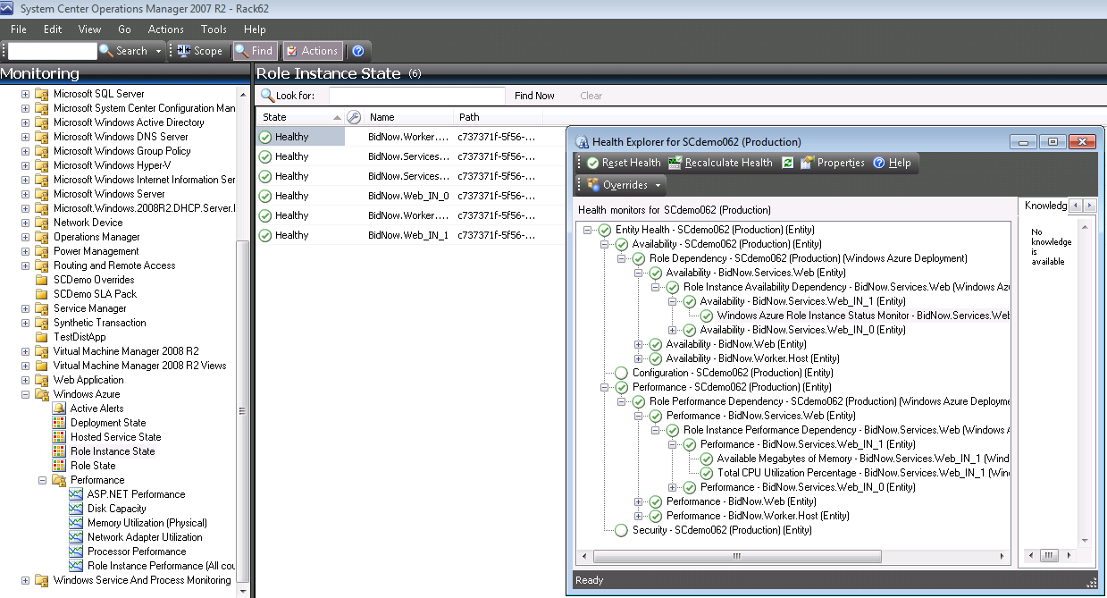
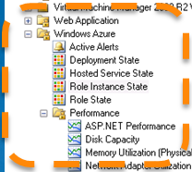
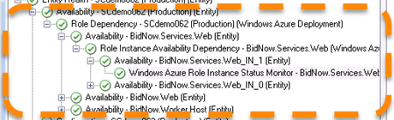
Windows Azure Management Pack

Slide 26
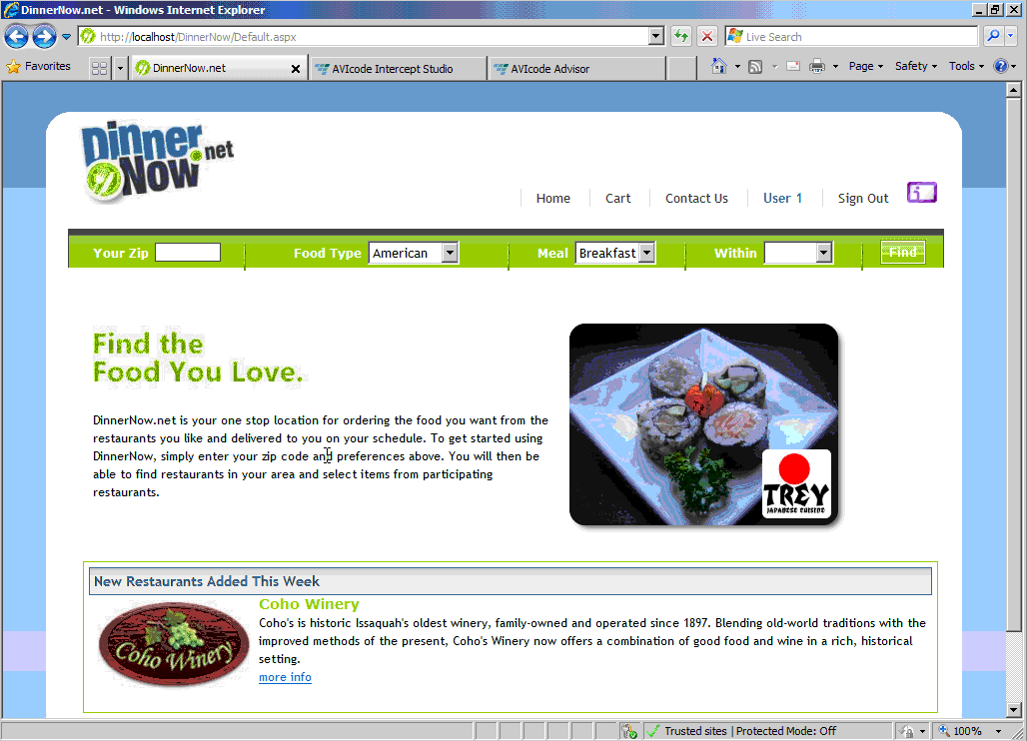
Monitoring Cloud Applications - AVICode

Slide 27
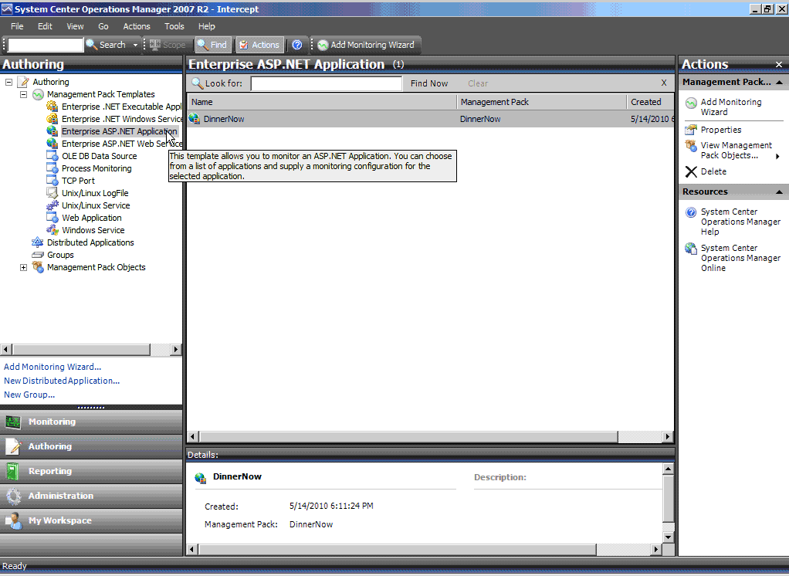

Slide 28
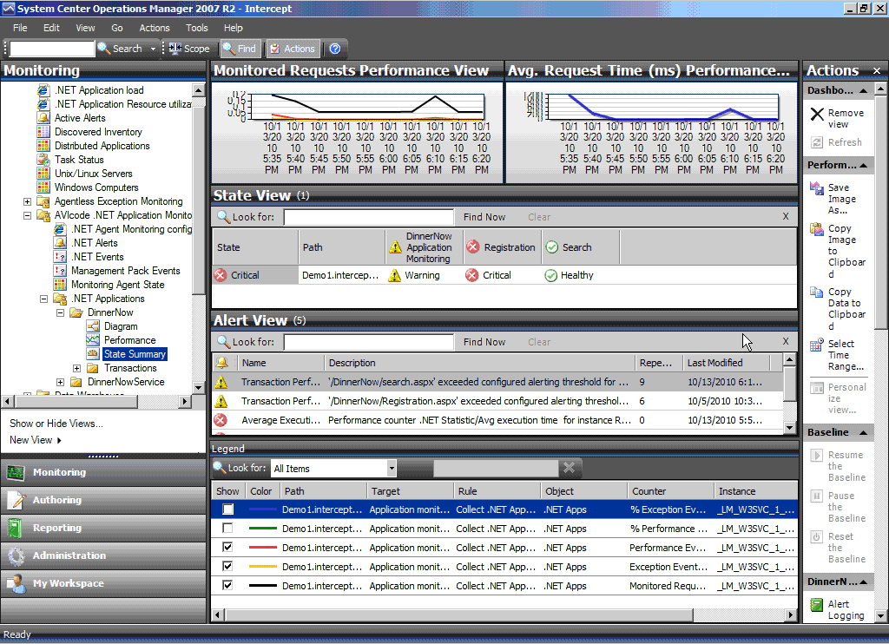

Slide 30
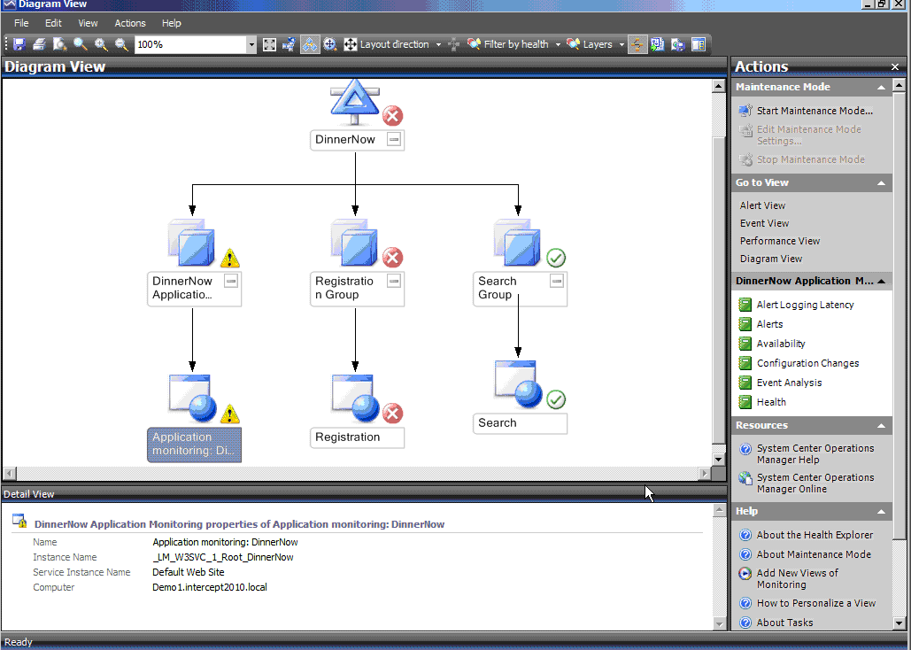

Slide 31
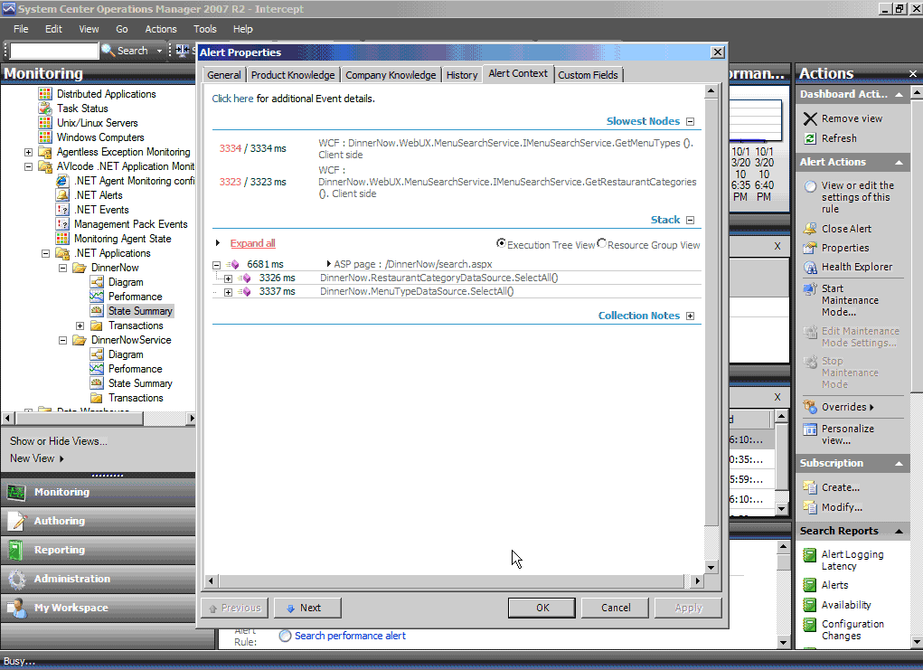

Slide 32
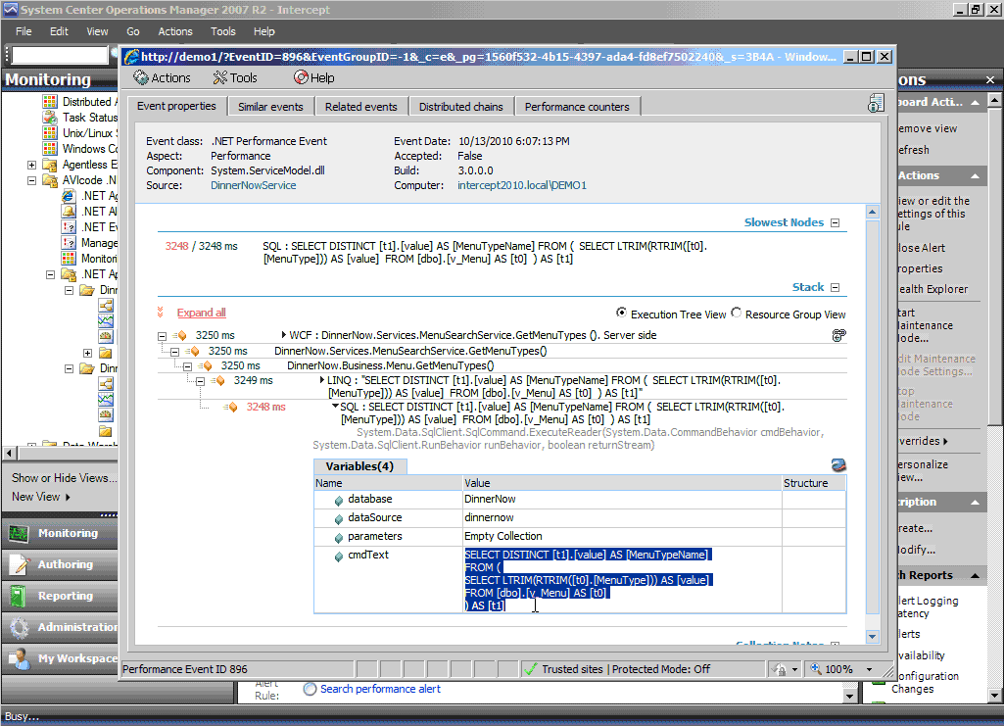

Slide 33
Application/Service Level Monitoring
Distributed Application in System Center allow for holistic view and ability to drill down into the problem
AVICode can see into certain types of applications
  Java, Windows Azure, etc. treated as black box
  You see what comes in
  You see what comes out
  You can point out things like time it takes, but you can’t get the deep knowledge as you could with an On Premises .Net App

Slide 34
Protection in the Cloud

Slide 35
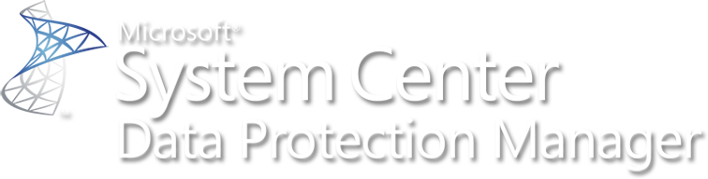
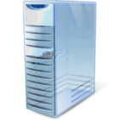

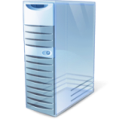




DPM 2010 – Disaster Recovery
One-click DPM DR failover and failback
Separate schedules per DPM server
Chaining support
Offsite tapes without courier services
Restore servers directly from offsite DPM
FS1 \ data
(share)
AccountingdB
(SQLdb)
Mailboxes
(Exch)
FS2 E:\team
(directory)
DPM
FS1_data (share)
SQL25\AccountingdB (sql)
EX23\SG1\Mailboxes (exchange)
FS2_E:\team\ (directory)
DPM DR
FS1_data (share)
SQL25\AccountingdB (sql)
EX23\SG1\Mailboxes (exchange)
FS2_E:\team\ (directory)

Slide 36
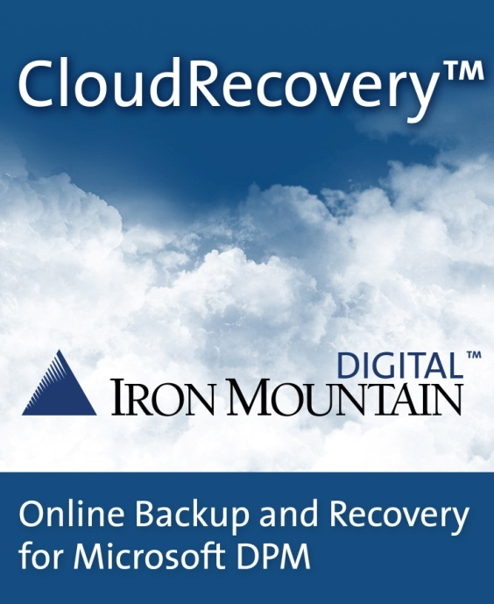
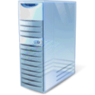

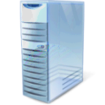








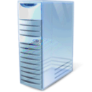


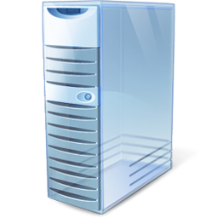
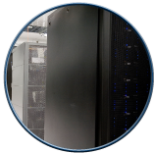
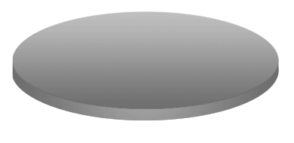

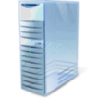









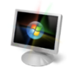





Iron Mountain CloudRecovery™
Online Snapshots (up to 512)
Active Directory®
System State
Disk-based
Recovery
Mirrored
Data Center
Data Center
Data available
for recovery
Up to
Every 15 minutes
Iron Mountain
Data Center
Tape-based
Backup
file services

Slide 37
IT as a Service
Identity
Provisioning
Monitoring
Protection
Database
Application
Data

Slide 38
Summary
Session Objective(s):
  Get an overview of how System Center solutions are used to help drive customer adoption of our cloud services
  Understand how System Center solutions today are used to monitor Windows Azure based services
  Learn about Better Together scenarios between Windows Azure and upcoming System Center solutions
Key Takeaways
  System Center Provides Solutions for Private and Public Clouds
  You need the entire suite working together

Slide 39
Related Sessions
All sessions in the SIM Track ☺
Hands On Labs on the technologies covered

Slide 40
Track Resources
Don’t forget to visit the Cloud Power area within the TLC (Blue Section) to see product demos and speak with experts about the Server & Cloud Platform solutions that help drive your business forward.
You can also find the latest information about our products at the following links:
Cloud Power - http://www.microsoft.com/cloud/
Private Cloud - http://www.microsoft.com/privatecloud/
Windows Server - http://www.microsoft.com/windowsserver/
Windows Azure - http://www.microsoft.com/windowsazure/
Microsoft System Center - http://www.microsoft.com/systemcenter/
Microsoft Forefront - http://www.microsoft.com/forefront/

Slide 41

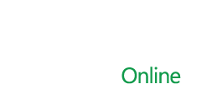

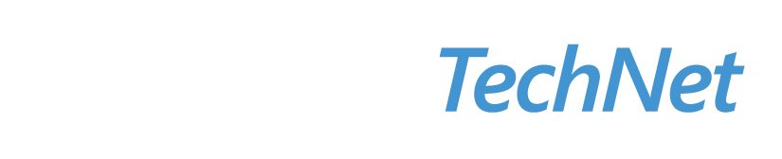

Resources
  Connect. Share. Discuss.
http://northamerica.msteched.com
Learning
  Sessions On-Demand & Community
  Microsoft Certification & Training Resources
www.microsoft.com/teched
www.microsoft.com/learning
  Resources for IT Professionals
  Resources for Developers
http://microsoft.com/technet
http://microsoft.com/msdn

Slide 42












Complete an evaluation on CommNet and
enter to win!

Slide 43


Slide 44

© 2011 Microsoft Corporation. All rights reserved. Microsoft, Windows, Windows Vista and other product names are or may be registered trademarks and/or trademarks in the U.S. and/or other countries.
The information herein is for informational purposes only and represents the current view of Microsoft Corporation as of the date of this presentation. Because Microsoft must respond to changing market conditions, it should not be interpreted to be a commitment on the part of Microsoft, and Microsoft cannot guarantee the accuracy of any information provided after the date of this presentation.
MICROSOFT MAKES NO WARRANTIES, EXPRESS, IMPLIED OR STATUTORY, AS TO THE INFORMATION IN THIS PRESENTATION.

