Slide 1

Preparing Identities for Cloud Services with Microsoft Forefront Identity Manager
SIM358
Mark Wahl, CISA
Architect
Microsoft Corporation

Slide 2
Objective
Understand how Microsoft Forefront Identity Manager can assist in preparing identity data for use by cloud services

Slide 3
Agenda
Cloud and identity management
Three cloud scenarios
  Delegated management of virtual machines in a private cloud
  Preparing users and groups for synchronization to Office 365
  Constructing claims for Software-as-a-Service applications
Q&A

Slide 4
Cloud And Identity Management

Slide 5
Cloud Terminology and Models
Infrastructure as a Service (IaaS)
Platform as a Service (PaaS)
Software as a Service (SaaS)

Slide 6




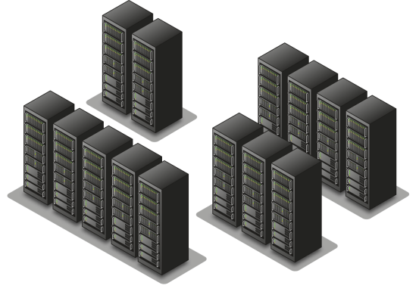


Cloud Deployment Models
SaaS
SaaS
PaaS
IaaS
PaaS
IaaS
Third-party-hosted public cloud
Microsoft-hosted public cloud
IaaS
Private cloud
Partner
On-Premises
User

Slide 7
Why Applications Need Identity
Identification and personalization
  “Hello <your name>”
Authentication
Authorization
Collaboration
  Global Address Lists, Distribution Lists

Slide 8
Cloud Identity Management Options
Use cloud service provider’s (CSP’s) IdM system
Synchronize on-premises identity store up to CSP
Federate identity from trusted third-party provider with CSP
Federate identity from on-premises directory with CSP

Slide 9
Forefront Identity Manager 2010
Ensures accurate identity data is available to applications
  Synchronizes users, groups across directories and databases
  Automates provisioning and de-provisioning
  Provides end user self-service experiences
  Manages smart card lifecycle for stronger authentication

Slide 10
Scenarios for Cloud Services with FIM
Delegated self-service control of private cloud infrastructure
  Self-service management of virtual machines through SC VMM
Improving identity data for use in Office 365
  Ensuring readiness for directory synchronization
Providing identity data to SaaS applications
  Enabling new claims-aware applications without modifying AD

Slide 11


First Scenario: Private Cloud

Slide 12
Managing Infrastructure-as-a-Service
Windows Server Hyper-V
  Windows Server role
  Managed through MMC snap-in tool
System Center Virtual Machine Manager
  Enables centralized management of IT infrastructure
  Optional self-service web portal

Slide 13
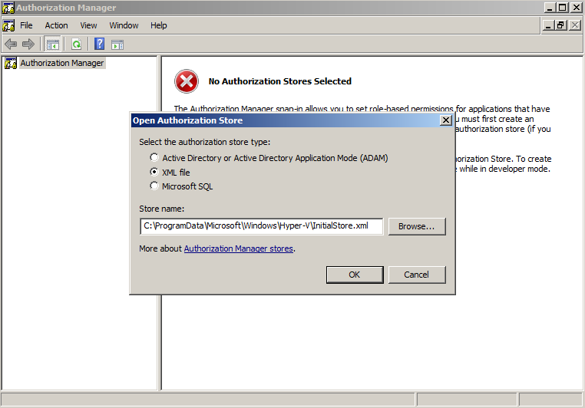
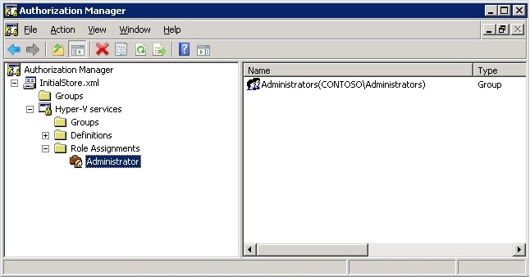
Hyper-V
Hyper-V operations can be controlled through Authorization Manager
Default role allows access to all operations
Additional roles with desired
rights can be created
  33 different operations,
  grouped under
    Hyper-V
    Service Operations
    Hyper-V
    Networks Operations
    Hyper-V VM
    Operations

Slide 14
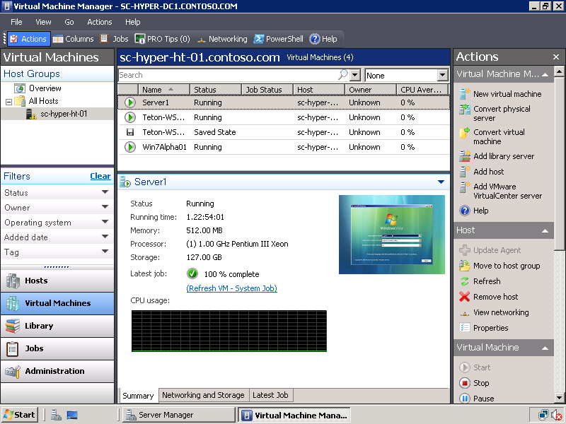
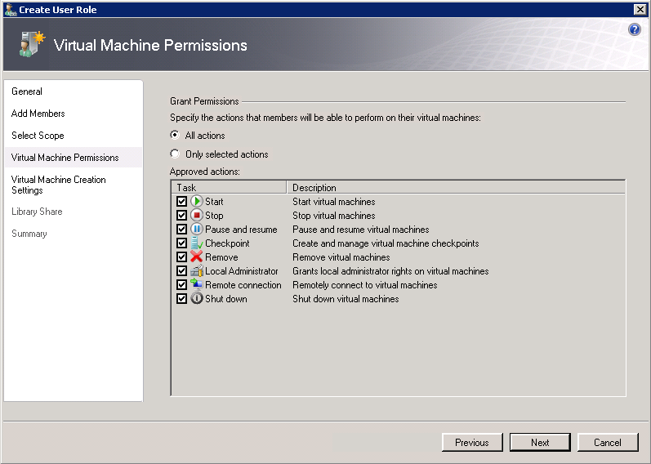
System Center Virtual Machine Manager
Authorization is based on assigning users to roles
Each role is associated with a profile:
Administrator profile
  Complete administrative access to all the hosts, virtual machines, and library servers in VMM 2008
Delegated Administrator profile
  Grants administrative access to a defined set of host groups and library servers
Self-Service User profile
  Administrative access to a defined set of virtual machines through the Web-based Virtual Machine Manager Self-Service Portal

Slide 15
Enhancing Private Cloud with FIM
Hyper-V and SC Virtual Machine Manager use roles
  Enables delegation of datacenter management
  Roles can contain users or groups from AD
FIM manage memberships in AD groups
Define Role in Hyper-V AzMan or VMM
Add Groups to roles
Manage Groups in FIM
Secure Delegated Admin

Slide 16
First Scenario Example:
Configuring SC VMM

Slide 17
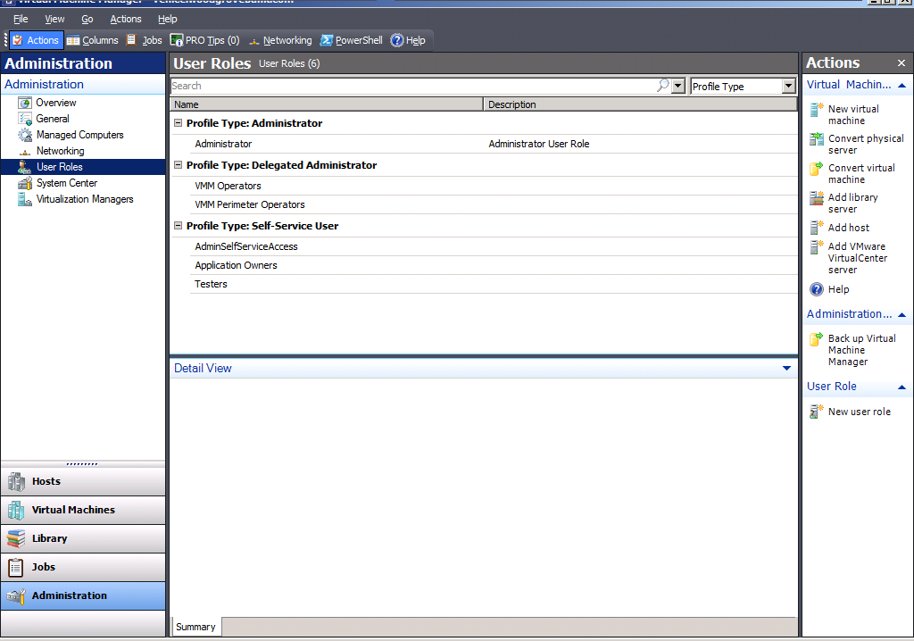

Slide 18
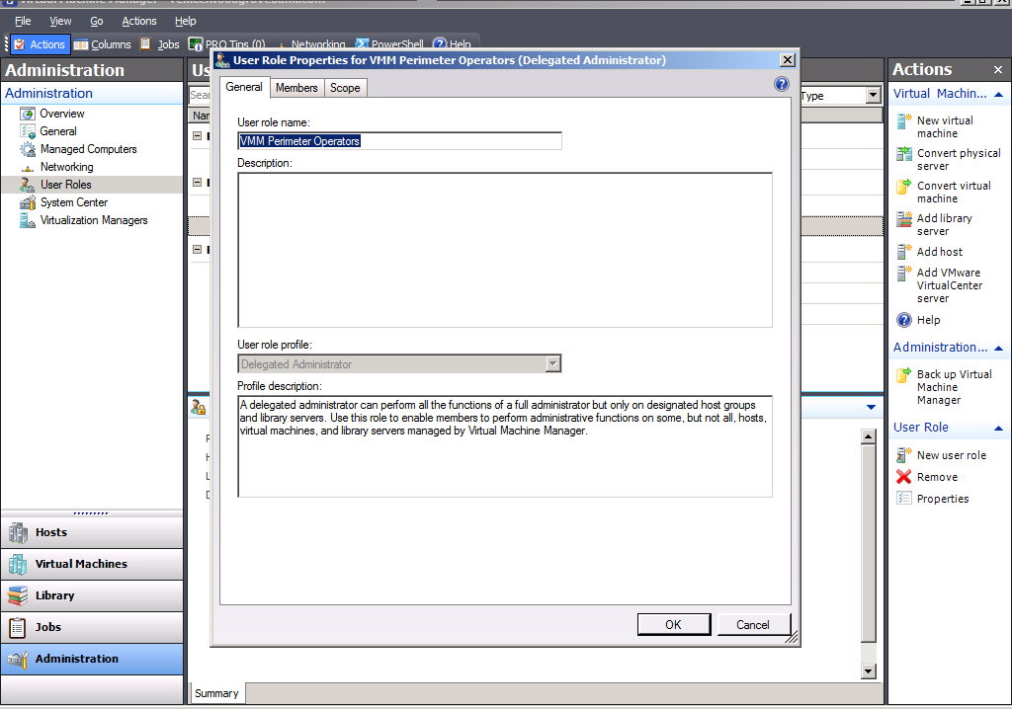

Slide 19
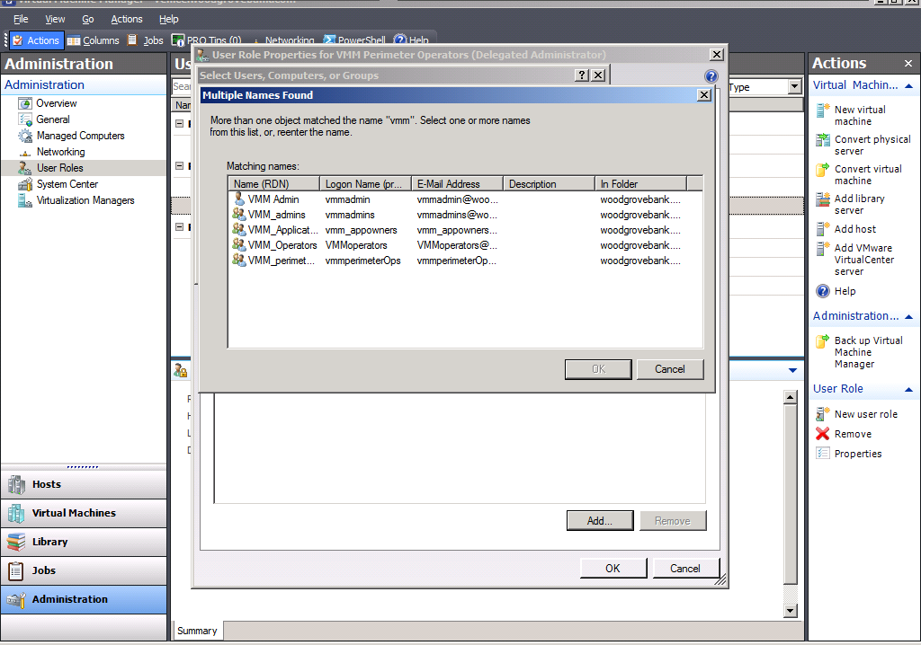

Slide 20
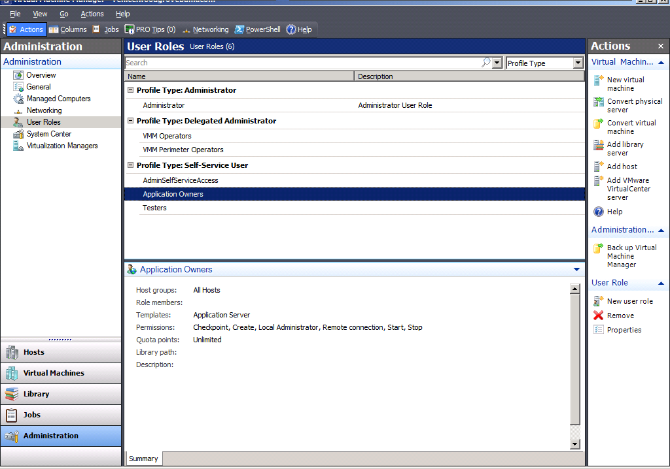

Slide 21
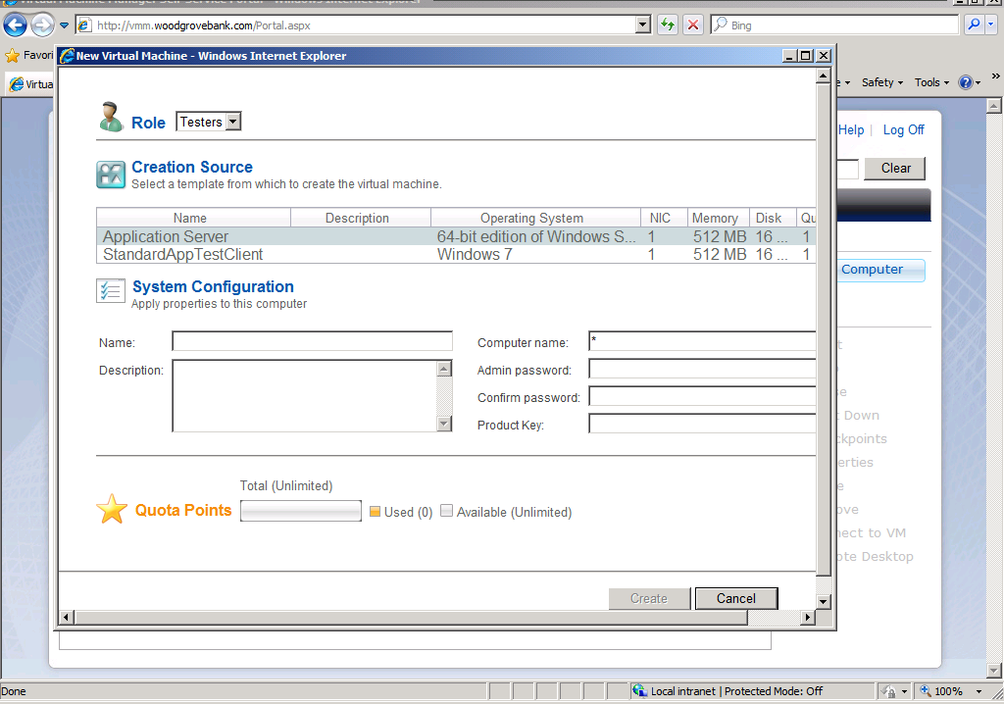

Slide 22


Second Scenario: Office365

Slide 23
Office 365 Identity Management Options
Use Microsoft Online IDs:
  User identities and credentials are mastered in the cloud
Use Microsoft Online IDs with Directory Sync:
  User identities are managed on-premises and synchronized to the cloud
  Credentials are managed in the cloud
Use Federation with Directory Sync:
  User identities are managed on-premises and synchronized to the cloud
  Credentials are controlled on premises

Slide 24



Office 365 Directory Sync and Authentication for On-Premises Directory
Trust
Identity services
On Premises
Authentication platform
Exchange
IdP
Active Directory Federation Services
SharePoint
AD
Online Directory Sync
Provisioning
platform
Lync
Directory
Forefront Identity Manager 2010
Admin portal

Slide 25
Migrating On-Premises to Office 365
Planning
Preparing
Implement Sync and Federation
License users
DeployBpos.com
Configure identity federation (optional)
License users in admin portal
MCS and Partner
offerings
Prepare the directory
Install and configure DirSync
Enterprise Deployment Guide
Readiness Tool

Slide 26
FIM and Office365
FIM’s processes ensure correctness/quality of data in AD
DirSync copies objects from AD to Office365
  Users
  Contacts
  Distribution Lists and Security Groups
ADFS handles user authentication

Slide 27
Getting Identities Ready for Office 365
Categorize users
  Users who should be licensed for cloud services
  Users who should be synched to the cloud but should not be activated/licensed
Tie users to authoritative sources
  e.g., detect changes in HR to drive user lifecycle
Sync from non-AD directories (Notes, OpenLDAP)
Perform forest consolidation (if necessary)
      A single forest will simplify synchronization and federation

Slide 28
Cleaning Identity Data – User Entries
Establish user lifecycle processes
  Flag orphan or dormant accounts
Flag non-person users who don’t need to be licensed for cloud
  (e.g., service accounts, Admins)
Flag person users who don’t need to be licensed
Define attribute cleaning process and responsible party for each category of users

Slide 29
Cleaning Identity Data – User Attributes
Clean attributes, checking for:
  Duplicate email, proxy addresses, account names, UPNs
  Latent errors, e.g., DisplayName values with trailing space
  Value constraints (see Deployment Guide Appendix D)
    samAccountName, givenName, sn, displayName, mail, mailNickname, proxyAddresses, userPrincipalName,…
Ensure necessary attributes are present
  Ensure quality of minimum attributes
    User Name, First Name, Last Name, Display Name, UPN (for federation)
Increase value with optional attributes to populate GAL
    Title, Address, City, Zip/Postal Code, …

Slide 30
Cleaning Identity Data – User Principal Names
For Federation- Must have unique UPN for each user
  UPN suffix must match a validated domain in Office 365
UPN Character restrictions
  Letters, numbers, dot or dash
  No dot before @ symbol
  cannot have dot ‘.’ immediately preceding ‘@’
  cannot exceed 113 chars (64 for username, 48 for domain)
  cannot contain !#$%&\*+-/=?^_`{|}~<>()

Slide 31
Cleaning Identity Data – Groups
What groups need to be in the cloud?
  Exchange/Notes other DLs
  Mail-enabled security groups
  Security Groups needed by SharePoint Online?
Check validity of membership rules
  E.g., groups with users who won’t be licensed in the cloud
Verify ownership/responsibility for maintenance

Slide 32
Planning
Preparing
Implement Sync and Federation
License users
Implement Directory sync and Federation
Forefront Identity Manager manages on-premises AD Directory Sync tool is the connector to cloud

Slide 33


Third Scenario:
Claims-aware Application

Slide 34
Claims-Based Identity Software Components
  Relying Party / Resource
    Consumes claims which describe an authenticated user
    Example: ASP.NET application with Windows Identity Foundation (WIF)
  Identity provider
    Authenticates the user
    Generates claims in a security token to be provided to the Relying Party
    Example: Active Directory Federation Services (ADFS)
Identity Provider
Relying Party
1. RP Requires claims
2. Get claims
User
3. Forward claims

Slide 35
Claims Sources for ADFS
When using ADFS to implement the Identity Provider,
  Authentication is always performed by AD
  Attributes can come from AD, other LDAP directories, SQL, or custom sources
Consider whether to put claim values in AD, or create SQL tables for new claims
  When should AD schema be extended ?
  If using SQL to provide additional data for ADFS, identify a unique key for users as both an AD attribute and table column

Slide 36
Third Scenario Example:
Managing Claim Values

Slide 37
Example Application Deployment
Single AD domain with ADFS
Custom application which needs:
  User Name
  User Role (in the application)
Construct and populate a SQL table
  Use a key to join with an AD attribute

Slide 38
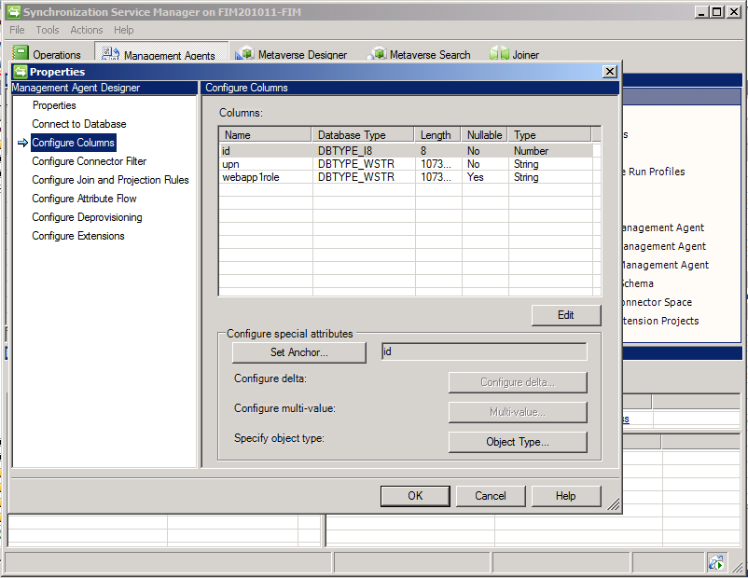

Slide 39
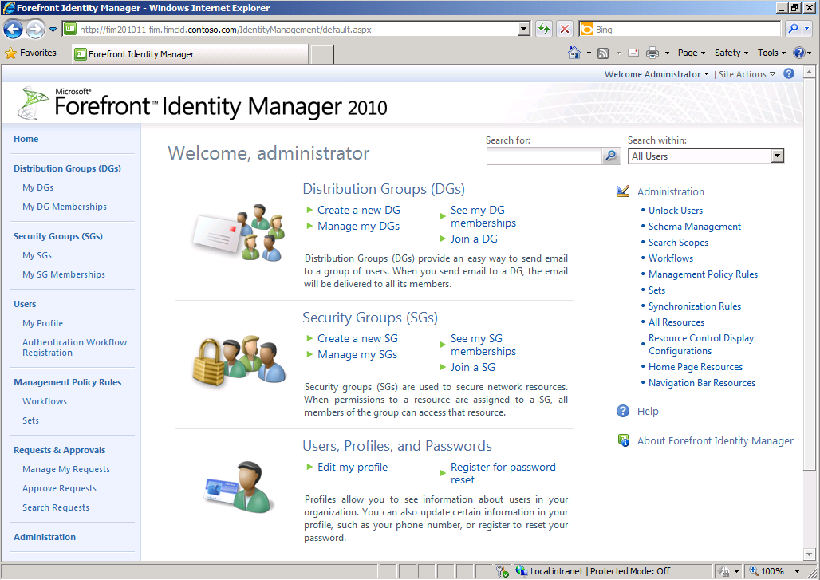

Slide 40
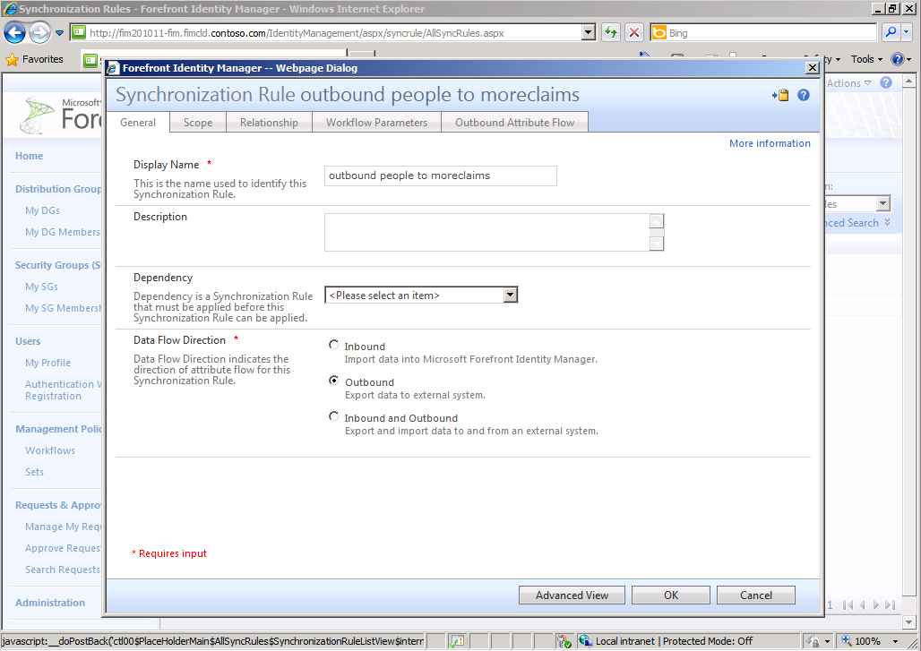

Slide 41
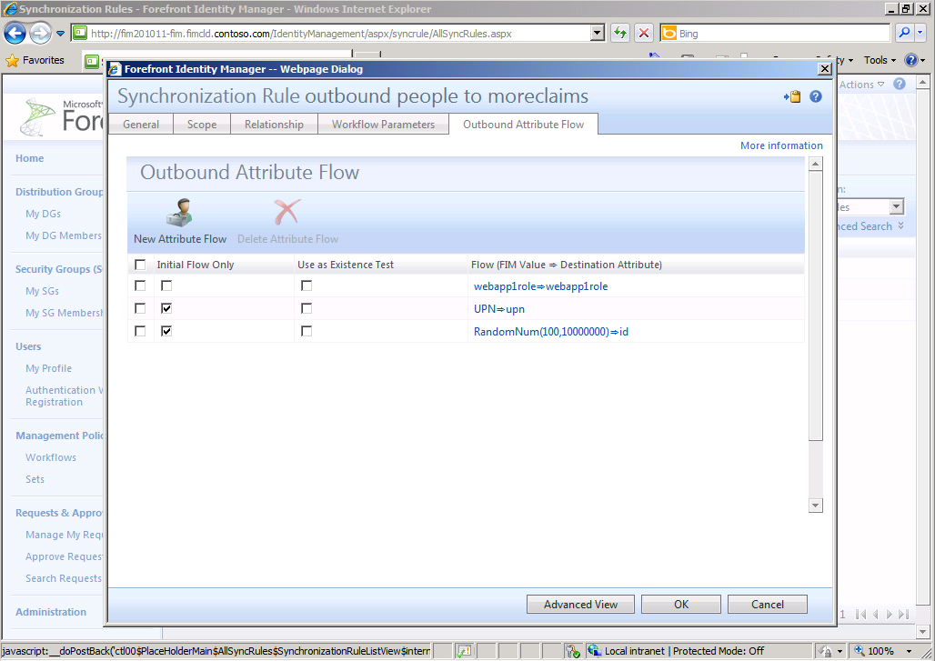

Slide 42
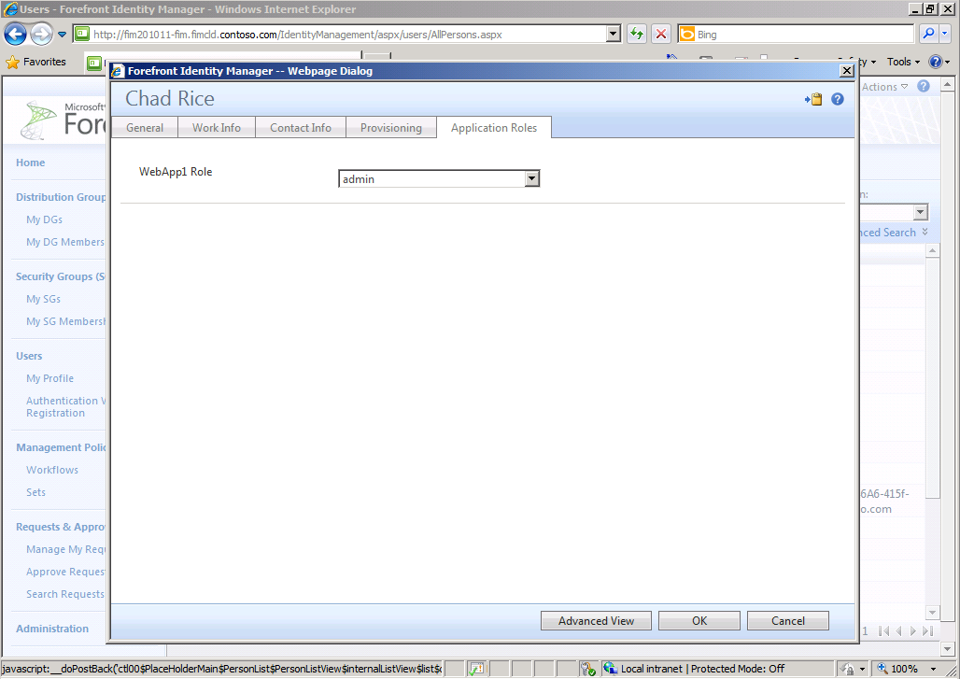

Slide 43
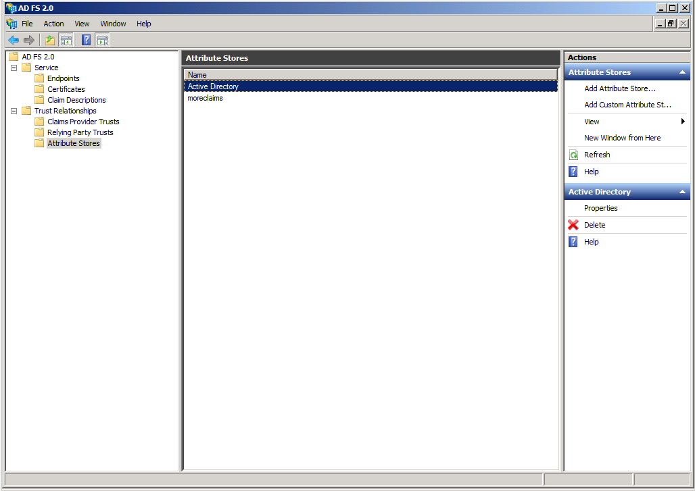

Slide 44
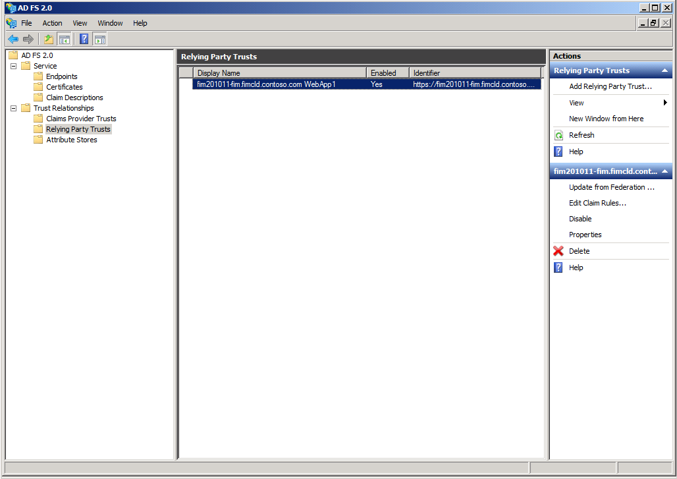

Slide 45
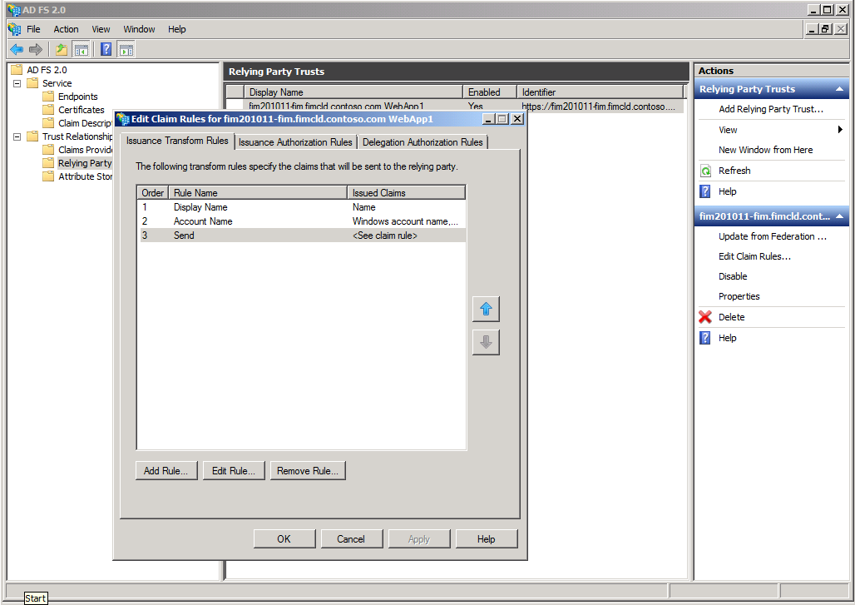

Slide 46
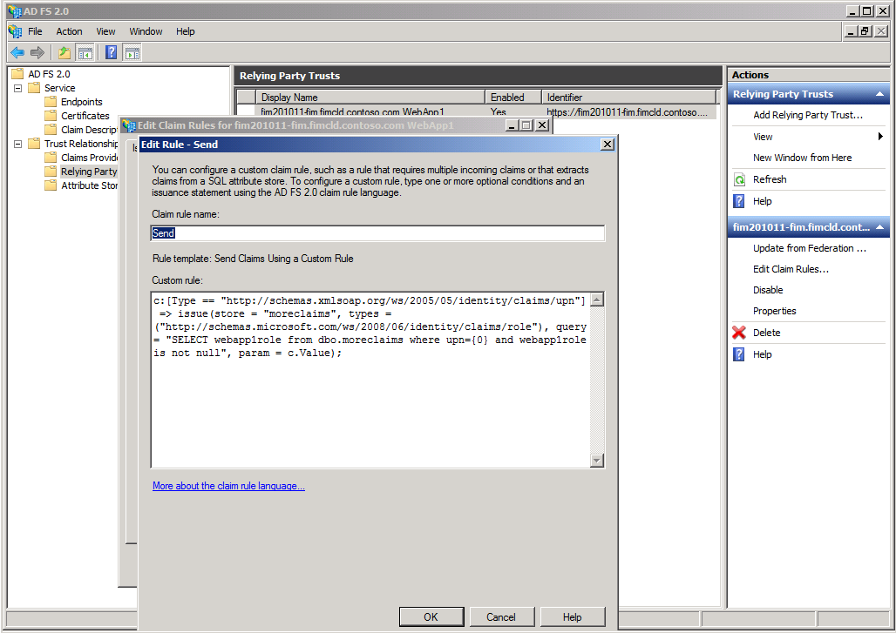

Slide 48
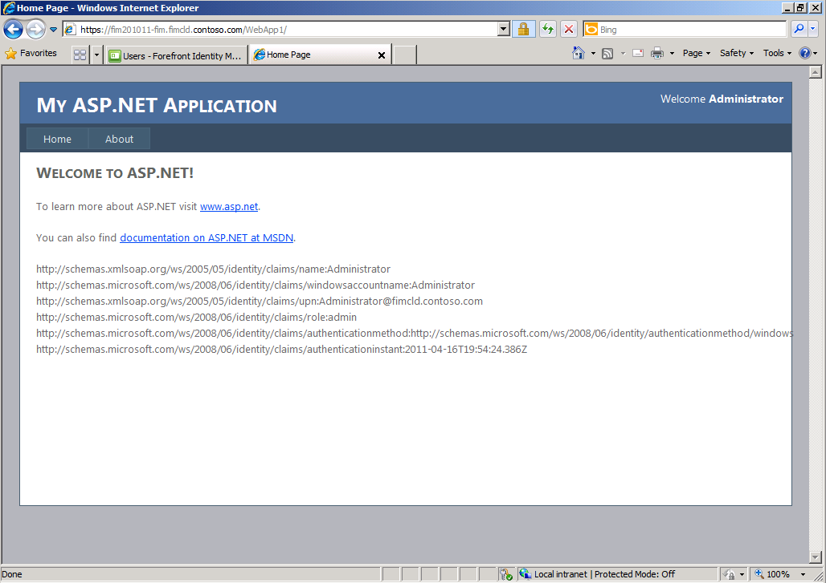

Slide 50
Next Steps
Help prepare for cloud with processes that improve quality of existing directory data and enhance data in AD
Review approaches that leverage FIM to prepare for cloud and ongoing management on-premises
Learn more about identity federation and how claims can simplify app development

Slide 51

Related Content
Required Slide
Speakers, please list the Breakout Sessions, Interactive Discussions, Labs, Demo Stations and Certification Exam that relate to your session. Also indicate when they can find you staffing in the TLC.
SIM315 Optimizing FIM (Thursday)
SIM332 Technical Overview (Tuesday)
SIM379-INT Self-service Password Reset (Wednesday)
SIM375-INT Chalk Talk with the Product Team (Tuesday)
SIM395-HOL FIM Overview
SIM399-HOL Managing Claims AuthN using FIM 2010
Forefront Identity Manager demos in the exhibition hall

Slide 52
Track Resources
Don’t forget to visit the Cloud Power area within the TLC (Blue Section) to see product demos and speak with experts about the Server & Cloud Platform solutions that help drive your business forward.
You can also find the latest information about our products at the following links:
Cloud Power - http://www.microsoft.com/cloud/
Private Cloud - http://www.microsoft.com/privatecloud/
Windows Server - http://www.microsoft.com/windowsserver/
Windows Azure - http://www.microsoft.com/windowsazure/
Microsoft System Center - http://www.microsoft.com/systemcenter/
Microsoft Forefront - http://www.microsoft.com/forefront/

Slide 53





Resources
  Connect. Share. Discuss.
http://northamerica.msteched.com
Learning
  Sessions On-Demand & Community
  Microsoft Certification & Training Resources
www.microsoft.com/teched
www.microsoft.com/learning
  Resources for IT Professionals
  Resources for Developers
http://microsoft.com/technet
http://microsoft.com/msdn

Slide 54












Complete an evaluation on CommNet and
enter to win!

Slide 55


Slide 56

© 2011 Microsoft Corporation. All rights reserved. Microsoft, Windows, Windows Vista and other product names are or may be registered trademarks and/or trademarks in the U.S. and/or other countries.
The information herein is for informational purposes only and represents the current view of Microsoft Corporation as of the date of this presentation. Because Microsoft must respond to changing market conditions, it should not be interpreted to be a commitment
on the part of Microsoft, and Microsoft cannot guarantee the accuracy of any information provided after the date of this presentation. MICROSOFT MAKES NO WARRANTIES, EXPRESS, IMPLIED OR STATUTORY, AS TO THE INFORMATION IN THIS PRESENTATION.

