Slide 1

Upgrading Norway To Windows 7
WCL206-R
Olav Tvedt
Deployment Ranger
EDB Ergogroup

Slide 2

Norway In A Nutshell
Population: 4 920 305
Capitol and biggest city: Oslo 600 000
Second biggest city: Bergen 261 000
Best Known For:
- Rattus Norvegicus
- Vikings
- Fjords
- Salmon
- Worlds Third Largest Petroleum Exporter

Slide 3
UNESCO World Heritage
Bryggen
Rock Art of Alta
Røros Mining Town and the Circumference
Struve Geodetic Arc
Urnes Stave Church
Vegaøyan -- The Vega Archipelago
West Norwegian Fjords – Geirangerfjord and Nærøyfjord

Slide 4






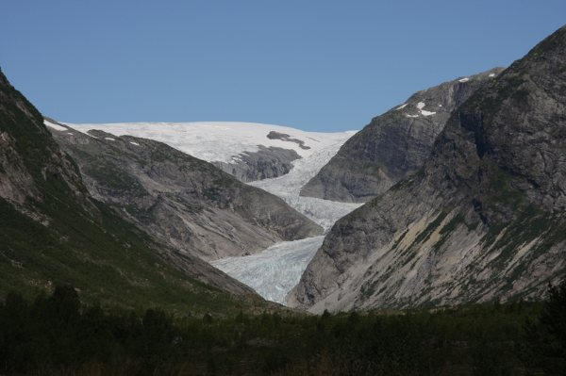



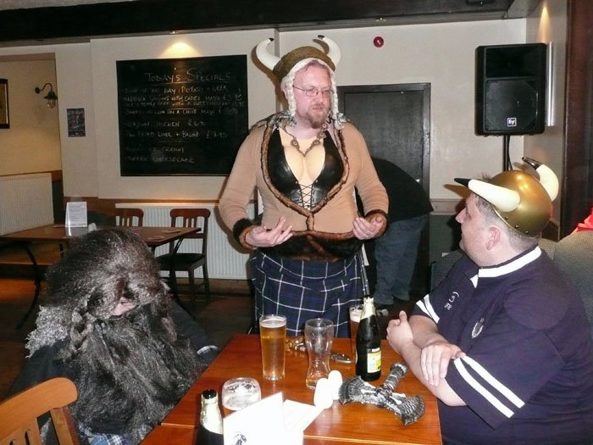

Norway In A Nutshell

Slide 5
Agenda
Challenge For Early Adopters
Difference In Customer, Size And Demands
Common Tools
Taking Care Of User Data
Deployment Tools
Keeping The Deployment Time Down And Security Up
End Results

Slide 6
Deployment Ranger Challenge
Stages Of Engagement
Early Adopters (January 2009)
Fast Followers (January 2010)
Late Movers (By Themselves)

Slide 7
Different Reasons And Different Goals
Reasons:
- Windows XP To Old, But Did Not Want Windows Vista
- Windows XP Not Optimized For Deployment
- Not Happy With Vista
- Direct Access
- Bitlocker / Bitlocker To Go
- Etc.
Goals:
- Save Money
- Save Time
- Security
- User Satisfaction And Productivity
- IT Worker Satisfaction And Productivity
- Attract New Employees

Slide 8
Challenges For Early Adopters
No Free Ride
Technology Uncertainty
Application Challenges
Supporting Multiple Platforms
User's Willingness To Change
User’s Productivity
Backup Solutions For Users

Slide 9











Early Adoption Program (January 2009)
7 Partners
13 Large And Enterprise Customers (500 and up)
64% Computers Running Windows 7

Slide 10
Fast Followers
11 Customers
- 100% Completed
More Demanding
Better Known Technology
Experience From Early Adapters
More Windows Features Used

Slide 11
Difference In Customer, Size And Demands
Sogn Og Fjordane Fylkeskommune (County Council)
6500 pc’s
Buskerud Fylkeskommune (County Council)
8000 pc’s
City Of Stavanger
3800 pc’s
Norwegian Petroleum Directorate
400 pc’s
STX OSV(Shipbulider)
1000 pc’s
GassCo (Gas Transporter)
400 pc’s
Eidsiva Energi (Electricity Supplier)
900 pc’s
Samlerhuset (Retailer Of Coins, Stamps And Collectibles)
200 pc’s

Slide 12

Partner And Customer
Taste The Same Medicine As The Customers
400 PC’ rolled out on RC
- Lots Of Applications Fixed With ACT
- Used MDT
- Bitlocker
- Sccm For Applications
Upgraded To RTM Version

Slide 13

Reason
- Save Money And Time
- Most Users Are Mobile
- Extend Life Time Of Old Computers
- Going From Novell To Microsoft
- Creating A Work Environment Attracting New Employees
- Creating A School Environment Attracting Students
Technologies Being Used
- Bitlocker
- Bitlocker To Go
- DirectAccess

Slide 14
The migration projects
Novell eDir → MS Active Directory
Lotus Notes → MS Outlook (Exchange)
WebSphere(IBM) → MS Sharepoint
Sametime → MS Office Communications Server (OCS)
Novell IDM → MS Forefront identity Manager (FIM)
ZenWorks → MS System Center Config Manager (SCCM)
MS Office 2000 → MS Office 2007
Windows XP → Windows 7

Slide 15
Result
Improved IT Efficiency
- Deployment Time Down From 2 – 2 ½ Hour To 15 – 30 Minutes
- DirectAccess Remote Computers Management
Reduced Costs
- $300.000 In Hardware Saving The First Year
Enhanced IT Security
- Protected Data With Bitlocker
Increased Productivity
- Improved User Interface
- Always Access To Resources With DirectAccess

Slide 16
Result Today
Above All Expectations
Users Takes It Directly
5 Year Old Computers Used Until Today
Large Reduction In Windows Related Helpdesk Questions
Are Now More Proactive And Less Firefighters

Slide 17

Reason
- Expanding From 50 To 400 Pc’s
- More Mobile Users
- Slow Logon
- No Standardization Of User Setup
Technologies Being Used
- Bitlocker
- App-V (Mdop)
- Branch Cache

Slide 18
Result
Improved IT Efficiency
- Group Policies For Better Control And Configuration
- App-V For Application Deployment
- Easy And Fast To Deploy A Standardized Desktop
Enhanced IT Security
- Protected Data With Bitlocker
Increased User Productivity
- Logon Time Reduced
- Branch Cache Gives Better Response To Branch Offices

Slide 19
Norwegian Petroleum Directorate
Reason
- Slow Logon
- Slow Redeploying Of Computers
- Most Users Are Mobile
- Need For Better Security
Technologies Being Used
- DirectAccess
- Bitlocker

Slide 20
Result
Improved IT Efficiency
- Group Policies For Better Control And Configuration
- App-V For Application Deployment
- Easy And Fast To Deploy A Standardized Desktop
Enhanced IT Security
- Protected Data With Bitlocker
Increased User Productivity
- Logon Time Reduced From 1 ½ - 10 Minutes To 20 – 40 seconds
- Branch Cache Gives Better Response To Branch Offices

Slide 21
Common Tools
Preparing For Deployment

Slide 22
Common Tools
Hardware Inventory
- Microsoft Assessment and Planning Toolkit (MAP)
- System Center Configuration Manager (SCCM)
- Custom Scripts
- Manual
Application Inventory
- Application Compatibility Toolkit (ACT)
- System Center Configuration Manager (SCCM)
- Manual

Slide 23
Microsoft Assessment and Planning Toolkit
Hardware inventory
Client Access Analysis
Compatibility Analysis
Moneysaving Analysis
Automatic Generation Of Reports
Agentless

Slide 24
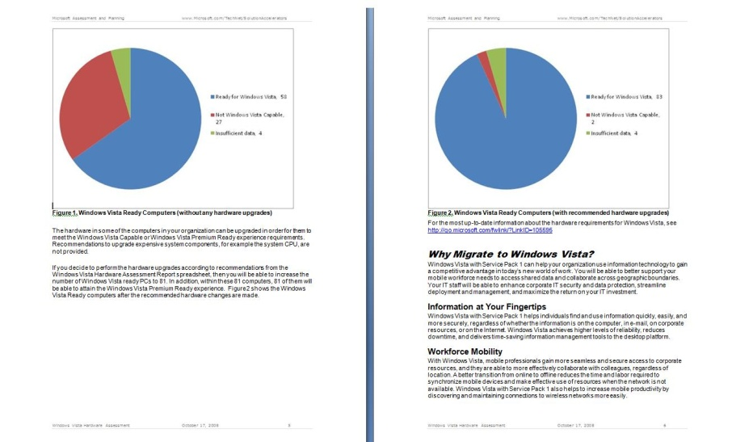


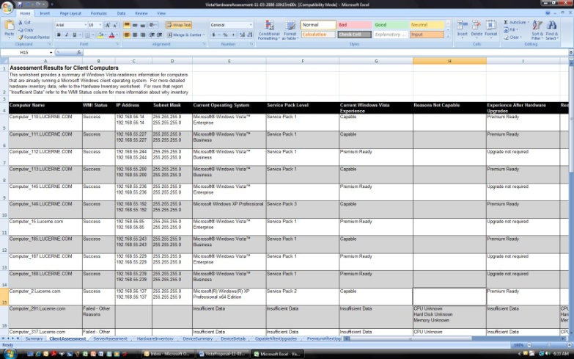
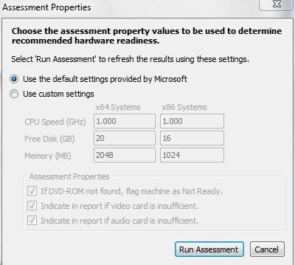
MAP: Windows 7
Proposals
Hardware
and Device Compatibility Assessment
Detailed Report
http://www.microsoft.com/MAP

Slide 25
MAP Reports And Proposals
Olav Tvedt
Deployment Ranger
EDB Ergogroup
demo

Slide 26
Application Compatibility Toolkit
Tools To:
- Check Application, Device And Computer Compatibility
- Check Internet Explorer Compatibility
- Shim Applications
- Much more..
Includes
- Application Compatibility Manager
- Compatibility Administrator
- Standard User Analyser
- Internet Explorer Compatibility Tester

Slide 27
Using ACT
Olav Tvedt
Deployment Ranger
EDB Ergogroup
demo

Slide 28
Taking Care Of User Data
Manual
- File Copy
- Windows Easy Transfer
Folder Redirection
- Group Policy
User State Migration Toolkit
- Windows Automated Installation Kit
- Automatic With MDT Or SCCM

Slide 29
Using USMT
Olav Tvedt
Deployment Ranger
EDB Ergogroup
demo

Slide 30
Deployment Tools
Windows Deployment Services (WDS)
- Built-in Feature Of Windows 2008 And Newer
Microsoft Deployment Toolkit (MDT)
- Free Download
Windows Automated Installation Kit
- Free Download
System Center Configuration Manager (SCCM)
- Licensed
- Can (Should) Be Extended With MDT

Slide 31
Keeping The Deployment Time Down And Security Up
Selecting The Right Type Of Image
- Thin
- Thick
- In-between
Basic Rule Of Safety
- Never Give A User Unpatched Computers
- Never Put An Unpatched Computer On The Network
Patching Must Be A Part Of The Deployment Process

Slide 32
Keeping The Deployment Time Down And Security Up
Patching During Installation = Longer Deployment Time
Longer Deployment Time = Unhappy Users
Pre Patched Images = Shorter Deployment Time
Shorter Deployment Time = Happy Users
How To Pre Patch:
- Virtual Computer As Master Images
- DISM
- Scripts

Slide 33
Offline Patching With DISM
Olav Tvedt
Deployment Ranger
EDB Ergogroup
demo

Slide 34
DISM CODES USED
dism /mount-wim /wimfile:C:\wim\boot.wim /index:1 /mountdir:C:\win7-Wim-update
Dism /image:C:\win7-Wim-update /Add-Package /PackagePath:C:\Win7-updates /IgnoreCheck
dism /unmount-wim /mountdir:C:\win7-Wim-update /commit

Slide 35
End Results For Microsoft Norway
64% All Client Computers Are Now Running Windows 7
- 9 Of 13 Early Adapters Running 100 % Windows 7
- 4 Left Mainly Held Back By Branch Offices
Unique early insight into a broad set of customer challenges
Reference Cases Of All Types And Sizes
Partner Infrastructure Trained And Ready

Slide 36
End Result For Customers
Saved Money
Saved Time
Satisfied Users
Satisfied IT Workers
More Secure
A Great Support Tool Called “Reinstall”
Media coverage and positive brand building

Slide 37

Related Content
Required Slide
Speakers, please list the Breakout Sessions, Interactive Discussions, Labs, Demo Stations and Certification Exam that relate to your session. Also indicate when they can find you staffing in the TLC.
WCL301 | A Geek's Guide to Windows User State Migration Tool (USMT) 4.0
WCL401 | Inside Panther: Troubleshooting the Windows Setup Engine
WCL403 | Troubleshooting Windows 7 Deployments: In Depth
WCL304 | Case of the Unexplained 2011: Windows Troubleshooting with Mark Russinovich
Remember The Hands-On Labs!!!

Slide 38
Track Resources
Don’t forget to visit the Cloud Power area within the TLC (Blue Section) to see product demos and speak with experts about the Server & Cloud Platform solutions that help drive your business forward.
You can also find the latest information about our products at the following links:
Cloud Power - http://www.microsoft.com/cloud/
Private Cloud - http://www.microsoft.com/privatecloud/
Windows Server - http://www.microsoft.com/windowsserver/
Windows Azure - http://www.microsoft.com/windowsazure/
Microsoft System Center - http://www.microsoft.com/systemcenter/
Microsoft Forefront - http://www.microsoft.com/forefront/

Slide 39





Resources
  Connect. Share. Discuss.
http://northamerica.msteched.com
Learning
  Sessions On-Demand & Community
  Microsoft Certification & Training Resources
www.microsoft.com/teched
www.microsoft.com/learning
  Resources for IT Professionals
  Resources for Developers
http://microsoft.com/technet
http://microsoft.com/msdn

Slide 40












Complete an evaluation on CommNet and
enter to win!

Slide 41


