Slide 2

Upgrading Norway To Windows 7
WCL206
Olav Tvedt
Deployment Ranger
EDB Ergogroup

Slide 3


DEMO ENVIROMENT
Domain:
Deployment.no
Domain:
Customer.no
DC1:
AD, DNS, DFS,
DHCP, MDT, WAIK
C-DC1:
AD, DNS, DHCP, WDS, MDT, WAIK
DepSrv2:
MDT, WAIK
DepSrv1:
WDS, MDT,
DFS, WAIK,
MAP, ACT
C-Client1
Windows 7
C-Client2
Without OS
Client1
Windows 7
USMT
Client2
Windows 7
Syspreped
Client3
Without OS

Slide 4
Deadlines & Resources
Thank you for taking part in TechEd North America 2011.
Below is a list of key dates and resources:
Important Content Deadlines – detailed instructions are found on the Speaker Portal at https://northamerica.msteched.com/signin:
  March 21 at Noon: Upload a DRAFT of your PPT for subject-matter expert (SME) review.
    March 21 to April 8: CONTENT REVIEW (track specific instructions are found on the speaker portal)
    May 10 at 5 pm PDT: Upload FINAL PPT presentation on the Speaker Portal. This is the version that
    you will use at the event.
    YOUR PROMPT FINAL PPT SUBMISSION IS APPRECIATED.
    No design support will be offered onsite.
  Slide Design Resources – Located on the Speaker Portal (graphics, webinar, etc.)
  If you include any third-party photography or art, licensing information and permission must be credited
  in the PPT or it will be deleted.
  Points of Contact
  Direct presentation questions to tespkr@microsoft.com
  Direct content questions to your Track PM
  PRINTING: This template is intentionally set to print in color or grayscale, not black and white
Notes:
© 2010 Microsoft Corporation. All rights reserved. Microsoft, Windows, Windows Vista and other product names are or may be registered trademarks and/or trademarks in the U.S. and/or other countries.
The information herein is for informational purposes only and represents the current view of Microsoft Corporation as of the date of this presentation. Because Microsoft must respond to changing market conditions, it should not be interpreted to be a commitment on the part of Microsoft, and Microsoft cannot guarantee the accuracy of any information provided after the date of this presentation.
MICROSOFT MAKES NO WARRANTIES, EXPRESS, IMPLIED OR STATUTORY, AS TO THE INFORMATION IN THIS PRESENTATION.

Slide 5
Scrub Checklist
Upload your final deck on the speaker portal on or before May 10, 2011 at 5 pm PDT.
PowerPoint presentations undergo a brief scrub process and are posted to CommNet for attendee access
at least 48 hours prior to the session. No design support will be available onsite.
The Scrub Process will:
Verify that required slides are included
Remove any non-template logos and graphics from the walk-in slide
Remove all comments, hidden slides and speaker notes from slides
Set file properties box
Reset printability to grayscale
Notify Presentation Manager of any images identified as unlicensed for escalation
Rename files to match naming convention
Correct session title and session code to match printed Mini Guide and Schedule Builder
Speakers:
Use the provided event template and associated colors, fonts, layout and transition slides
Correct product names to follow applicable branding rules

Slide 6

PowerPoint Template
Subtitle color
Example of a slide with a subhead
  Set the slide title in “All Caps”
  Set subheads in “Sentence case”
  Generally set subhead to 36pt or smaller so it will fit on a
  single line
  The subhead color is defined for this template but must be selected; In PowerPoint 2007/2010, it is the fifth font color
  from the left
Hyperlink color: www.microsoft.com

Slide 7
Chart Example

Slide 8

Slide for Showing Developer’s Software Code
Use this layout to show software code
  The font is Consolas, a monospace font
  The slide doesn’t use bullets but levels can be indented using the “Increase List Level” icon on the Home menu

Slide 9

Norway In A Nutshell
Population: 4 920 305
Capitol and biggest city: Oslo 600 000
Second biggest city: Bergen 261 000
Best Known For:
- Rattus Norvegicus
- Vikings
- Fjords
- Salmon
- Worlds Third Largest Petroleum Exporter
Notes:
Constitution Day
Population Norway 4 920 305 spread over 148.748 Square miles
Population Georgia 9.687.653 Spread over 59.435 Square miles
6 Hours into the future

Slide 10
UNESCO World Heritage
Bryggen
Rock Art of Alta
Røros Mining Town and the Circumference
Struve Geodetic Arc
Urnes Stave Church
Vegaøyan -- The Vega Archipelago
West Norwegian Fjords – Geirangerfjord and Nærøyfjord

Slide 11
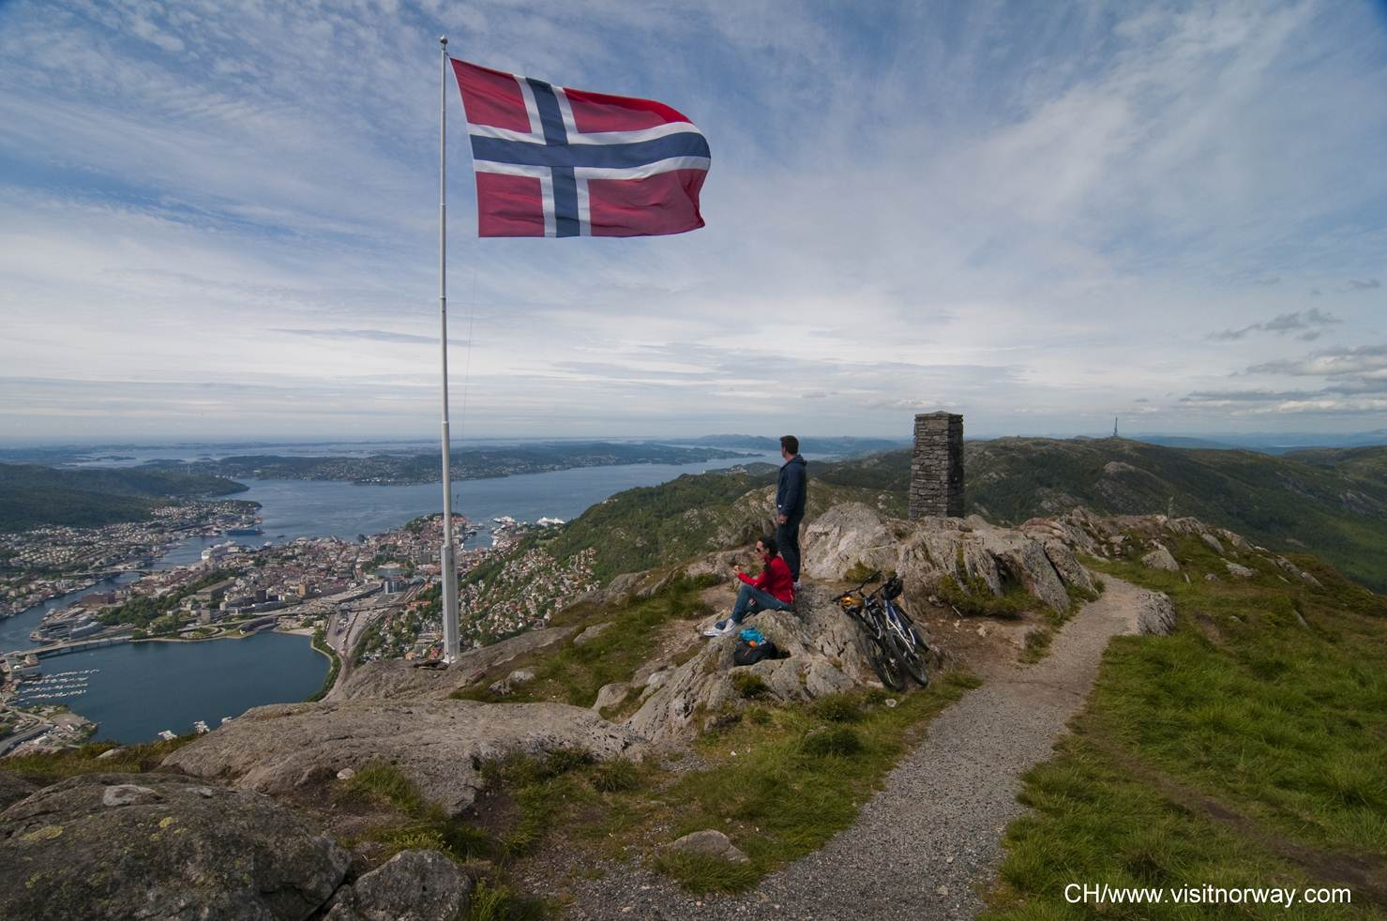

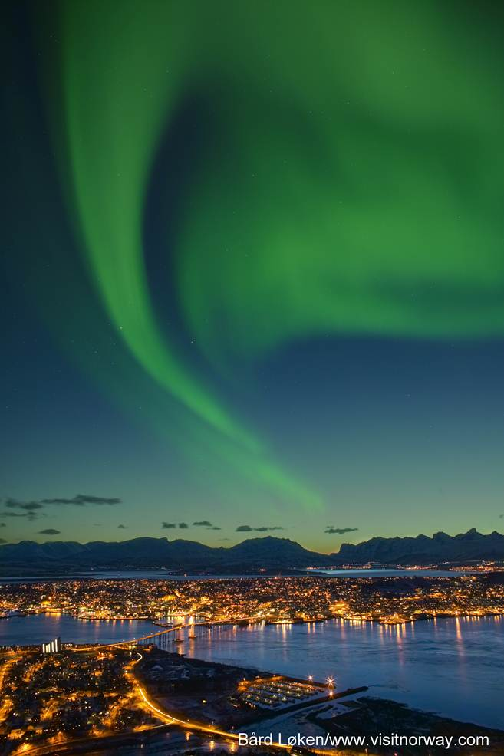
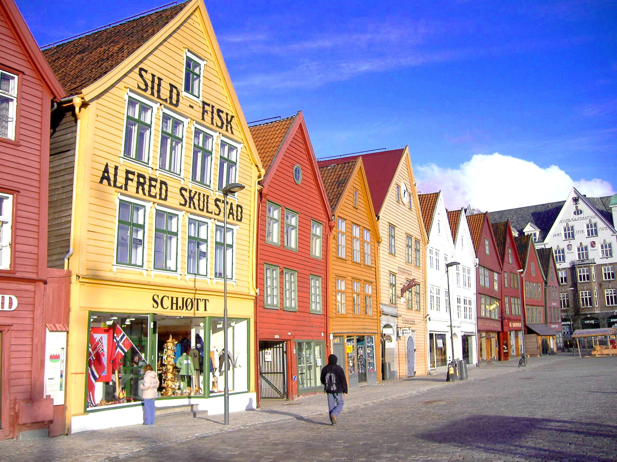


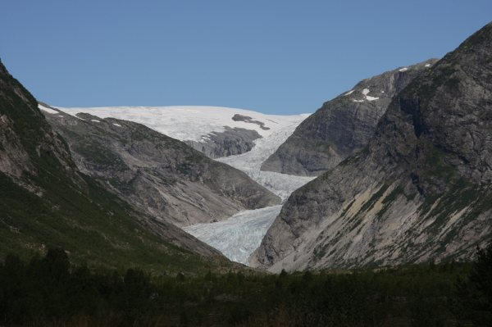



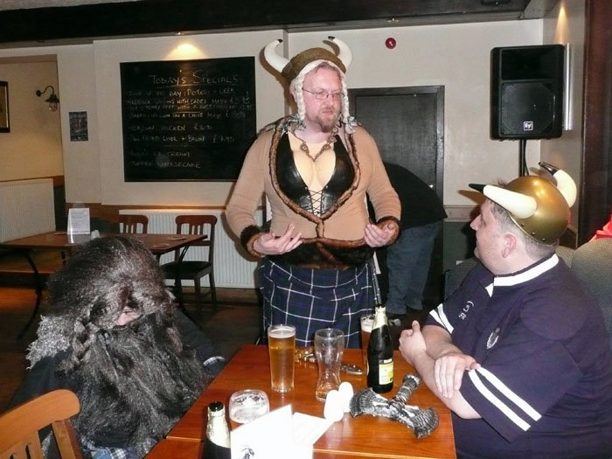

Norway In A Nutshell
Notes:
Glaciers
stave church
fjords and mountains
wharf in Bergen

Slide 12
Agenda
Challenge For Early Adopters
Difference In Customer, Size And Demands
Common Tools
Taking Care Of User Data
Deployment Tools
Keeping The Deployment Time Down And Security Up
End Results

Slide 13
Deployment Ranger Challenge
Stages Of Engagement
Early Adopters (January 2009)
Fast Followers (January 2010)
Late Movers (By Themselves)

Slide 14
Different Reasons And Different Goals
Reasons:
- Windows XP To Old, But Did Not Want Windows Vista
- Windows XP Not Optimized For Deployment
- Not Happy With Vista
- Direct Access
- Bitlocker / Bitlocker To Go
- Etc.
Goals:
- Save Money
- Save Time
- Security
- User Satisfaction And Productivity
- IT Worker Satisfaction And Productivity
- Attract New Employees

Slide 15
Challenges For Early Adopters
No Free Ride
Technology Uncertainty
Application Challenges
Supporting Multiple Platforms
User's Willingness To Change
User’s Productivity
Backup Solutions For Users

Slide 16











Early Adoption Program (January 2009)
7 Partners
13 Large And Enterprise Customers (500 and up)
64% Computers Running Windows 7

Slide 17
Fast Followers
11 Customers
- 100% Completed
More Demanding
Better Known Technology
Experience From Early Adapters
More Windows Features Used

Slide 18
Difference In Customer, Size And Demands
Sogn Og Fjordane Fylkeskommune (County Council)
6500 pc’s
Buskerud Fylkeskommune (County Council)
8000 pc’s
City Of Stavanger
3800 pc’s
Norwegian Petroleum Directorate
400 pc’s
STX OSV(Shipbulider)
1000 pc’s
GassCo (Gas Transporter)
400 pc’s
Eidsiva Energi (Electricity Supplier)
900 pc’s
Samlerhuset (Retailer Of Coins, Stamps And Collectibles)
200 pc’s

Slide 19

Partner And Customer
Taste The Same Medicine As The Customers
400 PC’ rolled out on RC
- Lots Of Applications Fixed With ACT
- Used MDT
- Bitlocker
- Sccm For Applications
Upgraded To RTM Version

Slide 20

Reason
- Save Money And Time
- Most Users Are Mobile
- Extend Life Time Of Old Computers
- Going From Novell To Microsoft
- Creating A Work Environment Attracting New Employees
- Creating A School Environment Attracting Students
Technologies Being Used
- Bitlocker
- Bitlocker To Go
- DirectAccess

Slide 21
The migration projects
Novell eDir → MS Active Directory
Lotus Notes → MS Outlook (Exchange)
WebSphere(IBM) → MS Sharepoint
Sametime → MS Office Communications Server (OCS)
Novell IDM → MS Forefront identity Manager (FIM)
ZenWorks → MS System Center Config Manager (SCCM)
MS Office 2000 → MS Office 2007
Windows XP → Windows 7
Notes:
After a thorough evaluation process, involving all the key vendors in the market, we decided to migrate our heterogenous platform to a standardised Microsoft plattform, utilizing the latest technologi all the way from infrastructure up to the application level.
In the Microsoft platform we found products that were of high quality (rated top quadrant by Gartner,) they are very well integrated with each other – and also with Line Of Business-applications, and they are supported by many partners, also locally, something that was important for us.
One can say that it might be risky to place all your eggs in one basket, but we were confident both in the technology, our partners and in the support from Microsoft.

Slide 22
Result
Improved IT Efficiency
- Deployment Time Down From 2 – 2 ½ Hour To 15 – 30 Minutes
- DirectAccess Remote Computers Management
Reduced Costs
- $300.000 In Hardware Saving The First Year
Enhanced IT Security
- Protected Data With Bitlocker
Increased Productivity
- Improved User Interface
- Always Access To Resources With DirectAccess

Slide 23
Result Today
Above All Expectations
Users Takes It Directly
5 Year Old Computers Used Until Today
Large Reduction In Windows Related Helpdesk Questions
Are Now More Proactive And Less Firefighters

Slide 24

Reason
- Expanding From 50 To 400 Pc’s
- More Mobile Users
- Slow Logon
- No Standardization Of User Setup
Technologies Being Used
- Bitlocker
- App-V (Mdop)
- Branch Cache

Slide 25
Result
Improved IT Efficiency
- Group Policies For Better Control And Configuration
- App-V For Application Deployment
- Easy And Fast To Deploy A Standardized Desktop
Enhanced IT Security
- Protected Data With Bitlocker
Increased User Productivity
- Logon Time Reduced
- Branch Cache Gives Better Response To Branch Offices

Slide 26
Norwegian Petroleum Directorate
Reason
- Slow Logon
- Slow Redeploying Of Computers
- Most Users Are Mobile
- Need For Better Security
Technologies Being Used
- DirectAccess
- Bitlocker

Slide 27
Result
Improved IT Efficiency
- Group Policies For Better Control And Configuration
- App-V For Application Deployment
- Easy And Fast To Deploy A Standardized Desktop
Enhanced IT Security
- Protected Data With Bitlocker
Increased User Productivity
- Logon Time Reduced From 1 ½ - 10 Minutes To 20 – 40 seconds
- Branch Cache Gives Better Response To Branch Offices

Slide 28
Common Tools
Preparing For Deployment

Slide 29
Common Tools
Hardware Inventory
- Microsoft Assessment and Planning Toolkit (MAP)
- System Center Configuration Manager (SCCM)
- Custom Scripts
- Manual
Application Inventory
- Application Compatibility Toolkit (ACT)
- System Center Configuration Manager (SCCM)
- Manual

Slide 30
Microsoft Assessment and Planning Toolkit
Hardware inventory
Client Access Analysis
Compatibility Analysis
Moneysaving Analysis
Automatic Generation Of Reports
Agentless

Slide 31
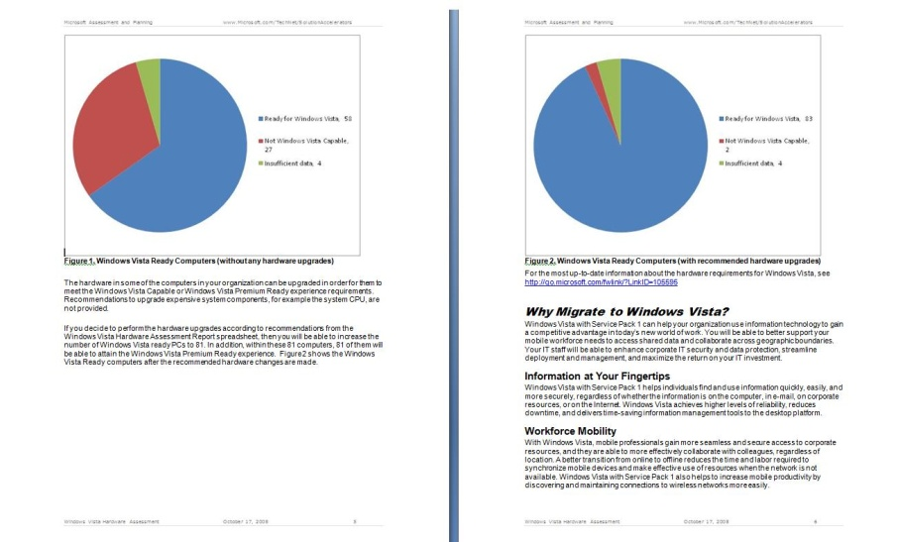


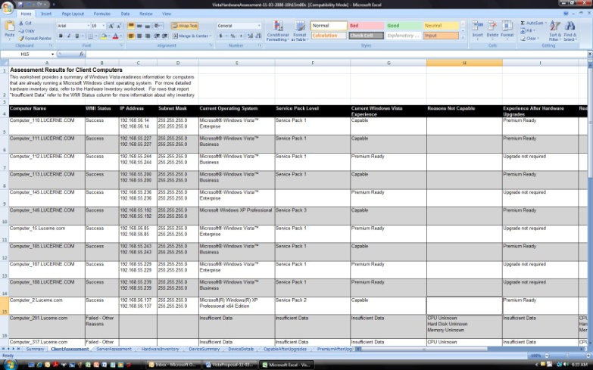
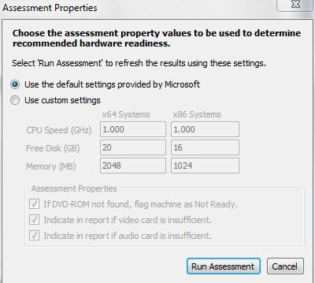
MAP: Windows 7
Proposals
Hardware
and Device Compatibility Assessment
Detailed Report
http://www.microsoft.com/MAP

Slide 32
MAP Reports And Proposals
Olav Tvedt
Deployment Ranger
EDB Ergogroup
demo

Slide 33
Application Compatibility Toolkit
Tools To:
- Check Application, Device And Computer Compatibility
- Check Internet Explorer Compatibility
- Shim Applications
- Much more..
Includes
- Application Compatibility Manager
- Compatibility Administrator
- Standard User Analyser
- Internet Explorer Compatibility Tester

Slide 34
Using ACT
Olav Tvedt
Deployment Ranger
EDB Ergogroup
demo
http://support.microsoft.com/kb/2533953 For Service Pack 1

Slide 35
Taking Care Of User Data
Manual
- File Copy
- Windows Easy Transfer
Folder Redirection
- Group Policy
User State Migration Toolkit
- Windows Automated Installation Kit
- Automatic With MDT Or SCCM

Slide 36
Using USMT
Olav Tvedt
Deployment Ranger
EDB Ergogroup
demo

Slide 37
Deployment Tools
Windows Deployment Services (WDS)
- Built-in Feature Of Windows 2008 And Newer
Microsoft Deployment Toolkit (MDT)
- Free Download
Windows Automated Installation Kit
- Free Download
System Center Configuration Manager (SCCM)
- Licensed
- Can (Should) Be Extended With MDT

Slide 38
Keeping The Deployment Time Down And Security Up
Selecting The Right Type Of Image
- Thin
- Thick
- In-between
Basic Rule Of Safety
- Never Give A User Unpatched Computers
- Never Put An Unpatched Computer On The Network
Patching Must Be A Part Of The Deployment Process

Slide 39
Keeping The Deployment Time Down And Security Up
Patching During Installation = Longer Deployment Time
Longer Deployment Time = Unhappy Users
Pre Patched Images = Shorter Deployment Time
Shorter Deployment Time = Happy Users
How To Pre Patch:
- Virtual Computer As Master Images
- DISM
- Scripts

Slide 40
Offline Patching With DISM
Olav Tvedt
Deployment Ranger
EDB Ergogroup
demo

Slide 41
DISM CODES USED
dism /mount-wim /wimfile:C:\wim\boot.wim /index:1 /mountdir:C:\win7-Wim-update
Dism /image:C:\win7-Wim-update /Add-Package /PackagePath:C:\Win7-updates /IgnoreCheck
dism /unmount-wim /mountdir:C:\win7-Wim-update /commit

Slide 42
End Results For Microsoft Norway
64% All Client Computers Are Now Running Windows 7
- 9 Of 13 Early Adapters Running 100 % Windows 7
- 4 Left Mainly Held Back By Branch Offices
Unique early insight into a broad set of customer challenges
Reference Cases Of All Types And Sizes
Partner Infrastructure Trained And Ready

Slide 43
End Result For Customers
Saved Money
Saved Time
Satisfied Users
Satisfied IT Workers
More Secure
A Great Support Tool Called “Reinstall”
Media coverage and positive brand building

Slide 44
Related Content
Required Slide
Speakers, please list the Breakout Sessions, Interactive Discussions, Labs, Demo Stations and Certification Exam that relate to your session. Also indicate when they can find you staffing in the TLC.
WCL301 | A Geek's Guide to Windows User State Migration Tool (USMT) 4.0
WCL401 | Inside Panther: Troubleshooting the Windows Setup Engine
WCL403 | Troubleshooting Windows 7 Deployments: In Depth
WCL304 | Case of the Unexplained 2011: Windows Troubleshooting with Mark Russinovich
Remember The Hands-On Labs!!!

Slide 45
Track Resources
Don’t forget to visit the Cloud Power area within the TLC (Blue Section) to see product demos and speak with experts about the Server & Cloud Platform solutions that help drive your business forward.
You can also find the latest information about our products at the following links:
Cloud Power - http://www.microsoft.com/cloud/
Private Cloud - http://www.microsoft.com/privatecloud/
Windows Server - http://www.microsoft.com/windowsserver/
Windows Azure - http://www.microsoft.com/windowsazure/
Microsoft System Center - http://www.microsoft.com/systemcenter/
Microsoft Forefront - http://www.microsoft.com/forefront/

Slide 46





Resources
  Connect. Share. Discuss.
http://northamerica.msteched.com
Learning
  Sessions On-Demand & Community
  Microsoft Certification & Training Resources
www.microsoft.com/teched
www.microsoft.com/learning
  Resources for IT Professionals
  Resources for Developers
http://microsoft.com/technet
http://microsoft.com/msdn

Slide 47












Complete an evaluation on CommNet and
enter to win!

Slide 48

Notes:
New for TechEd 2011, we will be working with Microsoft Tag (http://tag.microsoft.com/overview.aspx) to create unique Tags for every session at the event. Your session Tag will appear on both the room signage and at the end of your presentation. With your session Tag, attendees will be able to scan as they enter the room to retrieve session details, view speaker bios, and engage in discussions; or scan at the end of the presentation to evaluate your session and download materials. We’re excited to integrate Microsoft Tag across the My TechEd mobile experience this year.

