Slide 1
The Case of the Unexplained…
WCL304
Mark Russinovich
Technical Fellow
Windows Azure

Slide 2
Outline
Introduction
Sluggish Performance
Application Hangs
Error Messages
Malware
Blue Screens

Slide 3
Case of the Unexplained…
This is the 2011 version of the “case of the unexplained” talk series
  Previous versions covered different cases
    Can view webcast on Sysinternals->Mark’s webcasts
Based on real case studies
  Some of these have been written up on my blog

Slide 4
Troubleshooting
Most applications do a poor job of reporting unexpected errors
  Locked, missing or corrupt files
  Missing or corrupt registry data
  Permissions problems
Errors manifest in several different ways
  Misleading error messages
  Crashes or hangs

Slide 5
Purpose of Talk
Show you how to solve these classes of problems by peering beneath the surface
  Interpreting process, file and registry activity
  Interpreting call stacks
You’ll learn tools and techniques to help you solve seemingly unsolvable problems

Slide 6
Tools We’ll Use
Sysinternals: www.microsoft.com/technet/sysinternals (\\redmond\files\SYSINTERNALS\LBI\Latest)
  Process Explorer – process/thread viewer
  Process Monitor – file/registry/process/thread tracing
  Autoruns – displays all autostart locations
  SigCheck – shows file version information
  PsExec – execute processes remotely or in the system account
  TcpView – shows TCP/IP endpoints
  Strings – dumps printable strings in any file
  Zoomit – presentation tool I’m using
Microsoft downloads:
  Debugging Tools for Windows: Windbg application and kernel debugger: www.microsoft.com/whdc/devtools/debugging (//dbg)

Slide 7
Outline
Sluggish Performance
Application Hangs
Error Messages
Malware
Blue Screens

Slide 8
Process Explorer
Process Explorer is a Task Manager replacement
  You can literally replace Task Manager with Options->Replace Task Manager
Hide-when-minimized to always have it handy
  Hover the mouse to see a tooltip showing the process consuming the most CPU
Open System Information graph to see CPU usage history
  Graphs are time stamped with hover showing biggest consumer at point in time
  Also includes other activity such as I/O, kernel memory limits

Slide 9
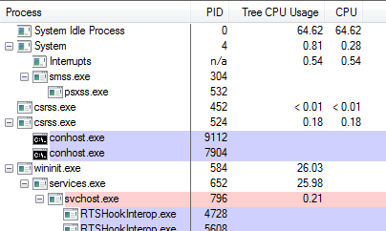
Process Explorer 2010 Updates
Versions 12 and 14 included many enhancements, big and small:
  Network and disk
  activity
  Multi-tab system
  information
  Tree CPU usage
  Improved DLL scanning algorithm
  Command-lines in process tooltips
  Svchost information
  Service threads
  .NET assembly information
  Support for > 64

Slide 10
More precise CPU accounting
Task Manager, Resource Monitor and older Process Explorer versions use time-slice accounting
  Whatever thread is executing at a timer tick (typically 15.6ms) is charged for the entire time slice
  Charge is kernel mode if thread is in kernel mode, user mode for user mode
Process Explorer v14.1 uses cycle counts
  Full cycle count usage on Win7/Server 2008 R2 because of new API
  On Vista uses cycle counts to detect < time slice
  On XP, uses context switches to detect < time slice
Sub 0.01 usage is shown as < 0.01

Slide 11

The Case of the Slow Website
Users reported that web sites were slow on one of their webfarm nodes
Administrator started by running Process Explorer
  Noticed that System process was spiking to 25% (1 of 4 cores)
Needed to look deeper…

Slide 12
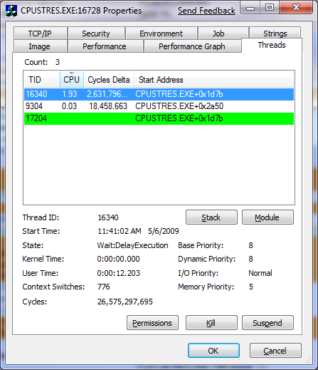
Viewing Threads
Task Manager doesn’t show thread details within a process
Process Explorer does on “Threads” tab
Displays thread details such as ID, CPU usage, start time, state, priority
Start address is where the thread began running (not where it is now)
Click Module to get details on module containing thread start address

Slide 13
Thread Start Functions and Symbol Information
Process Explorer can map the addresses within a module to the names of functions
  This can help identify which component within a process is responsible for CPU usage
Configure Process Explorer’s symbol engine:
  Download the latest Debugging Tools for Windows from Microsoft (free)
  Use dbghelp.dll from the Debugging Tools
  Point at the Microsoft public symbol server (or internal symbol
  server if you have access)

Slide 14
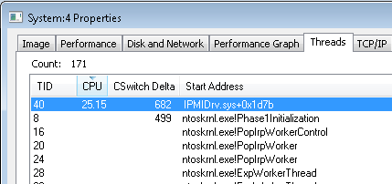
The Case of the Slow Website (Cont)
Opened threads tab for system process and saw IPMIDrv.sys consuming CPU:

Slide 15
The Case of the Slow Website: Solved
Researched IPMIDrv.sys: “Intelligent Platform Management Interface” (Microsoft Windows driver)
  Sends monitoring information to Baseboard Management Controller (BMC)
  No updates or fixes
  IPMI data goes through Dell Remote Access Controller (DRAC), which acts as the BMC, to the Chassis Management Controller (CMC)
Checked DRAC status and it showed blade was not connected to the CMC
Reseated blade: problem solved

Slide 16
The Case of the Exchange CPU Spikes
Users complained about sporadic sluggish email
  10-30 second pauses
  Multiple users at different hours
Microsoft Support asked the customer to collect the ‘% Processor Time’ performance counter at 5-second
samples for 24 hours

Slide 17
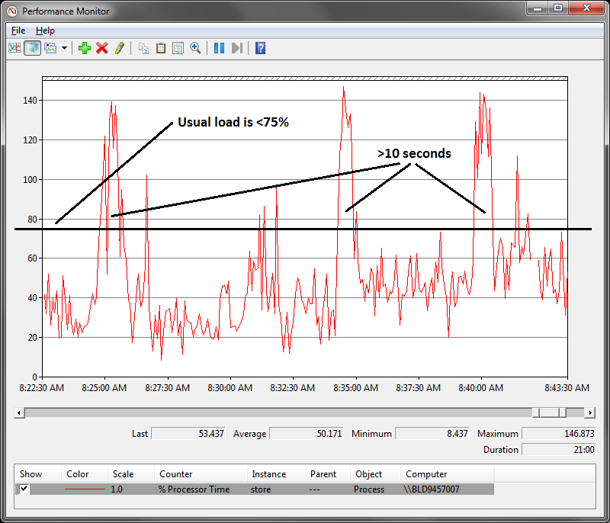
The Case of the Exchange CPU Spikes (Cont)
Analysis of the data revealed:
  Typical CPU usage of < 75% (relative to a single core)
  Average spike lasted around 10 seconds
Needed to capture dump of Store.exe during CPU spike..

Slide 18
Procdump
Utility to capture process dumps
Multiple triggers:
  CPU usage
  Private memory usage
  1st and 2nd-chance exceptions
  Hung windows
  Performance counters
  Just get a dump
Supports process reflection (Win7/Server 2008 R2)

Slide 19
The Case of the Exchange CPU Spikes (Cont)
Had customer run Procdump to capture dumps at
the spikes:
procdump -n 20 -s 10 -c 75 -u store.exe c:\dumps\store_75pc_10sec.dmp
  -n: Capture 20 dumps
  -s: Spike must last at least 10 seconds
  -c: Spike must exceed 75%
  -u: Spike CPU usage is relative to one core

Slide 20
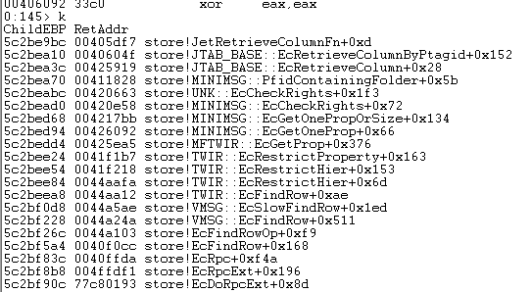
The Case of the Exchange CPU Spikes (Cont)
Opened each minidump in WinDbg and looked at stack of busy thread
  The default thread context is the busiest thread
  Found most common stack pointed at Store!EcFindRow:
Theory was that long searches result of large mailboxes

Slide 21
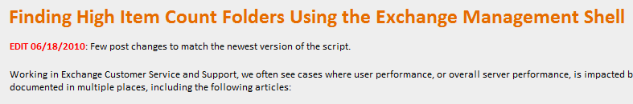
The Case of the Exchange CPU Spikes: Solved
Had customer follow this Exchange blog post:
  http://msexchangeteam.com/archive/2009/12/07/453450.aspx
Got an item count of all mailbox folders
  Asked high Item Count users to reduce the number of messages in identified folders
No more CPU spikes: problem solved

Slide 22
Outline
Sluggish Performance
Application Hangs
Error Messages
Application Crashes
Blue Screens

Slide 23
Process Monitor
Process Monitor is a real-time file, registry, process and thread monitor
  Works on Windows XP and higher, including 64-bit Windows
  It replaces Filemon and Regmon, but you can use Filemon and Regmon on older operating systems
  Enhancements over Filemon/Regmon include:
    More advanced filtering
    Operation call stacks
    Boot-time logging
    Data mining views
    Process tree to see short-lived processes
When in doubt, run Process Monitor!
  It will often show you the cause for error messages
  It many times tells you what is causing sluggish performance

Slide 24
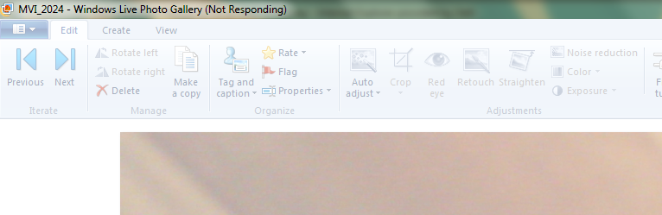
The Case of the Photogallery Hangs
Windows Live Photogallery hung after watching a movie:
Process Explorer threads view didn’t reveal any clues
When in doubt, run Process Monitor!
Restarted Photogallery and captured a Process Monitor trace of first movie playback

Slide 25
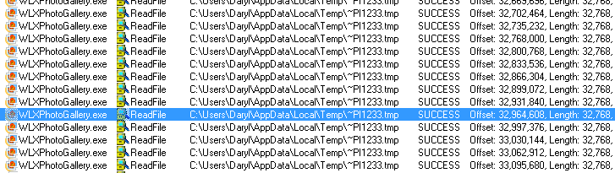
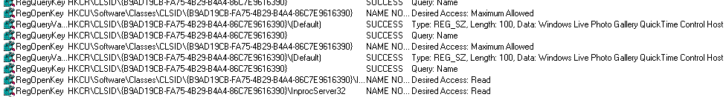
The Case of the Photogallery Hangs (Cont)
Set a filter for “photogallery” and worked backwards from end of log
Last several thousand operations were unrelated background operations:
Then came across references to COM object:

Slide 26
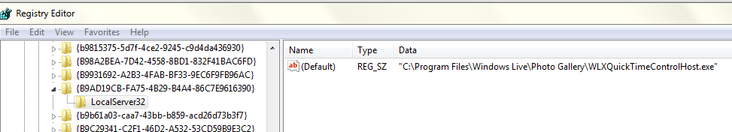
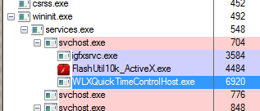
The Case of the Photogallery Hangs (Cont)
Did a “Jump To” to go to the COM object’s registry settings
  Saw that host image was WLXQuickTimeControlHost.exe:
Process was still running:

Slide 27
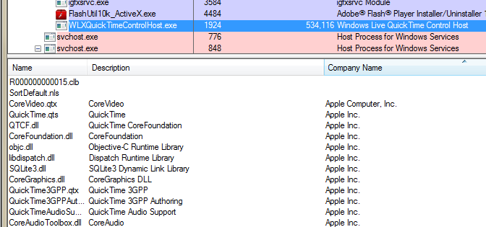
The Case of the Photogallery Hangs (Cont)
Terminated WLXQuickTimeControlHost: Photogallery unfroze
  But, after playing the movie again, hang reproduced
  Again, terminating WLXQuickTimeControlHost unfroze
Looked at what was loaded in host and saw lots of Apple Quicktime DLLs:
Reinstalled Quicktime: Problem solved

Slide 28
Outline
Sluggish Performance
Application Hangs
Error Messages
Application Crashes
Blue Screens

Slide 29
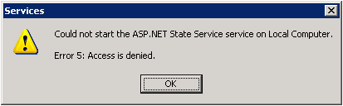
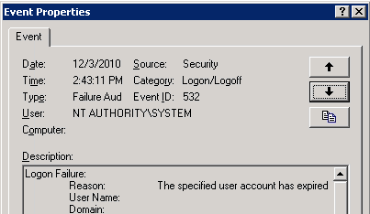
The Case of the Failed ASP.NET Startup
ASP.NET State Service failed to start:
Event log showed this error:
Admin checked Kerberos settings, account, etc.: no problems

Slide 30

The Case of the Failed ASP.NET Startup (Cont)
Admin captured a Process Monitor trace of the service startup
  Set a filter for Services.exe
  Searched for “denied” and found two entries:

Slide 31
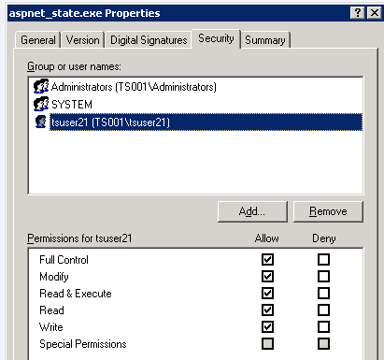
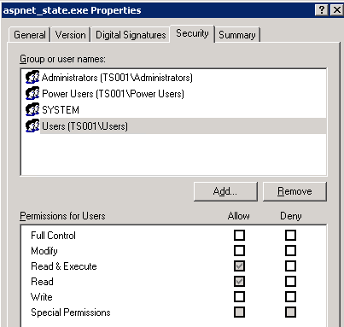
The Case of the Failed ASP.NET Startup: Solved
Permissions on file were modified from defaults:
Fixed permissions: problem solved
Actual Permissions
Default Permissions

Slide 32
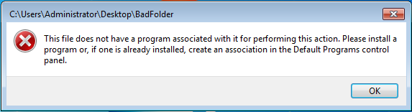
The Case of the Folders That Wouldn’t Open
User got an error trying to open any folder in Explorer:
Decided to capture Process Monitor trace and compare with one from another system not experiencing the problem
  Set filter for just Explorer activity to get rid of noise

Slide 33
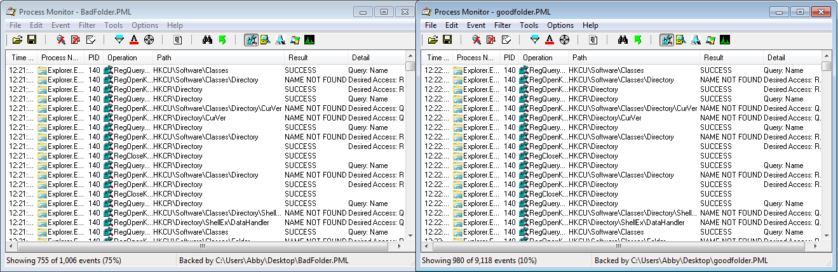
The Case of the Folders That Wouldn’t Open (Cont)
Found common reference point and excluded preceding entries:

Slide 34


The Case of the Folders That Wouldn’t Open: Solved
Found reference to Registry value missing in broken system and present in working one:
Exported value and imported it on broken system: problem solved
Broken System
Working System

Slide 35
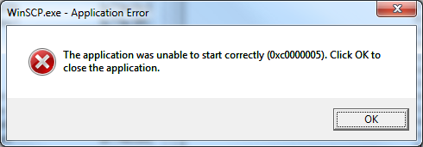
The Case of the WinSCP Error
Administrator tried to copy firmware files to VMWare ESX server using WinSCP (freeware FTP client), but got an error:
Having seen a “Case of the Unexplained” talk, he immediately captured a Process Monitor trace

Slide 36
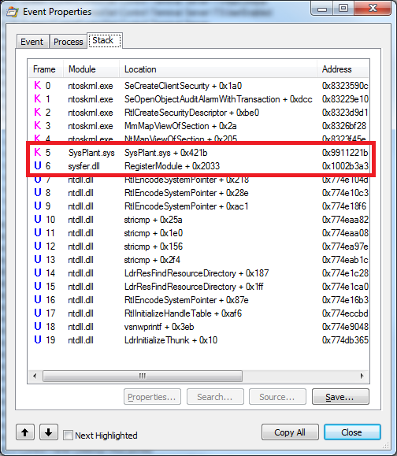
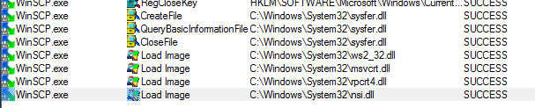
The Case of the WinSCP Error (Cont)
Set an include filter for winscp.exe, which left 200 events
  Nothing stood out
Looked at the stack of the
last operation
  Saw two suspicious modules

Slide 37
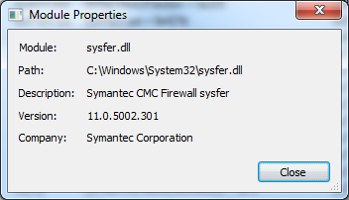
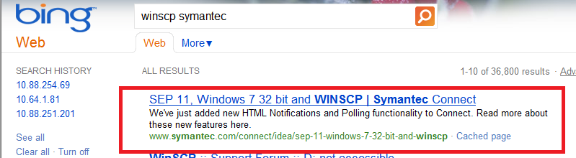
The Case of the WinSCP Error: Solved
Looked at file properties for the DLLs and both were Symantec:
Bing search lead to post that described the problem and pointed at an update that fixed it

Slide 38
Outline
Sluggish Performance
Application Hangs
Error Messages
Malware
Blue Screens

Slide 39
The Case of the Sysinternals-Blocking Malware
Friend asked user to take a look at system suspected of being infected with malware
  Boot and logons took a long time
  Microsoft Security Essentials (MSE) malware scan would never complete
  Nothing jumped out in Task Manager
Tried running Sysinternals tools, but all exited immediately after starting:
  Autoruns
  Process Monitor
  Process Explorer
  Even Notepad opening a text file named “Process Explorer” would also terminate

Slide 40
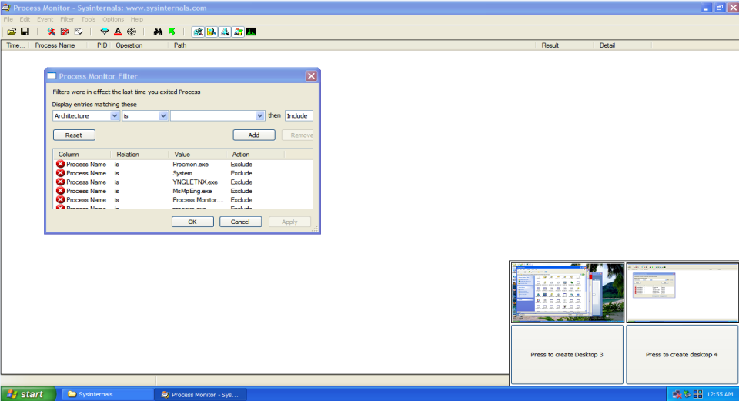
The Case of the Sysinternals-Blocking Malware (Cont)
Looking through Sysinternals suite, noticed Desktops utility
  Hoped malware might not be smart enough to monitor additional desktops
Sure enough, was able to launch Process Monitor and other tools:
  Malware probably
  looks for tools in
  window titles
  Window enumeration
  only returns windows
  of current desktop

Slide 41
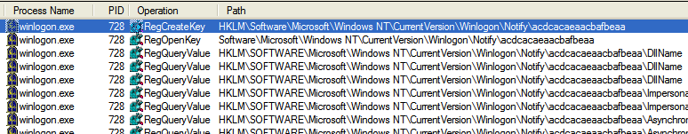

The Case of the Sysinternals-Blocking Malware (Cont)
Nothing suspicious in Process Explorer
Next, ran Process Monitor
  Noticed a lot of Winlogon activity, so set a filter to include it
  Could see a once-per-second check of a strange key:
Saw name of random DLL in the key:

Slide 42
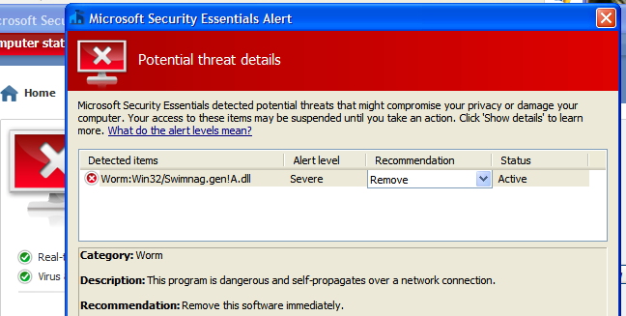
The Case of the Sysinternals-Blocking Malware: Solved
Tried deleting the key, but after refreshing it was back
Went back to MSE and directed it to scan just the random DLL image file on disk:
After clean, was able to delete Registry key and system was back to normal: problem solved

Slide 43
Outline
Sluggish Performance
Application Hangs
Error Messages
Malware
Blue Screens

Slide 44
Blue Screen Crashes
Windows has various components that run in Kernel Mode, the highest privilege mode of the OS
  OS components: Ntoskrnl.exe, Hal.dll
  Drivers: Ntfs.sys, Tcpip.sys, device drivers
Kernel-mode components are privileged extensions to the OS have to adhere to various rules
  Not accessing invalid memory
  Accessing memory at the right “Interrupt Request Level”
  Not causing resource deadlocks
When a kernel-mode component performs an illegal operation, Windows crashes (blue screens)
  Crashing helps preserve the integrity of user data
  A resource deadlock can hang the system

Slide 45
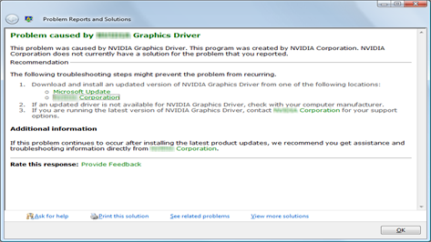
Online Crash Analysis
When you reboot after a crash, Windows offers to upload it to Microsoft Online Crash Analysis (OCA)
  Automated server generates a thumbprint of the crash and uses it as a key in a database
  If the database has an entry, the user is told the cause and directed at a fix

Slide 46
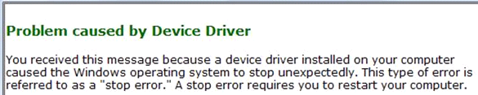
Basic Crash Dump Analysis
Many times OCA doesn’t know the cause:
Basic crash dump analysis is easy and it might tell you the cause
  Requires Windbg and symbol configuration
  Dump files are in either:
    \Windows\Memory.dmp: Vista+ and servers
    \Windows\Minidump: Windows 2000 Pro, Windows XP, Vista+

Slide 47
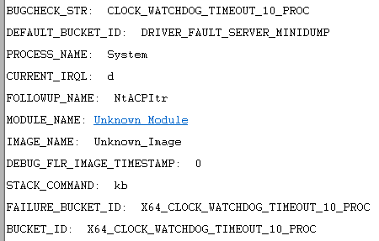
The Case of the Hyper-V Crashes
Server experienced 3 crashes within a couple of days
Administrator saw “Case of the Unexplained” so opened a dump

Slide 48
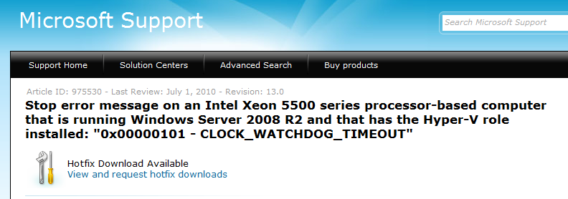
The Case of the Hyper-V Crashes: Solved
Did a Web search for “x64 clock watchdog timeout” and found a hotfix for Xeon servers running Hyper-V:
Applied hotfix: problem solved

Slide 49
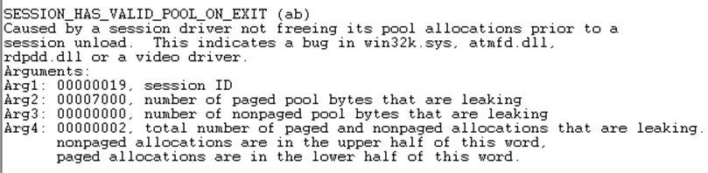
The Case of the Crashing Citrix Server Farm
Citrix servers were sporadically crashing
Administrator saw a “Case of the Unexplained” and decided to investigate
Crash dump didn’t reveal anything:

Slide 50
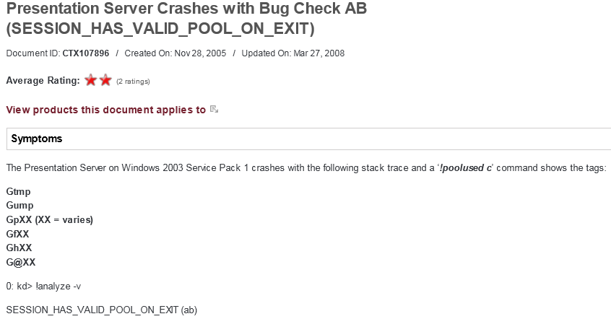
The Case of the Crashing Citrix Server Farm: Solved
Did a Web search for “session_has_valid_pool_on_exit and citrix”:
Downloaded and installed hotfix: problem solved

Slide 51
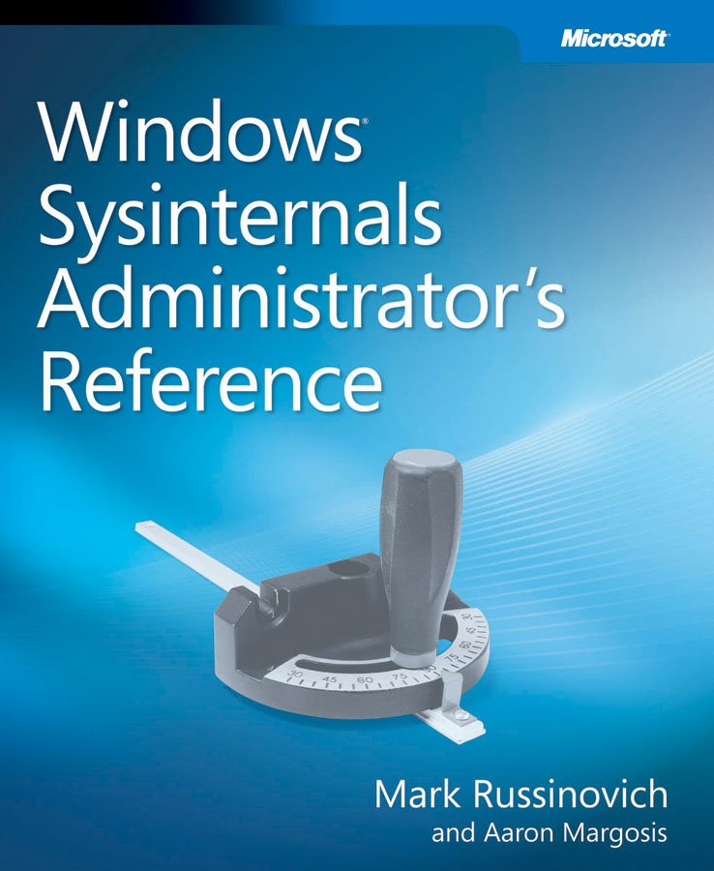
The Sysinternals Administrator’s Reference
The official guide to the Sysinternals tools
  Covers every tool, every feature, with tips
  Written by markruss and aaronmar
  Available in June
Full chapters on the major tools:
  Process Explorer
  Process Monitor
  Autoruns
Other chapters by tool group
  Security, process, AD, desktop, …

Slide 52
Summary and More Information
A few basic tools and techniques can solve seemingly impossible problems
  I learn by always trying to determine the root cause
Resources:
  Sysinternals Administrator’s Reference
  Webcasts of two previous “Case of the Unexplained “ talked
    Sysinternals->Mark’s Webcasts
  My blog
  Windows Internals: understand the way the OS works
If you’ve solved one, send me a description, screenshots and log files!

Slide 53

Track Resources
Don’t forget to visit the Cloud Power area within the TLC (Blue Section) to see product demos and speak with experts about the Server & Cloud Platform solutions that help drive your business forward.
You can also find the latest information about our products at the following links:
Cloud Power - http://www.microsoft.com/cloud/
Private Cloud - http://www.microsoft.com/privatecloud/
Windows Server - http://www.microsoft.com/windowsserver/
Windows Azure - http://www.microsoft.com/windowsazure/
Microsoft System Center - http://www.microsoft.com/systemcenter/
Microsoft Forefront - http://www.microsoft.com/forefront/

Slide 54





Resources
  Connect. Share. Discuss.
http://northamerica.msteched.com
Learning
  Sessions On-Demand & Community
  Microsoft Certification & Training Resources
www.microsoft.com/teched
www.microsoft.com/learning
  Resources for IT Professionals
  Resources for Developers
http://microsoft.com/technet
http://microsoft.com/msdn

Slide 55












Complete an evaluation on CommNet and
enter to win!

Slide 56


