Slide 1

Touch Me, Stretch Me, Squeeze Me
The Windows 7 WPF Multi-Touch Story
WCL314
Guy Smith-Ferrier
Technical Architect
@GuySmithFerrier

Slide 2
Agenda
Good, Better, Best
What you need to get started
Manipulation API
Raw touch API
Surface Toolkit For Windows Touch

Slide 3
Good, Better, Best
Good (e.g. calc.exe, any regular WPF app)
Better (e.g. Windows 7, Paint)
Best (e.g. Microsoft Surface Collage,
Microsoft Surface Lagoon)

Slide 4
Microsoft Touch Pack For Windows 7
Free download from Microsoft including:-
  Microsoft Blackboard
  Microsoft Garden Pond
  Microsoft Rebound
  Microsoft Surface Globe
  Microsoft Surface Collage
  Microsoft Surface Lagoon
Videos of all applications in use
  http://windows7center.com/news/windows-7-touch-pack/

Slide 5
What You Need To Get Started
Either:-
  a multi-touch laptop/desktop
Or:-
  a regular laptop/desktop
Windows 7
Visual Studio 2010
'Optionally'
  Surface Toolkit For Windows Touch
  Surface SDK

Slide 6
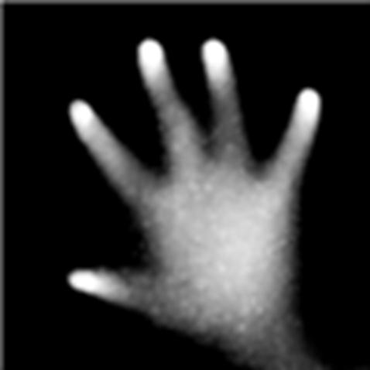
Simulating Multi-Touch
Multi-Touch Vista
  http://multitouchvista.codeplex.com
Works with Windows
Vista and Windows 7
Emulates multi-touch
using multiple mice

Slide 7
Getting Started with the Manipulation API
Guy Smith-Ferrier
Technical Architect
@GuySmithFerrier
demo

Slide 8
Touch Comparison With Mouse
Touch Event | Mouse Event
TouchDown | MouseDown
PreviewTouchDown | PreviewMouseDown
TouchMove | MouseMove
PreviewTouchMove | PreviewMouseMove
TouchUp | MouseUp
PreviewTouchUp | PreviewMouseUp
TouchEnter | MouseEnter
TouchLeave | MouseLeave
GotTouchCapture | GotMouseCapture
LostTouchCapture | LostMouseCapture

Slide 9
Getting Started with the
Raw Touch API
Guy Smith-Ferrier
Technical Architect
@GuySmithFerrier
demo

Slide 10
Surface Toolkit For Windows Touch
Download from:-
  http://www.microsoft.com/downloads/details.aspx?FamilyID=801907A7-B2DD-4E63-9FF3-8A2E63932A74&displaylang=en&displaylang=en
Includes:-
  Replacement controls that understand multi-touch
  New controls that are appropriate for multi-touch
  Touch visualizations (auras, trails and tethers)
  Drag and drop framework for multi-touch
Not available for Silverlight

Slide 11
Surface Toolkit Traditional Controls Comparison
WPF Control | Surface Toolkit Control
Window | SurfaceWindow
Button | SurfaceButton
CheckBox | SurfaceCheckBox
InkCanvas | SurfaceInkCanvas
ListBox | SurfaceListBox
ListBoxItem | SurfaceListBoxItem
RadioButton | SurfaceRadioButton
ScrollViewer | SurfaceScrollViewer
Slider | SurfaceSlider
TextBox | SurfaceTextBox

Slide 12
Surface Toolkit Traditional Controls
Guy Smith-Ferrier
Technical Architect
@GuySmithFerrier
demo

Slide 13
Surface Toolkit ScatterView and Library Controls
Guy Smith-Ferrier
Technical Architect
@GuySmithFerrier
demo

Slide 14
Information Resources
Natural User Interfaces in .NET, Joshua Blake, Manning (due Summer 2011)
Developing for Microsoft Surface, Dr. Neil Roodyn
  ebook available from http://www.nsquaredsolutions.com/surfacebook
Microsoft Surface Design and Development Training videos
  http://www.microsoft.com/surface/en/us/Pages/Technical/Training.aspx

Slide 15
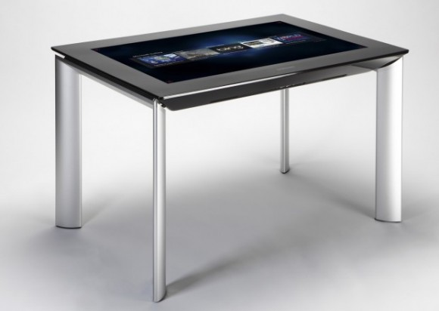
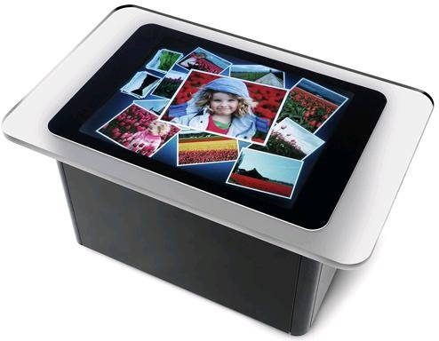
Microsoft Surface 2.0
Uses PixelSense
  4" thick
Runs on Windows 7
Surface 2 SDK to be
released in 2011
Samsung SUR40 costs $7600

Slide 16
Free Surface 2 Controls
As soon as the Surface 2 SDK is released InfoStrat will release free "Data Visualization Controls"
  DeepZoom
  PowerPoint Viewer
  PivotViewer
  PhysicsCanvas
Watch a video:-
  http://www.youtube.com/watch?v=lEVtjHlrf4I

Slide 17
Summary
If you do nothing touch is promoted to mouse
There are two touch APIs for WPF:-
  Manipulation API for high level
  Raw Touch API for low level
Use the Surface Toolkit for most of the application
Use the APIs for building user controls and customized behaviour

Slide 18

Track Resources
Don’t forget to visit the Cloud Power area within the TLC (Blue Section) to see product demos and speak with experts about the Server & Cloud Platform solutions that help drive your business forward.
You can also find the latest information about our products at the following links:
Cloud Power - http://www.microsoft.com/cloud/
Private Cloud - http://www.microsoft.com/privatecloud/
Windows Server - http://www.microsoft.com/windowsserver/
Windows Azure - http://www.microsoft.com/windowsazure/
Microsoft System Center - http://www.microsoft.com/systemcenter/
Microsoft Forefront - http://www.microsoft.com/forefront/

Slide 19





Resources
  Connect. Share. Discuss.
http://northamerica.msteched.com
Learning
  Sessions On-Demand & Community
  Microsoft Certification & Training Resources
www.microsoft.com/teched
www.microsoft.com/learning
  Resources for IT Professionals
  Resources for Developers
http://microsoft.com/technet
http://microsoft.com/msdn

Slide 20












Complete an evaluation on CommNet and
enter to win!

Slide 21


