Slide 1

Introduction to Internet Explorer 9
WCL 319
Anurag Pandit
Product Manager
Microsoft

Slide 2



fast clean trusted interoperable
IT friendly

Slide 3
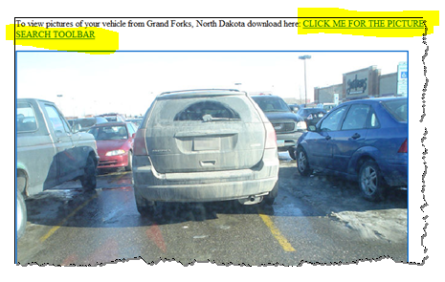
Socially Engineered Threats
  “PARKING VIOLATION: This vehicle is in violation of standard parking regulations.
  To view pictures with information about your parking preferences, go to website …”

Slide 4
Browser Features
demo

Slide 5

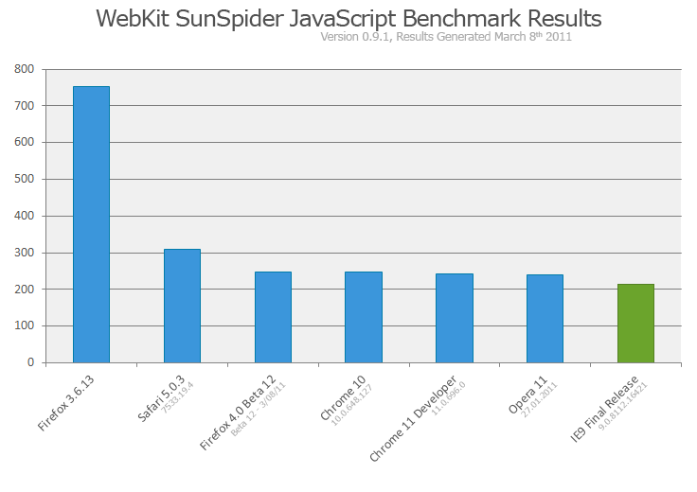
All Around Fast
Using the power of your whole PC
Focus is on making the real world sites fast

Slide 6
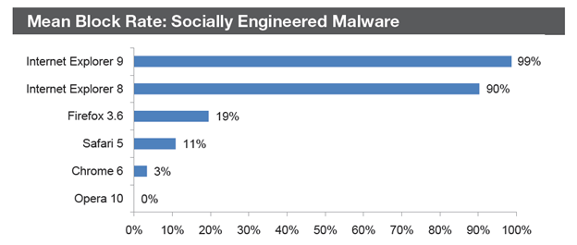
Trusted
Secure, reliable and private

Slide 7

Interoperable
Enabling “same markup”
The HTML
Working Group
411 group participants
40 W3C
Member Organizations
280 Invited experts
9 Mailing lists
4000 emails on public-html

Slide 8
IT Features

Slide 9










Windows Internet Explorer 9 and the Optimized Desktop
  Make People Productive Anywhere
  Enhanced Security & Protection
Data
Search Accelerators
Web Slices
Settings
Roaming User Profiles
Architectural Changes
Protected Mode/DEP/NX
Better Reliability
Crash isolation
Applications
Built-in Remote Desktop Services
End-User Protection
SmartScreen Filter, InPrivate Browsing
  Reduce Costs by Streamlining PC Management
Unparalleled Manageability
1,500+ group policy settings
Single Sign On Support, Slipstreaming, IEAK

Slide 10














Internet Explorer Migration Process
Inventory
Prioritize
Test & Mitigate
Virtualize
What do
we have?
What do
we need?
How do
we get there?
Can I
virtualize?

Slide 11
Application Compatibility
demo

Slide 12
Compatible
Document modes allow flexibility
If deployed browser is | Default doc mode for Intranet* | Developer choice via X-UA-Compatible tag | Default doc mode for Internet* | Developer choice via X-UA-Compatible tag
Internet Explorer 7 | IE7 standards | -- | IE7 standards | --
Internet Explorer 8 | IE7 standards | IE8 standards | IE8 standards | IE7 standards
Internet Explorer 9 | IE7 standards | IE8 or IE9 standards | IE9 standards | IE7 or IE8 standards
* Applies if Quirks mode is not specified via site DOCTYPE.
Read more about how Internet Explorer determines doc mode.

Slide 13
Configure and Manage
Many options available using IEAK9, Unattended Install, and Group Policy
You can pin sites to the Windows 7 Taskbar in the
standard IT Windows image
You can set your user’s homepage and new
tab page to an intranet portal
You can direct users to an internal IT help site when
they go to the Help Menu
You can specify a policy list of sites you want to be
displayed in Compatibility View mode

Slide 14
Deploy and Update
The Optimized Desktop infrastructure
Deploy
Use Active Directory, Windows Server Update Services (WSUS),
System Center Configuration Manager (SCCM), or Systems
Management Server (SMS) to deploy alongside Windows
Slipstream
Add Internet Explorer 8 or 9 onto your existing Windows Vista or
Windows 7 image using the Windows Automated Installation Kit (WAIK)
and Microsoft Deployment Toolkit (MDT)
Update
Updates managed through standard Windows update processes
to keep Internet Explorer is up-to-date

Slide 15
Management Features
demo

Slide 16
Best Practices and Key Learning from
Early Enterprise Adopters
Consider end-user education for the new browser interface
Remember these best practices for application migration
Understand the top troubleshooting issues
Learn more about Internet Explorer 9 deployment and application compatibility

Slide 17
Value Prop

Slide 18
Windows 7 and Internet Explorer
Deployment Guidance
Explore
Plan/Test
Explore
Plan/Test
Pilot
Deploy
Switch to deploying
Internet Explorer 9 with Windows 7
  If you are starting your Windows 7 migration planning …
  Make Internet Explorer 9 a part of your formal deployment plans instead of Internet Explorer 8
  If you are doing application testing for your Windows 7 and Internet Explorer 8 migration …
  Make Internet Explorer 9 part of the formal deployment plans instead of Internet Explorer 8

Slide 19
Windows 7 and Internet Explorer
Deployment Guidance
Explore
Plan/Test
Pilot
Deploy
Pilot
Deploy
Continue Windows 7 with Internet Explorer 8
Add Pilot for Internet Explorer 9
  If you are well underway with your Windows 7 and Internet Explorer 8 deployment …
  Continue with your deployment, so your business can realize the benefits of Windows 7 and Internet Explorer 8 immediately.
  In parallel, pilot Internet Explorer 9, and make Internet Explorer 9 part of your longer term desktop strategy. Your investment in testing and deploying Internet Explorer 8 today will carry forward for your future Internet Explorer 9 deployment, given the high degree of compatibility between Internet Explorer 8 and Internet Explorer 9.

Slide 20

Related Content – Sessions
Required Slide
Speakers, please list the Breakout Sessions, Interactive Discussions, Labs, Demo Stations and Certification Exam that relate to your session. Also indicate when they can find you staffing in the TLC.
WCL318 | Windows 7 and Windows Internet Explorer Readiness Assessment with Microsoft Assessment and Planning (MAP) 5.5 Toolkit
Wednesday, May 18 | 8:30 AM - 9:45 AM | Room: B407
WCL214 | Windows Internet Explorer 9 in the Enterprise - Breakout Session
Thursday, May 19 | 8:30 AM - 9:45 AM | Room: B309
WCL315 | Troubleshooting Application Compatibility Issues with Windows Internet Explorer 9
Thursday, May 19 | 1:00 PM - 2:15 PM | Room: B103
DEV332 - Enhancing Pinned Sites with Windows Internet Explorer 9
Thursday, May 19 | 4:30 PM - 5:45 PM | Room: B314

Slide 21
Related Content – Hands On Labs
Required Slide
Speakers, please list the Breakout Sessions, Interactive Discussions, Labs, Demo Stations and Certification Exam that relate to your session. Also indicate when they can find you staffing in the TLC.
WCL379-HOL | Windows 7 and Windows Internet Explorer Readiness Assessment with Microsoft Assessment and Planning (MAP) 5.5 Toolkit
WCL373-HOL | Windows Internet Explorer Application Compatibility
WCL384-HOL | Establishing Security Baselines for Windows
Internet Explorer
WCL385-HOL | Deploying Windows Internet Explorer 9

Slide 22
Track Resources
Don’t forget to visit the Cloud Power area within the TLC (Blue Section) to see product demos and speak with experts about the Server & Cloud Platform solutions that help drive your business forward.
You can also find the latest information about our products at the following links:
Cloud Power - http://www.microsoft.com/cloud/
Private Cloud - http://www.microsoft.com/privatecloud/
Windows Server - http://www.microsoft.com/windowsserver/
Windows Azure - http://www.microsoft.com/windowsazure/
Microsoft System Center - http://www.microsoft.com/systemcenter/
Microsoft Forefront - http://www.microsoft.com/forefront/

Slide 23





Resources
  Connect. Share. Discuss.
http://northamerica.msteched.com
Learning
  Sessions On-Demand & Community
  Microsoft Certification & Training Resources
www.microsoft.com/teched
www.microsoft.com/learning
  Resources for IT Professionals
  Resources for Developers
http://microsoft.com/technet
http://microsoft.com/msdn

Slide 24












Complete an evaluation on CommNet and
enter to win!

Slide 25


Slide 26

© 2011 Microsoft Corporation. All rights reserved. Microsoft, Windows, Windows Vista and other product names are or may be registered trademarks and/or trademarks in the U.S. and/or other countries.
The information herein is for informational purposes only and represents the current view of Microsoft Corporation as of the date of this presentation. Because Microsoft must respond to changing market conditions, it should not be interpreted to be a commitment
on the part of Microsoft, and Microsoft cannot guarantee the accuracy of any information provided after the date of this presentation. MICROSOFT MAKES NO WARRANTIES, EXPRESS, IMPLIED OR STATUTORY, AS TO THE INFORMATION IN THIS PRESENTATION.

