Slide 1
Deploying Windows Phone 7 in the Enterprise
WPH301
Darren Hall
Microsoft Services – Mobility Architect

Slide 2
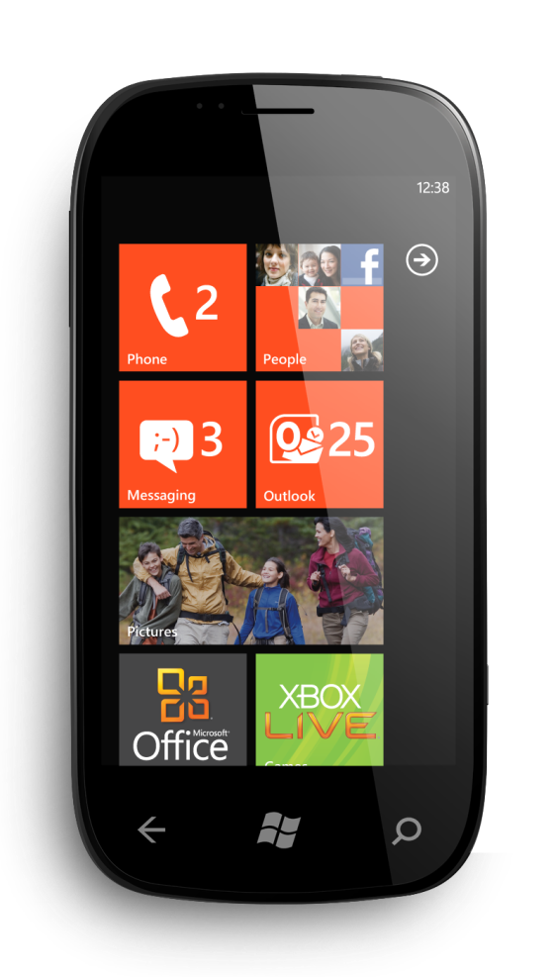
During this Session
You have a Chance to
Win a Windows Phone
announcement

Slide 3
Agenda
Overview
Roadmap for Business
Risk Management (security model, application security, security management)
Deploying Windows Phone 7 with Exchange Server
Device Management (EAS support to configure the device by Exchange Server)
SharePoint and Windows Phone 7, UAG
LOB Application Options (distribution, data encryption, and authentication)
Windows Phone 7 Updates

Slide 4















Addressing Business Organizations’ Needs
Captivating and Productive Experiences
Works with Existing Infrastructure
Powerful
Platform for Solutions

Slide 5


Windows® Phone Roadmap for Business
TODAY
2011
A phone end
users want
Take advantage of
the enterprise cloud
Compelling end user experiences
Innovative productivity
New application platform
Extended productivity scenarios – Lync and Office 365
Enable new application categories – background processing, IE9/HTML5, and SQL
Data leak prevention – IRM
Geographic expansion
Spring update
CDMA – Verizon and Sprint
Exchange 2003 GAL lookup

Slide 6
Risk Management with
Windows Phone

Slide 7
Protection of Data at Rest
Preventing access to confidential information
by a 3rd party
GOAL
This is normally achieved by device lock, remote wipe and encryption of the data
CONTROLS
Lack of manageability and key exposure
WEAKNESSES

Slide 8
Windows Phone Storage
Single partition HD model files system
SD cards are locked via a standard SD card lock mechanism
Unique 128-bit key pairs the SD card to the phone
Removing the card will reset the phone and wipe all data
Access to the SD card is prevented from any another device
SD controller on the card will prevent access to the card unless the correct 128-bit password is supplied

Slide 9
Windows Phone Data Protection
Device Lock
Using simple PIN or alphanumeric password
Manageable with Exchange ActiveSync
Remote Wipe
Mechanisms to help protect data
SD card is secured via the standard SD lock mechanism
Files system spans the device flash and the SD card
No phone file system access from a PC or a 3rd party app running on the phone
Zune software does not sync of documents or e-mail
Data leak prevention with IRM e-mail and RMS

Slide 10
Malware Protection
Preventing malware tools to highjack the system or access data
GOAL
This is normally achieved by certification and anti-malware service
CONTROLS
Jailbreak, verifiability, and time sensitive
WEAKNESSES

Slide 11
Windows Phone Malware Protection
Application model
Managed code only with API control
Application sandboxing and least privileged model
Location policy control
No side loading and no jailbreak
Controlled background processing of applications
Marketplace
Developer verification and application certification
Internet Explorer Mobile Lock Down
Windows Phone update

Slide 12
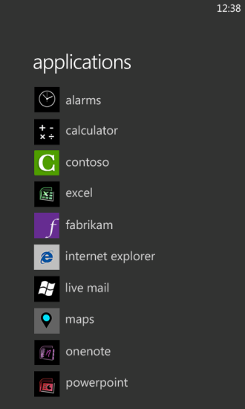
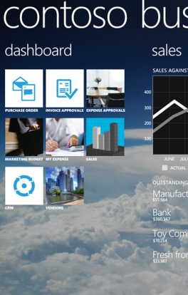




App Lifecycle
.xap
.dll
Windows Phone Marketplace
Phone only installs .xap packages signed by marketplace
Phone handles all aspects of .xap installation based on the manifest
Individual apps cannot make arbitrary changes to the phone during installation
Users control install, update, and uninstall, while the marketplace controls revocation
Individual apps do not control their own lifecycle on the phone

Slide 13





App Isolation and Execution
.xap
.xap
Applications and licenses
Application install folders
.dll
.dll
Running applications
Phone only runs apps that have a valid marketplace license
Apps are sandboxed into separate security accounts while installed and at runtime
Resource allocation policy keeps the foreground app responsive and ensures the user can always use Start to run a new app

Slide 14
Secure Access
Preventing access to confidential information by a 3rd party snooping on the wire
GOAL
This is normally achieved with VPN
CONTROLS
Complexity
to users and manageability
WEAKNESSES

Slide 15
Windows Phone Access
HTTP and HTTPS – 128-bit or 256-bit SSL
Wi-Fi – Open, WEP, WPA (PSK, ENT) and WPA2 (PSK, ENT)
Bluetooth 2.1 (Microsoft driver only)
WinSockets (UDP, TCP)
Authentication
Certificate authentication with Proxy (Exchange)
NTLM for Outlook, SharePoint, and Internet Explorer
PEAP-MSCHAPv2 for enterprise authentication
UAG support for SharePoint Mobile

Slide 16



Application Model
Application
.xap
Uniquely identifiable, licensable, and serviceable software product packaged as a XAP
app icon
start token
metadata
.dll
Application deployment
Steps include Ingestion, Certification, and Signing
Windows Phone Marketplace
Application license
Crypto-verifiable object issued to grant rights to an application
Windows Phone Marketplace

Slide 17
App Hosting and Runtime
App Domain
Each app executes inside an isolated,
least-privileged host process
All app code is transparent and CLS-verifiable, mitigating impact of common attacks
Frameworks enable app code to interact with app model, UI model, phone functionality
Silverlight Application Object
XNA Game Object
Frameworks
Silverlight
XNA
HTML/JavaScript
System provides host process for app code
CLR
App Model Host
App Model
UI Model
Cloud Integration
Xbox LIVE
Bing
Location
Push notifications
Windows Live ID
App management
Licensing
Chamber isolation
Software updates
Shell frame
Session manager
Direct3D
Compositor
Sandbox enforced for host process based on declared capabilities
Push notifications
Windows Live ID
Kernel
Security
Networking
Storage
Hardware BSP
A-GPS Accelerometer Compass Light Proximity
Media Wi-Fi Radio Graphics
A-GPS
Compass
Hardware Foundation

Slide 18
Windows Phone 7 Security Model
Policy System makes security decisions
Security Model
Central repository of rules
3-tuple {Principal, Right, Resource}
Trusted Computing Base (TCB)
Fixed
Permissions
Chamber
Types
Chamber Model
Least Privilege Chamber (LPC)
Elevated Rights
Chamber boundary is security boundary
Chambers defined using policy rules
4 chamber types, 3 fixed size, one can be expanded with capabilities (LPC)
Standard Rights
Capabilities
Dynamic
Permissions
(LPC)
Expressed in application manifest
Disclosed on Marketplace
Defines app’s security boundary/sandbox on phone

Slide 19
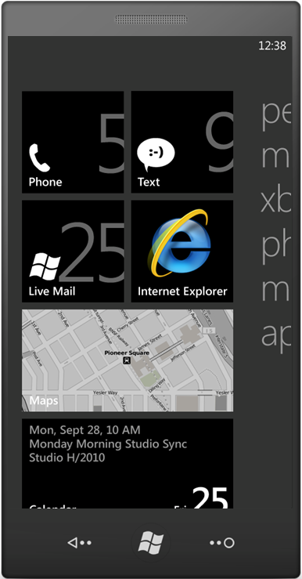
Application Installation Flow
.xap
New XAP package
Windows Phone
Marketplace
Install
Package signature check
License retrieval
Create license state
Setup secure sandbox
Task provisioning
Create app folders
Provision isolated storage
.dll
Marketplace
Client
Package Manager
Package manager aggregates lifecycle notifications
to the WM7 platform
Shell
App DB
Sec. DB
App Folders

Slide 20
Application Update Flow
.xap
Update XAP package
Windows Phone
Marketplace
Update
Package signature check
License retrieval
Update license state
Reuse old secure sandbox
Task provisioning
Backup data
Wipe install folder
Provision isolated storage
.dll
Marketplace
Client
Package Manager
Shell
App DB
Sec. DB
App Folders

Slide 21
Application Uninstall and Revoke Flow
.xap
Delete License
Windows Phone
Marketplace
Uninstall
Wipe app sandbox
Wipe app folder hierarchy
Delete license
.dll
Marketplace
Client
Revocation
Delete license
Update license state in App DB
Package Manager
Shell
App DB
Sec. DB
App Folders

Slide 22
Deploying Windows Phone with Exchange Server

Slide 23
Enterprise Active Sync Integration
Windows Phone Supported EAS Policies*
Password Required
Password Expiration
Password History
Allow Simple Password
Password Length
Idle Timeout Value
Device Wipe Threshold
Complex Password Required
Password Complexity
Remote Wipe
* All other EAS policies not explicitly mentioned always return False

Slide 24
Enterprise Active Sync Feature Support
EAS Feature | Exchange Server 2003 | Exchange Server 2007 | Exchange Server 2010
Direct Push | X | X | X
Email Sync | X | X | X
Calendar Sync | X | X | X
Contacts Sync | X | X | X
Remote Wipe | X | X | X
Sync Multiple Folders | X | X | X
128-bit SSL Encrypted Transmission | X | X | X
User Initiated Remote Wipe |  | X | X
HTML E-mail |  | X | X
GAL Lookup | X* | X | X
Follow-up Flags |  | X | X
Meeting Attendee Information |  | X | X
Autodiscover |  | X | X
Bandwidth Reductions |  | X | X
Reply State |  |  | X
Nickname Cache |  |  | X
Block/Allow/Quarantine List |  |  | X
Allow Attachment Download |  |  | X
256-bit SSL Encrypted Transmission |  |  | X
Server Search |  |  | X
IRM Email |  |  | X**
* Requires Windows Phone 7 March Update ** Requires Exchange Server 2010 SP1

Slide 25
New EAS Policy
Demonstration
demo

Slide 26
IRM Overview and Requirements
Infrastructure requirements
Exchange requirements
Device requirements

Slide 27
Information Rights Management Requirements
The following requirements apply
The Client Access servers in your organization must be running Exchange 2010 SP1
An AD RMS server must be deployed in your organization
IRM must be enabled for internal messages. This is a prerequisite for all IRM features in Exchange 2010. For details, see Enable or Disable IRM for
Internal Messages
IRM must be enabled in the Exchange ActiveSync mailbox policy. You can enable or disable IRM for different sets of users using different Exchange ActiveSync mailbox policies
Devices that support Exchange ActiveSync protocol version 14.1, including Windows phones, can support IRM in Exchange ActiveSync. The device's mobile e-mail application must support the RightsManagementInformation
tag defined in Exchange ActiveSync version 14.1

Slide 28
Information Rights Management
demo

Slide 29
Using Certificates with Exchange
Installing certificates via Windows Internet Explorer®
Any device accessible URL
User can inspect and optionally choose to install the certificate
Installing certificates via e-mail
Certificate installer supports using .cer, .p7b and .pfx files
Root Certificates
Self-signed certs are possible but recommend chaining off
an existing root certificate
For further details on certificates configuration and other IT Pro info

Slide 30
Device Management
Using EAS Policies

Slide 31
Exchange Active Sync Security-Related Policies
EAS also provides the ability to manage security for Windows Phone 7 users through the use of security–related policies that are configured by IT departments, similar to Group Policy settings for operating systems and applications. EAS security-related configuration policies that can be managed by the IT department include the following…
Requires the user to set a device locking personal identification number (PIN) before the phone starts synchronizing email, calendar and contact information with a Microsoft Exchange Server
[PasswordRequired]
Sets the validity period of a PIN, after which the PIN has to be renewed
[PasswordExpiration]
Prevents the user from re-using the same PIN repeatedly
[PasswordHistory]
Can be used to prevent the user from using a simple PIN, such as 1111
[AllowSimplePassword]
Sets the minimal number of numeric characters in the PIN
[MinPasswordLength]
Defines the time before a phone locks when not in use
[IdleTimeoutFrequencyType]
Defines the number of times a wrong PIN can be used before the phone wipes and resets to factory settings
[DeviceWipeThreshold]
In addition, Remote Device Wipe can be initiated either by a user through Microsoft Outlook® Web App or by an Exchange administrator.

Slide 32
SharePoint and
Windows Phone 7

Slide 33
SharePoint Workspace Mobile Features
Enable users to access SharePoint 2010 files so they can collaborate with their team while away from the office or on the go
Browse sites, view SharePoint lists and libraries
Sync documents offline
Enable secure transmissions with SSL connectivity
Utilizes the built-in SSL VPN support for
Microsoft Forefront® Unified Access Gateway

Slide 34
Mobile Line of Business
Application Options

Slide 35
LOB Demonstration
demo

Slide 36
Windows Phone 7 Updates

Slide 37
Windows Phone Update
Microsoft is now enabling Windows Phones to be updated after purchase
Leadership role in update planning, development, validation, and distribution
Mechanisms to update Windows Phones…
Windows Phone Update
Operating System Updates
Enables Microsoft and partners to send OS software updates to Windows Phones via Zune on the PC
Microsoft-owned applications
Core OS feature enhancements
Bug and security fixes
Microsoft Updates
OEM, MO, Qualcomm, and IHV updates
File, database, driver, registry, policy, and settings
Pre-loaded applications (first run only)
OEM Updates
Windows Phone Marketplace
Application Updates
Enables partners to send partner application updates
to Windows Phones via Marketplace
OEM/MO Updates
Pre-loaded applications (after first run)
2nd-party applications acquired via Marketplace
ISV Updates
3rd-party applications acquired via Marketplace

Slide 38
Microsoft and OEM Updates
Microsoft Updates
OEM Updates
Ships Code From
Microsoft-only
OEM, MO, Qualcomm and IHV(s)
Update Authority
Microsoft
OEM
Testing
Lead: Microsoft
Others: OEM and MO(s)
Lead: OEM
Others: Microsoft and MO(s)
Timing
Microsoft Set Cadence
Timed with
Microsoft Update Schedule
Distributed To
All Windows Phone 7 devices
Specific Phone/Operator Pairings
One download installed by the end-user
via Zune Software on a PC

Slide 39
Q&A

Slide 40

© 2011 Microsoft Corporation.
All rights reserved. Microsoft, Windows, Windows Vista and other product names are or may be registered trademarks and/or trademarks in the U.S. and/or other countries.
The information herein is for informational purposes only and represents the current view of Microsoft Corporation as of the date of this presentation. Because Microsoft must respond to changing market conditions, it should not be interpreted to be a commitment on the part of Microsoft, and Microsoft cannot guarantee the accuracy of any information provided after the date of this presentation.
Microsoft makes no warranties, express, implied or statutory, as to the information in this presentation.

Slide 41
Windows Phone Related Content
Monday, May 16
Required Slide
Speakers, please list the Breakout Sessions, Interactive Discussions, Labs, Demo Stations and Certification Exam that relate to your session. Also indicate when they can find you staffing in the TLC.
WPH201: Windows Phone: What’s New?
WPH371-INT: Building a Mobile Message Queue for Windows Phone
WPH312: What’s New for Windows Phone Development with
Microsoft Silverlight?
WPH302: Windows Phone Productivity Scenarios with Microsoft Exchange Server 2010 and Microsoft Office 365
WPH373: Meet the Windows Phone Application Platform
Engineering Team

Slide 42
Windows Phone Related Content
Tuesday, May 17
WPH308: Multi-tasking and Application Switching for Windows Phone
OSP312: Developing Microsoft Office Business Solutions that Span
the PC, Windows Phone, and the Web
WPH309: Enhanced Push Notifications and Live Tiles for
Windows Phone
WPH303: Understanding the Windows Phone Development Tools
COS315: Building Windows Phone Applications with the
Windows Azure Platform

Slide 43
Windows Phone Related Content
Tuesday, May 17
WPH305: Internet Explorer 9 on Windows Phone
OSP209 Building Your First Windows Phone Application for
Microsoft SharePoint 2010
WPH203: Understanding Windows Phone Marketplace
WPH375-INT: Building Multi-tasking Enabled Windows Phone Applications

Slide 44
Windows Phone Related Content
Wednesday, May 18
WPH202: Windows Phone at Microsoft
DEV317: Using Microsoft Visual Basic to Build Windows Phone Applications
WPH310: Building Your First Windows Phone Game with XNA
WPH374-INT: Hardcore Windows Phone Development Questions
DEV205: Microsoft Expression for Developers: Demystifying User Interface Design
WPH306: Building Windows Phone Applications with Microsoft Silverlight and XNA
WPH304: New Windows Phone Data Access Features

Slide 45
Windows Phone Related Content
Thursday, May 19
WPH301: Deploying Windows Phone in the Enterprise
DPR303: Developing Enterprise-Grade Mobile Solutions
WPH307: Connecting Windows Phones and Slates to Windows Azure
WPH372-INT: Windows Phone Marketplace: Interactive
WPH311: Lessons Learned about Application Performance on Windows Phone
WPH311: Lessons Learned about Application Performance on Windows Phone
SIM323: User Identity and Authentication for Desktop and Phone Applications

Slide 46
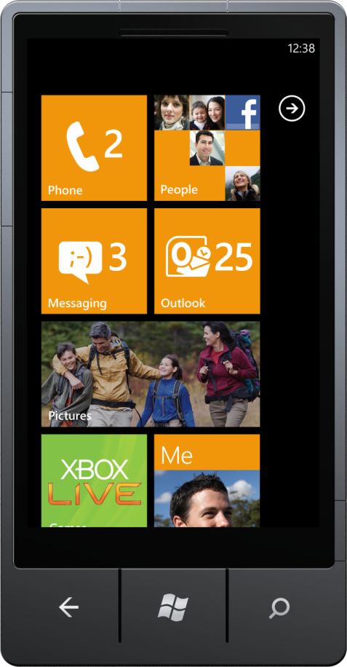
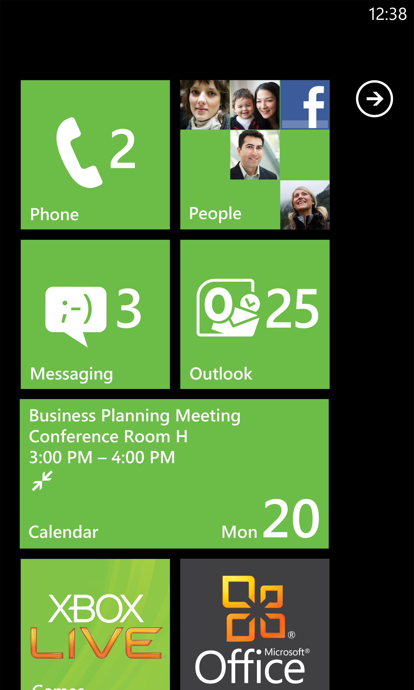
Windows Phone Resources
Questions? Demos? The latest phones?
Visit the
Windows Phone Technical Learning Center for demos and more…
Business IT resources
  blogs.technet.com/b/
  windows_phone_4_it_pros
Developer resources
craete.msdn.com
Experience Windows Phone 7 on-line
and get a backstage pass
www.windowsphone.com

Slide 47
Win a Windows Phone Contest
HAT CONTEST*
SESSION CONTEST*
  QUESTIONS?
  How do you enter?
  During each
  Windows Phone session the moderator will post a question; the first person to correctly answer the question and is called on by the moderator will potentially win
Go to the
WPC Information Counter
at the TLC
Enter by visiting the
Windows Phone booth, accepting a free
Windows Phone branded
hat, and wearing that hat during the Event
  How am I selected?
* Restrictions apply please see contest rules for eligibility and restrictions. Contest rules are displayed in the Technical Learning Center at the
WPH info counter
  Each day of the event,
  a Windows Phone representative will randomly select up to 5 people who
  are observed wearing their
  Windows Phone branded hat

Slide 48





Resources
  Connect. Share. Discuss.
http://northamerica.msteched.com
Learning
  Sessions On-Demand & Community
  Microsoft Certification & Training Resources
www.microsoft.com/teched
www.microsoft.com/learning
  Resources for IT Professionals
  Resources for Developers
http://microsoft.com/technet
http://microsoft.com/msdn

Slide 49












Complete an evaluation on CommNet and
enter to win!

Slide 50


Slide 51

© 2011 Microsoft Corporation. All rights reserved. Microsoft, Windows, Windows Vista and other product names are or may be registered trademarks and/or trademarks in the U.S. and/or other countries.
The information herein is for informational purposes only and represents the current view of Microsoft Corporation as of the date of this presentation. Because Microsoft must respond to changing market conditions, it should not be interpreted to be a commitment
on the part of Microsoft, and Microsoft cannot guarantee the accuracy of any information provided after the date of this presentation. MICROSOFT MAKES NO WARRANTIES, EXPRESS, IMPLIED OR STATUTORY, AS TO THE INFORMATION IN THIS PRESENTATION.

