Slide 1

RemoteFX Hardware Selection and Deployment Considerations for VDI and Sessions
WSV201
Eric Han
Senior Program Manager
Microsoft

Slide 2
Agenda
Why RemoteFX and Demo
Architecture of Server and Client with Diagrams
Capacity Planning and Graphs
Deployment Considerations and Hardware
RemoteFX Partners

Slide 3
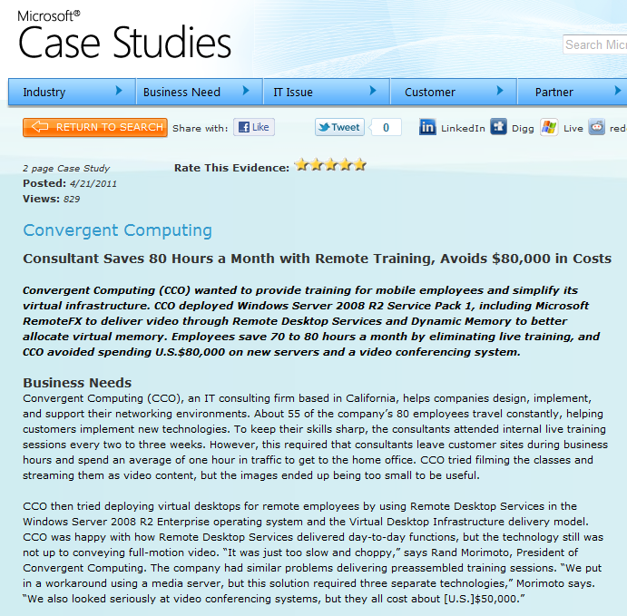
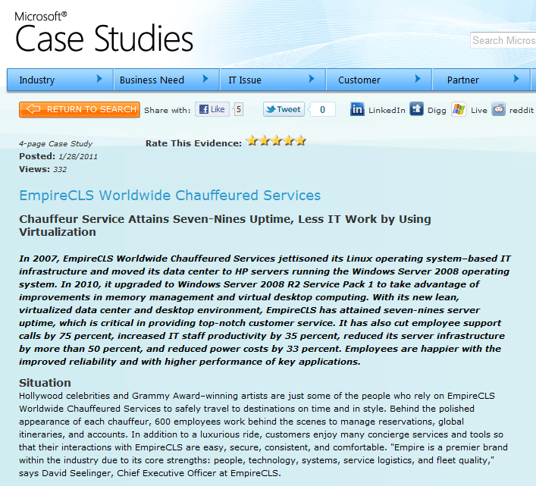
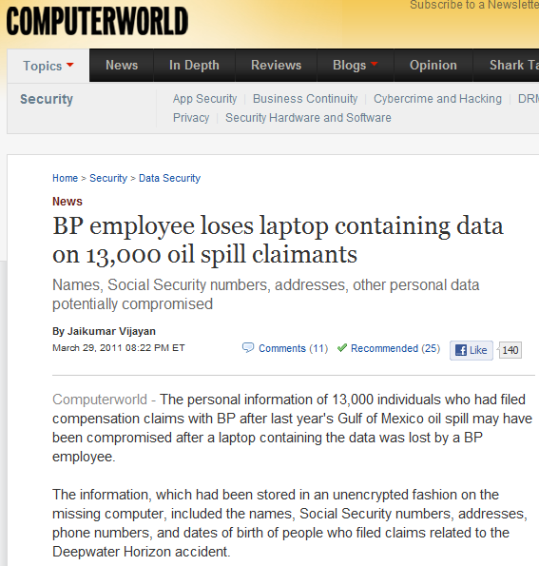
Why RemoteFX VDI
IT: Control and Compliance
Applications: Knowledge Workers with Multimedia
Employees: Access to Applications
Multimedia and 3D:
Google Earth
Flash
PowerPoint
Silverlight
Skype
Visual Studio 10
Windows Media Player
Windows Presentation Format
Windows Desktop (DWM)
“We’ve been really impressed with the RemoteFX feature in Windows Server 2008 R2 SP1. The reduction in power consumption and the rich graphical user experience are both significant advantages. We now use VDI for more than 75 percent of our work force worldwide. With Windows Server 2008 R2 SP1, our employees get a rich graphical user experience, better phone quality, and USB remote access within the VDI session.“
Alan Bourassa
Chief Information Officer, EmpireCLS Worldwide Chauffeured Services
We save 70 to 80 hours each month by delivering classes remotely using RemoteFX in Windows Server 2008 R2 Service Pack 1. At our consultant billing rate of $250 an hour, that’s more than $200,000 a year.
Rand Morimoto
President, Convergent Computing
http://www.computerworld.com/s/article/9215316/BP_employee_loses_laptop_containing_data_on_13_000_oil_spill_claimants

Slide 4

RemoteFX Enabled Client
Hector Angulo
Product Manager, Wyse Zero
Wyse Technology
demo

Slide 5
Agenda
Why RemoteFX and Demo
Architecture of Server and Client with Diagrams
Capacity Planning and Graphs
Deployment Considerations and Hardware
RemoteFX Partners

Slide 6
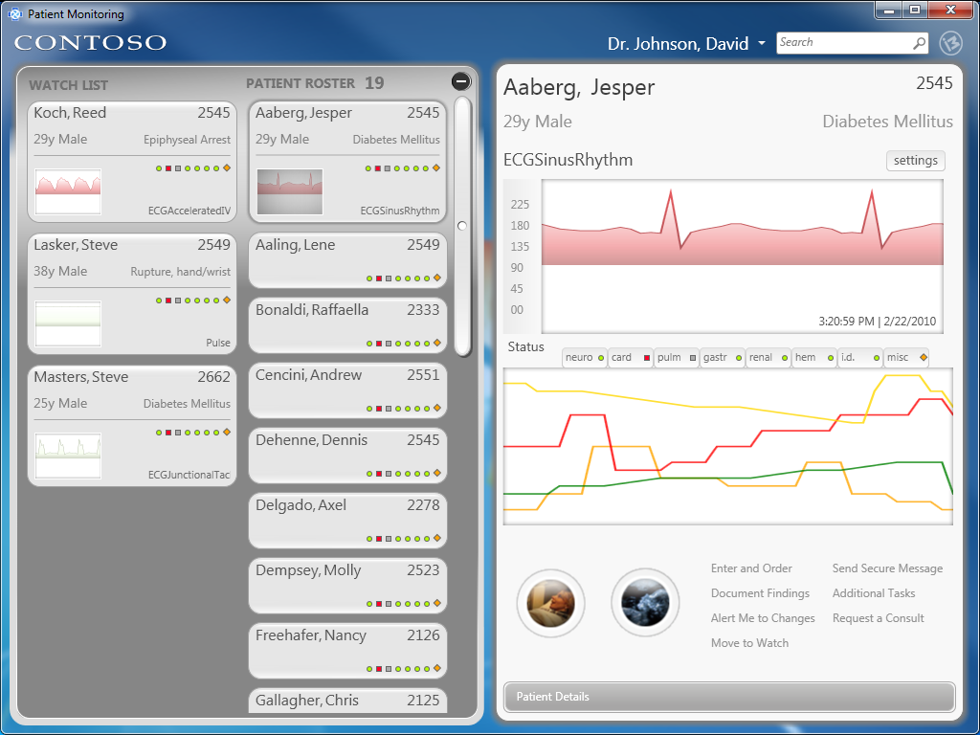
Architecture for Server Remoting
Hyper-V`
Host
Virtual
Machine
RDP 7.1
RDVGM
Render
Capture
Encode
VM Management
components
WDDM
U-Mode vGPU
K-Mode vGPU
Platform Integration with Hyper-V components
WDDM Driver
Hardware GPU

Slide 7
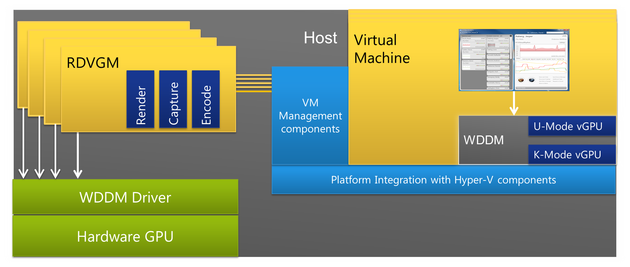

Summary of Server and VM Operations
Application calls standard libraries
within the VM
The virtual GPU is a 3D graphics driver in the VM, integrated with Hyper-V. Driver presents the industry’s first WDDM driver
in a VM
The management components manage shared
resources and control the lifetime of the RDVGM processes
  Consumed amount of VRAM is a function of VM’s monitors and resolutions
  System Memory and VRAM consumption documented in whitepaper
The RDVGM operates on behalf of the VM within the host:
  Render – draw, flip, rotate, etc. Supporting behavior of DirectX applications in a VM
  Capture – capture frames, difference for changes, and throttle based on admin control and client backpressure. Capture rate controllable by Group Policy
  Encode – encode in GPU /CPU. Encode level controllable by Group Policy
Encoded data then transferred to each VM. A RemoteFX module in the VM (not drawn)
sends to the client

Slide 8
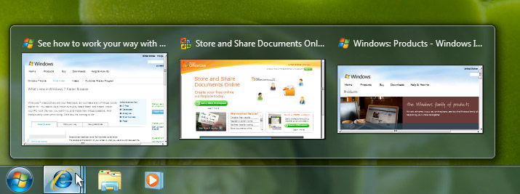
Client Architecture – Decoding RemoteFX
Core Services
Networking/
Security
Virtual Channels
Devices
Bulk Decompress
Key/Mouse
Decode RemoteFX
CPU
RemoteFX
Decode Abstraction Layer
RDP 7.1
CPU/
GPU
Bitmap
HW Decoder
Aero UX
Thin Client

Slide 9
IT Monitoring and Control
demo and video

Slide 10
Agenda
Why RemoteFX and Demo
Architecture of Server and Client with Diagrams
Capacity Planning and Graphs
Deployment Considerations and Hardware
RemoteFX Partners

Slide 11
Capacity Planning Overview
What we did in testing
  Added multimedia criteria and content
  Constrained some variables
  Ran benchmark and measured
Caveats
  Data is based on benchmark
  Recommend piloting
“Knowledge Worker with Multimedia Scenario”
  Word
  Outlook
  PowerPoint
  WMV
  Flash
  …

Slide 12
Capacity Planning and Performance
Scalability measures performance as we add users
RemoteFX reserves resources to help ensure performance
  System Memory – below includes Hyper-V formula for a 2GB VM
  Video Memory – below value is constant
System Memory Reservation (Server) Values are for 2GB Virtual Machine
Resolution Maximum | Monitor | Monitors | Monitors | 4 Monitors
1024x768 | 72 MB | 85 MB | 99 MB | 112 MB
1280x1024 | 108 MB | 145 MB | 183 MB | 220 MB
1600x1200 | 166 MB | 247 MB
1920x1200 | 183 MB | 278 MB
Video Memory Reservation (Server GPUs) Values consistent for any Virtual Machine
Resolution Maximum | Monitor | Monitors | Monitors | 4 Monitors
1024x768 | 75 MB | 105 MB | 135 MB | 165 MB
1280x1024 | 125 MB | 175 MB | 225 MB | 275 MB
1600x1200 | 184 MB | 257 MB | NA | NA
1900x1200 | 220 MB | 308 MB | NA | NA
*above is reservation on host, separate from dynamic versus static memory.

Slide 13
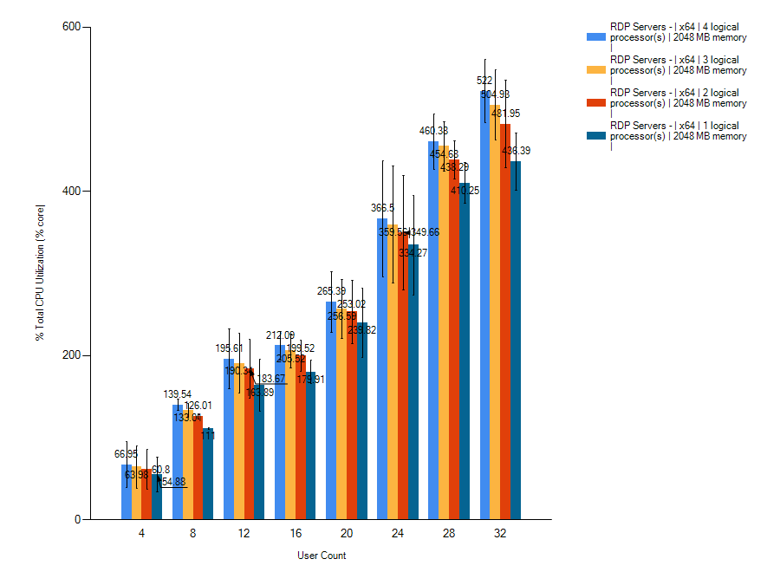
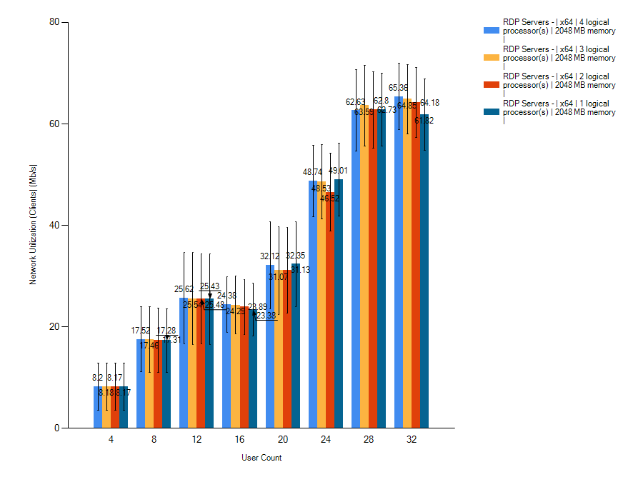
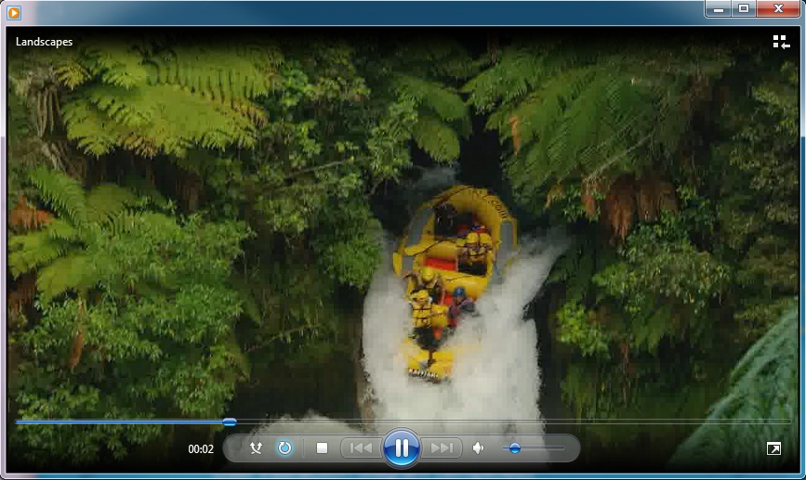
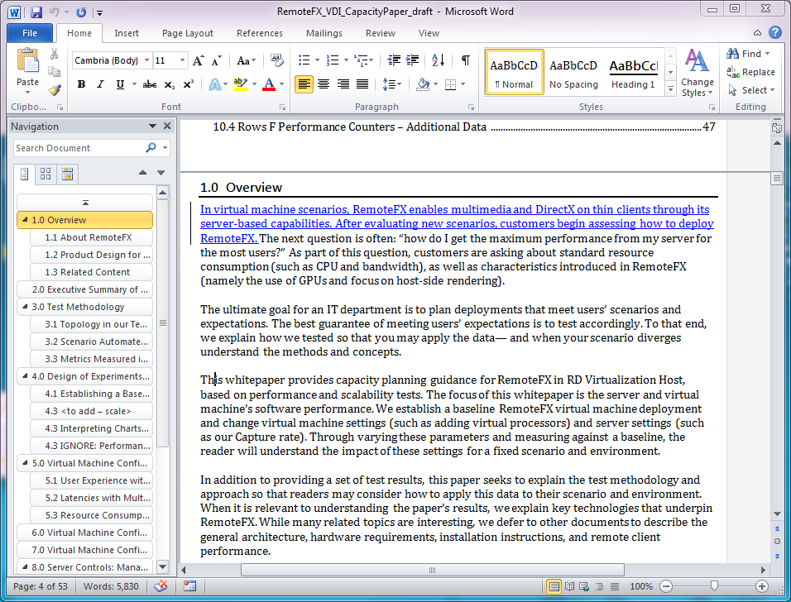
Capacity Planning Measurement
Add users and measure criteria
  User Experience
  Resources
Input Response Time
(Common to RDVH)
Frame Rate and Jitter
(Introduced with RemoteFX)
Example: CPU Utilization
Example: Network Utilization

Slide 14
Capacity Planning for Comparability
Results applicable anywhere
Variables in test
  Virtual Machine Settings
  RemoteFX Settings
Row | Virtual Machine Configuration |  |  |  | RemoteFX Server Settings
 | Vproc # / System Memory | Static or Dynamic Memory | Arch | Monitor Resolution | Capture Frame Rate | Image Quality
A | 1-4 / 1024 | Static | 32-bit | 1280x1024 | Default | Default
B | 1-4 / 2048 | Static | 64-bit | 1280x1024 | Default | Default
C | 2 / 2048, 3072, 4096 | Dynamic | 64-bit | 1280x1024 | Default | Default
D | 2 / 2048 | Dynamic | 64-bit | 1024 x 768 1280 x 1024 1600 x 1200 1920 x 1200 | Default | Default
E | 2 /2048 | Dynamic | 64-bit | 1280x1024 | High | Medium
 |  |  |  |  | Medium (Default) | Medium (Default)
 |  |  |  |  | Low | Medium
F | 2 /2048 | Dynamic | 64-bit | 1280x1024 | High | Low
 |  |  |  |  | Medium (Default) | Medium (Default)
 |  |  |  |  | Low | High

Slide 15
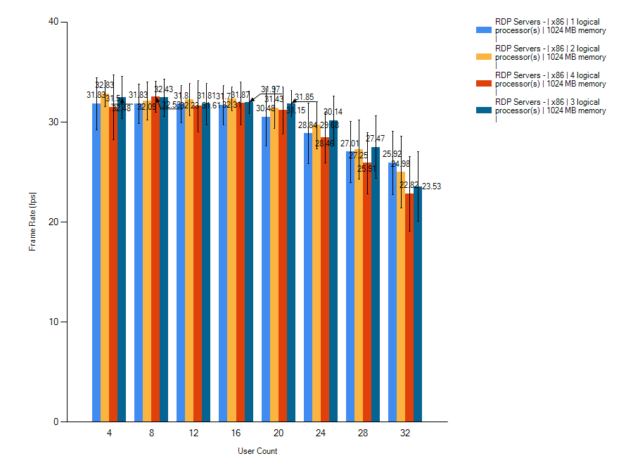
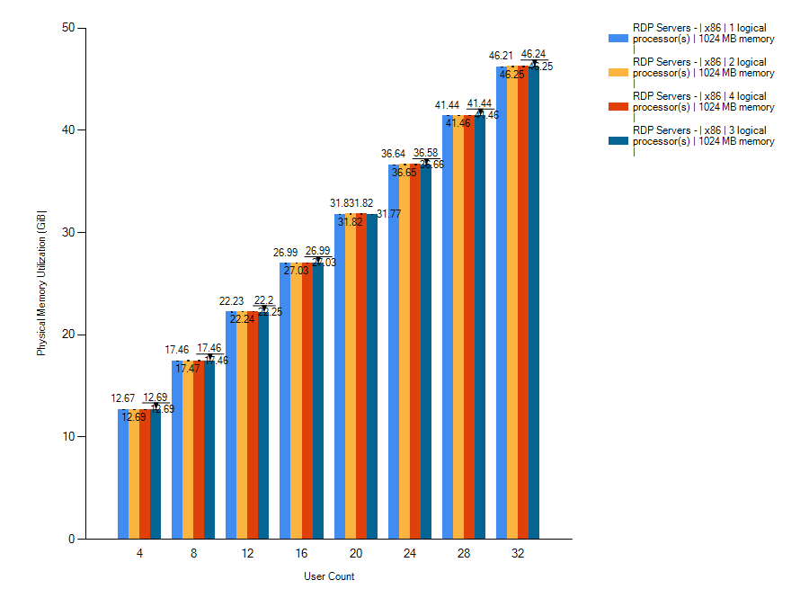
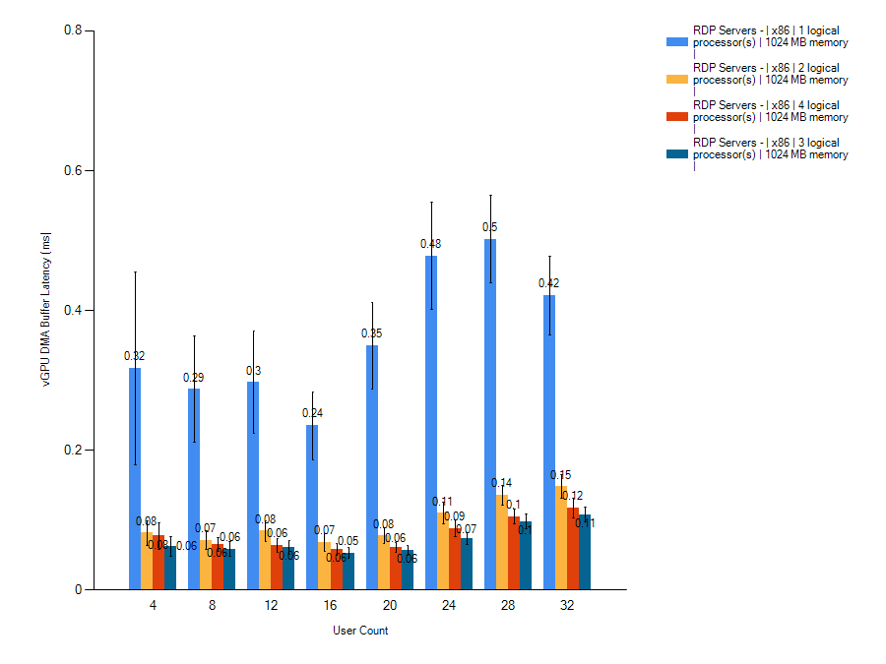
Capacity Planning Recommendation
Next slides provide key takeaways
Virtual Processors
OS Architecture
Dynamic and Static Memory
Capture Frame Rate Setting
Image Quality Setting
More in upcoming June
whitepaper

Slide 16
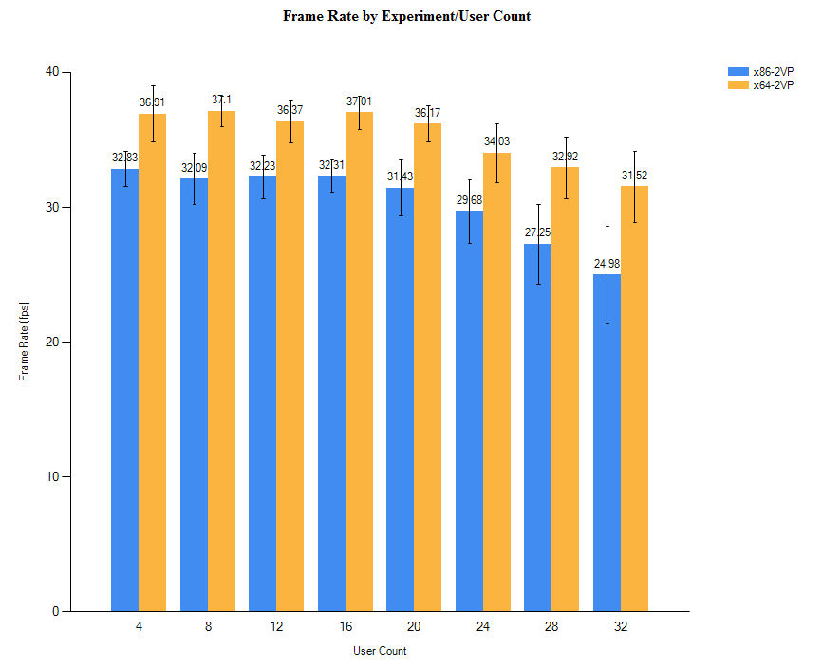
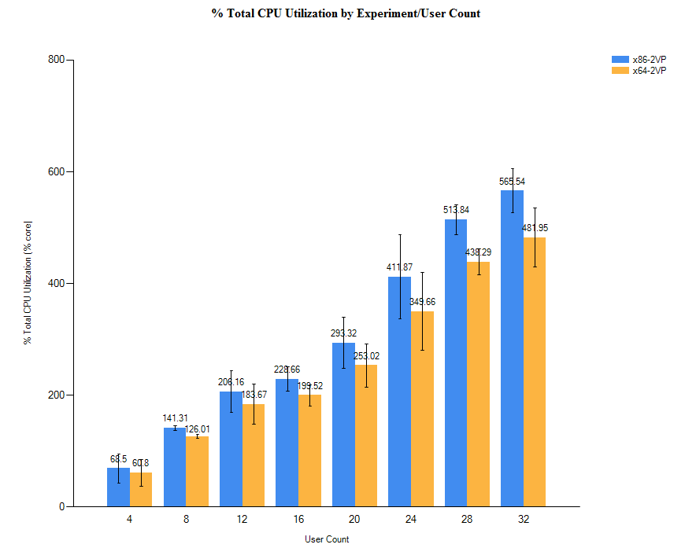
Capacity Planning Recommendation
Virtual Processor and OS
Recommendation based on results
  Dual Processor
  64-bit OS Virtual Machines
64-bit
CPU Utilization
Frame Rate
32-bit
Users (4 – 32)
Users (4 – 32)

Slide 17
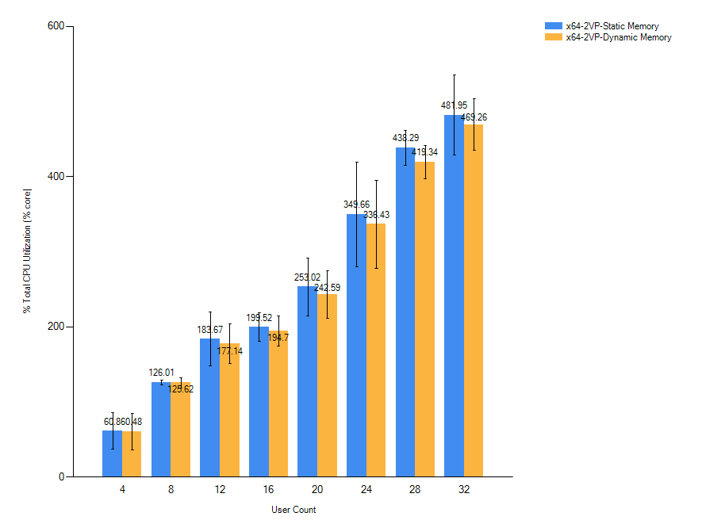
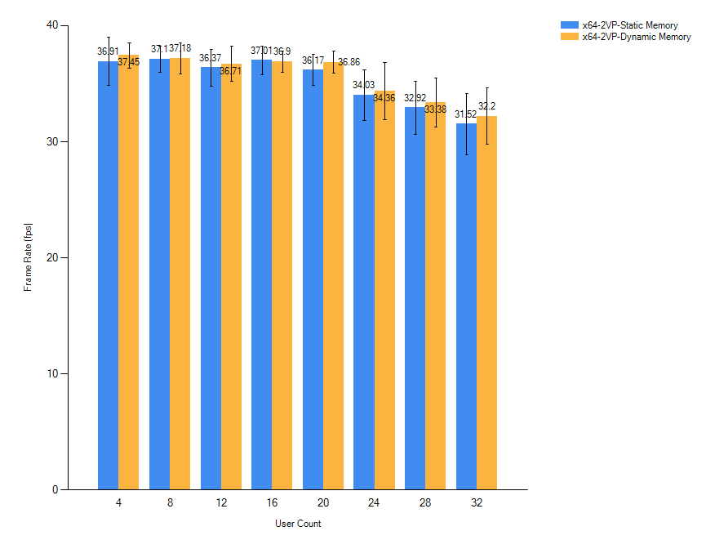
Capacity planning recommendation
Dynamic and static memory
Dynamic and Static Memory near equal Frame Rates
and Resource Utilization
CPU Utilization
Frame Rate
Users (4 – 32)
Users (4 – 32)

Slide 18
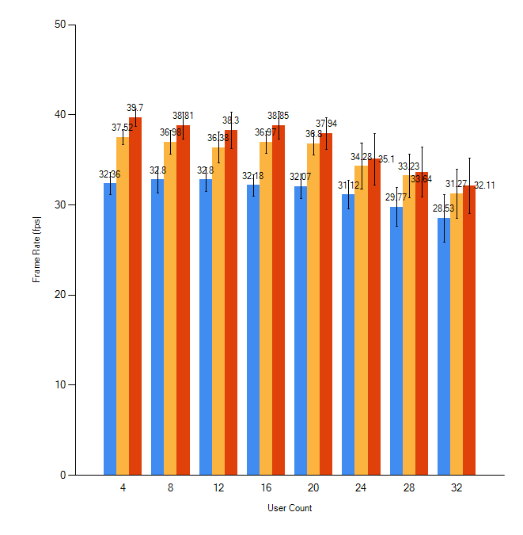
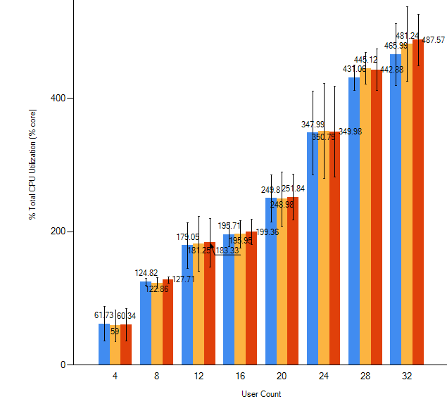
Capacity Planning Recommendation
Capture frame rate
Recommendation based on results [here]
  Frame rate 39 FPS versus 32 FPS at four VMs
  CPU Utilization comparable
39 FPS
High Capture
37 FPS
Med. Capture
32 FPS
Low Capture
CPU Utiliz.
Frame Rate
Users (4 – 32)
Users (4 – 32)

Slide 19
Capacity Planning Recommendation
Maximize experience, balanced, minimize resource use
 | RemoteFX Server Settings |  | Purpose of this configuration
Label | Capture Frame Rate | Image Quality
Experience | High | High | Maximize user experience.
Default | Medium (Default) | Medium (Default) | Baseline configuration to facilitate comparisons.
Resource | Low | Low | Minimize server resource consumption.

Slide 20
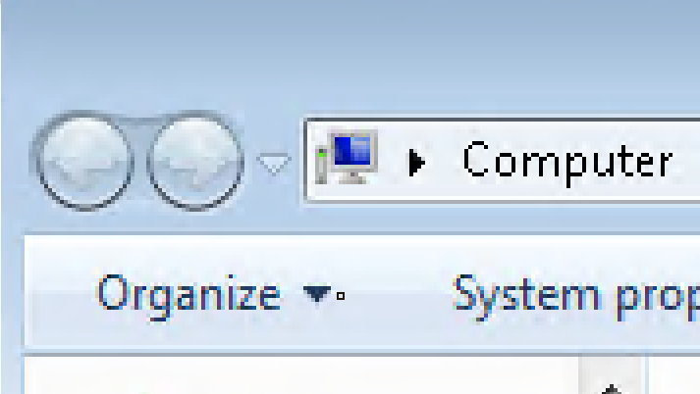
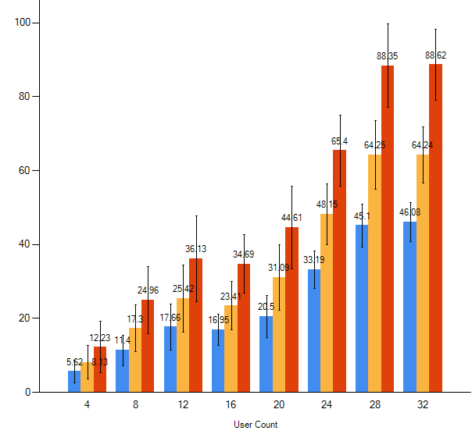
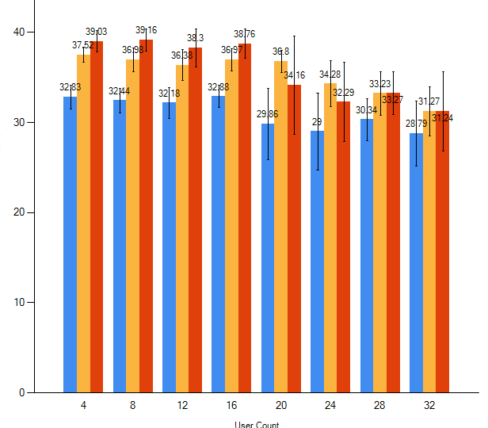
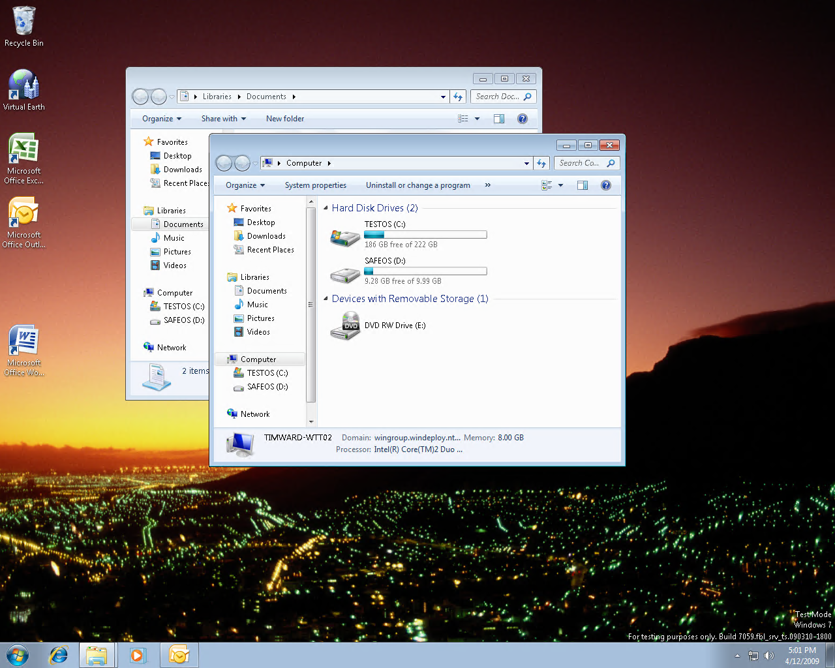

Capacity Planning Recommendation
Maximize experience, balanced, minimize resource use
Frame rate mirrors Capacity test
Image Quality Setting varies, changing network load
88 Mbps
32 users
37 FPS
Default
39 FPS
Experience
32 FPS
Resource
Network (Mbps)
64 Mbps
32 users
Frame Rate
46 Mbps
32 users
Low Image
High Image
Users (4 – 32)
Users (4 – 32)

Slide 21
Agenda
Why RemoteFX and Demo
Architecture of Server and Client with Diagrams
Capacity Planning and Graphs
Deployment Considerations and Hardware
RemoteFX Partners

Slide 22
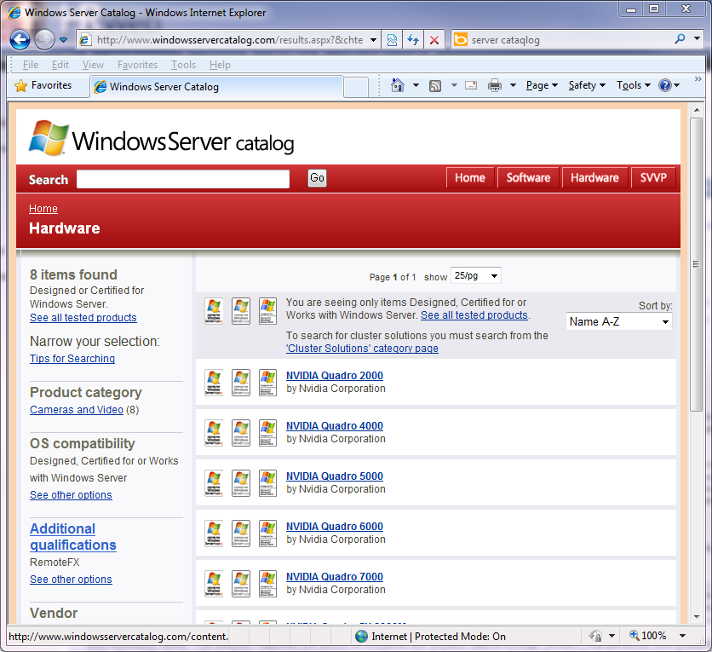
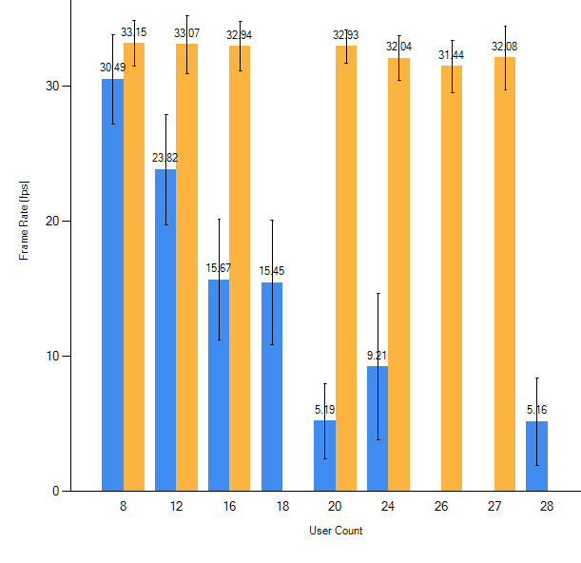
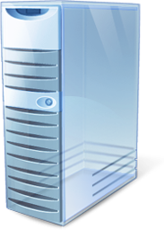
Deployment Considerations
Server Requirements in Hardware Requirements
GPUs with RemoteFX Logo Additional
Qualification in Server Catalog
Hardware Considerations
SLAT CPU
GPU AQ
BMC Video
Frame Rate

Slide 23
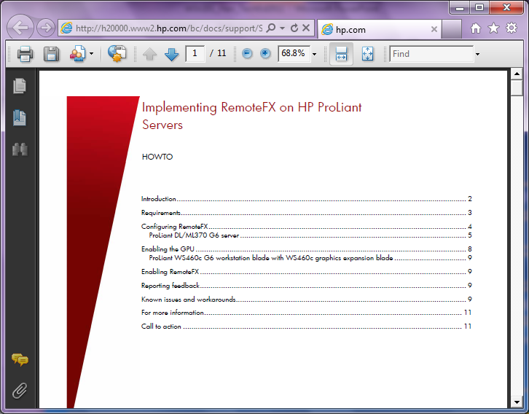
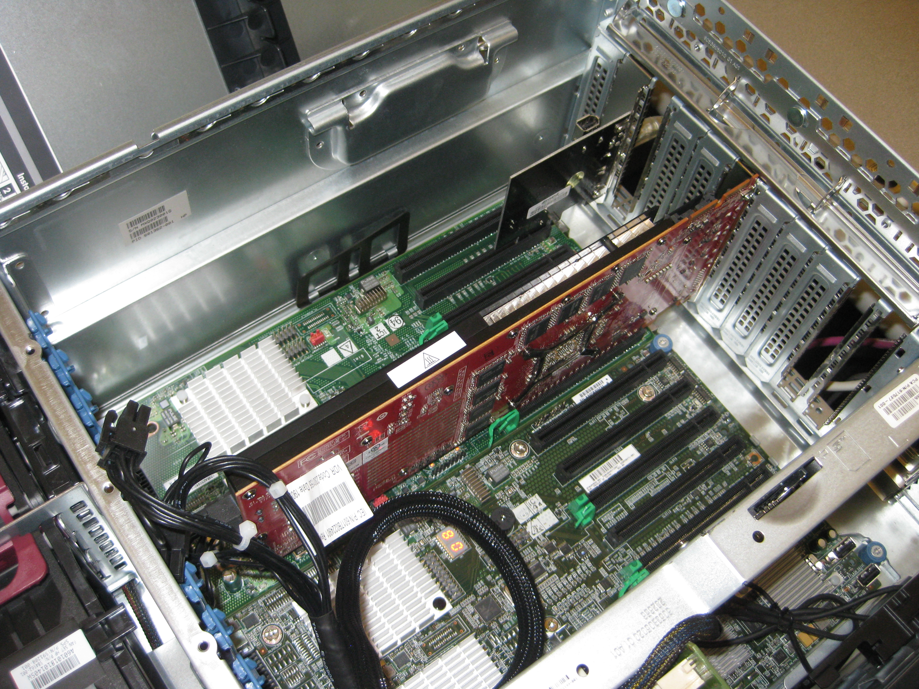
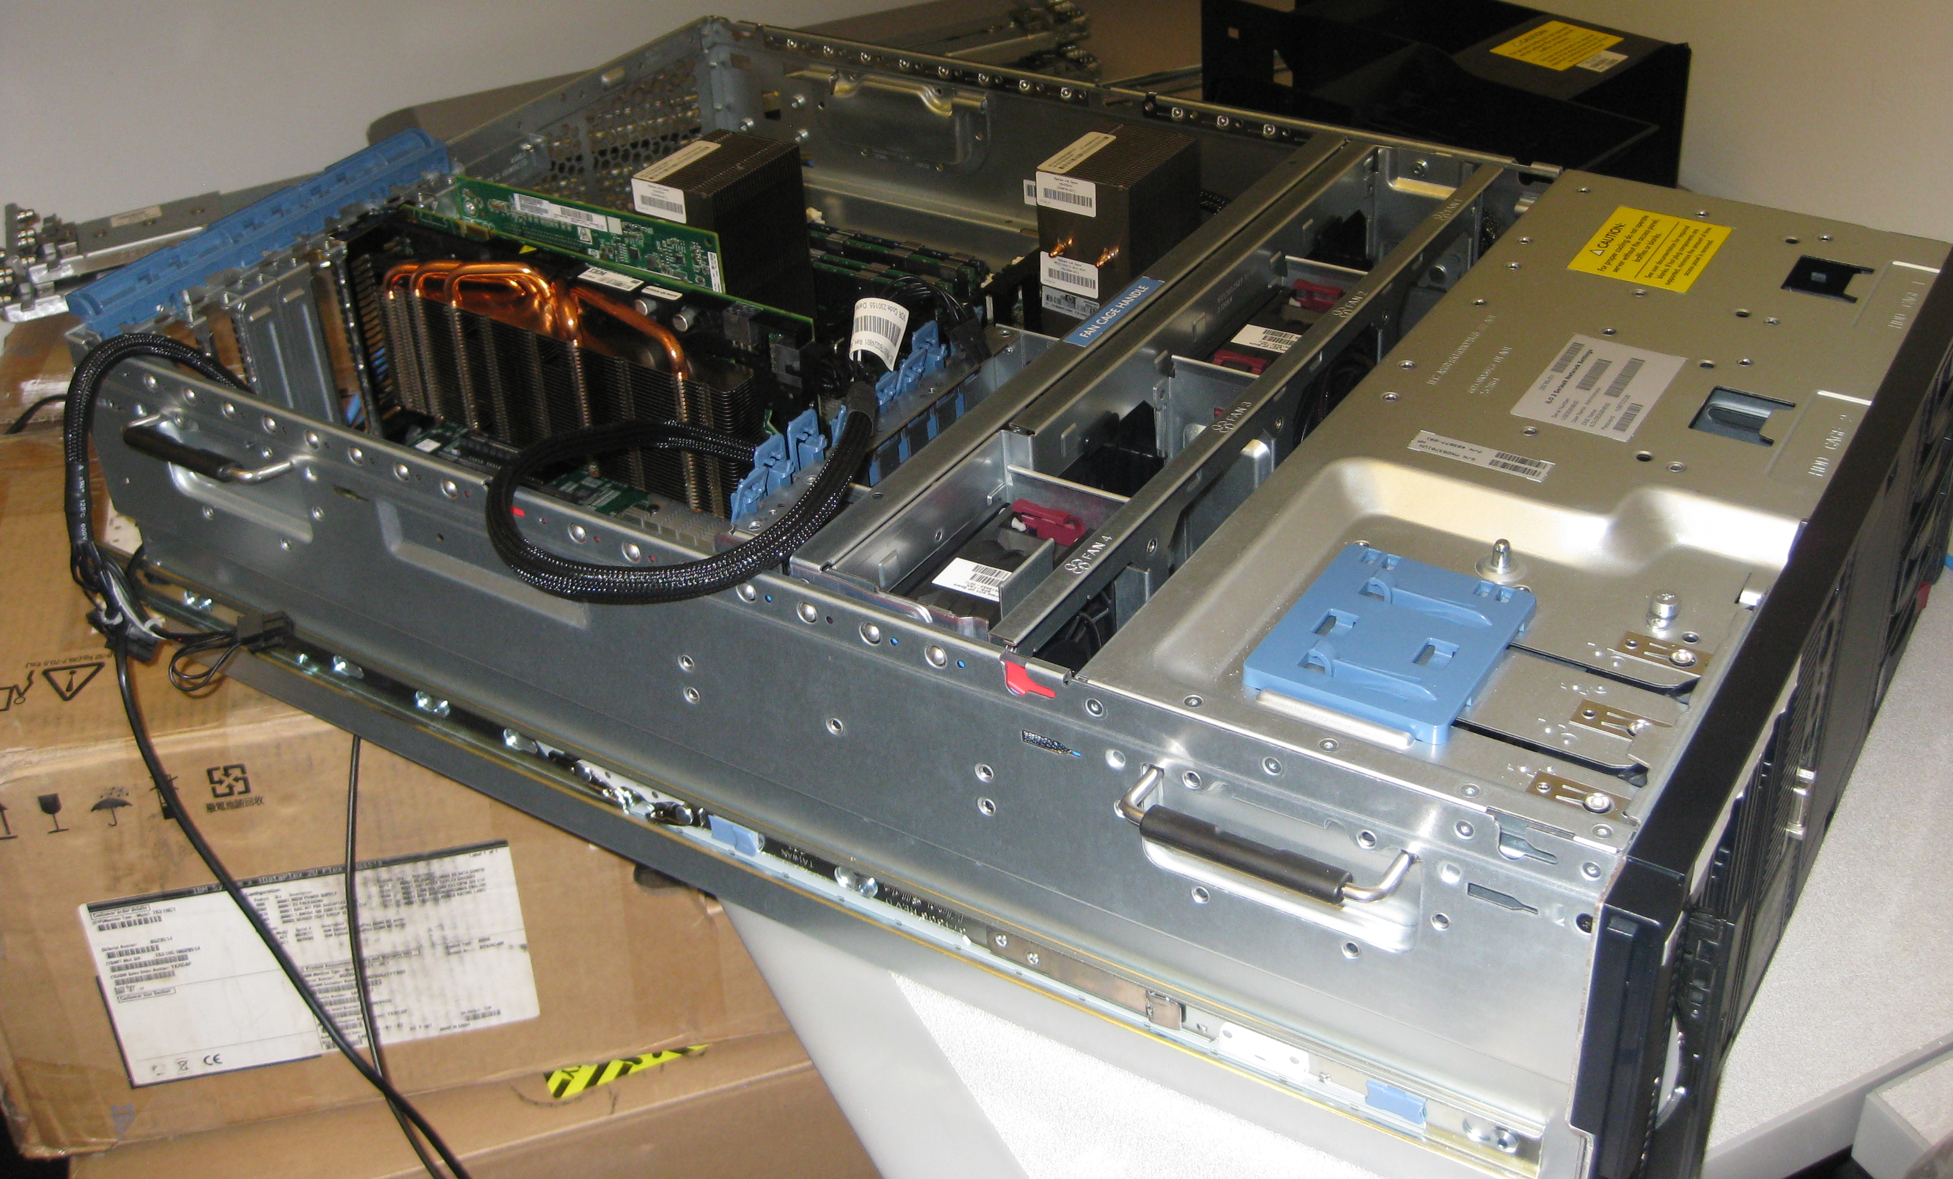
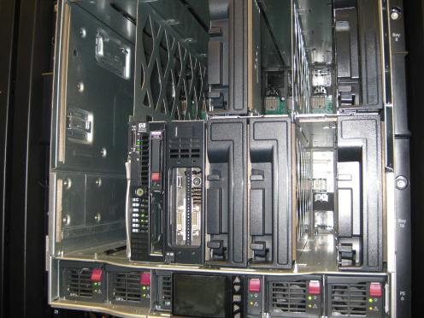
HP Proliant
RemoteFX Hardware
HP ProLiant DL/ML370 G6 Server
HP ProLiant WS460c G6 Workstation Blade
with WS460c Graphics Expansion Blade

Slide 24
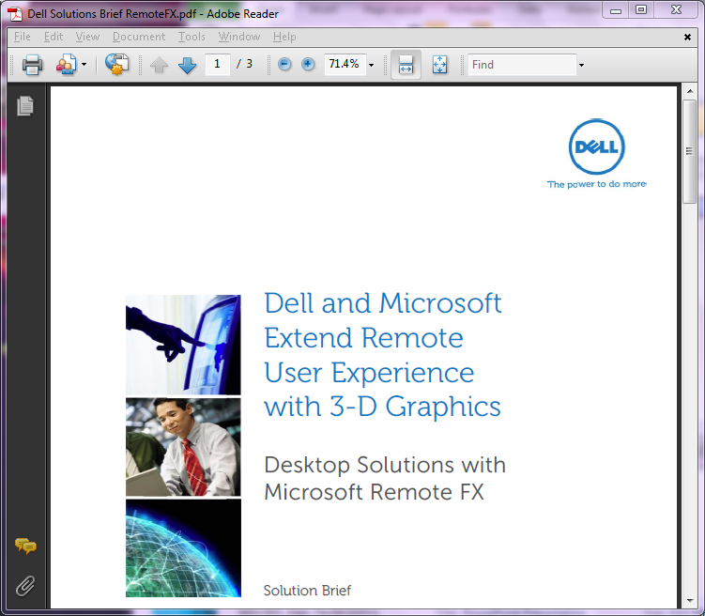
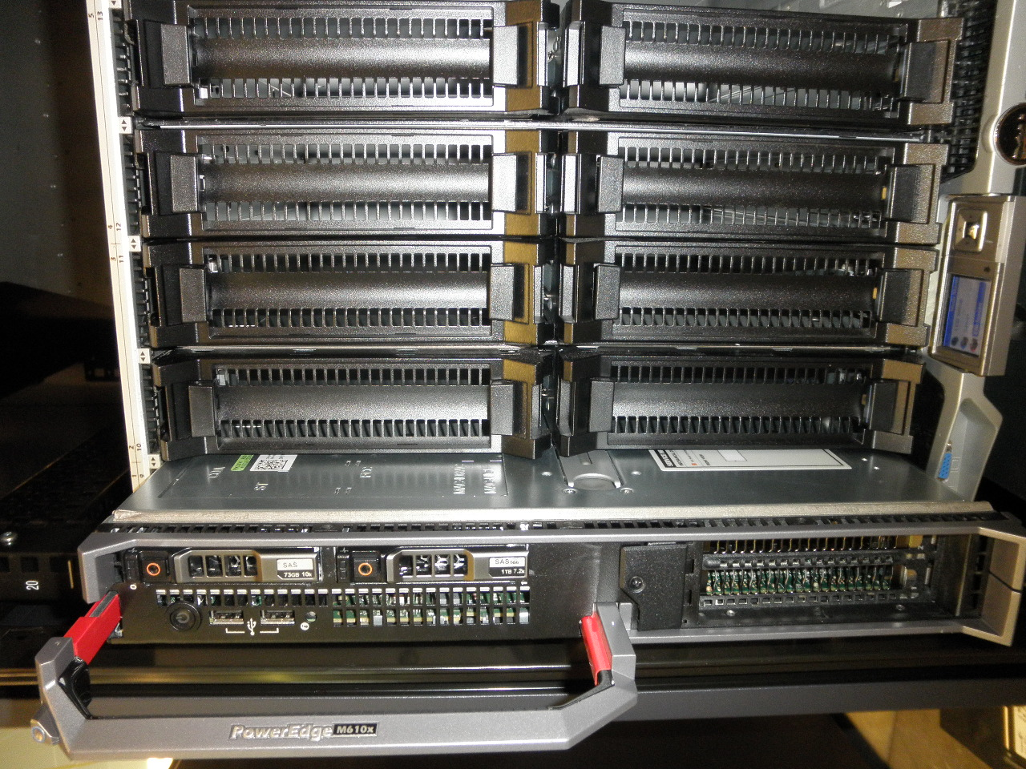
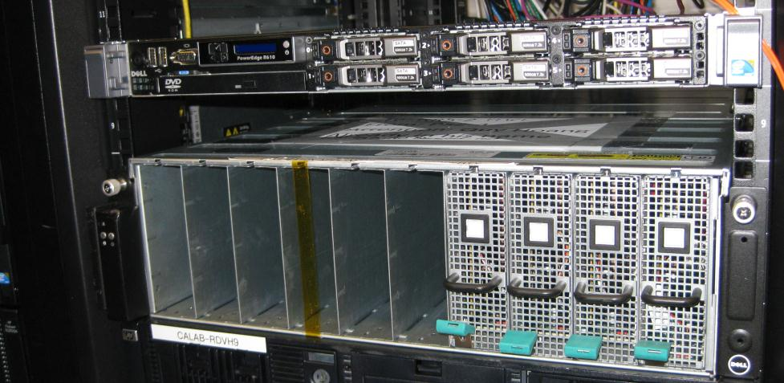
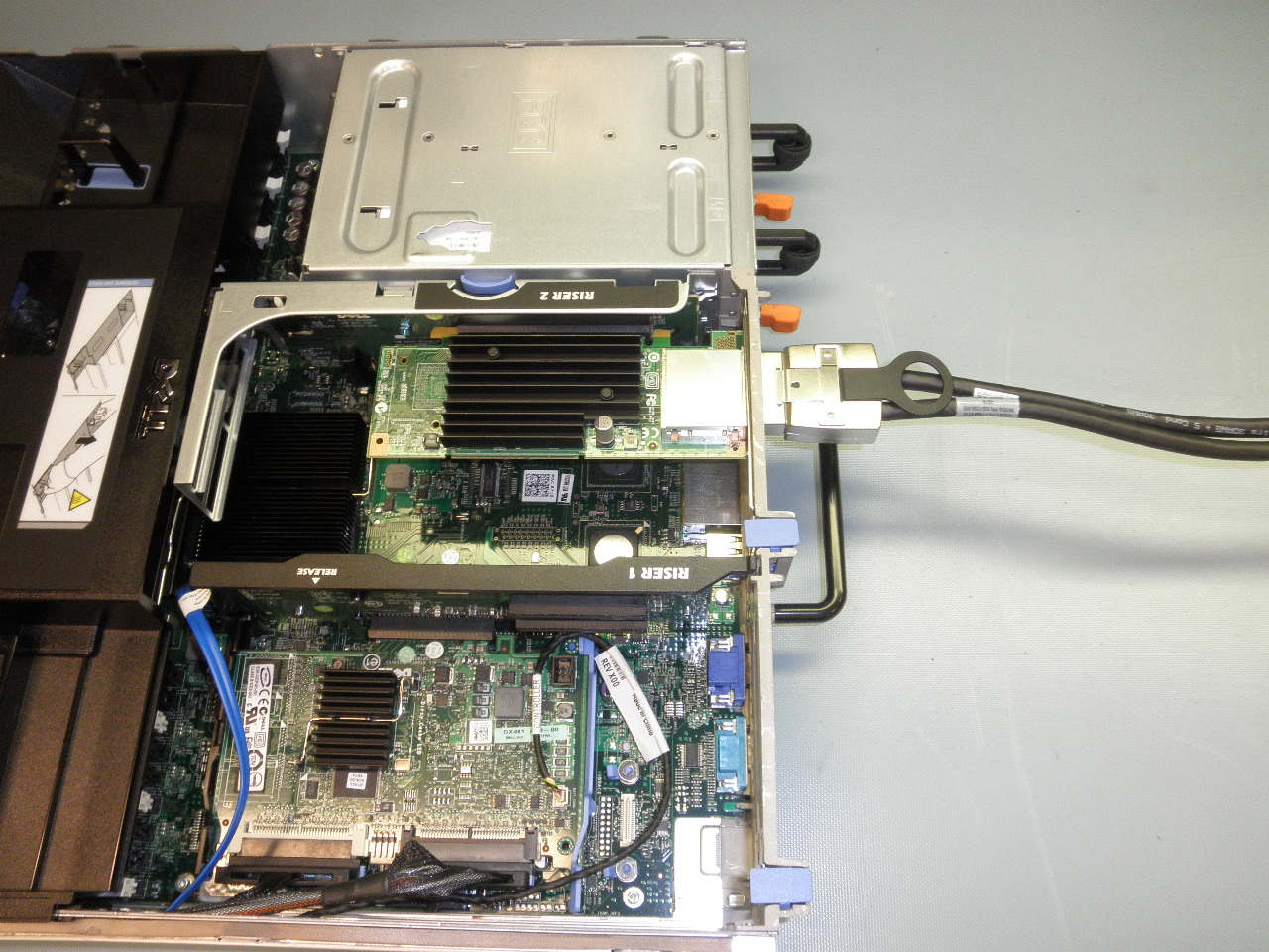
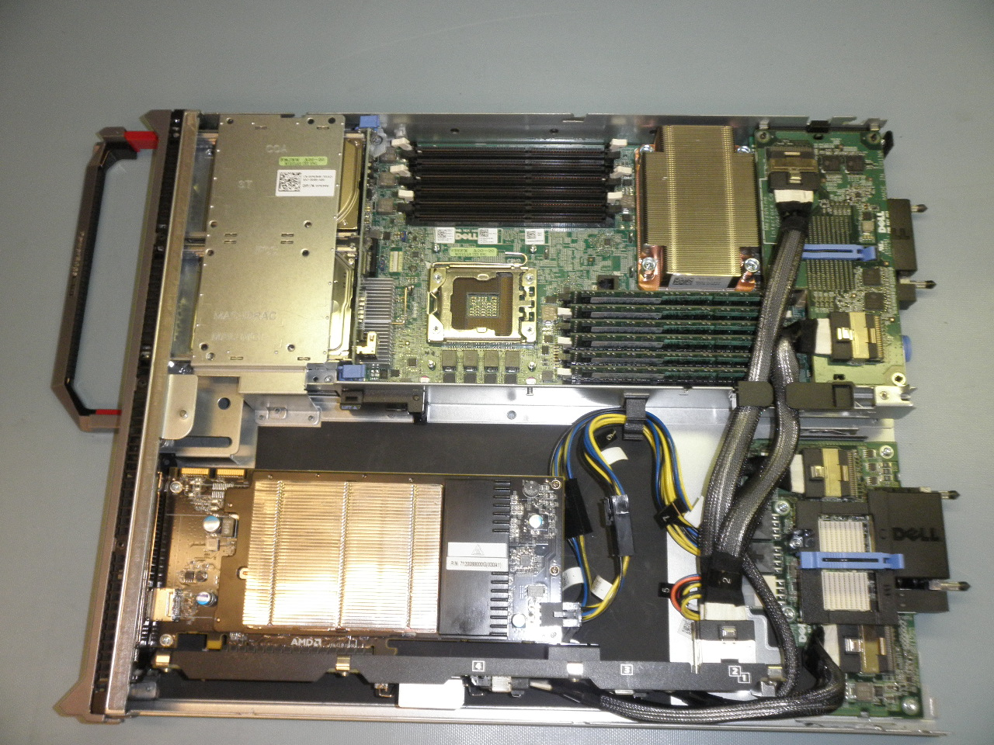
Dell PowerEdge Servers and Appliances
RemoteFX Hardware
Dell PowerEdge R710 and M610x
Dell PowerEdge C410x
Nvidia M2070Q and AMD v7800

Slide 25
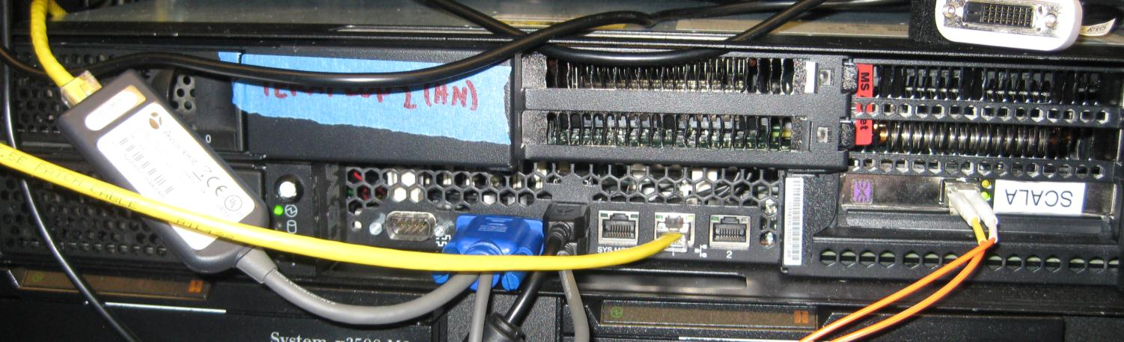
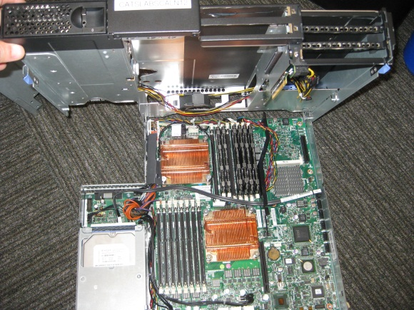
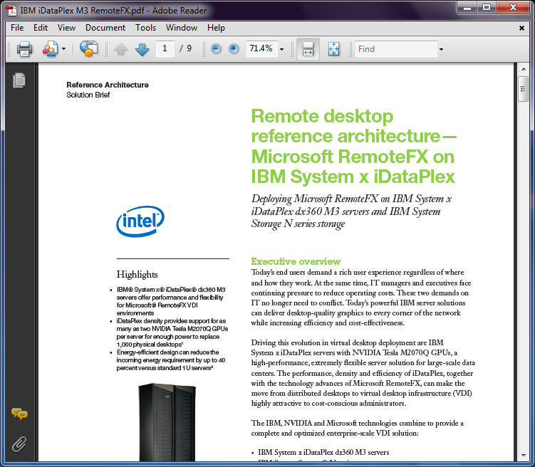
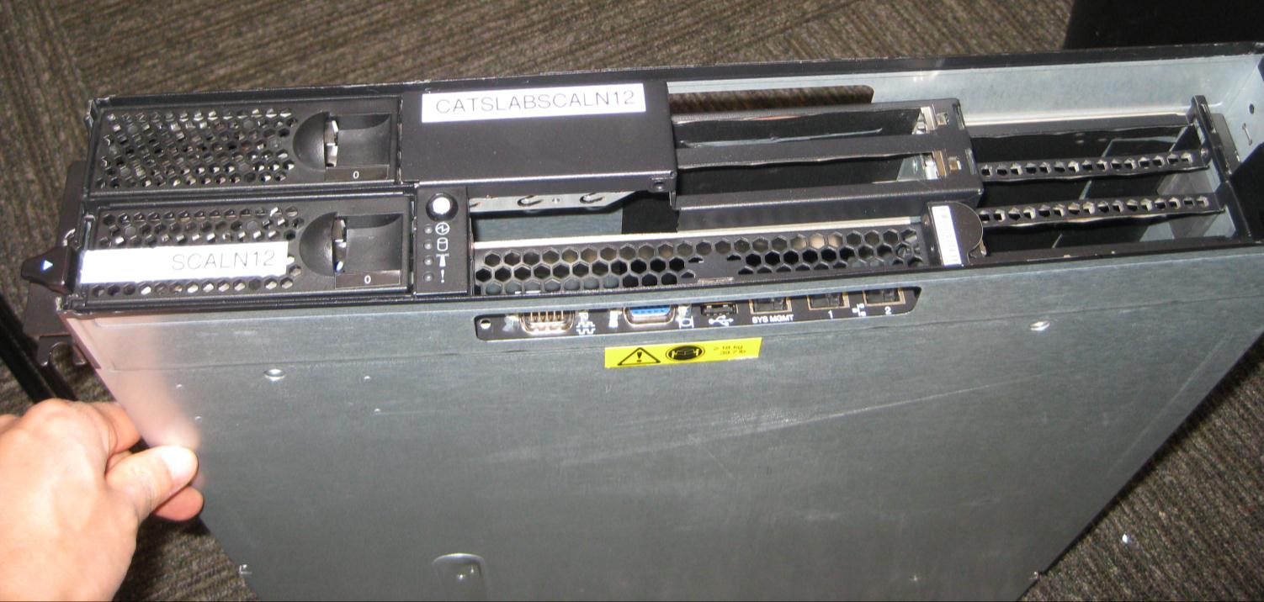
IBM iDataPlex dx360 M3
RemoteFX Hardware
IBM iDataPlex
Nvidia M2070Q

Slide 26


















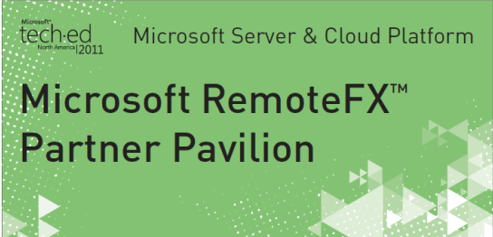
RemoteFX Partners
Please visit these partners at the
Microsoft RemoteFX Partner Pavilion here at TechEd:

Slide 27
Related Content
Required Slide
Speakers, please list the Breakout Sessions, Interactive Discussions, Labs, Demo Stations and Certification Exam that relate to your session. Also indicate when they can find you staffing in the TLC.
Breakout Sessions (RemoteFX GPU Virtualization – Deep Dive: VIR313)
Capacity Planning Whitepaper (Watch the team blog: http://blogs.msdn.com/b/rds)
Case Studies (search for ‘RemoteFX’ www.microsoft.com/casestudies)
Server Architecture and Offerings
  Dell: http://content.dell.com/us/en/enterprise/d/shared-content~solutions~en/Documents~solution-brief-microsoft-remote.pdf.aspx
  IBM: http://www.ibm.com/common/ssi/cgi-bin/ssialias?infotype=PM&subtype=SP&appname=STGE_XS_XG_USEN&htmlfid=XSS03076USEN
  &attachment=XSS03076USEN.PDF (just published)
  HP: http://h20000.www2.hp.com/bc/docs/support/SupportManual/c02478570/c02478570.pdf and www.hp.com/go/cv
GPU Offerings and Drivers
  AMD: http://www.amd.com/us/products/workstation/graphics/software/Pages/remote-fx.aspx
  Nvidia: http://blogs.nvidia.com/2011/02/it’s-here—nvidia-quadro-driving-virtual-desktops-with-microsoft-remotefx

Slide 28
Summary
Why RemoteFX and Demo
Architecture of Server and Client with Diagrams
Capacity Planning and Graphs
Deployment and Hardware Pictures
RemoteFX Partners
Case Studies and Demo with Wyse Zero Client
Architecture for Server Remoting and Client
Overview of Operations (provided as a Handout)
Testing Approach
Recommendation based on Testing
Upcoming Whitepaper in June
Ecosystem Investments to Make Your Selection Easier
Servers Offerings and Reference Guides from Partners
Industry Leading Partners for Server, Client, WAN Acceleration, Thin Clients, Decoders
Thank You, Eric Han
Find Me Later At… RemoteFX Partner Pavilion

Slide 29
Track Resources
Don’t forget to visit the Cloud Power area within the TLC (Blue Section) to see product demos and speak with experts about the Server & Cloud Platform solutions that help drive your business forward.
You can also find the latest information about our products at the following links:
Cloud Power - http://www.microsoft.com/cloud/
Private Cloud - http://www.microsoft.com/privatecloud/
Windows Server - http://www.microsoft.com/windowsserver/
Windows Azure - http://www.microsoft.com/windowsazure/
Microsoft System Center - http://www.microsoft.com/systemcenter/
Microsoft Forefront - http://www.microsoft.com/forefront/

Slide 30





Resources
  Connect. Share. Discuss.
http://northamerica.msteched.com
Learning
  Sessions On-Demand & Community
  Microsoft Certification & Training Resources
www.microsoft.com/teched
www.microsoft.com/learning
  Resources for IT Professionals
  Resources for Developers
http://microsoft.com/technet
http://microsoft.com/msdn

Slide 31












Complete an evaluation on CommNet and
enter to win!

Slide 32


Slide 33

© 2011 Microsoft Corporation. All rights reserved. Microsoft, Windows, Windows Vista and other product names are or may be registered trademarks and/or trademarks in the U.S. and/or other countries.
The information herein is for informational purposes only and represents the current view of Microsoft Corporation as of the date of this presentation. Because Microsoft must respond to changing market conditions, it should not be interpreted to be a commitment
on the part of Microsoft, and Microsoft cannot guarantee the accuracy of any information provided after the date of this presentation. MICROSOFT MAKES NO WARRANTIES, EXPRESS, IMPLIED OR STATUTORY, AS TO THE INFORMATION IN THIS PRESENTATION.

