Slide 1

Introducing Windows HPC Server
WSV207
David Chappell
Principal
Chappell & Associates

Slide 2
Agenda
Cluster Computing with Windows HPC Server: The Basics
Using Windows HPC Server: Application Types
The Technology of Windows HPC Server: A Closer Look

Slide 3
Cluster Computing with Windows HPC Server: The Basics

Slide 4
What’s the Problem?
Some applications run too slowly on a single computer
  Splitting them up into chunks, then running those chunks in parallel on multiple computers can speed them up
Doing this effectively requires creating a compute cluster, with:
  Tools to create and manage the cluster
  A scheduler for running applications on the cluster
  More . . .

Slide 5
What is a Cluster?
A modern view
A cluster is a group of machines that act in a unified way to run parallel applications
A modern cluster can contain three types of nodes:
  Servers running on-premises
  Desktop workstations running on-premises
  Servers running in a public cloud

Slide 6

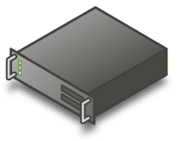

Running a Parallel Application on a Cluster
An illustration
Application
Logic
Logic
Logic
Logic
Logic
Desktop
Workstations
On-Premises
Servers
Public Cloud Servers
Cluster

Slide 7
What is Windows HPC Server?
Windows HPC Server is a version of Windows Server that includes technology for creating, using, and managing a compute cluster
  This talk describes Windows HPC Server 2008 R2 SP2, available in mid-2011
A Windows HPC cluster includes:
  A head node running on-premises
  Some number of compute nodes running on-premises and/or on Windows Azure

Slide 8

A Windows HPC Application on a Cluster
Windows HPC Application
Client
Logic
Job Scheduling
Cluster Management
Logic
Logic
Windows HPC
Server
Head Node
Windows 7
Windows HPC Server
Windows Azure
Compute Nodes

Slide 9
Using Windows HPC Server: Application Types

Slide 10
Using Windows HPC Server
Four types of applications (jobs)
MPI applications
Embarrassingly parallel applications
Excel applications
Big data applications

Slide 11
MPI Applications
Basics
Components in the job interact with each other while the job runs
  Using the Message Passing Interface (MPI)
  Commonly rely on high-bandwidth networks
What they’re used for:
  Simulations: car crashes, nuclear reactions, building materials
    Typically with packaged applications
  A common goal is to learn how something behaves in the real world without physically creating and testing it

Slide 12
MPI Applications
An illustration
MPI Job
Logic
Logic
Logic
1) Submit job
Client
Logic
Logic
Logic
2) Get results
Logic
Logic
Logic

Slide 13
Embarrassingly Parallel Applications
Basics
Components in the job do not interact with each other while the job runs
  Two categories:
    Parametric sweep jobs: run independent EXEs on each compute node
    SOA jobs: run WCF services on each compute node
What they’re used for:
  Financial services, such as pricing a bond
    Typically with custom applications
  A common goal is to explore many possible futures, then use the results to predict a likely outcome

Slide 14
Embarrassingly Parallel Applications
An illustration
Embarrassingly Parallel Job
Logic
Logic
Logic
1) Submit job
2) (Optionally) Interact with application
Client
Logic
Logic
Logic
3) Get results
Logic
Logic
Logic

Slide 15
Excel Applications
Basics
Options:
  Run Excel 2010 on each node in the cluster
  Run the logic of an Excel user-defined function (UDF) on the cluster
  Use Excel as the client for a SOA job
What they’re used for:
  Offloading Excel calculations onto a cluster for better performance

Slide 16

Excel Applications
An illustration
Workbook
Workbook
Workbook
Excel
Excel
Excel
1) Submit workbook
Workbook
Workbook
Workbook
2) Get results
Excel
Excel
Excel
Excel
Workbook
Workbook
Workbook
Excel
Excel
Excel

Slide 17
Big Data Applications
Basics
The goal is to use many disk drives in parallel to rapidly read large amounts of unstructured data
  Big data applications are I/O bound, not CPU bound
  Windows HPC Server provides LINQ to HPC for this
    Formerly code-named “Dryad”
What they’re used for:
  Examining large amounts of log data, e.g., from a Web farm
  Correlating ad spend with traffic
  Creating search engine indexes
  More . . .

Slide 18
Big Data Applications
An illustration
LINQ to HPC Job
Logic
Logic
Logic
Data
Data
Data
1) Submit job
LINQ to HPC Client
Logic
Logic
Logic
2) Get results
Data
Data
Data
Logic
Logic
Logic
Data
Data
Data

Slide 19
The Technology of Windows HPC Server: A Closer Look

Slide 20


Managing a Cluster
What Windows HPC Server provides
HPC Management Service
HPC Management Service
HPC Cluster Manager
HPC Management Service
Client
Head Node
Compute Nodes

Slide 21
HPC Cluster Manager
Five views
Configuration: Setting up the network for a cluster, adding users, etc.
Node Management: Adding and removing nodes, monitoring the status of a cluster’s nodes
Job Management: Submitting, monitoring, and managing cluster applications
Diagnostics: Running diagnostic tests on one or more nodes in the cluster
Charts and Reports: Providing information about the cluster’s behavior

Slide 22
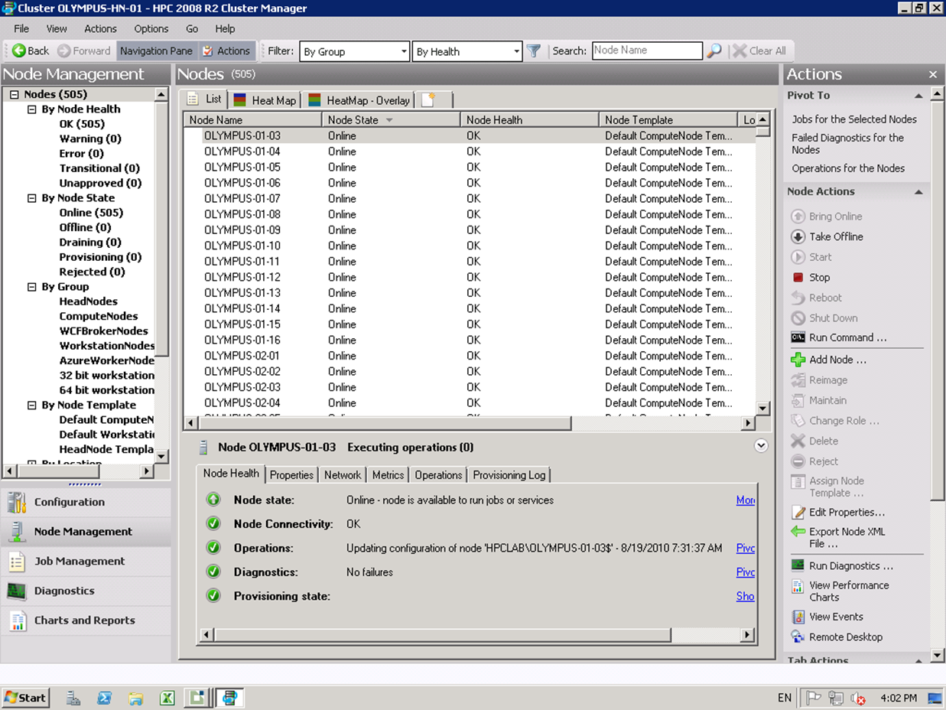
HPC Cluster Manager
Node Management view: List
List of nodes in the cluster
Details about a particular node
View selection

Slide 23
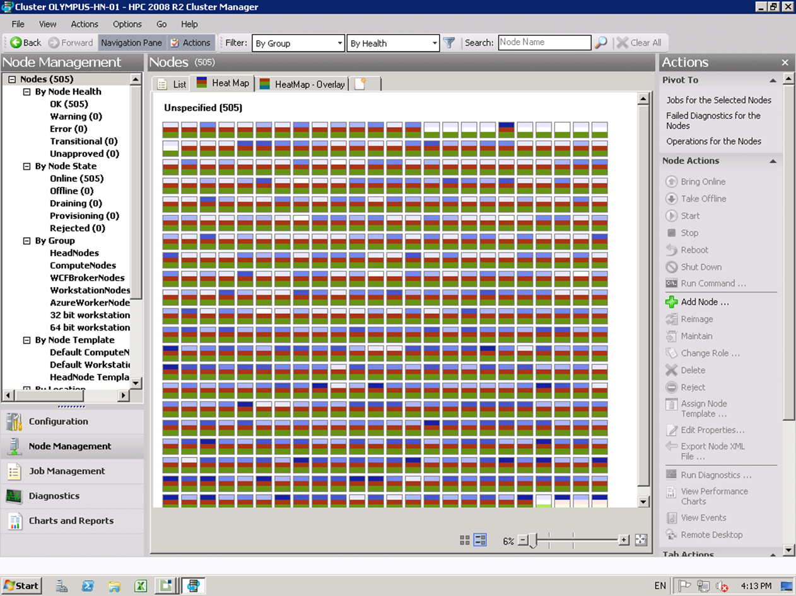
HPC Cluster Manager
Node Management view: Heat map
Each square represents a compute node
Each color shows a performance counter value

Slide 24
Running a Job
Illustrating the process
Windows HPC Job
Logic
4) Monitor job
1) Submit job
Logic
Node
Manager
Job
Manager Console
HPC Job Scheduler
Node
Manager
3) Select and run job
Job Queue
2) Place job in queue
Client
Head Node
Compute Nodes

Slide 25
Running a Job
Options
Jobs can be submitted in many ways:
  Command line, PowerShell, .NET API, browser, etc.
The HPC Job Scheduler implements two scheduling options:
  Queued: Runs jobs in first-come, first-served fashion
    Although higher-priority jobs can displace lower-priority jobs
  Balanced: Gives as many queued jobs as possible the minimum resources they require
    Any remaining resources are then allocated to higher-priority jobs

Slide 26
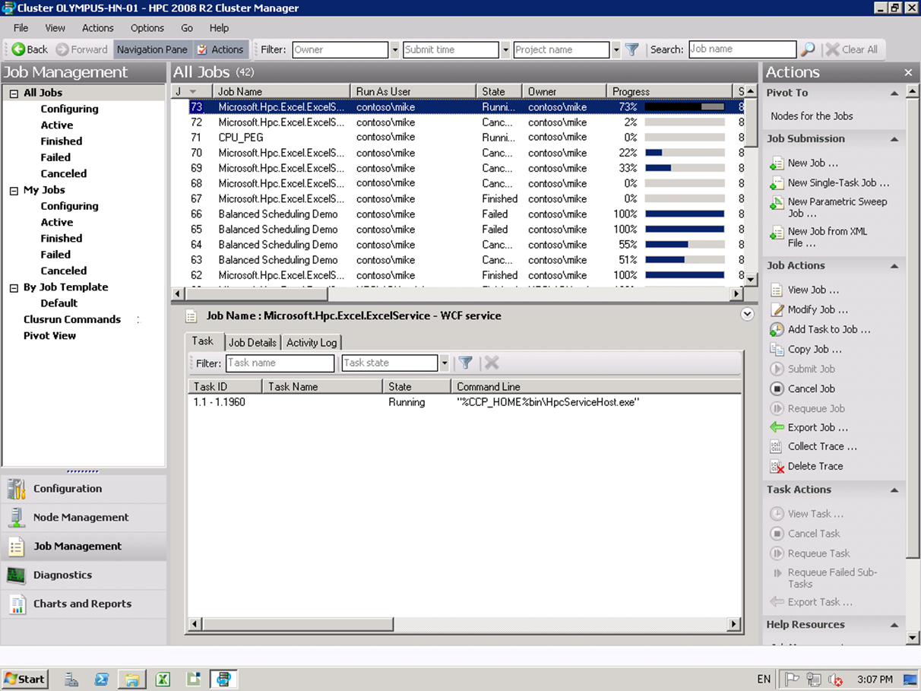
Running a Job
Monitoring job progress
List of jobs currently running on the cluster
Another option for submitting new jobs
Details about a particular job

Slide 27
Running a SOA Job
A closer look
HPC Job Scheduler
2) Schedule and start job
SOA Job
1) Submit job
WCF Service
3) Hand off job to broker node
4) Connect client with broker node
6) Pass requests to
services
WCF Service
Client
Request Queue
5) Submit requests
7) Return results
Client
Head Node
Broker Node
Compute Nodes

Slide 28
Supporting Big Data
LINQ to HPC applications are the newest option in Windows HPC Server
  The technology first shipped in Windows HPC Server 2008 R2 SP2
Challenges:
  Storing big data: Addressed by the Distributed Storage Catalog (DSC)
  Writing applications that process big data: Addressed by LINQ to HPC

Slide 29
Supporting Big Data
Illustrating the DSC
Distributed Storage Catalog
DSC File Set
DSC File
DSC File
DSC File
Head
Node
Compute Nodes

Slide 30
Supporting Big Data
Data locality in LINQ to HPC jobs
LINQ to HPC Client
LINQ to HPC Job
Logic
Logic
Logic
DSC File
Set
Data
Data
Data
Compute Nodes

Slide 31
Supporting Big Data
Running a LINQ to HPC job
2) Schedule and start job
LINQ to HPC Job
1) Execute LINQ to HPC query and submit job
Logic
Logic
4) Start and run job’s logic
HPC Job Scheduler
Distributed Storage Catalog
3) Find DSC files in input DSC file set
DSC
File
DSC
File
LINQ to
HPC Client
Client
Head Node
On-Premises Servers
Cluster

Slide 32

Cluster Computing on Windows
The evolution of Windows HPC Server
2011
MPI jobs, SOA jobs, Excel, Big data
On-premises servers, desktop workstations, cloud instances
2010
MPI jobs, SOA jobs, Excel
On-premises servers, desktop workstations
Kinds of Applications
2008
MPI jobs, SOA jobs
On-premises servers
2006
MPI jobs
On-premises servers
Kinds of Compute Nodes

Slide 33

About the Speaker
David Chappell is Principal of Chappell & Associates (www.davidchappell.com) in San Francisco, California. Through his speaking, writing, and consulting, he helps people around the world understand, use, and make better decisions about new technology. David has been the keynote speaker for more than a hundred events and conferences on five continents, and his seminars have been attended by tens of thousands of IT decision makers, architects, and developers in forty countries. His books have been published in a dozen languages and used regularly in courses at MIT, ETH Zurich, and other universities. In his consulting practice, he has helped clients such as Hewlett-Packard, IBM, Microsoft, Stanford University, and Target Corporation adopt new technologies, market new products, train their sales staffs, and create business plans. Earlier in his career, David wrote networking software, chaired a U.S. national standards working group, and played keyboards with the Peabody-award-winning Children’s Radio Theater. He holds a B.S. in Economics and an M.S. in Computer Science, both from the University of Wisconsin-Madison.

Slide 34

Track Resources
Don’t forget to visit the Cloud Power area within the TLC (Blue Section) to see product demos and speak with experts about the Server & Cloud Platform solutions that help drive your business forward.
You can also find the latest information about our products at the following links:
Cloud Power - http://www.microsoft.com/cloud/
Private Cloud - http://www.microsoft.com/privatecloud/
Windows Server - http://www.microsoft.com/windowsserver/
Windows Azure - http://www.microsoft.com/windowsazure/
Microsoft System Center - http://www.microsoft.com/systemcenter/
Microsoft Forefront - http://www.microsoft.com/forefront/

Slide 35





Resources
  Connect. Share. Discuss.
http://northamerica.msteched.com
Learning
  Sessions On-Demand & Community
  Microsoft Certification & Training Resources
www.microsoft.com/teched
www.microsoft.com/learning
  Resources for IT Professionals
  Resources for Developers
http://microsoft.com/technet
http://microsoft.com/msdn

Slide 36












Complete an evaluation on CommNet and
enter to win!

Slide 37


