Slide 2

Deploying Windows Server 2008 R2 Using
Microsoft Deployment Toolkit 2010 Lite Touch and Windows Deployment Services
WSV304
Mikael Nystrom
Senior Executive Consultant
TrueSec
Johan Arwidmark
Chief Technical Architect
Knowledge Factory

Slide 3
Agenda
Deploy Windows Server 2008 R2 with MDT 2010
Answer files and Task Sequences
Customizing the Lite Touch Environments
Hardware detection and driver injection
Pre- and Post-configuration actions
  Array and BIOS config (WinPE)
  Support and Management Apps
  Server Roles

Slide 4

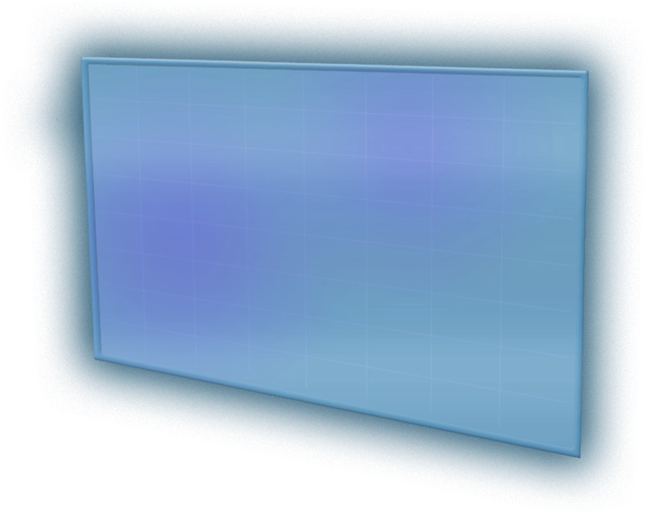
What is MDT 2010?
End-to-end guidance, best practices, and tools for efficient planning, building, and deploying Windows
Based on real-world experience and industry best practices
Manual Deployment
High cost
Fully Automated
Low cost
Notes:
5/17/2011 11:38 AM
4
© 2006 Microsoft Corporation. All rights reserved. Microsoft, Windows, Windows Vista and other product names are or may be registered trademarks and/or trademarks in the U.S. and/or other countries.
The information herein is for informational purposes only and represents the current view of Microsoft Corporation as of the date of this presentation. Because Microsoft must respond to changing market conditions, it should not be interpreted to be a commitment on the part of Microsoft, and Microsoft cannot guarantee the accuracy of any information provided after the date of this presentation.
MICROSOFT MAKES NO WARRANTIES, EXPRESS, IMPLIED OR STATUTORY, AS TO THE INFORMATION IN THIS PRESENTATION.

Slide 5
Lite Touch Scenarios
Deployment without management infrastructure
Manually initiated
Uses network share, Windows Deployment Services, CD/DVD, or USB
Refresh, upgrade, replace, new computer
Notes:
5/17/2011 11:38 AM
5
© 2006 Microsoft Corporation. All rights reserved. Microsoft, Windows, Windows Vista and other product names are or may be registered trademarks and/or trademarks in the U.S. and/or other countries.
The information herein is for informational purposes only and represents the current view of Microsoft Corporation as of the date of this presentation. Because Microsoft must respond to changing market conditions, it should not be interpreted to be a commitment on the part of Microsoft, and Microsoft cannot guarantee the accuracy of any information provided after the date of this presentation.
MICROSOFT MAKES NO WARRANTIES, EXPRESS, IMPLIED OR STATUTORY, AS TO THE INFORMATION IN THIS PRESENTATION.

Slide 6
Lite Touch Deployment
demo

Slide 7
Customizing Lite Touch
Rules (Customsettings.ini) controls the deployment
Open Architecture
  Vbscript
  HTA
Wizard Editor available from Codeplex
Notes:
5/17/2011 11:38 AM
7
© 2006 Microsoft Corporation. All rights reserved. Microsoft, Windows, Windows Vista and other product names are or may be registered trademarks and/or trademarks in the U.S. and/or other countries.
The information herein is for informational purposes only and represents the current view of Microsoft Corporation as of the date of this presentation. Because Microsoft must respond to changing market conditions, it should not be interpreted to be a commitment on the part of Microsoft, and Microsoft cannot guarantee the accuracy of any information provided after the date of this presentation.
MICROSOFT MAKES NO WARRANTIES, EXPRESS, IMPLIED OR STATUTORY, AS TO THE INFORMATION IN THIS PRESENTATION.

Slide 8
Customizing Lite Touch
demo

Slide 9
Drivers, BIOS and Arrays
Boot Critical Drivers
Hardware detection
Driver Injection
BIOS and Array Configuration
  Using Vendor Toolkits

Slide 10
Drivers, BIOS and Arrays Management
demo

Slide 11
Lite Touch Automation
The MDT Database
  SQL 2008 R2 or SQL Server 2008 R2 Express recommended
  MDT by default is using Named Pipes
  Create a Security Login

Slide 12
Lite Touch Automation
demo

Slide 13

Related Content
Required Slide
Speakers, please list the Breakout Sessions, Interactive Discussions, Labs, Demo Stations and Certification Exam that relate to your session. Also indicate when they can find you staffing in the TLC.
WCL403 | Troubleshooting Windows 7 Deployments: In Depth
WCL302 | Absolute Offline Servicing Windows OS
WCL316 | Maximizing Windows 7 Performance: Troubleshooting Tips
WCL401 | Inside Panther: Troubleshooting the Windows Setup Engine
OSP471-INT | Desktop Deployment Live Gameshow

Slide 14
Track Resources
Don’t forget to visit the Cloud Power area within the TLC (Blue Section) to see product demos and speak with experts about the Server & Cloud Platform solutions that help drive your business forward.
You can also find the latest information about our products at the following links:
Cloud Power - http://www.microsoft.com/cloud/
Private Cloud - http://www.microsoft.com/privatecloud/
Windows Server - http://www.microsoft.com/windowsserver/
Windows Azure - http://www.microsoft.com/windowsazure/
Microsoft System Center - http://www.microsoft.com/systemcenter/
Microsoft Forefront - http://www.microsoft.com/forefront/

Slide 15





Resources
  Connect. Share. Discuss.
http://northamerica.msteched.com
Learning
  Sessions On-Demand & Community
  Microsoft Certification & Training Resources
www.microsoft.com/teched
www.microsoft.com/learning
  Resources for IT Professionals
  Resources for Developers
http://microsoft.com/technet
http://microsoft.com/msdn

Slide 16












Complete an evaluation on CommNet and
enter to win!

Slide 17

Notes:
New for TechEd 2011, we will be working with Microsoft Tag (http://tag.microsoft.com/overview.aspx) to create unique Tags for every session at the event. Your session Tag will appear on both the room signage and at the end of your presentation. With your session Tag, attendees will be able to scan as they enter the room to retrieve session details, view speaker bios, and engage in discussions; or scan at the end of the presentation to evaluate your session and download materials. We’re excited to integrate Microsoft Tag across the My TechEd mobile experience this year.

