Slide 1

Windows Server 2008 R2 File Services Consolidation - Technology Update
WSV317-R
Jose Barreto
Principal Program Manager
Microsoft Corporation

Slide 2
Agenda
Session Objectives and Scenario Overview
File Server Scalability and Performance
File Server Name Consolidation
File Server Advanced Networking
File Server High Availability
In Review: Session Objectives

Slide 3
1.1. Session Objectives
Session Objective(s):
  Describe the technical improvements in Windows Server 2008 R2 file services, including performance, scalability and availability.
  Outline different strategies to implement name consolidation, network fault tolerance and higher availability in your file services.
  Compare a few recommended Windows Server 2008 R2 consolidated file services configurations.

Slide 4
1.2. Scenario Overview
File Servers are being consolidated
(as are many other services out there)
Consolidation will lead you to more shares running in fewer servers
More shares and users per server calls for higher scalability and performance
Users want assurances that:
  Servers can deliver on scalability and performance
  Path to files do not change with consolidation
  Networks can scale and be fault tolerant
  File Service is highly available
File Server
Sprawl
File Server
Consolidation
Investment
in File Services
Technologies

Slide 5
2. File Server Scalability and Performance
2.1. Improvements since Windows Server 2003
2.2. Sample Configuration – 24 spindles
2.3. Sample Configuration – 96 spindles
2.4. Sample Configuration – 192 spindles

Slide 6
2.1. Improvements since Windows Server 2003
SMB 2.1
8 years of innovation in File Services:
  Performance – more throughput, more users/server
  Scalability – more shares, more files and more users
  WAN Efficiency – faster over high latency
  Metrics – Using the File Server Capacity Tool (FSCT)
  Better together with Windows 7
What do you need to know about
moving to Windows Server 2008 R2?
DFS-R
Failover Clustering
File Services Role
Offline Files
CHKDSK
Folder Redirection
Durability
DFS-N
BranchCache
Leasing
Robocopy
Large MTU
Storage Server
File Classification Infrastructure (FCI)
8.3 naming

Slide 7
2.1a. SMB2 and SMB 2.1 improvements
Limits | SMB1 | SMB2
Number of users | Max 2^16 | Max 2^64
Number of open files | Max 2^16 | Max 2^64
Number of shares | Max 2^16 | Max 2^32
Increased file sharing scalability
Improved performance
  Request compounding reduces “chattiness”
  Asynchronous operations allow filling high latency pipelines
  Larger reads/writes can fill the pipe even with significant link latency
More secure and robust
  Small command set allows quicker innovation
  Stronger and more efficient signing (HMAC SHA-256 replaces MD5)
  Network fault tolerance with SMB2 durability
SMB 2.1 improvements
  Large MTU support
  Leasing improvements
Total | SMB1 | SMB2
Opcodes | >100 | 19

Slide 8
2.1b. Make sure you’re running the right version…
 | Windows Vista, Windows Server 2003, and prior operating systems | Windows Vista SP1+ and Windows Server 2008 | Windows 7 and Windows Server 2008 R2
Windows Vista, Windows Server 2003, and prior operating systems | SMB 1 | SMB 1 | SMB 1
Windows Vista SP1+ and Windows Server 2008 | SMB 1 | SMB 2 | SMB 2
Windows 7 and Windows Server 2008 R2 | SMB 1 | SMB 2 | SMB 2.1
If you’re running Windows Server 2003
or Windows XP, you‘re not using SMB2

Slide 9
2.1c. CHKDSK Improvements
CHKDSK time vs. number files per volume
CHKDSK time vs. volume size (10 million files)
Less than 2 hours to CHKDSK a volume with
100 million files
Hours
New white paper on CHKDSK available!
Seconds
Less than 7 minutes to CHKDSK a 15 TB volume with 10 million files
Files on Volume (Millions)
Volume Size (TB)
Important note: CHKDSK scales with the number of files in the volume, not the size of the volume.

Slide 10
2.1d. 8.3 naming disabling and stripping
Creating 100K files in a 1M files directory
Directory enumeration with 1M files directory
Huge benefits in file creation performance with 8.3 naming disabling or stripping
For enumeration, you need 8.3 naming stripping to see performance benefits

Slide 11
2.1e. DFS Namespace Scalability
Improved performance with Standalone Namespaces
Even better performance with 2008-mode Domain Namespaces
Dramatic improvement in WS 2008 compared to WS 2003 (standalone namespaces)
Additional performance for very large namespaces (300,000+ links) (both modes)
Windows Server 2008 R2 test run with up to 1.3 million (!) links per namespace
*http://www.snia.org/events/storage-developer2009/presentations/wednesday/SaadAnsari-Hasegawa_Barreto_DFS-N_Overview-rev.pdf

Slide 12
2.1f. Multi-threaded ROBOCOPY
Note: lower is better
Performance increase
with multiple threads
With multiple threads, ROBOCOPY is much faster on WAN connections
Syntax: robocopy /mt:128 /log:nul

Slide 13
2.1g. Scalability Improvement Over Time
WS2008 R2
4,400 users
WS2008
3,200 users
WS2003
1,200 users
Bottlenecked
on disk I/O
Running on server hardware “typical” of release date
(~$3,000 configuration with 12 disks on RAID-0)

Slide 14
2.2. Sample Configuration – 24 spindles
WS 2008 R2
7500+ Users
WS 2008 SP2
4500+ Users
Operating System | WS 2008 SP2 | WS 2008 R2
Users | 4,500 | 7,500
CPU: 1 x X5560 2.8GHz | 11.22% | 28.40%
Memory: 16GB | 44% | 58%
Disks: 24 RAID-10, HBA: 1 x 8Gb FC | 112 MB/s | 167 MB/s
Network: 1 x 10G | 121 MB/s | 183 MB/s
Bottlenecked
on disk I/O

Slide 15
2.3. Sample Configuration – 96 spindles
WS 2008 R2
16500+ Users
WS 2008 SP2
7500+ Users
Operating System | WS 2008 SP2 | WS 2008 R2
Users | 7,500 | 16,500
CPU: 2 x X5560 2.8GHz | 12.90% | 48.30%
Memory: 72GB | 17% | 17%
Disks: 96 RAID-10, HBA: 2 x 8Gb FC | 179 MB/s | 419 MB/s
Network: 1 x 10G | 197 MB/s | 457 MB/s
Bottlenecked
on controller I/O

Slide 16
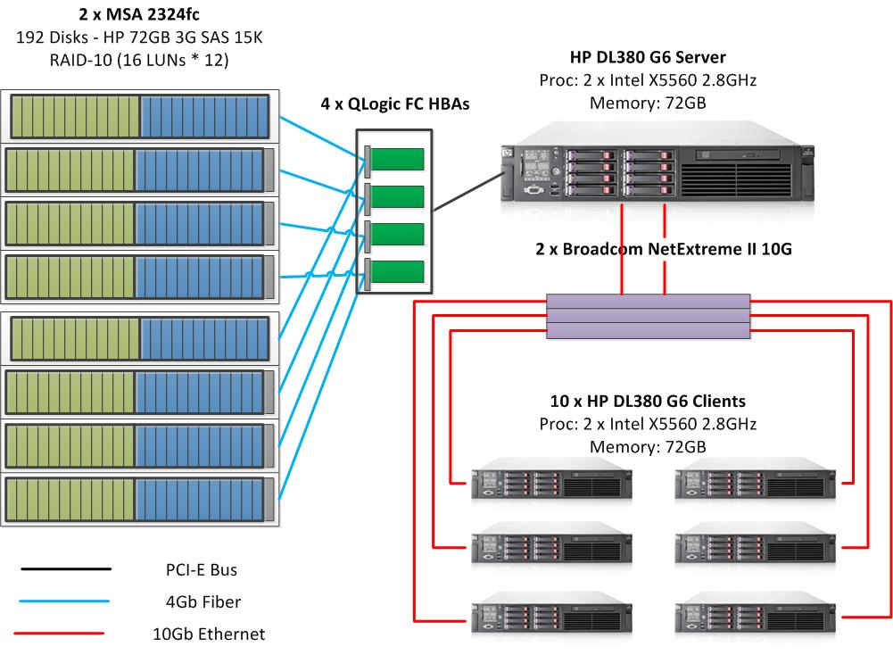
2.4. Sample Configuration – 192 spindles!
WS 2008 R2
23,000 users (!)
Bottleneck
on ?
Operating System | WS 2008 R2
Users | 23,000
CPU: 2 x X5560 2.8GHz | 63.10%
Memory: 72GB | 23%
Disks: 192 RAID-10, HBA: 4 x 8Gb FC | 601 MB/s
Network: 2 x 10G | 650 MB/s
New White Paper with these FSCT results available!

Slide 17
3. File Server Name Consolidation
3.1. The name problem
3.2. Static DNS Entries
3.3. Alternate Computer Names and Dynamic DNS
3.4. DFS Consolidation Roots
3.5. Virtual Machines
3.6. Failover Clusters

Slide 18
3.1. The name consolidation problem
FILE1
CFILE
\\FILE1\Orders
\\FILE1\Sales
\\FILE2\Training
\\FILE2\Software
\\FILE3\Engineering
\\FILE3\Sales
\\CFILE\Orders
\\CFILE\Sales
\\CFILE\Training
\\CFILE\Software
\\CFILE\Engineering
\\CFILE\Sales2
Orders
Orders
Sales
Sales
FILE2
Training
Training
Software
Software
FILE3
Engineering
Engineering
Sales
Sales2
The goal is to consolidate the file servers and keep the same UNC path

Slide 19
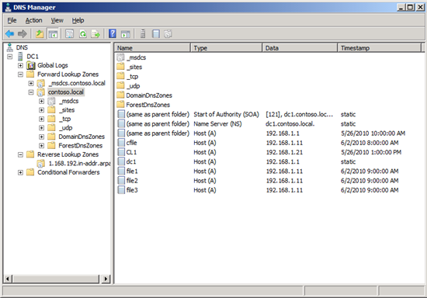
3.2. Static DNS Entries
Create A record (or CNAME record if using DHCP) in DNS for each consolidate file server
All shares will show under any of the names or IP addresses
Each consolidated file server shows as an A record in DNS
DNSCMD dc1.contoso.local /RecordAdd contoso.local File1 A 192.168.1.11
DNSCMD dc1.contoso.local /RecordAdd contoso.local File2 A 192.168.1.11
DNSCMD dc1.contoso.local /RecordAdd contoso.local File3 A 192.168.1.11

Slide 20
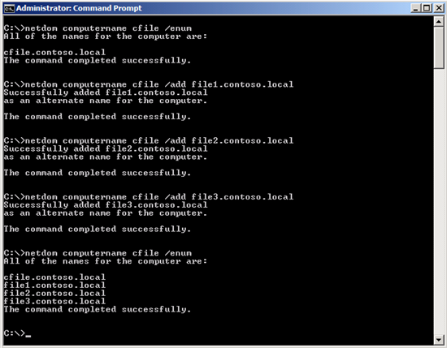

3.3. Alternate Computer Names and Dynamic DNS
Create alternate computer names for each of the consolidated file server
All shares will show under any of the names or IP addresses
Each consolidated file server shows as an alternate
computer name
NETDOM COMPUTERNAME cfile /ADD file1.contoso.local
NETDOM COMPUTERNAME cfile /ADD file2.contoso.local
NETDOM COMPUTERNAME cfile /ADD file2.contoso.local
IPCONFIG /registerdns

Slide 21
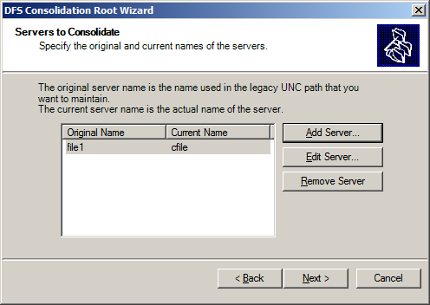
3.4. DFS Consolidation Roots
Create a consolidated DFS Namespace Root for each of the consolidated file server
Create links to the old shares in each DFS Namespace
Each share shows only under the specific namespace
Automate the process using FSMT
http://support.microsoft.com/kb/829885
Each consolidated file server is mapped to a new
DFS namespace root
DFSUTIL ROOT ADDSTD \\cfile\#file1
DFSUTIL ROOT ADDSTD \\cfile\#file2
DFSUTIL ROOT ADDSTD \\cfile\#file3

Slide 22
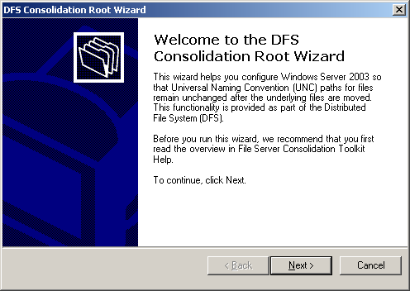
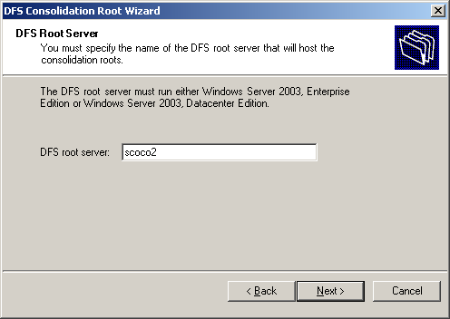
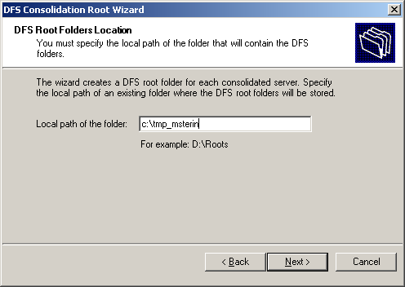
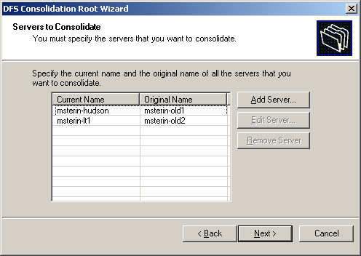
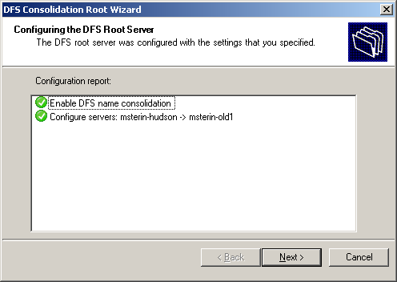
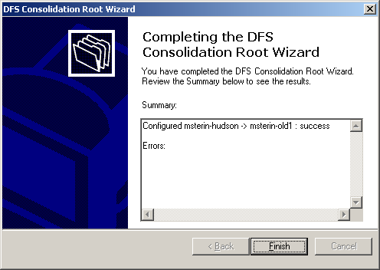
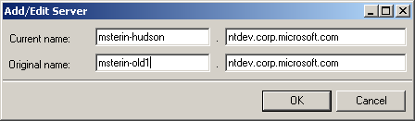
3.4. DFS Consolidation Roots
Wizard Start
DFS Server name?
DFS root folder?
Old server names?
Configure DFS
Wizard Finish
File Server Migration Toolkit 1.2

Slide 23
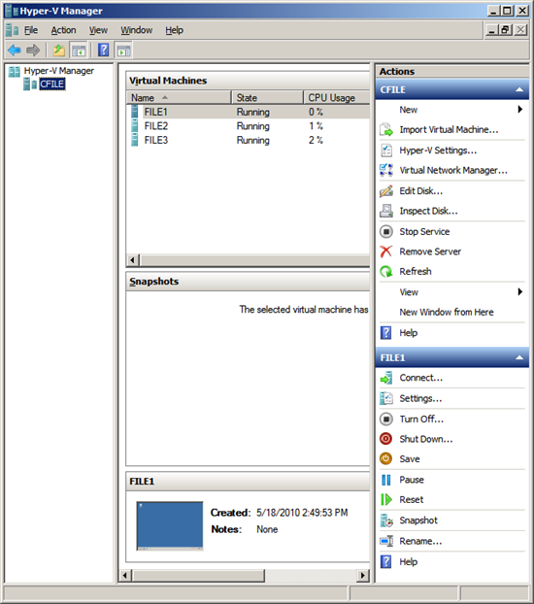
3.5. Virtual Machines
Create one VM per consolidated file server
Use a matching computer name and even a matching IP address
Leverage Physical to Virtual (P2V) tools
Each consolidated file server shows as virtual machine

Slide 24
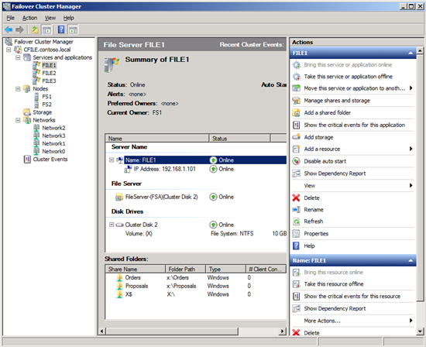
3.6. Failover Clusters
Each consolidated file server shows as cluster file service
Create one clustered file service (cluster group) per consolidated file server
Use a matching name and even a matching IP address

Slide 25
4. File Server Advanced Networking
4.1. DNS Round Robin
4.2. SMB2 Durability
4.3. Multiple IP addresses per cluster name
4.4. NIC Teaming
4.5. Sample Multi-NIC File Server Configurations

Slide 26
4.1. DNS Round Robin
DNS
Multiple NICs in the file server
File server IP addresses are registered with the DNS server (dynamically or manually)
When a client queries the name, it gets an ordered list
of IP addresses that is reordered by the DNS server with every request
File server clients favor the first IP address in the list received from the DNS server
If several clients access the file server by that DNS name, they tend to be distributed across the multiple IP addresses evenly
FILE1
192.168.1.1
192.168.2.1
192.168.3.1
CLIENT1
FILE1
192.168.1.1
192.168.2.1
192.168.3.1
CLIENT2
FILE1
192.168.3.1
192.168.1.1
192.168.2.1
FILE1
Router
192.168.1.1/24
192.168.2.1/24
192.168.3.1/24
CLIENT3
FILE1
192.168.2.1
192.168.3.1
192.168.1.1

Slide 27
4.2. SMB2 Durability
Multiple NICs in the file server
SMB client receive a list of IP addresses from the DNS server
SMB client connects to one of them
Upon network failure, handles survive
SMB2 client will try to reconnect, maybe using another NIC
Requires SMB2 (durable handles are default)
Opportunistic in nature (no guarantees)
Oplocks (opportunistic locks) are required for reconnection
Other SMB clients can break oplocks
Potential Network
Failure
Network Interfaces
Server
SMB

Slide 28
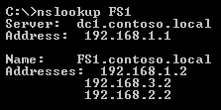
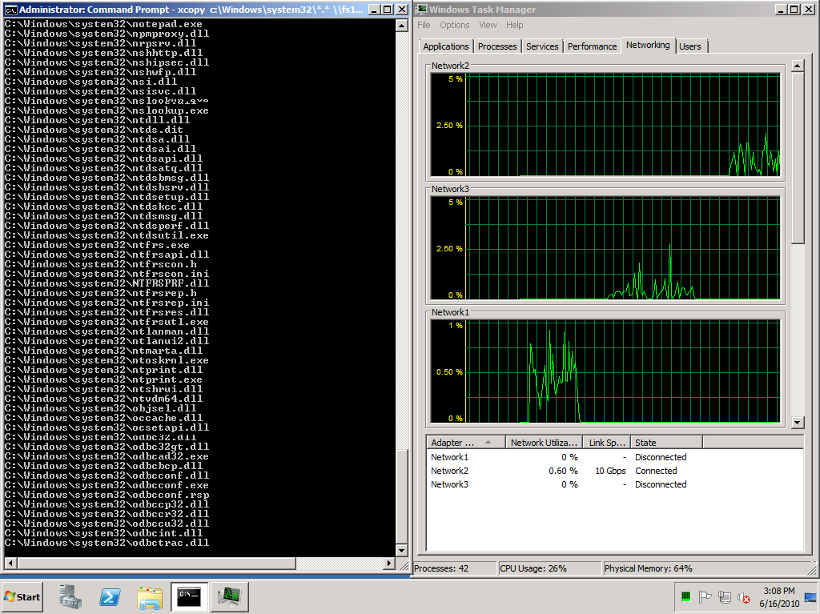
4.2. SMB2 Durability
Network3 disconnected, SMB2 uses Network2
Network1 disconnected, SMB2 uses etwork3
Copy starts, Network1 is used
DNS reports multiple IP addresses for the file server

Slide 29
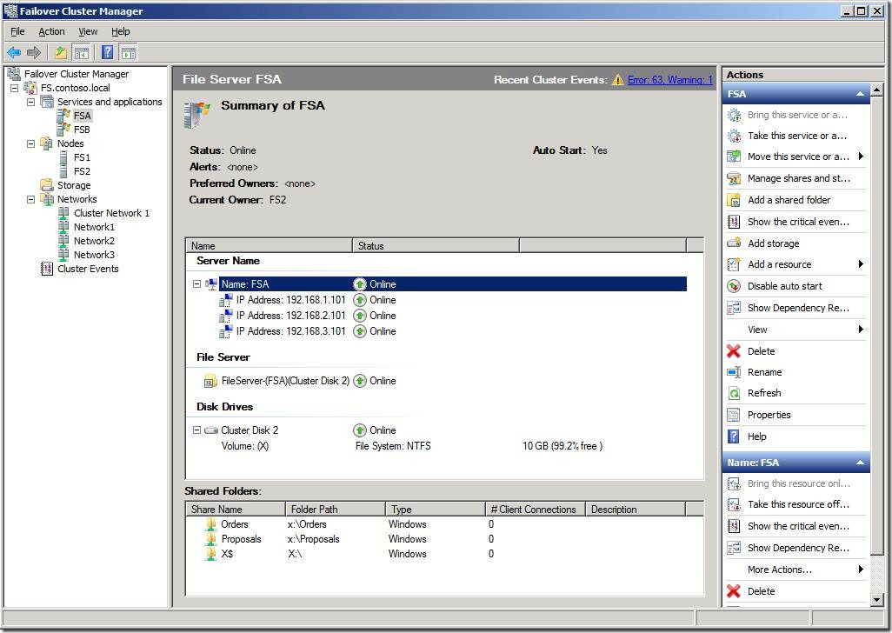
4.3. Multiple IP addresses per cluster name
Multiple cluster networks enabled for public access
Multiple IP addresses for each cluster name defined

Slide 30
Multiple NICs
DNS Round Robin
SMB2 Durability
demo

Slide 31
4.4. NIC Teaming
Several Physical NICs grouped into one Logical NIC
Also known as “Link Aggregation” or “Load Balancing and Fail-Over” (LBFO)
Available from most NIC vendors including Intel, Broadcom and HP
Support is provided by the NIC vendor
(See Microsoft KB 254101 and 968703)
Potential Network
Failure
Network Interfaces
Server
SMB

Slide 32
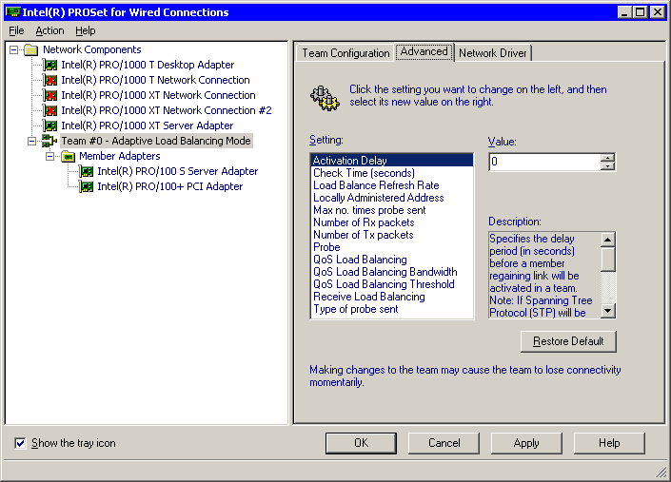
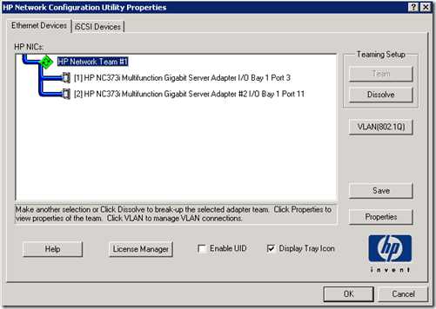
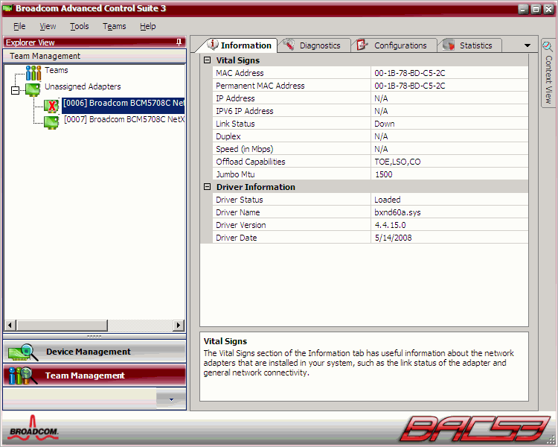
4.4. NIC Teaming
Make sure you have the latest versions of the vendor’s drivers

Slide 33
4.5. Sample Multi-NIC File Server Configurations
Standalone, single switch, single client NIC – 2nd NIC disabled
Standalone, single switch, single client NIC – NIC teaming
Standalone, single switch, single client NIC – same subnet
Standalone, multiple switches, single client NIC
Standalone, router, single client NIC
Standalone, multiple switches, multiple client NICs
Cluster, router, single client NIC
Cluster, multiple switches, multiple client NICs

Slide 34
4.5a. Standalone, single switch, single client NIC – 2nd NIC disabled
Client 1
192.168.1.21/24
File Server
Switch
192.168.1.1/24
Client 2
Disabled
192.168.1.22/24
Second NIC on the file server is wasted :-(

Slide 35
4.5b. Standalone, single switch, single client NIC – NIC teaming
Client 1
192.168.1.21/24
File Server
Switch
NIC Teaming
192.168.1.1/24
Client 2
192.168.1.22/24
NIC Teaming requires a third-party solution (from NIC vendor)

Slide 36
4.5c. Standalone, single switch, single client NIC – same subnet
Client 1
192.168.1.21/24
File Server
192.168.1.1/24
Switch
Client 2
192.168.1.2/24
192.168.1.22/24
Multiple NICs on the same computer on the same subnet is not a supported configuration.
See http://support.microsoft.com/kb/175767

Slide 37
4.5d. Standalone, multiple switches, single client NIC
Client 1
192.168.1.21/24
File Server
Switch 1
192.168.1.1/24
Client 2
Switch 2
192.168.2.1/24
192.168.2.21/24
Each NIC on the server supports a different set of clients.
Load is not balanced between NICs.

Slide 38
4.5e. Standalone, router, single client NIC
Client 1
10.1.1.21/24
File Server
Switch 3
Router
Switch 1
192.168.1.1/24
Client 2
Switch 4
Switch 2
192.168.2.1/24
10.1.2.21/24
Ideal for standalone multi-NIC file server with single-NIC file clients.
Could be combined with NIC teaming on the file server side.

Slide 39
4.5f. Standalone, multiple switches, multiple client NICs
Server 1
To client networks…
192.168.1.21/24
Router
192.168.2.21/24
File Server
Switch 1
192.168.1.1/24
Server 2
Switch 2
192.168.2.1/24
192.168.1.22/24
192.168.2.22/24
Ideal for standalone multi-NIC file server with multi-NIC file clients
Typical scenario is an application server (like SQL Server) using SMB2
Could be combined with NIC teaming on both sides

Slide 40
4.5g. Cluster, router, single client NIC
Client 1
File Server 1
File Service A
192.168.1.1/24
192.168.1.11
10.1.1.21/24
192.168.2.1/24
192.168.2.11
Switch 3
Router
Switch 1
Client 2
Switch 4
Switch 2
File Server 2
File Service B
10.1.2.21/24
192.168.1.2/24
192.168.1.12
192.168.2.2/24
192.168.2.12
Ideal for clustered multi-NIC file server with single-NIC file clients
Could be combined with NIC teaming on the file server side.

Slide 41
4.5h. Cluster, multiple switches, multiple client NICs
Server 1
To client networks…
File Server 1
File Service A
192.168.1.21/24
Router
192.168.1.1/24
192.168.1.11
192.168.2.21/24
192.168.2.1/24
192.168.2.11
Switch 1
Server 2
Switch 2
File Server 2
192.168.1.22/24
File Service B
192.168.1.2/24
192.168.1.12
192.168.2.22/24
192.168.2.2/24
192.168.2.12
Ideal for clustered multi-NIC file server with multi-NIC file clients
Typical scenario is an application server like SQL Server using SMB2
Could be combined with NIC teaming on both sides

Slide 42
5. File Server High Availability
5.1. Multi-Site DFS and Offline Files
5.2. Single-Site DFS
5.3. Cluster – Active/Passive vs. Multi-Active
5.4. File Server Cluster – FC SAN
5.5. File Server Cluster – SAS Array
5.6. File Server Cluster – iSCSI SAN
5.7. Virtual File Server with DFS
5.8. Virtual File Server – Host Cluster
5.9. Virtual File Server – Guest Cluster

Slide 43
5.1. Multi-site DFS and Offline Files
Two File Servers (1 in HQ, 1 in branch)
Distributed File System Namespaces (DFS-N)
Distributed File System Replication (DFS-R)
Client-side Caching (CSC), a.k.a. Offline Files
No open file replication
Potential replication delay between sites
Potential replication conflicts
Does not replace regular backups
Potential Client
Failure
CSC
Client
DAS
DFS-R
SMB
DFS-N
Potential Host
Failure
ServerBO
DAS
ServerHQ
Potential Host
Failure
DFS-R
SMB
DFS-N

Slide 44
5.2. Single-site DFS
Two File Servers
Directly Attached Storage (DAS)
Distributed File System Namespaces (DFS-N)
Distributed File System Replication (DFS-R)
Single-site with high/low priority targets
(use DFS-N Target Prioritization)
Low priority shares defined as read-only
(make read/write manually upon failure)
No open file replication
Non-replicated data lost if main file server fails
Does not replace regular backups
Network Interfaces
Server1
Server2
Read-Only
SMB
DFS-N
SMB
DFS-N
DFS-R
DFS-R
DAS
DAS
DAS
DAS
Potential Host
Failure

Slide 45
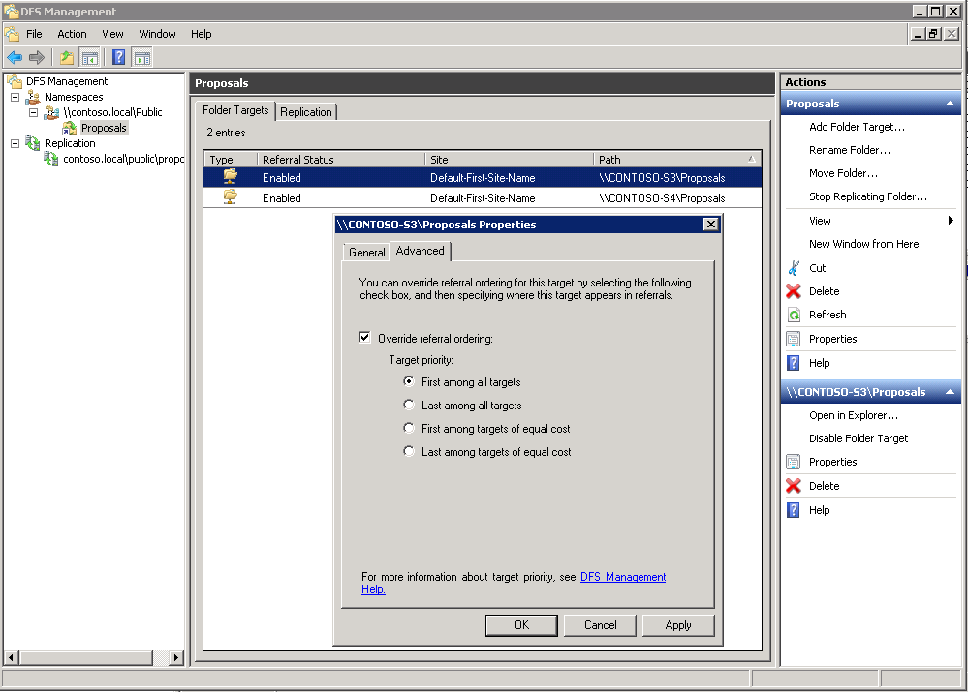
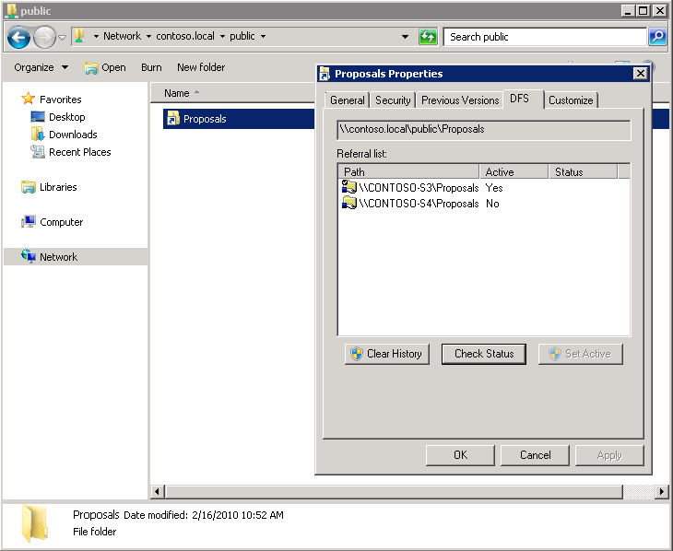
5.2. File Servers plus DFS
DFS Client:
Prioritized Target
is used
DFS Server:
Target priority
is defined

Slide 46
5.3. Cluster - Active/Passive vs. Multi-Active
1 service, 1 name
Active/Passive
2 volumes, 4 shares
\\FSA\Share1
\\FSA\Share2
\\FSA\Share3
\\FSA\Share4
No overload on failure
Easier to manage
Single name
2 services, 2 names
Dual Active
2 volumes, 4 shares
\\FSA\Share1
\\FSA\Share2
\\FSB\Share3
\\FSB\Share4
No idle nodes
Client
Client
Switch
Switch
FS1 = 10.1.1.1
FS2 = 10.1.1.2
FS1 = 10.1.1.1
FS2 = 10.1.1.2
Name=FSA
IP=10.1.1.3
Name=FSA
IP=10.1.1.3
Name=FSB
IP=10.1.1.4
Active
Passive
Share1
Share2
Share3
Share4
Share1
Share2
Share3
Share4
Shared Storage
Shared Storage

Slide 47
5.4. File Server Cluster – FC SAN
Two Nodes with Windows Server
Failover Clustering (WSFC)
Shared Storage
FC Array with dual controllers
Potential Host
Failure
Network Interfaces
Node1
Node2
WSFC
SMB
WSFC
SMB
FC HBA
FC HBA
FC Switch
FC Switch
Controller
1
Controller
2
FC Array

Slide 48
5.5. File Server Cluster – SAS Array
Two Nodes with Windows Server
Failover Clustering (WSFC)
Shared Storage
SAS Array with dual controllers
Network Interfaces
Potential Host
Failure
Node1
Node2
WSFC
SMB
WSFC
SMB
SAS HBA
SAS HBA
Controller
1
Controller
2
SAS Array

Slide 49

5.6. File Server Cluster – iSCSI SAN
Potential Host
Failure
Network Interfaces
Node1
Node2
WSFC
SMB
WSFC
SMB
iSCSI Initiator
iSCSI Initiator
iSCSI Network
Interfaces
Switch
Switch
Controller
1
Controller
2
iSCSI Array

Slide 50
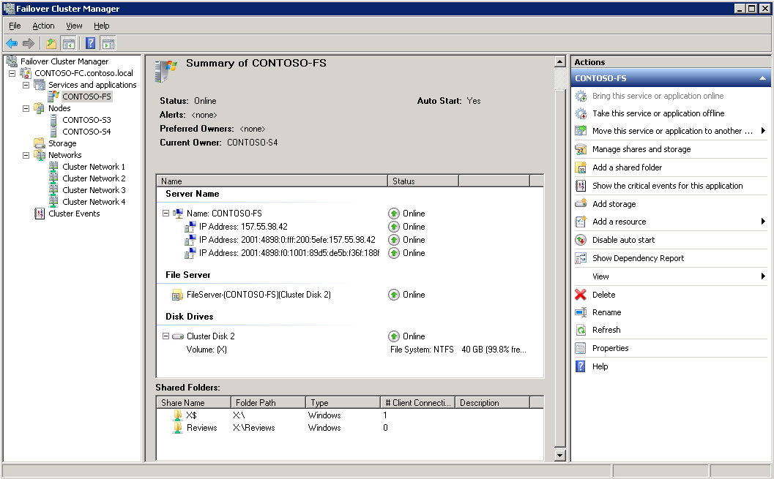
5.6. File Server Cluster – iSCSI SAN
File Service
is Highly Available
Running now on
CONTOSO-S4
Two potential nodes
Using Cluster Disk 2 as Shared Storage
File share is
called Reviews
Access path is
\\CONTOSO-FS\Reviews

Slide 51
5.7. Virtual File Server – DFS
Network Interfaces
Two Virtual File Servers
Directly Attached Storage (DAS)
DFS Namespaces (DFS-N)
DFS Replication (DFS-R)
Single-site with high/low priority targets
(use DFS-N Target Prioritization)
Low priority shares defined as read-only
(make read/write manually upon failure)
No open file replication
Non-replicated data lost if main file server fails
Does not replace regular backups
VM1 with
File Server
VM2 with File Server
Read-Only
SMB
DFS-N
SMB
DFS-N
DFS-R
DFS-R
Hyper-V 1
Hyper-V 2
Potential Host
Failure

Slide 52

5.8. Virtual File Server, Host Cluster
Network Interfaces
Hyper-V 1
VM with
File Server
Hyper-V 2
WSFC
SMB
WSFC
Potential Host
Failure
Shared Storage

Slide 53
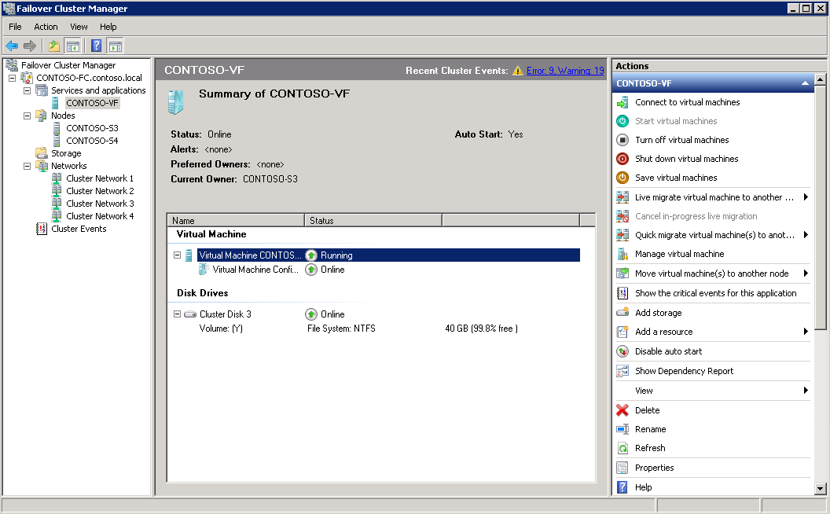
5.8. Virtual File Server, Host Cluster
Virtual Machine is Highly Available
File Service and
File Shares in the VM
(not visible here)

Slide 54

5.9. Virtual File Server, Guest Cluster
Network Interfaces
Potential Host
Failure
Hyper-V 1
Hyper-V 2
Node1
Node2
WSFC
SMB
WSFC
SMB
iSCSI Initiator
iSCSI Initiator
iSCSI Network
Interfaces
Switch
Switch
Controller
1
Controller
2
iSCSI Array

Slide 55
Virtual File Servers
Guest Cluster iSCSI SAN
demo

Slide 56
6. In Review: Session Objectives
Session Objective(s):
  Describe the technical improvements in Windows Server 2008 R2 file services, including performance, scalability and availability.
  Outline different strategies to implement name consolidation, network fault tolerance and higher availability in your file services.
  Compare a few recommended Windows Server 2008 R2 consolidated file services configurations.

Slide 57
Related Content
WSV317 | Windows Server 2008 R2 File Services Consolidation: Technology Update (Repeats on 5/19 at 10:15am)
WSV317-R | Windows Server 2008 R2 File Services Consolidation: Technology Update (Repeated from 5/18 at 10:15am)
WSV318 | Windows Storage Server 2008 R2 Technical Overview
Wednesday, May 18 | 3:15 PM - 4:30 PM | Room: B309
WSV313 | Microsoft iSCSI Software Target 3.3 for Application Storage
Tuesday, May 17 | 5:00 PM - 6:15 PM | Room: B101
WSV323 | Information Governance for Unstructured Data Using the Data Classification Toolkit for Windows Server 2008 R2
Wednesday, May 18 | 10:15 AM - 11:30 AM | Room: C206

Slide 58
Where to find me
Required Slide
Speakers, please list the Breakout Sessions, Interactive Discussions, Labs, Demo Stations and Certification Exam that relate to your session. Also indicate when they can find you staffing in the TLC.
Blog: http://blogs.technet.com/josebda
Twitter: http://twitter.com/josebarreto
Technical Learning Center (TLC) booth WSV (Windows Server) 13

Slide 59





Resources
  Connect. Share. Discuss.
http://northamerica.msteched.com
Learning
  Sessions On-Demand & Community
  Microsoft Certification & Training Resources
www.microsoft.com/teched
www.microsoft.com/learning
  Resources for IT Professionals
  Resources for Developers
http://microsoft.com/technet
http://microsoft.com/msdn

Slide 60












Required Slide
Complete an evaluation on CommNet and
enter to win!

Slide 61


Slide 62

© 2011 Microsoft Corporation. All rights reserved. Microsoft, Windows, Windows Vista and other product names are or may be registered trademarks and/or trademarks in the U.S. and/or other countries.
The information herein is for informational purposes only and represents the current view of Microsoft Corporation as of the date of this presentation. Because Microsoft must respond to changing market conditions, it should not be interpreted to be a commitment
on the part of Microsoft, and Microsoft cannot guarantee the accuracy of any information provided after the date of this presentation. MICROSOFT MAKES NO WARRANTIES, EXPRESS, IMPLIED OR STATUTORY, AS TO THE INFORMATION IN THIS PRESENTATION.

