Slide 1
Windows Authentication Deep Dive:
What Every Administrator Should Know
(Repeats on 5/19 at 10:15am)
WSV320
Gary Olsen
Solution Architect, Hewlett-Packard Technology Services
Don McCall
Master Technologist, World Wide Technical Expert Center
Hewlett-Packard Company

Slide 2
Welcome to Atlanta, all y’all ☺
Gotta visit the Cyclorama
  Visit the WHAT???
This should be a 4 hour presentation…
Buckle your seat belts!
  We talk fast and don’t wait for stragglers!
Session is recorded

Slide 3
Agenda
Kerberos – how it works
Kerberos – Windows Implementation
Cross Platform Interoperability
Service Delegations for Applications
Windows Time Service
Troubleshooting – tips, tools, examples

Slide 4
Why should you care about authentication?
Active Directory is built to provide a common authentication method in the domain
  Clients, Servers, Applications
Nothing happens in the domain without being authenticated first
Major source of help desk tickets!
Kerberos makes Authentication secure
  “…an authentication protocol for trusted clients on untrusted networks” (Fulvio Riccardi- “Kerberos Protocol Tutorial”)

Slide 5
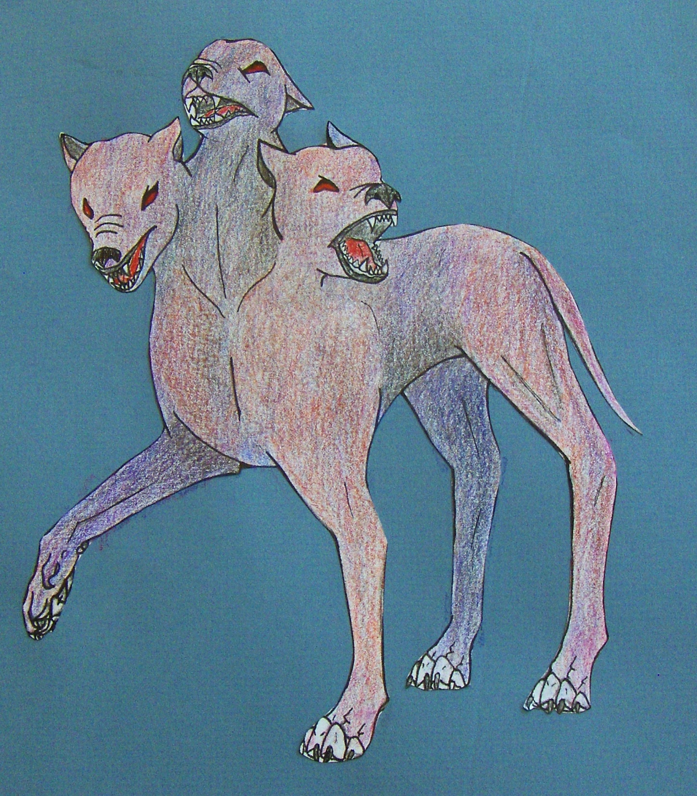
Trusted 3rd Party
Client
Service
Cerberus
Art by Natasha Johnson

Slide 6
Overview
Domain Controller/KDC
Authentication Service (AS)
Krb_AS_REQ
Caroline
Tyler
Jack
AS_REP
TGT
DB
Domain Controller/KDC
Caroline
TGT
TGS_REQ
Ticket Granting Service (TGS)
TGS_REP
Service Ticket
AP_REQ
Service Ticket
Application Server/Services (AP)
AP_REP optional

Slide 7
Passwords, Shared Secrets and the Database
Acct created on KDC w/password
  Unencrypted pwd + SALT +string2Key = Shared Secret
User enters password w/name, requesting service(s): Secret Key generated on client (matches DB version)
User & AS communicate using the shared secret
Request for TGT
DB
AS
Caroline
Tyler
Jack
Caroline
Here’s the ticket if you prove who you are
TGT

Slide 8
Replay Attack
TGT
TGS_REQ
Ticket Granting Service (TGS)
TGS_REP
Service Ticket
AP_REQ
Service Ticket
Application Server/Services

Slide 9
Security via the Authenticator
Session key (user)
User
Principal
Authenticator
AP_REQ
AP_REQ
Application Server
Timestamp
Authenticator Created
Service Ticket
Client sends AP_Req
Service shared secret
Session key (user)
AP_REQ
Client timestamp compared to server time – must be within 5 min (default)
Replay Cache – AS_REQ Time must be earlier or same as previous authenticator
Pre-Authentication uses an authenticator (Kerberos v5) default in Windows AD. Can be disabled

Slide 10
Ticket Lifetime
Access
Services
User accesses resources for lifetime of ticket
Tickets CAN be renewable
10 hrs (group policy)
Service Ticket
KDC

Slide 11
Windows
Kerberos Implementation

Slide 12
Kerberos Authentication Interactive Domain Logon
Username
Password
domain
1. Type in username,password,domain
2. Locate KDC for domain by DNS lookup for AD service
3. AS request sent (twice, actually – remember pre-authentication default in Windows )
AS_REQ
Windows
Active Directory
4. Group membership expanded by KDC, added to TGT auth data (PAC) and returned to client via AS_RESP
TGT
KDC=
AS + TGS + DB
5. Send TGS requests for session ticket to workstation***
Windows Domain Controller

Slide 13
Kerberos Authorization
Network Server connection
\\server\sharename
Application Server (target)
2. Present service ticket
at connection setup
Ticket
3. Verifies service
ticket issued
by KDC
TGT
Send TGT
and get service
ticket from KDC for target server
Ticket
Windows Active
Directory
Key Distribution
Center (KDC)
Windows Domain Controller

Slide 14
Cross-Domain Authentication
Corp.Net
AMS.Corp.net
EMEA.Corp.net
KDC
3
KDC
TGT(EMEA)
2
TICKET
1
TGT (AMS)
TGT(EMEA)
AppSrv1.EMEA.Corp.net
4
TICKET
Windows Client
Windows Server

Slide 15
Cross Platform Interoperability
Sharing Resources between MIT Kerberos V5 Realms and Windows Server Forests

Slide 16
Using Unix KDCs With
Windows Authorization
COMPANY.REALM
AD.Corp.net
MIT
KDC
Windows
KDC
TGT
3
1
R-TGT
R-TGT
TICKET
4
2
Possibly Service Name Mapping to Windows account
TICKET
Generic client
5
Windows Server

Slide 17
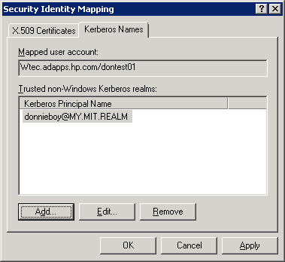
Mapping MIT kerberos users to Windows Domain user
Allows MIT kerberos user to log onto Windows Domain joined workstation
Configured via ADUC
  Advanced features
  Name Mappings…
  Trusted MIT realm only

Slide 18
Unix/Linux Clients access Windows service
W2k8.company.com
PAC?
1
TGT
Windows
KDC
PAC?
TGT
2
TICKET
3
Krb5.conf
4
TICKET
Kerberos client
Unix/Linux Client
Windows Application Server

Slide 19
Unix/Linux Clients offer Domain protected service
W2K8.company.com
Krb5.conf
Krb5.keytab
Kerberos client
MS aware service
Other stuff…
Computer
account
Shared secret
Windows
KDC
TICKET
TGT
TICKET
Linux Application Server (e.g. Samba)
Windows Client
With Windows Auth Data (PAC)

Slide 20
Principal names: Who and What
Service Principal Names (SPN) – the WHAT
  We don’t talk to computers, we talk to SERVICES running ON computers
    CIFS
    HOST
    HTTP
    LDAP
    Many others
  Maybe it’s ok to access a file share from this machine, but NOT ok to use the same credentials to access an sql instance. Thus service tickets, not ‘server tickets’.
User Principal Names (UPN) – the WHO
Service tickets have both

Slide 21
The keytab file
Keytab entry:
    Kvno (version number)
  Principal Name
  EncType
  Key (encrypted with enctype)
Example:
KVNO Principal (EncType) (Key)
---- ---------------------------------------------------------------------
2 host/gwendlyn.w2k8r2sa.don.mccall@W2K8R2SA.DON.MCCALL (DES cbc mode with CRC-32) (0x290d9eb0d5e58598)
2 host/gwendlyn.w2k8r2sa.don.mccall@W2K8R2SA.DON.MCCALL (DES cbc mode with RSA-MD5) (0x290d9eb0d5e58598)
2 host/gwendlyn.w2k8r2sa.don.mccall@W2K8R2SA.DON.MCCALL (ArcFour with HMAC/md5) (0x81006d5b9c982fc1bdf18823ecffa79c)

Slide 22
Troubleshooting Example:
KRB_ERROR_UNKNOWN_PRINCIPAL_NAME
Microsoft KDC’s treat SPN’s in a caseless manner.***
Not all Kerberos implementations are as forgiving.
Examining the Service ticket to determine the SPN
***REALMS are always uppercase, however

Slide 23
Troubleshooting Example:
KRB_ERROR_UNKNOWN_PRINCIPAL_NAME
Samba on HP-UX, using keytab for shared secret.
*Keytab entries:
KVNO Principal
---- --------------------------------------------------------------------------
2 host/gwendlyn.w2k8r2sa.don.mccall@W2K8R2SA.DON.MCCALL
2 host/gwendlyn@W2K8R2SA.DON.MCCALL
2 GWENDLYN$@W2K8R2SA.DON.MCCALL
2 CIFS/gwendlyn.w2k8r2sa.don.mccall@W2K8R2SA.DON.MCCALL
2 CIFS/gwendlyn@W2K8R2SA.DON.MCCALL
Active Directory Computer account created:
sAMAccountName:
GWENDLYN$
servicePrincipalName:
HOST/gwendlyn.w2k8r2sa.don.mccall
HOST/GWENDLYN
  *actual keytab file had 3X this many principals, as there is one for each of the enctypes (I had three defined) supported.

Slide 24
Troubleshooting Example:
KRB_ERROR_UNKNOWN_PRINCIPAL_NAME
Steps taken on the HP-UX system:
# kinit administrator
Password for administrator@W2K8R2SA.DON.MCCALL:
# smbclient //gwendlyn/tmp -k
cli_session_setup_blob: receive failed (NT_STATUS_LOGON_FAILURE)
session setup failed: NT_STATUS_LOGON_FAILURE
# grep “matched keytab principals” /var/opt/samba/log.16.113.26.218
[2011/04/13 11:21:38, 3] ads_keytab_verify_ticket: krb5_rd_req failed for all matched
keytab principals

Slide 25
Troubleshooting Demo: KRB_ERROR_UNKNOWN_PRINCIPAL_NAME
Break here for Network trace analysis
What we’re looking for in the trace:
- Kerberos: TGS Response Cname: administrator
+ Length: Length = 1588
- TgsRep: Kerberos TGS Response
+ ApplicationTag:
- KdcRep: KRB_TGS_REP (13)
+ SequenceHeader:
+ Tag0:
+ PvNo: 5
+ Tag1:
+ MsgType: KRB_TGS_REP (13)
+ Tag3:
+ Crealm: W2K8R2SA.DON.MCCALL
+ Tag4:
+ Cname: administrator
+ Tag5:
- Ticket: Realm: W2K8R2SA.DON.MCCALL, Sname: cifs/gwendlyn.w2k8r2sa.don.mccall

Slide 26
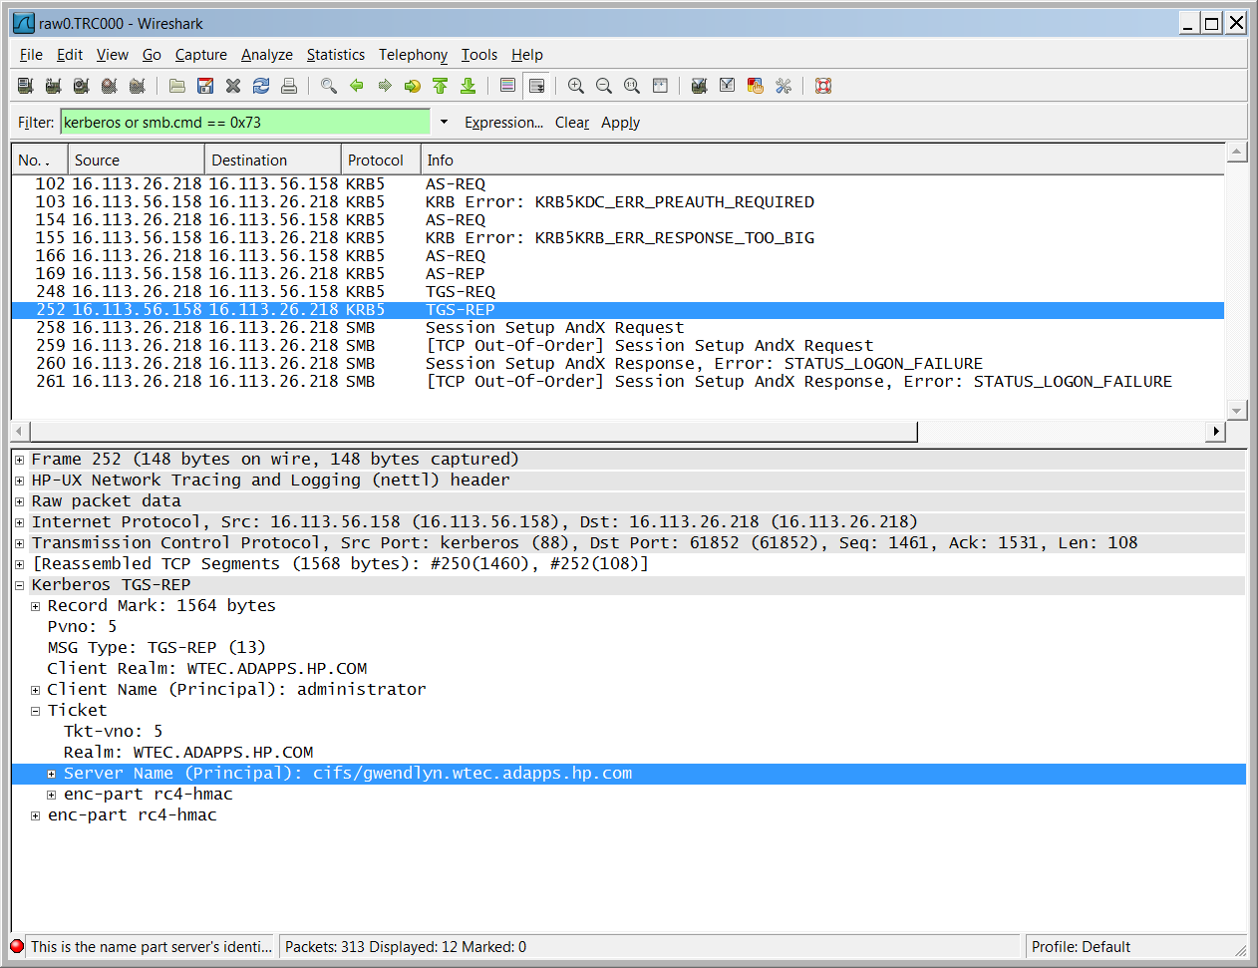

Slide 27
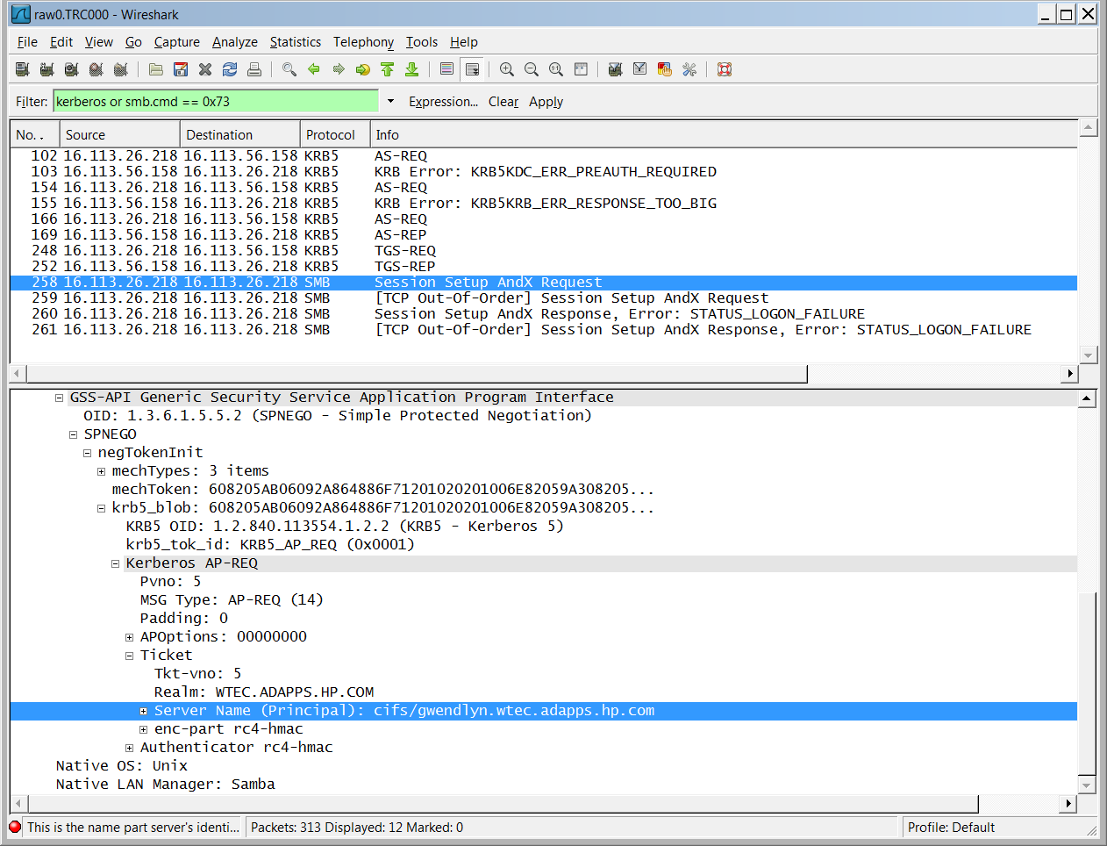

Slide 28
Service Delegations for Applications

Slide 29
Think ‘forwardable tickets’ **PLUS**
Accessing services across the internet and firewalls
Useful when a service you access requires access on your behalf to another service
  Outward facing web server that is backed by data on firewalled sql server
Delegation allows initial service to present your service ticket to another service on your behalf.

Slide 30
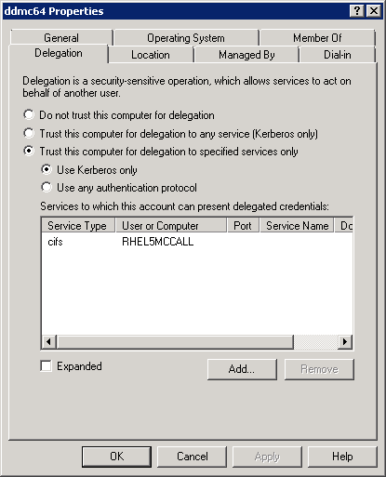
Constrained vs. Unconstrained Delegation
ADUC – Computer object properties – Delegation tab
Trust for specified services only
Windows 2000 ONLY had unconstrained delegation – all or nothing!

Slide 31
Windows Time Service

Slide 32
AD Domain Hierarchy for Time Sync
PDC Emulator
External NTP
Time Source
DC
Sync with PDC in parent domain
PDC Emulator
PDC Emulator
Can sync with any DC in own domain
Server
DC
DC
Workstation

Slide 33
It’s all about UTC
Coordinated Universal Time
AD Authentication depends on Kerberos
  Kerberos requires <5min Time Skew, uses NTP
  NTP uses a “reference clock” to synch time.
Each Computer has a “reference clock” set at UTC time
  Ref. clocks are used to sync time across network
Reference clock not affected by Time Zone
  Time Zone is for local display convenience
Changing “system time” in UI changes UTC time
  Time zone does not affect UTC time

Slide 34
Troubleshooting Example
Symptoms
  Replication broken: TPN incorrect
  Net Time, Net View (access denied errors)
  Kerberos Event ID 4 in System log
    KRB_AP_ERR_MODIFIED
    Pwd used to encrypt service ticket on app server
Normal Solution:
  Purge Kerberos Tickets (Klist Purge)
  Stop KDC Service, set to manual
  Reboot
  Set SC password: Netdom /resetpwd /server
  Reset KDC service to automatic

Slide 35
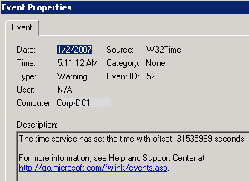
Troubleshooting Example
Solution failed
  Event ID 52 in System log setting time offset to – 1 year in seconds.
  An hour later, another one setting it to + 1 yr. offset

Slide 36

Troubleshooting Example Cause/Solution
Cause: External time source forced PDC time server back 1 year.
  Long enough for SC passwords to get hosed
  Did it again a week later
Solution:
  Change External Time source
  KB 884776
    registry value to disallow time changes > value
    Able to set it for a + or – reset value.
    We set it for 15 minutes each way.

Slide 37
Troubleshooting -Tips and Tools
Time Service not started
Changing group membership, etc. need new ticket.
  Revoke/Purge with Kerbtray.exe, Klist.exe
Kerberos time skew, ticket lifetime, etc. defined in Group Policy: Account Policies
W32tm.exe
/resynch – forces a clock resync
  /config /syncFromFlags:DomHier – forces NTP client to resynch from a DC
  /monitor /domain:WTEC (lists skew from PDC for all DCs in domain)

Slide 38
C:\>w32tm /monitor /domain:wtec
WTEC-DC1.Wtec.adapps.hp.com *** PDC *** [16.113.26.95]:
ICMP: 171ms delay.
NTP: +0.0000000s offset from WTEC-DC1.Wtec.adapps.hp.com
RefID: atl-resolver.americas.hp.net [15.227.128.51]
WTEC-DC2.Wtec.adapps.hp.com [16.56.172.105]:
ICMP: 0ms delay.
NTP: -0.0227096s offset from WTEC-DC1.Wtec.adapps.hp.com
RefID: WTEC-DC1.Wtec.adapps.hp.com [16.113.26.95]
WTEC-DC3.Wtec.adapps.hp.com [15.31.56.61]:
ICMP: error IP_REQ_TIMED_OUT - no response in 1000ms
NTP: error ERROR_TIMEOUT - no response from server in 1000m
mccall.Wtec.adapps.hp.com [16.113.9.141]:
ICMP: 170ms delay.
NTP: +9.1344128s offset from WTEC-DC1.Wtec.adapps.hp.com
RefID: WTEC-DC1.Wtec.adapps.hp.com [16.113.26.95]
wtec-dc4.Wtec.adapps.hp.com [16.144.206.141]:
ICMP: 361ms delay.
NTP: +9.1279869s offset from WTEC-DC1.Wtec.adapps.hp.com
RefID: WTEC-DC1.Wtec.adapps.hp.com [16.113.26.95]
gse-exch3.Wtec.adapps.hp.com [16.25.249.129]:
ICMP: 24ms delay.
NTP: +9.1188723s offset from WTEC-DC1.Wtec.adapps.hp.com
RefID: WTEC-DC1.Wtec.adapps.hp.com [16.113.26.95]
C:\>w32tm /monitor /domain:wtec
WTEC-DC1.Wtec.adapps.hp.com *** PDC *** [16.113.26.95]:
ICMP: 171ms delay.
NTP: +0.0000000s offset from WTEC-DC1.Wtec.adapps.hp.com
RefID: forwarders.americas.hp.net [15.227.128.51]
WTEC-DC2.Wtec.adapps.hp.com [16.56.172.105]:
ICMP: 0ms delay.
NTP: +0.0068319s offset from WTEC-DC1.Wtec.adapps.hp.com
RefID: WTEC-DC1.Wtec.adapps.hp.com [16.113.26.95]
WTEC-DC3.Wtec.adapps.hp.com [15.31.56.61]:
ICMP: 224ms delay.
NTP: +0.0264724s offset from WTEC-DC1.Wtec.adapps.hp.com
RefID: WTEC-DC1.Wtec.adapps.hp.com [16.113.26.95]
mccall.Wtec.adapps.hp.com [16.113.9.141]:
ICMP: 170ms delay.
NTP: +0.0115832s offset from WTEC-DC1.Wtec.adapps.hp.com
RefID: WTEC-DC1.Wtec.adapps.hp.com [16.113.26.95]
wtec-dc4.Wtec.adapps.hp.com [16.144.206.141]:
ICMP: 361ms delay.
NTP: -0.0362574s offset from WTEC-DC1.Wtec.adapps.hp.com
RefID: WTEC-DC1.Wtec.adapps.hp.com [16.113.26.95]
gse-exch3.Wtec.adapps.hp.com [16.25.249.129]:
ICMP: 24ms delay.
NTP: +0.0063204s offset from WTEC-DC1.Wtec.adapps.hp.com
RefID: WTEC-DC1.Wtec.adapps.hp.com [16.113.26.95]
Time skew compared to DC1 = 9.13 sec.
W32tm /-resync
W32tm /config
/SyncFromFlags:WTEC
NTP Synchronizes time (over period of time)

Slide 39
Troubleshooting Demo
ETW to the rescue!
Provides a mechanism to trace events raised by:
  operating system kernel
  kernel-mode device drivers
  user-mode applications
Logman
  C:>Logman query providers (find provider pertaining to what you want to do)
Windows 2003 providers of interest:
  Active Directory: Core Active Directory: Kerberos
  Active Directory: SAM Active Directory: NetLogon
Windows 2008 providers of interest: (387 Providers and counting!)
  Active Directory Domain Services: Core
  Active Directory Domain Services: SAM
  Active Directory: Kerberos Client
  Active Directory: Kerberos KDC

Slide 40
ETW Cheat Sheet
Basic Commands
  C:>Logman query providers (find provider pertaining to what you want to do)
  C:> logman create trace “LDAP1" -p "active directory: core" -o c:\etw\LDAP1
  C:>logman query
  C:>Logman Start LDAP1
    Reproduce the search, bind, etc
    C:>Logman Stop LDAP1
  Creates LDAP1_00001.etl
  Create report: tracerpt LDAP1_000001.etl -of csv -o Ldap1.csv
    -of sets file type (default = xml)
    -o = output file name default is dumpfile.csv. Produces the most interesting dump of ldap activity
    -Summary, -Report – statistical data
Run the trace with multiple providers
  Logman Create Trace CoreKerb –pf c:\etw\coreKerb.txt –o c:\Etw\CoreKerb
  Then create the “coreKerb.txt” input file with provider names in quotes on a single line (for Windows 2008):
  “Active Directory Domain Services: Core””Active Directory: Kerberos KDC”
  Windows 2003 providers have different names..
Reuse the traces – Logman Query lists them

Slide 41
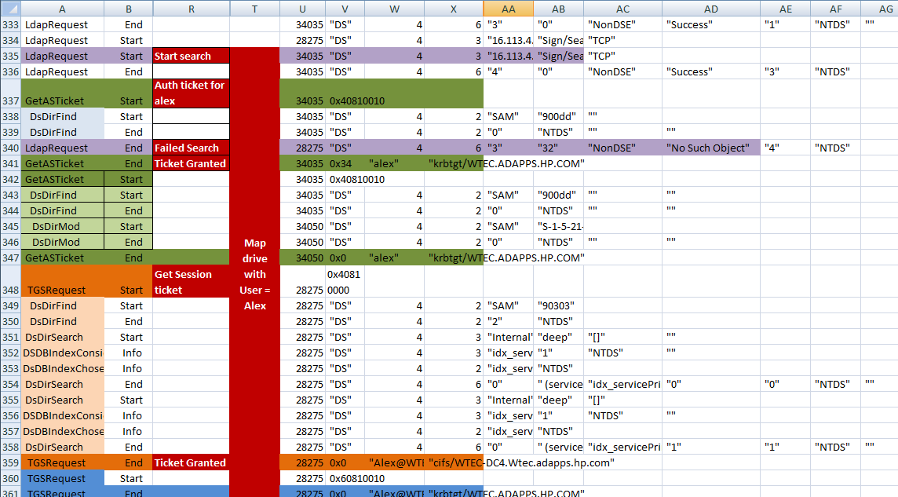

Slide 42
Resources
Kerberos Protocol Tutorial – MIT Kerberos Consortium
http://www.kerberos.org/software/tutorial.html
About Kerberos constrained delegation
http://technet.microsoft.com/en-us/library/cc995228.aspx
IIS and Kerberos (good description of how delegation works)
Part 3: http://www.adopenstatic.com/cs/blogs/ken/archive/2007/01/16/1054.aspx
Part 4: http://www.adopenstatic.com/cs/blogs/ken/archive/2007/01/28/1282.aspx
Kerberos: The Network Authentication Protocol
http://web.mit.edu/kerberos/
How the Kerberos V5 Authentication Protocol Works
http://technet.microsoft.com/en-us/library/cc772815(WS.10).aspx
Event Tracing for Windows: A fresh look at an old tool (by Gary Olsen)
http://searchwindowsserver.techtarget.com/tip/Event-Tracing-for-Windows-A-fresh-look-at-an-old-tool

Slide 43

Track Resources
Don’t forget to visit the Cloud Power area within the TLC (Blue Section) to see product demos and speak with experts about the Server & Cloud Platform solutions that help drive your business forward.
You can also find the latest information about our products at the following links:
Cloud Power - http://www.microsoft.com/cloud/
Private Cloud - http://www.microsoft.com/privatecloud/
Windows Server - http://www.microsoft.com/windowsserver/
Windows Azure - http://www.microsoft.com/windowsazure/
Microsoft System Center - http://www.microsoft.com/systemcenter/
Microsoft Forefront - http://www.microsoft.com/forefront/

Slide 44





Resources
  Connect. Share. Discuss.
http://northamerica.msteched.com
Learning
  Sessions On-Demand & Community
  Microsoft Certification & Training Resources
www.microsoft.com/teched
www.microsoft.com/learning
  Resources for IT Professionals
  Resources for Developers
http://microsoft.com/technet
http://microsoft.com/msdn

Slide 45












Complete an evaluation on CommNet and
enter to win!

Slide 46


