Slide 1

Designing a BranchCache Infrastructure
WSV324
Manish Kalra
Senior Product Manager
Microsoft

Slide 2
Agenda
1. Problem Background
2. BranchCache Solution Modes
3. Accelerated Protocols and Workloads
4. Deployment and Management
5. BranchCache Protocols and Content Identification
6. Security

Slide 3
Problem Background

Slide 4






Problem Background
Thin, expensive WAN links between
main office and branch offices
High link utilization
Poor application responsiveness
Trend towards data centralization

Slide 5





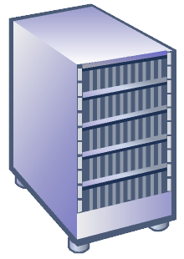
Branch – The Problem Space
$$
$$
$$
$$
$$
$$
$$
$$
$$
$$
$$
$$
$$
$$
$$
$$
$$
$$
$$
$$
$$
$$
$$
$$

Slide 6
BranchCache Solution Modes

Slide 7



BranchCache Modes
Distributed cache mode operates on a single subnet. At a multiple-subnet branch office that is configured for distributed cache mode, a file downloaded to one subnet cannot be shared with client computers on other subnets
Distributed Cache
  Content cache at a branch office is distributed among client computers
Branch Office
IIS
File Server
Group Policy
Management
Hosted Cache
Main Office
Branch Office
  Content cache at a branch office is hosted on a server computer

Slide 8







Hosted Cache vs Distributed Cache
Enterprise
Distributed Cache
Data cached amongst clients
Hosted Cache
Data cached at hosted cache server
Recommended for branches without any infrastructure
Easy to deploy: Enabled on clients through Group Policy
Cache availability decreases with laptops that go offline
Recommended for larger branches
Cache stored centrally: can use existing server in the branch
Cache availability is high
Enables branch-wide caching

Slide 9
Which do I Choose
You can use the following guidelines to determine the mode in which you want to deploy BranchCache:
For a branch office that contains less than 100 users and does not have any local servers, use distributed cache mode.
For a branch office (either single subnet or multiple-subnet) that contains less than 100 users and also contains a local server that you can use as a hosted cache server, use hosted cache mode.
For a multiple-subnet branch office that contains more than 100 users, but less than 100 users per subnet, use distributed cache mode.

Slide 10
BranchCache Software Requirements
Operating systems for BranchCache CLIENT COMPUTER functionality:
Windows® 7 Enterprise
Windows® 7 Ultimate
Operating systems for BranchCache CONTENT SERVER functionality:
Windows Server® 2008 R2 family of operating systems can be used as BranchCache content servers, with the following exceptions:
Windows Server® 2008 R2 Enterprise Core Install with Hyper-V, BranchCache is not supported.
In Windows Server® 2008 R2 Datacenter Core Install with Hyper-V, BranchCache is not supported.
Operating systems for BranchCache HOSTED CACHE server functionality:
Windows Server® 2008 R2 Enterprise
Windows Server 2008 R2 Enterprise with Hyper-V
Windows Server 2008 R2 Enterprise Core Install
Windows Server 2008 R2 Enterprise Core Install with Hyper-V
Windows Server 2008 R2 for Itanium-Based Systems
Windows Server® 2008 R2 Datacenter
Windows Server® 2008 R2 Datacenter with Hyper-V
Windows Server 2008 R2 Datacenter Core Install with Hyper-V

Slide 11



BranchCache Distributed Cache
ID
Get
Data
Data
ID
Main Office
Get
Get
Data
Get
Branch Office

Slide 12
BranchCache Hosted Cache
Get
Data
Data
ID
ID
ID
Main Office
Get
ID
Get
Get
Search
Search
ID
Data
Offer
ID
Request
Data
ID
Branch Office
Put

Slide 13
Protocols and Workloads

Slide 14
BranchCache is a Platform
Content Server
Uses server side Peer Distribution APIs to get identifiers for data. IDs are packed in a Content Information structure
Content Information Structure
Transmitted over the accelerated protocol instead of data. Contains everything the client needs to find data locally.
Client
Feeds the Content Information structure into the client side Peer Distribution APIs to find and download content locally.

Slide 15
Framework
3rd Party Applications
Office
CopyFile
Explorer
SharePoint
Office
BITS
WMP
IE
SMB
HTTP
BranchCache™

Slide 16
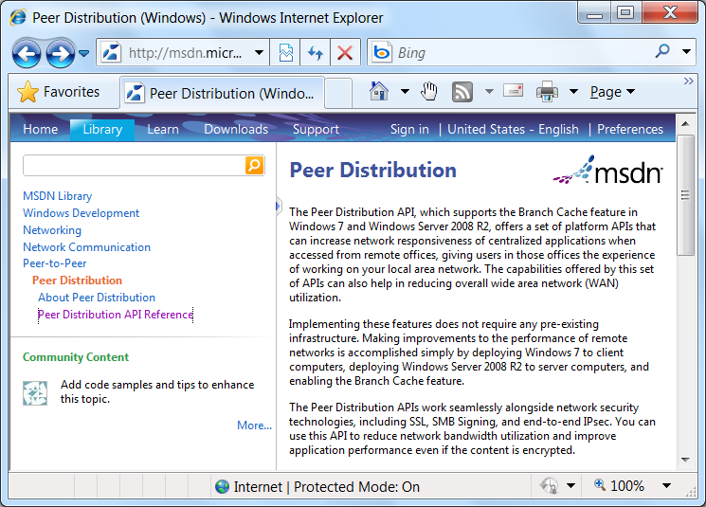
Peer Distribution on MSDN

Slide 17
Deployment and Management

Slide 18
Deployment Overview
3. Use Group Policy to enable Windows BranchCache on Windows 7 clients
Set BranchCache Distributed Cache Mode. This applies to all clients in the GPO
Install the optional “Windows BranchCache” component on a Windows 2008 R2 web or file server
If you’re using BranchCache on a file server you’ll need to install the File Services Role as well as BranchCache for remote files
Branch Office
IIS
File Server
Group Policy
Management
Hosted Cache
Main Office
Branch Office
  3. Install a hosted cache in your branch. Configure clients to use it with Group Policy
  Set BranchCache Hosted Cache Mode. Specify a server to host the cache
  4. Install Cert

Slide 19
Deployment Overview
4. Configure GPO setting “LanMan Server” in the BranchCache Policy to allow hash generation
Branch Office
IIS
File Server
Group Policy
Management
Hosted Cache
Main Office
Branch Office

Slide 20
Configuration Manager & WSUS
Goals
Reduce WAN utilization in the remote office scenario
Reduce the number of actively managed Distribution Points
For users, transfer content faster and with less restrictions in the remote office scenario
Integration
Distribution Points (DPs) run on Windows Server 2008 R2
Download packages (apps, updates etc) once into a branch office, get it from other clients or the Hosted Cache after that
Support for Configuration Manager (and WSUS) clients available on Windows Vista, Windows Server 2008 R2

Slide 21
Application Virtualization (AppV)
Goals
Make users productive quickly in branch offices
Save on the need for deploying IT infrastructure in branch offices
Reduce bandwidth utilization over the WAN link to save costs
Integration
HTTP Streaming in AppV optimized using BranchCache
Virtual applications only have to traverse the WAN link once
Eliminate IIS Servers (AppV staging servers) from the branch office
Support available on Windows 7 and Windows Server 2008 R2

Slide 22
SharePoint & IIS
Goals
Improve SharePoint, IIS responsiveness in branch offices without requiring separate branch infrastructure
Enable Office Web Applications to see improved performance in branch offices
Integration
IIS and SharePoint need to run on Windows Server 2008 R2
Users never get stale content; if content is updated, the content identifiers change
Support available for Windows 7 and Windows 2008 R2

Slide 23
File Servers
Goals
Improve the SMB protocol to reduce chattiness over the WAN link, and be aware of common application behaviors
Reduce bandwidth utilization over the WAN link, and improve performance of applications (Robocopy, Office etc) in branch offices
Integration
BranchCache integration ensures that data needs to move over the WAN link only once
SMB Transparent Caching enables better road-warrior scenarios
All application semantics around locking are automatically maintained
Available on Windows 7 and Windows Server 2008 R2

Slide 24
BranchCache Protocols and Content Identification

Slide 25
Data, Bocks and Segments
Hashes
Returned by server
Segment hashes, Block hashes
up to ~2000x data reduction
Blocks
Unit of download
B1
B2
Bn
B1
B2
Bn
B1
B2
Bn
Segments
Unit of discovery
S1
S2
S3
Content

Slide 26
Security

Slide 27
Security Overview
Server transmits content information structure to the client only if the client has access. Transfer happens over the accelerated protocol.
Server authenticates the client and performs authorization checks
Client downloads encrypted blocks from a peer or the hosted cache and decrypts them with the encryption key,
Client uses content information structure to calculate:
-segment id (public)
-encryption key (private)
Cached data is stored in the clear, but can be protected with BitLocker or EFS
Client multicasts the segment id to find a peer with the data

Slide 28
Security Computations
Client
Encryption key
Ke = Kp
Segment Id
Hash(Kp, HoD + K)
Segment Secret
Kp = Hash(HoD, Ks)
Segment hash of data
HoD = Hash (Blockhashes)
Server secret key
Ks
Block hashes
Hash(block)
B1
B2
Bn
Blocks
Server

Slide 29
Security of Data at Rest
Clients
Cache only contains content requested by the client
Data in cache ACL’d so that it is only accessible if authorized by the server
If data leakage is a concern, then use BitLocker or EFS
Hosted Cache
Cache contains content requested by all branch clients
Use BitLocker or EFS to encrypt cache as necessary
All data can be purged from the cache using netsh

Slide 30
How is SSL Optimized?
Client
Server
IE
IIS
Data in clear
Data in clear
HTTP
Branch Cache
Branch Cache
HTTP
Data in clear
Data in clear
SSL
SSL
Data encrypted
Data encrypted
Sockets
Sockets
Data encrypted
Data encrypted
IPsec
IPsec
Data encrypted

Slide 31

Common Deployment Questions
Can Hosted Cache be clustered
  NO
Where is the default location of hostedcache
  Windows Partition
Can it be moved
  Yes – netsh branchcache set localcache
Can I clear the cache
  Yes – netsh branchcache flush
Does Hosted Cache work with DFS-R
  NO
What is the default time the content sits in the cache
  We prune the cache on a least recently used basis, meaning content gets pushed out by other content when the cache fills up. We kill content after 28 days if it hasn’t been used.
Can I generate/delete hash files
  YES for FILE SERVER Role – Use HASHGEN
  http://technet.microsoft.com/en-us/library/ff660040(WS.10).aspx

Slide 32
BranchCache In Action
demo

Slide 33
BranchCache Resources
Collateral
Protocols
Content Identification (PCCRC)
Discovery (PCCRD)
Retrieval (PCCRR)
Hosted Cache Offer (PCHC)
HTTP extensions for BranchCache (PCCRTP)
SMB extensions for BranchCache (SMB2.1)
BranchCache Executive Overview
BranchCache Technical Overview
BranchCache Security Guide
BranchCache Deployment Guide
Case studies (partial)
Sporton International
Convergent Computing
E-mail
Netmon Parsers
branchbg@microsoft.com
Protocol parsers
Website
http://www.branchcache.com

Slide 34
Track Resources
Don’t forget to visit the Cloud Power area within the TLC (Blue Section) to see product demos and speak with experts about the Server & Cloud Platform solutions that help drive your business forward.
You can also find the latest information about our products at the following links:
Cloud Power - http://www.microsoft.com/cloud/
Private Cloud - http://www.microsoft.com/privatecloud/
Windows Server - http://www.microsoft.com/windowsserver/
Windows Azure - http://www.microsoft.com/windowsazure/
Microsoft System Center - http://www.microsoft.com/systemcenter/
Microsoft Forefront - http://www.microsoft.com/forefront/

Slide 35





Resources
  Connect. Share. Discuss.
http://northamerica.msteched.com
Learning
  Sessions On-Demand & Community
  Microsoft Certification & Training Resources
www.microsoft.com/teched
www.microsoft.com/learning
  Resources for IT Professionals
  Resources for Developers
http://microsoft.com/technet
http://microsoft.com/msdn

Slide 36












Complete an evaluation on CommNet and
enter to win!

Slide 37


Slide 38

© 2011 Microsoft Corporation. All rights reserved. Microsoft, Windows, Windows Vista and other product names are or may be registered trademarks and/or trademarks in the U.S. and/or other countries.
The information herein is for informational purposes only and represents the current view of Microsoft Corporation as of the date of this presentation. Because Microsoft must respond to changing market conditions, it should not be interpreted to be a commitment
on the part of Microsoft, and Microsoft cannot guarantee the accuracy of any information provided after the date of this presentation. MICROSOFT MAKES NO WARRANTIES, EXPRESS, IMPLIED OR STATUTORY, AS TO THE INFORMATION IN THIS PRESENTATION.

