Slide 1
Create experiences that span devices
PLAT-475T
John Sheehan
Partner Software Development Engineer
Microsoft Corporation

Slide 2
Great apps deliver a continuous experience for your customers as they switch between apps and PCs

Slide 3
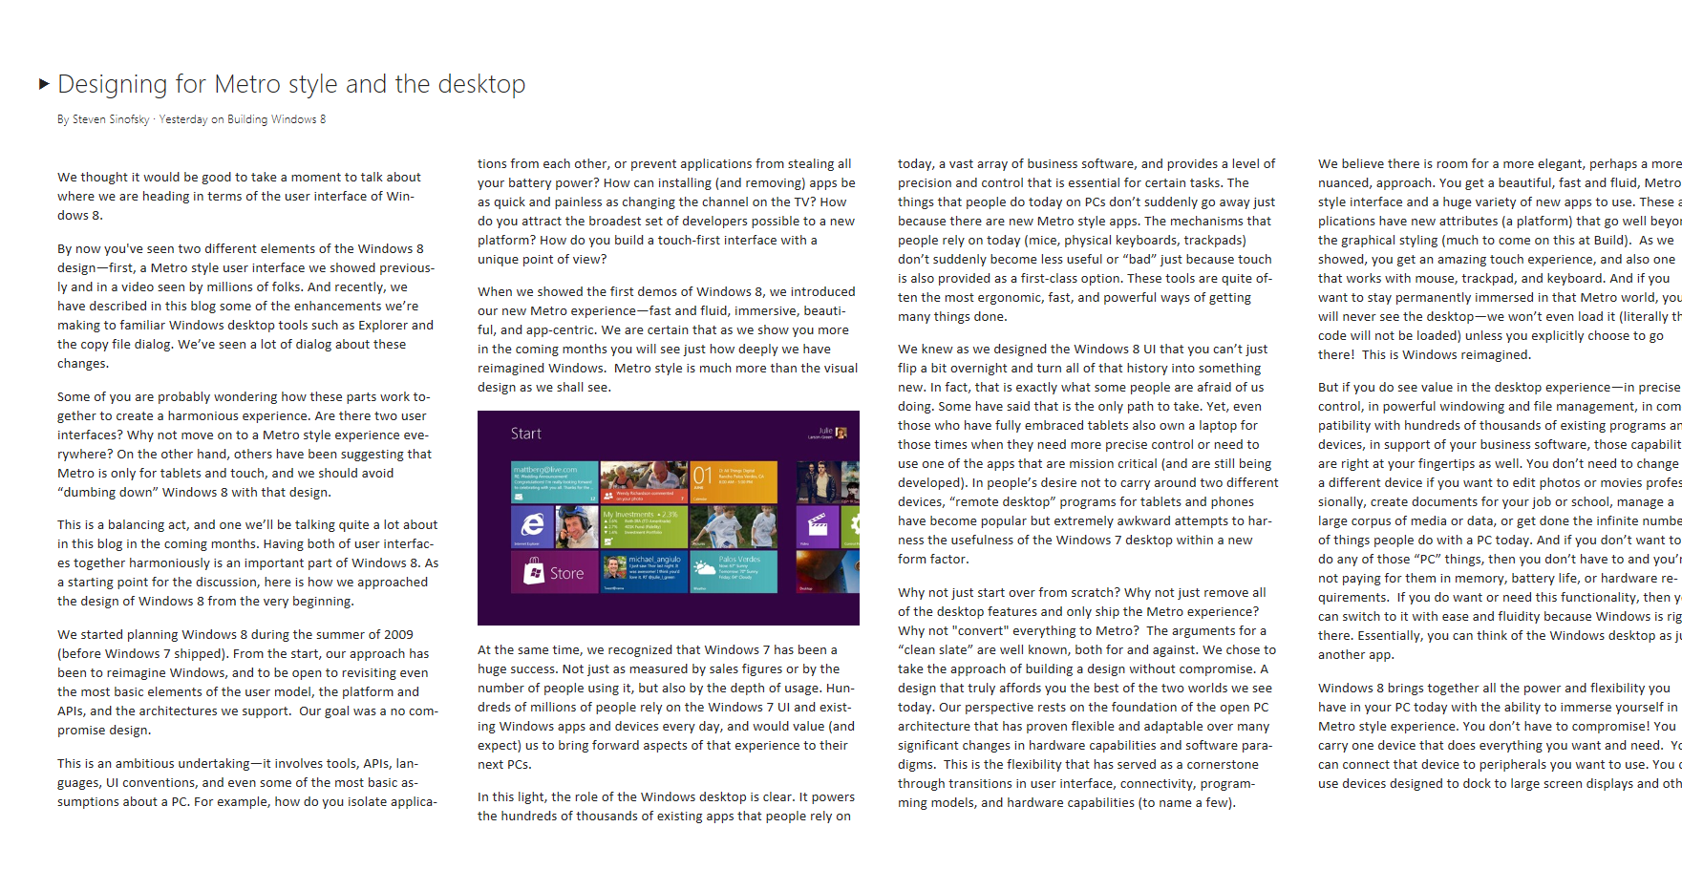
Many ways to enable a continuous experience on one PC
Registry
Settings XML and .ini Files
Cookies
Your Custom Format

Slide 4
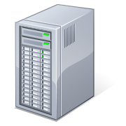
Across many PCs?
Registry
Settings XML and .ini Files
Cookies
Your Custom Format

Slide 5
Continuity across many PCs: today
Register a domain
Setup your services and infrastructure
Figure out security and user management
Build sync infrastructure
Scale your service for millions of users
Or…
appData.roamingSettings.values[“restaurant”] = “Mario’s”;

Slide 6
Agenda
Continuous experience when users switch between apps
Managing app settings and data
Managing app data during suspend and resume
Managing changes in network connectivity
Continuous experience when users switch between PCs
Roaming app settings and data
Roaming files
You’ll leave with examples of how to
Enable customers to seamlessly switch back to your app
Use the Live cloud for free to deliver continuity across devices

Slide 7
One unified API for app data management
App container
App Package
Windows.Storage.ApplicationData
App code
Web/XAML
Windows Runtime

Slide 8
App data vs. user data
App data
Settings
Files
Session State
Local Cache
User data
Documents
Photos
Music
Videos

Slide 9
One PC vs. many PCs
Local
Roaming
Large caches for offline use
Offline storage for HTML5 based apps
Temporary data and device specific configuration data
Small, key-value pairs for app settings
User context like where they left off in a book or video
Small configuration files in your custom format

Slide 10
Continuity on one PC

Slide 11
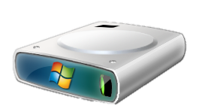
App data access is local
App uses data normally
Local Storage

Slide 12
Video app
demo
Part 1

Slide 13
Settings guidelines in a Metro style app
Always available
Simple and familiar commands
Light dismiss
Instant commit
Less is more

Slide 14
Continuity across
many PCs

Slide 15
How roaming works
App uses data normally
Local
Storage
Data syncs for the user’s Microsoft account

Slide 16
Roaming consistency
CompositeSetting
Group of settings that roam as a unit
Use these for tightly-bound data
E-mail account settings
Coordinates
File consistency
Roaming occurs after you release the file
Last writer wins

Slide 17
Video app
demo
Part 2

Slide 18
Always available

Slide 19
Thinking about connectivity
Your app is not always connected
Cache data locally
Use LocalFolder for storage
Maintain a continuous experience

Slide 20
Always fresh

Slide 21
Save and restore app session
Running
App
suspending
Suspended
App
Terminated
App
low memory
resuming

Slide 22
Thinking about the app lifecycle
Your app needs to handle suspension
It should save the current user session
It may get terminated
This should be transparent to the user and the experience
WinJS.Application.sessionState makes it easy

Slide 23
Review

Slide 24
Create a continuous user experience!
Preserve settings across PCs
Create a consistent settings experience leveraging the settings charm
Preserve customer experience and context as they move across PCs
Deliver a great offline experience
Save and restore session state during suspend and resume
Make your app fresh and available everywhere!

Slide 25
If you want to know more, attend our Chalk Talk…

Slide 26
Related sessions
[PLAT-402C] Deep dive on app data roaming
[PLAT-894T] Seamlessly interacting with web and local data
[APP-409T] Fundamentals of Metro style apps: how and when your app will run
[PLAT-134C] The complete developer's guide to the SkyDrive API

Slide 27
Further reading and documentation
App Data
How to manage app data

Slide 28
thank you
Feedback and questions http://forums.dev.windows.com
Session feedback http://bldw.in/SessionFeedback

Slide 29
© 2011 Microsoft Corporation. All rights reserved. Microsoft, Windows, Windows Vista and other product names are or may be registered trademarks and/or trademarks in the U.S. and/or other countries.
The information herein is for informational purposes only and represents the current view of Microsoft Corporation as of the date of this presentation. Because Microsoft must respond to changing market conditions, it should not be interpreted to be a commitment on the part of Microsoft, and Microsoft cannot guarantee the accuracy of any information provided after the date of this presentation. MICROSOFT MAKES NO WARRANTIES, EXPRESS, IMPLIED OR STATUTORY, AS TO THE INFORMATION IN THIS PRESENTATION.

