Slide 1
Using Windows Server 8 for building private and public IaaS clouds
SAC-429T
Jeff Woolsey, Yigal Edery
Microsoft Corporation

Slide 2
Windows Server 8 is Cloud Optimized
Enable Multi Tenant Clouds
High Scale & Low Cost Datacenters
Manageable & Extensible

Slide 3
Building your own private and public clouds just got a lot easier with Windows Server 8.

Slide 4
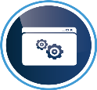
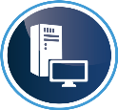
Cloud Taxonomy and Uses
Software
SaaS
Application is consumed as a service.
Cloud provider runs the application, consumer doesn’t need to develop anything – charged for “app level” assets
Cloud intelligence built into the application
Platform
PaaS
Application Platform for developing cloud-ready apps
Platform includes native services for scalability & resiliency
Apps have to be designed to run on the PaaS cloud – unaware of the “server” on which they run
Infrastructure
IaaS
“Virtual Machines for rent” service
Cloud provider runs a datacenter that offers dynamic VM, storage and networks allocation, and charges for allocation and usage metrics of these resources
Tenant owns the infrastructure and treats it as a ‘server’ in the cloud

Slide 5
The Evolution of the Data Center
Windows Server 8
(Infrastructure as a Service)
Server virtualization
Cloud
Potential to Scale
Characteristics
Dedicated servers
No virtualization
Server virtualization
Shared Compute, Storage, Network
Multi-tenancy & isolation
Converged network fabric
Hybrid clouds
Benefits
Hardware isolation
Server consolidation
Some scale-out
Heterogeneous server hardware
Efficient infrastructure utilization
Automatic deployment / migration of Apps, VM’s and Services
Scaling of network/storage

Slide 6
Windows Server 8 is Cloud Optimized
Enable Multi Tenant Clouds
High Scale & Low Cost Datacenters
Manageable & Extensible

Slide 7
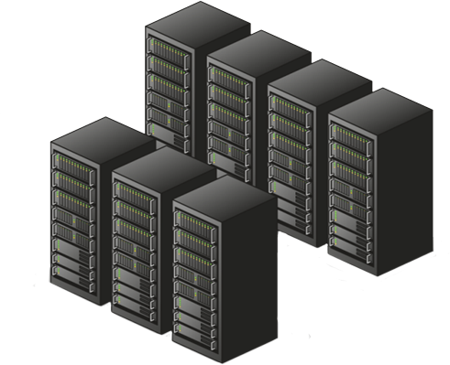
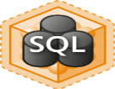
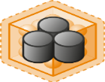
The Multi-Tenant Cloud
Secure Isolation Between Tenants
Dynamic Placement of Services
QoS and Resource Metering
Multiple Customers on Shared Infrastructure
Hoster
Contoso Bank
Woodgrove Bank

Slide 8
The Multi-Tenant Cloud
Secure Isolation Between Tenants
Dynamic Placement of Services
QoS & Resource Metering
Hyper-V Extensible Switch
Isolation Policies
PVLANs
Hyper-V Network Virtualization
Complete VM Mobility
Cross-Premise Connectivity
Virtual Machine QoS Policies
Resource Meters
Performance Counters
LEARN
MORE
[668] Enabling the Hybrid Cloud Using Remote Access Appliances

Slide 9
Multi-Tenant Network Requirements
Tenant wants to easily move VMs to/from the cloud
Hoster wants to place VMs anywhere in the data center
Both want: Easy Onboarding, Flexibility & Isolation
Woodgrove Bank
Blue 10.1.0.0/16
Cloud Data Center
Contoso Bank
Red 10.1.0.0/16

Slide 10
One Solution: PVLAN
u
Green
10.1.1.31
Blue 10.1.1.21
Red1
10.1.1.11
Red2
10.1.1.12
Hyper-V Switch
Isolated
4, 7
Isolated
4, 7
Community
4, 9
Community
4, 9
Win 8 Host
To Internet (10.1.1.1)
Isolation Scenario
Hoster wants to isolate all VMs from each other and allow internet connectivity
#1 Customer Ask from hosters
Community Scenario
Hoster wants tenant VMs to interact with each other but not with other tenant VMs
Requires a VLAN id for each “community” (limited scalability, only 4095 VLAN IDs)

Slide 11
Introducing Hyper-V Network Virtualization
Woodgrove VM
Contoso VM
Woodgrove network
Contoso network
Physical
server
Physical network
Hyper-V Machine Virtualization
Run multiple virtual servers on a physical server
Each VM has illusion it is running as a physical server
Hyper-V Network Virtualization
Run multiple virtual networks on a physical network
Each virtual network has illusion it is running as a physical fabric
LEARN
MORE
[442] Hyper-V Network Virtualization

Slide 12
Your Thoughts on VM Mobility
Don’t provide new features that preclude Live Migration.
I want to be able to securely move any part of a VM anywhere, at any time.
No Limits.

Slide 13
Virtual Machine Mobility
Live Migration with High Availability
SMB Live Migration
Live Storage Migration

Slide 14
Live Storage Migration
Enables Storage Load Balancing
No downtime servicing
Leverages Hyper-V Offloaded Data Transfer (ODX)
Hyper-V
Virtual Machine
1
VHD Stack
3
2
VHD
VHD
4
5
Source Device
Destination Device

Slide 15
Wouldn’t it be great if you could Live Migrate a VM with nothing but an ethernet cable?
We think so too…

Slide 16
Virtual Machine Mobility
demo

Slide 17
QoS & Resource Metering
Virtual Machine Switch QoS/Policy
Resource Meters
Performance Counters

Slide 18
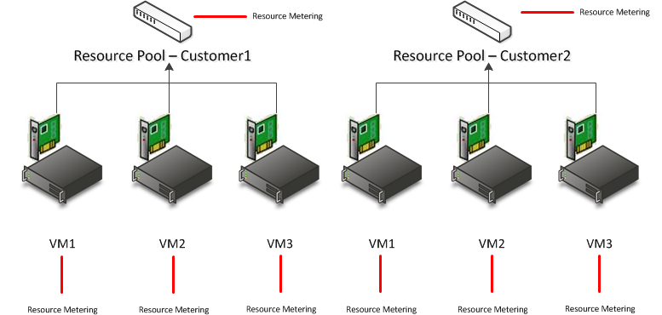
Hyper-V Resource Meters
Historic Resource utilization information, persistence through live migrations
Network
Incoming & Outgoing Traffic per IP Address Range
Storage
High Water-Mark Disk Allocation
Memory
Low & High Water-Mark Memory Utilization
Average Memory Utilization
CPU
Average CPU Utilization

Slide 19
DynamicOps
partner
Chad Jones
Vice President, Strategy and Product Management

Slide 20
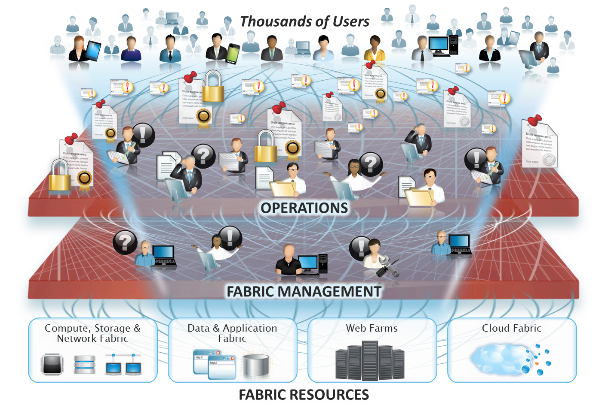
Operational Challenges

Slide 21
The DynamicOps Cloud

Slide 22
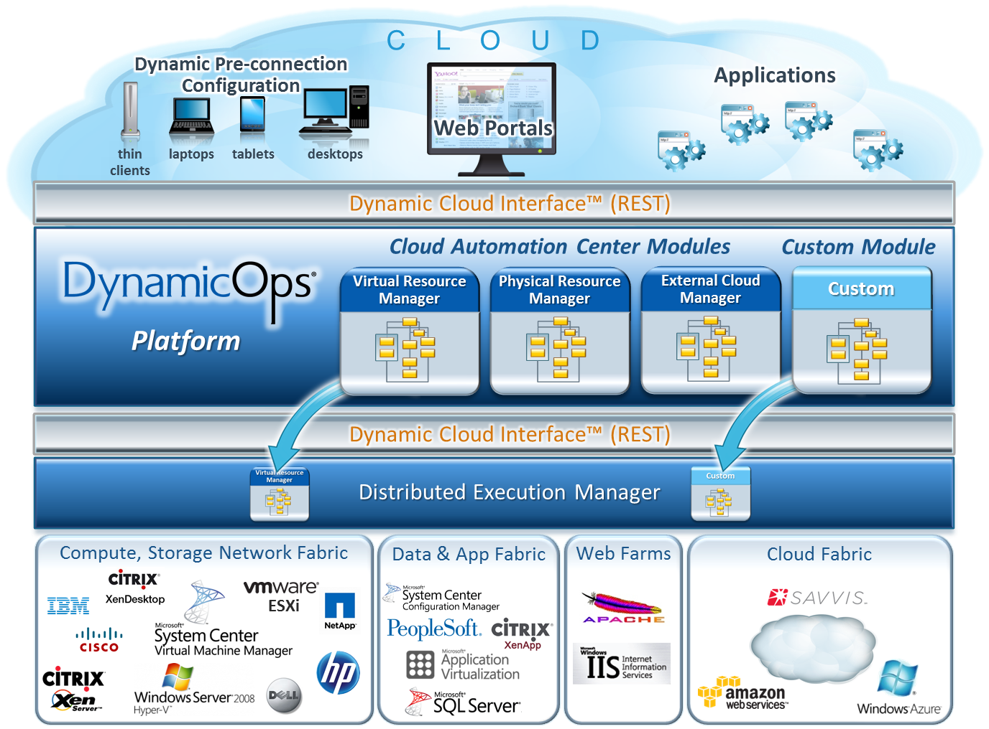
DynamicOps Cloud Platform™

Slide 23
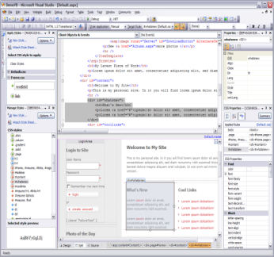
Model based Development
Models
Examples:
Cisco UCS, Dell and HP server management Self-Service Virtual Machine Management
Module
Modules
Collection of models
Example:
Virtual Resource Manager
CDK Developers Edition
Integrated with Visual Studio Native developers interface
Data Access Layer | Events / Triggers | Workflows | Activities | Security
Defines how data systems are accessed Exposed through an auto-generated secure RESTful Odata compliant URI | Events that trigger CRUD actions including: Data driven events User interaction Active monitoring systems | Workflows tie activities together to perform functions Example Create VM Edit VM properties Archive VM Design Center manageable | Basic block of functionality Utilizes ANY language C#, C, C++ J#, Java Python, PERL PowerShell VB, VB.NET More Examples Create Container Load ISO | Granular, user-centric security is assigned to workflows, activities and data access

Slide 24
Using Resource Meters for Right-Sizing VMs
demo

Slide 25
Windows Server 8 is Cloud Optimized
Enable Multi Tenant Clouds
High Scale & Low Cost Datacenters
Manageable & Extensible

Slide 26
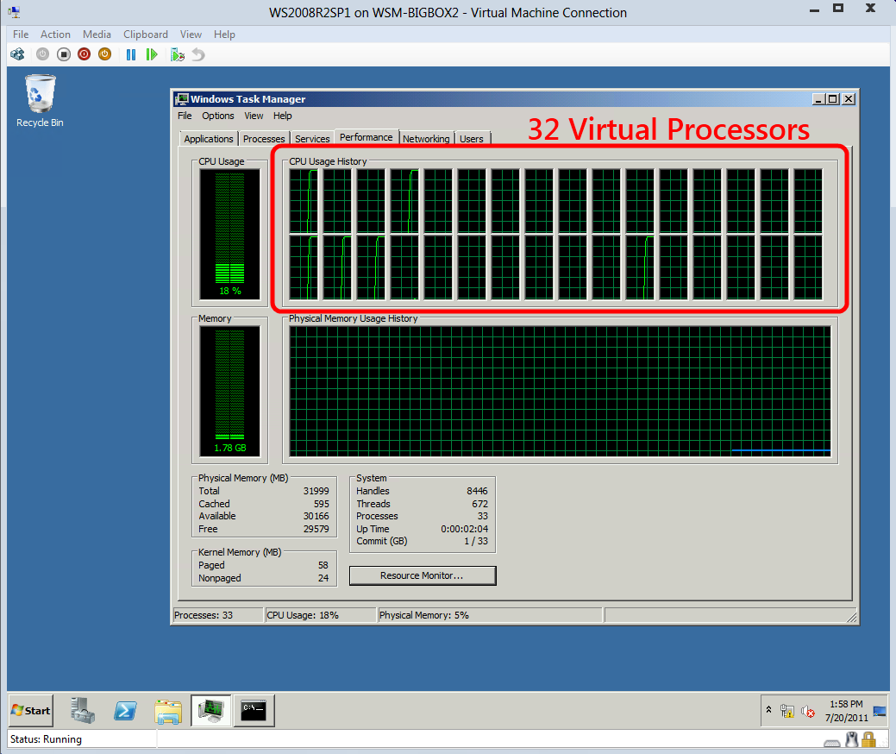
Leveraging Modern Hardware
Hyper-V performance and scale
CPU & Memory
Networking
Storage
PHY: 160 Logical Processors
PHY: Up to 2 TB of RAM
VM: 32 VPs
VM: 512 GB Memory
WHEA/RAS
Guest NUMA
Removal of VP: LP Ratios
Dynamic Virtual Machine Queue (DVMQ)
Single Root I/O Virtualization (SR-IOV)
Receive Side Scaling (RSS)
Receive Side Coalescing (RSC)
IPSec Task Offload
Storage Offload (ODX)
SMB2 Direct (RDMA)
Guest Fiber Channel (MPIO)
4k Native Disk Support

Slide 27
High Availability & Data Protection
Windows NIC Teaming
Virtual Machine Fiber Channel
Hyper-V Replica: Failover Replication
BitLocker and High Availability

Slide 28
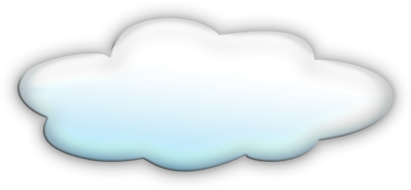
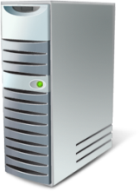
Hyper-V Replica
Disaster Recovery Scenarios:
Planned, Unplanned and Test Failover
Pre-configuration for IP settings for primary/remote location
Key Features:
RPO/RTO in minutes
Seamless integration with Hyper-V and Clustering
Automatically handles all VM mobility scenarios (e.g. Live migration)
Supports heterogonous storage between primary and recovery

Slide 29
So You’re a Cloud Provider…
I have good processes in place, but other safeguards can I use to protect my customer’s Data?

Slide 30
Server Hard Disks Appear on eBay
Real Case : A LARGE Power Company
Data on drives used in servers, contained:
Proprietary company information such as memos, correspondence
Customers data (460,000+) & Confidential employee information
The Company had processes in place to either physically destroy drives or scrub them to U.S. DOD standards
Degaussing
Overwriting the data with a minimum of three specified patterns
According to Gartner about 1/3 companies use outside companies to dispose of PCs & Servers

Slide 31
Critical Safeguard for the Cloud Encrypted cluster volumes
TPMs can be leveraged for the first time in server scenarios
BitLocker encrypted cluster disks
Support for traditional failover disks
Support for Cluster Shared Volumes
Cluster Name Object (CNO) identity used to lock and unlock Clustered volumes
Enables physical security for deployments outside of secure datacenters
Branch office deployments
Volume level encryption for compliance requirements
LEARN
MORE
HW-462T – Hardware-based security is here: TPMs Unleashed

Slide 32
Predictable Network & Lower Storage Cost
Datacenter QoS via
DCB (HW QoS)
OS Level QoS
Hyper-V over SMB2
RDMA
Spaces
Thin Provisioning
Storage De-dup
Network
Storage
LEARN
MORE
[439] QoS and Converged Fabric in the data center (DCB & VM QoS)
LEARN
MORE
[444, 446] Designing Systems for Continuous Availability

Slide 33
Windows Server 8 is Cloud Optimized
Enable Multi Tenant Clouds
High Scale & Low Cost Datacenters
Manageable & Extensible

Slide 34
Open, Extensible & Standards Based
PowerShell / WMI
Workflows
Manageable
Hyper-V Extensible Switch
Management through PowerShell
Extensible
Open / Standards Based
WMIv2 / CIM
OData
Data Center TCP

Slide 35
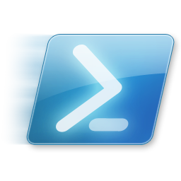
Managing with PowerShell
File Servers & Shares
Hyper-V configurations
Virtual Machines
Failover Clusters
Network Configuration
Hyper-V Extensible Switch
Hyper-V Replica
Use PowerShell to manage and monitor Windows Server 8 Clouds
Leverage the PowerShell community and skills and build your own tools
Simple and consistent APIs to manage and monitor
Write WMIv2 providers, get PowerShell for free!
LEARN
MORE
[644] Make Your Product Manageable
LEARN
MORE
[565] PowerShell: Better Way to Manage the Cloud & Datacenter Networking

Slide 36
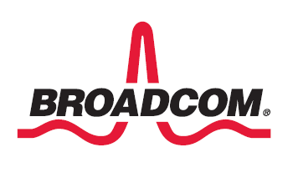
Hyper-V Extensible Switch
Virtual Machine
Virtual Machine
Root Partition
Augment Hyper-V Virtual Switch capabilities
Monitoring
Traffic filtering / shaping
Forwarding algorithms
VM NIC
Host NIC
VM NIC
Hyper-V Switch
Capture Extensions
WFP Extensions
Filtering Extensions
Forwarding Extension
Physical NIC
LEARN
MORE
[559] Extending the Hyper-V Switch
PAGE 36

Slide 37
Recap

Slide 38
Windows Server 8 is Cloud Optimized
Enable Multi Tenant Clouds
Network Virtualization. Dynamic VM Placement. Secure Isolation. …
High Scale & Low Cost Datacenters
Leverage Hardware. High Availability. SMB2. Low Cost Storage. …
Manageable & Extensible
WMIv2. PowerShell. Extensible Switch. …

Slide 39
Call to Action
Windows Server 8 offers a broad range of extensibility points
Plenty of opportunities for you to build
Windows Server 8 leverages the latest hardware advancements
Design Systems that takes advantage of these innovations
Read the White Paper:
“Building IaaS Clouds Using Windows Server 8”
http://go.microsoft.com/fwlink/p/?LinkId=228511
Go to the relevant sessions and explore your opportunities!

Slide 40
Related sessions
SAC-430T: Designing the building blocks for a Windows Server 8 cloud
SAC-442T: Building secure, scalable multi-tenant clouds using Hyper-V Network Virtualization
SAC-559T: Extending the Hyper-V switch
SAC-437T: A deep dive into Hyper-V networking
SAC-433T: Network acceleration and other NIC technologies for the data center
SAC-439T: Enabling multi-tenancy and converged fabric for the cloud using QoS
SAC-565T: Windows networking with PowerShell: A foundation for data center management

Slide 41
thank you
Feedback and questions http://forums.dev.windows.com
Session feedback http://bldw.in/SessionFeedback

Slide 42
© 2011 Microsoft Corporation. All rights reserved. Microsoft, Windows, Windows Vista and other product names are or may be registered trademarks and/or trademarks in the U.S. and/or other countries.
The information herein is for informational purposes only and represents the current view of Microsoft Corporation as of the date of this presentation. Because Microsoft must respond to changing market conditions, it should not be interpreted to be a commitment on the part of Microsoft, and Microsoft cannot guarantee the accuracy of any information provided after the date of this presentation. MICROSOFT MAKES NO WARRANTIES, EXPRESS, IMPLIED OR STATUTORY, AS TO THE INFORMATION IN THIS PRESENTATION.

