Slide 1
SAC-433T
Network acceleration and other NIC technologies for the data center
Don Stanwyck, Senior Program Manager
Michael Nanakul, Senior Test Lead

Slide 2
What’s this session about?
WHO WILL BENEFIT FROM THIS TALK
Hardware vendors planning support for Windows Server 8
OEMs planning to source networking equipment for systems running Windows Server 8
Anyone needing to learn about the latest advances in networking support for Windows Server 8

Slide 3
What’s this session about?
TOPICS
What new networking enhancements are in the Windows 8 networking stack?
How does Windows Server 8 use the latest hardware acceleration and task offloads to enhance the customer experience?
What should NICs support to best meet customer needs with Windows Server 8?

Slide 4
What’s this session about?
WHAT YOU’LL LEAVE WITH
A broad overview of the new networking capabilities supported in Windows Server 8 – and how they work for customers
Enough acronyms to make you sound like a networking expert at your next cocktail party discussion

Slide 5
What customers want in the cloud
Performance
Cost
Reliability

Slide 6
Hardware offloads make cloud performance possible

Slide 7
The network stack optimizes specific scenarios.

Slide 8
Improved network performance and reliability greater workload densities lower operational costs

Slide 9
Roadmap for this session
Fabric convergence in the cloud
Datacenter bridging (DCB)
Remote direct memory access (RDMA)
Datacenter TCP (DCTCP)
Operations Reliability
Consistent Device Naming (CDN)
NIC Teaming (LBFO)
Flexible, secure clouds
Generic Routing Encapsulation (GRE)
IPsec Task Offload v2 (IPsecTOv2) for VMs
High Performance Networking Offloads
Receive Side Scaling (RSS) extensions
Receive Segment Coalescing (RSC)
Dynamic Virtual Memory Queues (VMQ)
Single-Root I/O Virtualization (SR-IOV)

Slide 10
Fabric convergence in the cloud
reducing costs of storage and infrastructure

Slide 11
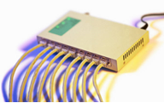
Bottlenecks in the converged fabric cloud
In the host stack
In the host NIC
In the network

Slide 12
Convergence in the cloud
QoS, Bandwidth management
Congestion avoidance leading to full pipes with small buffers
DCB
DCTCP
Fast data transfer for storage and high-performance applications
Network Direct / kernel-mode RDMA / SMB2-Direct

Slide 13
Traffic congestion
Stop and go
or smooth flow?

Slide 14
Datacenter TCP (DCTCP)
Windows 8 addresses congestion in the network by reacting to degree of congestion, not presence of congestion
Goal: Low latency, high burst tolerance, and high throughput, with shallow buffered switches
Requires ECN (RFC 3168) capable switches

Slide 15
DCTCP Needs Less Buffer Memory than TCP
1 Gbps flow controlled by TCP
Requires 400 to 600 KB of memory
TCP sawtooth visible
1 Gbps flow controlled by DCTCP
Requires 30KB of memory
Smooth

Slide 16
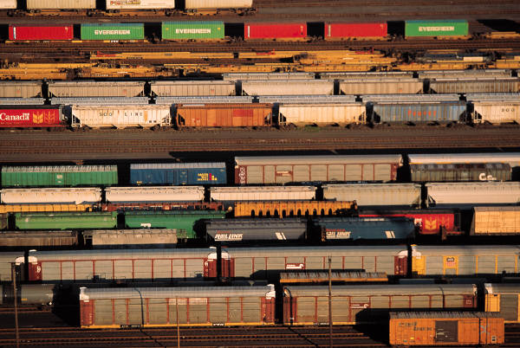
Assigned lanes to avoid local adapter and switch congestion

Slide 17
Datacenter Bridging (DCB)
Addresses congestion in the network adapter and the network by reserving bandwidth for particular traffic types
Windows 8 provides support and control for DCB, tags packets by traffic type
Provides lossless transport for mission critical workloads
Requires:
Enhanced Transmission Selection (IEEE 802.1Qaz)
Priority Flow Control (IEEE 802.1Qbb)
(Optional) Datacenter Bridging Exchange protocol
(Not required) Congestion Notification (IEEE 802.1Qau)

Slide 18
“Beam me up, Scotty”
kRDMA

Slide 19
Remote DMA (Network Direct, SMB2-Direct)
Addresses congestion in the network stack by offloading the stack to the network adapter
Storage traffic seeks higher throughput with lower CPU utilization
SMB2-Direct uses new RDMA capability if the NICs present support RDMA
HPC’s Network Direct feature is now in Windows Server 8 for low latency, high speed application-to-application data transfer
LEARN
MORE
Session 446 – Designing Systems for Continuous Availability & Scalability

Slide 20
Remote DMA (Network Direct, SMB2-Direct)
Initial testing with SMB2-Direct saw
CPU utilization drop by almost 2/3rds
File access latency drop to approximate local storage
Demonstrated at the Server Keynote
2 Gbytes/sec throughput
<1% CPU utilization
. . . . And we’re not done!

Slide 21
Reliability is job 1

Slide 22
Reliability
Predictable, consistent names for NICs
Bandwidth aggregation and NIC failure protection
CDN
NIC Teaming

Slide 23
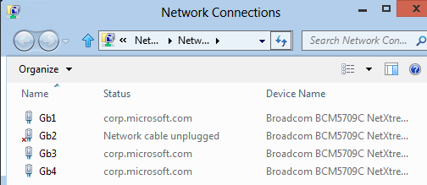
Meaningful names for Ethernet ports

Slide 24
Consistent Device Naming (CDN)
BIOS supplied naming consistently identifies NICs with names, numbers - Names can be printed on the chassis!
Most major OEMs have signed up to ship their machines with CDN-compliant BIOS
Microsoft’s implementation of PCI-SIG Engineering Change Notice (ECN)
http://www.pcisig.com/specifications/pciexpress/specifications/ECR_Slot_Naming-10.pdf.
NIC Vendors – if your driver uses a virtual bus driver you need to talk to us!

Slide 25
NIC Teaming (LBFO)
Customers are tired of administering different teaming solutions that often don’t work well with their Windows Server features.

Slide 26
NIC Teaming (LBFO)
Many NIC vendors are tired of spending resources engineering and supporting a teaming solution that doesn’t show an income stream.

Slide 27
NIC Teaming (LBFO)
The most popular feature in the data center just got better!
Microsoft supported, inbox, vendor agnostic teaming
Managed through PowerShell or an on-box UI
Support multiple servers from a single interface

Slide 28
NIC Teaming configurations
TCP/IP
Stack
TCP/IP Stack
Up to 32 NICs
Unlimited virtual interfaces
Multiple teaming modes
Local/Remote management through PowerShell or UI
Hyper-V
Switch
VM
VM
VM
NIC Teaming
NIC Teaming

Slide 29
NIC Teaming
demo

Slide 30
Clouds must be flexible and secure

Slide 31
Flexible, secure cloud
Isolation of private networks
Better security with reduced VM CPU use
GRE
IPsecTOv2 for VMs

Slide 32
Separating hosted clients through virtualization
Blue VM
Red VM
Blue network
Red network
Virtualization
Physical
server
Physical
network

Slide 33
Generic Routing Encapsulation (GRE)
Multi-tenant environments need to hide the tenant’s own multi-premise networking from the datacenter’s networking.
GRE (RFCs 2784 & 2890) provides the mechanism to tunnel tenant networks over the datacenter network
Without NIC participation GRE breaks today’s task offloads
NIC vendors should support GRE offload if they want to be used in cloud hosting scenarios
LEARN
MORE
Session 442 - Building Secure, Scalable Multi-Tenant Clouds Using Network Virtualization

Slide 34
IPsec Task Offload v2 (IPsecTOv2) for VMs
Compliance (SOX, HIPPA, etc.)
IPsec is a required security protocol in many networks
IPsec is a CPU intensive workload
IPsecTOv2 was only available to native and host workloads in Windows Server 2008 R2
Now extended to VMs
Managed by the Hyper-V switch

Slide 35
High-performance networking hosts create lower OP-EX clouds

Slide 36
High-performance hosts
Direct data placement in VMs
Reduced packet header processing
Interrupt spreading across
k-groups
Dynamic reassignment of queues
SR-IOV
RSC
RSS
VMQ

Slide 37
Single root I/O Virtualization (SR-IOV)
For virtual networking the Holy Grail is near-native-I/O
reduces CPU, reduces latency, and increases network throughput
Improved hardware usage = allows more VMs per host
VM network I/O bypasses the host, moved directly between the VM and NIC
Requires:
Chipset:
Interrupt and DMA remapping: VT-d2 or IOMMU
Access Control Services (ACS) on PCIe root ports
Alternative Routing-ID Interpretation (ARI)
CPU: Hardware virtualization, EPT or NPT
LEARN
MORE
Session 437 - A Deep Dive into Hyper-V Networking

Slide 38
Receive Segment Coalescing (RSC)
Coalesces packets in the NIC so the stack processes fewer headers
Multiple packets belonging to connection that arrive within a single interrupt are coalesced to a larger packet (max of 64 K) by the NIC
10 – 30% improvement in I/O overhead

Slide 39
Receive Side Scaling (RSS)
RSS has been helping servers scale for many years. Windows 8 takes RSS to the next generation of servers
Spreads interrupts across all available CPUs – even for those very large scale hosts
RSS now works across k-groups
RSS now load balances UDP traffic across the CPUs

Slide 40
Dynamic Virtual Machine Queues (VMQ)
VMQ is to virtualization what RSS is to native workloads
Dynamic VMQ reassigns available queues based on changing networking demands of the VMs

Slide 41
Review

Slide 42
Performance and reliability reduce costs

Slide 43
New and improved hardware offloads and networking stack make Windows Server 8 the best OS for your datacenter or cloud

Slide 44
Your next steps
Customers demand better network performance.
IHVs: Join us in making it happen. Make sure your NICs are delivering the features customers want.
OEMs: Set your sourcing requirements to ensure customers get the performance and scale to meet their needs

Slide 45
For more information
RELATED SESSIONS
Session SAC-429T
Session SAC-430T
Session SAC-437T
Session SAC-439T
Session SAC-442T
Session SAC-559T
Session SAC-565T
Session HW-566T
Session SAC-593T
Session HW-667P
Contacts
General networking questions on these topics: ndis6fb@microsoft.com
CONTACT: buildmultimedia@microsoft.com

Slide 46
thank you
Feedback and questions http://forums.dev.windows.com
Session feedback http://bldw.in/SessionFeedback

Slide 47
© 2011 Microsoft Corporation. All rights reserved. Microsoft, Windows, Windows Vista and other product names are or may be registered trademarks and/or trademarks in the U.S. and/or other countries.
The information herein is for informational purposes only and represents the current view of Microsoft Corporation as of the date of this presentation. Because Microsoft must respond to changing market conditions, it should not be interpreted to be a commitment on the part of Microsoft, and Microsoft cannot guarantee the accuracy of any information provided after the date of this presentation. MICROSOFT MAKES NO WARRANTIES, EXPRESS, IMPLIED OR STATUTORY, AS TO THE INFORMATION IN THIS PRESENTATION.

