Slide 1
A deep dive into Hyper-V networking
SAC-437T
See-Mong Tan / Pankaj Garg
Program Management Lead / Software Development Lead
Microsoft Corporation

Slide 2
Agenda
Multi-tenant hybrid clouds
Habits of highly successful cloud networks
You’ll leave with an understanding of
How Hyper-V networking is optimized to build hybrid clouds
The many opportunities for partners to innovate

Slide 3
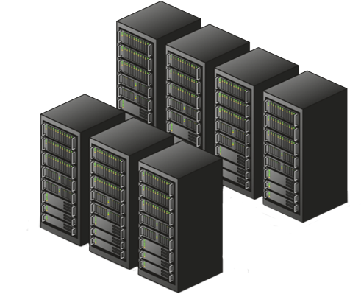
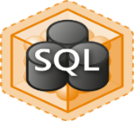


Hybrid Clouds
Data Center
Tenant 1: Multiple VM Workloads
Tenant 2: Multiple VM Workloads
Windows Server 8 is optimized for Hybrid Clouds to host multi-tenant workloads

Slide 4
Reliability
Data Center
Tenant 1: Multiple VM Workloads
Tenant 2: Multiple VM Workloads
Even when hardware fails…
… customers want continuous availability.

Slide 5

Security
Data Center
Tenant 1: Multiple VM Workloads
Tenant 2: Multiple VM Workloads
In a multi-tenant environment…
… customers want security and isolation

Slide 6
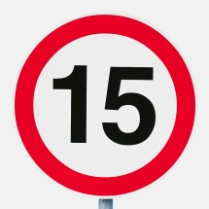
Predictability
Data Center
Tenant 1: Multiple VM Workloads
Tenant 2: Multiple VM Workloads
Even when multiple VMs are competing for bandwidth…
… customers want predictability

Slide 7



Scalability
Data Center
Tenant 1: Multiple VM Workloads
Tenant 2: Multiple VM Workloads
Cloud admins want scalability
…and customers want performance

Slide 8
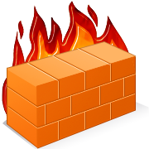
Extensibility
Data Center
Tenant 1: Multiple VM Workloads
Tenant 2: Multiple VM Workloads
Customers want specialized functionality with lots of choice…
… for firewalls, monitoring and physical fabric integration

Slide 9
Windows Server 8 Is Designed for the Cloud
Manageability
Reliability
Extensibility
Scalability
Security
Predictability

Slide 10
Manageability
Reliability
Extensibility
Scalability
Security
Predictability

Slide 11
Windows Server 8 NIC teaming provides reliability against hardware failures

Slide 12
NIC Teaming
Hyper-V Extensible Switch
LBFO Admin GUI
LBFO Provider
Frame distribution/aggregation
Failure detection
Control protocol implementation
WMI
LBFO Configuration DLL
IOCTL
Virtual miniport 1
Port 1
Port 2
Port 3
IM Mux
Protocol edge
User mode
Kernel mode
NIC 1
NIC 2
NIC 3
Multiple modes: switch dependent and switch independent
Hashing modes: port and 4-tuple
Active active and active standby
Network switch
LEARN
MORE
Session 433 – Acceleration & Other NIC Technologies for the Data Center

Slide 13
Manageability
Reliability
Extensibility
Scalability
Security
Predictability

Slide 14
Windows Server 8 provides security features required to host multi-tenant workloads in a hybrid cloud

Slide 15
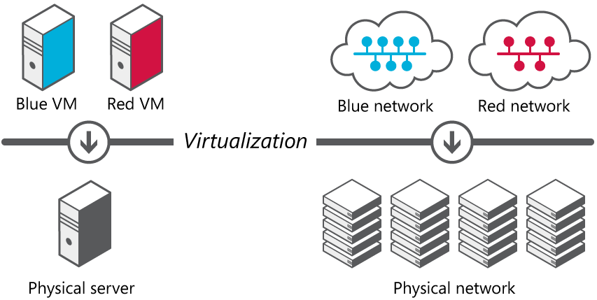
Network Virtualization
Server Virtualization
Run multiple virtual servers on a physical server
Each VM has illusion it is running as a physical server
Network virtualization
Run multiple virtual networks on a physical network
Each virtual network has illusion it is running as a physical fabric

Slide 16
Other Features
Port ACLs
PVLAN
DHCP Guard
LEARN
MORE
Session 442 – Designing and Extending Multi-Tenant Clouds using Network Virtualization

Slide 17
Manageability
Reliability
Extensibility
Scalability
Security
Predictability

Slide 18
Windows Server 8 QoS provides predictable performance in a multi-tenant environment

Slide 19
Hyper-V QoS
Management OS
VM 1
VM n
Live Migration
Hyper-V virtual switch
Storage
Management
LBFO Team NIC
Phy NIC
Phy NIC
Maximum and Minimum
Absolute vs Weight
LEARN
MORE
Session 439 – QoS and Converged Fabric in the Data Center

Slide 20
QoS Maximum Bandwidth
demo

Slide 21
Manageability
Reliability
Extensibility
Scalability
Security
Predictability

Slide 22
Windows Server 8 performance features enable efficient hybrid cloud operations

Slide 23
SR-IOV
Host
Host
Root Partition
Virtual Machine
Root Partition
Virtual Machine
Hyper-V Switch
Virtual NIC
Hyper-V Switch
Virtual Function
Routing
VLAN Filtering
Data Copy
Routing
VLAN Filtering
Data Copy
VMBUS
Physical NIC
SR-IOV Physical NIC
Network I/O path without SRIOV
Network I/O path with SRIOV
Windows Server 8 supports direct device assignment to virtual machines without compromising flexibility

Slide 24
Live Migration with SR-IOV
demo

Slide 25
Dynamic Virtual Machine Queue (D-VMQ)
Root Partition
Root Partition
Root Partition
Root Partition
CPU
0
CPU
1
CPU
3
CPU
0
CPU
1
CPU
3
CPU
0
CPU
1
CPU
3
CPU
2
CPU
2
CPU
0
CPU
1
CPU
2
CPU
3
CPU
2
Physical NIC
Physical NIC
Physical NIC
Physical NIC
No VMQ
Static VMQ
Windows Server 8 Dynamic VMQ
Adaptive network processing across CPU to provide optimal power and performance across changing workloads

Slide 26
Other Offloads
Receive Side Coalescing (RSC)
IPsec Task Offload
LEARN
MORE
Session 433 – Acceleration & Other NIC Technologies for the Data Center

Slide 27
Call to Action
  NIC vendors
  Implement offloads in your hardware to deliver high performance
  Server vendors
  Support SR-IOV on your servers to deliver high performance

Slide 28
Manageability
Reliability
Extensibility
Scalability
Security
Predictability

Slide 29
Windows Server 8 allows partners to extend Hyper-V Switch

Slide 30




Hyper-V Extensible Switch
Virtual Machine
Virtual Machine
Root Partition
VM NIC
Host NIC
VM NIC
Hyper-V Switch
Extension Protocol
Capture Extensions
Certified
Extensions
WFP Extensions
Filtering Extensions
Forwarding Extension
Extension Miniport
Physical NIC
LEARN
MORE
Session 559 - Extending the Hyper-V Switch

Slide 31
Call to Action
  Security vendors
  Implement firewall and security appliances as switch extension
  Switch vendors
  Implement switch extension to provide unified management of physical and virtual switches
  Network monitoring software
  Implement switch extension to provide monitoring inside Hyper-V virtual switch

Slide 32
Manageability
Reliability
Extensibility
Scalability
Security
Predictability

Slide 33
The management capabilities in Windows Server 8 allows cloud admins to manage large scale hybrid clouds

Slide 34
Hyper-V Metering
Built-in metering capabilities allows cloud admins to build chargeback models based on network usage

Slide 35
Hyper-V Metering and Live Migration
Virtual Machine
Configuration
Usage Data
Host 1
Host 2
Extensible Switch
Extensible Switch
Extension Protocol
Extension Protocol
Extension
Extension
Extension Miniport
Extension Miniport
Metering configuration and usage data is preserved across live migration

Slide 36
Other Features
PowerShell
Unified Tracing
Port Mirroring
LEARN
MORE
Session 565 – Windows Networking with PowerShell: A Foundation for Datacenter Management

Slide 37
Windows Server 8 Is Designed for the Cloud
Manageability
Reliability
Predictability
Scalability
Extensibility
Security

Slide 38
Call To Action
OEMs should make sure that server SKUs and networking gear are enhanced to take full advantage of Hyper-V Networking capabilities for high performance, cost-effective Hybrid Clouds

Slide 39
For more information
RELATED SESSIONS
[SAC-429T] Using Windows Server 8 for building private and public IaaS clouds
[SAC-559T] Extending the Hyper-V switch
[SAC-433T] Network acceleration and other NIC technologies for the data center
[SAC-439T] Enabling multi-tenancy and converged fabric for the cloud using QoS
[SAC-442T] Building secure, scalable multi-tenant clouds using Hyper-V Network Virtualization
[SAC-565T] Windows networking with PowerShell: A foundation for data center management
[SAC-430T] Designing the building blocks for a Windows Server 8 cloud

Slide 40
thank you
Feedback and questions http://forums.dev.windows.com
Session feedback
http://bldw.in/SessionFeedback

Slide 41

© 2011 Microsoft Corporation. All rights reserved. Microsoft, Windows, Windows Vista and other product names are or may be registered trademarks and/or trademarks in the U.S. and/or other countries.
The information herein is for informational purposes only and represents the current view of Microsoft Corporation as of the date of this presentation. Because Microsoft must respond to changing market conditions, it should not be interpreted to be a commitment on the part of Microsoft, and Microsoft cannot guarantee the accuracy of any information provided after the date of this presentation. MICROSOFT MAKES NO WARRANTIES, EXPRESS, IMPLIED OR STATUTORY, AS TO THE INFORMATION IN THIS PRESENTATION.

