Slide 1
Building and running HPC apps in Windows Azure
SAC-452T
Greg Burgess
Principal Development Manager
High Performance Computing Team
Microsoft Corporation

Slide 2
Agenda slide
WHO WILL BENEFIT FROM THIS TALK
TOPICS
WHAT YOU’LL LEAVE WITH
Developers of computational intensive apps
App developers who would like to support “bursting” computational work from apps to Windows Azure
What is the Windows Azure Scheduler
Using the Azure Scheduler and HPC Runtimes
How easy it is to build computational intensive services within Windows Azure using the Windows Azure Scheduler and HPC Runtimes

Slide 3
What’s the Problem?
Some apps run too slowly on a single computer
Splitting them up into chunks, then running those chunks in parallel on multiple computers can speed them up
Doing this effectively requires creating a compute cluster, with:
Tools to create and manage the cluster
A scheduler for running apps on the cluster

Slide 4
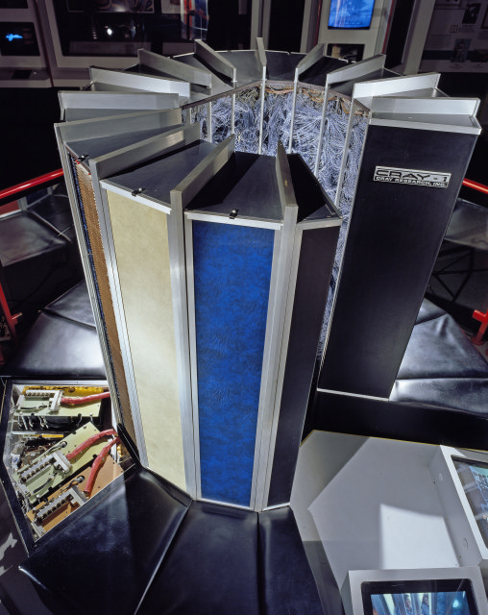
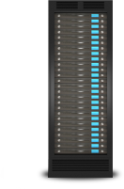
What does High Performance Computing have in common with Windows Azure?
Solve large computational problems
HPC is best described as massively parallel
Becoming critical part of R&D for businesses
Windows HPC Programming Models
Parametric Sweep (Batch)
MPI (Numerical solvers /Scientific Simulations)
Data Analytics

Slide 5
Example Workloads That Can Use a Cluster
Digital media rendering and encoding
Financial and insurance risk calculation
Engineering modeling and simulation
Computational life sciences
Earth sciences
Data analytics

Slide 6
Embarrassingly Parallel Apps An illustration
Cluster of Compute Nodes
Compute Node
Compute Node
Compute Node
Application Logic
Application Logic
Application Logic
1) Submit work
2) (Optionally) Interact with application
Compute Node
Compute Node
Compute Node
Application Logic
Application Logic
Application Logic
3) Get results
Compute Node
Compute Node
Compute Node
Application Logic
Application Logic
Application Logic
Credit: David Chappell

Slide 7
Tightly Coupled App (MPI) An illustration
Cluster of Compute Nodes
Compute Node
Compute Node
Compute Node
Application Logic
Application Logic
Application Logic
1) Submit work
Compute Node
Compute Node
Compute Node
Application Logic
Application Logic
Application Logic
2) Get results
Compute Node
Compute Node
Compute Node
Application Logic
Application Logic
Application Logic
Credit: David Chappell

Slide 8
Data Analytics An illustration
Cluster of Compute Nodes
Compute Node
Compute Node
Compute Node
Application
Application
Application
1) Submit work
Compute Node
Compute Node
Compute Node
Application
Application
Application
2) Get results
Compute Node
Compute Node
Compute Node
Application
Application
Application
Credit: David Chappell

Slide 9
Digital Rendering Windows Azure
demo

Slide 10
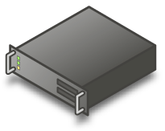
HPC Server makes this easy
Windows HPC Application
Client
Logic
Job Scheduling
Cluster Management
Logic
Logic
Windows HPC
Server
Head Node
Windows HPC Server
Windows 7
Windows Azure
Compute Nodes

Slide 11
HPC Server Components
HPC Scheduler
Job submission API and portal
Distributed Runtimes
Parametric Sweeps
Job queue and priorities
Task activation and monitoring
Resource sharing policies
Cluster SOA
MPI
LINQ to HPC
System Administration
Cluster Deployment
Monitoring
Diagnostics
Reporting
Excel
Currently on the third major release of the components for our On Premise
based cluster software

Slide 12
Components in HPC SP3 SDK for Windows Azure
Azure Scheduler
Job submission API and portal
Distributed Runtimes
Parametric Sweeps
Job queue and priorities
Task activation and monitoring
Resource sharing policies
Cluster SOA
MPI
LINQ to HPC
System Administration
Cluster Deployment
Monitoring
Diagnostics
Reporting
Excel
The full HPC Job Scheduler and Runtimes are available
Management of the compute resources will be handled by Windows Azure

Slide 13
Windows Azure Scheduler In Action
A Windows Azure Deployment
Front End
Compute Worker
Node Manager
Application Front End (Web Page)
Application
Compute Worker
Windows Azure Scheduler
Compute Worker
Compute Worker
Standard HPC
Job Scheduler API
Compute Worker

Slide 14
Building a Scheduler Enabled Deployment
Azure Subscription
Your application
Construct a base CS Package
Customize and Deploy

Slide 15
Using Visual Studio and helper scripts to build the Rendering Demo
demo

Slide 16
Behind the scenes of the Rendering Demo
demo

Slide 17
Wrapping it up!

Slide 18
Windows Azure Scheduler – What is it?
A component in the HPC SP3 Release that can be used by ISV’s for building solutions in Windows Azure
PaaS – Application Bursting
SaaS – Manages Compute jobs within a Service
The same Job Scheduler that is used in the HPC 2008 R2 SP2 Pack
Priority based First Come First Served batch scheduling with Backfill
Graceful and Immediate Preemption
HPC Grow/Shrink
Service Balanced Scheduling
CLUSRUN!

Slide 19
Benefits to Developers – Why?
No need to re-write infrastructure for managing the app lifetime, focus on the app
Better granularity of control and access for actions(tasks) with in a run.
Offer capability like cancel, re-queue, addition to existing tasks.
Offer Job/task level auditing – CPU, Memory usage, task location.
As runtimes ( MPI, SOA, LINQ to HPC) become available, Applications can leverage the integration of the runtimes with the HPC Scheduler
Use same API to work against the HPC scheduler and runtime on premise or in Windows Azure
Make the application available in Windows Azure right away, while longer term platform features emerge.
Users brings their own license
Users get billed by azure directly
Security via isolated deployment per customer

Slide 20
Who would use it?
Do it yourself cluster
Power user
In house developer
Packaged software
Leverage additional compute resource in Windows Azure
Software as a Service
Vendor pays for the compute resources
Vendor bills end user directly

Slide 21
Resources
http://connect.microsoft.com/hpc
http://blogs.msdn.com/b/hpctrekker/
http://msdn.microsoft.com/en-us/HPCAzureBurstTrainingCourse

Slide 22
thank you
Feedback and Questions: http://forums.dev.windows.com
Session Feedback: http://bldw.in/SessionFeedback

Slide 23
© 2011 Microsoft Corporation. All rights reserved. Microsoft, Windows, Windows Vista and other product names are or may be registered trademarks and/or trademarks in the U.S. and/or other countries.
The information herein is for informational purposes only and represents the current view of Microsoft Corporation as of the date of this presentation. Because Microsoft must respond to changing market conditions, it should not be interpreted to be a commitment on the part of Microsoft, and Microsoft cannot guarantee the accuracy of any information provided after the date of this presentation. MICROSOFT MAKES NO WARRANTIES, EXPRESS, IMPLIED OR STATUTORY, AS TO THE INFORMATION IN THIS PRESENTATION.

