Slide 1
Extending the Hyper-V switch
SAC-559T
Bob Combs / Luis Hernandez
Program Manager / Software Development Engineer
Microsoft Corporation

Slide 2
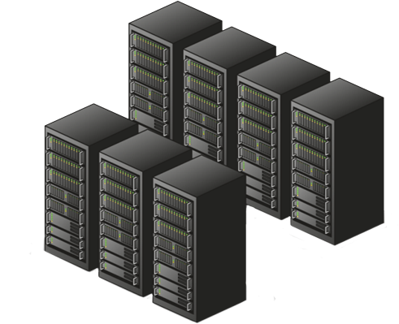
Cloud Demand Is Increasing
Cloud demands
Integrated protection
Ability to add virtual appliances
Integration between virtual and physical data center networking

Slide 3
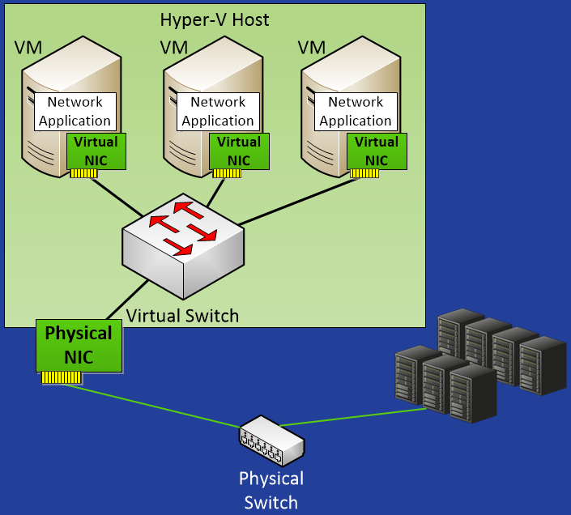
Hyper-V Switch
Network traffic between Virtual Machines, the external network, and the Host OS is handled by the Hyper-V Virtual Switch

Slide 4
Introducing Hyper-V Extensible Switch

Slide 5
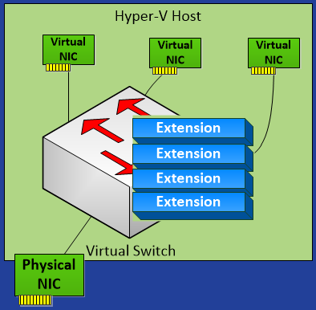
Introducing Hyper-V Extensible Switch
Write only the functionality you want
Get services for free
Quicker development
Higher customer satisfaction
Lower support costs
Open platform lets you write only the functionality you want (no “all or none” switch replacement)
Core services lets extensions fully interoperate with Hyper-V, including getting Live Migration for free
Quicker development time with familiar Windows API (WFP and NDIS)
Increase customer satisfaction and reliability from the Windows framework and Windows 8 Certification program
Unified tracing makes it easier to diagnose issues resulting in lower support costs

Slide 6
Details of The Hyper-V Extensible Switch

Slide 7
Hyper-V Extensible Switch
Virtual Machine
Virtual Machine
Root Partition
Extensions are Filters or Windows Filtering Platform Providers
Extension state/configuration is unique to each instance of an Extensible Switch on a machine
VM NIC
Host NIC
VM NIC
Virtual Switch
Extension Protocol
Extension
Extension
Extension
Extension
Extension Miniport
Physical NIC
PAGE 7

Slide 8
Hyper-V Extensible Switch
Virtual Machine
Virtual Machine
Root Partition
Traffic is processed in two stages
Ingress - before destinations are defined
Egress - after destinations are defined
VM NIC
Host NIC
VM NIC
Virtual Switch
Extension Protocol
Ingress Traffic
Egress Traffic
Extension
Extension
Extension
Extension
Extension Miniport
Physical NIC
PAGE 8

Slide 9
Hyper-V Extensible Switch
Virtual Machine
Virtual Machine
Root Partition
Extensions learn about the VM lifecycle
Extensions can veto state changes
VM NIC
Host NIC
VM NIC
Virtual Switch
Extension Protocol
Port Create
Extension
NIC
Connect
Port Create
Extension
Extension
Extension
Extension Miniport
Physical NIC
PAGE 9

Slide 10
Hyper-V Extensible Switch
Virtual Machine
Virtual Machine
Multiple Extensions can co-exist on the same Extensible Switch
Integrates with built in Extensible Switch features
You can focus on providing targeted functionality, not replacing the Extensible Switch
Root Partition
VM NIC
Host NIC
VM NIC
Virtual Switch
Extension Protocol
Extension A
Extension B
Extension C
Extension D
Extension Miniport
Physical NIC
PAGE 10

Slide 11
Capture Extensions
Virtual Machine
Virtual Machine
Root Partition
Capture extensions can inspect traffic and generate new traffic for report purposes
Capture extensions do not modify existing Extensible Switch traffic
VM NIC
Host NIC
VM NIC
Virtual Switch
Extension Protocol
Capture Extensions
Extension
Extension
Extension
Extension Miniport
Physical NIC
PAGE 11

Slide 12
sFlow traffic monitoring in Hyper-V
demo
Stuart Johnston
Chief Security Architect
Inmon

Slide 13
Windows Filtering Platform Extensions
Virtual Machine
Virtual Machine
Windows Filter Platform (WFP) Extensions can inspect, drop, modify, and insert packets using WFP APIs
Windows Antivirus and Firewall software uses WFP for traffic filtering
Root Partition
BFE Service
Firewall
VM NIC
Host NIC
VM NIC
Filtering Engine
Callout
Virtual Switch
Extension Protocol
Capture Extensions
WFP Extensions
Extension
Extension
Extension Miniport
Physical NIC
PAGE 13

Slide 14
Virtual Firewall v3.0 for Hyper-V
demo
Konstantin Malkov
Software CTO
5Nine

Slide 15
NDIS Filtering Extensions
Virtual Machine
Virtual Machine
Root Partition
Filtering extensions can also be implemented using NDIS filtering APIs
VM NIC
Host NIC
VM NIC
Virtual Switch
Extension Protocol
Capture Extensions
WFP Extensions
Filtering Extensions
Extension
Extension Miniport
Physical NIC
PAGE 15

Slide 16
Hyper-V Switch Extension for VM DoS Prevention
demo
Eric Smiley
Technical Marketing Engineer
Broadcom

Slide 17
Forwarding Extensions
Virtual Machine
Virtual Machine
Root Partition
Forwarding extensions direct traffic, defining the destination(s) of each packet
Forwarding extensions can capture and filter traffic
VM NIC
Host NIC
VM NIC
Virtual Switch
Extension Protocol
Capture Extensions
WFP Extensions
Filtering Extensions
Forwarding Extension
Extension Miniport
Physical NIC
PAGE 17

Slide 18
Cisco Nexus 1000V Switch for Hyper-V
demo
Prashant Gandhi
Senior Director, Product Marketing
Cisco

Slide 19
UCS for Hyper-V
demo
Arnab Basu
UCS VM-FEM Product Manager
Cisco

Slide 20
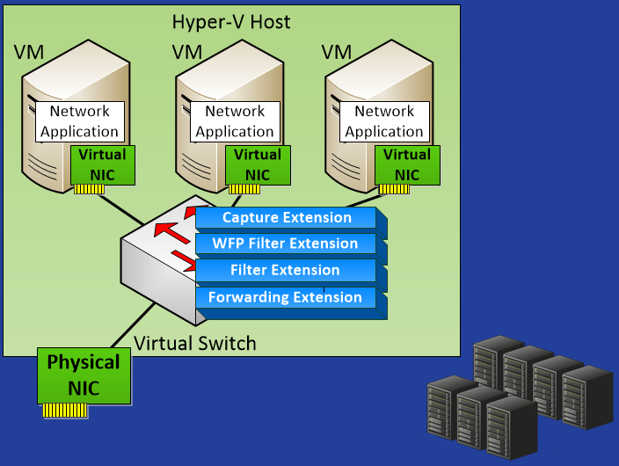
Uniformly Managing Network Resources
Network management packages can extend control across physical and virtual switches for a uniform management experience
Management
Console

Slide 21
OpenFlow for Hyper-V
demo
Su-Hun Yun
Senior Manager, OpenFlow Business Development
NEC

Slide 22
Managing Extensions
Standard interfaces are available to
Discover, enable, disable, and reorder extensions
Configure extensions and query extension status
Diagnose extension operation

Slide 23
Extensions and Live Migration
Extension configuration automatically moves with VM, and extensions can attach runtime state on Live Migration
Virtual Machine
Configuration
Host 1
Host 2
Extensible Switch
Extensible Switch
Extension Protocol
Extension Protocol
Runtime State
Extension A
Extension A
Extension Miniport
Extension Miniport
PAGE 23

Slide 24
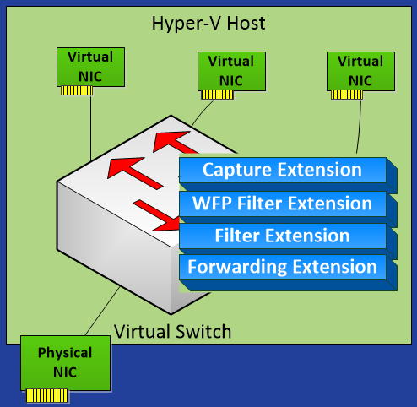
Summary
Write only the functionality you want
Get services for free
Quicker development
Higher customer satisfaction
Lower support costs

Slide 25
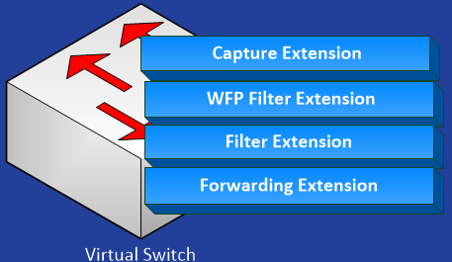
Call To Action
Add new capabilities to the Hyper-V Extensible Switch
Implement as a Switch Extension

Slide 26
Related sessions
[SAC-429T] Using Windows Server 8 for building private and public IaaS clouds
[SAC-437T] A deep dive into Hyper-V networking
[SAC-433T] Network acceleration and other NIC technologies for the data center
[SAC-439T] Enabling multi-tenancy and converged fabric for the cloud using QoS
[SAC-442T] Building secure, scalable multi-tenant clouds using Hyper-V Network Virtualization
[SAC-565T] Windows networking with PowerShell: A foundation for data center management

Slide 27
Further reading and documentation
Windows Filtering Platform (WFP) API
NDIS extension API
Forwarding extension sample
WFP provider sample
Building Infrastructure as a Service clouds using WS8
Blogs: http://blogs.microsoft.com/b8
Extension help alias – ws8cloudnetfb@microsoft.com

Slide 28
thank you
Feedback and questions http://forums.dev.windows.com
Session feedback http://bldw.in/SessionFeedback

Slide 29
© 2011 Microsoft Corporation. All rights reserved. Microsoft, Windows, Windows Vista and other product names are or may be registered trademarks and/or trademarks in the U.S. and/or other countries.
The information herein is for informational purposes only and represents the current view of Microsoft Corporation as of the date of this presentation. Because Microsoft must respond to changing market conditions, it should not be interpreted to be a commitment on the part of Microsoft, and Microsoft cannot guarantee the accuracy of any information provided after the date of this presentation. MICROSOFT MAKES NO WARRANTIES, EXPRESS, IMPLIED OR STATUTORY, AS TO THE INFORMATION IN THIS PRESENTATION.

