Slide 1
Optimal Cloud Performance with BranchCache
SAC-592T
Tyler Barton
Program Manager
Andrew Cunningham
Software Design Engineer
Microsoft Corporation

Slide 2
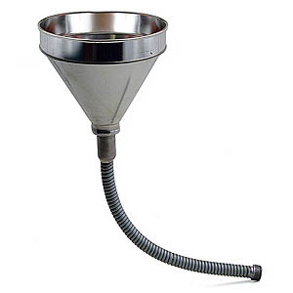




Problem
When servers are far, bandwidth costs money, applications slow down and people get frustrated
When servers are close, bandwidth is free, applications are fast and everyone is happy
Nobody likes waiting
1
1
1
0
0
0
1
0
1
1
1
1
1
1
0
1
1
1
0
0
0
1
1
0
0
1
0
1
0
1
0
1
1
0
1
1
1
1
1
0
1
1
1
1
0
1
0
00101011010001011110100010101001001
11010100000000001101111111010101010
10100101101011110101110100010101011
01001011101010100101001010010011011
11100000010101110100011010101101010

Slide 3
BranchCache
1
0
1
1
0
0
1
0
0
1
0
1
1
0
1
0
0
1
1
0
0
1
0
0
1
0
1
1
0
1
0
1
0
1
1
0
0
1
0
0
1
0
1
1
0
1
0
1
0
1
1
0
1
1
0
1
1
0
1
1
0
1
1
0
0
0
1
0
0
1
1
1
0
0
1
1
0
1
0
1
0
1
1
0
1
1
0
1
1
0
0
1
0
0
1
0
1
1
0
1
0
1
0
1
1
0
1
1
0
1
1
1
0
1
0
1
1
0
1
0
0
1
0
0
1
1
0
1
0
1
0
1
1
0
0
1
0
0
1
0
1
1
0
1
0
1
1
0
1
0
1
0
1
1
0
1
1
1
0
0
1
0
0
1
1
0
1
1
0
1
0
1
0
1
1
1
0
1
0
0
1
0
1
1
0
1
0
1
0
1
1
0
0
1
0
0
1
0
1
1
0
1
0
1
0
1
1
0
0
0
1
0
0
1
1
1
0
0
1
1
0
1
0
1
0
1
1
0
0
1
0
0
1
0
1
1
0
1
0
1
0
1
1
1
0
0
0
0
1
0
0
1
1
1
0
1
1
1
0
1
0
0
1
0
0
0
1
0
1
1
0
1
1
0
1
1
0
0
1
0
0
1
0
1
1
0
1
0
1
0
1
1
1
0
0
0
0
1
0
0
1
1
1
0
1
1
1
0
0
1
0
0
1
1
0
1
0
1
1
0
0
1
0
0
1
0
1
1
0
1
1
1
0
0
1
0
1
1
0
0
1
0
0
1
0
1
0
1
1
1
0
0
0
1
0
0
1
1
0
1
0
1
0
1
1
0
0
1
0
0
1
0
1
1
0
1
0
1
0
11
10
11
10
1
1
0
01
11
01
11
1
1
0
11
10
10
11
11
10
1
1
0
11
10
11
10
1
1
0
11
10
10
11
11
10
1
1
0
11
10
10
11
11
10
1

Slide 4




Opportunity
Cloud to Cloud
  BranchCache can aid in transfers between data centers
Storage
VMs
Compute
Private Cloud
Public Cloud
  BranchCache speeds up applications deployed on Windows Server without changes.
  BranchCache API can be used to accelerate new applications and protocols.

Slide 5
Agenda
Free Cache!
How apps on Windows get caching without code
New Programs, Protocols and Possibilities
How to use the Peer Distribution API
It’s Really Raining Hard Now
BranchCache and the public cloud
Sharing with Everyone
BranchCache appliances and opportunities

Slide 6
Free Cache!
How Apps on Windows get caching without code

Slide 7
The Windows BranchCache Framework
3rd Party Applications
Office
CopyFile
Explorer
SharePoint 12
Office
BITS
WMP
IE
SMB 2
HTTP
BranchCache™

Slide 8


BranchCache Hosted Cache
Get
Data
Data
ID
ID
ID
Get
ID
Get
Get
Search
Search
ID
Data
Offer
ID
Request
Data
ID
Put

Slide 9

BranchCache Distributed Cache
ID
Get
Data
Data
ID
Get
Get
Data
Get

Slide 10

What Are These Identifiers?
Identifiers
Block Hashes
ID1
ID2
ID3
ID4
ID5
ID6
ID7
ID8
ID9
Blocks
32K – 128K
Fingerprint
Used to choose boundaries
Content

Slide 11


Security
BranchCache accelerates e2e encrypted traffic (TLS/HTTPs, Ipsec)
Cached data encrypted on disk and in transit between clients
Prevents unauthorized access to cached data

Slide 12
BranchCache Security Model
Server transmits content information structure to the client only if the client has access. Transfer happens over the accelerated protocol.
Server authenticates the client and performs authorization checks.
Client downloads encrypted blocks from a peer or the hosted cache and decrypts them with the encryption key.
Client uses content information structure to calculate:
-segment id (public)
-encryption key (private)
Client multicasts the segment id to find a peer with the data.
Cached data is stored in encrypted.

Slide 13



Deployment
Enable BranchCache on clients with PowerShell or Group Policy.
Use distributed cache mode for offices without servers
Hosted cache servers may be automatically detected.
Install the optional BranchCache component on Windows web and file servers
IIS
File Server
Group Policy
Management
  Multiple hosted cache servers can be used in large, busy locations.

Slide 14
BranchCache and HTTP
demo
Tyler Barton
Program Manager
Windows Bandwidth Optimization Services

Slide 15
New Programs, Protocols and Possibilities
How to use the Peer Distribution API

Slide 16
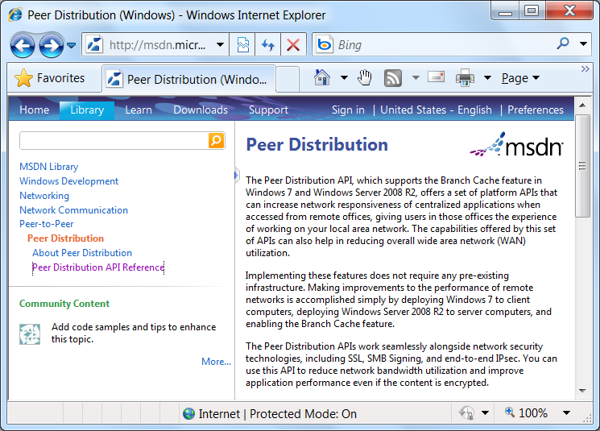
Peer Distribution on MSDN

Slide 17
New Protocols and Applications
SMB 2
HTTP
Your App
Your Protocol
BranchCache

Slide 18
Peer Distribution Overview
Generate Identifiers
Use the server side Peer Distribution APIs on the server to calculate identifiers for data that would traverse the WAN.
Transmit Identifiers
Identifiers are packaged in a structure called
Content Information.
It must be sent to the client.
Handle Cache Misses
Retrieve data from the server and add it to the BranchCache cache for peers to access.
Search for Data
Feed the Content Information structure into the client side APIs to search for data.

Slide 19
HTTP Flow
PeerDistClientOpenContent
PeerDistClientAddContentInformation
PeerDistClientCompleteContentInformation
Content
Information
PeerDistServerPublishStream
PeerDistServerAddToStream
PeerDistServerCompleteStream
PeerDistServerCloseStreamHandle
GET /images/logo.png HTTP/1.1 …
Accept-Encoding: gzip, peerdist
Data
HTTP/1.1 200 OK …
Content-Encoding : peerdist
Content
Information
Data
PeerDistClientStreamRead /
PeerDistClientBlockRead
PeerDistClientCloseContent
Content
Information
Hash
Cache
PeerDistServerOpenContentInformation
PeerDistServerRetrieveContentInformation
PeerDistServerCloseContentInformation
Data Cache

Slide 20
Missing Data
GET /images/logo.png HTTP/1.1 …
Accept-Encoding: gzip, peerdist
Data
PeerDistClientAddData
PeerDistClientCloseContent
HTTP/1.1 200 OK …
Content-Encoding : gzip
Data
Cache

Slide 21
It’s Really Raining Hard Now
BranchCache and the public cloud

Slide 22
PaaS
Storage
VMs
  Cloud service doesn’t generate hashes for you……
  ….but your data is still far away.
Compute
  Generate hashes on the client!

Slide 23
BranchCache and Windows Azure Storage
Peerdist API
Data
Data
IDs
Storage
IDs
Use Peerdist API
to generate IDs.
Upload data and IDs as
separate blobs
First download IDs
Download data on cache miss
Peerdist API
Pass data into Peerdist API to add it to the cache
Pass IDs into Peerdist API to search

Slide 24
BranchCache and Azure Storage
demo
Tyler Barton
Program Manager
Windows Bandwidth Optimization Services

Slide 25
Sharing with Everyone
BranchCache appliances and opportunities

Slide 26
Hosted Cache Offering
If you make an appliance, consider including hosted cache functionality.
Hosted cache can work alongside other workloads and can simply be a Windows Server virtual machine.

Slide 27
BranchCache Protocols
PCCRD - Discovery
Based on WS-Discovery. Find data on computers in the same subnet
PCCRTP - HTTP
Extensions for retrieving Content Information over HTTP
PCCRD
PCCRTP
PCCRR
IIS
PCCRR - Retrieval
Used by a client to download blocks from a peer or the hosted cache. Also used by the hosted cache to download from a client
File Server
SMB 2.1
SMB 2.1
Extensions for retrieving Content Information over SMB
PCCRR
PCCRR
PCHC
PCHC – Hosted Cache Offer
Used by a client to alert the hosted cache when new blocks are available.

Slide 28
Summary
BranchCache is a simple, secure technology that can optimize connected applications without code changes.
The Peer Distribution API can be used to instrument new protocols.
BranchCache can speed up communication with the public cloud.
Support BranchCache on your appliances

Slide 29
For more information
DOCUMENTATION & ARTICLES
  www.branchcache.com
CONTACT
  branch@microsoft.com

Slide 30

© 2011 Microsoft Corporation. All rights reserved. Microsoft, Windows, Windows Vista and other product names are or may be registered trademarks and/or trademarks in the U.S. and/or other countries.
The information herein is for informational purposes only and represents the current view of Microsoft Corporation as of the date of this presentation. Because Microsoft must respond to changing market conditions, it should not be interpreted to be a commitment on the part of Microsoft, and Microsoft cannot guarantee the accuracy of any information provided after the date of this presentation. MICROSOFT MAKES NO WARRANTIES, EXPRESS, IMPLIED OR STATUTORY, AS TO THE INFORMATION IN THIS PRESENTATION.

Slide 31
BranchCache and the Public Cloud
Put
Data
hash
Application generates hashes for data using Peerdist apis. Data and hashes uploaded as separate files
Get
Get
Application downloads hash file and uses the peerdist apis to look for content locally.
In the case of a cache miss, application explicitly downloads data file, and feeds data into the peerdist apis so that the content is available to peers.

Slide 32


BranchCache In Windows 8
Management
BranchCache can be deployed without branch by branch configuration.
New tools enable prehashing and preloading content from alternate media.
Performance
Smaller variable sized blocks enable de-duplication across files and improved bandwidth savings and performance.
Scale
BranchCache scales to larger offices, and can be used at HQ.
Multiple hosted cache servers can be deployed in a single office.
Cloud Ready
BranchCache works everywhere you access the cloud from.

Slide 33







Hosted Cache vs Distributed Cache
Enterprise
Distributed Cache
Data cached amongst clients
Hosted Cache
Data cached at hosted cache server
Recommended for branches without any infrastructure
Easy to deploy: Enabled on clients through Group Policy
Cache availability decreases with laptops that go offline
Recommended for larger branches
Cache stored centrally: can use existing server in the branch
Cache availability is high
Enables branch-wide caching

Slide 34
Security Computations
Client
Encryption key
Ke = Kp
Segment Id
Hash(Kp, HoD + K)
Segment Secret
Kp = Hash(HoD, Ks)
Segment hash of data
HoD = Hash (Blockhashes)
Server secret key
Ks
Block hashes
Hash(block)
B1
B2
Bn
Blocks
Server

Slide 35


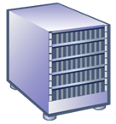
HTTP/HTTPS Integration
IE
IIS
Open
URL
Data
“Branch Cache Capable”
Data
Get data
wininet
http.sys
Hashlist
Hashlist
Data
Data
Hashlist
Branch
Cache
Branch
Cache
Data
Hashlist
H1
H2
H3
H4
H5

