Slide 1
What’s new in Windows Azure?
SAC-851
James Conard
Sr. Director
Developer & Platform Evangelism
Microsoft Corporation

Slide 2
Windows Azure Platform Core Services
Scalable environment for running code
Enables .NET, C++, PHP, Ruby, Python, …
Automated service management
Compute
Scalable and highly available cloud storage
Blobs, Tables, Queues, Drives
REST APIs and client libraries
Storage
Database
SQL Relational Database
Familiar programming model & tools

Slide 3
OPTION 2
Windows Azure SDK 1.3
New Portal Experience
Startup Tasks & Admin mode
Full IIS
Windows Server 2008 R2
Remote Desktop & co-admins
Windows Azure Connect (CTP)
Virtual Machine Role (beta)
Extra Small Instances (beta)
Caching & Access Control (CTP)
SQL Azure Reporting Private
Windows Azure Platform
Access Control Service 2.0 GA
Caching GA
Windows Azure Traffic Mgr CTP
Windows Azure SDK 1.4
MSDN Offers Expanded
SQL Azure Import/Export with DAC 2.0 CTP
AppFabric Apps CTP
HPC 2008 R2 SP2
2010 nov
2010 nov
2011 feb
2011 feb
2011 mar
2011 mar
2011 may
2011 may
2011 jun
2011 jun
2011 july
2011 july
Trial expands to 750 x-small hrs
CDN Expands to 24 nodes
SQL Azure Management APIs
SQL Azure DAC Fx 1.1 support
Service Bus CTP
Free Ingress
Application Marketplace
SQL Server Denali CTP3
SQL Azure co-admin

Slide 4
Development Enhancements
Manageability Enhancements
Manageability Enhancements
New & Enhanced Services
New & Enhanced Services

Slide 5
September 2011 Visual Studio Tools
ASP.NET MVC3 Template
Profiling in the Cloud
Multiple Cloud Configurations
Validation
Simplified packaging and deployment dialogs
Generate cloud service project

Slide 6
Windows Azure SDK 1.5
Fundamental improvements including emulator performance and assembly/package validation before deployment
CSUpload.exe
Uploading service certificates used for Remote Desktop from the command line
CSEncrypt.exe
Encrypt remote desktop passwords from the command line

Slide 7
Windows Azure SDK & Visual Studio Tools Updates
demo

Slide 8
Development Enhancements
Manageability Enhancements
New & Enhanced Services

Slide 9
Service Management API
Create Hosted Service
Create a new Hosted Service (i.e. foo.cloudapp.net)
Create Storage Account
Create a new storage account for using blobs, tables, and queues
Detailed Status Information for instances
15 different instance states including: RoleStateUnknown, CreatingVM , StartingVM, CreatingRole, StartingRole, ReadyRole, BusyRole, StoppingRole, StoppingVM
Rollback
Cancel a service configuration update or in-place upgrade and revert instances to the previous service package/configuration
Can be called only when an upgrade or configuration change is in progress on the deployment
Subscription & Quota Information
Basic information about a subscription including: subscription name, status, and email addresses of the Account and Service Administrators
Current and max usage for storage accounts, hosted services, and cores

Slide 10
Service Management
demo

Slide 11
Windows Azure Storage - Analytics
Analyze and debug your Windows Azure Storage usage
Logs
Understand and debug your storage usage
Record the meta information for all executed requests to a storage account to files in blob storage
Metrics
Get a summary of key statistics for Blobs, Tables and Queues
Record hourly aggregated summary of all transactions and daily capacity utilized for a storage account
Auto cleanup using retention policy defined in days
LEARN
MORE
Inside Windows Azure Storage: What's New and Under the Hood Deep Dive

Slide 12
Storage Analytics
demo

Slide 13
SQL Azure Database Enhancements
SQL Azure Import/Export
Import and export schema and data using a single .bacpac file
Archive directly to BLOB storage
Migrate SQL Server schema and data to SQL Azure
Multiple servers/subscription
Create new logical servers within the same subscription
Up to 6 servers per subscription & 150 databases in each SQL Azure server
Service Management API
REST API for managing SQL Azure Servers & Firewall rules programmatically
Uses X509 client certificates for authentication – just like Windows Azure
Full DAC 1.1 support including in-place upgrades of database schemas
Co-admins!

Slide 14
SQL Azure Database Enhancements
demo

Slide 15
Development Enhancements
Manageability Enhancements
New & Enhanced Services

Slide 16
Windows Azure Storage - Geo-replication
All Windows Azure Blob and Table data geo-replicated within US, with Europe, or within Asia across two centers 100s miles apart from each other
Data is not replicated across regions
Asynchronous replication off critical path of live requests
Geo-replication enabled by default for all storage accounts
To disable geo-rep, contact Microsoft Windows Azure Support
Geo-replication included in current price of storage
LEARN
MORE
Inside Windows Azure Storage: What's New and Under the Hood Deep Dive

Slide 17
Service Bus September Release
Queues
Reliable, durable storage – up to 1GB per Queue
Balance Work Across a Pool of Workers
Publish Work To Workers That Are Temporarily Offline
Enable Scheduled Batch Processing
Topics
All the features of Queues + Publish / Subscribe
Publish Events To Many Subscribers
Rules to select messages based on conditions
Subscriptions can have filters and actions
Messaging API, WCF, and HTTP/REST Interfaces
Now available!
LEARN
MORE
Building Loosely Coupled Applications with Windows Azure Service Bus Topics and Queues

Slide 18
Service Bus September Release
demo

Slide 19
Marketplace
Discover and purchase apps & datasets
Subscription-based access to apps
Apps can be paid or unpaid
App qualifications:
SaaS applications
Must be commercially available
Paid apps need to provide endpoints for provisioning & cancelation
Adding 25 new countries on October 6th
https://marketplace.windowsazure.com

Slide 20
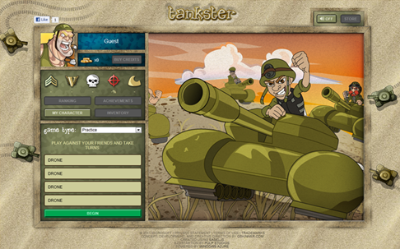
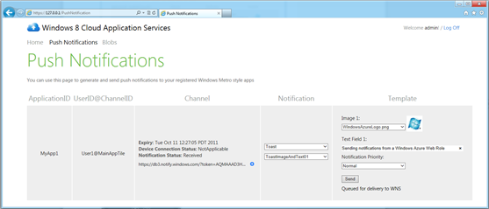
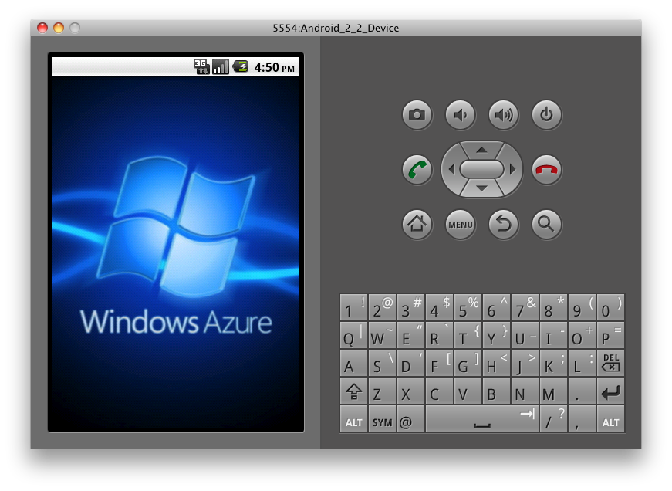
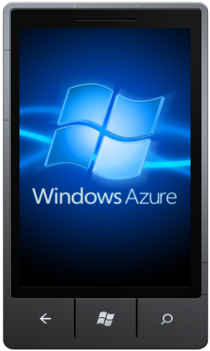
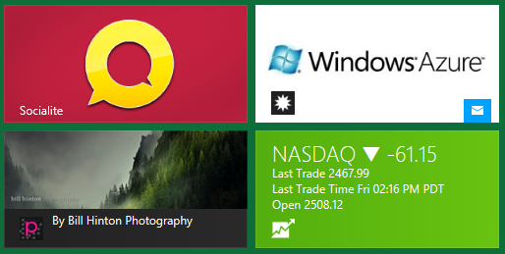
Toolkits
Devices
Social Games
Windows 8
For building Windows Phone, iOS, and Android apps
Includes clients for Windows Azure storage
Authentication with multiple identity providers using ACS
Example REST services for building turn-based games
Uses several services: compute, storage, CDN, etc.
Designed for scalability & perf
Live at http://tankster.net
Starting point for building Windows 8 Metro style apps with Windows Azure
Sample & libraries for Windows Push Notification
BUILD Session #868
BUILD Session #871
BUILD Session #873

Slide 21
Additional Sessions at BUILD
 | Session # | Session Title
Wed | 853 | Inside Windows Azure: the Cloud Operating System
 | 961 | Inside Windows Azure Storage: What's New and Under the Hood Deep Dive
Thursday | 850 | Getting Started with Windows Azure
 | 862 | Building Loosely Coupled Applications with Windows Azure Service Bus Topics & Queues
 | 858 | Identity and Access Management for Windows Azure Applications
Friday | 872 | Building Windows 8 and Windows Azure Applications
 | 861 | Using Cloud Storage from Windows 8 Applications
 | 859 | Monitoring and Troubleshooting Windows Azure Applications
 | 870 | Building Scalable Web Applications with Windows Azure
 | 869 | Building Global & Highly Available Services Using Windows Azure
Complete list at http://windowsazure.com/build

Slide 22
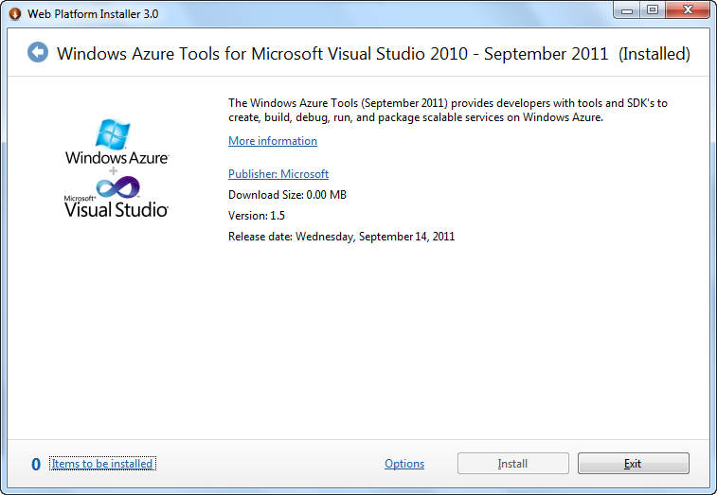
Resources
New bits available today in WebPI:
Windows Azure SDK & Tools 1.5
Windows Azure AppFabric SDK 1.5
ASP.NET MVC4 Preview
http://windowsazure.com
Windows Azure Platform Training Kit
Hands-on labs, samples, and presentations
http://bit.ly/WAPTKAug2011

Slide 23
© 2011 Microsoft Corporation. All rights reserved. Microsoft, Windows, Windows Vista and other product names are or may be registered trademarks and/or trademarks in the U.S. and/or other countries.
The information herein is for informational purposes only and represents the current view of Microsoft Corporation as of the date of this presentation. Because Microsoft must respond to changing market conditions, it should not be interpreted to be a commitment on the part of Microsoft, and Microsoft cannot guarantee the accuracy of any information provided after the date of this presentation. MICROSOFT MAKES NO WARRANTIES, EXPRESS, IMPLIED OR STATUTORY, AS TO THE INFORMATION IN THIS PRESENTATION.

