Slide 1
Using cloud storage from Windows apps
SAC-861T
Wade Wegner
Technical Evangelist Lead
Microsoft Corporation

Slide 2
Agenda
Review the various cloud storage offerings
Detailed discussion of the different storage options for Windows Azure
Present ideas and thoughts on how to go about using cloud storage from Windows Azure in Windows 8
You’ll leave with an …
… understanding of the various storage options in Windows Azure and how you can use them

Slide 3
Applications Use Data Data Needs to be Stored The Cloud Can Help

Slide 6
Why Does My App Need Data?
Enriches and personalizes applications
Makes applications more appealing
Provide useful services and capabilities
Differentiate your application from others

Slide 7
Why Cloud Storage?
Elasticity
Scale
Cost model
Near your cloud applications
Personalize applications

Slide 8
Choices for application developers
Windows Live SkyDrive
Windows Azure Storage
SQL Azure Database

Slide 9
Windows Live SkyDrive
Simple Storage, Simple Sharing
Store, organize, and download files, photos, and favorites
Collaborate on documents
Power your app with Live services
Dare Obasanjo
APP-784T
September 16, 2011 from 10:30AM to 11:30AM

Slide 10
Windows Azure Storage
Persistent and durable storage for both structured and unstructured data, as well as asynchronous messaging
Highly scalable
REST-based interfaces

Slide 11
SQL Azure Database
Highly available and scalable cloud database service
Managed service (no setup or management)
Familiar Relational Database Management System (RDMS)
High availability and fault tolerance built in

Slide 12
Three difference forms of cloud storage?

Slide 13
Value props to each
Windows Live SkyDrive
Using Windows & Live ID
Personal file storage
Synchronize personal assets and apps across Windows devices
Free
Windows Azure Storage
CDN
Fault-tolerance
Structured, non-relational data
Queues
Geo replication
Near compute
REST & Managed APIs
SQL Azure Database
Relational data
Additional services such as reporting, sync, backup/restore, export/import

Slide 14
Windows Live SkyDrive Sessions
The complete developer's guide to the SkyDrive API
Power your app with Live services
Steve Gordon
PLAT-134C
September 16, 2011 from 12:30PM to 1:30PM
Dare Obasanjo
APP-784T
September 16, 2011 from 10:30AM to 11:30AM

Slide 15
Windows Azure Storage

Slide 16
Windows Azure Storage
Windows Azure Tables
Non-relational structured storage
Massive scale-out
OData
Windows Azure Blobs
Big files
REST
Windows Azure Queues
Persistent Async Messaging
Enqueue, Dequeue

Slide 17
Windows Azure Data Storage Concepts
Container
Blobs
https://<account>.blob.core.windows.net/<container>
Account
Table
Entities
https://<account>.table.core.windows.net/<table>
Queue
Messages
https://<account>.queue.core.windows.net/<queue>

Slide 18
Windows Azure Blobs
A highly scalable and durable file system in the cloud
An account can create many containers
No limit on number of blobs in a container
Associate metadata with blobs
Share your blobs
Public containers, Shared Access Signature (SAS)
Upload/Download Blobs
Allows range reads
Conditional operations – If-Match, If-Not-Modified-Since etc.

Slide 19
Windows Azure Blobs Types – Block Blobs
Targeted at streaming workloads
Each blob consists of a sequence of blocks
2 Phase commit: Blocks are uploaded and then separately committed
Efficient continuation and retry
Random range reads possible
Size limit 200GB per blob

Slide 20
Block blobs
Block 1
Block 2
Block 3
Block 4
Block 1
File has variable sized blocks
Upload blocks in parallel using PutBlock
Retry failed blocks
Commit the blob using PutBlockList
Local file
Block 1
Block 2
Block 3
Block 4
Cloud blob

Slide 21
Example Put Block
PUT http://myaccount.blob.core.windows.net/mycontainer/myblob?comp=block&amp;blockid=AAAAAA%3D%3D HTTP/1.1
Request Headers:
x-ms-version: 2009-09-19
x-ms-date: Sun, 27 Sep 2009 14:37:35 GMT
Authorization: SharedKey myaccount:J4ma1VuFnlJ7yfk/Gu1GxzbfdJloYmBPWlfhZ/xn7GI=
Content-Length: 1048576

Slide 22
Windows Azure Blobs Types – Page Blobs
Targeted at random write workloads
Each blob consists of an array of pages
Size limit 1TB per blob
Page
Each page range write is committed on PUT
Page is 512 bytes in size
Write boundary aligned at multiple of 512 byte
Range reads possible
Pages that do not have data are zeroed out

Slide 23
Page blobs
Write 5K bytes – PutPage
Clear 2K bytes starting at offset 1K – ClearPage
Overwrite 2K bytes starting at 2K – PutPage
Truncate blob to 3K - SetMaxBlobSize
0
5120
0
1024
3072
5120
0
2048
4096
5120
0
3072

Slide 24
Example: Put Page
PUT http://myaccount.blob.core.windows.net/mycontainer/myblob?comp=page HTTP/1.1
Request Headers:
x-ms-page-write: update
x-ms-date: Fri, 16 Sep 2011 22:15:50 GMT
x-ms-version: 2011-08-18
x-ms-range: bytes=0-65535
Authorization: SharedKey myaccount:4KdWDiTdA9HmIF9+WF/8WfYOpUrFhieGIT7f0av+GEI=
Content-Length: 65536

Slide 25
Content Delivery Network
Enhance end user performance by placing copies of data closer to users
24 physical nodes globally
Smooth streaming

Slide 26
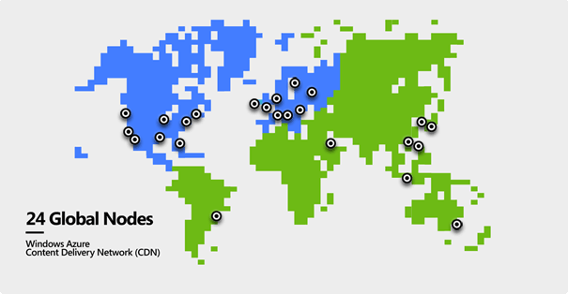
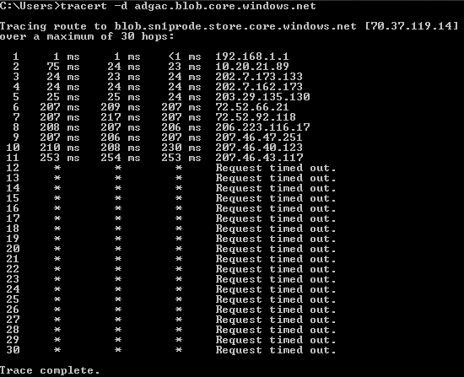
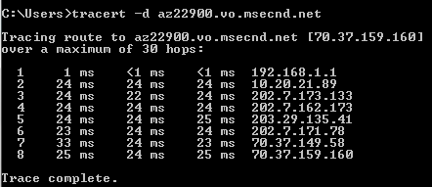
Content Delivery Network

Slide 27
Windows Azure Tables
Massively Scalable and Durable Structured Storage
Provides flexible schema
A storage account can contain many tables
No limit on number of entities (aka rows) in each table

Slide 28
Simple API for Tables
Simple REST API
Familiar and Easy to use API
OData Protocol
WCF Data Services - .NET classes and LINQ

Slide 29
Features
Shared Key and Shared Key Lite Authentication
Continuation Tokens for Query Pagination
Primary Key System
PartitionKey
RowKey
Timestamp System Property

Slide 30
Example body of POST to create a Table
<?xml version="1.0" encoding="utf-8" standalone="yes"?>
<entry xmlns:d="http://schemas.microsoft.com/ado/2007/08/dataservices"
xmlns:m="http://schemas.microsoft.com/ado/2007/08/dataservices/metadata
xmlns="http://www.w3.org/2005/Atom">
<title />
<updated>2009-03-18T11:48:34.9840639-07:00</updated>
<author>
<name/>
</author>
<id/>
<content type="application/xml">
<m:properties>
<d:TableName>mytable</d:TableName>
</m:properties>
</content>
</entry>

Slide 31
Windows Azure Queues
Highly scalable, available and provides reliable message delivery
A storage account can create any number of queues
Access is provided via REST

Slide 32
Windows Azure Queue Message
64K message size limit and default expiry of 7 days
Programming semantics – Ensures that a message can be processed at least once
Get message to make the message invisible
Delete message to remove the message

Slide 33
Example Put Message
POST http://myaccount.queue.core.windows.net/messages?visibilitytimeout=30&timeout=30 HTTP/1.1
Headers:
x-ms-version: 2011-08-18
x-ms-date: Tue, 30 Aug 2011 01:03:21 GMT
Authorization: SharedKey myaccount:sr8rIheJmCd6npMSx7DfAY3L//V3uWvSXOzUBCV9wnk=
Content-Length: 100
Body:
<QueueMessage>
<MessageText>PHNhbXBsZT5zYW1wbGUgbWVzc2FnZTwvc2FtcGxlPg==</MessageText>
</QueueMessage>

Slide 34
Storage Analytics
Performs logging and provides metrics for a storage account
Trace requests
Analyze usage trends
Diagnose issues
Must be enabled individually
Aggregated data stored in blobs and tables

Slide 35
New Features in Windows Azure Storage
Windows Azure Geo-replication
Table Upsert
Table Query Projection
Improved Blob HTTP header support
Queue UpdateMessage
Queue InsertMessage with visibility timeout
Inside Windows Azure storage: what's new & under the hood
Brad Calder
SAC-961T
September 14, 2011 from 5:00PM to 6:00PM

Slide 36
Storage Service Versioning
Operations provided by the storage service API may have multiple versions
Use the x-ms-version request header
Request Headers:
x-ms-version: 2011-08-18

Slide 37
Windows Azure Storage Takeaways
Scalable data abstractions to build your applications
Blobs – Files and large objects
Tables – Massively scalable structured storage
Queues – Reliable delivery of messages
More info on Windows Azure Storage at:
http://blogs.msdn.com/windowsazurestorage/

Slide 38
SQL Azure

Slide 39
SQL Azure Database
Easy provisioning and deployment
Auto high-availability and fault tolerance
No need for server or VM administration
Database utility; pay as you grow
Business-ready SLAs
Enable multi-tenant solutions
World-wide presence
Build cloud-based database solutions on relational model
Leverage existing skills through known developer and management tools
Managed Service
Scale on Demand
Innovate Faster

Slide 40
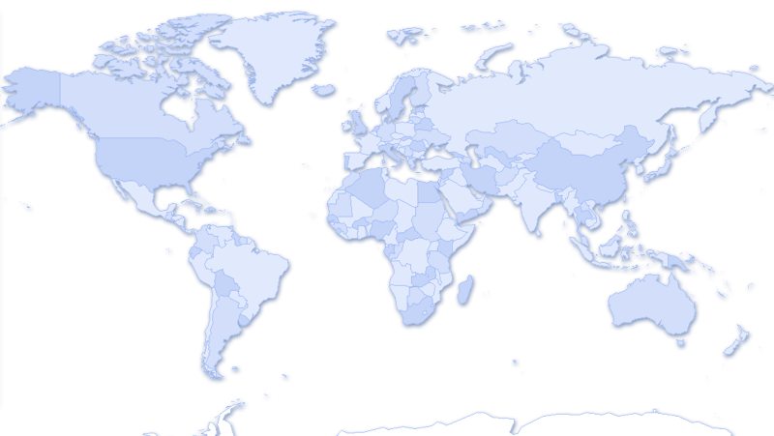
SQL Azure Database
Single Logical
Database
Multiple Physical Replicas
Replica 1
Single Primary
Replica 2
Was based on SQL Server 2008 engine
Use same tools and data access frameworks
Six global datacenters
High Availability & Redundancy
Reads are completed at the primary
Writes are replicated to a quorum of secondaries
DB
Replica 3
Multiple
Secondaries

Slide 41
Comparing SQL Server and SQL Azure
Goal is symmetry:
T-SQL, features
Tools
Connectivity
Frameworks

Slide 42
Variations from SQL Server
Source database version
SQL Azure based on SQL Server 2008
Table design
Clustered index required
No physical/server configuration
Features
Some features not yet available
E.g. Agent, Full-text, encryption, service broker, SQL CLR

Slide 43
Connection Model
SQL Azure exposes native SQL Server TDS protocol
Use existing client libraries
ADO.NET, ODBC, PHP
Client libraries pre-installed in Windows Azure roles
Support for ASP.NET controls
Applications connect directly to a database
Cannot hop across DBs (no USE)

Slide 44
Deployment
Deploy via T-SQL scripts
Support for SQL Server Data-Tier Applications (DAC) feature
DACPAC is unit of deployment
Cloud or on-premise is a deployment time choice
Create Logical Server in same region as Windows Azure Affinity Group for code-near architecture

Slide 45
Security Model
Uses regular SQL security model
Authenticate logins, map to users and roles
Authorize users and roles to SQL objects
Support for standard SQL Auth logins
Username + password

Slide 46
Interacting with Cloud Storage from Windows 8

Slide 47
Storage Secrets
Windows Azure
Storage name
Storage key
SQL Azure
Username
Password
Once your share your secret, it’s no longer secret

Slide 48
How do we keep secrets secret?
Proxy the requests
Client sends data to web role
Web role sends data to storage
(2)
Web
Role
(1)

Slide 49
What are the options?
Choices | Direct | Proxy | Other
Blob (private) | x | x | x (SAS)
Blob (public) | x | x (write) | x (read-only)
Table | x | x
Queue | x | x
Database |  | x

Slide 50
Using Shared Access Signatures
Client makes request of Web Role for SAS
Web Role sends client SAS
Client makes request
Client gets response
Web
Role
(3)
(4)
(2)
(1)

Slide 51
SQL Azure
Client sends request to proxy
Proxy makes SQL call against SQL Azure
SQL Azure returns a response
Proxy returns response to device
(2)
Web
Role
(3)
(4)
(1)
Building device & cloud apps
Wade Wegner
SAC-868T
September 15, 2011 from 2:30PM to 3:30PM

Slide 52
MVC Controller
[OutputCache(Duration = 0, NoStore = true, VaryByParam = "*", Location = OutputCacheLocation.None)]
public JsonResult GetRandomCompliment()
{
var account = CloudStorageAccount.Parse(RoleEnvironment.GetConfigurationSettingValue("DataConnectionString"));
var ctx = account.CreateCloudTableClient().GetDataServiceContext();
var compliments = (from c in ctx.CreateQuery<Compliment>("compliments")
where c.PartitionKey == string.Empty && c.Approved
select c).AsTableServiceQuery().ToList();
var compliment = compliments[new Random().Next(compliments.Count)];
return JsonForCompliment(compliment);
}

Slide 53
JsonResult
private JsonResult JsonForCompliment(Compliment compliment)
{
var result = Json(new
{
Text = compliment.Text,
AudioBaseUrl = new UriBuilder(
CloudStorageAccount.Parse(RoleEnvironment.GetConfigurationSettingValue("DataConnectionString"))
.CreateCloudBlobClient().GetContainerReference("audio").GetBlobReference(compliment.AudioBlob).Uri)
{ Scheme = "http", Host = "audio.flatterist.com", Port = 80 }.Uri.AbsoluteUri,
Id = compliment.RowKey,
ShortUrl = compliment.ShortUrl
});
result.JsonRequestBehavior = JsonRequestBehavior.AllowGet;
return result;
}

Slide 54
Calling a MVC REST API
demo

Slide 55
Summary
There are many opportunities for leveraging Cloud Storage in your Windows 8 applications
Choose the right solution based on your need
Windows Azure Storage and SQL Azure Database provide compelling opportunities for using data in Windows 8 applications

Slide 56
Related sessions
[SAC-850T] Getting started with Windows Azure
[SAC-858T] Identity and access management for Windows Azure apps
[SAC-863T] Delivering notifications with the Windows Push Notification Service and Windows Azure
[SAC-868T] Building device & cloud apps
[SAC-869T] Building global and highly-available services using Windows Azure
[SAC-870T] Building scalable web apps with Windows Azure
[SAC-871T] Building social games for Windows 8 with Windows Azure
[SAC-961T] Inside Windows Azure storage: what's new and under the hood deep dive

Slide 57
thank you
Feedback and questions http://forums.dev.windows.com
Session feedback http://bldw.in/SessionFeedback

Slide 58
© 2011 Microsoft Corporation. All rights reserved. Microsoft, Windows, Windows Vista and other product names are or may be registered trademarks and/or trademarks in the U.S. and/or other countries.
The information herein is for informational purposes only and represents the current view of Microsoft Corporation as of the date of this presentation. Because Microsoft must respond to changing market conditions, it should not be interpreted to be a commitment on the part of Microsoft, and Microsoft cannot guarantee the accuracy of any information provided after the date of this presentation. MICROSOFT MAKES NO WARRANTIES, EXPRESS, IMPLIED OR STATUTORY, AS TO THE INFORMATION IN THIS PRESENTATION.

