Slide 1
Building Windows 8 and Windows Azure apps
SAC-872T
Steve Marx
Technical Product Manager, Microsoft
blog.smarx.com / @smarx

Slide 2
Assumptions
You’re comfortable building web apps
You’re new to building Windows 8 apps
You’re relatively new to building Windows Azure apps

Slide 3
Agenda
Windows Azure Basics
Relevant Metro Style App Features
Windows 8 + Windows Azure Patterns

Slide 4
Windows Azure Basics

Slide 5
Windows Azure
Microsoft’s cloud platform
Designed for:
Scalability
High availability
Developer agility

Slide 6
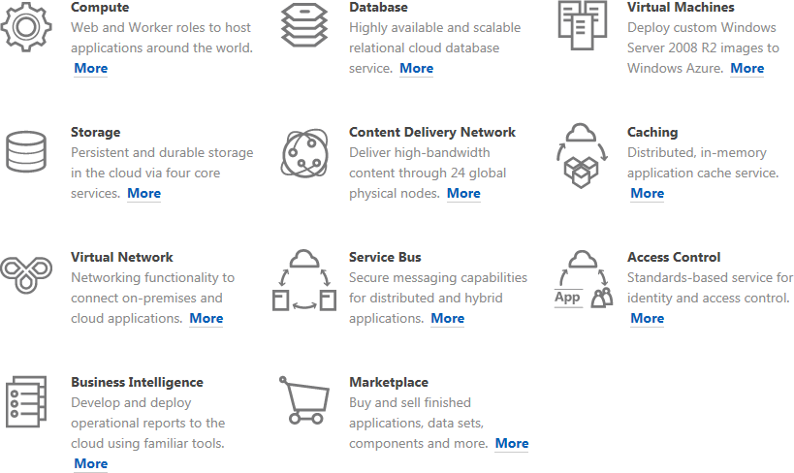

Slide 7
Windows Azure Development
Any tools, any languages (VS and .NET common)
Develop and test locally, publish to cloud
Applications consist of roles (components)
Run on VMs
Scaled/upgraded independently
Flexible storage options
SQL Azure
Blobs
Tables

Slide 8
Windows Azure App - Typical Architecture
Web Role
Worker Role
LB

Slide 9
Storage Options
SQL Azure
Relational database
Highly available
Managed for you as a service
Windows Azure Tables
Non-relational structured storage
Massive scale-out
OData
Windows Azure Blobs
Big files
REST

Slide 10
Windows Azure lets you manage applications, not virtual machines.

Slide 11
Relevant Metro Style App Features

Slide 12
Networking Options
XMLHttpRequest (good old Ajax)
WebSockets
Raw TCP/UDP

Slide 13
Making HTTP Requests
WinJS.Application.onmainwindowactivated = function (e) {
WinJS.xhr({
url: 'http://www.flatterist.com/api/getrandomcompliment'
}).then(function (xhr) {
document.getElementById('text').innerText =
JSON.parse(xhr.response).Text;
});
}

Slide 14
Databinding
HTML-compliant “data-*” attributes
WinJS.UI and WinJS.Binding namespaces

Slide 15
Databinding
<div id="messages"></div>
<div id="template" data-win-control="WinJS.Binding.Template">
<h1 data-win-bind="innerText: title"></h1>
<p data-win-bind="innerText: body"></p>
</div>
…
WinJS.UI.processAll();
WinJS.UI.getControl(document.getElementById("template"))
.render({ title: "Hello", body: "Hello, BUILD!" })
.then(function (e) { messages.appendChild(e); });

Slide 16
Notifications
Built-in notification mechanism
Server push to client
Tile
Badge
Toast
Do not require running app
LEARN
MORE
863: Delivering notifications with the Windows Push Notification Service and Windows Azure

Slide 17
Notifications: Opening a Channel
Windows.Networking.PushNotifications.PushNotificationChannelManager
.createPushNotificationChannelForApplicationAsync()
.then(function (chan) {
WinJS.xhr({
url: 'http://www.flatterist.com/api/registerchanneluri',
type: 'POST',
headers: {'Content-Type': 'application/x-www-form-urlencoded'},
data: "id=user1&uri=" + escape(chan.uri)
});
});

Slide 18
Notifications with the Windows Azure Toolkit for Windows 8
var result = new ToastNotification(new WNSAccessTokenProvider(clientID, clientSecret))
{
Text = new List<string> { text },
ToastType = ToastType.ToastText01,
Priority = NotificationPriority.Normal
}.Send(channelUri);
Console.WriteLine(result.StatusCode);

Slide 19
Windows 8 + Windows Azure Patterns

Slide 20
Thin Client, Thick Cloud
Example: weather app
Data, business logic in the cloud
Rich UI on the client
(alternate interfaces via web, other devices)
Requires:
Cloud storage (blobs, tables, SQL Azure)
Request/response communication (XHR)
Local databinding
LEARN
MORE
861: Using cloud storage from Windows apps
LEARN
MORE
868: Building device and cloud apps

Slide 21
Real-Time Interaction
Example: social game
Log-in to server
Interactive client UI
Real-time updates between players
Requires:
Identity
Real-time communication (WebSockets)
LEARN
MORE
871: Building social games for Windows 8 with Windows Azure
LEARN
MORE
858: Identity and access management for Windows Azure apps

Slide 22
Subscription/Syndication
Example: RSS reader
Subscribe via client application
Server generated notifications
Client UI for full viewing
Requires:
Web service call to subscribe
Notifications in the cloud
LEARN
MORE
863: Delivering notifications with the Windows Push Notification Service and Windows Azure

Slide 23
For more information
RELATED SESSIONS
DOCUMENTATION & ARTICLES
858: Identity and access management for Windows Azure apps
861: Using cloud storage from Windows apps
863: Delivering notifications with the Windows Push Notification Service and Windows Azure
868: Building device and cloud apps
871: Building social games for Windows 8 with Windows Azure
http://windowsazure.com
http://watwindows8.codeplex.com

Slide 24
thank you
Feedback and questions http://forums.dev.windows.com
Session feedback http://bldw.in/SessionFeedback

Slide 25
© 2011 Microsoft Corporation. All rights reserved. Microsoft, Windows, Windows Vista and other product names are or may be registered trademarks and/or trademarks in the U.S. and/or other countries.
The information herein is for informational purposes only and represents the current view of Microsoft Corporation as of the date of this presentation. Because Microsoft must respond to changing market conditions, it should not be interpreted to be a commitment on the part of Microsoft, and Microsoft cannot guarantee the accuracy of any information provided after the date of this presentation. MICROSOFT MAKES NO WARRANTIES, EXPRESS, IMPLIED OR STATUTORY, AS TO THE INFORMATION IN THIS PRESENTATION.

