Slide 1
Windows Server 8
SAC-973F
Bill Laing
Corporate Vice President
Server & Cloud Division
Mike Neil
General Manager
Windows Server

Slide 2
Microsoft’s Public Cloud Services
The Public Cloud

Slide 3
Microsoft’s Public Cloud Learning
The Public Cloud
The Private Cloud

Slide 4
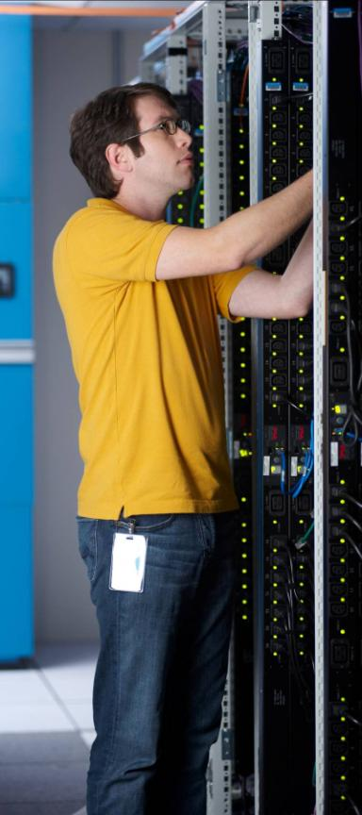
Windows Server 8
Cloud Optimize Your IT
Beyond Virtualization
Beyond Virtualization
The Power of Many Servers, The Simplicity of One
Every App, Any Cloud
Modern Workstyle, Enabled

Slide 5
complet
Build Your Private Cloud, offer Public Cloud Services, or Securely Connect to Public Cloud Services
Complete Virtualization Platform
Network virtualization
Live storage migration
Multi-tenancy
NIC teaming…
Increase Scalability and Performance
160 logical processors
32 virtual processors
Virtual fiber channel
Offloaded data transfer…
Connect to Cloud Services
Hyper-V replica
Cross-premise connectivity
IP address mobility
Cloud backup…
Beyond Virtualization

Slide 6
Hyper-V VM Scale and Mobility (Jeff Woolsey) Hyper-V Network Virtualization (Ross Ortega)
demo

Slide 7
Extensible Hyper-V Virtual Switch
Disaster Recovery Cloud Services with Hyper-V Replica
Hybrid Cloud with Hyper-V Network Virtualization
Multi-tenant-aware network gateway
Highly available storage appliances...
Partner Opportunities
The Windows Server 8 platform offers partners maximum flexibility in designing software and hardware infrastructure extensions which help deliver dynamic, high-performance and multi-tenant-aware cloud solutions.
Beyond Virtualization

Slide 8
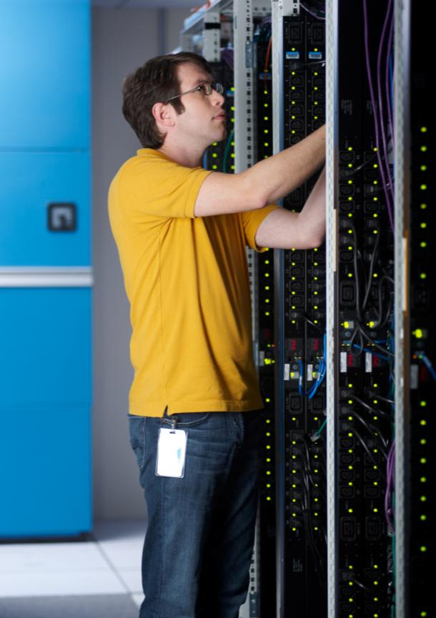
Windows Server 8 offers the best economics by integrating a highly available and easy to manage multiserver platform with breakthrough efficiency and ubiquitous automation.
The Most Efficient, Continuously Available and Manageable Windows Server
Continuous Availability
SMB transparent failover
Automated cluster patching
Online file system repairs
Automatic load balancing…
Cost Efficiency
Storage spaces
Thin provisioning
Data deduplication
Multi-protocol support…
Management Efficiency
>2300 PowerShell commands
Remote server administration
Knowledge sharing
Multi-machine management…
The Power of Many Servers –
The Simplicity of One

Slide 9
Managing Your Multi-Server Environment (Jeffrey Snover) Deduplication and SMB Transparent Failover (Ahmed-El-Shimi and Claus Joergensen)
demo

Slide 10
Multi-server management and resilient workflows
Cluster Shared Volume (CSV) integration
Multi-tenant-aware management and diagnostic tools
Storage management
Extended PowerShell command set
…
Partner Opportunities
Through comprehensive scripting and integration options in Windows Server 8, partners can further enhance server and datacenter manageability and help accelerate a highly available, cost-effective IT environment.
The Power of Many Servers –
The Simplicity of One

Slide 11
Open Application and Web Platform for the Datacenter and the Cloud
Cross-Premises Flexibility
Symmetry between clouds
Common management
Common developer tools…
Scalable & Flexible App Platform
Distributed caching
Pub/Sub messaging
Multi-tenant app container…
Scalable & Flexible Web Platform
Multi-tenant web sites
Sandboxing and QoS
NUMA-aware scaling for IIS…
Every App, Any Cloud
Open Web Platform
Open source support
Support for HTML 5
WebSocket protocol…

Slide 12
Hybrid Apps (Stefan Schackow)
demo

Slide 13
Greater density and multi-tenancy hosting with IIS8
Scalable apps for private and public clouds
Extension of open programming tools
Websocket extensions
…
Partner Opportunities
Enhanced frameworks and open programming tools in Windows Server 8 allow partners to develop scalable cloud applications, taking advantage of the most comprehensive, enterprise-ready application platform.
Every App, Any Cloud

Slide 14
Secure Access to Your Personalized Work Environment From Anywhere
Anywhere Access, Any Device
Remote sessions, VDI or apps
USB device support
Simplified VDI Management…
Full Windows Experience
RemoteFX for WAN
User VHDs
RDP 3D graphics and sound…
Enhanced Security & Compliance
Claims-based file access
Centralized access and audit
Simplified DirectAccess…
Modern Workstyle,
Enabled

Slide 15
Secure Data Access and Compliance (Nir Ben Zvi and Rutwick Bhatt) Rich Remote Desktop (Gaurav Daga)
demo

Slide 16
Identity management, data lifecycle protection, reporting tools
Claims-based access
Modern remote apps
Broad remote desktop access device support
Remote access appliances
BranchCache protocol enhancements
…
Partner Opportunities
Value-added software solutions and new types of access devices allow partners to broaden the Windows Server 8 value proposition for secure anywhere access to corporate data and resources, combined with strong identity and data classification.
Modern Workstyle,
Enabled

Slide 17
Built for the Future
For more information, please attend the sessions and hands on labs of the Server & Cloud track.
Enjoy the conference!
Windows Server 8
32 virtual processors per VM
512GB virtual machine memory
New 16TB VHDX format
Native 4k disk support
Hyper-V Replica
Hyper-V virtual fiber channel
Live storage migration
Windows NIC teaming
Concurrent live migration
Support for AES/NI
Support for up to 63 nodes per cluster
Support for 4000 VMs per cluster
Hyper-V support for up to 2 TB of physical memory
Hyper-V intelligent second level paging
Live VHD merge
Cluster shared volumes v2
SMB 2 Support
RDMA support in SMB
Scale-out file server
Multi-channel SMB
SRIOV Networking
Thousands of PowerShell commands
Virtual NIC monitor mode
Rest APIs for PowerShell commands
150 Hyper-V PowerShell commands
Storage PowerShell
Network PowerShell
Multi-Tenancy, Port ACLs / Firewall
Storage metering
Storage Spaces
SMI-S support inbox
Virtual NUMA support
CPU metering
Network metering
Memory metering
RemoteFX
3D graphics remoting
Touch remoting
USB remoting
VDI
Guest Application Health Monitoring
VM Hardware Error Isolation
VM Failover Prioritization
Trusted boot support
Removable Shell & IE
Enables roles in VHDs Offline
Multi-machine management protocol
Integrated workflows and PowerShell
…

Slide 18
© 2011 Microsoft Corporation. All rights reserved. Microsoft, Windows, Windows Vista and other product names are or may be registered trademarks and/or trademarks in the U.S. and/or other countries.
The information herein is for informational purposes only and represents the current view of Microsoft Corporation as of the date of this presentation. Because Microsoft must respond to changing market conditions, it should not be interpreted to be a commitment on the part of Microsoft, and Microsoft cannot guarantee the accuracy of any information provided after the date of this presentation. MICROSOFT MAKES NO WARRANTIES, EXPRESS, IMPLIED OR STATUTORY, AS TO THE INFORMATION IN THIS PRESENTATION.

