Slide 2
Developing and Testing on Windows 8 with Client Hyper-V
455
Mathew John, Bart House
Principal PM, Principal SDE
Hyper-V, Microsoft Corporation
Notes:
Welcome: thanks for attending; exciting week
Self Intro
Questions ok

Slide 3
Agenda
Learn about applying virtualization techniques in your environment
Walk through a development cycle using Client Hyper-V
Automated setup
Rapid development & test, and more
Understand the limits & requirements of Client Hyper-V
You’ll leave with examples of how to
Utilize Client Hyper-V in your development environment
Notes:
Examples of using Hyper-V
Scripting
Reqs

Slide 4
Building your own Lab to go is easy
Notes:
What’s a lab?
Multi-machine
Isolation between the environments
Quick deployment of env & app (I should be able to setup my multi-machine env in seconds)
Debugging friendly (no special cables, or setup)
Shareable
Easy to backup & manage. Possible to have centralized libraries
“To Go”
Portable
accessible from anywhere
flexible
Dev, Enthusiasts, Consultants, IT Pros
Existing virtualization solutions
Windows developers benefit inbox
we also wanted to do this for ourselves

Slide 5
Client Hyper-V in Windows 8
32 Virtual Processors
NUMA in VM
512 GB RAM
Sleep
Hibernate
Management console
Manage Server Hyper-V
Snapshots
1024 running VMs
VHD
VHDX (16TB)
Dynamic disks
Differencing disks
4K sector size
Pass through disks
DMTF compliant WMI
Networking offloads
Fixed VHD
CentOS 5.2-5.6, 6.0
Live Storage Move
Native VHD Boot
32-bit & 64-bit Guest OS
Windows XP SP3
Windows Vista
Red Hat Enterprise Linux 5.2-5.6, 6.0, 6.1
Windows Home Server 2011
Windows Server 2003 R2 SP2
Windows 7 SP1
Windows Server 2003 SP2
Dynamic Memory
Windows SBS 2011
Remote management
Windows Storage Server 2008 R2
PowerShell
Windows Server 2008
Windows Server 2008 R2
Export snapshot(s)
Resource Pools
External, Internal & Private Networks
Bi-direction audio
Enlightened IDE & SCSI controllers
Hyper-V on SMB
256 virtual drives
Virtual DVD & Floppy
12 Virtual NICs
VLAN
Key Value Pair communication with Guest
3D Graphics (Software)
Multi-point touch
USB redirection
Integrated shutdown
Wireless NICs
Export & Import VMs
ICs in the box
User defined meta data for VHDX
VHDX Resiliency
SUSE Linux Enterprise Server 10, 11
Hyper-V Extensible Switch
Notes:
Hyper-V: machine virtualization; shipping since W2k8
Hyper-V & Client Hyper-V used interchangeably in the presentation
32 & 64-bit VMs
Windows & non-Windows guests
Extensible Switch (particularly useful for devs)
Pick a couple of more points
Additional benefit for Server Hyper-V users
Parity (image & mgmt)
Next – walk through of a development cycle and Hyper-V applicability
Bart to take over

Slide 6
Automate deployments using Hyper-V
Building Apps using Hyper-V
Rapid development & test using VMs
Debug using snapshots
Build flexible infrastructure
Final validation on hardware
Automate Deployments using scripts
Automate Deployments using scripts

Slide 7
PowerShell Support
Applied what we learned in Win 7
Fast & Intuitive
~150 new Hyper-V cmdlets
All Hyper-V Manager UI capability can be scripted
And more!
Perfect for automation

Slide 8
PowerShell Example: Scenario Setup
Setup/teardown fast
Client/server, down-level OS, over-consolidation scenarios
Dir *.xml | import-vm | start-vm

Slide 9
PowerShell: Setup multi-machine environment
DEMO

Slide 10
PowerShell Considerations
You can use PS remoting to manage hosts remotely
Use get-command to discover capabilities
PS> get-command –module hyper-V

Slide 11
Shared Rich Multi-VM Environments
Available on tablets, laptops and desktops
Create rich multi-VM environments
No longer need multiple physical machines
Developers, testers, program mangers, sales people
Environments easily shared
Virtualized environment the same no matter the hardware

Slide 12
Rapid development & test using VMs
Building Apps using Hyper-V
Rapid development & test using VMs
Debug using snapshots
Build flexible infrastructure
Final validation on hardware
Automate Deployments using scripts
Notes:
Move on deployment and test

Slide 13
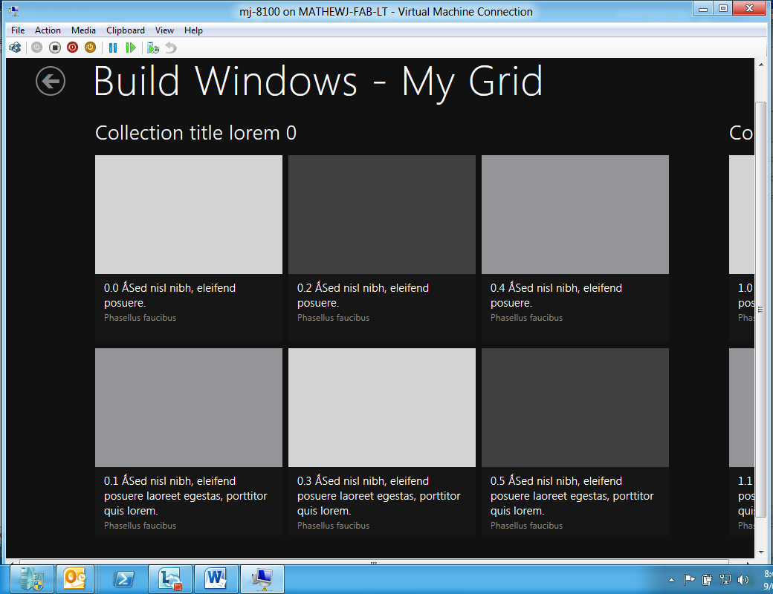
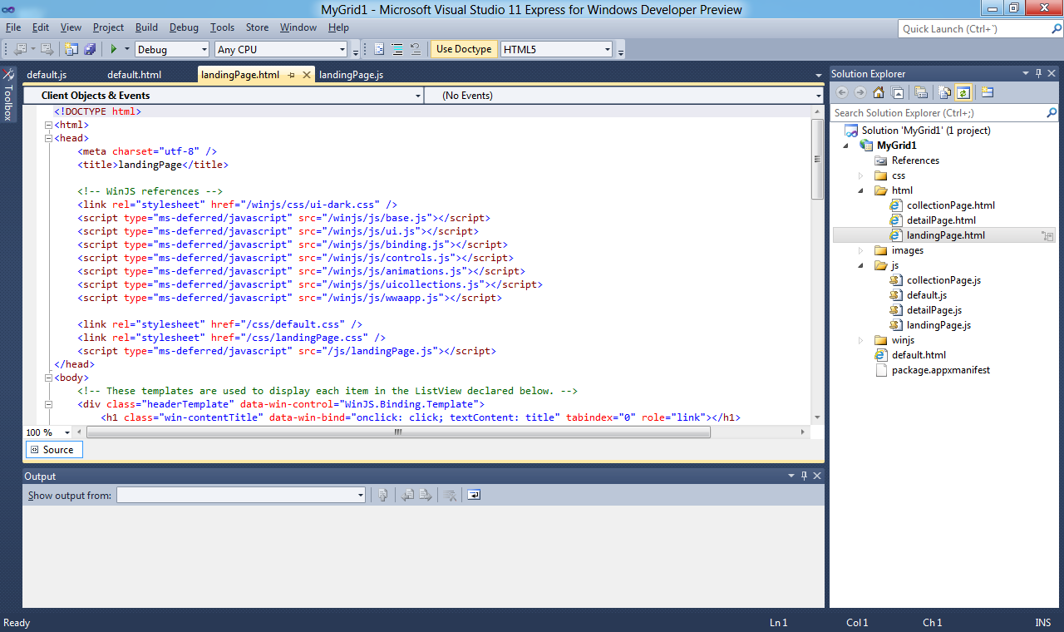
Developing with Hyper-V – Demo Flow
Physical Machine
Test Environment (in VM)
Windows 8
Development Environment (Parent)
Windows 8
Remote Deployment

Slide 14
Testing Metro Style Applications with Hyper-V
Demo
Build Metro Style App (on the host)
Remote Debug the app in the VM

Slide 15
Pristine Test Environment
Full development environment
Corporate joined, SDKs, tools
Pristine test environment
Private network
Only software installed needed for scenario
Pre-release self-hosting on single physical box

Slide 16
Debug using Snapshots
Building Apps using Hyper-V
Rapid development & test using VMs
Debug using snapshots
Build flexible infrastructure
Final validation on hardware
Automate Deployments using scripts
Notes:
Move to snapshots

Slide 17
Virtual Machine Snapshots
Great for capturing a point in time
Testers can record exact situation for bug repro and continue
Developers can replay a scenario over and over
Sales can rapidly transition from one scenario to another
Waiting for snapshot merge is a thing of the past

Slide 18
VM Snapshots
DEMO
Notes:
Demo
What if we need to save / use snapshot somewhere else … next topic

Slide 19
Build flexible infrastructure
Building Apps using Hyper-V
Rapid development & test using VMs
Debug using snapshots
Build flexible infrastructure
Final validation on hardware
Automate Deployments using scripts

Slide 20
Flexible Infrastructure using Hyper-V
100% compatibility from Client to Server Hyper-V
Support low cost file shares
VM library shared across organization
Move VM’s storage while VM is running
Physical storage filling up
Shared out snapshots
Moving between machines without interruption

Slide 21
Storage Move
Demo
Hyper-V on File Share
Live Storage Move

Slide 22
Final validation on hardware
Building Apps using Hyper-V
Rapid development & test using VMs
Debug using snapshots
Leverage flexible infrastructure
Final validation on hardware
Automate Deployments using scripts

Slide 23
Developing with Hyper-V – Demo Flow
Physical Machine
Test Environment (in VM)
Windows 8
Development Environment (Parent)
Windows 8
(NativeVHDBoot)
Remote Deployment

Slide 24
Boot Physical with VHDX
Demo
Notes:
Switch to demo system.

Slide 25
Client Hyper-V Capabilities and Requirements

Slide 26
Busting Myths
VMs are not(?) meant for the following classes
Hardware* based testing
GPU intensive* apps
High precision timer* apps
Notes:
Hardware
USB is redirected (through RDC)
GPU intensive -- good enough for typical apps
show fishtank (compare)
High precision
Complex real time apps
sub-10ms timer interrupts (as measured from an external source)
Depends on load on physical
Need to take care when analyzing performance.
Processor cycles can lie within the guest (access host counters to see truth)
Xperf can still be used to get an understanding of where time is going
If box is not overconsolidated (and you are not taking a lot of time in the host OS), then traces should generally be accurate.

Slide 27
Requirements to run Client Hyper-V
64-bit Windows 8
Processor requirements:
Hardware Virtualization
Second Level Address Translation
Notes:
SLAT
EPT for Intel & RVI/NPT for AMD
New processors have it
Why SLAT, and why not for Server Hyper-V.
- TLB flushes – jitter, inconsistent experience
Need as many physical logical processors as your largest VM you would like to run.

Slide 28
Recap
With Client Hyper-V you can easily build your lab to go
Notes:
If nothing else, just remember – (line above)
Demos showed many Hyper-V features. Lot more. I encourage you to experiment.
VMs on laptop - Sleep/Hibernate/WiFi
Hyper-V Win8 support –
Multipoint touch
3D Graphics
Value to anyone needing sandbox or multi-machine environments
Improves developer efficiency
Easy to switch contexts
keep the OS+App images up to date
Build flexible infrastructure
IT Pro
Complete parity with Server Hyper-V
Thank you for taking the time to listen to us.

Slide 29
Questions?

Slide 30
© 2011 Microsoft Corporation. All rights reserved. Microsoft, Windows, Windows Vista and other product names are or may be registered trademarks and/or trademarks in the U.S. and/or other countries.
The information herein is for informational purposes only and represents the current view of Microsoft Corporation as of the date of this presentation. Because Microsoft must respond to changing market conditions, it should not be interpreted to be a commitment on the part of Microsoft, and Microsoft cannot guarantee the accuracy of any information provided after the date of this presentation. MICROSOFT MAKES NO WARRANTIES, EXPRESS, IMPLIED OR STATUTORY, AS TO THE INFORMATION IN THIS PRESENTATION.

