Slide 1
Windows Store: How does it work?
Giorgio Sardo
Director, Windows Evangelism
@gisardo
2-120

Slide 2
Agenda
Reach
Economics
Submission
Promotion

Slide 3
Reach & opportunity

Slide 4
The largest developer opportunity. Ever.
450million
~
Windows PCs will be sold over the next 5 quarters
(Goldman Sachs estimate for October 2012 to December 2013)

Slide 5
Installed by default on every PC

Slide 6
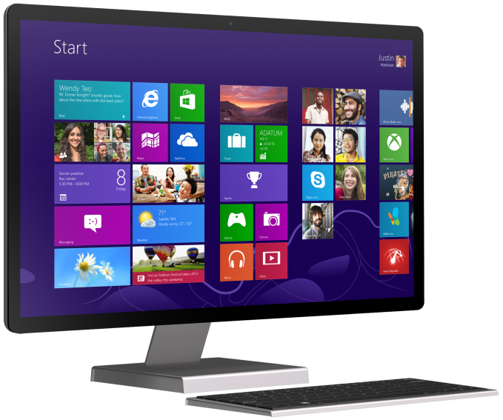
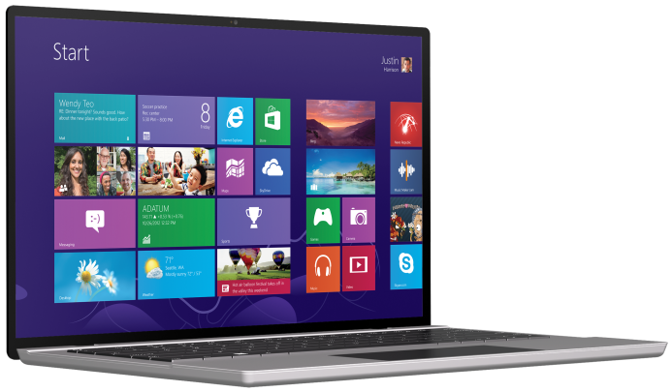
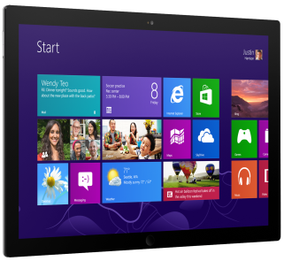
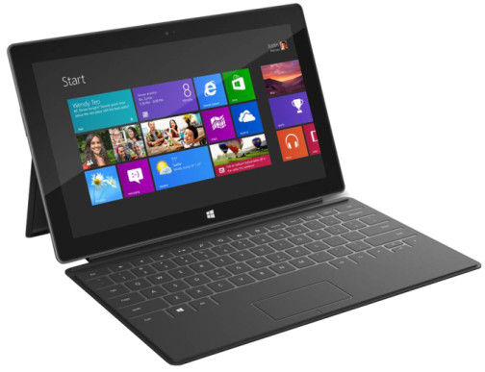
Installed by default on every PC

Slide 7
Unprecedented reach
Store
Apps
Developers
Payouts
230+
countries
100+
languages
120+
markets
80+
currencies

Slide 8
For example…
To generate $1 million in profits
Price point: $4.99
~250,000 sales
of Windows customers
0
.
0
5 %

Slide 9
DEMO
Grantophone

Slide 10
Monetization options

Slide 11
Flexible economics
< Your App >
Microsoft commerce APIs
3rd Party commerce APIs
Microsoft advertising
3rd Party advertising
Microsoft analytics
3rd Party analytics

Slide 12
Best revenue sharing
70%
for new apps
Starts at
80%
once your app makes $25,000
Jumps to

Slide 13
Trials drive higher revenue
70x
10%
10x
downloads
conversion
revenue
Windows Phone Developer blog, March 2011

Slide 14
In-app commerce
Microsoft commerce
3rd Party commerce
One time purchase
Purchases over time
Use your existing commerce
Time limited trials
Feature differentiated trials
Persistent purchases
Expiring purchases
Existing relationship
Subscriptions
Consumable purchases

Slide 15
DEMO
Microsoft Commerce, Subscriptions, and PayPal

Slide 16
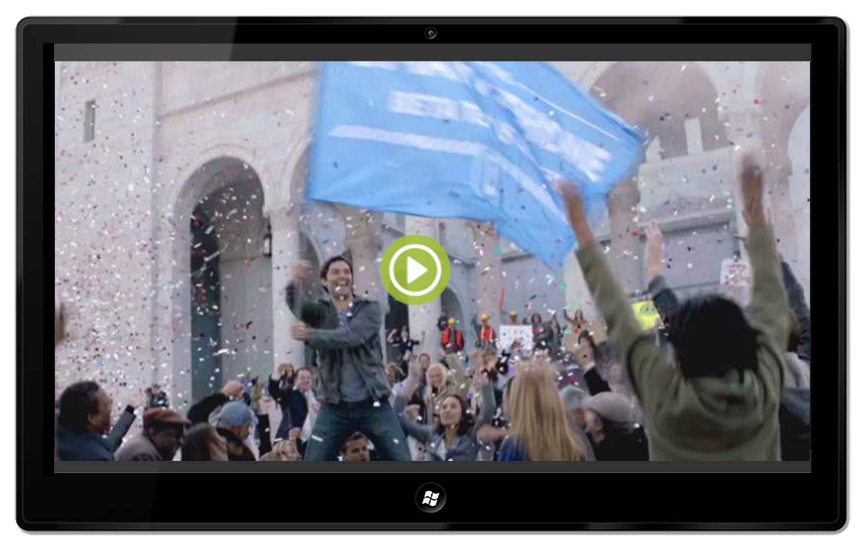
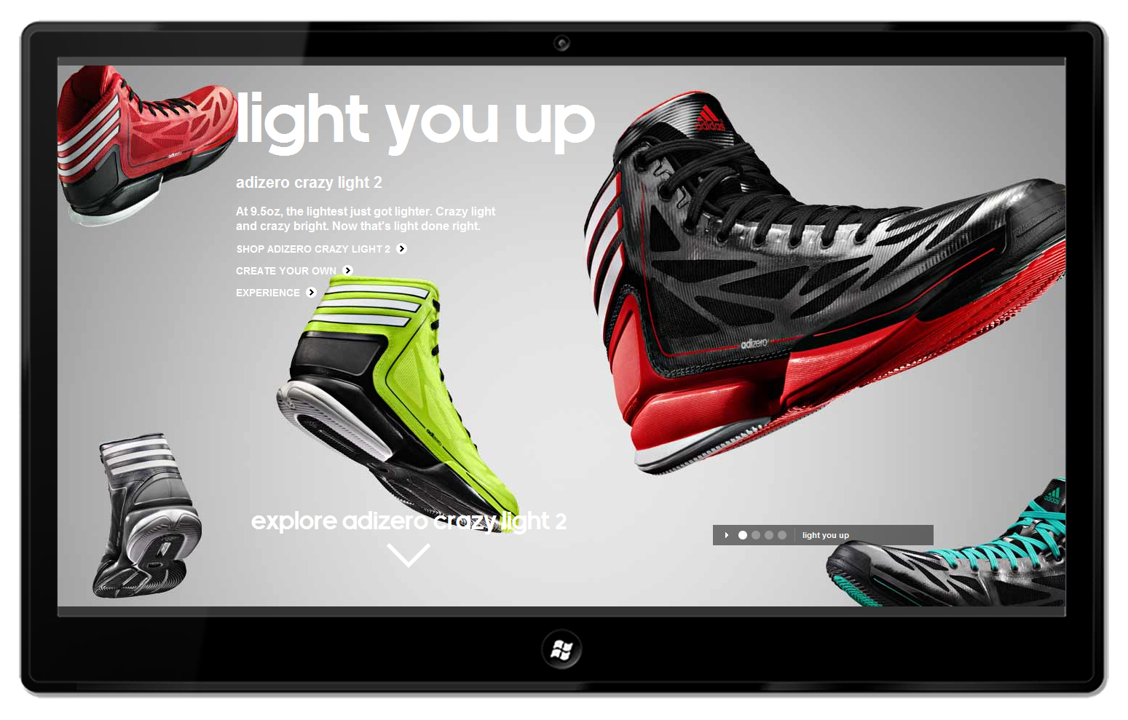
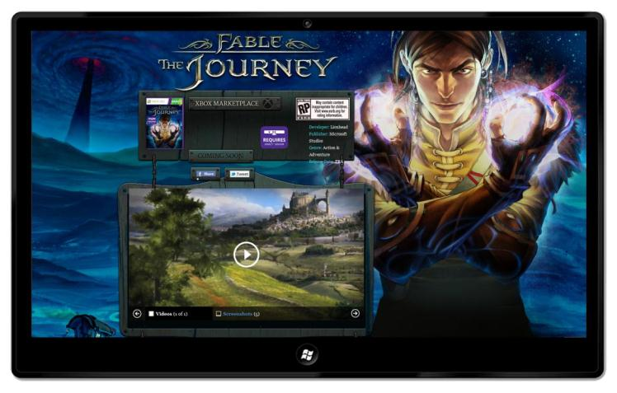
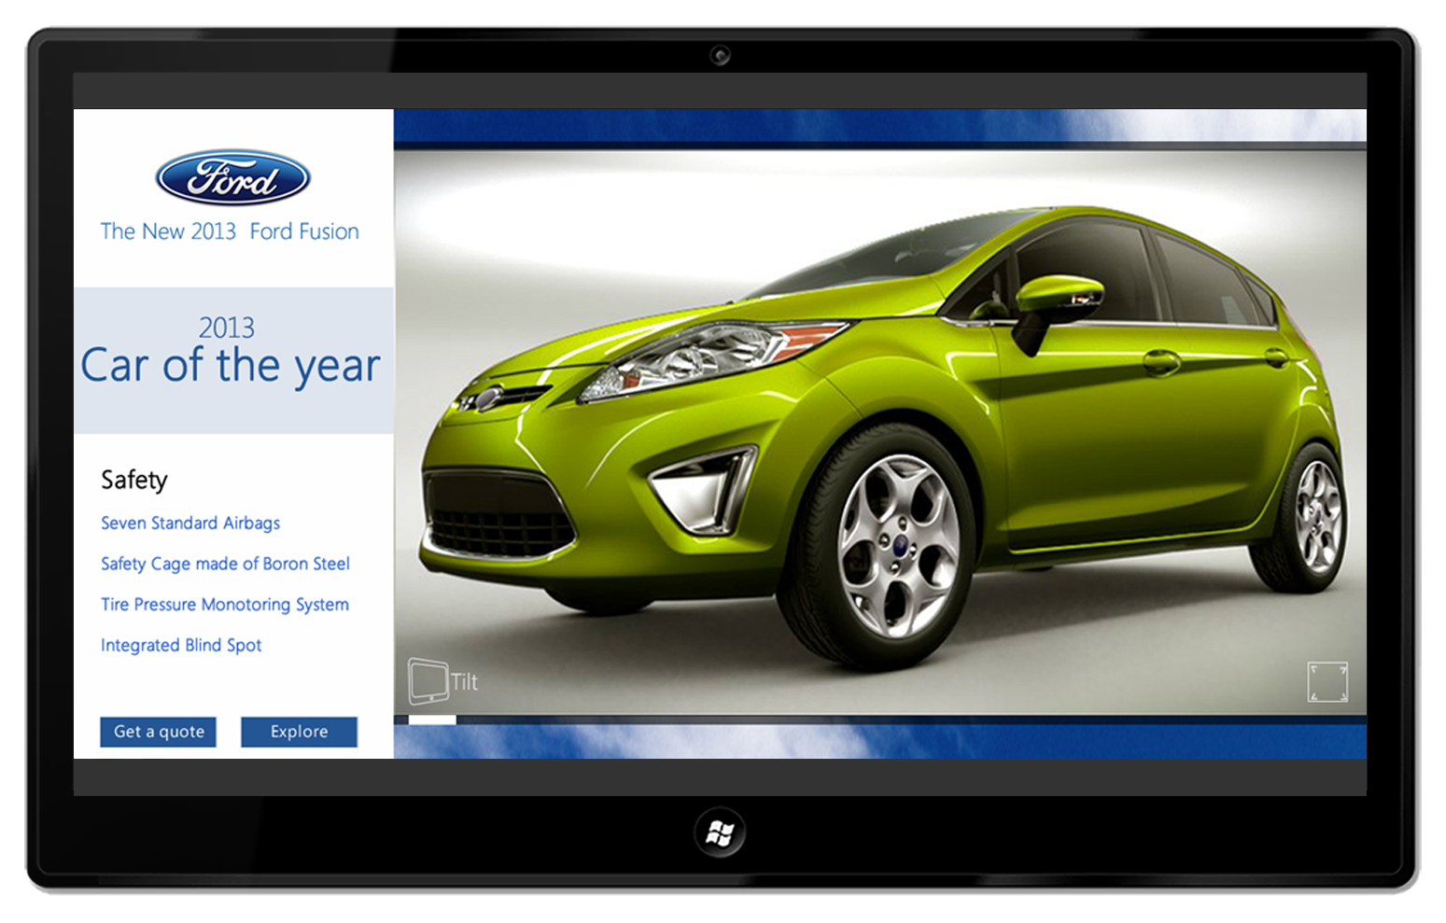
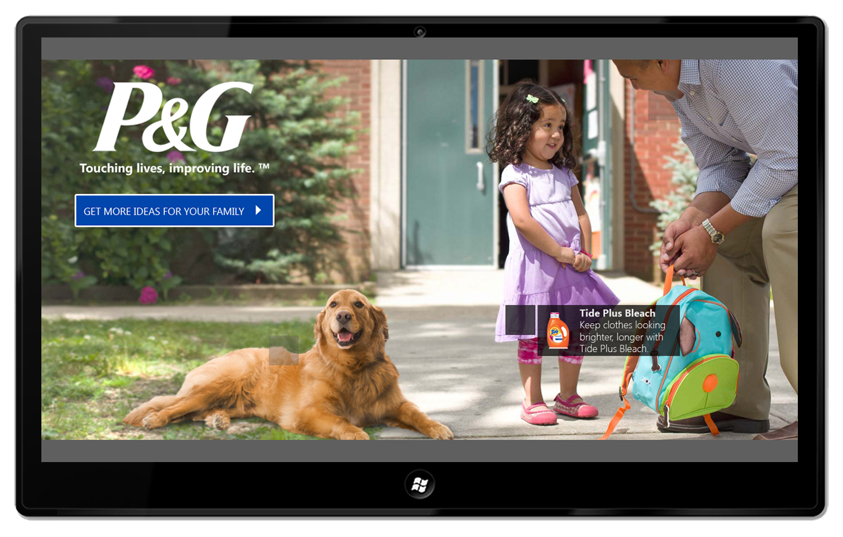
Microsoft Advertising SDK

Slide 17
DEMO
Microsoft Advertising

Slide 18
Transparent submissions

Slide 19
Developer registration
Free
Free developer accounts
Free testing and side-loading
Free tools (Visual Studio 2012 Express)

Slide 20
Store registration
Free
$49
$99
Students (Dreamspark)
Startups (Bizspark)
MSDN subscribers
Individual
Business

Slide 21
DEMO
Creating a Store account

Slide 22
DEMO
Submitting an app

Slide 23
Dealing with certification issues
On a “clean” machine
On high-end and low-end hardware
Before and after logging-in
Run WACK locally
1
Resolution docs updated frequently!
Requirements: aka.ms/StoreReq
Resolving issues: aka.ms/StoreFix
Read policies and resolution docs
2
Contact support
3
Available on phone, e-mail, and live chat
aka.ms/StoreSupport

Slide 24
1.2 App must be fully functional
Common reasons for failure
The developer didn’t provide a test account in the Notes to Testers field
The app includes “coming soon”, “more to come” for primary user scenarios
The app description uses screen shots or statements that imply features that don't appear to be implemented
The app plays background audio, but does not correctly implement play, pause, and play/pause events to enable users to control audio playback
aka.ms/StoreFix

Slide 25
3.8 App must meet the basic performance
On high and low-end machines
The app must launch in 5 seconds or fewer
The app must suspend in 5 seconds or fewer
aka.ms/StoreFix

Slide 26
4.1 Privacy policy
If the app declares internet capabilities, you must
Add privacy policy in the app settings
Specify a privacy policy URL in the submission metadata
aka.ms/StoreFix

Slide 27
6.5 App must be localized
Your app must be localized in each language defined in the app manifest, including
App chrome, content
App metadata
Screenshots, promo images
aka.ms/StoreFix

Slide 28
DEMO
Developer Dashboard & Analytics

Slide 29
Promotion

Slide 30
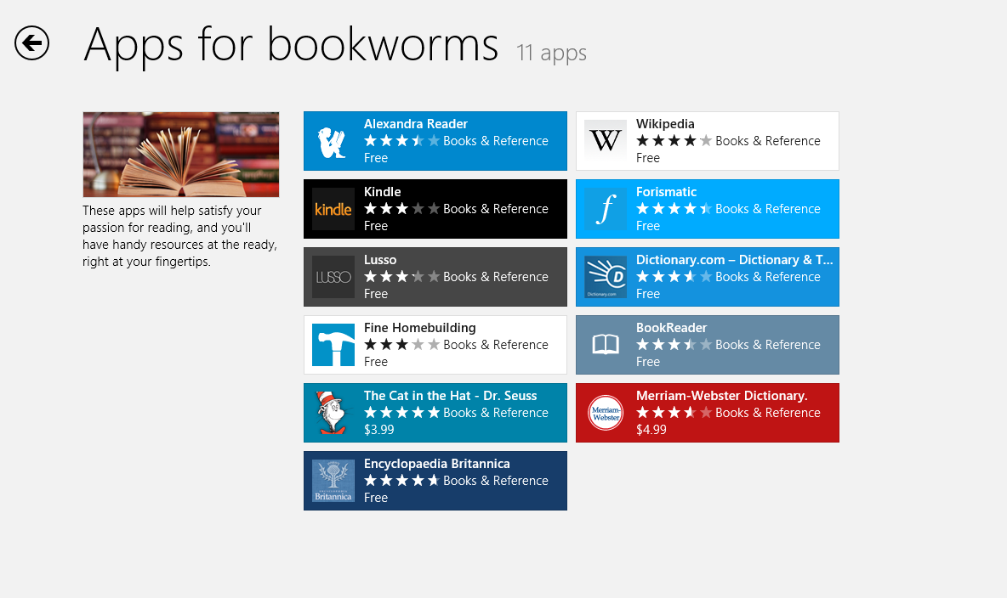
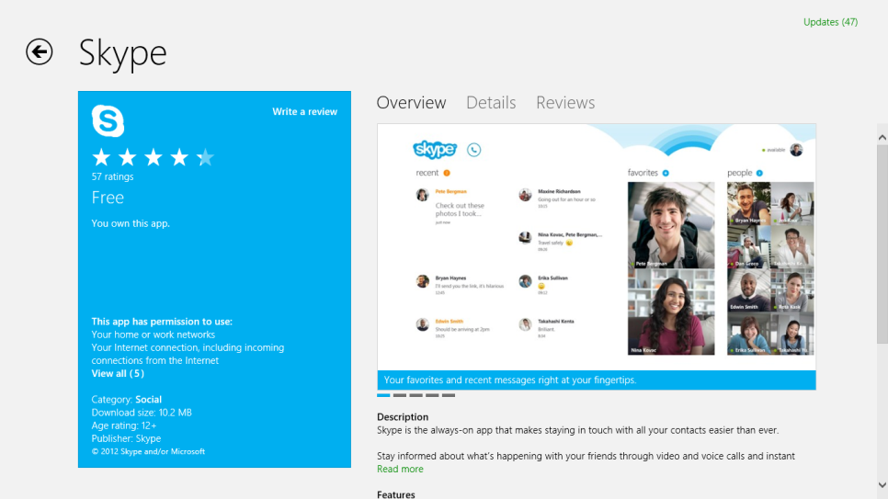
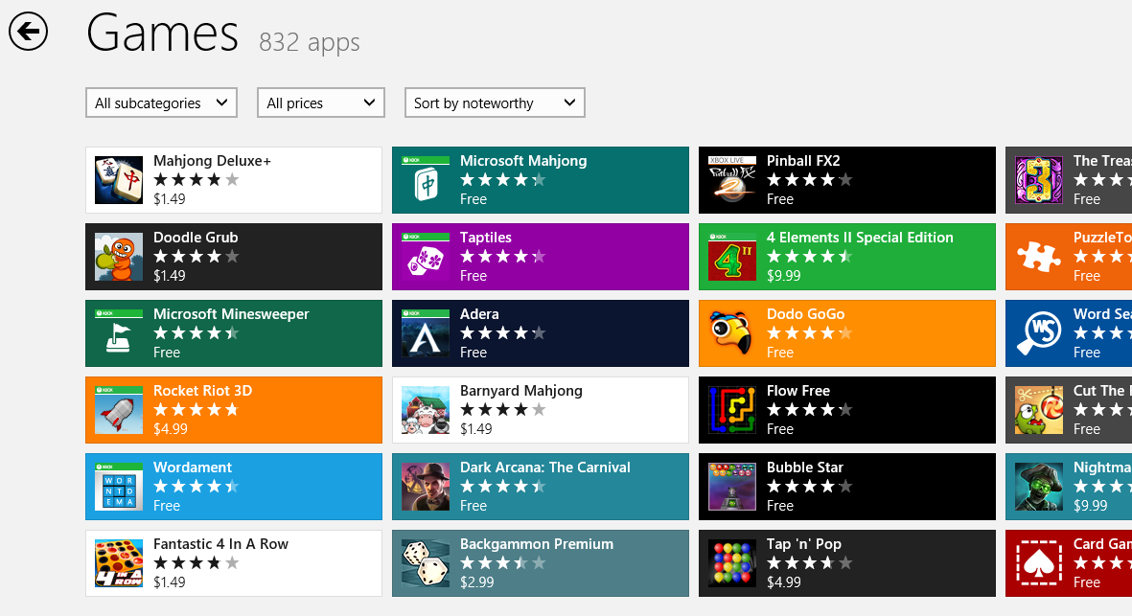
Store anatomy
Store home
Editorial promotion
App listing
Category

Slide 31
Tips for spotlight promotion
Build a great app! ☺
Follow Windows UX Guidelines (design.windows.com)
Support x32, x64, and ARM
Submit all 4 promotional assets
Follow-up on users’ reviews

Slide 32
DEMO
Bing, IE10 and Windows Store

Slide 33
Next Steps
Create a Store account
Reserve your app name
Fill the submission metadata
Certify the app
Promote your app!

Slide 34
Related sessions
3-121. Making money with your apps 10/30, 17:45
3-113. Monetizing with advertising 11/2, 8:30
Please submit session evals on the Build Windows 8 App or at http://aka.ms/BuildSessions

Slide 35
Resources
www.windowsstore.com
Policies: aka.ms/StoreReq
Certification: aka.ms/StoreFix
Support: aka.ms/StoreSupport
Badges: aka.ms/StoreBadge
Please submit session evals on the Build Windows 8 App or at http://aka.ms/BuildSessions

Slide 36
Resources
Develop: http://msdn.microsoft.com/en-US/windows/apps/br229512
Design: http://design.windows.com/
Samples: http://code.msdn.microsoft.com/windowsapps/Windows-8-Modern-Style-App-Samples
Videos: http://channel9.msdn.com/Windows
Please submit session evals by using the Build Windows 8 app
or at http://aka.ms/BuildSessions

