Slide 2
Introduction to Windows Store app development for Android programmers
Hanu Kommalapati
Senior Technical Director
http://blogs.msdn.com/hanuk
@HanuK
Jennifer Marsman
Principal Technology Evangelist
http://blogs.msdn.com/jennifer
@JenniferMarsman
3-006

Slide 3
Agenda
Architecture
User interface concepts
Navigation
Data in apps
Asynchronous development
Sharing
Certification and app store

Slide 4
Windows Store apps… lots of choices
Windows Store Apps
XAML
HTML / CSS
C++
C#
VB
JavaScript
WinRT APIs
Communication
& Data
Graphics & Media
Devices & Printing
Application Model
Windows Core OS Services

Slide 5
Environment map
Android
Windows 8
Windows, Mac, and Linux
Development OS
Windows 8
Android
Runtime OS
Windows 8
Eclipse, IntelliJ, and NetBeans
IDE
Visual Studio 2012
Android SDK
SDK
Windows 8 SDK
Android Developer Tools (ADT) Plugin for Eclipse
Visual Studio Templates and Blend for Visual Studio
Tools
Java, C++
Language
C#, VB.NET, Javascript, C++
Android Runtime
Runtime
WinRT

Slide 6
UI element map
Android
Windows 8
Activity
Unit of Display
Page
View
Widget Base
Control
ViewGroup
Layout Base
Panel
Observer Interfaces
Event Handling
Delegates
Fragments
Reusable Components
User Control

Slide 7
Control map
Android
Windows 8
widgets
controls
TextView
Display text
TextBlock
EditText
Edit text
TextBox
RadioButton
Radio button
RadioButton
Android Extras
QuickContactBadge
RatingsBar
AnalogClock
TextClock
Windows 8 Extras
Hub
Flyout
CommandBar
HyperLink
CheckBox
Check box
CheckBox
Button
Submit
Button
ProgressBar
Show progress
ProgressBar & Ring
LinearLayout
Display a list of widgets
StackPanel
ListView
Vertical list of widgets
ListView
GridView
2-dimensional grid
Grid
ImageView
Display image
Image
Spinner
Select from a list
ComboBox
Date & TimePicker
Date and Time
Date & TimePicker

Slide 8
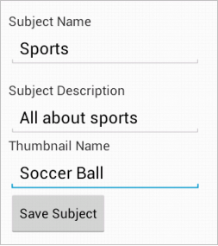
Android – screen layout (XML)
<LinearLayout>
<TextView … />
<EditText id=“@+id/etSubName” … />
<TextView … />
<EditText id=“@+id/etSubDesc” … />
<TextView … />
<EditText id=“@+id/etTnailName” … />
<Button id=“@+id/btSave” android:onClick=“onClick” … />
</LinearLayout>

Slide 9
Android – screen layout (code)
//SubEditActivity.java
public class SubEditActivity extends Activity {
private EditText etSubName;
private EditText etSubDesc;
private EditText etTnailName;
private Button btSave;
@Override
protected void onCreate(Bundle savedInstanceState) {
super.onCreate(savedInstanceState);
setContentView(R.layout.activity_main);
etSubName = (EditText)this.findViewById(R.id.etSubName);
etSubName = (EditText)this.findViewById(R.id.etSubDesc);
etTnailName = (EditText)this.findViewById(R.id.etTnailName);
btSave = (Button)this.findViewById(R.id.btSave);
}
public void onClick(View view) {
db.save(etSubName.getText(), etSubDesc.getText(),
etTnailName.getText());
}
}

Slide 10
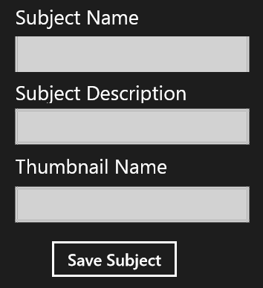
Windows 8 – screen layout (XAML)
<StackPanel>
<TextBlock … />
<TextBox Name=“tbSubName” … />
<TextBlock … />
<TextBox Name=“tbSubDesc” … />
<TextBlock … />
<TextBox Name=“tbTnailName” … />
<Button Name=“btSave” Click="btSave_Click" … />
</StackPanel>

Slide 11
Windows 8 – screen layout (code)
//SubEditPage.xaml.cs
public sealed partial class SubEditPage : Page
{
private void btSave_Click(object sender, RoutedEventArgs e)
{
db.Save(tbSubName.Text, tbSubDesc.Text, tbTnailName.Text);
}
}

Slide 12
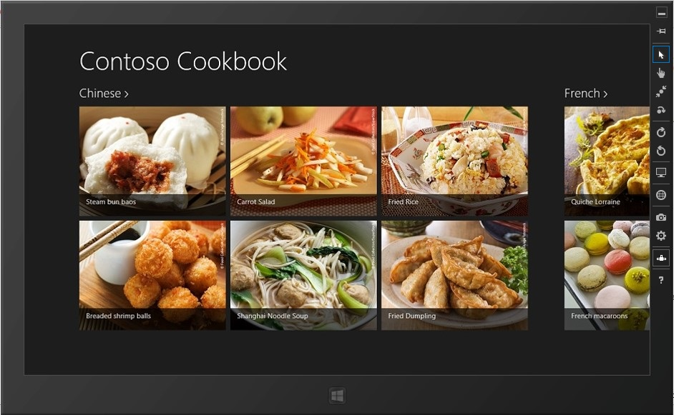
Windows 8 – Simulator
Simulates:
Touch and gestures
Orientation
Screen Resolutions
Location
Network
Also takes screenshots

Slide 13
Demo
Building your first app

Slide 14
Android – navigation within an app
Explicit Intent
Activity1
Source Activity Reference
Destination Activity Type
Parameter Data
Do work
Activity2
User/program actions
Activity2.finish()
Press “Back” button

Slide 15
Windows 8 – navigation within an app
Frame.Navigate()
Page1
Destination Page Type
Parameter Data
Do work
Page2
User/program actions
Frame.GoBack()
Frame.Navigate()
Page3

Slide 16
Windows 8 – navigation within an app
public sealed partial class Page1 : Page
{
private void btnNext_Click(object sender, RoutedEventArgs e)
{
this.Frame.Navigate(typeof(Page2),tbSourceData.Text);
}
}
// Page1.xaml.cs

Slide 17
Windows 8 – navigation within an app
public sealed partial class Page2 : Page {
// Invoked when about to be displayed in a Frame.
protected override void OnNavigatedTo(NavigationEventArgs e) {
if (e.Parameter != null) {
// Do something with the shared data
tbSharedData.Text = e.Parameter as string;
}
}
private void btnBack_Click(object sender, RoutedEventArgs e) {
if (this.Frame.CanGoBack)
this.Frame.GoBack();
}
}
// Page2.xaml.cs

Slide 18
Demo
Navigation and Visual Studio templates

Slide 19
Visual Studio project templates

Slide 20
Blank app

Slide 21
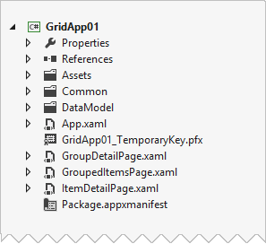
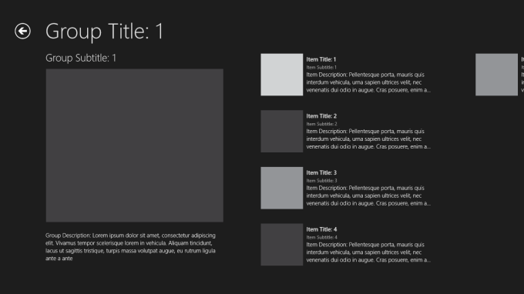
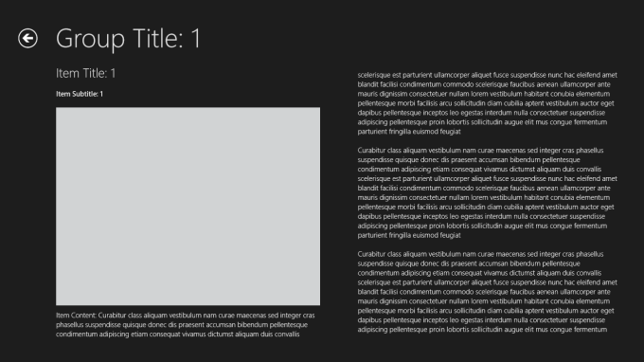
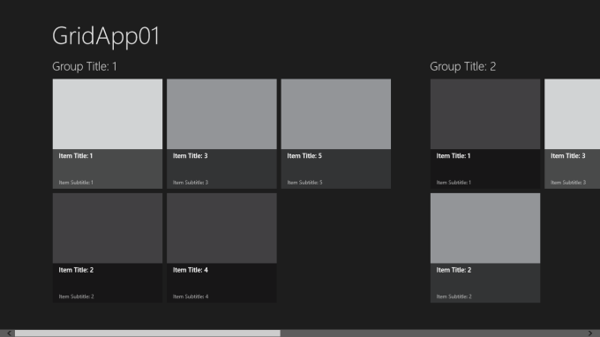
Grid app
Main Page
Groups
Items
3-Tier UI Hierarchy for Grouped Data

Slide 22
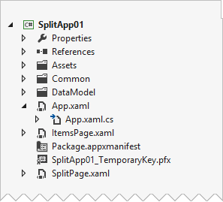
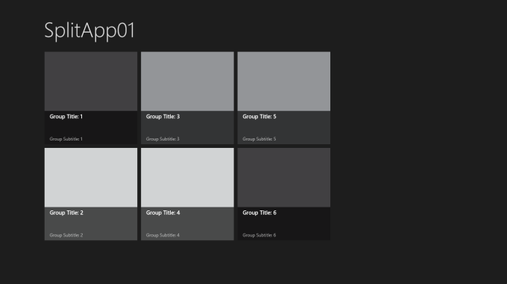
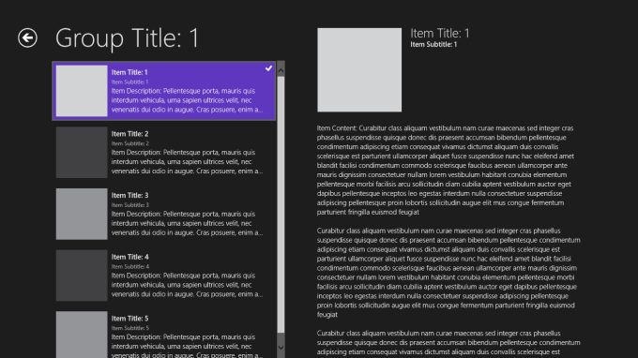
Split app
Main Page
Groups
Items
2-Tier UI Hierarchy for Grouped Data

Slide 23
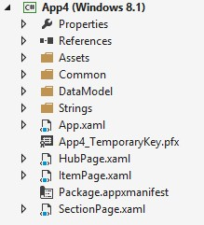
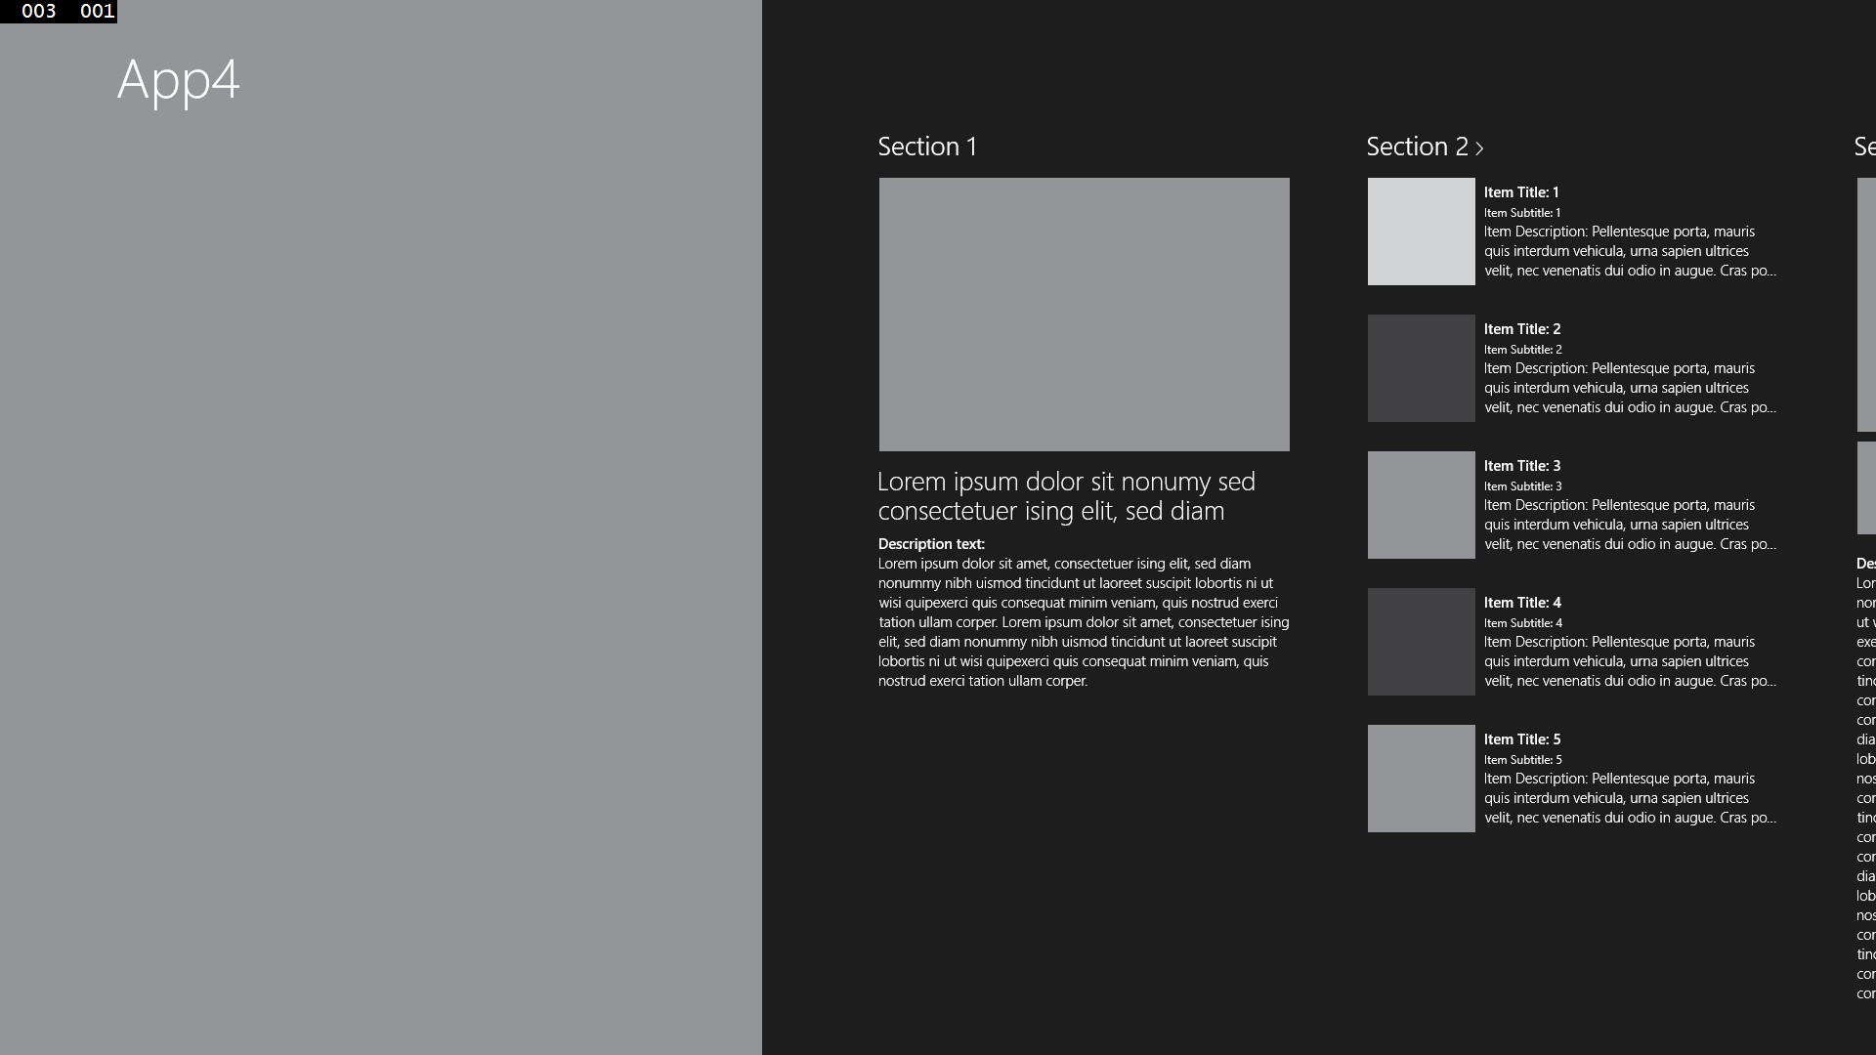
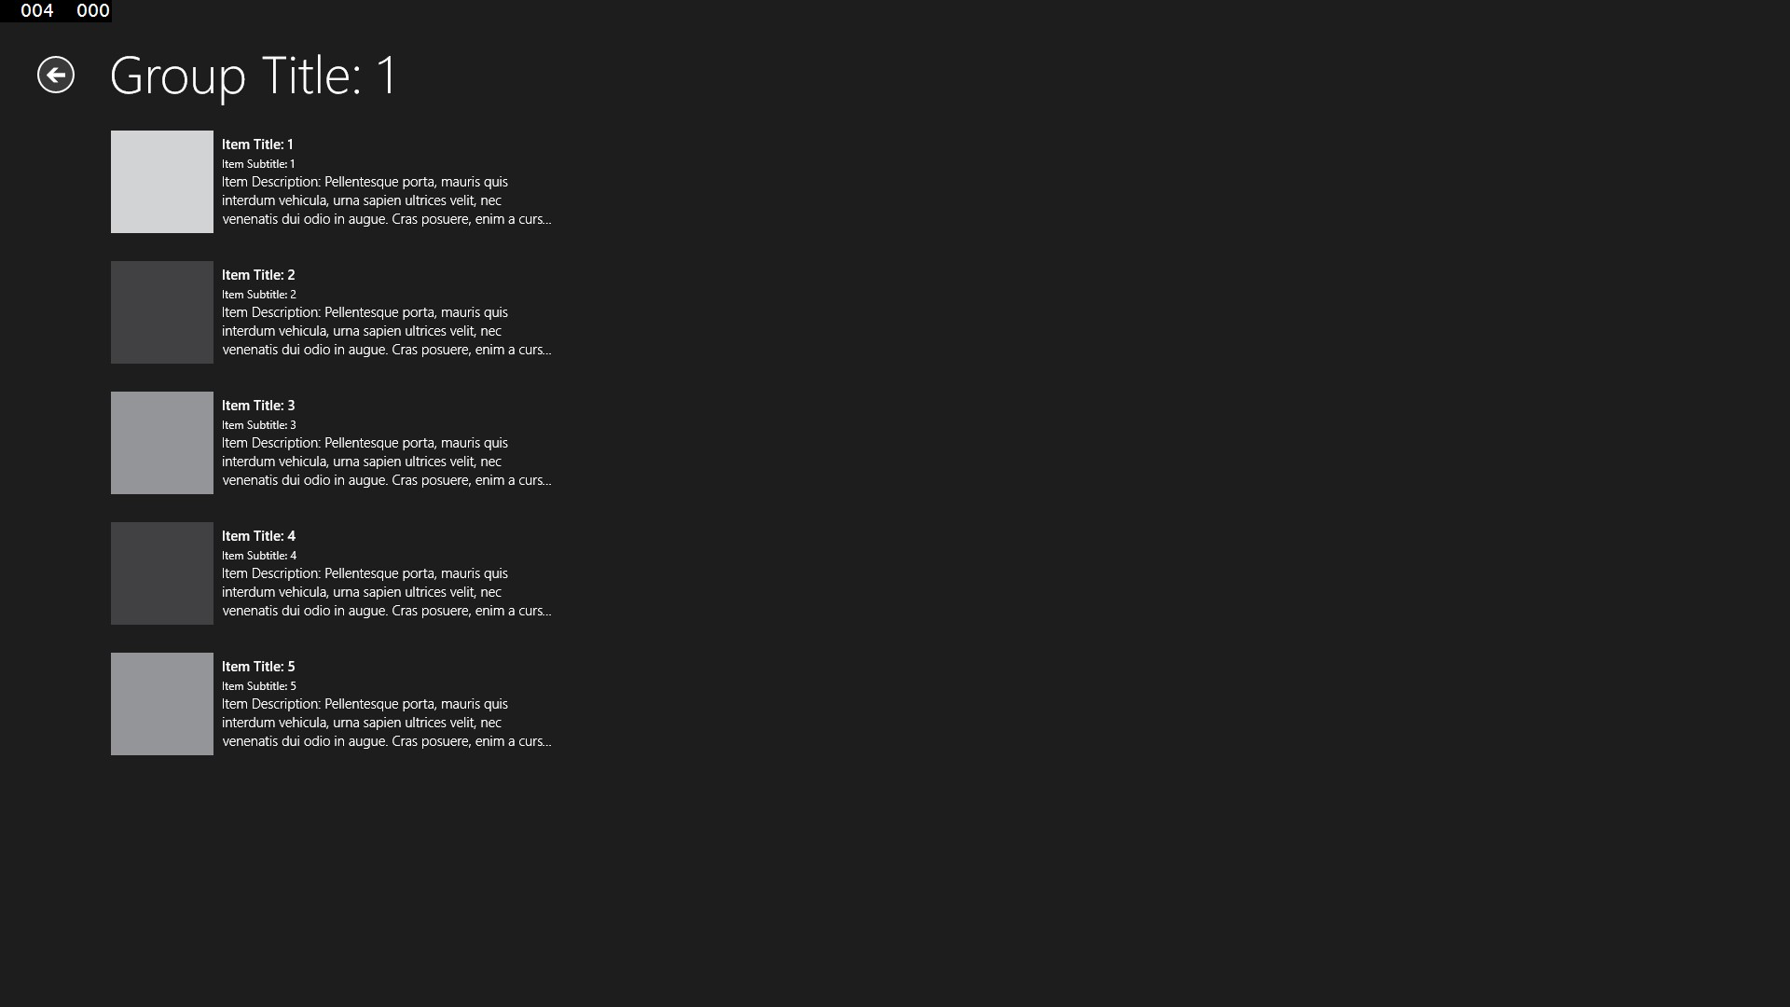
Hub app
Main Page
Groups
Items
2-Tier UI Hierarchy for Grouped Data

Slide 24
Android – data display
1
ListActivity
LearningSubject
Inherits
Name
SubjectArea
Description
TasksComplete
Create ArrayList
SubjectListActivity
2
setListAdapter()
3
Customized ArrayAdapter
4
Category
Subject Name
Tasks Done
Physics
Quantum Mechanics
5
Comp Sci
Algorithms
7
Development
Big Data
4
ListView

Slide 25
Windows 8 - data display
ListView
LearningSubject
Category
Subject Name
Tasks Done
Name
SubjectArea
Description
TasksComplete
Physics
Quantum Mechanics
5
Set ItemsSource
Create ArrayList
Comp Sci
Algorithms
7
Development
Big Data
4

Slide 26
Demo
Data binding

Slide 27
Android: async execution (pseudo code)
public class FileDownloadTask extends
AsyncTask<String, Integer, String> {
private Context _context;
FileDownloadTask(Context context) {
_context = context;
}
@Override
protected void onPreExecute() {
//prepare the state for doInBackground()
}
@Override
protected String doInBackground(String... fileNames) {
return downloadFile(fileNames);
}
@Override
protected void onProgressUpdate(Integer... progress) {
//using the _context update the UI of the progress
}
@Override
protected void onPostExecute(String fileName) {
if(result != null) {
//display the file name in the UI using _context
}
else {
//display error using _context
}
}
}
private filename downloadFile(URL url, saveFileName) {
try {
HttpURLConnection con =
(HttpURLConnection)url.openConnection();
InputStream inStream = con.getInputStream();
BufferedInputStream bInstream = new
BufferedInputStream(inStream );
ByteArrayBuffer buff = new ByteArrayBuffer(2000);
int current = 0;
while ((current = bInstream.read()) != -1){
buff.append((byte)current);
}
File file = new File(_context.getExternalCacheDir(),
saveFileName);
FileOutputStream oStream = new FileOutputStream(file);
oStream.write(buff.buffer());
oStream.close();
return file.getAbsolutePath();
}
catch (Exception e) {
//update UI with error
}
}

Slide 28
Windows 8 – async execution (pseudo code)
async Task<string> DownloadFile(Uri uri, string destFileName) {
HttpClient hc = new HttpClient();
try {
using (Stream src = await hc.GetStreamAsync(uri)) {
StorageFile file = await DownloadsFolder.CreateFileAsync(destFileName);
using (Stream dest = await file.OpenStreamForWriteAsync()) {
await src.CopyToAsync(dest);
return file.Path;
}
}
}
catch (Exception ex) {
return ex.Message;
}
}

Slide 29
Demo
Async programming demo

Slide 30
Windows 8 – sharing data with other apps
Mail
ShareSource
App
Sharing Contract
Twitter
Other ShareTargets

Slide 31
Demo
Sharing

Slide 32
Windows 8 – sharing data with other apps
//SourceApp.Page1
public sealed partial class Page1 : Page {
public Page1() {
this.InitializeComponent();
RegisterForSharing();
}
private void RegisterForSharing() {
DataTransferManager dataTransferManager = DataTransferManager.GetForCurrentView();
dataTransferManager.DataRequested += new TypedEventHandler<DataTransferManager,
DataRequestedEventArgs>(this.DataRequested);
}
private void DataRequested(DataTransferManager sender, DataRequestedEventArgs e) {
DataRequest request = e.Request;
request.Data.Properties.Title = "Sharing text from Source App";
request.Data.Properties.Description = "Demo of sharing contract";
request.Data.SetText(textBox.Text);
}
}

Slide 33
Windows 8 – receive data from other apps
//TargetApp: App class overrides OnShareTargetActivated to display the sharing page
sealed partial class TargetApp : Application {
protected override void OnShareTargetActivated(ShareTargetActivatedEventArgs args)
{
ShareTargetPage1 shareTargetPage = new ShareTargetPage1();
shareTargetPage.ActivatePage(args);
}
}
//TargetApp.ShareTargetPage1 receives shared text
public sealed partial class ShareTargetPage1 : Page {
public async void ActivatePage(ShareTargetActivatedEventArgs args)
{
string data = await args.shareOperation.Data.GetTextAsync();
Window.Current.Content = this;
Window.Current.Activate();
await Dispatcher.RunAsync(CoreDispatcherPriority.Normal, () =>
{ this.tbShareResult.Text = data;});
}
}

Slide 34
Windows Store – app publication process
Acquire Microsoft Account
Package and Submit the App to the Store
Review for Correct Behavior
Register for Windows Store
Review for Proper Use of Advertising
Review for UX, Crashes, Input Devices, and Perf
Reserve the App Name
Fix Errors
Review for Privacy and User Protection
Implement the App
Review for Offensive Content
Review for Localization & Accessibility
App Approved
No Errors

Slide 35
Top certification tips
Run the Windows App Certification Kit (WACK)
Read the documentation
Use the Visual Studio simulator for testing touch, different screen sizes, resolutions, orientations, etc.
Test for performance
Provide a privacy policy if your app connects to the internet
http://aka.ms/CertTips

Slide 36
Windows Store vs. Google Play
Windows Store | Google Play
70% revenue share for the first $25K USD; then 80% | 70% revenue share
In-app purchases allowed outside of Store | Must use Google Play for payment
Can sell apps for $1.49-$999.99 USD | Can sell apps for $0.99-$200 USD
$49 or $99 annual dev registration | $25 one-time dev registration
Can buy apps in 231 countries and sell from 121 countries | Can buy apps in 136 countries and sell from 32 countries
Certification process | Direct publish
Time and feature-based trials | Trials for in-app purchase subscriptions
Simulator to test licensing and purchasing | Must test billing from a device
http://aka.ms/WinStoreVsGooglePlay

Slide 37
How do I get started?
Download Windows 8 (evaluation copy at http://aka.ms/Win8EvalForDevs)
Download Visual Studio Express 2012 for Windows 8: http://aka.ms/JenVS2012
Register for a Windows Store developer account: https://appdev.microsoft.com/storeportals/
Use the portal (reference, samples, forums): http://dev.windows.com

Slide 38
Resources
Windows 8 Dev Center: http://dev.windows.com
Samples: http://code.msdn.microsoft.com/windowsapps
Cookbook hands-on lab (in XAML/CS or HTML/JS): http://aka.ms/ContosoCookbook
Resources for Android developers: http://aka.ms/Android
Resources for iOS developers: http://aka.ms/iOS
Office hours: http://usdpe.ohours.org
Online training: http://aka.ms/AppBuilderCR

Slide 39
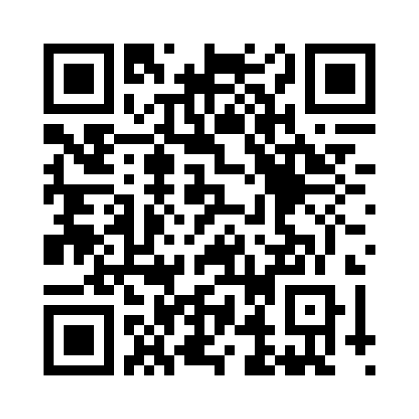
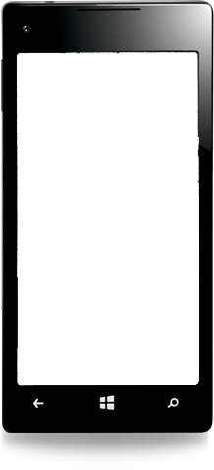
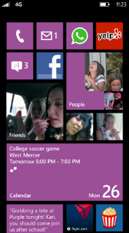
Evaluate this session
Required Slide
*delete this box when your slide is finalized
Your MS Tag will be inserted here during the final scrub.
Scan this QR code to evaluate this session and be automatically entered in a drawing to win a prize!

