Slide 2
Upgrading Windows 8 apps to Windows 8.1
Polita Paulus
Principal Program Manager
3-077

Slide 3
We are covering today…
Upgrading XAML & HTML apps from Windows 8 to Windows 8.1 using Visual Studio.
We will not cover C++.
If you haven’t written your first Windows 8 app, this isn’t the talk for you.

Slide 4
Agenda
Why should I upgrade?
Demo: Upgrading the Windows Blog Reader XAML app
Demo: Upgrading the Windows Blog Reader HTML app
Submitting to the Windows Store

Slide 5
Why should I upgrade my app to Windows 8.1?

Slide 6
Windows 8.1 apps are just faster without code changes
5-30% faster: Startup time of an app with a ListView
2x faster:
List panning
10-20% lower:
Memory usage in XAML
15-35% faster: Editing in a WinJS ListView

Slide 7
Performance video
Windows 8
Windows 8.1

Slide 8
Build on new Windows 8.1 features
Calendar and Contact contracts
Text to speech APIs
Content pre-fetch for up-to-date content
Resource packs
Numerous DirectX improvements
Media: DASH and media stream source
Color fonts (Emoji)
XAML: Hub, DatePicker, TimePicker, Flyout, CommandBar, WebView improvements, data binding improvements
WinJS: Hub, NavBar, ItemsControl, Repeater drag and drop, scheduler, object lifetime improvements (dispose pattern)
XAML/DX – SwapChainPanel, many performance improvements
New side-by-side (50/50) windowing states
Multi-window apps
Launcher APIs for launcher windowing preferences
Support for apps projecting on a secondary monitor
New SearchBox control and search guidance
Small tile size and Large tile size
Lock screen image apps
Lock screen calling apps
Web platform support for WebView, WebGL, WebCrypto, DASH
Offline web content
PDF rendering APIs
New class drivers: Bluetooth & USB
Mag strips and Barcode scanning
3D printing
Wi-Fi Direct
Geo-fencing APIs
Basic smart card APIs
Fingerprint APIs
Improved media capture APIs and photo sequence support
Store: Consumables, auto-updates, Alipay, MS gift cards, improved analytics
8GB app packages (up from 2GB)
Built in SkyDrive support
New WinRT based HTTP stack
Improved integration with Azure Mobile Services
Accounts control – for authentication UI for common providers
Web Authentication Broker improvements (sharing with IE, cached/roamed credentials)
Anti-tampering app protection
Precision touchpad support
Performance improvements across Windows

Slide 9
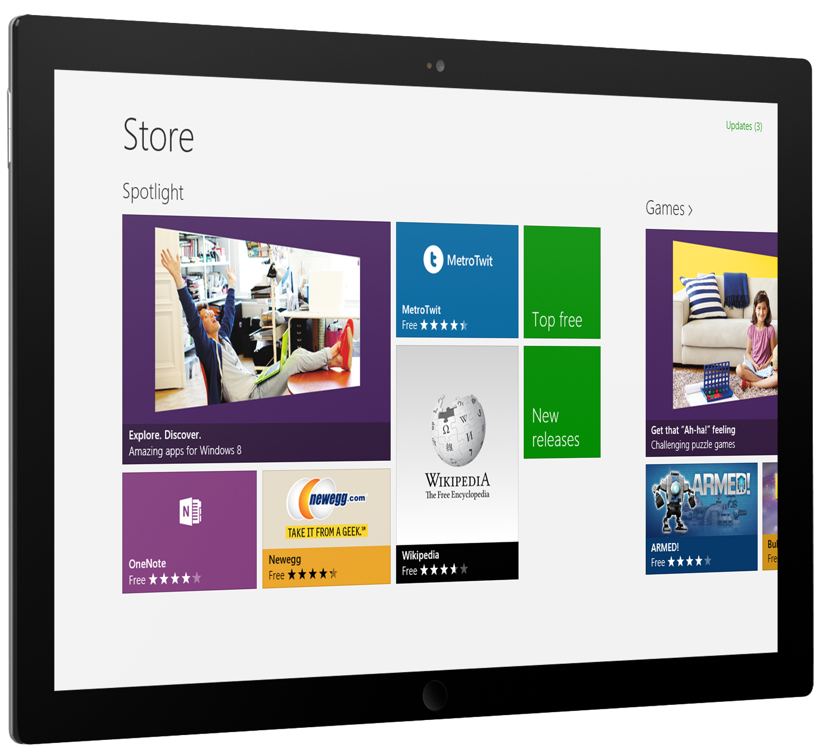
Windows 8.1 apps that take advantage of the platform are more likely to be featured in the Store for Windows 8.1 users.

Slide 10
Upgrading: the complete picture
Upgrading your app to Windows 8.1 is about taking advantage of Windows 8.1 to build a better app.
Getting up and running
Retargeting and building for 8.1
Hitting your stride
Using new 8.1 features
Crossing the finish line
Submitting your app

Slide 11
How do I maintain code for two apps?
Create a new branch and integrate bug fixes, or
Copy your whole solution and make bug fixes in both solutions.
A single solution with projects that target different Windows versions and shared references is possible but can get messy.

Slide 12
Visual Studio 2013 Supported Projects
Profession, Premium, and Ultimate
Create, edit, build Windows 8.1 projects
Upgrade Windows 8 projects to Windows 8.1
Edit and build Windows 8 projects
Express
Create, edit, build Windows 8.1 projects
Upgrade Windows 8 projects to Windows 8.1
Visual Studio 2012 and Visual Studio 2013 run side by side

Slide 13
Let’s get to work!

Slide 14
Upgrading Windows Blog Reader (XAML)
Code available here on MSDN

Slide 15
Upgrading Windows Blog Reader (HTML)
Code available here on MSDN

Slide 16
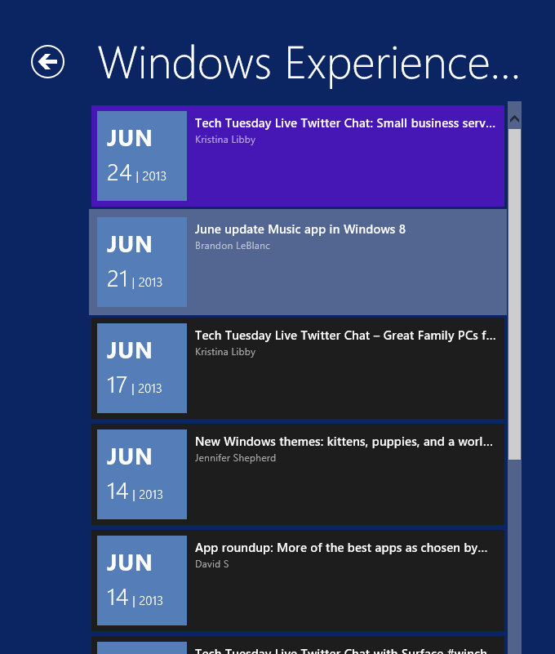
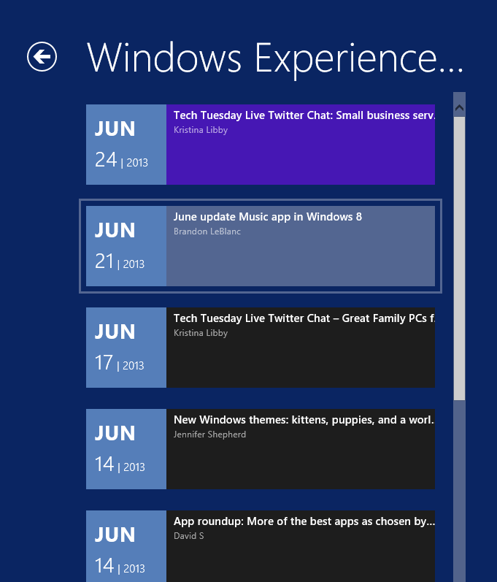
Windows 8
Windows 8.1

Slide 17
Upgrading Windows Blog Reader (HTML)
Code available here on MSDN

Slide 18
Window sizes

Slide 19
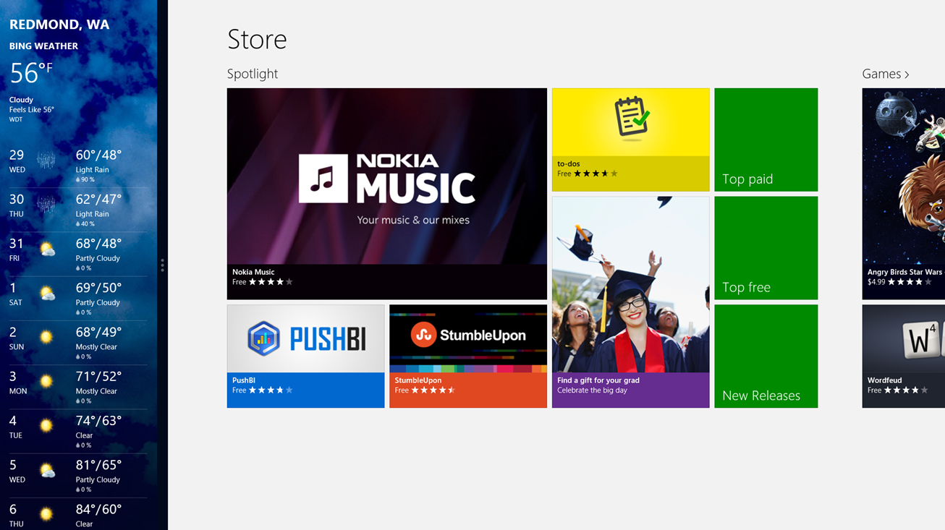
Screenshots
Screenshots must be full bleed images.
The Start screen and Store screen are provided here.

Slide 20
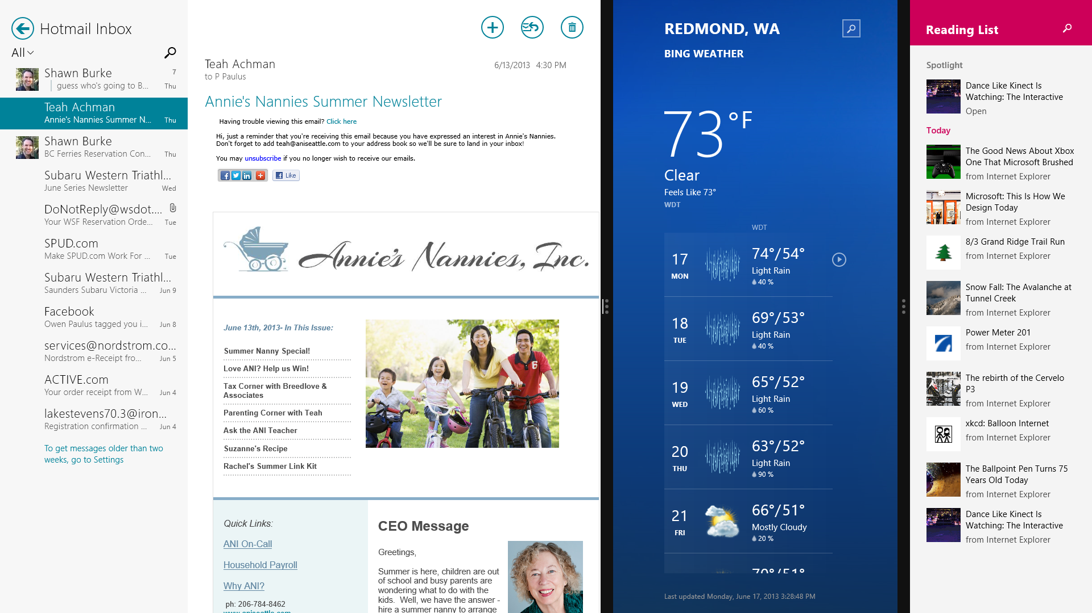
<Need split screenshot from Blue>

Slide 21
Window sizes: what you need to know
Moving beyond snapped and filled…
A window can be any width greater than 500px
An app can opt into being resized down to 320px
No more snapped state
Deprecated APIs:
ApplicationView.Value
ApplicationValue.TryUnsnap()
Instead, query for window size directly

Slide 22
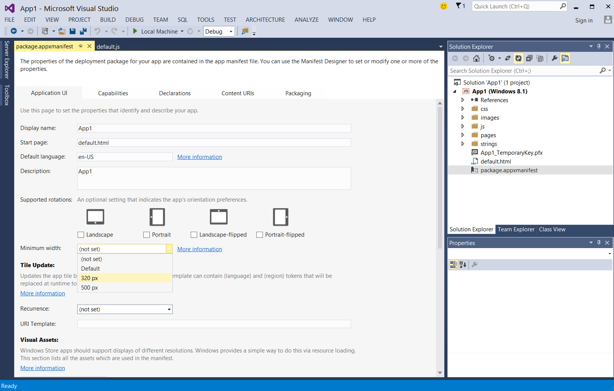
Window sizes: minimum window size
Windows 8.1 apps will resize down to 500px by default, but developers can choose to support resizing down to 320px.

Slide 23
Getting window size in HTML
Windows 8
}
function onSizeChanged() {
// Get view state
var currentViewState = ApplicationView.value;
if (currentViewState === ApplicationViewState.fullScreenLandscape) {
// Full screen Landscape layout
} else if (currentViewState === ApplicationViewState.fullScreenPortrait) {
// Full screen Portrait layout
} else if (currentViewState === ApplicationViewState.filled) {
// Filled layout
} else if (currentViewState === ApplicationViewState.snapped) {
// Snapped layout
}
}
Windows 8.1
function onSizeChanged() {
// Get window size
var windowWidth = document.documentElement.offsetWidth;
// App code to change layout based on window width
}

Slide 24
CSS styling for window sizes
Windows 8
}
@media (-ms-view-state: fullscreen-landscape) {
/* CSS styles for full screen landscape */
}
@media (-ms-view-state: fullscreen-portrait) {
/* CSS styles for full screen portrait */
}
@media (-ms-view-state: filled) {
/* CSS styles for filled*/
}
@media (-ms-view-state: snapped) {
/* CSS styles for snapped */
}
Windows 8.1
@media (min-width: 500px) and (max-width: 1023px) {
/* CSS styles to change layout based on window width */
}
@media (min-width: 1024px) {
/* CSS styles to change layout based on window width */
}

Slide 25
Getting orientation in HTML
Windows 8
}
function onSizeChanged() {
// Get view state
var currentViewState = ApplicationView.value;
if (currentViewState == ApplicationViewState.fullScreenLandscape || currentViewState == ApplicationViewState.filled) {
// Landscape layouts
} else if (currentViewState == ApplicationViewState.fullScreenPortrait) {
// Portrait layouts
}
}
Windows 8.1
function onSizeChanged() {
// Get the window orientation
var winOrientation = ApplicationView.getForCurrentView().orientation;
if (winOrientation === ApplicationViewOrientation.landscape) {
// Landscape layouts
} else if (winOrientation === ApplicationViewOrientation.portrait) {
// Portrait layouts
}
}

Slide 26
CSS styling for orientation
Windows 8
}
@media (-ms-view-state: fullscreen-landscape) or (-ms-view-state: filled) {
/* CSS styles for landscape layouts */
}
@media (-ms-view-state: fullscreen-portrait) {
/* CSS styles for portrait layouts */
}
Windows 8.1
@media (orientation: landscape) {
/* CSS styles for landscape layouts */
}
@media (orientation: portrait) {
/* CSS styles for portrait layouts */
}

Slide 27
Getting window size in XAML
Windows 8
}
private void WindowSizeChanged(object sender, WindowSizeChangedEventArgs e) {
// Get view state
ApplicationViewState currentViewState = ApplicationView.Value;
if (currentViewState == ApplicationViewState.FullScreenLandscape) {
// Full screen Landscape layout
}
else if (currentViewState == ApplicationViewState.FullScreenPortrait) {
// Full screen Portrait layout
}
else if (currentViewState == ApplicationViewState.Filled) {
// Filled layout
}
else if (currentViewState == ApplicationViewState.Snapped) {
// Snapped layout
}
}
Windows 8.1
private void WindowSizeChanged(object sender, WindowSizeChangedEventArgs e) {
// Get window size
var WindowWidth = Window.Current.Bounds.Width;
// App code to change layout based on window width
}

Slide 28
Getting orientation in XAML
Windows 8
}
private void WindowSizeChanged(object sender, WindowSizeChangedEventArgs e) {
// Get view state
ApplicationViewState currentViewState = ApplicationView.Value;
if (currentViewState == ApplicationViewState.FullScreenLandscape || currentViewState == ApplicationViewState.Filled) {
// Landscape layouts
}
else if (currentViewState == ApplicationViewState.FullScreenPortrait) {
// Portrait layouts
}
}
Windows 8.1
private void WindowSizeChanged(object sender, WindowSizeChangedEventArgs e) {
// Get window orientation
ApplicationViewOrientation winOrientation = ApplicationView.GetForCurrentView().Orientation;
if (winOrientation == ApplicationViewOrientation.Landscape) {
// Landscape layouts
}
else if (winOrientation == ApplicationViewOrientation.Portrait) {
// Portrait layouts
}
}

Slide 29
Design your app to work best on the window sizes, devices, and orientations you wish to support.

Slide 30
Changes that may impact your app
We did significant performance and feature work. There are some changes you should be aware of when migrating your Windows 8 app.
IE DOCMODE11
WinJS ListView changes
API deprecations and behavior changes

Slide 31
What does it mean to have two platform versions?
Some things are the same across your versions
App name
Ratings and reviews
Pricing
Markets
Keywords
Copyright, trademark, license info, & privacy policy
Promotional (branding) images
Website and support
Some things are different between your versions
Description
Features
Screenshots

Slide 32
A note about version numbers
If you have Windows 8 and Windows 8.1 app packages for the same app, the version numbers of your Windows 8 packages must never exceed the first published version number of your Windows 8.1 package.

Slide 33
Let’s submit to the Windows Store!
Code available here on MSDN

Slide 34
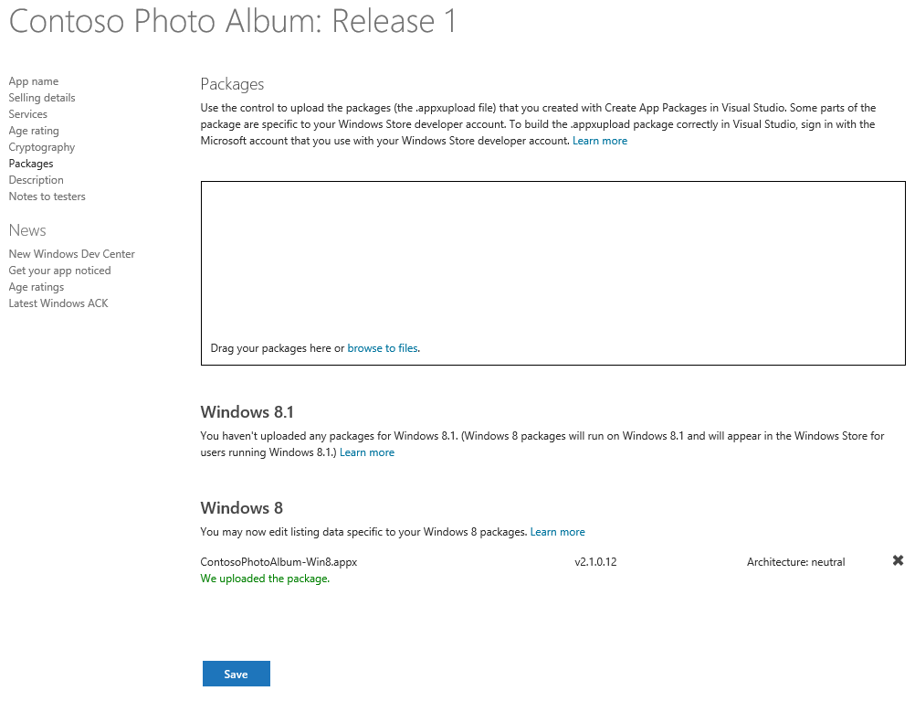

Slide 35
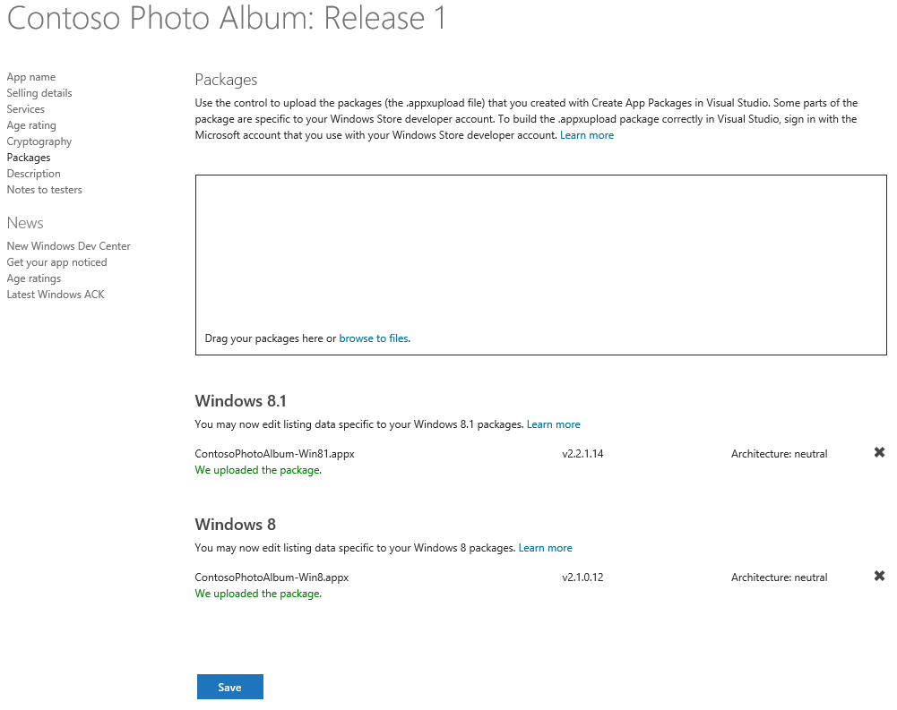

Slide 36
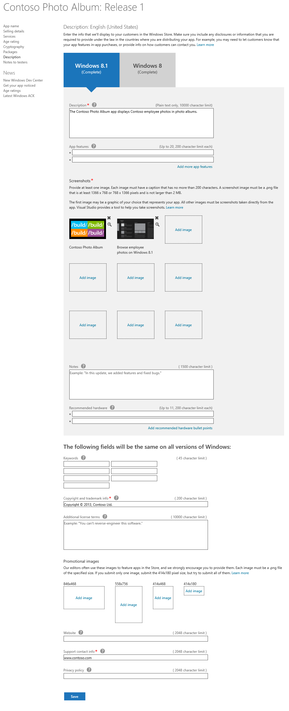

Slide 37
Resources
3-125: The fast lane for app certification
2-150: Beautiful apps at any size on any screen
Migration guidance is available in Visual Studio and on MSDN
I will be in Office Hours Thursday afternoon and Friday morning

Slide 38
Please fill out a session evaluation!

Slide 39
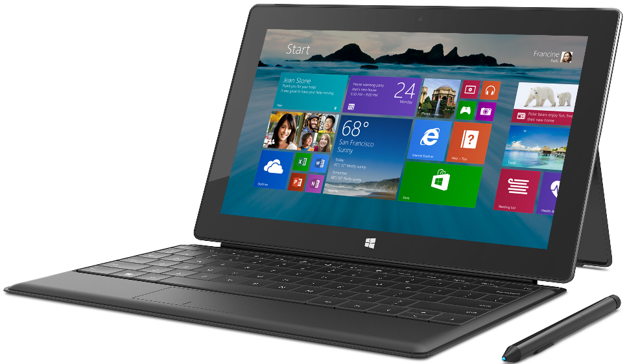
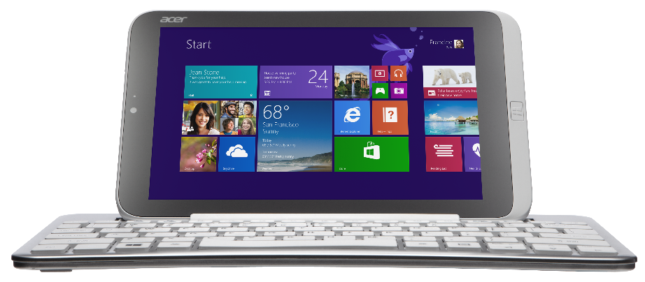
Acer Iconia W3, Surface Pro, and Surface Type Cover
Get your goodies
Device distribution starts after sessions conclude today (approximately 6:00pm) in the Big Room, Hall D.
If you choose not to pick up your devices tonight, distribution will continue for the duration of the conference at Registration in the North Lobby.

Slide 40
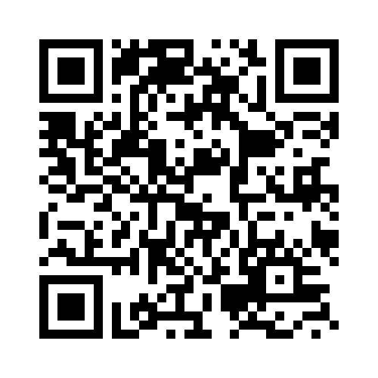
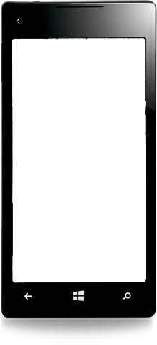
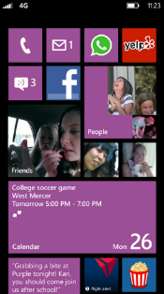
Evaluate this session
Required Slide
*delete this box when your slide is finalized
Your MS Tag will be inserted here during the final scrub.
Scan this QR code to evaluate this session and be automatically entered in a drawing to win a prize!

