Slide 1
Updated Agenda
12:00PM–1:00PM | Session #1
1:00PM–2:00PM | Lunch

Slide 3
AllJoyn: Building Universal Windows Apps that Discover, Connect, and Interact with Other Devices and Cloud Services Using AllJoyn
2-623
Brian Rockwell Gavin Gear

Slide 4
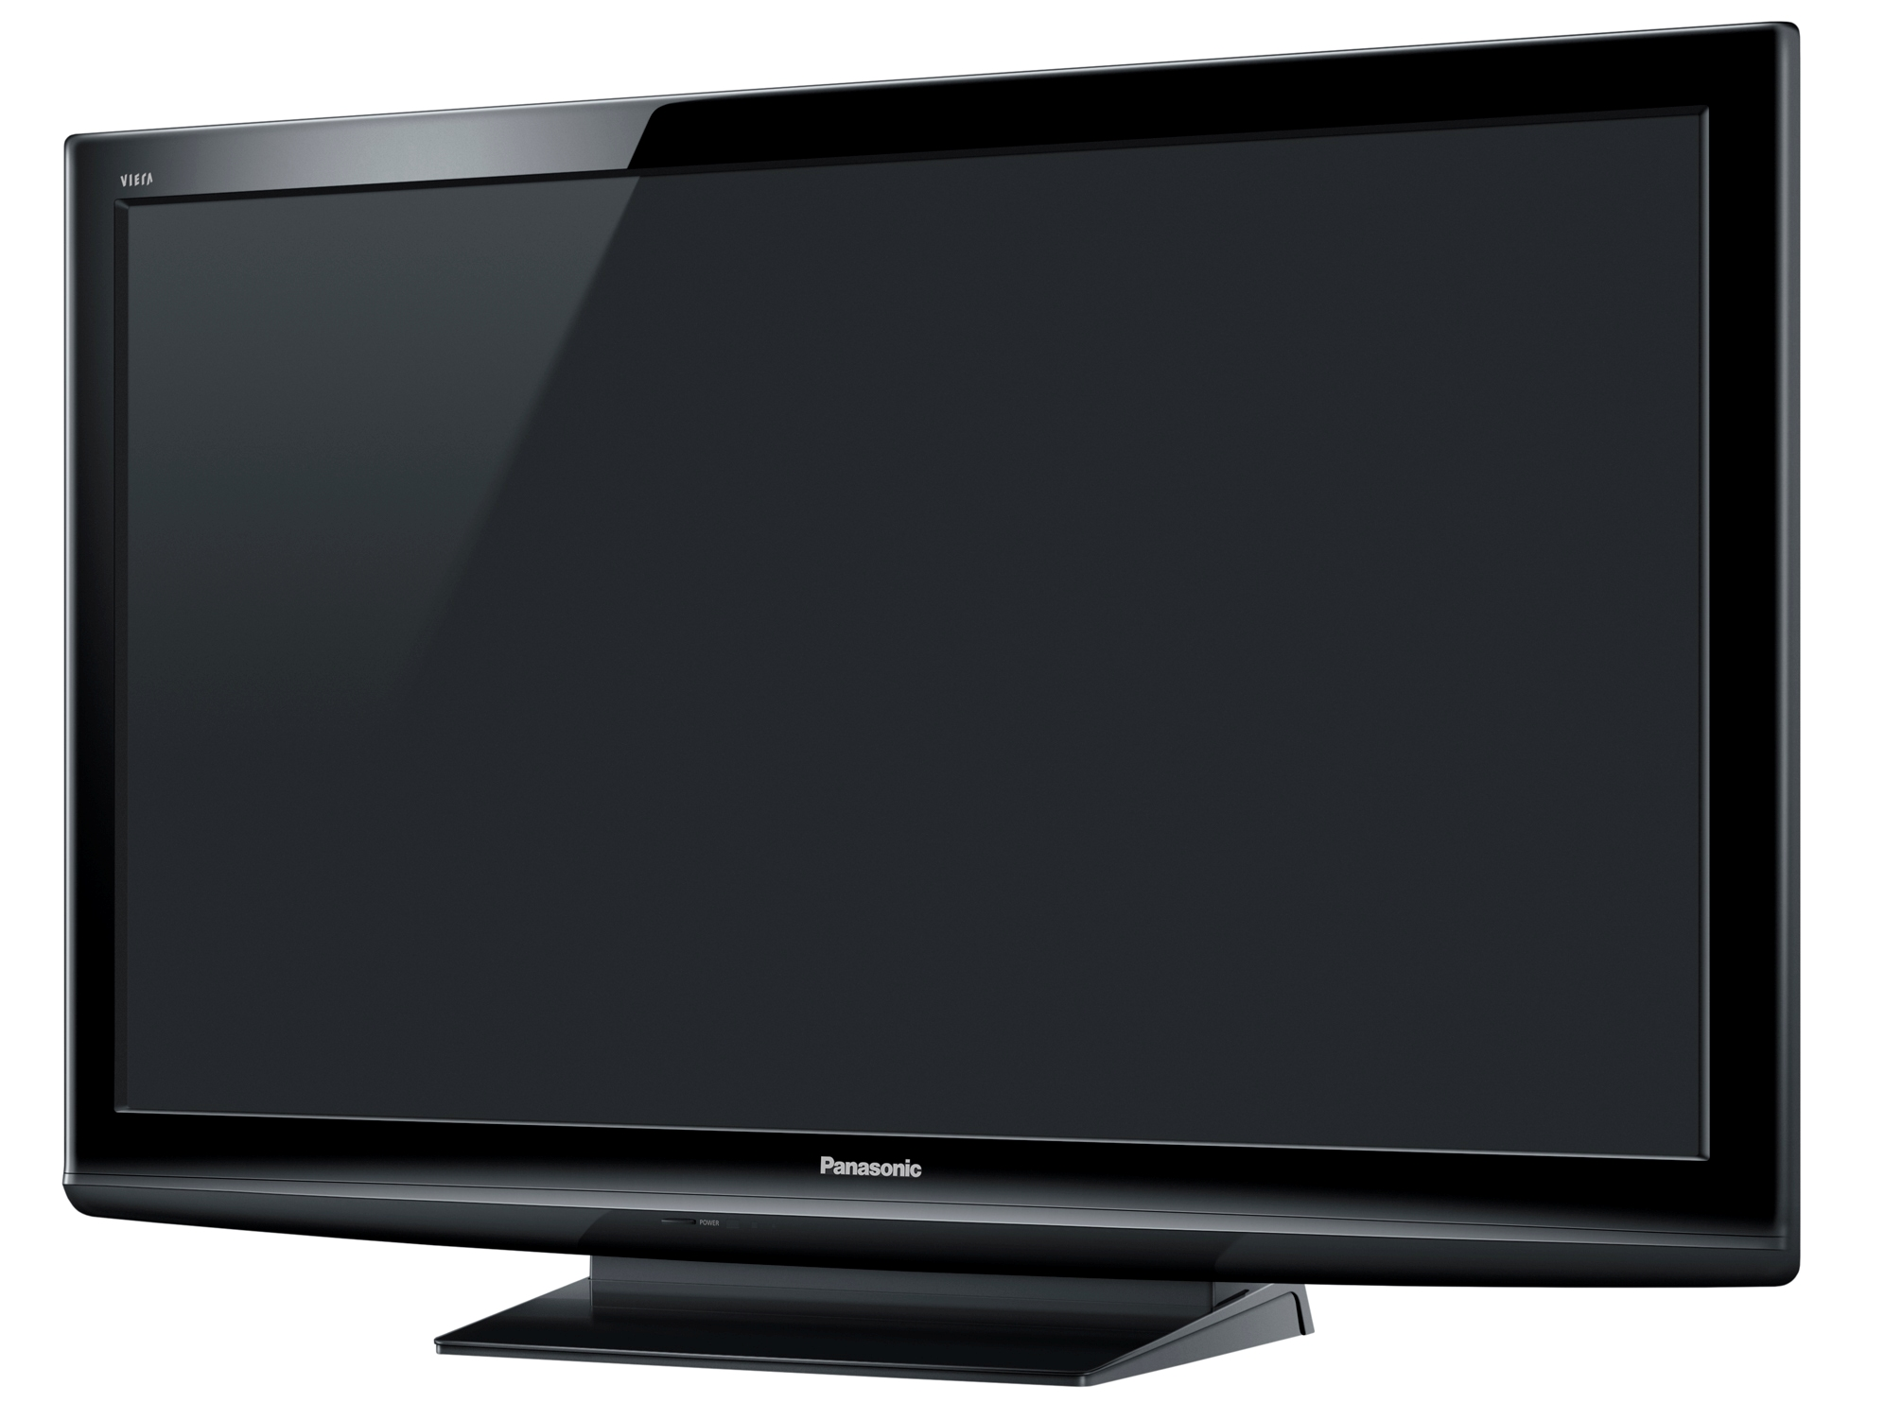
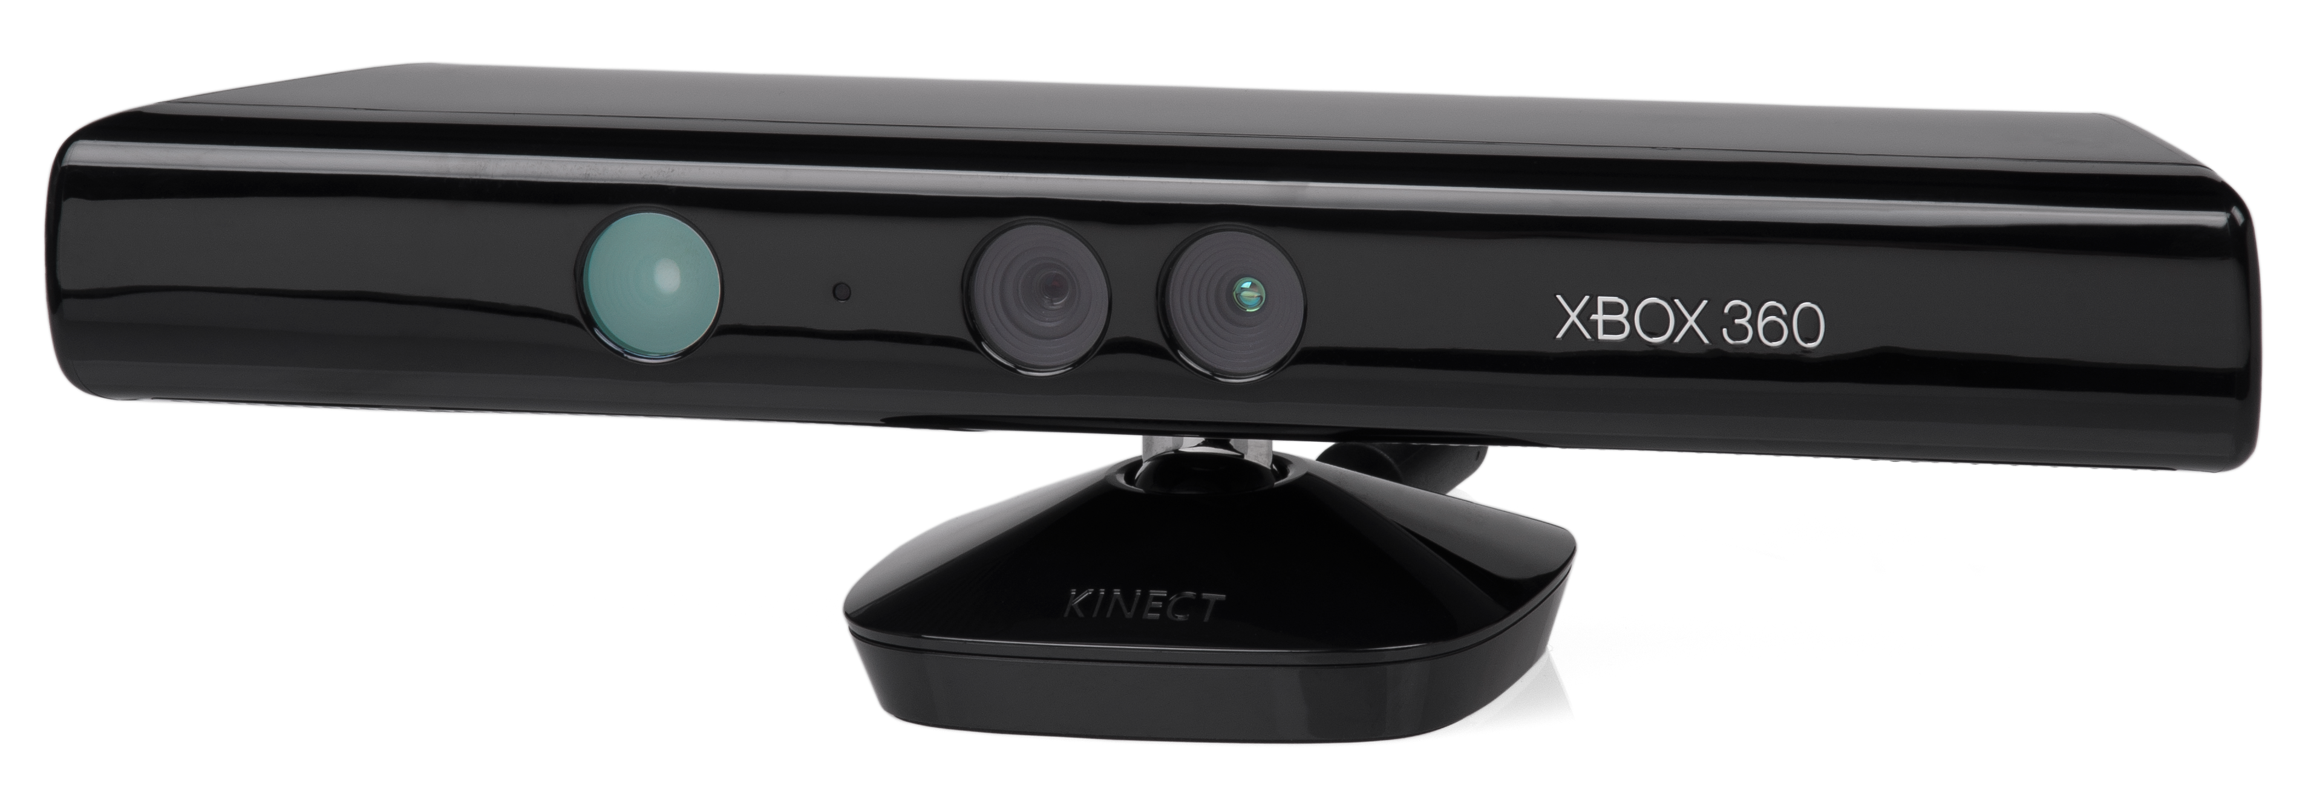
My Dream Home Theater (2010)

Slide 5
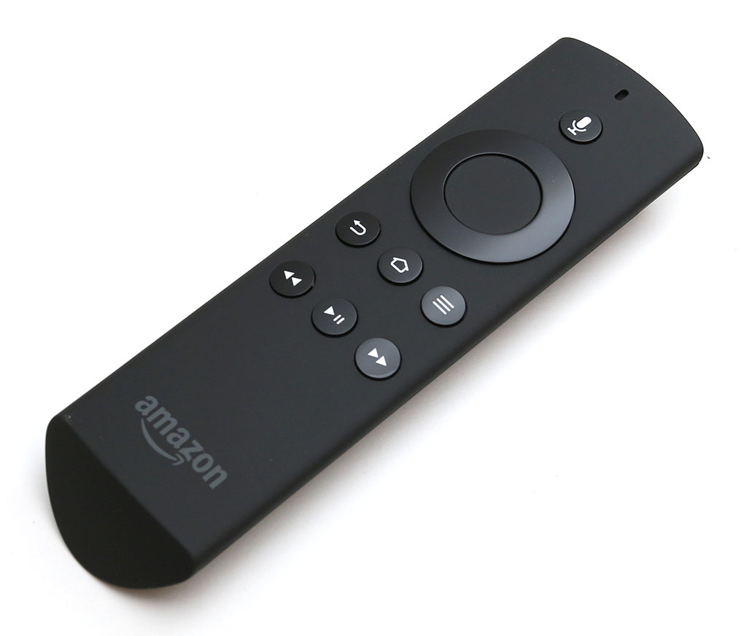
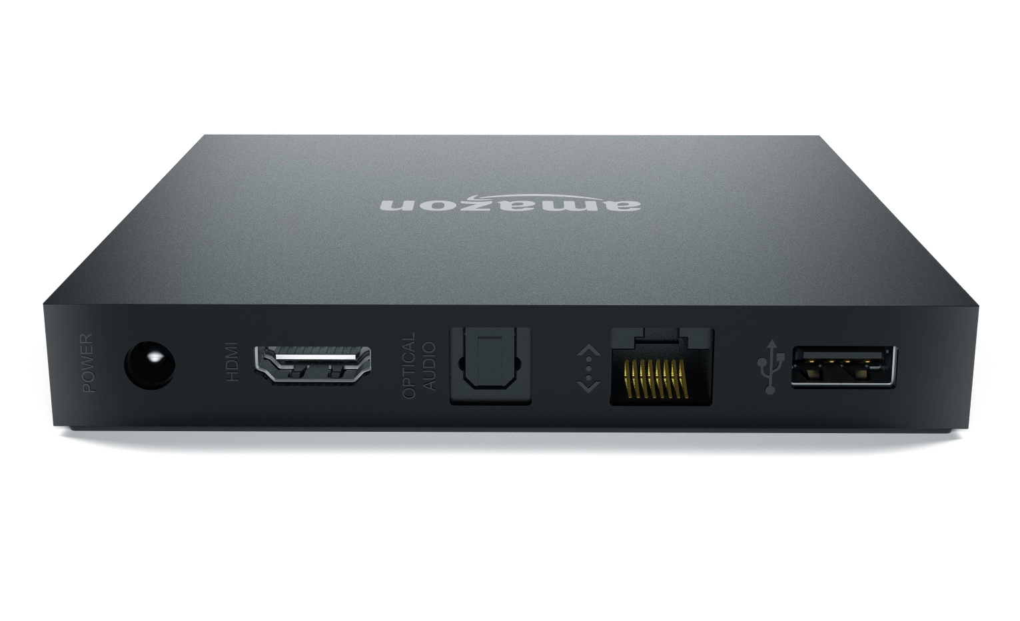
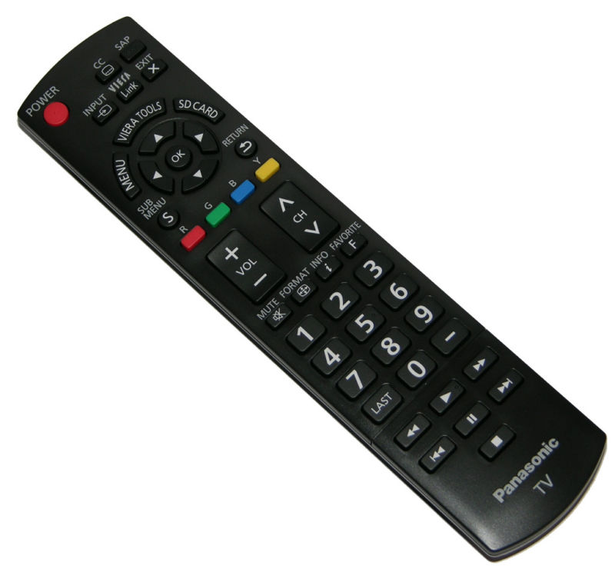
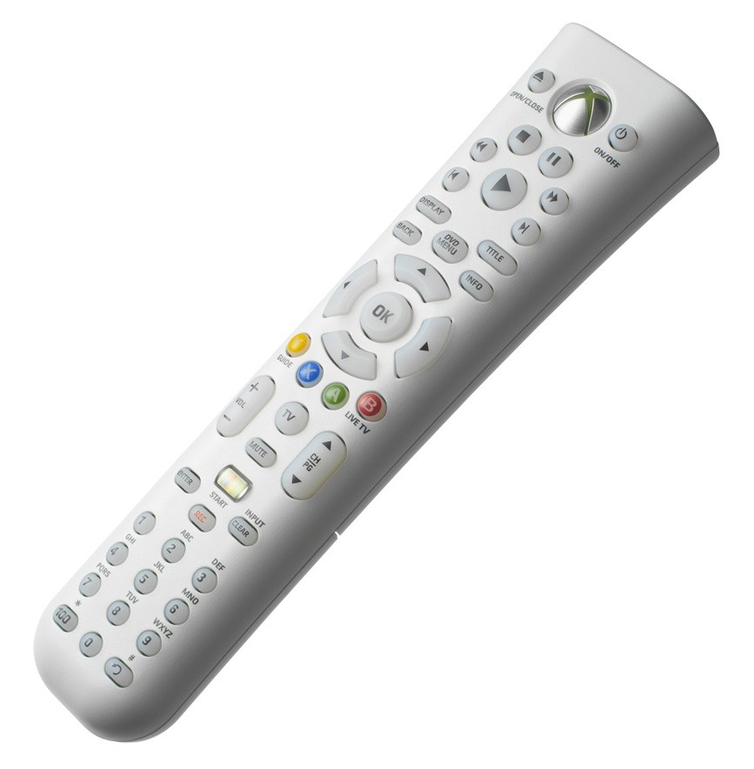
My Current Home Theater (2015)
Fire
HDMI
Bluetooth
Television
IR
Xbox (Universal)
HDMI
Vieralink
IR
HDMI
Wall/Repeater

Slide 6
Agenda
AllSeen and AllJoyn
AllJoyn Platforms and APIs
AllJoyn in Windows 10
Building an AllJoyn App for Windows 10
Getting Involved, Looking Forward

Slide 7
AllSeen and AllJoyn
AllJoyn is an open source communication framework that enables IoT device and app interoperability.
The AllSeen Alliance is a non-profit consortium that oversees AllJoyn. Stated focus is to enable the “Internet of Everything”.
The AllSeen Alliance is a cross-platform Linux Foundation Collaborative Project.
AllJoyn

Slide 8
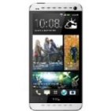
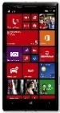
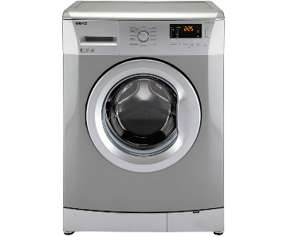
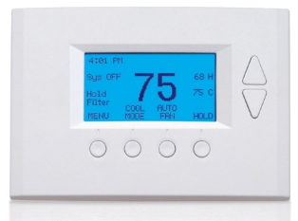
IoT Barrier: Proprietary Solutions
IHV Transport
ISV Schema
OS API
Closed System

Slide 9
AllJoyn Enables IoT Device Interoperability
AllJoyn

Slide 10
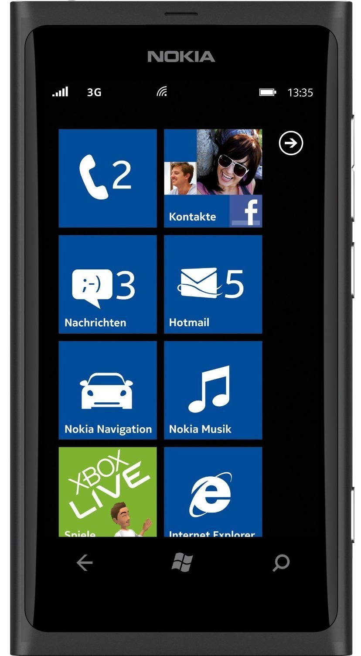
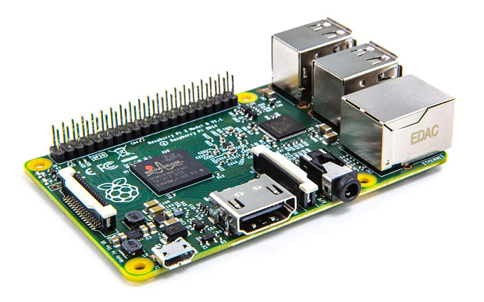
Example AllJoyn Device: Smoke Detector
Updateable Firmware
Onboard WiFi
Device Metadata
Fire Detected
AllJoyn App
AllJoyn Device
Notifications
Cancel
Control

Slide 11
AllJoyn Platforms and APIs
Standard Core SDK
Standard Core Apps/Firmware
C
UWP
Java
obj-C
Thin Core SDK
AllJoyn C++ Core API
Thin Core Apps/Firmware
AllJoyn C Core API
~10K code size
Microcontroller-class device
~1,700K code size
Full-OS class devices

Slide 12
AllJoyn Common Service Frameworks
About
Discovery and app/device metadata
Notification
Send and receive device notifications
Onboarding
Get devices onto wireless networks
Configuration
Manage and configure devices

Slide 13
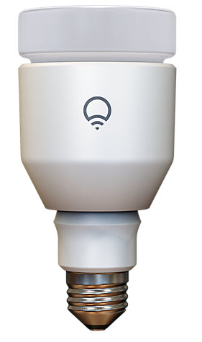
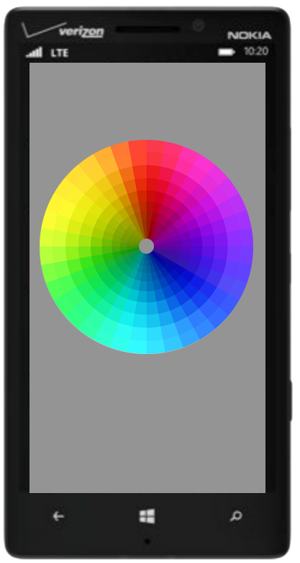
AllJoyn Software Roles
Consumer (client)
Discovers and connects to one or more producers. Controls thing and consumes data from thing.
Producer (server)
Represents a “thing” that implements one or more AllJoyn interfaces.
Lamp
Lighting App
Lamp
Lamp
Lighting Controller
AllJoyn apps/devices can be producers, consumers, or both

Slide 14
AllJoyn in Windows 10
Integrated AllJoyn Runtime
Servicing, reduced code size
Router Node Service
Optimized performance, full integration
C and UWP APIs
Reduced code size, integrated with Windows SDK
Visual Studio and SDK Integration
Seamless AllJoyn device and app development
Samples
C and UWP Samples

Slide 15
Demo: AllJoyn Apps and Devices

Slide 16
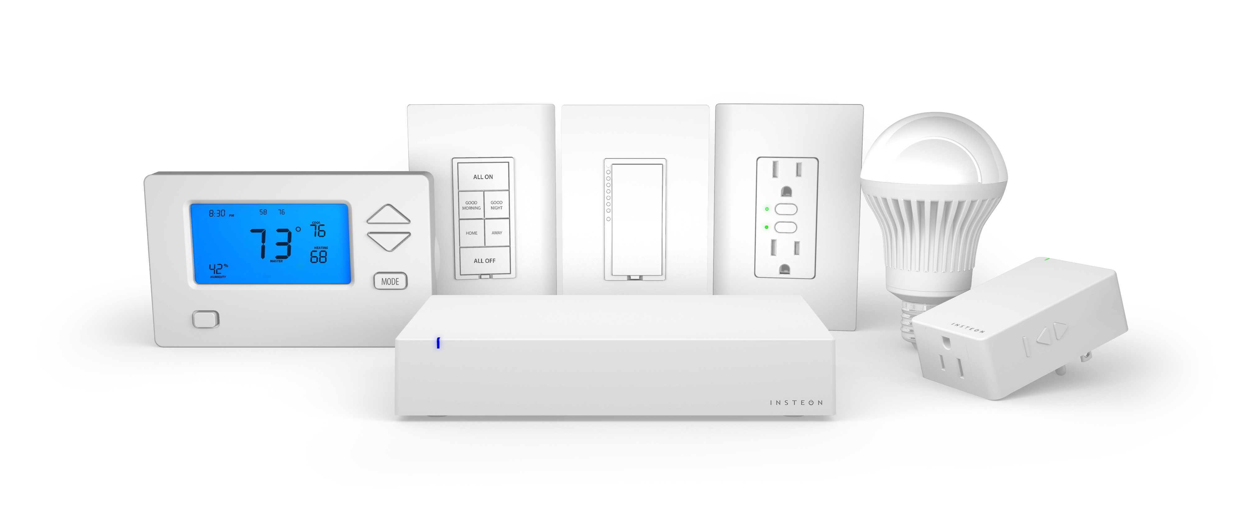
Joe Dada, CEO Insteon - "Finally an integrated home automation experience that people have been promised for years is now available through Microsoft Windows 10 and AllJoyn. Developers accessing the Windows 10 SDK for AllJoyn will have access to Insteon’s 200+ products through our new AllJoyn-enabled Hub."

Slide 17
Through AllJoyn, any developer can create apps using the AllJoyn-Enabled Hub and Insteon devices.
The AllJoyn-Enabled Hub opens Insteon’s entire collection of devices to developers.
Insteon will personalize the smart home experience though Cortana and Live Tiles.
Insteon taking a leadership role in the AllSeen Alliance, bringing the Connected Home to the present.

Slide 18
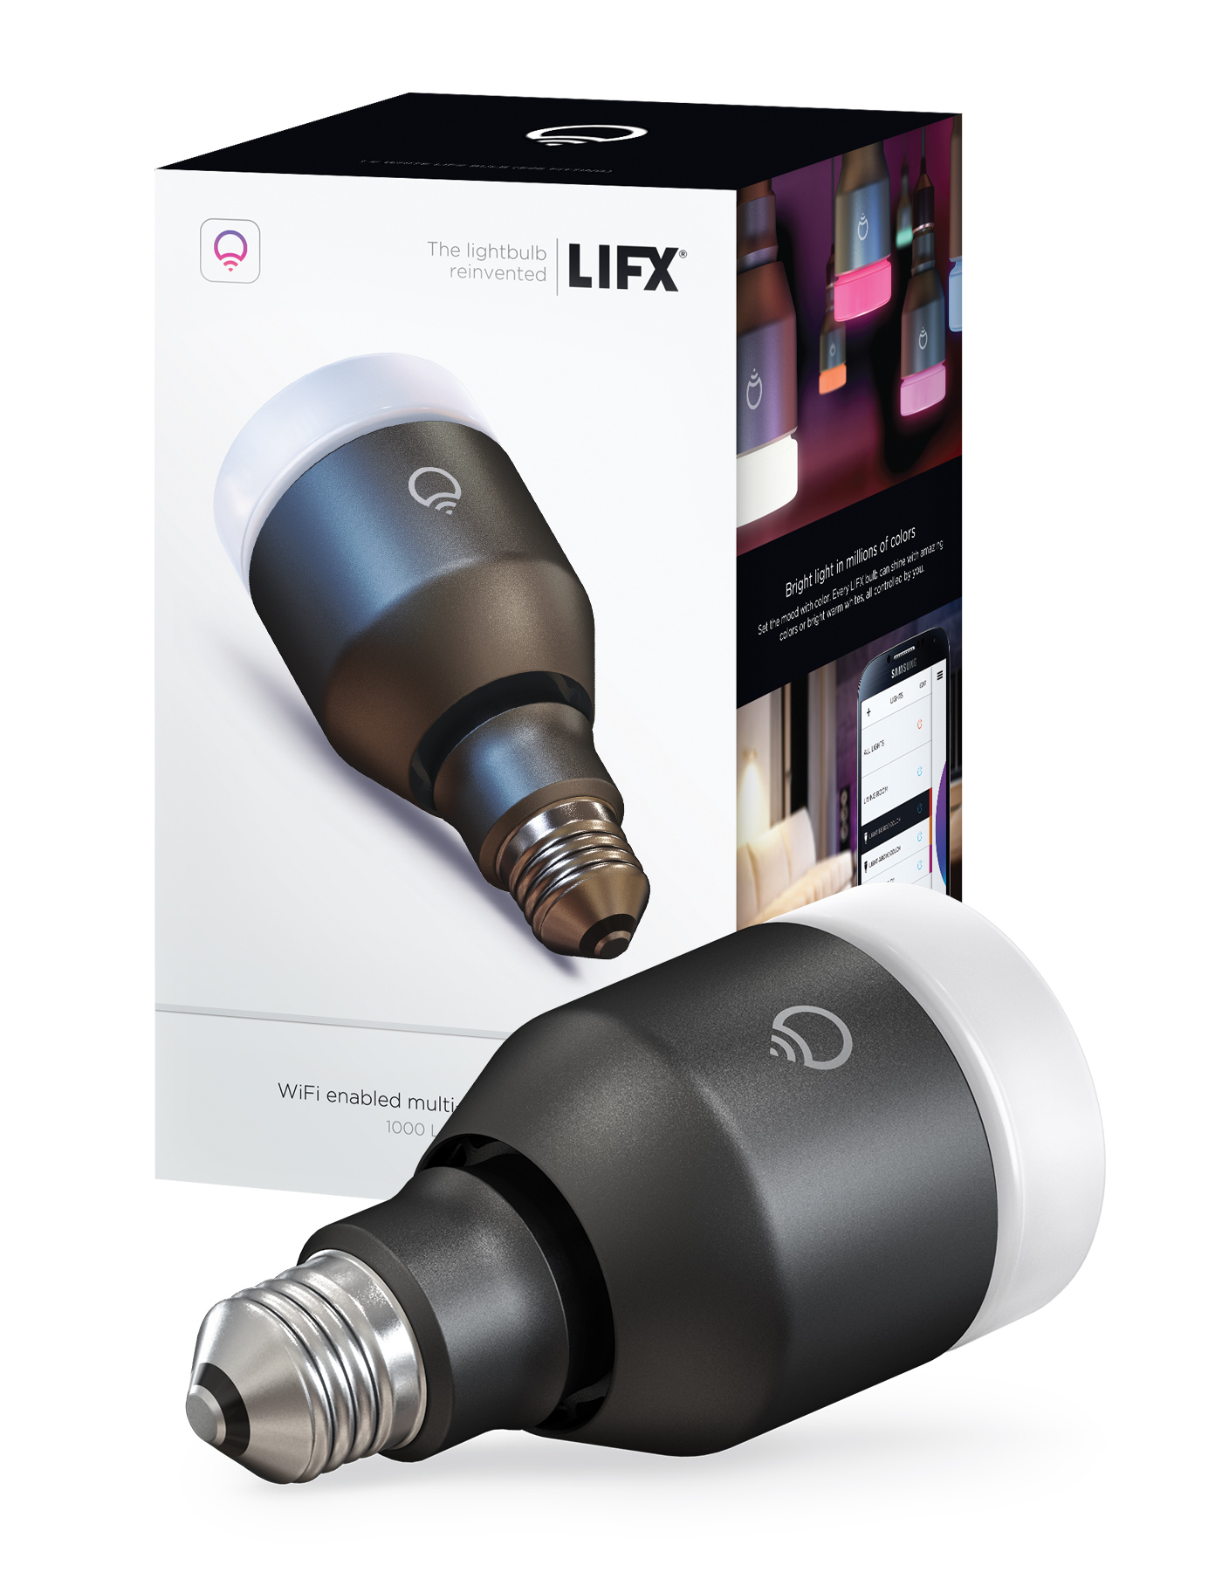
John Cameron, VP Product, LIFX – "Fill the room with color . With out-of-the-box control of LIFX smart bulbs, the Microsoft Windows 10 SDK for AllJoyn unlocks an entirely new canvas of light for developers. Games can immerse players with real-time control of living space colors. Apps can set the perfect mood-lighting. Even appliances can send status alerts to a lamp in a distant room."

Slide 19
LIFX multicolor and white LED bulbs feature the AllJoyn Lighting Service Framework.
Window 10 will have a premiere lighting experience with greater interactivity through Cortana and Live Tiles.
Windows 10 features the perfect tools to quickly and easily integrate LIFX bulbs into any project, be it mood lighting, video integration, or even an augmented gaming experience.

Slide 20
AllJoyn UWP App Development
Install Windows 10 and SDK/Tools
Identify and/or Define AllJoyn interfaces
Generate code
Implement and hook up AllJoyn functionality
Build for targets
Test and Certify

Slide 21
Windows.Devices.AllJoyn Overview
UWP App Code
AllJoyn UWP API
Windows.Devices.AllJoyn
Component
(generated)
Component
(generated)
AllJoyn Standard Client API (C)
MSAJAPI.lib

Slide 22
AllJoyn UWP Code Generator
Output:
Windows Runtime Component (UWP)
Input:
AllJoyn Interface(s)
AllJoyn
Code
Generator
(UWP)
Consumer and Watcher Code
(*.cpp, *.h)
Introspection
xml
Producer Code
(*.cpp, *.h)
From documentation or running device

Slide 23
AllJoyn UWP Interactions
AllJoyn Devices
AllJoyn UWP App
Bulb
Producer
AllJoyn
Router
Bulb
Producer
Bulb
Producer
Bulb
Watcher
Bulb Consumer
Bulb Consumer
Bulb Consumer
AllJoyn Bus
AllJoyn Bus
Toaster
Producer
Toaster
Watcher
Toaster Consumer

Slide 24
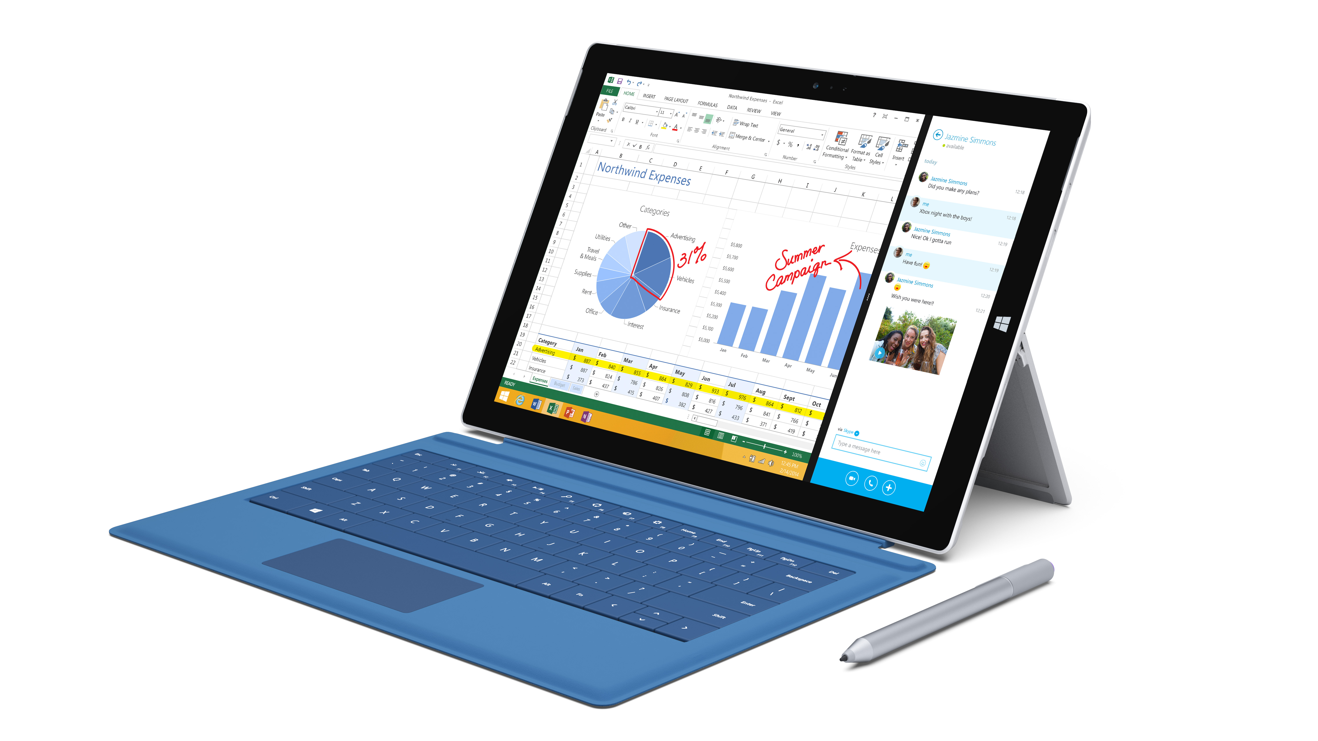
Windows 10 AllJoyn UWP
AllJoyn and Shared App Code
Layout file(s), XAML, HTML 5, …
Small Device App
Phone App
PC App
Xbox App

Slide 25
Coding Walkthrough: Building a WinRT AllJoyn App for Windows 10

Slide 26
Device System Bridge (DSB) Framework
Non-AllJoyn Devices
AllJoyn Endpoints
ZigBee Device
Plugin
Device System Bridge
(DSB)
Virtual AllJoyn Device
AllJoyn Apps and Devices
Z-Wave Device
Plugin
Virtual AllJoyn Device
…
…
BACnet Stack
Plugin
Virtual AllJoyn Device

Slide 27
Coming Soon
Insteon AllJoyn support and UWP app
Visual Studio 2015 AllJoyn Integration
Windows 10 AllJoyn Samples

Slide 28
Call To Action
Install Windows 10
Build AllJoyn-enabled UWP apps and devices
Send Microsoft your Feedback
Get Involved with the AllSeen Alliance
Contribute Code back to Alliance

Slide 29
Q&A

Slide 30
Resources
Other relevant sessions:
652: Internet of Things: Overview
752: Building consumer and enterprise device solutions with Windows 10 IoT
724: Windows for Makers: Raspberry Pi 2, Arduino, and more!
617: Windows + Open Source Software
AllJoyn Resources:
AllSeen Alliance: http://allseenalliance.org
Windows 10 IoT: http://windowsondevices.com
MSDN documentation for Windows 10 AllJoyn
Windows 10 AllJoyn Samples

Slide 32
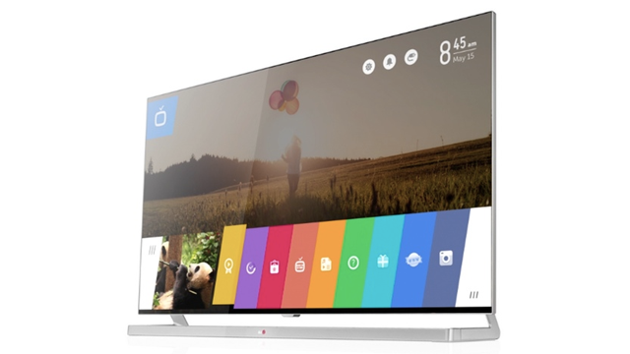
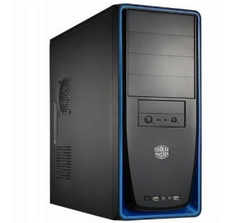
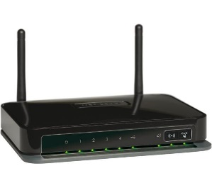
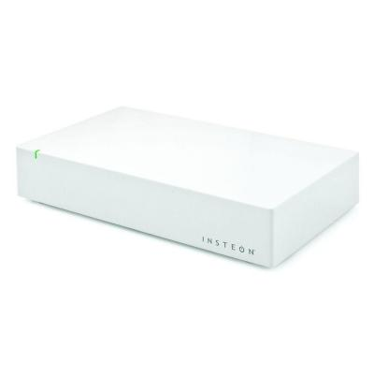
AllJoyn session AV/space/power requirements
Legend:
Black: SCP team brings
Blue: Provided by event
Red: Power Requirements
LG 42” WebOS TV
In-room Console PC
(slides)
Coding Demo PC
(primary)
Coding Demo PC
(backup)
Overhead Camera
Power:
3 prong
Power:
2 prong
Power:
3 prong
(3) 2 prong brick
Power:
3 prong
clicker
WiFi Router
VGA (1920x1080)
RPI Toaster
Ethernet
VGA (1920x1080)
Power:
2 prong brick
Power:
2 prong brick
2 prong std.
AV Switcher
Insteon Hub
Battery powered Insteon devices (Z-Wave or similar)
Power:
(2 )2 prong std
Power:
2 prong brick
Lamp
Lamp
Lamp
Lamp

