Slide 2
Information Protection in 2013: Readiness and Implementation Considerations
WCA-B321
Tim Davis

Slide 3
We are promising:
I can protect any file type
I can consume protected files on important devices
I can share with anyone and they can sign up for free
I can share with any business user
I can share with any individual (LiveID/GMAIL ID)
I can keep my data on-premise (if the cloud scares me)
I can control my RMS ‘tenant key’ from on-premise
I am aware of what is going on with my protected data
I can rely on MSFT + Partners for complete solutions

Slide 4
Decisions, Decisions, Decisions
Azure AD RM for O365 is easiest way to get IP
  Info protection is most approachable if you can adopt Office 365
AADRM Hybrid Connector is quickest way to get IP
  Office 2013 + the hybrid connector get you going very quickly.
For the most paranoid, use the BYOK key offers
  Bring your own key + logging + log analysis (from partners) + key rejuvenation
Generic Protection offer creates maximum reach
  If your favorite RMS-enlightened app is not yet on yet on your platform, then use *.PFILE protection. It assumes a bit more trust (and there is a greater risk of data leakage) but works everywhere and is far, far better than what you do now(!).
  IPViewer and new SDKS available on 6 platforms

Slide 5




Session Goals
Enterprise
Storage
Devices

Slide 6

End Of Session
Enterprise
Cloud Drives
Devices

Slide 7
Modern RMS Offers
EMail
Portals
Storage
Protection
Exchange
Online
SharePoint
Online
Cloud
Drives
Azure
AD RMS
Cloud Ready
Exchange
SharePoint
Cloud Accepting
Windows FCI
AD RMS
Cloud Hesitant

Slide 8
Demo: Office

Slide 9
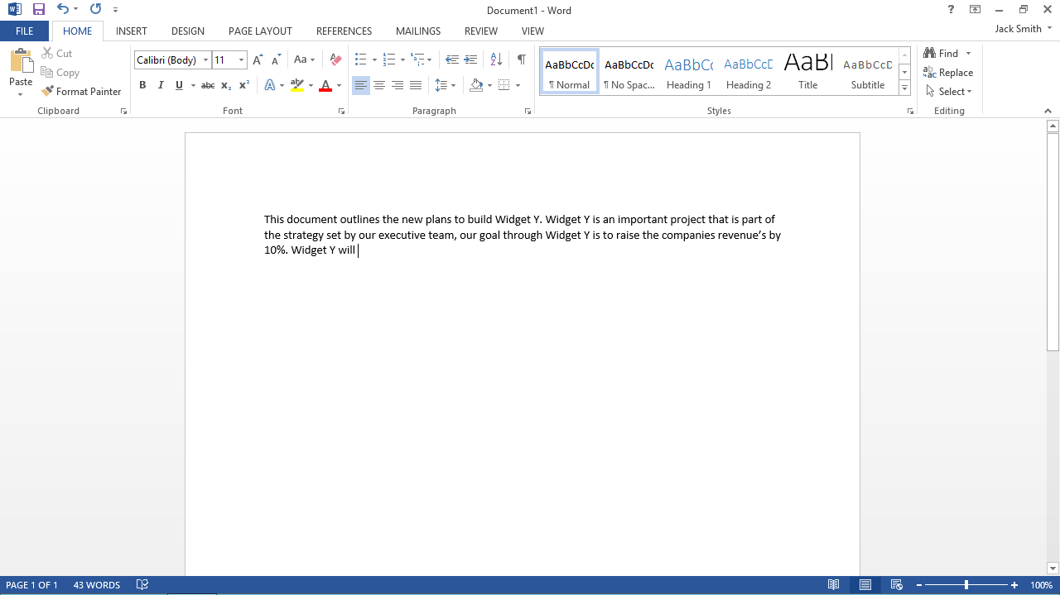
User initiated Protection -

Slide 10
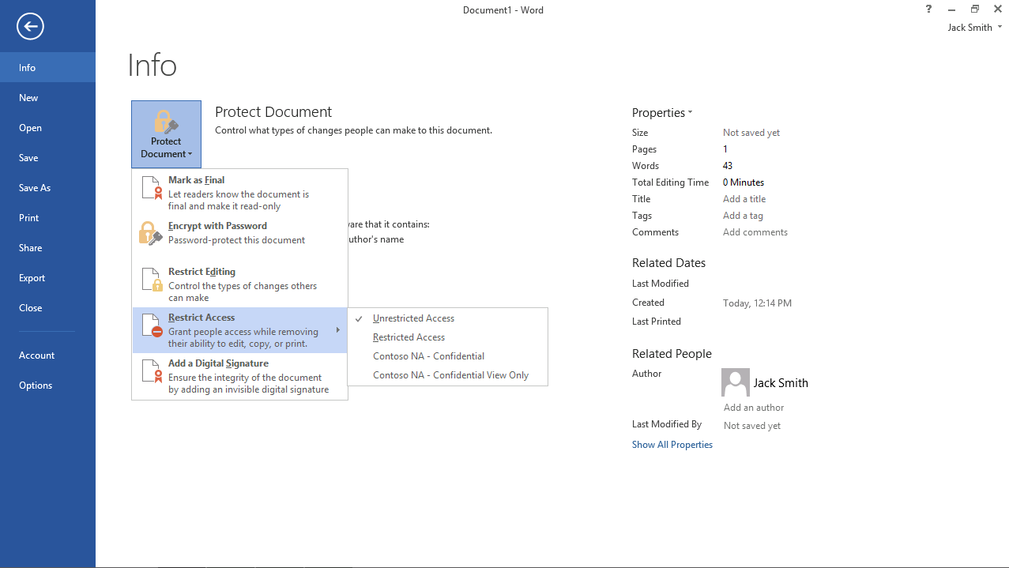

Slide 11
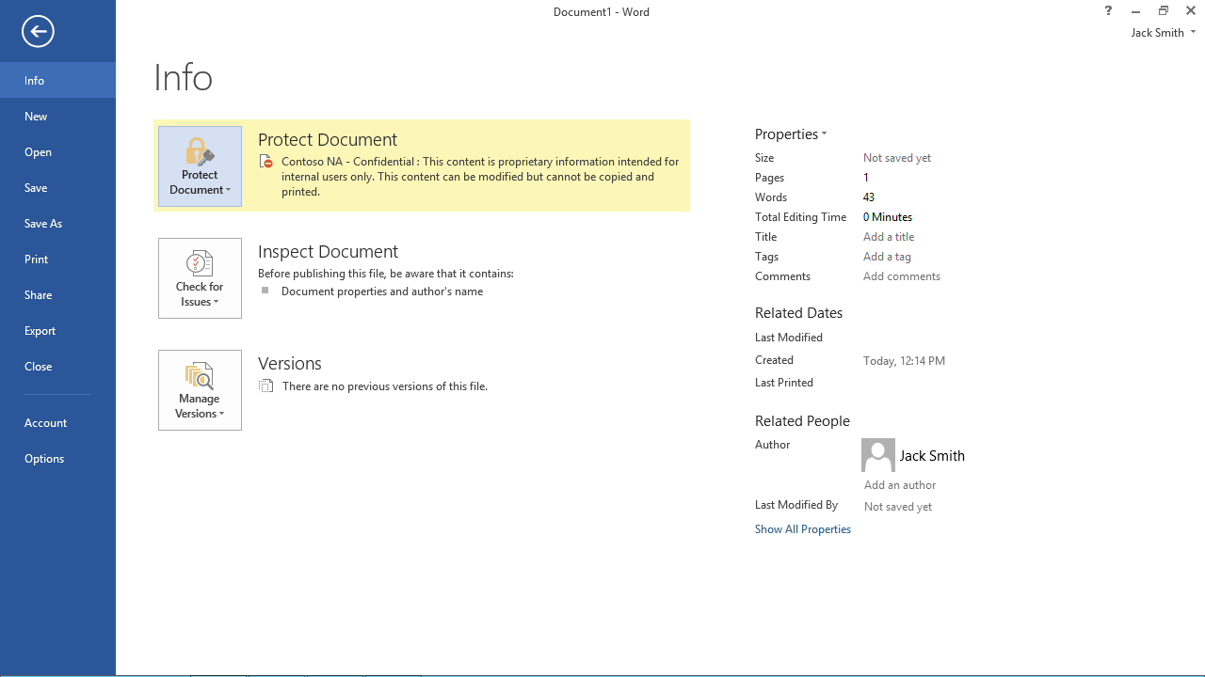

Slide 12
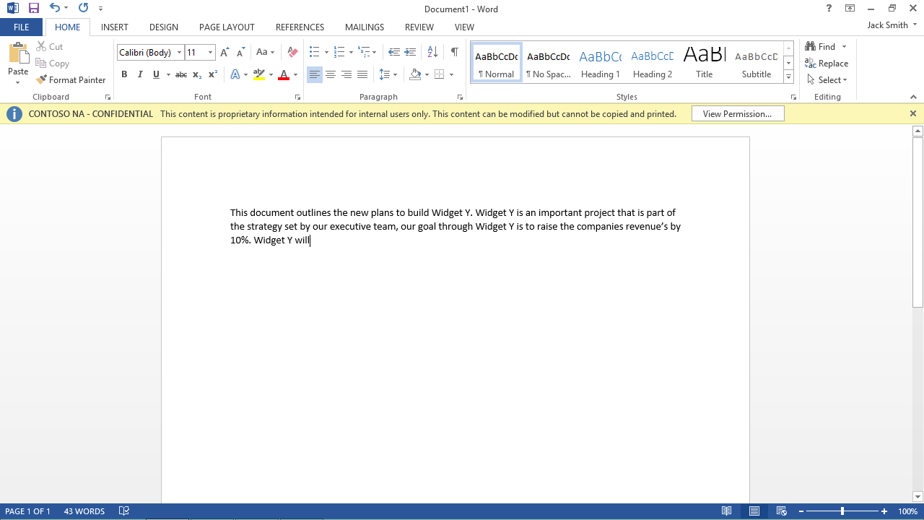

Slide 13
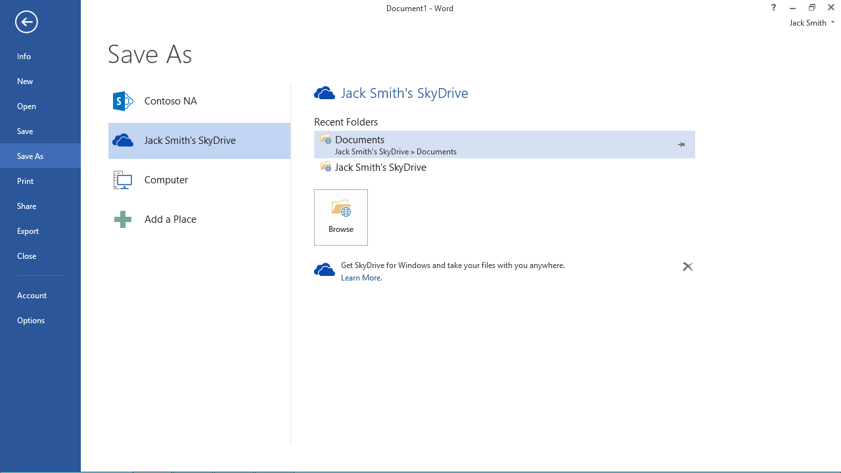

Slide 14
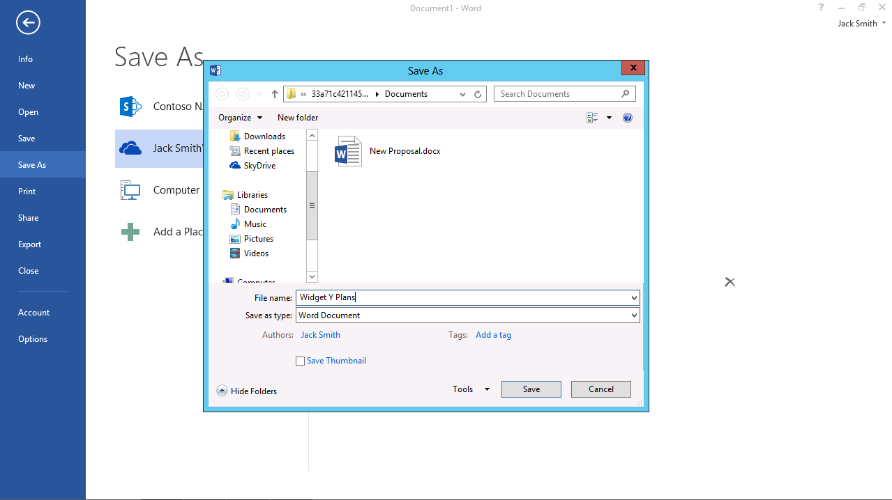

Slide 15
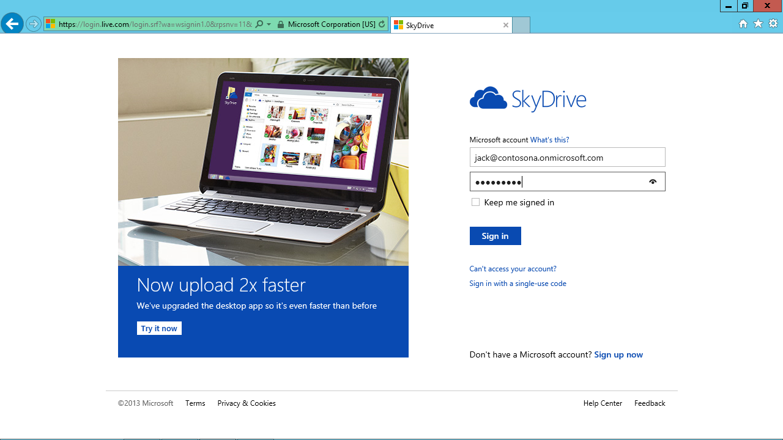

Slide 16
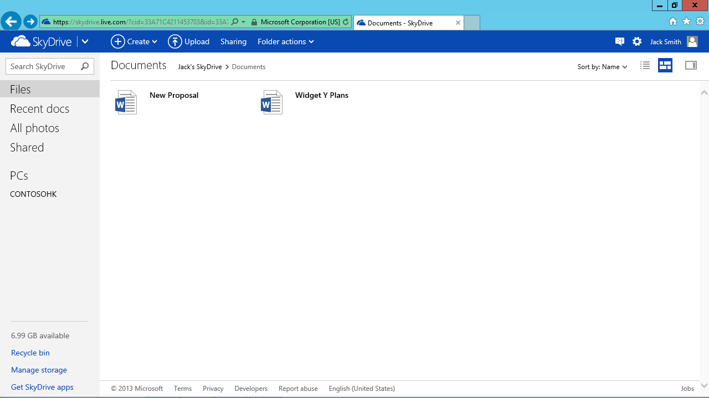

Slide 17
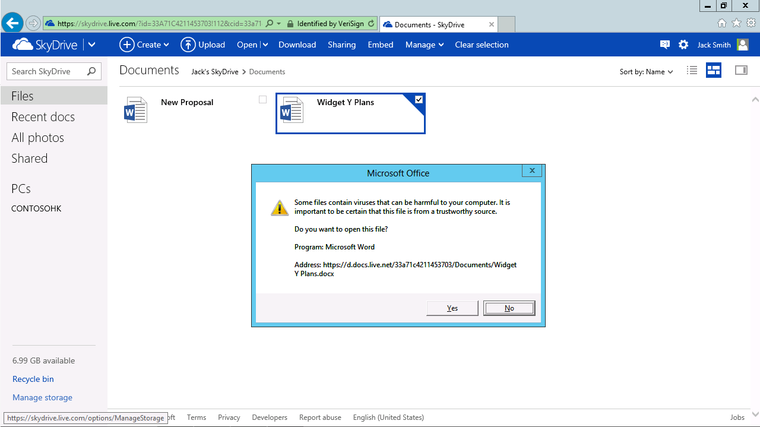

Slide 18
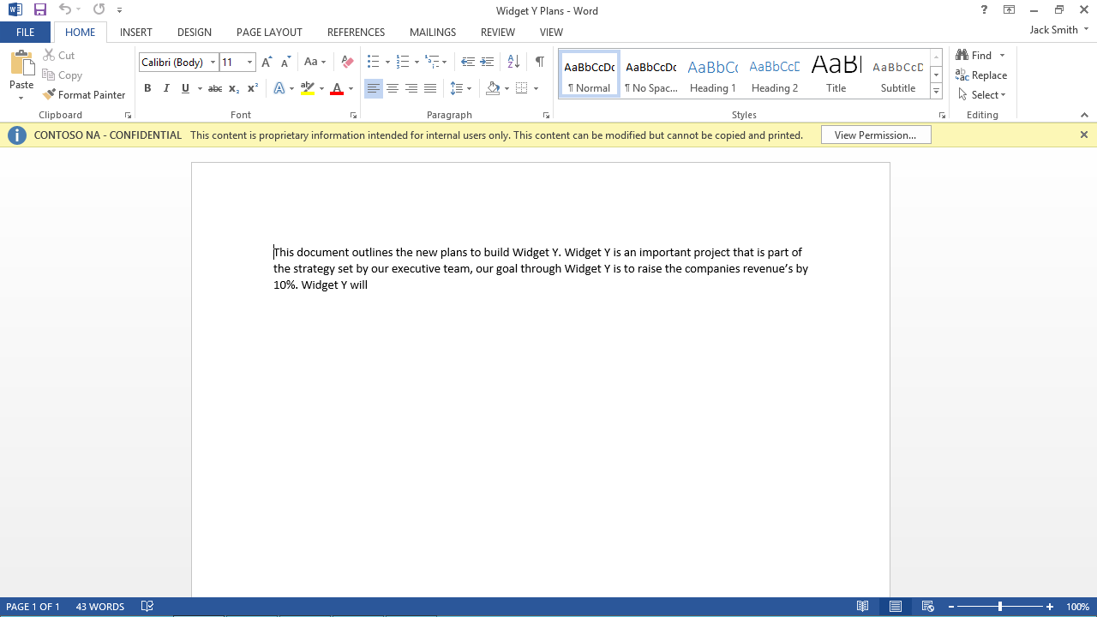

Slide 19
Demo: Exchange

Slide 20
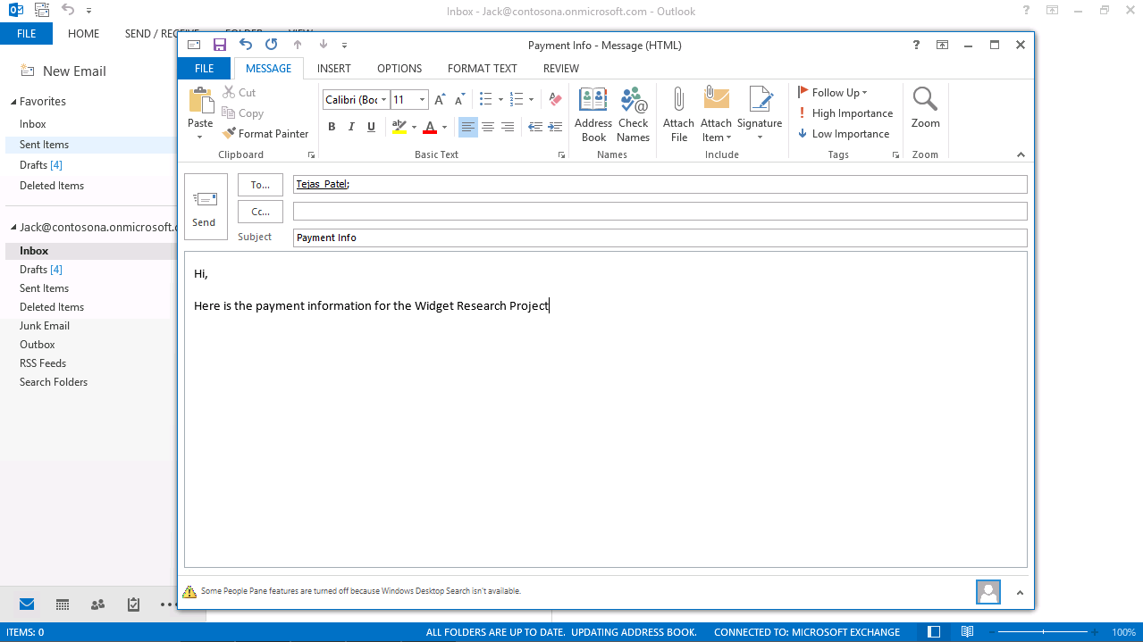

Slide 21
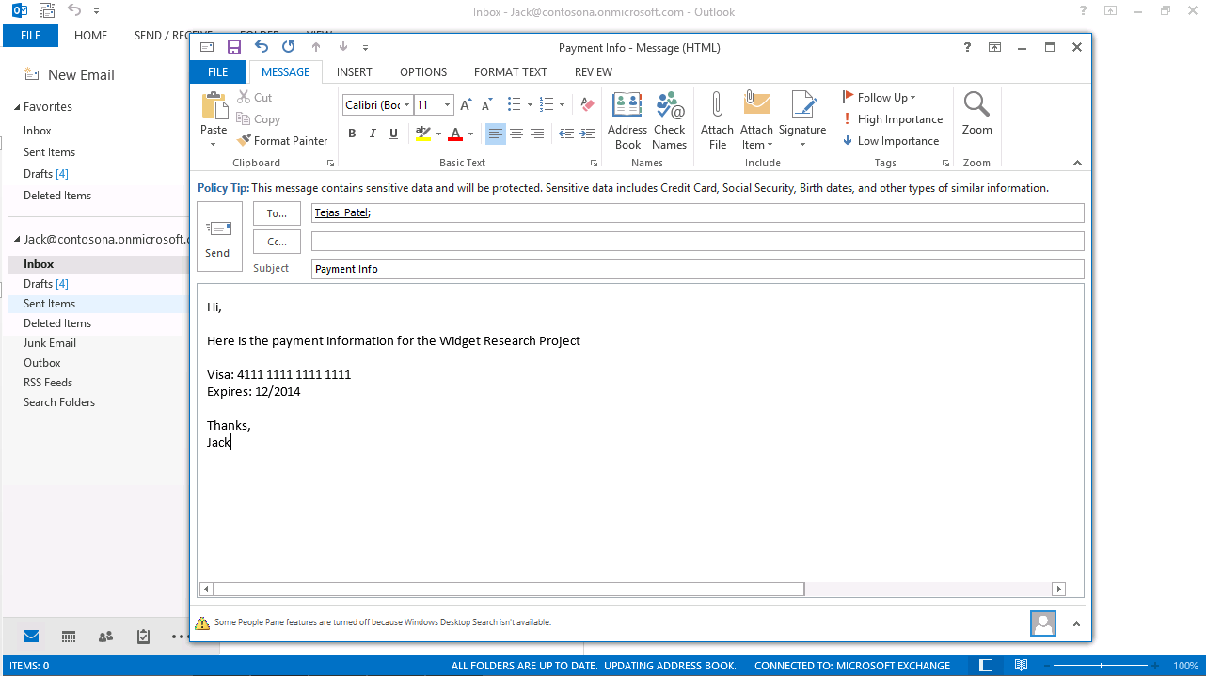

Slide 22
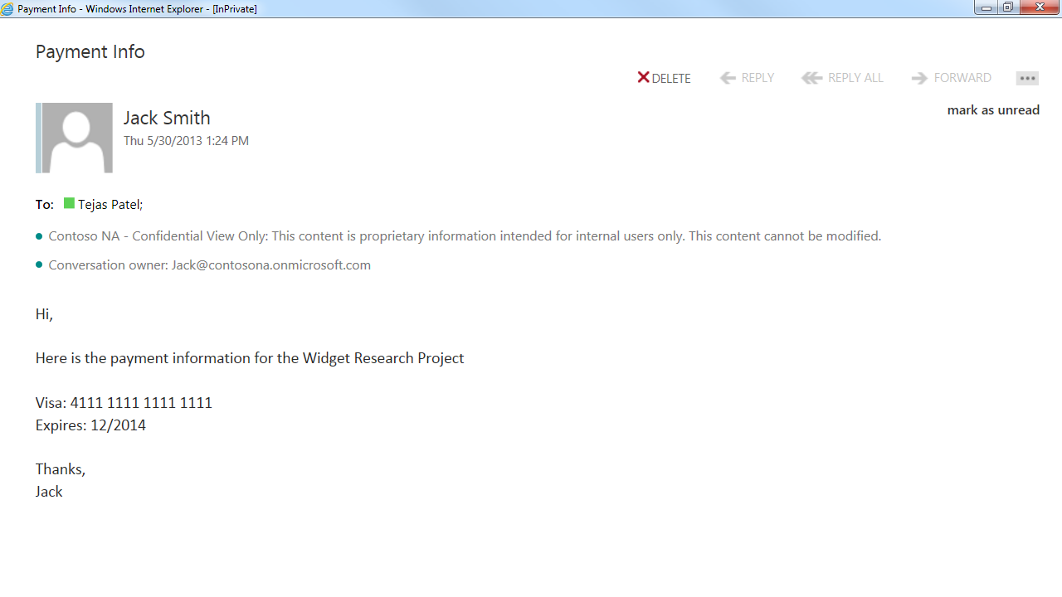

Slide 23
Demo: SharePoint

Slide 24
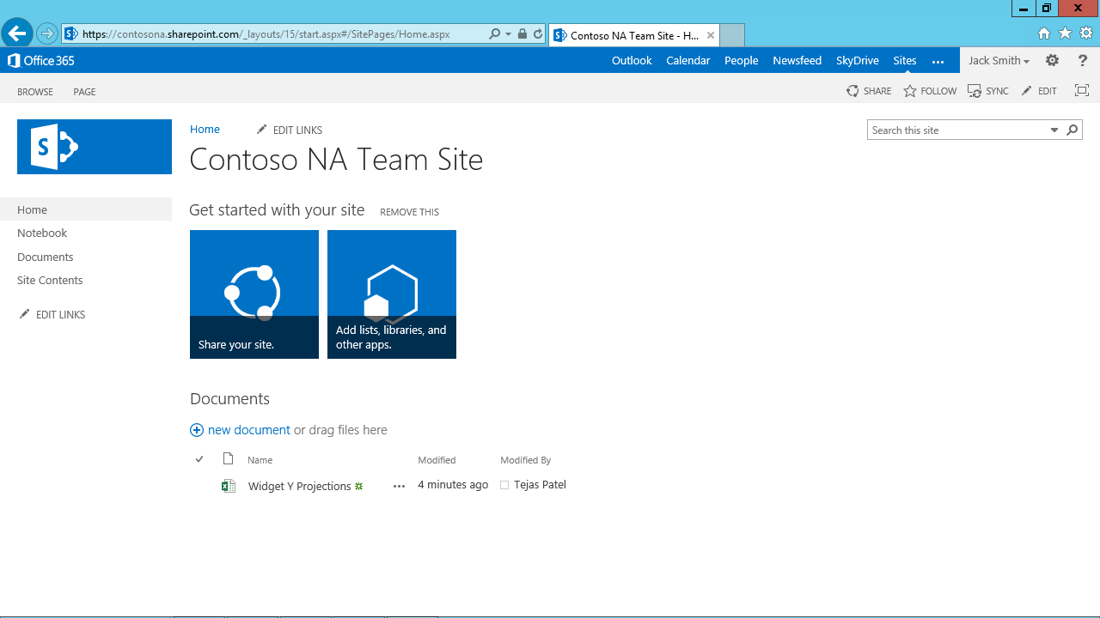
SharePoint Doc Libs

Slide 25
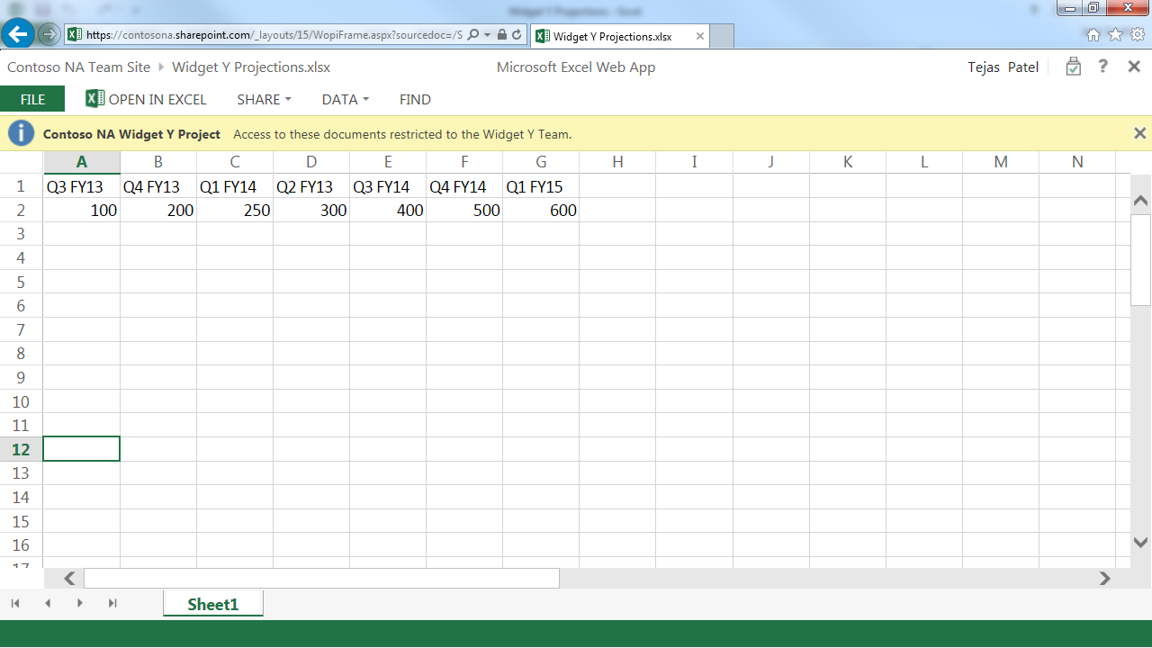
SharePoint Doc Libs

Slide 26
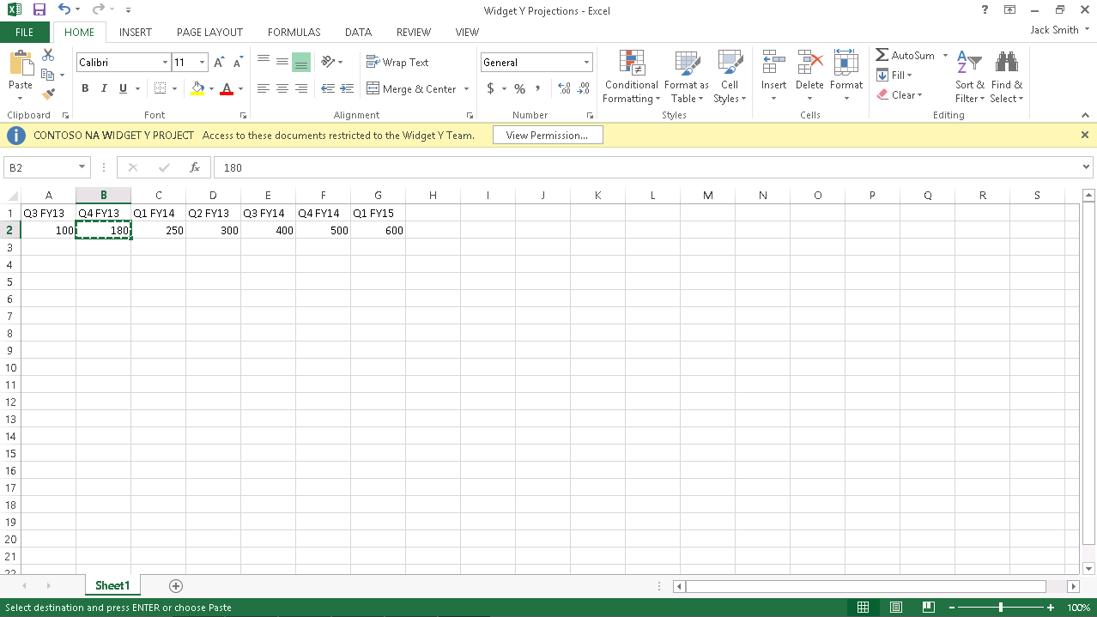

Slide 27
Azure AD RM
Office 365 service
  Offered in the same regions as Office 365
  Provides the same SLA requirements
  Follows the compliance requirements
  Follows the same trustworthiness requirements
Pending SKU updates
  Government Suite “G” sku
    More details available soon

Slide 28
Modern RMS Topologies
FY13 FY14
Cloud Ready
Office365 with
Azure AD RM
Cloud Accepting
Azure ADRM
Connector / O365 Services
Azure ADRM
Managed Connector
Azure ADRM
Connector + BYOK + Enlightened Apps
Cloud Hesitant
AD RMS
Azure ADRM
Limited connector/BYOK use

Slide 29


Cloud bound Organization (without RMS)
ExO
SPO
RMSO
AAD
DeviceEAS
Office
Apps
RMS
Apps
Device EAS
Office
EAS
RMS
Apps
AD
Ex
SP

Slide 30
Enable AADRM Overview
Enable AADRM
  Step performed from the Office 365 Portal
  Just a single step to Activate!
Enable SharePoint Online
  Enable IRM globally within your Organization
  Enable SharePoint IRM Document Library
Enable Exchange Online
  Enable IRM for your Organization
  Requires a few PowerShell Cmdlets
Enable Client for AADRM
  Deploy via configuration script for Office 2010 or install IP Viewer
  Install IP viewer for updated sharing capabilities

Slide 31
Enable AADRM

Slide 32
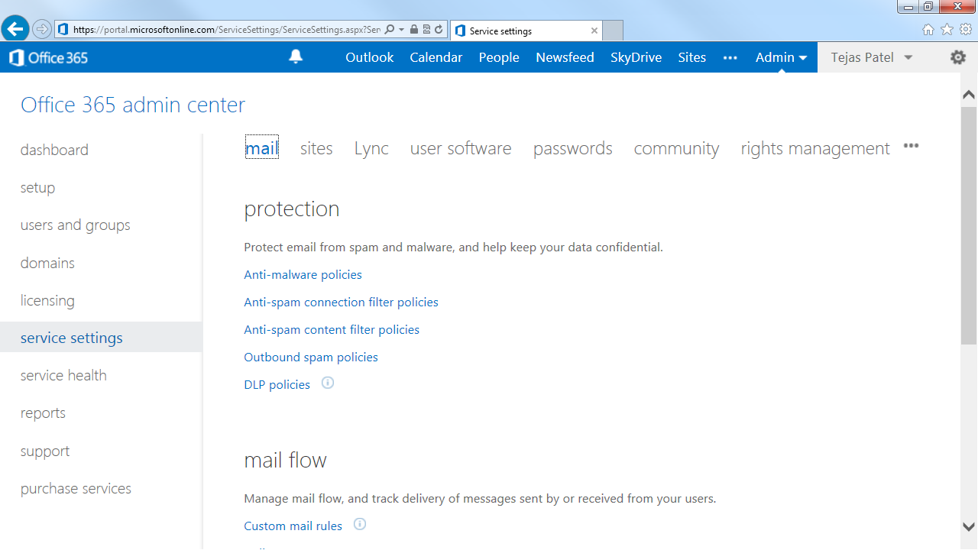

Slide 33
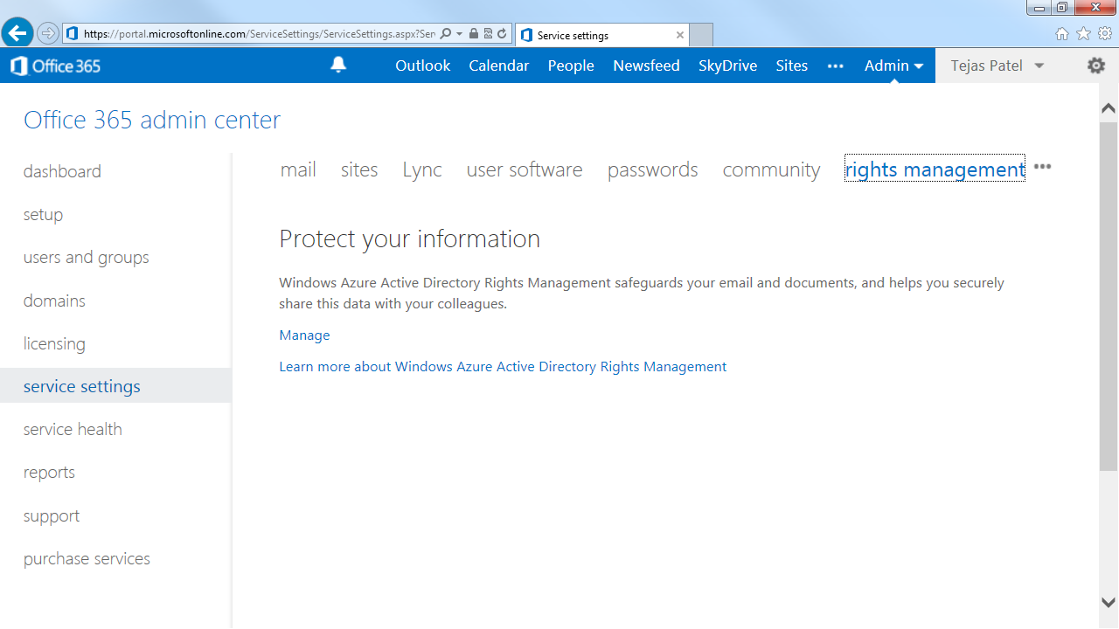

Slide 34
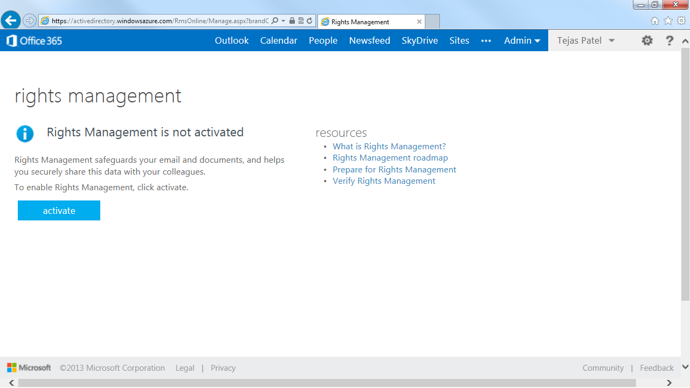

Slide 35
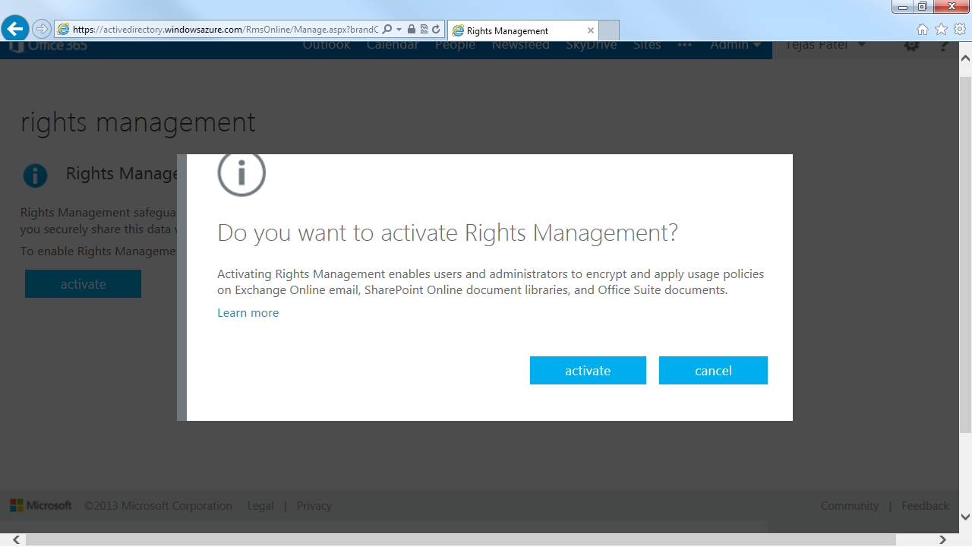

Slide 36
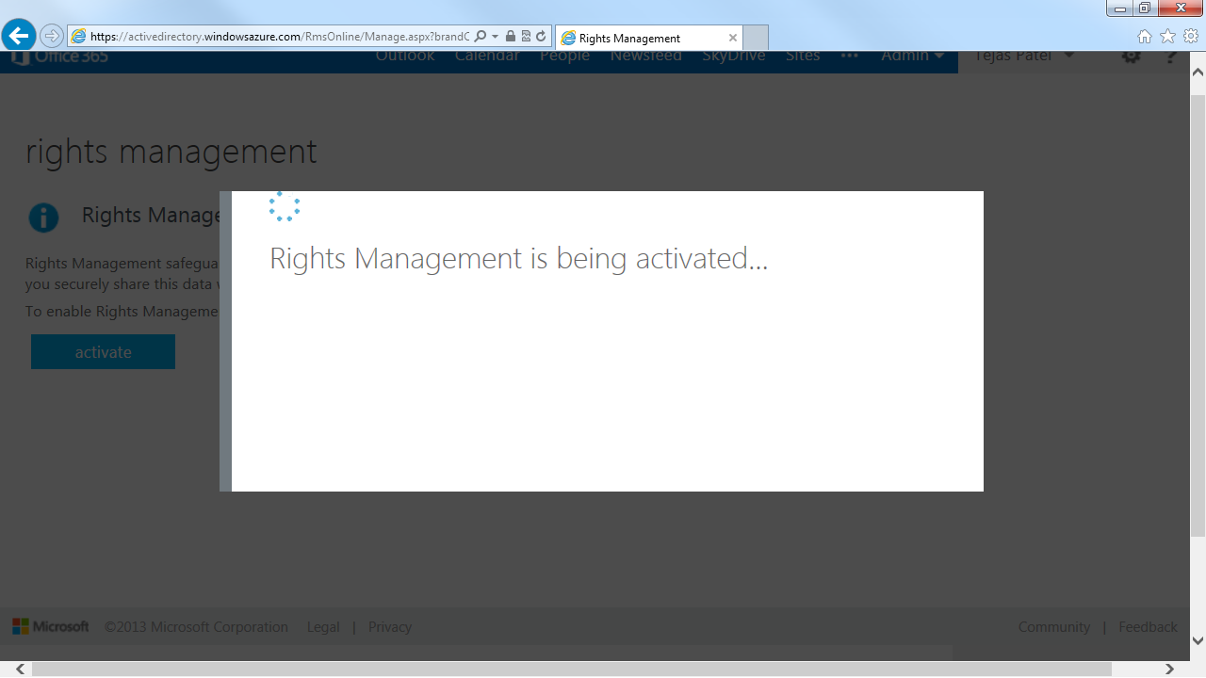

Slide 37
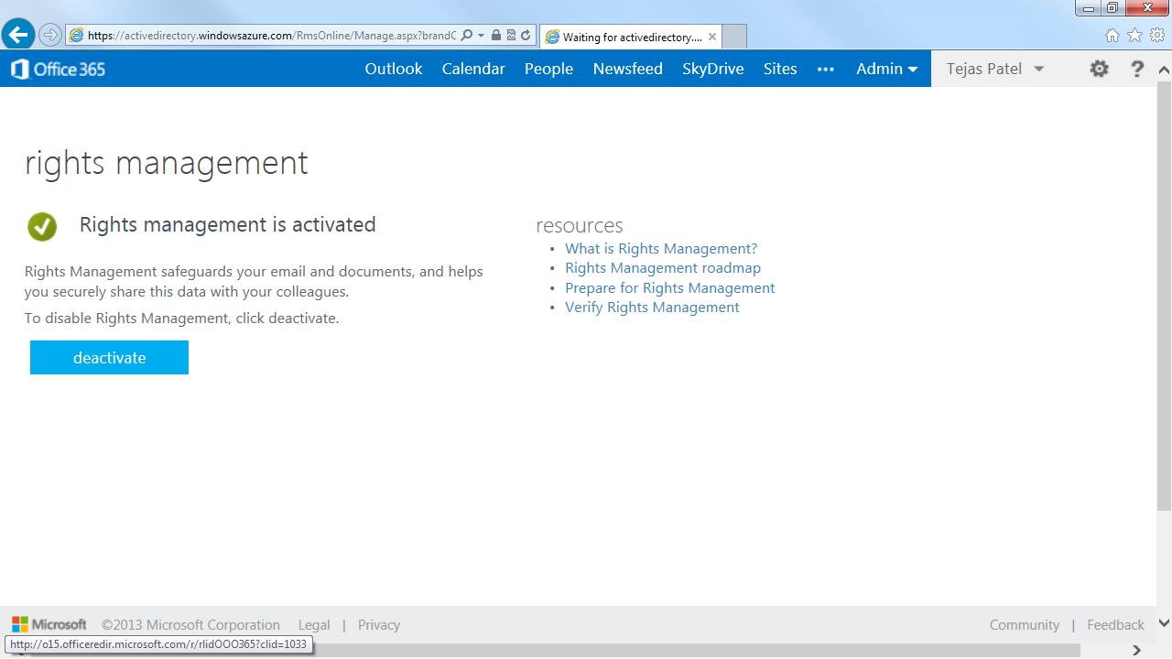

Slide 38
Enable SharePoint Online

Slide 39
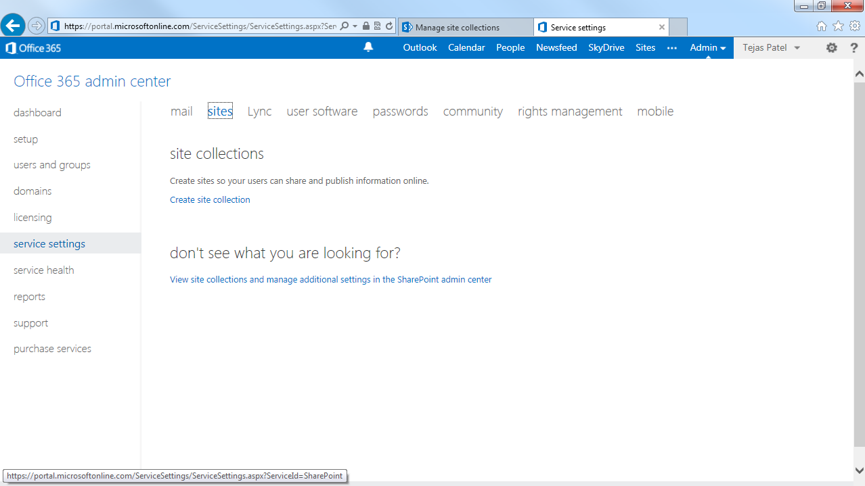

Slide 40
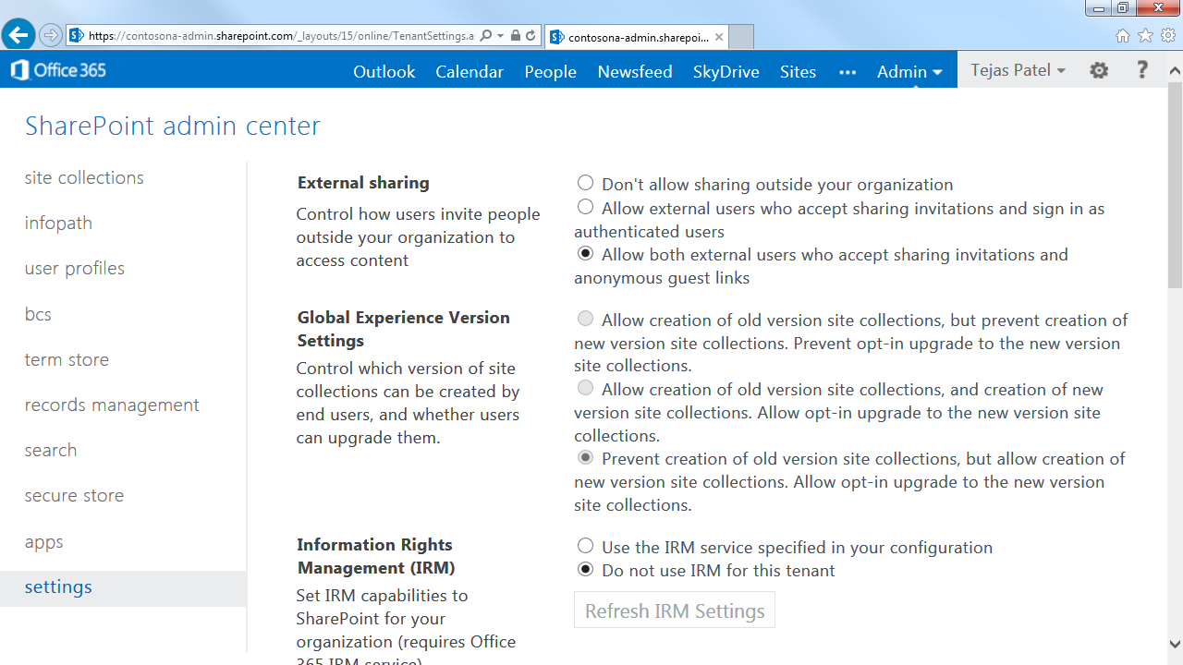

Slide 41
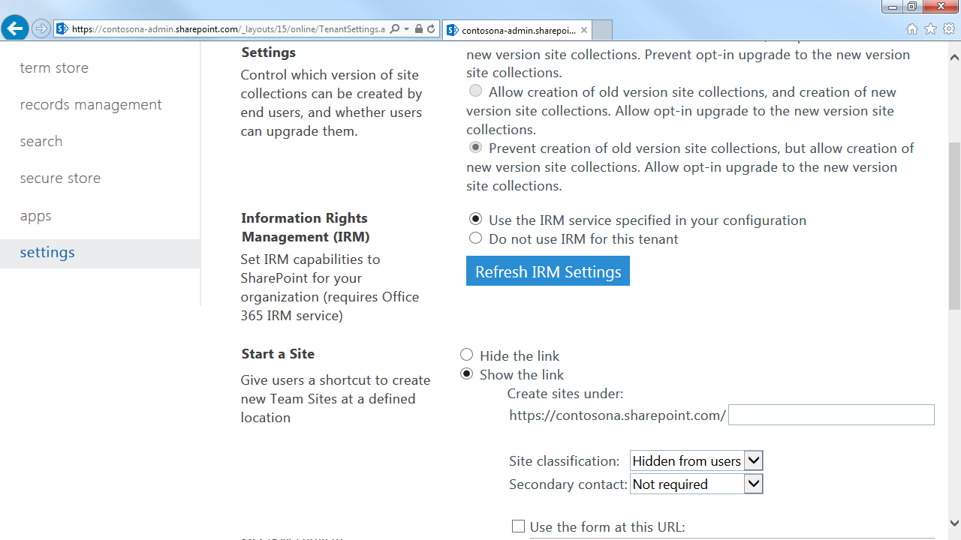

Slide 42
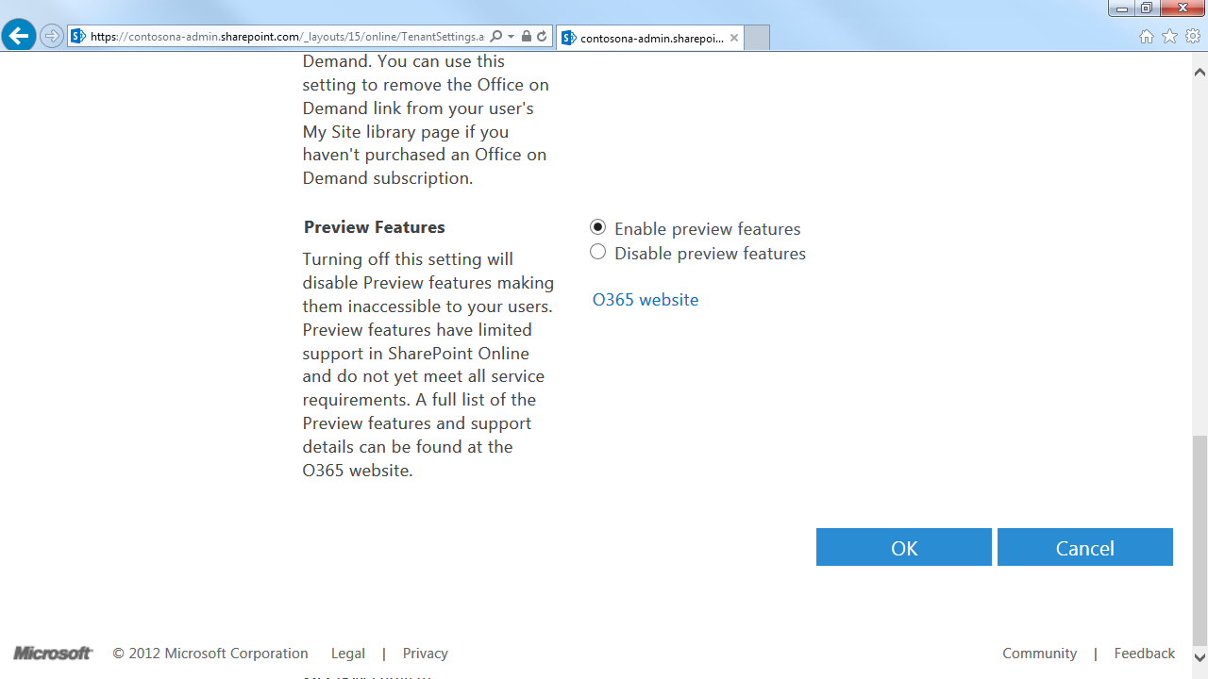

Slide 43
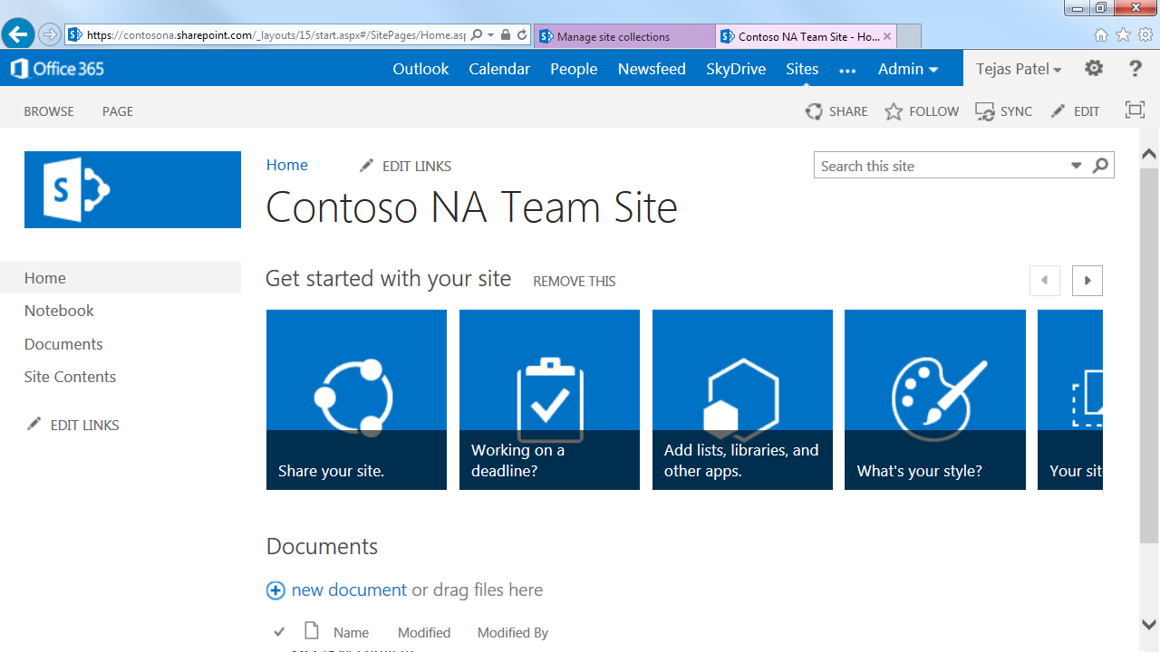

Slide 44
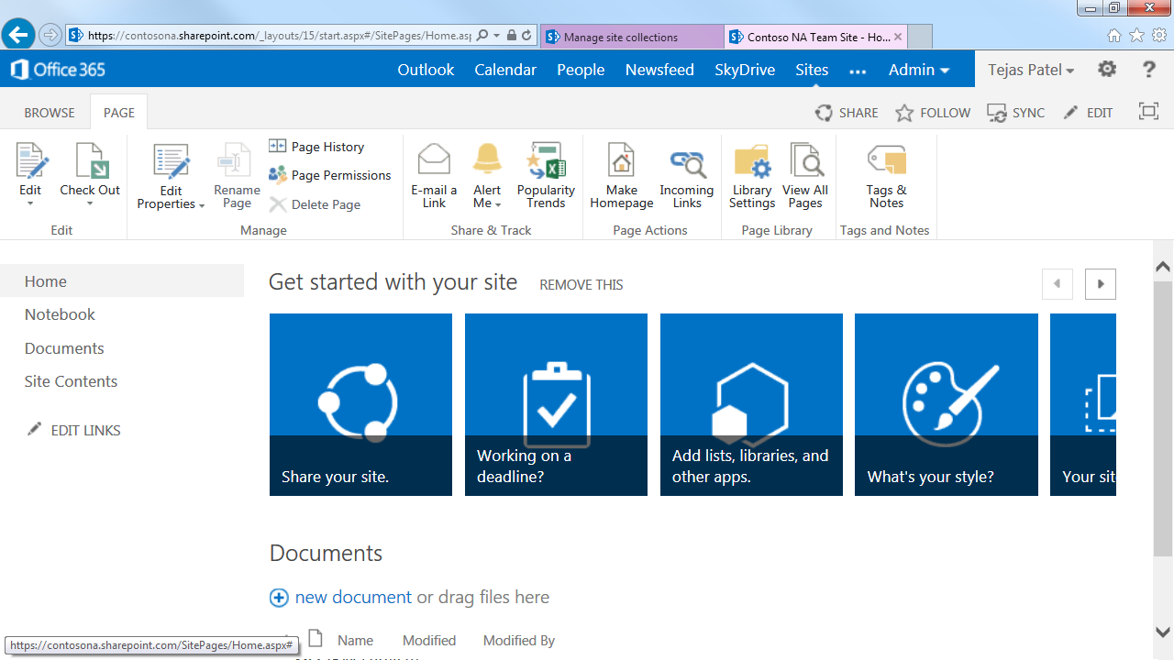

Slide 45
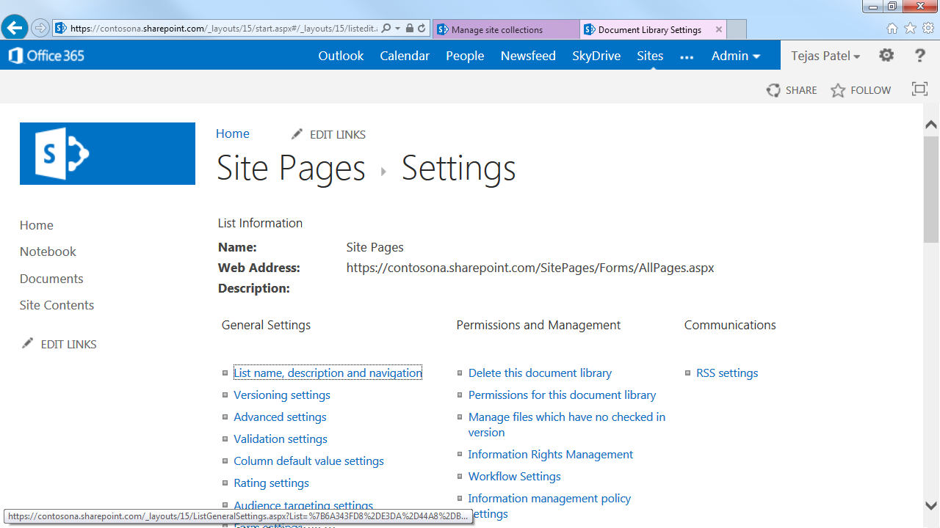

Slide 46
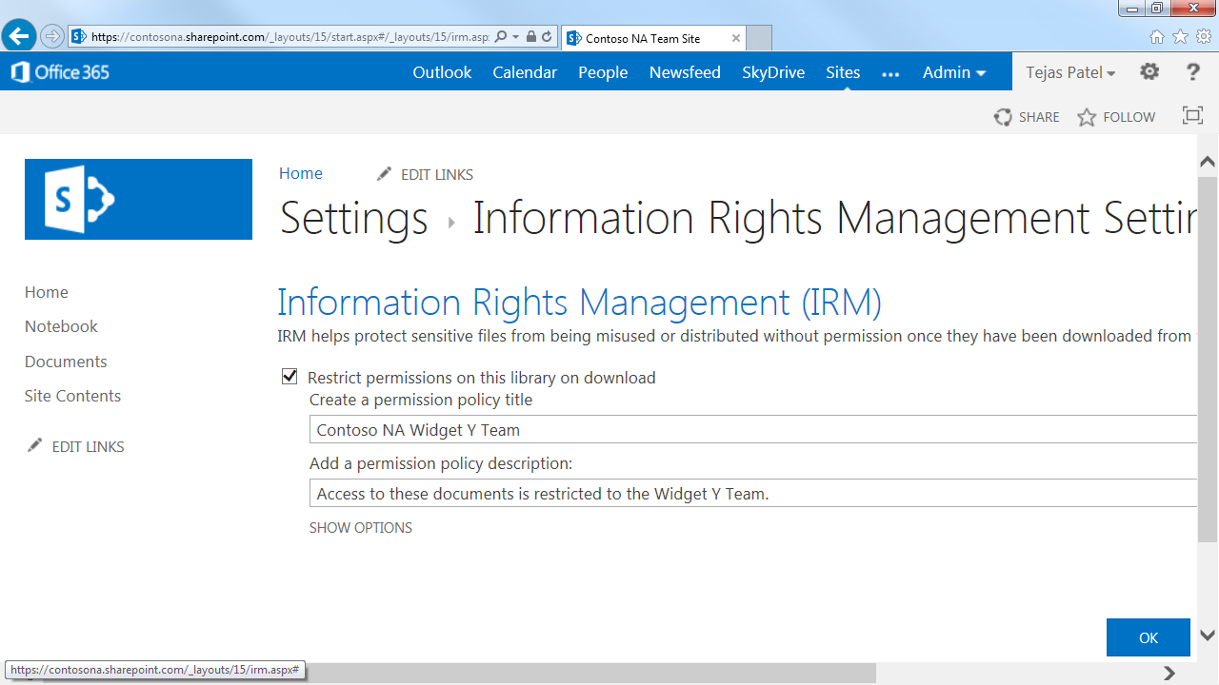

Slide 47
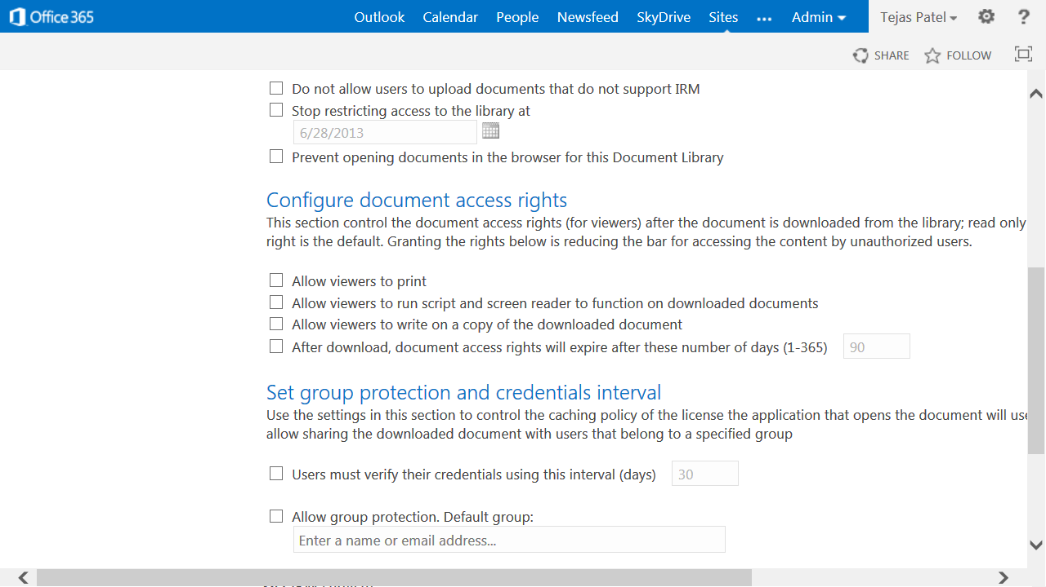

Slide 48
Enable Exchange Online

Slide 49
Connect to Exchange Online via PS
  $LiveCred = Get-Credential
  $Session = New-PSSession -ConfigurationName Microsoft.Exchange -ConnectionUri https://ps.outlook.com/powershell/ -Credential $LiveCred -Authentication Basic –AllowRedirection
  Import-PSSession $Session

Slide 50
Configure Exchange Online for AADRM
  Set-IRMConfiguration –RMSOnlineKeySharingLocation "https://sp-rms.na.aadrm.com/TenantManagement/ServicePartner.svc"
  Import-RMSTrustedPublishingDomain -RMSOnline -name "RMS Online"
  Set-IRMConfiguration -InternalLicensingEnabled $true

Slide 51
Client Deployment Considerations
Office 2013 and 2010
  Office 2013 natively integrated with AADRM
  Office 2010 will require IP Viewer, in the interim can be configured via tool and qfe’s.
IP Viewer
  Will configure Office 2010 to simplify client deployment*
  Viewer can be deployed by IT, or installed by users to configure system
  Viewer will support IT deployment mechanisms, SCCM, GPO etc..
  For more info on viewer see Dan’s talk

Slide 52
Try it yourself!
Available Now
  Get an Office 365 E3 trial account
  http://office.microsoft.com/en-us/redir/FX103030346.aspx
  Create user accounts, turn on RMS, Exchange and SharePoint features
  Create a second trial organization to test collaboration
  Learn more about Exchange offer
  http://office.microsoft.com/en-us/redir/FX103739072.aspx
  Use Foxit PDF reader with built-in RMS
  http://www.foxitsoftware.com/

Slide 53
Cloud-Accepting Enterprise (without RMS)
RMSO
AAD
Office
Apps
RMS
Apps
Device
(EAS)
Office
Apps
RMS
Apps
AD
Ex
SP
Conn.

Slide 54
AADRM Connector Details
Connects On-Premise Workloads to AADRM
  Simple Deployment, just two servers for redundancy
  Simple Administration, maintain a list of authorized applications
Supports On-Premise Server Applications
  SharePoint 2010/2013, Exchange 2010/2013
  QFE’s need to be applied on Exchange and SharePoint
Hybrid Workload Integration
  Can also be used in conjunction with Exchange Online and SharePoint Online
  Workloads and users can work with content created online or on-premise within your organization

Slide 55
AADRM Connector Details
Requires AD Synchronization to AAD
  Enables User lookups and Group Expansion for Authorization
  Use Dirsync or FIM
  ADFS or Password Synchronization enables seamless User Authentication
Requires WS ’08 R2 or WS ‘12
  SKU’s supported (All non-core versions supported)
  Minimum Hardware requirements (same as Base OS)

Slide 56
Enable AADRM Connector Overview:
Federate with AAD
    Enable DirSync (more information here)
    Enable ADFS or Password Synchronization
Enable AADRM
    Step performed in AADRM Mgmt. UI
    Same as Cloud Bound steps for AADRM
Install and Configure Connector
    Install Connector Software
    Configure Connector
    Configure Load Balancing and SSL (optional)

Slide 57
Enable AADRM Connector Overview:
Enable SharePoint and Exchange to use Connector
    Install latest Exchange updates (Exchange 2010 or Exchange 2013)
    Install MSDRM QFE (SharePoint 2010) or MSIPC QFE (SharePoint 2013)
    Configure redirection for Exchange and SharePoint
Enable IRM functionality in SharePoint and Exchange
    SharePoint 2010 or SharePoint 2013
    Exchange 2010 or Exchange 2013
    Enable ADFS (more information here)
Enable AADRM
    Step performed in Office 365 Portal
    Same as Cloud Bound steps
Install and Configure Connector
    Install Connector
    Configure Connector

Slide 58
Federate with AAD
OUC-B341 – Thursday 2:45- 4:00
Microsoft Office 365 Directory and Access Management with Windows Azure Active Directory

Slide 59
Enable AADRM

Slide 60
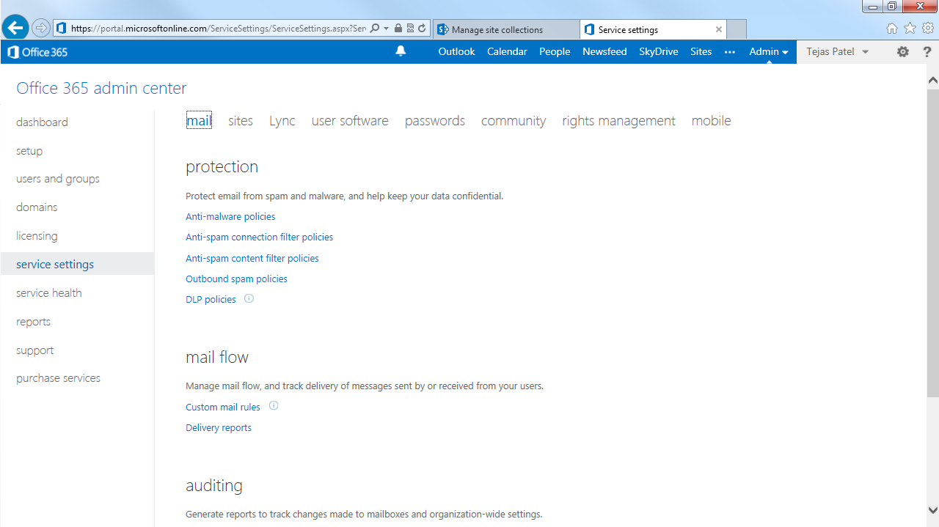

Slide 61
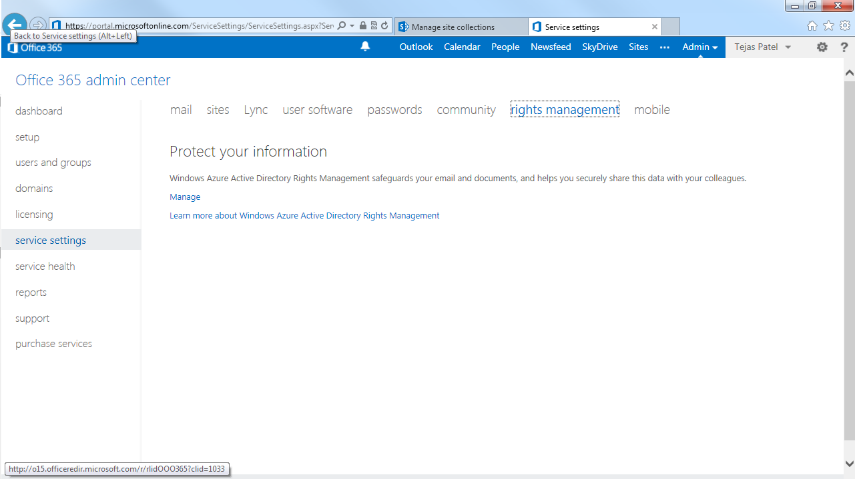

Slide 62
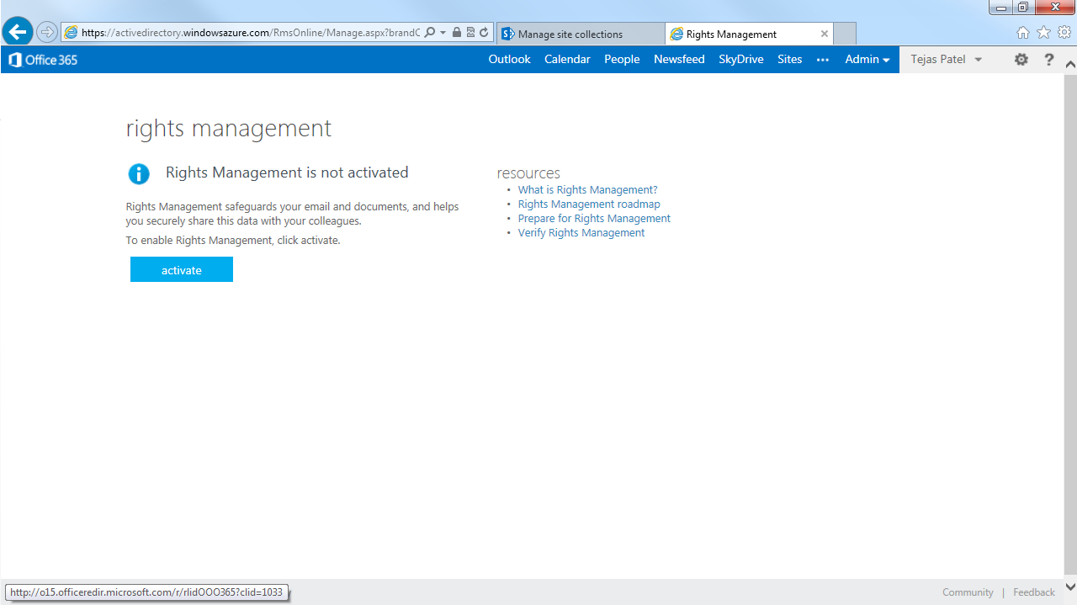

Slide 63
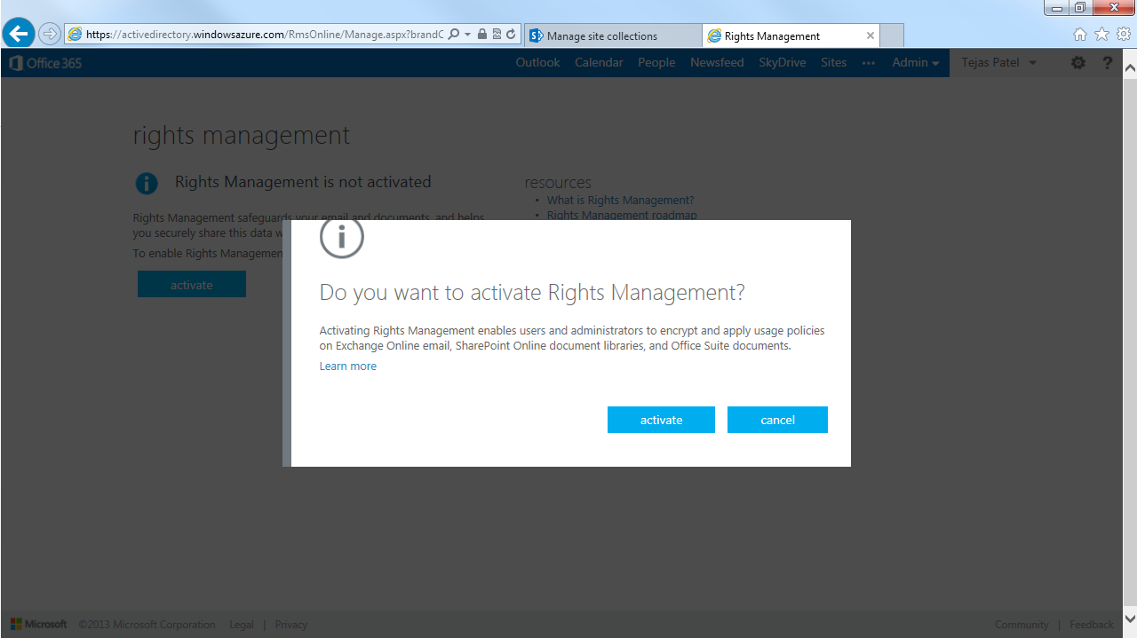

Slide 64
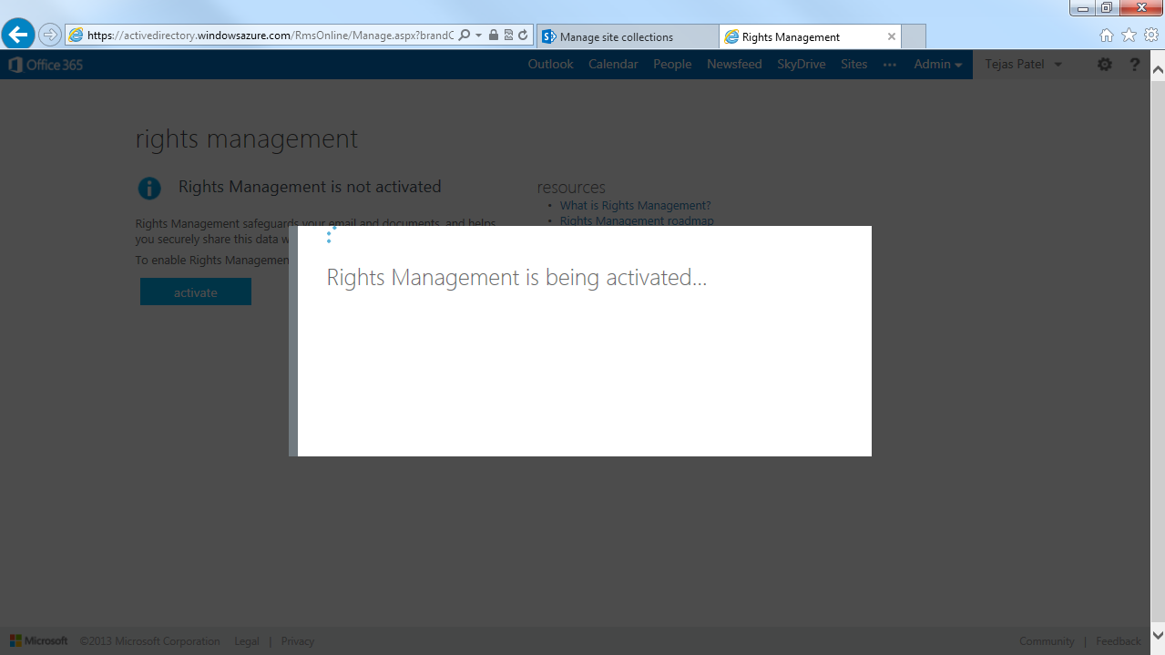

Slide 65
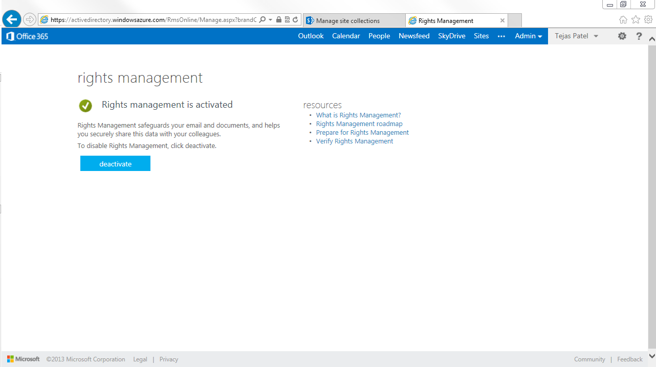

Slide 66
Install Connector

Slide 67
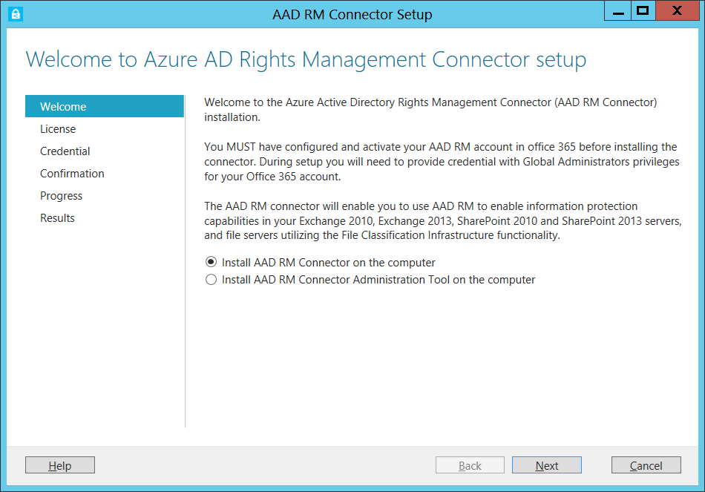

Slide 68
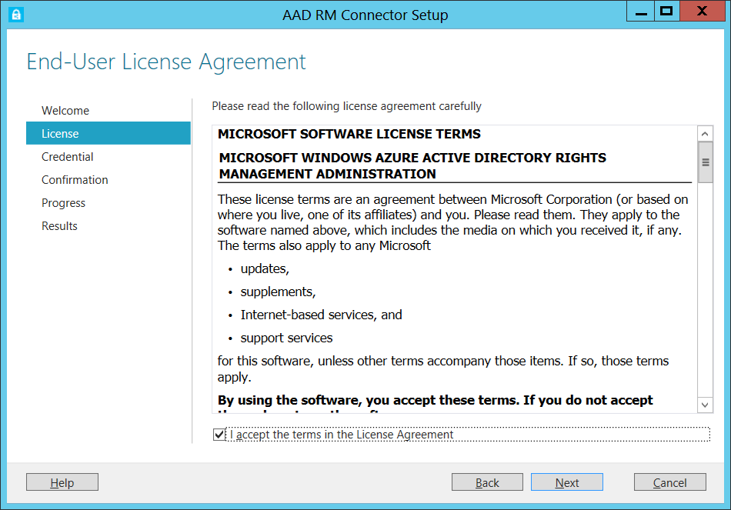

Slide 69
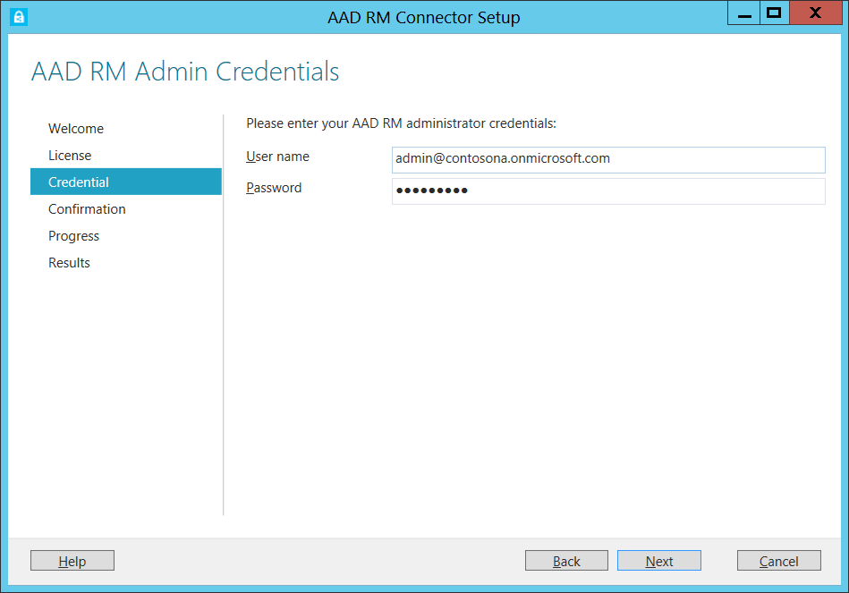

Slide 70
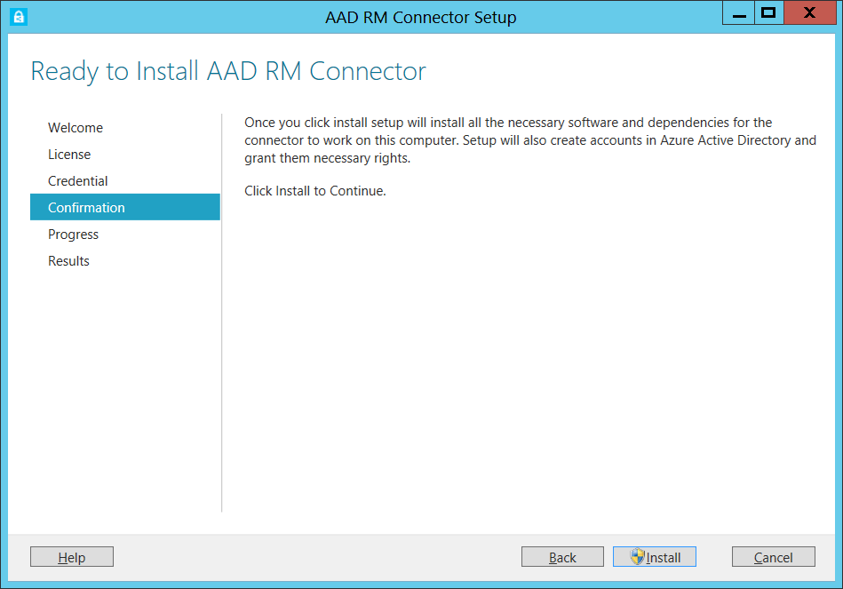

Slide 71
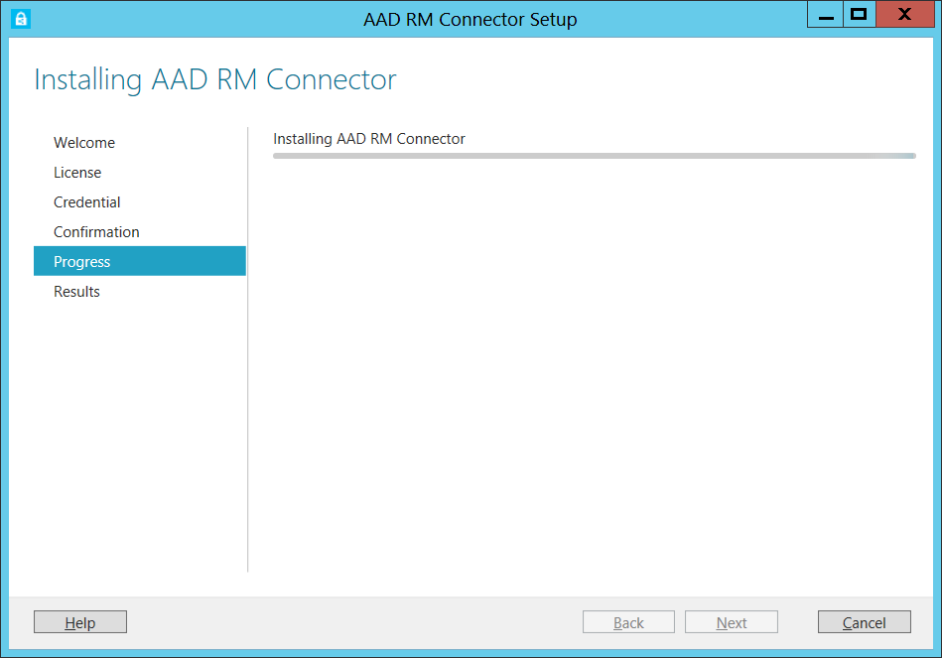

Slide 72
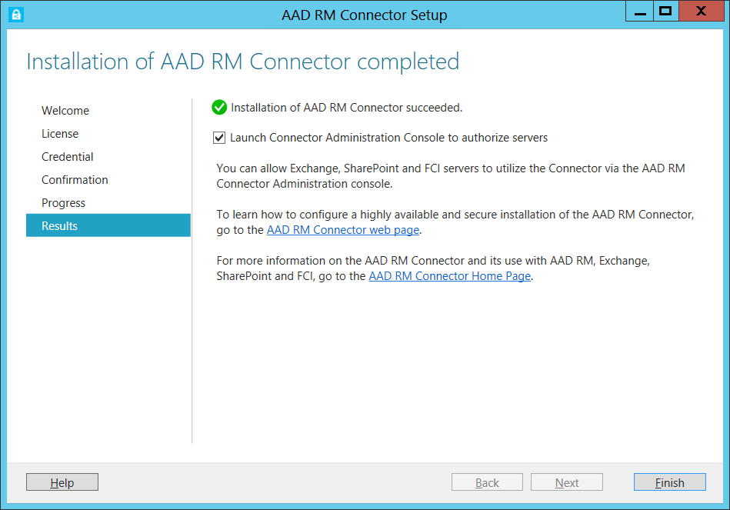

Slide 73
Configure Connector

Slide 74
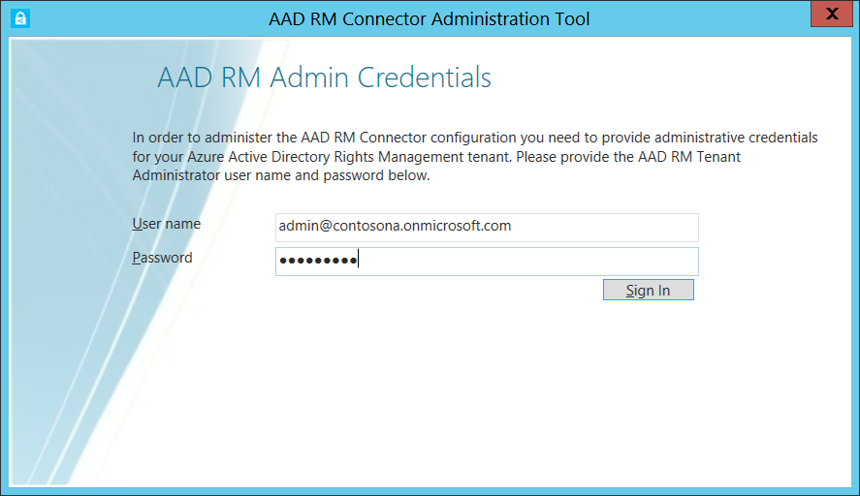

Slide 75
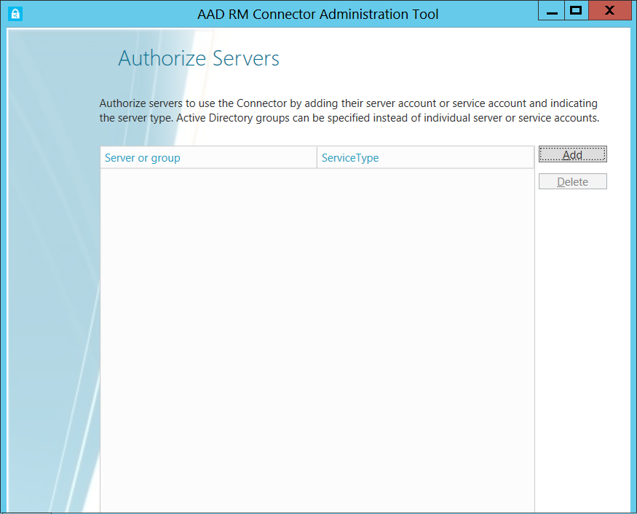

Slide 76
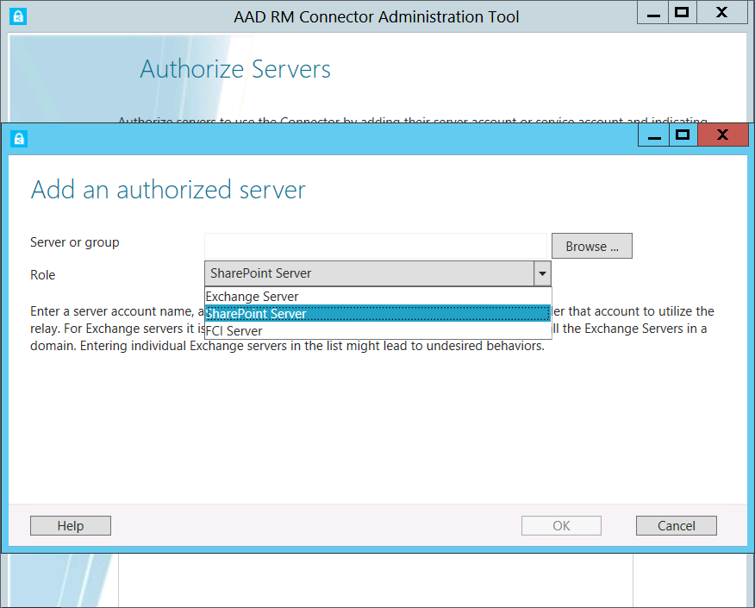

Slide 77
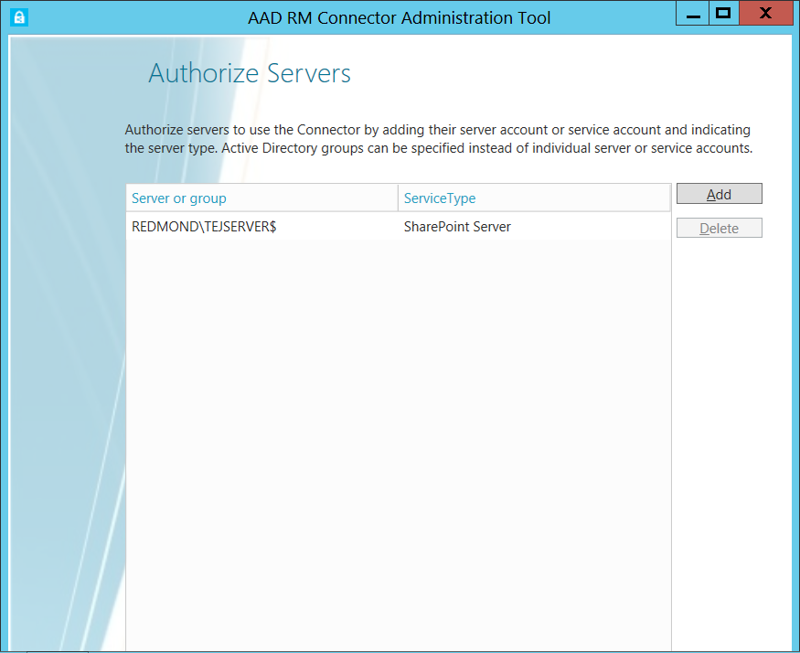

Slide 78
Prepare Exchange and SharePoint

Slide 79
Configure Exchange and SharePoint
Update required for Exchange 2010/2013
  Will be released as a Cumulative Update
Update required for SharePoint 2013
  Will be released as a QFE for the MSIPC client
Configuration required to use the Connector
  Configuration must be applied via the registry to route calls via the connector to AADRM
  Additional tool provided to generate registry files, GPO’s or local configuration.

Slide 80
Configure SharePoint and Exchange
  ServerConfigScript.ps1
  Please enter your connector URL “http://aadrmconnector.contosona.com”
  Do you want to generate registry[R] files or a GPO script creation script [G] G
  GPO Generation Script Created: CreateConnectorGPO.ps1
  Please run the GPO script and assign the GPO to the desired servers

Slide 81
Enable Exchange

Slide 82
Configure Exchange for AADRM
  Set-IRMConfiguration -InternalLicensingEnabled $true
  Get-IRMConfiguration

Slide 83
Enable SharePoint

Slide 84
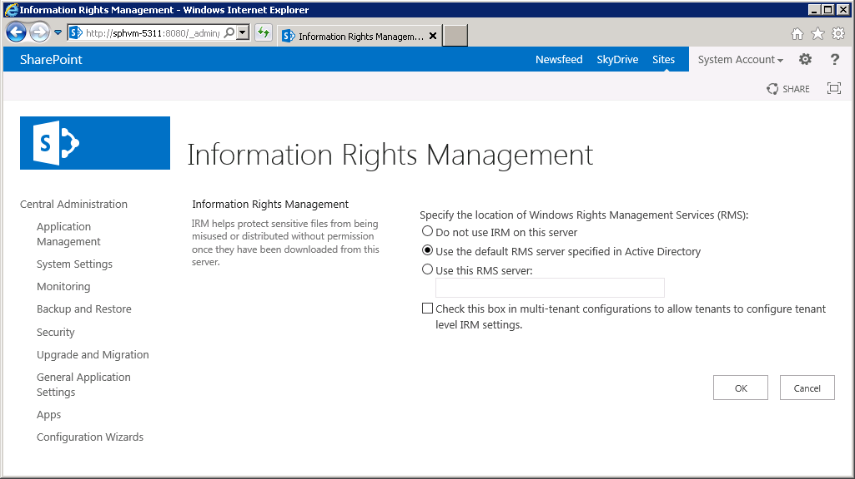

Slide 85
Cloud-Hesitant Enterprise (without RMS)
RMSO
KMS
(HSM)
AAD
Office
Apps
RMS
Apps
Device
(EAS)
Office Apps
Legacy
RMS
Apps
AD
Ex
SP
Conn.
HSM

Slide 86
Advanced Key Management
  Keep track of what is happening with your data
      Monitor for abuse, Report on usage, and Support forensic analysis
      Near Real time logging
  Provides capability to Bring Your Own Key (BYOK)
    Bring your key on your terms
    Supports Hybrid ADRMS/AADRM
Works on-premises and online.
  Enables IRM support for Exchange, SharePoint and FCI servers located on-premises and online
  Integrates with Directory Synchronization for Group Membership
  Integrates with ADFS to enable SSO

Slide 87
Logging Details
Provides you request logs in near real time
      Allows you to Monitor for abuse, Report on usage, and Support forensic analysis
      All RMS transactions such as client bootstrapping, license acquisition, etc…
      Logs hosted on Azure Storage, you are billed for your own usage.
To consume logs
      Use AADRM log download tool provided by us.
      Write your own tool with the Azure Storage SDK
      Purchase an ISV Application for rich monitoring, reporting and forensics

Slide 88
Enable Logging

Slide 89
Enabling Logging Steps
Create Azure Storage Account
    Enroll for Azure (if you haven’t already)
    Create Storage Account
    Copy the storage account name and access key
Configure AADRM
    Powershell Cmdlets
    Access Logs via Tool

Slide 90
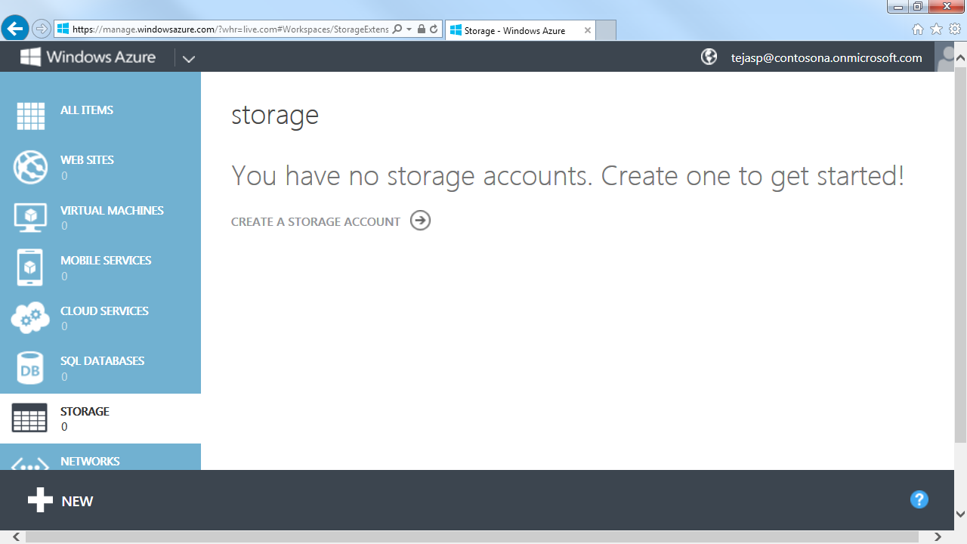

Slide 91
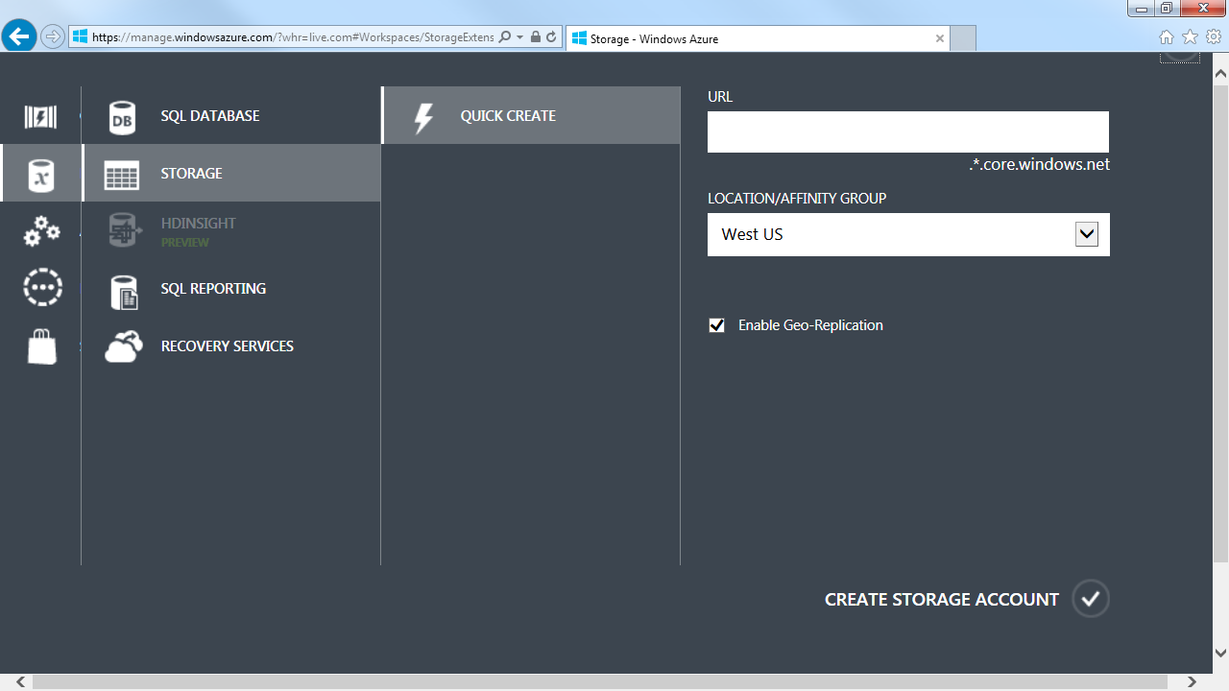

Slide 92


Slide 93


Slide 94


Slide 95


Slide 96

Configure and Access Logs
  PS C:\> Set-AadrmUsageLogConfig -StorageAccount contosonalogstore -AccessKey WnTimuvtnjbpiSHYjHJqSysBTPmKIy1UgV+br6nLx1pehLgd/mq6ppVyow+jJ71s/yUSz7LtNvSfjo980X8Vng==
  PS C:\> Get-AadrmUsageLog –Path “C:\temp” –FromCounter 00010000 -ToCounter 00020000

Slide 97
BYOK Details
Thales HSMs host your keys in locked cages
  Follow your procedures to generate a key
  Requires Thales device to transfer keys
    If key is in a different HSM, must work with the HSM vendor to export keys and Thales to get it into a Thales HSM.
  We can’t leak them given they are in an HSM with ‘no export’
  Can monitor key usage in near real time using Logging (covered earlier)
Initial key ceremony is air-gapped and with quorum
  Your key is cached by our HSMs so we need to securely trans-crypt them to our HSM’s security world.
  You fly to Redmond, trans-crypt the key, and leave with it (we keep nothing).
Works on-premises and online.
  Enables IRM support for Exchange, SharePoint and FCI servers located on-premises and online
  Integrates with Directory Synchronization for Group Membership
  Integrates with ADFS to enable SSO

Slide 98
BYOK

Slide 99
BYOK Overview
Create Keys
    Step performed by your organization
    Follow your own procedure or create in Thales device
    Back-Up Keys!
Transfer Keys
    Fly out to Redmond for key transfer ceremony*
    Transfer keys from your Thales security world to our security world
Follow Additional Steps to enable RM
    Enable AADRM
    Enable Logging
    Deploy Connector
    Configure Server Applications
    Enable IRM functionality within Applications
Works on-premises and online.
  Enables IRM support for Exchange, SharePoint and FCI servers located on-premises and online
  Integrates with Directory Synchronization for Group Membership
  Integrates with ADFS to enable SSO

Slide 100
Create Keys
  C:\> new-world.exe --initialize --km-type=rijndael --module=1 --acs-quorum=2/4
  (Creates a new Thales security world and sets the quorum, commands supported on any Thales dev)
  C:\> generatekey --generate simple type=RSA size=2048 protect=module ident=contosokey plainname=contosokey nvram=no pubexp=
  (This creates a new key pair, specifies key length, which must be RSA 2048)
  C:\> cngimport –import -M --key=contosokey --appname=simple contosokey
  (This allow for CNG tools to work with this key)

Slide 101
Transfer Keys
  C:\> mk-reprogram.exe --owner c:\Temp\Destination add c:\Temp\Source
    (Loads our security world, and your security world into the same HSM and requests Admin cards from both security worlds)
  C:\> key-xfer-im.exe c:\Temp\Source c:\Temp\Destination --module
  c:\Temp\Source\key_caping_machine--675e91181ab66e8ff26a48f11b41a9b853a5098b
    (Transcripts your key from your security world into ours)
  In your presence we will factory reset the HSM and wipe the machine.
  Our operators now upload key to the AADRM Service HSM’s

Slide 102
Hybrid RMS

Slide 103
Hybrid ADRMS/AADRM
ExO
SPO
RMSO
KMS
AAD
Device EAS
Office
RMS
Apps
Device EAS
Legacy
Office
RMS
Apps
AD
Ex
SP
RMS
HSM

Slide 104
Hybrid Enterprise with ADRMS/AADRM
  Enables updated device support
  Supports Windows RT, iOS, Android
  Content can flow through your enterprise
  Workloads, Discovery & BI tools can work with content created online or on-premise
  Simplifies collaboration via AAD
  Identity Federation via AAD
  Support for consumer Identity providers

Slide 105
Enable ADRMS/AADRM Overview:
(Just a combination of the other steps!)
Federate with AAD
    Enable Directory Synchronization
    Enable ADFS or Password Sync
BYOK from AD RMS
    BYOK into AADRM
    Import into Exchange Online
Enable AADRM
    Step performed in Office 365 Portal
    Same as Cloud Bound steps

Slide 106
Enable ADRMS/AADRM Overview:
Enable SharePoint Online
Enable IRM globally within your Organization
  Enable SharePoint IRM Document Library
Enable Exchange Online
        Enable IRM for your Organization
        Requires a few PowerShell Cmdlets
Enable Client for AADRM
        Deploy Configuration script for Office 2010 or install IP Viewer
        Install IP viewer for updated sharing capabilities

Slide 107
Buying RMS
On-Premise
  Usual channels to purchase Windows Server + CALs (or ECALs)
  Generic protection support will be offered for free as a download for CAL users.
  Devices support limited to the capabilities offered by Exchange Active Sync.
Office 365 offer
  Purchase Office 365 E3/E4 plan and Azure AD RM is available
Azure AD RM offer to ‘extend’ all use cases
  Purchase ‘Azure AD RM’ premium SKU via Office 365 portal
  This premium SKU will include Hybrid, BYOK™ and other value-add capabilities.
    $2/user/month for all uses. E.g.: Third party apps use this SKU too without surcharge.
  Ad-hoc sign up will be free via an invisible, automatically managed SKU

Slide 108
This can be a bit overwhelming…
It’s really simpler than it sounds but should you desire help, there are many folks in the know:
Your Microsoft Sales Partner
  You know where to find them + they know where to find you. We support them directly.
Microsoft Consulting Services (MCS)
  Your sales partner can help make the connection. We support them directly.
Synergy Advisors
  Cristian and his team specialize in RMS deployments these days.
  Several of their folks are staffing our booth so please drop by.
When all else fails, AskIPTeam@microsoft.com

Slide 109
In Closing
The RMS offering has grown. A lot!
  Fewer challenges given device reach, app reach and easier-than-ever to use
The focus is on complete, long-lived solutions
  Anchor on the end-game of collaboration and solve data leakage the same way
Options for each stage of your architecture
You are in control of your keys
Price is right
The time for revisiting information protection is now

Slide 110

Related content
Part #1 of this talk WCA-B322 by Dan Plastina
Channel9.msdn.com/Series/Information-Protection
See Product Demo at Microsoft Booth
blogs.technet.com/rms
Questions related to info protection:
AskIPTeam@microsoft.com

Slide 111

Resources
Learning
  Sessions on Demand
  Microsoft Certification & Training Resources
http://channel9.msdn.com/Events/TechEd
www.microsoft.com/learning
TechNet
msdn
  Resources for IT Professionals
  Resources for Developers
http://microsoft.com/technet
http://microsoft.com/msdn

Slide 112



Evaluate this session
Required Slide
*delete this box when your slide is finalized
Your MS Tag will be inserted here during the final scrub.
Scan this QR code to
evaluate this session.

Slide 113

© 2013 Microsoft Corporation. All rights reserved. Microsoft, Windows and other product names are or may be registered trademarks and/or trademarks in the U.S. and/or other countries.
The information herein is for informational purposes only and represents the current view of Microsoft Corporation as of the date of this presentation. Because Microsoft must respond to changing market conditions, it should not be interpreted to be a commitment on the part of Microsoft, and Microsoft cannot guarantee the accuracy of any information provided after the date of this presentation. MICROSOFT MAKES NO WARRANTIES, EXPRESS, IMPLIED OR STATUTORY, AS TO THE INFORMATION IN THIS PRESENTATION.

