Slide 2
Best Practices for Building Your Strategy for a Private Cloud
ATC-B204
Eduardo Kassner
Principal, Enterprise Strategy
Microsoft Corporation

Slide 3
Lets agree first
What is your goal
Steps to build a private cloud
How Microsoft can help
Cloud Attributes vs Standard IT Functions

Slide 4
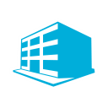

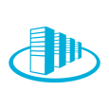



Lets agree that an Optimized Data Center is not yet a Cloud
Optimized
Data Center
Cloud Attributes
Pooled resources
Consolidated
Automation
Managed
+
=
Self-service
Virtualized
Cloud
Elasticity
Cost Efficient
Usage-based

Slide 5
Where is your offering today?
User Login / Full functionality
Access
Access
Front End
Application
Stacks
Front End
Application
Application
Stack
Application
Service Unit 4
End to end service offering
Full stack automation and resiliency
Full service ownership
Data
Data Base
Data
Focus is Business Agility
OS Ready
Service Unit 3
Application environment replication
Application stack automation
Certified or Compliant environment added value
OS
Just HW
OS
OS
OS
Focus is IT Efficency
Configuration
Units
Virtualization
Virtualization
Virtualization
Virtualization
Virtualization
HW
HW
HW
HW
HW
Service Unit 2
Application Independence
Environment Automation
Operating environment automation
Storage
Storage
Storage
Storage
Storage
Network
Network
Network
Network
Network
Service Unit 1
Collocation offerings
Stack independence
Infrastructure automation
Facilities
Facilities
Facilities
Facilities
Facilities
Service Unit 1
Service Unit 2
Service Unit 3
Service Unit 4

Slide 6
How much of the stack is tied up to your applications?
Data Center 1
Data Center 2
Private or Public Cloud
Application 1
Application 1
Application 1
Application 1
Processing
Processing
Processing
Processing
Data
Processing
Data
Processing
Data
Data
Data
Data
Processing
Data
OS
OS
OS
OS
HW
HW
HW
HW
HW
Storage
Storage
Storage
Storage
Storage
Networking
Networking
Networking
Networking
Networking
No Mobility
VM Mobility
Workload
Mobility
Service Management

Slide 7
Different Starting Points…
Will get you to different Goals

Slide 8





There have been many innovations in the market, providing many opportunities to upgrade.
Focus
Projects
Market offerings
Investments VS benefits
Access
Automation
Continuity
Private Cloud Suites
Front End
flexible development
unified management
common identity
integrated virtualization
complete data platform
Pooled Resources
Integration &
Customizability
Configuration Management
Operations Management
Virtual Environment Management
Automation & Orchestration
Service Management (CMDB)
Identity & Security Management
Data Protection Management
Application / Workload Management
60% Avg Lower TCO
60% Avg More Efficient
* Around 30% increased benefit from virtualizing and standardizing
Application
Service
Management
Workload
Relocation
Data
Self Service
Elasticity
OS
Usage Based
Which Private Cloud project are you working on?
consolidation
Virtual Processing
Hypervisors VS Cloud Suites
Speed: 50X or lower deployment time
Utilization: 80% better use of capacity
Disaster Recovery
Virtualization
IaaS
Hosted
Cloud
Hypervisors
Virtual & Cloud Management Suites
Virtual Networking Switches
Security Suites
virtual datacenter
Virtual Storage
manage down time
Virtual Networking
HW
pooling
Modular Processing
Components vs Appliances
Storage
Blades / Performance / Modular
Via Standardization
30% Avg Lower TCO
30% Avg Increased Efficiency
management
Modular Storage
Network
Modular Storage / Cloud Storage
balancing
Modular Balanced Networking
Modular Networking / Integrated / Virtualized
power
Modular Efficient Power Distribution
ITPACs or PODS
Facilities
Large Investment to Develop
Capex down (45% reduction)
Opex Down (50% reduction)
cooling
Modular Cheaper Cooling
Power
Cooling
Processing
location
Modular Power Backup
Sources: Microsoft Data Center Benefits; 2010 Microsoft Spotlight on Cost Study, Microsoft Optimization Benefits

Slide 9
After talking to about 150+ IT environments about a Private Cloud…
Defined measurement of success
Motivation
for the project ?
Benefits expected ?
What phase is the project at ?
80%
80%
60%
90%
Infrastructure Optimization
Standardization
Self Service
Efficiency
Continuity
Security & Compliance
IT Efficiency
Efficiency
Lowering Budget
Automation
Enable Self Service
Exploration or Design
No Specific KPI’s
May reutilize existing SLAs
Plan utilize exisitng KPI’s
15%
18%
25%
10%
Application Optimization
Modernization
Elasticity
Integration
Extensibility
Modularity
Expanded Interfaces
Business Agility
Agility
Integration
Business Alignment
Lower Operational Costs
Compliance
Top
OPEX <-> CAPEX
Architecting or starting to deploy
IT KPI’s
Mean Time to deploy
Mean Time to recover
IT FTE / Server
Cost per Server per Year
Cost per Client per Year
Quality of Service
5%
2%
But 80% as a result of Efficiency
2%
Business KPI’s
Conception to Service
Reduction in Opex
Incremental Revenue
Incremental Margin
Time to Market
Reduction of Process Complexity
Facility Optimization
Power
Temperature
Access & Security
Supply Chain
Costs
Bottom Line Cost Management
TCO (Total Cost of Ownership)
ROI (Return on Investment)
Long Term Investment
Short Term
Using a private cloud
Virtualized
Consolidated
Some automation
Some self service

Slide 10

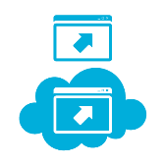

Thoughts on where to start
Legacy Application Modernization
Break Application &/or Data Dependencies
Compliance / Audit Process
Enable your
applications for:
Capacity
Performance
Security
Audit
Enable
Component Mobility
Data Mobility
Multi sourcing
Define a Short / Long term
Activity Based Management
Value Realization Framework
Build an Application Catalogue
Define & Deploy
Standard Environments
Define & Manage
Service Definitions
Define & Provide
Service Catalogue
Define a Facilities / HW
Strategy
Measure your
unit costs
Continuous
Monitor
Architect above the
Infrastructure Layer
Seek Integration
Start with Test / Dev

Slide 11





What is your journey
Trends
Key Performance Indicators
Operational Maturity
Desired Attributes
IT KPI’s
Mean Time to deploy
Mean Time to recover
IT FTE / Server
Cost per Server per Year
Cost per Client per Year
IT KPI’s
Mean Time to deploy
Mean Time to recover
IT FTE / Server
Cost per Server per Year
Cost per Client per Year
Access
Self Service
Self Service
Security
Monitored
Configured
Automated
Highly Available
Security
New
apps
Monitored
Configured
Automated
Highly Available
New
apps
Front End
Multi-Tenancy
Multi-Tenancy
Auditing and Compliance
Automated
Auditing and Compliance
Automated
Application
Resource Pooling
Resource Pooling
Access Anywhere
Device
proliferation
Access Anywhere
Device
proliferation
Hardware
Software & Dev
Process & Templates
Pooled Resources
Data
Hardware
Software & Dev
Process & Templates
Pooled Resources
Workload
Relocation
Workload
Relocation
Client & Device Mgmt
OS
Standardized
Client & Device Mgmt
Standardized
Business KPI’s
Conception to Service
Reduction in Opex
Incremental Revenue
Incremental Margin
Time to Market
Reduction of Process Complexity
Your Cloud
Business KPI’s
Conception to Service
Reduction in Opex
Incremental Revenue
Incremental Margin
Time to Market
Reduction of Process Complexity
Virtualization
Scalable
Scalable
Metering & Chargeback
Data explosion
Metering & Chargeback
Data explosion
Secure
Compliant
Auditable
Resilient
Secure
Compliant
Auditable
Resilient
HW
Elasticity
Elasticity
Resource Mgmt
Storage
Secure
Resource Mgmt
Secure
Continuity
Continuity
Service Mgmt
Network
Reusable
Efficient
Metered
Service Mgmt
Cloud computing
Reusable
Efficient
Metered
Cloud computing
Facilities
Integration
Integration
Customizability
Customizability
Cost Efficient
Cost Efficient

Slide 12











Can we agree on the attributes of cloud computing?
Attributes | Analyst 1 | Analyst 2 | Analyst 3 | Analyst 4 | Vendor 1 | Standard 1
Access anywhere | ✓ |  |  |  |  | ✓
Browser based | ✓
Scalable |  |  | ✓ | ✓ | ✓
Control |  | Low |  | Low
Published APIs (abstracted) | ✓ |  |  | ✓ | ✓
Elastic (on-demand) | ✓ |  | ✓ | ✓ | ✓ | ✓
Self service | ✓ |  |  |  |  | ✓
Customizable | Low | Low
Failure resistant (always available)
Metered by use | ✓ | ✓ | ✓ | ✓ |  | ✓
Highly Automated |  | ✓
Service-based |  |  | ✓
On-Demand |  |  |  | ✓ |  | ✓
Cloud Attributes
Elasticity
Access Anywhere
Security
Resource Pooling
Multi-Tenancy
Integration
Customizability
Resource Management
Metering &
Charge Back
Self Service
Auditing & Compliance
Scalability
Continuity
Workload
Relocation
Service
Management

Slide 13






When talking about Cloud… First think about attributes for your services
Service #1
Service #2
Service #3
Service #4
CONTINUITY
Data Center Management and Virtualization
Security
Networking
Storage
IT Process and Compliance
Self Service
Scalable
Metering & Chargeback
Elasticity
Self Service
Scalable
Scalable
Elasticity
Resource Mgmt
Metering & Chargeback
Multi-Tenancy
Elasticity
Elasticity
Continuity
Service Mgmt
Customizability
Access Anywhere
Access Anywhere
Integration
Private
Hybrid
Public
Public
Resource Pooling
Elasticity
Scalability
Continuity
Multi-Tenancy
Service Mgmt
Resource Mgmt
Metering & Chargeback
Security
Auditing and Compliance
Access Anywhere
Self Service
Workload
Relocation
Integration

Slide 14

7 years of experience world wide
7 Years of success across the World
15,000 IT environments analyzed
Basic
Standardized
Rationalized
Dynamic
Uncoordinated, manual
infrastructure
Managed IT infrastructure
with limited automation
Managed and consolidated IT infrastructure
with maximum automation
Fully automated management, business-linked SLAs, dynamic resource usage
Business and IT Cross Capability Conversations
TCO and Efficiency studies

Slide 15
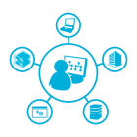
Attribute |
Continuity
Mapped what are the required IT operational capabilities needed to achieve each cloud attribute

Slide 16
Steps to build a
Private Cloud

Slide 17







Steps to build a Private Cloud
Build
Run
Step 1
Step 2
Step 3
Step 4
Step 5
Step 6
Step 7
Extreme Standardization
Base lining / Health Management
Service Management
SLA
Process Engineering & Pre-Production
Automation & Orchestration
Service Lifecycle
Self Service
Quality
Configuration Units
Design
for catastrophe
Agree on service
delivered
Quality Assurance
Pre production
Automate best
practices
Build a consistent
quality delivery cycle
Provide user with
a provisioning &
service level portal

Slide 18
How Microsoft can help

Slide 19
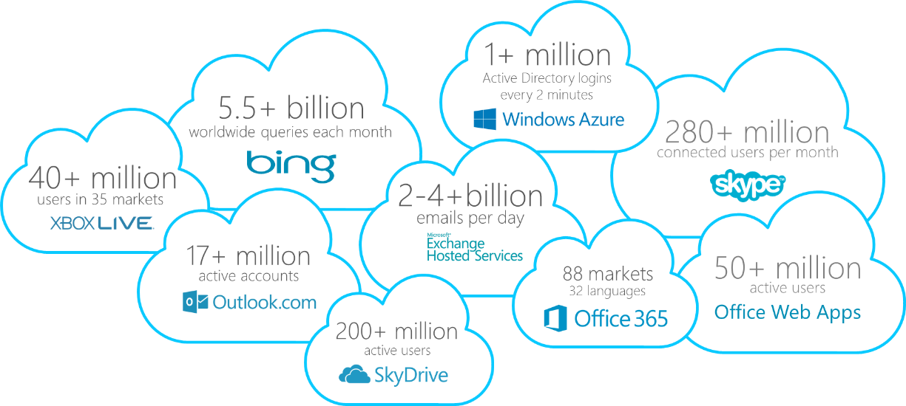
200+ Cloud Services
1+ billion customers, 20+ Million Businesses, 76+ markets worldwide

Slide 20


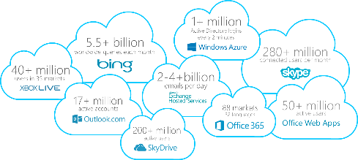
cloud-scale feedback cycle

Slide 21
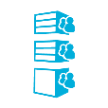





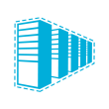

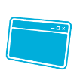
The Microsoft 2012 stack
AZURE
Operations Manager
Configuration Manager
Virtual Machine Manager
AZURE + Office 365
Management
Suite
Orchestrator
IaaS, SaaS and PaaS
Service Manager
Data Protection Manager
App Controller
System Center 2012
Windows
Server 2012
Authentication
Security
Partner’s
Data Center
Modular
Console
Hyper-V Replica
Storage Pools + to cloud backup
Windows Server 2012 Hyper-V
NIC Teaming + Load Balancing
PowerShell
Partner Cloud
Windows Server 2012
Hyper-V
Windows Server
2012
Authentication
Security
VDI
Application
Virtualization
Developer
Windows Server 2012
Hyper-V
Hyper-V Server (Free Version)
Windows Server 2012
Hyper-V
Visual Studio & .NET
Standard (2 Virtual Machines)
Hyper Visor
Data Center (Unlimited Virtualization)

Slide 22






The value can you expect from Microsoft
Focus
Projects
Market offerings
System Center 2012 + Windows Server
Access
Automation
Continuity
Configuration Manager
Operations Manager
Virtual Machine Manager
Orchestrator & Power Shell
Service Manager
Active Directory, FIM,
End Point Protection
Data Protection Manager
App Controller
Front End
flexible development
unified management
common identity
integrated virtualization
complete data platform
Pooled Resources
Integration &
Customizability
Application
Service
Management
Workload
Relocation
Data
Self Service
Elasticity
OS
Usage Based
consolidation
Virtual Processing
Hyper-V + Windows Server 2012
Virtualization
IaaS
Hosted
Cloud
Azure
Windows Server 2012
PowerShell
Hyper-V
virtual datacenter
Virtual Storage
manage down time
Virtual Networking
Service Offerings
Partner Solutions
Planning & Design Guides
Solution Accelerators
Technical Readiness
Certification
HW
pooling
Modular Processing
FAST TRACK
Storage
management
Modular Storage
Network
balancing
Modular Balanced Networking
power
Modular Efficient Power Distribution
ITPACs or PODS
Facilities
cooling
Modular Cheaper Cooling
location
Modular Power Backup

Slide 23




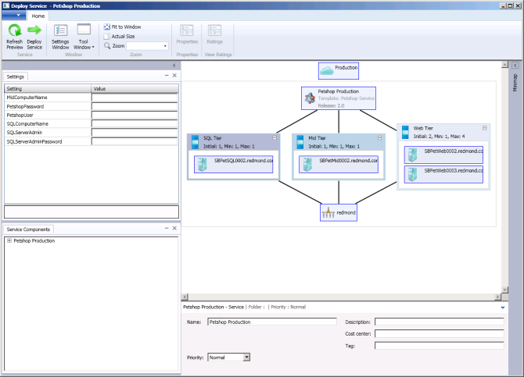
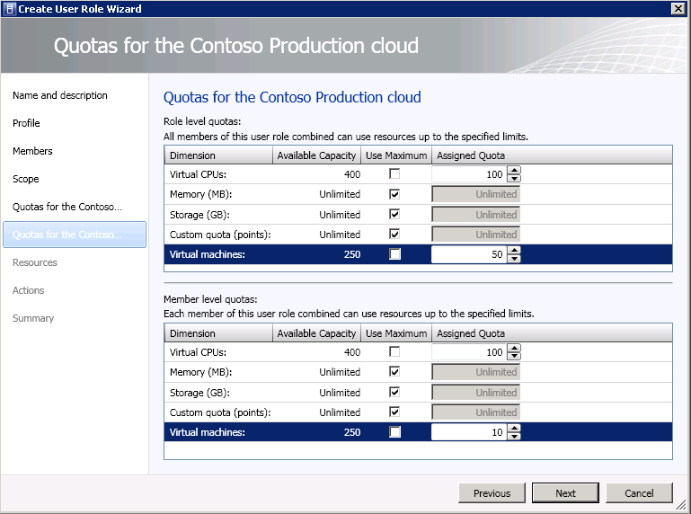
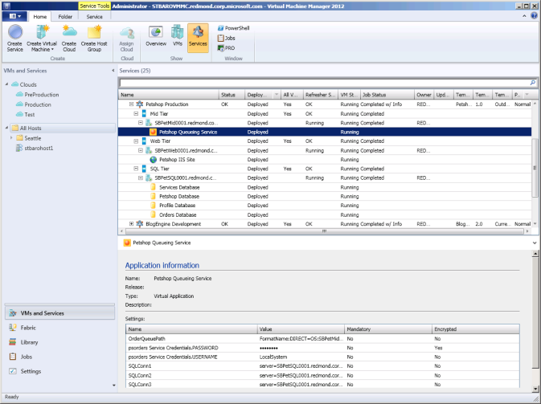
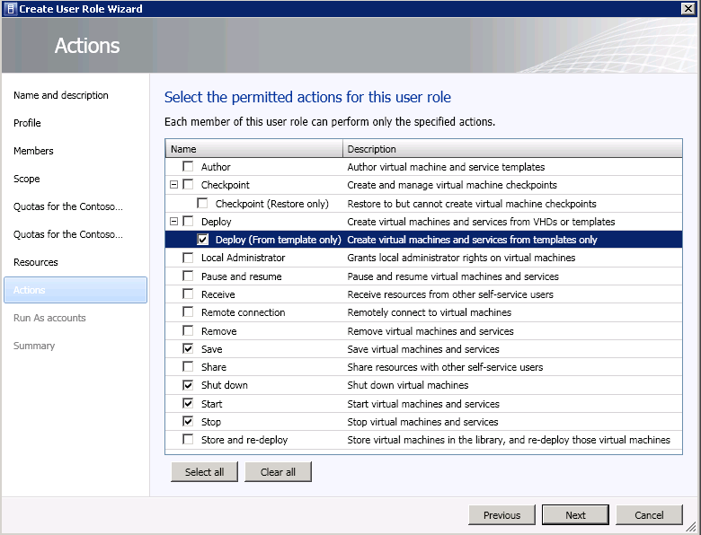

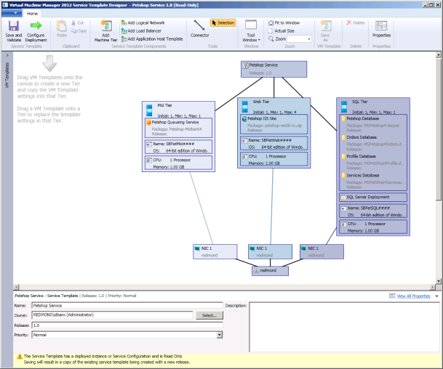



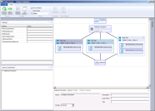


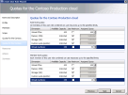
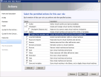
Design and Create your Cloud Services
Pool Resources & Existing investments
Assign Roles, Quotas & Actions
Create Service Template
Deploy Services
Monitor Deployed Services
SC Virtual Machine Manager
SC App Controller
Pool Resources
with existing investments
Assign Roles,
Quotas & Actions
Create a Service Template
Deploy Services
Monitor Deployed Services
Microsoft
Hyper-V
VMware
vSphere
Citrix
XenServer
Administrator
Delegated
Administrator
Read Only
Administrator
Self
Service
User
App Resource
silo #1
App Resource
silo #2
App Resource
silo #3
Any Action
Administration
Operations
Revocable Actions
Quota Controlled
Microsoft
Hyper-V
VMware
vSphere
Citrix
XenServer
compute
storage
network
compute
storage
network

Slide 24
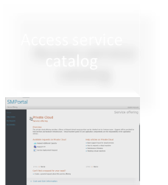
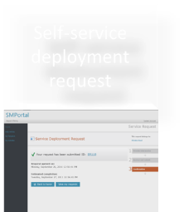
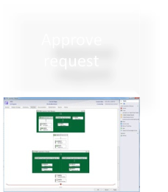
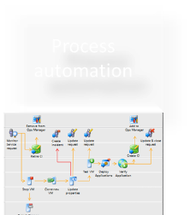
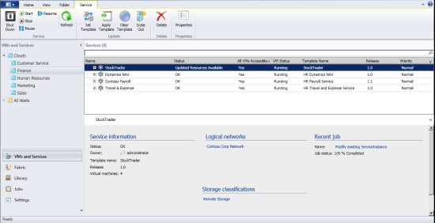
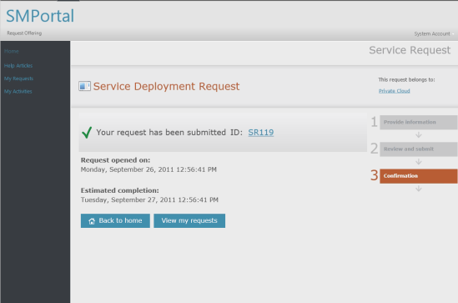
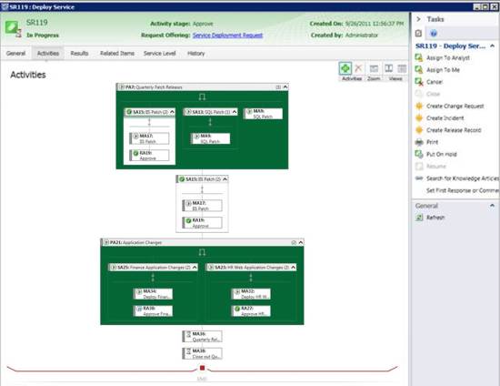
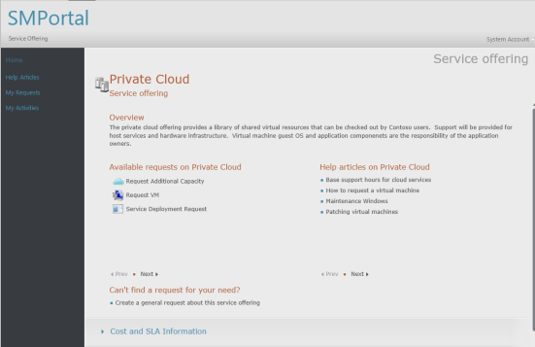
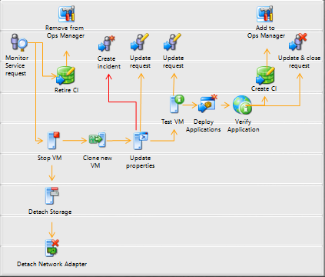
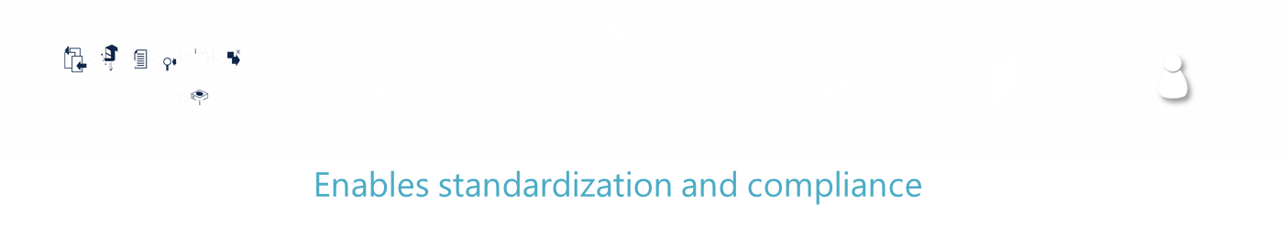

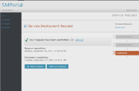
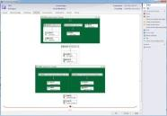
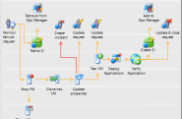
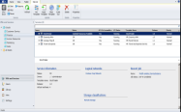
Predictable Service Delivery
Approve request
Provision service
Self-service deployment request
Access service catalog
Process automation
SC Virtual Machine Manager
SC Virtual Machine Manager
SC Virtual Machine Manager
SC Service Manager
SC Orchestrator
SC App Controller
SC App Controller
Access service catalog
Self-service deployment request
Approve request
Process automation
Provision service

Slide 25
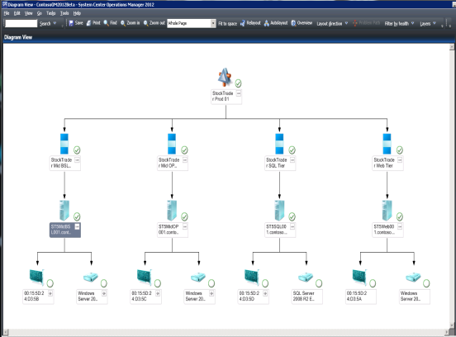
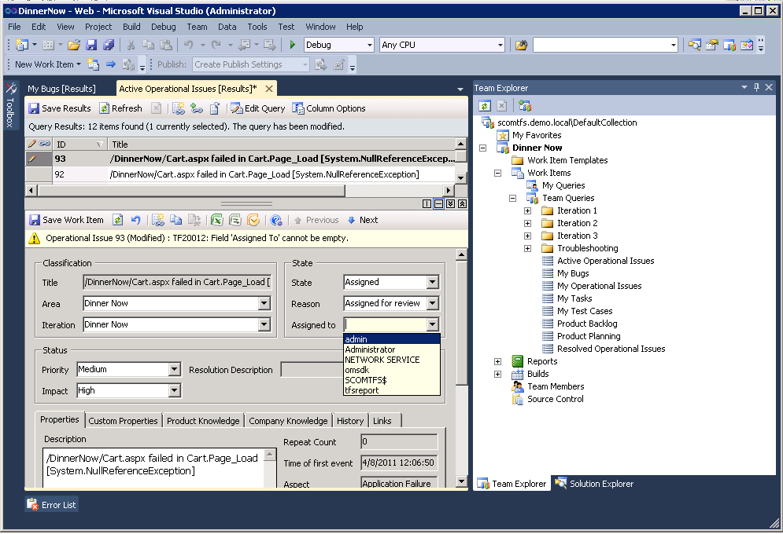
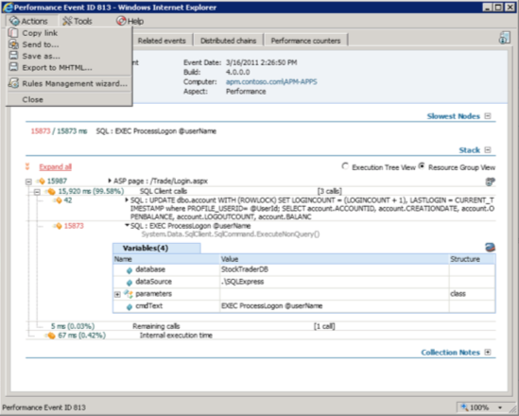
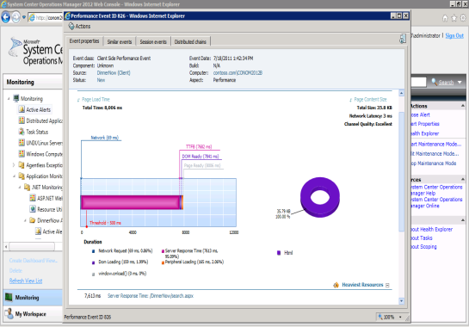
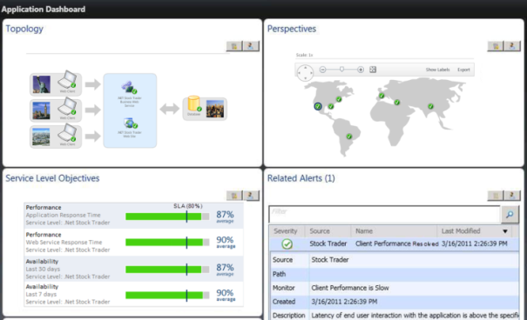





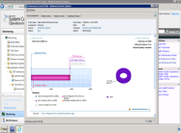

Predictable Application SLA
Discover application dependencies
Isolate root cause
Monitor
end user and application components
Triage & Remediate
Deep application diagnostics and insight helps you “get to green”
SC Operations Manager
AVICode
AVICode
Visual Studio Team System
Discover application dependencies
Discover application dependencies
Monitor
end user and application components
Monitor
end user and application components
Isolate root cause
Isolate root cause
Triage & Remediate
Notes:
25

Slide 26

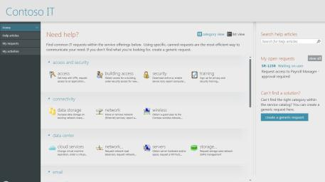











Self Service
VMM
Library
Templates
User Roles
Publish
App
Owner
DC Admin
CMDB
Runbooks
Templates
Services
VMs
Hosts
Users

Slide 27
ING Direct – Australia
Bank in a Box

Slide 28
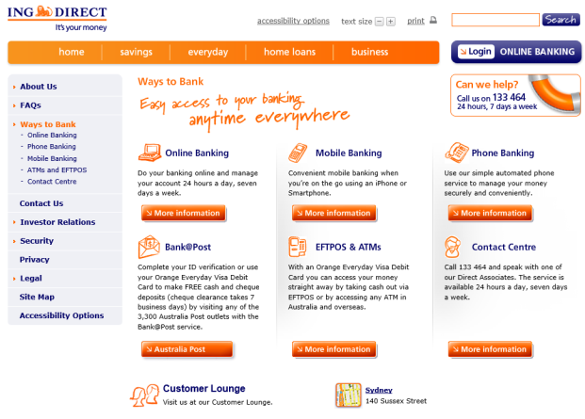
About ING DIRECT in Australia

Slide 29




The ING Innovation Pipeline Challenge
Inability to take on New Work
Challenged Project
Management
18 Month Project Backlog
Business Innovation
delayed

Slide 30


Impact on business agility
220 VMs
( 10 configurations with 22 VMs each in 12min, 20 secs)
Self Service
Cloud Agility
Automated Test Assets
Agile Licencing
http://www.microsoft.com/casestudies/Microsoft-Hyper-V/ING-DIRECT-Australia/Online-Bank-Boosts-IT-Efficiency-by-Percent-with-Upgrade-Strengthens-Innovation/710000001688

Slide 31
Summary

Slide 32
Steps to build a Private Cloud
=
=
Tools capabilities skills
Prioritize stack integration over high end features… whatever isn't integrated out of the box, you'll end up building, running, and supporting
You will need more skills not less… Prioritize PEOPLE
A lot more Statistical analysis, Quality Assurance and Control, Service Definitions and Business Architecture are a good thing
Build
Run
Step 1
Step 2
Step 3
Step 4
Step 5
Step 6
Step 7
Extreme Standardization
Base lining / Health Management
Service Management
SLA
Process Engineering & Pre-Production
Automation & Orchestration
Service Lifecycle
Self Service
Quality
Configuration Units
Design
for catastrophe
Agree on service
delivered
Quality Assurance
Pre production
Automate best
practices
Build a consistent
quality delivery cycle
Provide user with
a provisioning &
service level portal

Slide 33
Resources

Slide 34
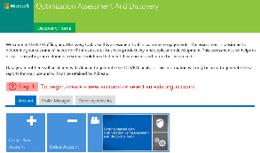
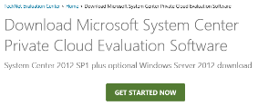
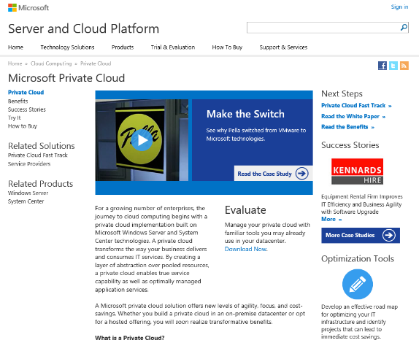
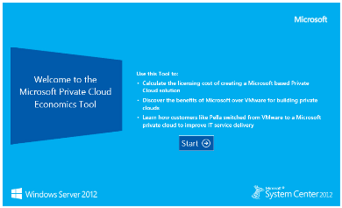
Microsoft Private Cloud resources http://www.microsoft.com/privatecloud
http://technet.microsoft.com/en-us/evalcenter/hh505660.aspx?wt.mc_id=TEC_103_1_33
http://www.microsoft.com/optimization/tools/overview.mspx
Private Cloud Economics Tool

Slide 35
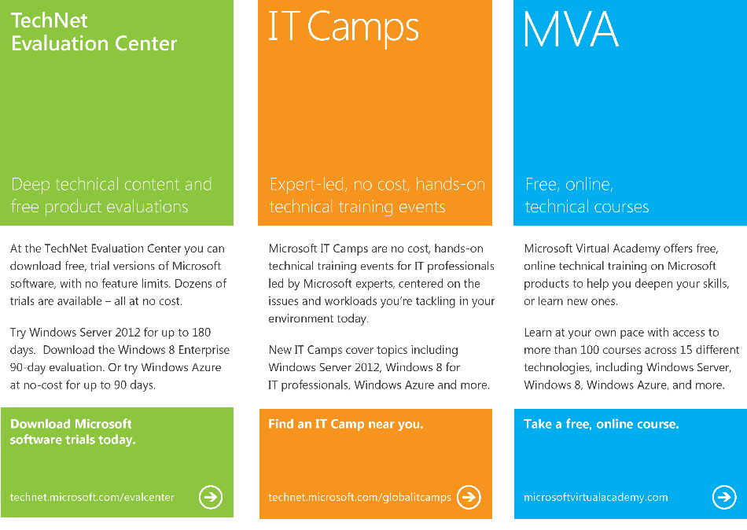
TechNet Evaluation Center
Download Microsoft software trials today.
technet.microsoft.com/evalcenter
Microsoft Virtual Academy
Take a free, online course.
microsoftvirtualacademy.com
IT Camps
Find an additional IT Camp near you.
technet.microsoft.com/globalitcamps
Microsoft Certifications
Get certified on Microsoft Products & Technologies.
aka.ms/certifications
Microsoft Training
Microsoft Learning Partners
http://aka.ms/CPLS
  Class Locator
  http://aka.ms/ClassLocator
  Windows Server
  http://aka.ms/MOCWinServ
  Virtualization
  http://aka.ms/MOC-Virt
Microsoft Training & Certification
  Windows Server
  http://aka.ms/WinServCert
  Virtualization
  http://aka.ms/MCSE-PrivCloud

Slide 36

Trustworthy Computing Resources
Trustworthy Computing (TwC) is a long-term, collaborative effort to deliver more secure, private,
and reliable computing experiences for everyone.
Learn more at:
http://microsoft.com/twc
Cloud Security Readiness Tool
Pass the Hash Guidance
Data, Insights and Guidance (Security Intelligence Report, volume 14)
and more…

Slide 37

Resources
Learning
  Sessions on Demand
  Microsoft Certification & Training Resources
http://channel9.msdn.com/Events/TechEd
www.microsoft.com/learning
TechNet
msdn
  Resources for IT Professionals
  Resources for Developers
http://microsoft.com/technet
http://microsoft.com/msdn

Slide 38




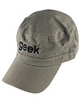
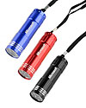
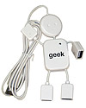
Complete an evaluation on CommNet and enter to win!

Slide 39
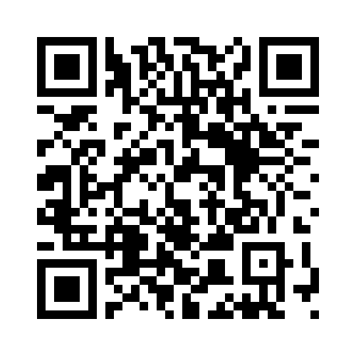


Evaluate this session
Required Slide
*delete this box when your slide is finalized
Your MS Tag will be inserted here during the final scrub.
Scan this QR code to evaluate this session and be automatically entered in a drawing to
win a prize

Slide 40

© 2013 Microsoft Corporation. All rights reserved. Microsoft, Windows and other product names are or may be registered trademarks and/or trademarks in the U.S. and/or other countries.
The information herein is for informational purposes only and represents the current view of Microsoft Corporation as of the date of this presentation. Because Microsoft must respond to changing market conditions, it should not be interpreted to be a commitment on the part of Microsoft, and Microsoft cannot guarantee the accuracy of any information provided after the date of this presentation. MICROSOFT MAKES NO WARRANTIES, EXPRESS, IMPLIED OR STATUTORY, AS TO THE INFORMATION IN THIS PRESENTATION.

