Slide 2
Devices + Services demystified…
ATC-B206
Ulrich Homann
Chief Architect, WW Enterprise Services
Microsoft Corp.

Slide 3
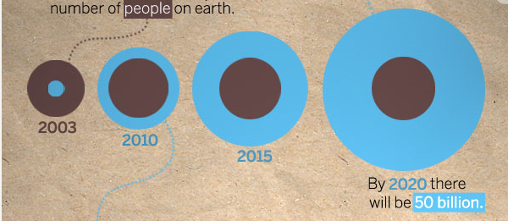

Devices change the picture
50 billion
2003
2010
2015
2020
Cisco

Slide 4
Long term opportunity
INDUSTRUMENTED INDUSTRIAL MACHINE
Intelligence flows back into machines
Extraction and storage of proprietary machine data stream
PHYSICAL AND HUMAN NETWORKS
technology
new
query
mobile
database
compression
Storage
database
data
SQL
big data
new
processing
SECURE, CLOUD-BASED NETWORK
INDUSTRIAL DATA SYSTEMS
Data sharing with the right people and machines
Machine-based algorithms and data analysis
REMOTE AND CENTRALIZED DATA VISUALIZATION
BIG DATA ANALYTICS
Source: GE Industrial Internet, “Pushing the boundaries of Minds and Machines”

Slide 5
Long term opportunity
What if… Potential Performance Gains in Key Sectors
Industry
Segment
Type of Savings
Estimated Value Over 15 Years (Billion nominal US dollars)
Aviation
Commercial
1% Fuel Savings
$30B
Power
Gas-fired Generation
1% Fuel Savings
$66B
Healthcare
System-wide
1% Reduction in System Inefficiency
$63B
Rail
Freight
1% Reduction in System Inefficiency
$27B
Oil & Gas
Exploration & Development
1% Reduction in Capital Inefficiency
$90B
Note: Illustrative based on potential one percent savings applied across specific global industry sectors.
Source: GE estimates

Slide 6

Connected Devices & Continuous Services
Connected Device Apps
Social
Web APIs (REST, OData)
Unified Management
Multi-tier
SOA
Private
IaaS
PaaS
On-Premises Infrastructure
Public Cloud Infrastructure

Slide 7

A diversity of
Single Line Display
Embedded (Small 3”)
Embedded (Medium 5”)
Wearable
Phone
Small Tablet
Interface Types
and Sizes
Laptop
(small)
Laptop
(medium)
Laptop
(large)
Desktop
Advertising
Display
Device Tailored
Storage Types
Cloud
Local
Camera
GPS
Accelerometer
Altimeter
Sensors
Motion
Light
Connectivity
Power

Slide 8

Devices and services principles
Devices
Each device is a connected device
Each device is a cache - device loss/recreation is a non-event
Device state (apps & users) is stored in a cloud (default is SkyDrive)
App & User state is transparently accessible from any device
A device does not have to have a user interface or even users (sensors, etc.)
Plus
Connectivity: Win8 network guidance | Identity: A device can have an identity Services or individuals can be authorized to interact with/from the device | Integration: Data Notifications Integration patterns
Services
Services are designed with a “Cloud First” mindset with a failsafe implementation
RESTful APIs are designed using best practices
Services default to delivering data using a standard protocol (OData)
People-centric or social-enabled services utilize open protocols (Open Graph)
User identity, be it an individual or software, will ideally utilize an open protocol (OAuth)
Services are data-centric and/or insight-enabled

Slide 9
Progression level | Device focus | (+) focus | Services focus
3 | Insight-enabled: Telemetry: emitting events Models: accept models and adjust based upon insight model | No change to 1 | Consumption of event data (mobile services? 2-way notifications?) Model analysis Model output: recommendations, etc.
2 | Social-enabled: Consumer: social contracts (Windows - share/connected address books) Enterprise: Open Graph API | No change to 1 | Open Graph API integration Introduction of social signals against service objects or actions based upon signals
1 | Device App: Data and Settings are cached (Apps & Users) Notifications (Live tiles) are enabled | HTTP/s Azure mobile services [ISB integration patterns] [Service-specific RESTful API’s] | One or more services are being accessed Data is exchanged between app & service(s)
0 | Native Device App: Data and Settings are cached (Apps & Users) | HTTP/s Simple RESTful API’s | Cloud storage: SkyDrive (default)

Slide 10



Incorporate Open Standards
  Unlock Data from Silos
  Make data readily consumable
  Great for consumption from multiple mainstream clients, i.e. Excel
  Great for consumption of data in composite client services and apps
  Provide the ability to delegate access
  Predictable experience
  Support across authentication from multiple client types
  User control over what is accessed
  Participate
  in a social
  graph
Common approach to the social graph for Enterprise and Consumer scenarios
Enable any web page to become a rich object in a social graph
Enable social graph connectivity in services and client apps

Slide 11




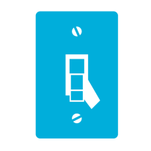







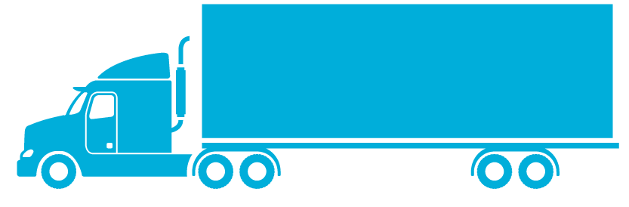




Scenarios
Firmware/Software Delivery
Insight Delivery
Dashboards & Remote Mgmt
Device to Infrastructure
Geo-Tracking
Media Delivery & Playback
Fitness/Health
Connected Operations
Connected Vehicles

Slide 12
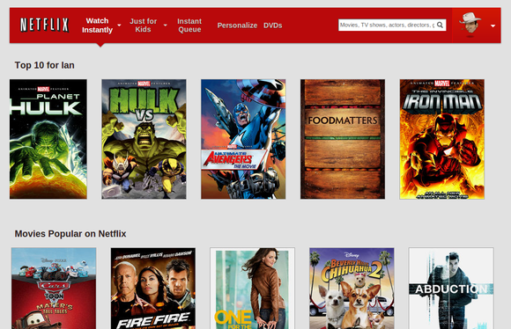
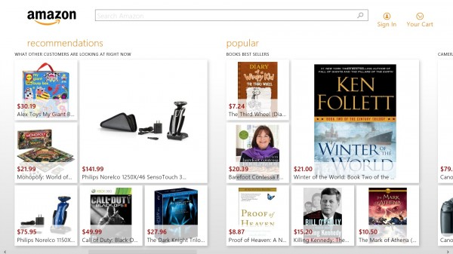
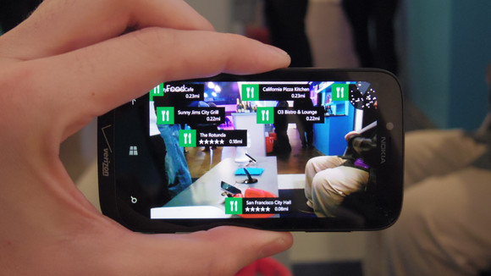
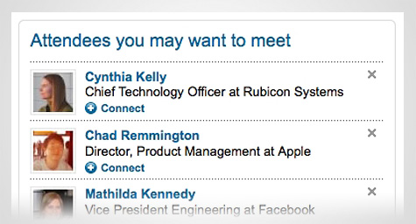
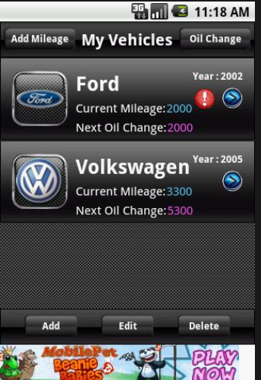
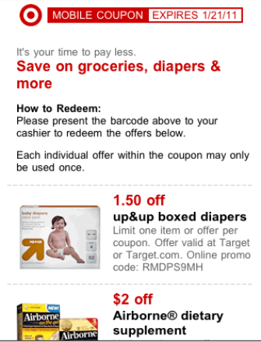
Scenarios
Firmware/Software Delivery
Insight Delivery
Dashboards & Remote Mgmt
Device to Infrastructure
Geo-Tracking
Media Delivery & Playback
Fitness/Health
Connected Operations
Connected Vehicles
Connected Retail

Slide 13
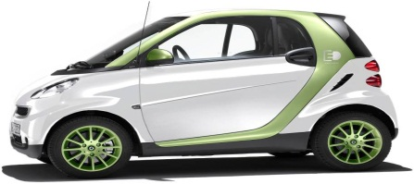
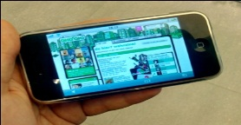

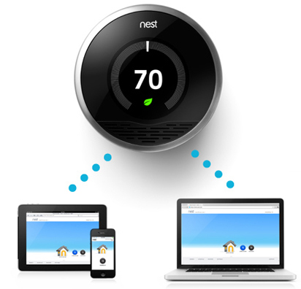
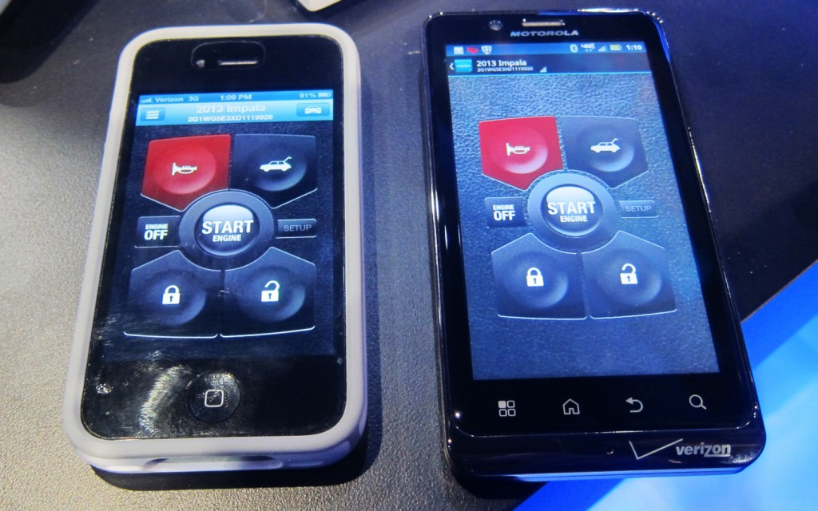
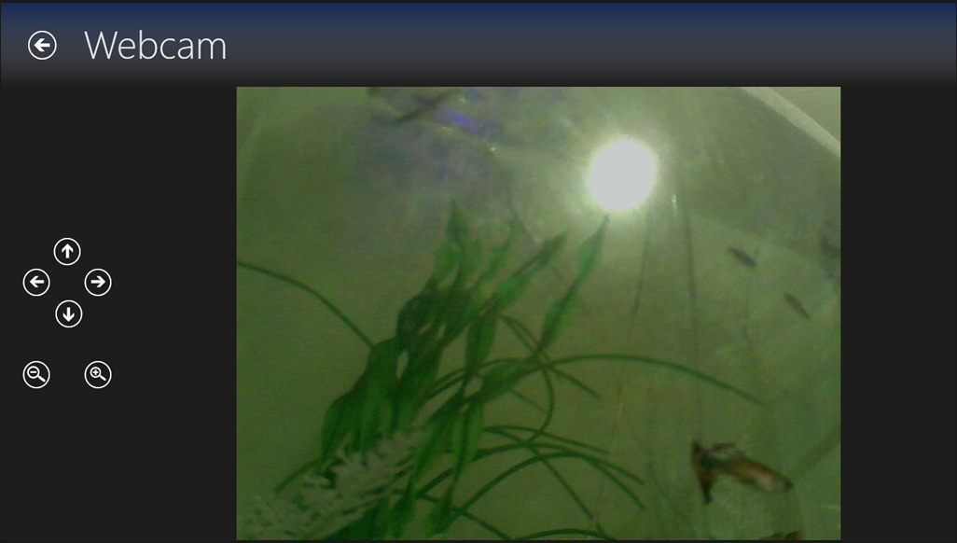
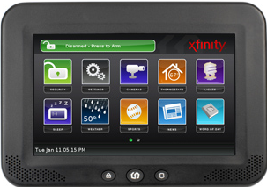
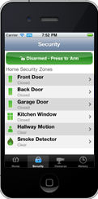
Scenarios
Firmware/Software Delivery
Insight Delivery
Dashboards & Remote Mgmt
Device to Infrastructure
Geo-Tracking
Media Delivery & Playback
Fitness/Health
Connected Operations
Connected Vehicles
Connected Retail

Slide 14

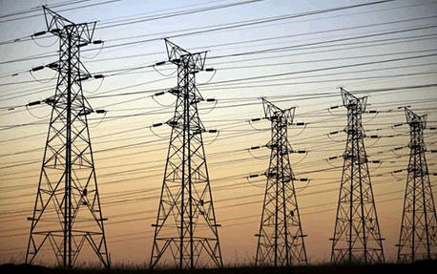
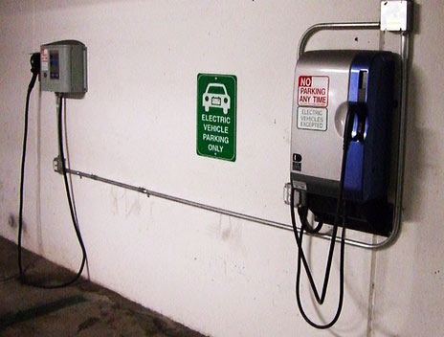
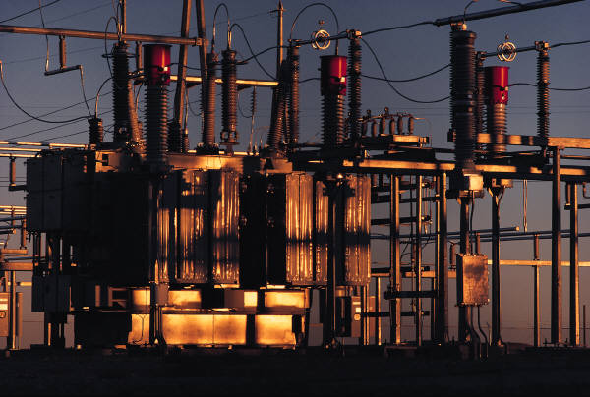
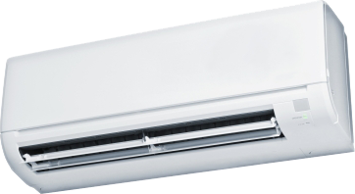
Scenarios
Firmware/Software Delivery
Insight Delivery
Dashboards & Remote Mgmt
Device to Infrastructure
Geo-Tracking
Media Delivery & Playback
Fitness/Health
Connected Operations
Connected Vehicles
Connected Retail

Slide 15
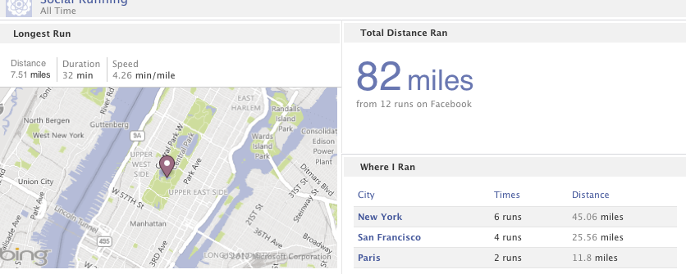
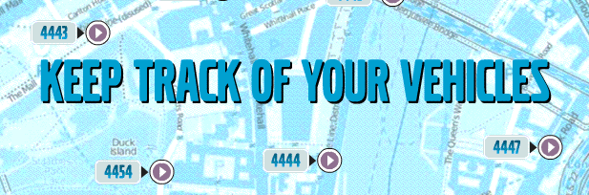



Scenarios
Firmware/Software Delivery
Insight Delivery
Dashboards & Remote Mgmt
Device to Infrastructure
Geo-Tracking
Media Delivery & Playback
Fitness/Health
Connected Operations
Connected Vehicles
Connected Retail

Slide 16
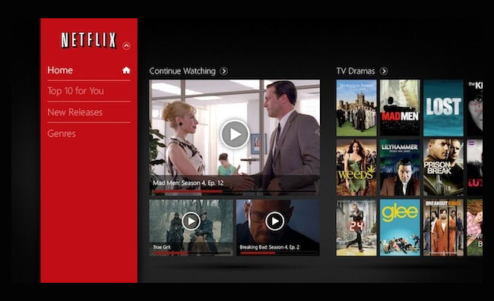
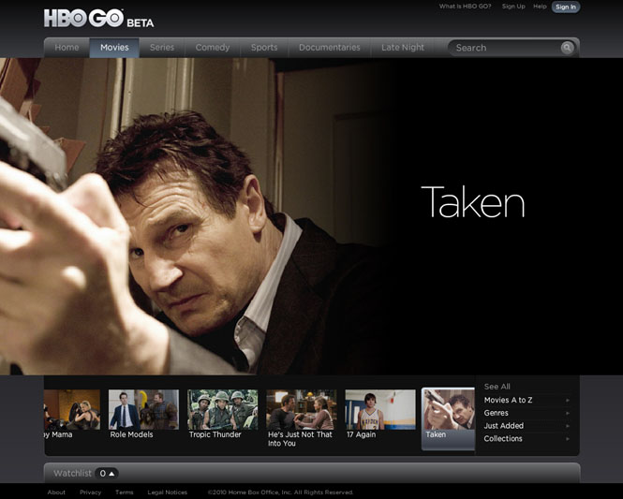
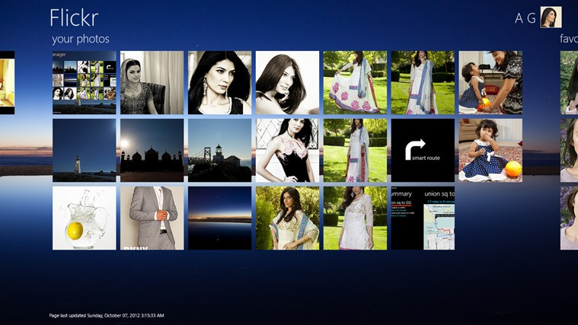
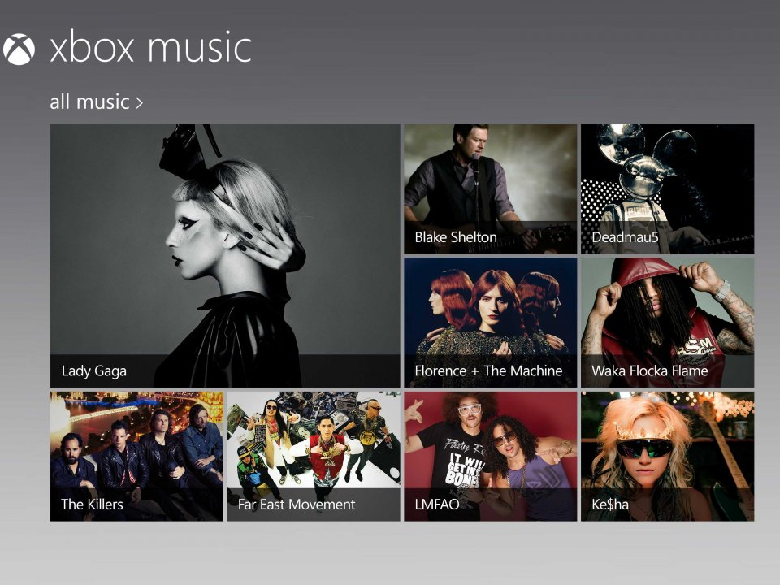
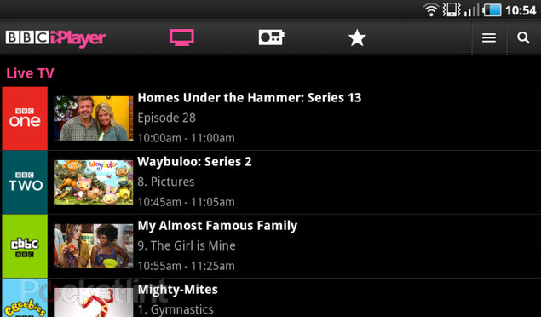
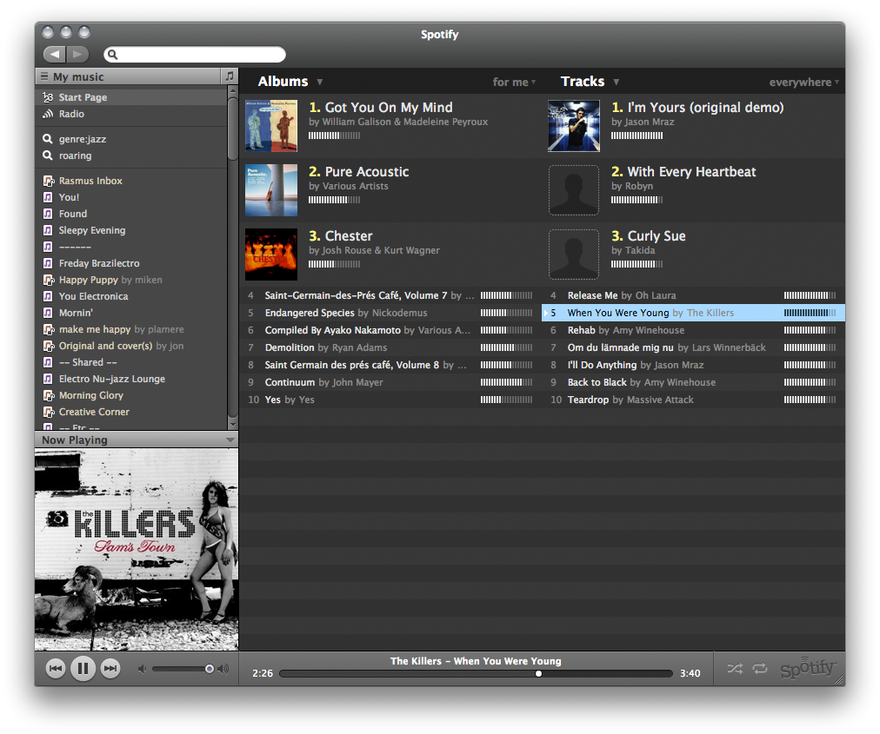
Scenarios
Firmware/Software Delivery
Insight Delivery
Dashboards & Remote Mgmt
Device to Infrastructure
Geo-Tracking
Media Delivery & Playback
Fitness/Health
Connected Operations
Connected Vehicles
Connected Retail

Slide 17
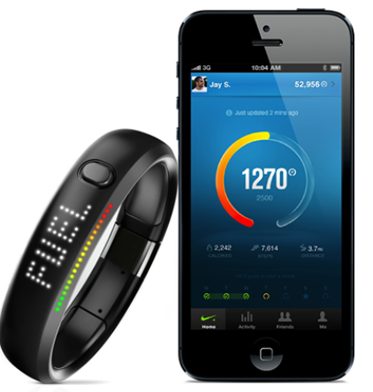
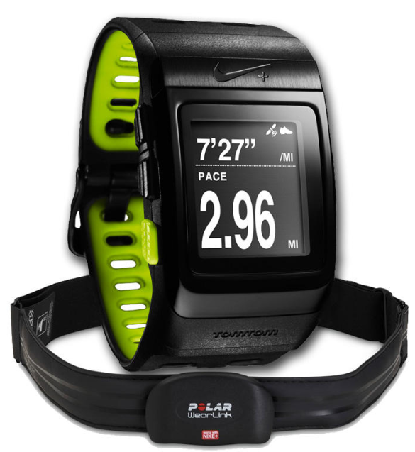
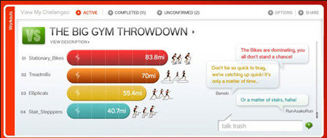
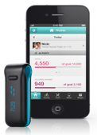
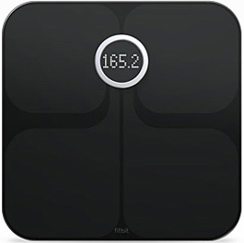
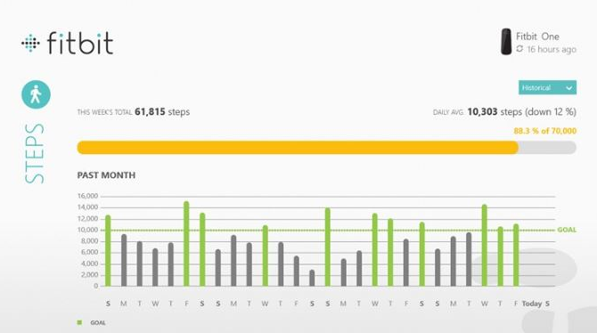
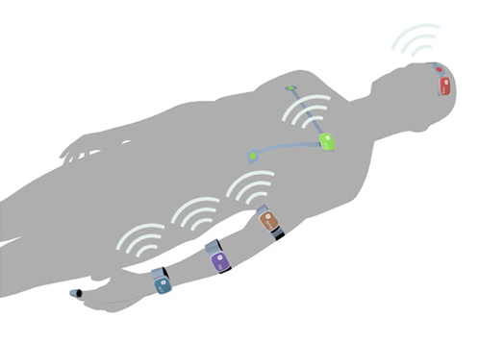
Scenarios
Firmware/Software Delivery
Insight Delivery
Dashboards & Remote Mgmt
Device to Infrastructure
Geo-Tracking
Media Delivery & Playback
Fitness/Health
Connected Operations
Connected Vehicles
Connected Retail

Slide 18


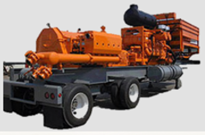

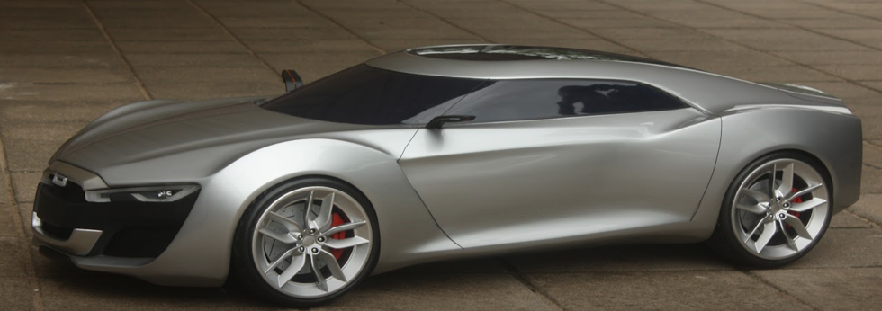
Scenarios
Firmware/Software Delivery
Insight Delivery
Dashboards & Remote Mgmt
Device to Infrastructure
Geo-Tracking
Media Delivery & Playback
Fitness/Health
Connected Operations
Connected Vehicles
Connected Retail

Slide 19
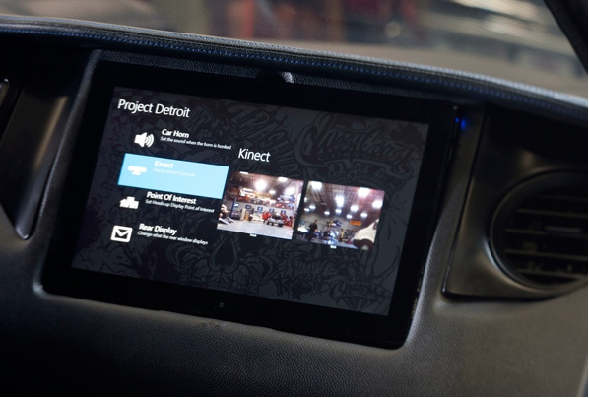
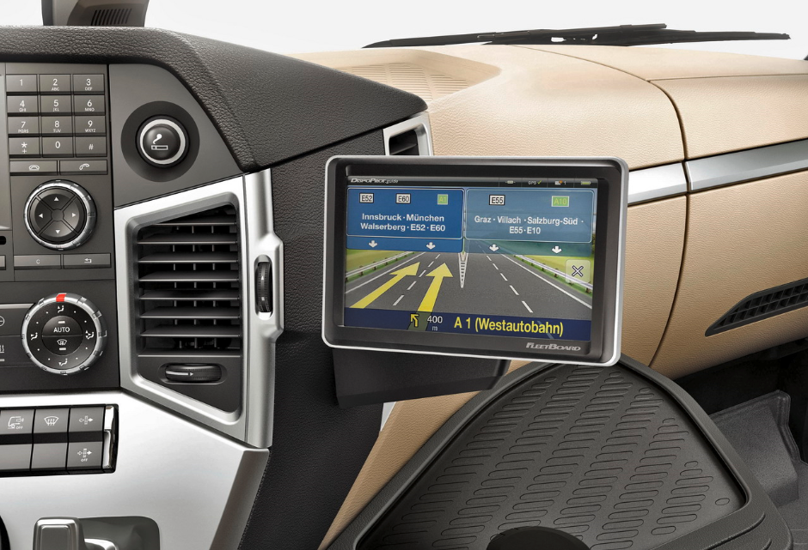
Scenarios
Firmware/Software Delivery
Insight Delivery
Dashboards & Remote Mgmt
Device to Infrastructure
Geo-Tracking
Media Delivery & Playback
Fitness/Health
Connected Operations
Connected Vehicles
Connected Retail

Slide 20
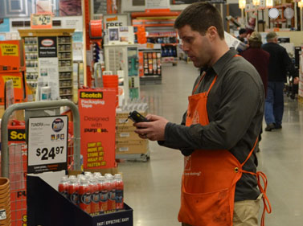
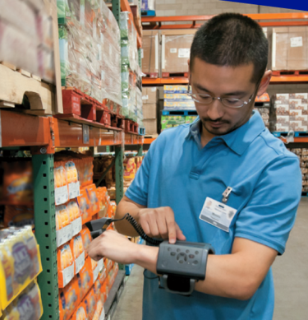
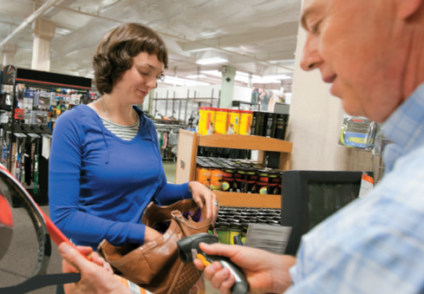
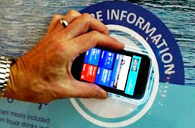
Scenarios
Firmware/Software Delivery
Insight Delivery
Dashboards & Remote Mgmt
Device to Infrastructure
Geo-Tracking
Media Delivery & Playback
Fitness/Health
Connected Operations
Connected Vehicles
Connected Retail

Slide 21
Progression level | Device focus | (+) focus | Services focus
3 | Insight-enabled: Telemetry: emitting events Models: accept models and adjust based upon insight model | No change to 1 | Consumption of event data (mobile services? 2-way notifications?) Model analysis Model output: recommendations, etc.
2 | Social-enabled: Consumer: social contracts (Windows - share/connected address books) Enterprise: Open Graph API | No change to 1 | Open Graph API integration Introduction of social signals against service objects or actions based upon signals
1 | Device App: Data and Settings are cached (Apps & Users) Notifications (Live tiles) are enabled | HTTP/s Azure mobile services [ISB integration patterns] [Service-specific RESTful API’s] | One or more services are being accessed Data is exchanged between app & service(s)
0 | Native Device App: Data and Settings are cached (Apps & Users) | HTTP/s Simple RESTful API’s | Cloud storage: SkyDrive (default)

Slide 22
Fundamentals of Telemetry & Insight
  Collect
  Analyze
  Consume
  Instrument apps
  Deliver events to analytics service
  Receive and store many live data streams
  Real-time and historical analysis of event streams
  Aggregations, pivots and patterns
  Publish analytics in a consumable format
  Inform and Influence
  Make better decisions

Slide 23
Insight Perspectives
  User
  Behavior of an individual, targeted user
  User behavior, individualized experience
  Business
  Business activities and KPIs
  Videos played, social activity
  Application
  Health, performance & activity of the application layer and dependent services
  SQL client calls and logins, .NET exceptions, API calls, ASP.NET sessions
  Dependent services (SQL, memcached, etc).
  Infrastructure
  Health of the underlying system infrastructure
  CPU, memory, network.
  Available capacity, headroom

Slide 24
Characterizing Signals
  Continuous / Discrete
  Is the signal continuous or discrete?
  Continuous. Performance counters (CPU, memory network).
  Discrete. Log file entries (API call record).
  Information Content
  How much information is in the signal?
  Continuous. How often to sample? Nyquist rate?
  Discrete. Which records to keep/filter?
  Access type (push/pull)
  How is the signal captured?
  Push. Listen for push, filter/drop/acquire?
  Pull. Poll periodically?
  Ambient / Active
  How is the signal generated?
  Ambient. Baked in telemetry (perf counter, etc). May need to configure?
  Active. Need to actively instrument applications and/or systems?

Slide 25
Sources of Signals
  Infrastructure
  Performance counters
  Native performance counters ~ 1 second resolution.
  “Azure” perf counters 5-15 min at scale.
  Generally need hybrid approach
  ETW channels. Super detailed – high volume.
  Generally need local aggregation and/or filtering, batch distribution
  Application
  Managed applications.
  Automatic instrumentation via AVIcode, etc (profiling API). Rich timing information, context typically needs to be inferred
  Manual tracing via System.Diagnostics, Nlog, log4net, etc. Development investment required.
  Azure services (samples)
  SQL Azure. DMVs and system calls provide app-level insight. Requires manual collection infrastructure (polling).
  Memcached. Client APIs provide cluster-level statistics

Slide 26
Consumer Patterns
  Inform
  Canonical dashboard, allowing exploration of visualizations (time series charts, plots, etc)
  React
  Automated reaction to changing events (alerts, threshold violation, alarms -> trigger a workflow, email, etc)
  Explore
  Ad hoc exploration of data sets, combining different pivots, views and perspectives.
  Driven by diagnostics (inform/react to negative event -> explore to determine resolution) or desire to create more “known” questions

Slide 27
Monitor, mine, manage pattern
Monitor and collect events
Mine system events to produce active model (e.g. fraud detection, preventative maintenance)
Manage active event stream via event engine
3
Response Stream
Event Engine
Event Stream
Digital
Shoebox
1
2
Model
Generation

Slide 28
Fundamentals of insight-enabled apps
  Collect
  Analyze
  Consume
  Instrument apps
  Deliver events to analytics service
  Receive and store many live data streams
  Real-time and historical analysis of event streams
  Aggregations, pivots and patterns
  Anticipate
  Accelerate
  Alter

Slide 29
Data fundamentals http://msdn.microsoft.com/en-us/library/ms954587.aspx
Reference Data
  Immutable (versions)
  Requires open schema for interop
  Models (e.g. demographics) are common insight-related reference data
Activity Data
  Low concurrency updates (e.g. shopping basket)
  Ideal encapsulation concept for devices apps
Messages
(data exchange)
  Entity data (RESTful design)
  Could either be: Reference Data, Activity Data (reload from cloud), Notifications (real-time or batched)
Resource (shared) Data
  Not part of apps on devices
  Highly concurrent update (e.g. inventory)
  Should live in worker role

Slide 30
Consuming insight
  Inform
  Inform the app or service about relevant changes in conditions, etc.
  Command & Control
  Reacting to external insights with immediate action inside the app
  Enhanced Data
  Providing new or enhanced data or models for app or service
  Spans the entire data landscape (see slide 5 for reference)

Slide 31
Progression level | Device focus | (+) focus | Services focus
3 | Insight-enabled: Telemetry: emitting events Models: accept models and adjust based upon insight model | No change to 1 | Consumption of event data (mobile services? 2-way notifications?) Model analysis Model output: recommendations, etc.
2 | Social-enabled: Consumer: social contracts (Windows - share/connected address books) Enterprise: Open Graph API | No change to 1 | Open Graph API integration Introduction of social signals against service objects or actions based upon signals
1 | Device App: Data and Settings are cached (Apps & Users) Notifications (Live tiles) are enabled | HTTP/s Azure mobile services [ISB integration patterns] [Service-specific RESTful API’s] | One or more services are being accessed Data is exchanged between app & service(s)
0 | Native Device App: Data and Settings are cached (Apps & Users) | HTTP/s Simple RESTful API’s | Cloud storage: SkyDrive (default)

Slide 32
The Social Platform Taxonomy
Microsoft social media platform taxonomy | User goals | Company goals | Sample platforms
Social networks An online network to maintain existing relationships or connect people based on shared interests | Maintain and create relationships Life feed | Engage in conversation Build brand awareness | Facebook, Orkut, Google+, Xing, Vkontakte (Russia), SinaWeibo (China), LinkedIn
Blogs A platform for users to create personal sites for posting written, video, or other content. | Share opinions Life feed Hosting platforms allow people to create their own blogs | Listen to customer perspectives Engage in customer conversation Individualize blogs | Blogger, WordPress, Tangler
Microblogs Users exchange small elements of content such as short sentences, individual images, or video links | Share short messages Actively follow interest areas (brands, people, companies) | Track real-time trends Stay top-of-mind with consumers | Twitter, Tumblr, Mixi (Japan)
Media sharing A community forum where users have access to videos, clips, photos, and audio | Share digital media in an easy access format Browse for interesting media | Use media to show consumers using or enjoying the brand or products Customer engagement | YouTube, Flickr, Instagram
Social bookmarking A method of saving content from webpages in a single online location for future use and sharing with other Internet users | Save pictures, websites and other digital content Share content with friends | Build brand awareness Drive traffic to company website | Pinterest, StumbleUpon, Reddit, Delicious
Geo-social A platform used on mobile devices to locate, use and share reviews with other users of nearby services | Locate services and friends nearby Create and read reviews | Obtain user data Target advertising | Yelp, Foursquare, Facebook (develop new or utilize working platforms)
E-commerce Platforms where products are sold to and reviewed by consumers | Search product attributes Read and create product reviews | Provide mini focus groups Product improvement/ development | Amazon, Consmr, Crowdstorm, Fancy
Brand-based communities Online blogs devoted to a specific brand or product | Connect with a brand Create a sense of belonging | Build customer loyalty Promote new products Receive feedback from customers | Popular sites include: Harley Davidson, Twilight, American Express
Virtual communities A group of people engaging in a digital life | Reinvent one’s identity Instant communication share | Create brand communities Target advertising | Zynga, SecondLife, Sims

Slide 33
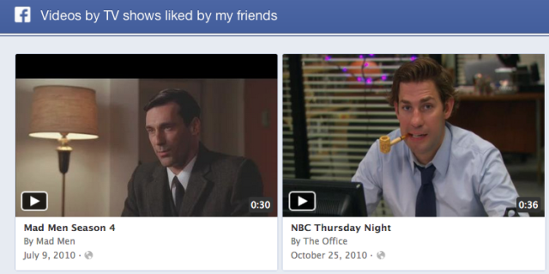
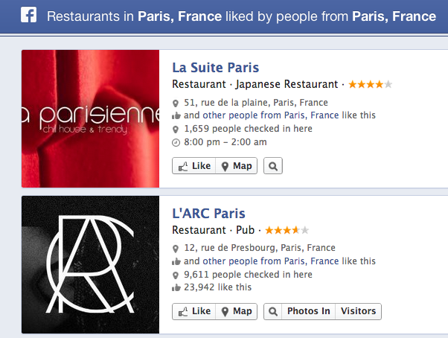
Adapting the app experience: the Power of the Graph

Slide 34
The Open Graph protocol enables any web page to become a rich object in a social graph.

Slide 35
The Open Graph protocol is based on RDFa and implemented
using <meta> tags in the <head>
of your web pages.

Slide 36
Standardize the verbs – interacting with the social ‘fabric’
  Share
  Like
  Follow

Slide 37
Devices + Services Scenarios
require a set of
Capabilities
which can be delivered to participants via one or more
Application Types
which are a part of the overall solution
Architecture
that should incorporate
Open Standards

Slide 38
Recap
Significant number of devices and services
opportunities across verticals
Many of the scenarios are built on a common set of
capabilities
HTTP, REST, Oauth and OData are important
Microsoft’s cloud platforms can connect to a diversity of devices –
even if they’re not running Windows.

Slide 39

Trustworthy Computing Resources
Trustworthy Computing (TwC) is a long-term, collaborative effort to deliver more secure, private,
and reliable computing experiences for everyone.
Learn more at:
http://microsoft.com/twc
Cloud Security Readiness Tool
Pass the Hash Guidance
Data, Insights and Guidance (Security Intelligence Report, volume 14)
and more…

Slide 40

Resources
Learning
  Sessions on Demand
  Microsoft Certification & Training Resources
http://channel9.msdn.com/Events/TechEd
www.microsoft.com/learning
TechNet
msdn
  Resources for IT Professionals
  Resources for Developers
http://microsoft.com/technet
http://microsoft.com/msdn

Slide 41




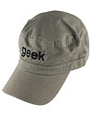

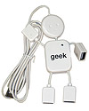
Complete an evaluation on CommNet and enter to win!

Slide 42
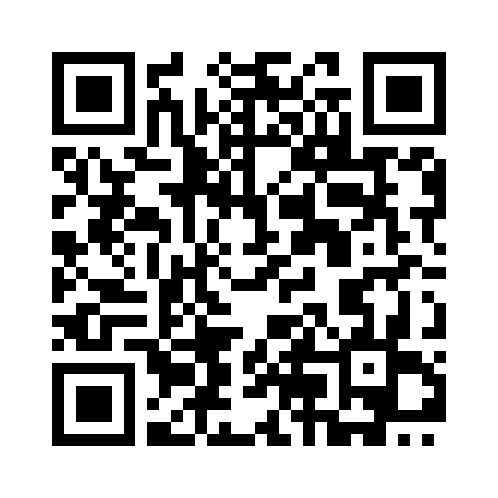


Evaluate this session
Required Slide
*delete this box when your slide is finalized
Your MS Tag will be inserted here during the final scrub.
Scan this QR code to evaluate this session and be automatically entered in a drawing to
win a prize

Slide 43

© 2013 Microsoft Corporation. All rights reserved. Microsoft, Windows and other product names are or may be registered trademarks and/or trademarks in the U.S. and/or other countries.
The information herein is for informational purposes only and represents the current view of Microsoft Corporation as of the date of this presentation. Because Microsoft must respond to changing market conditions, it should not be interpreted to be a commitment on the part of Microsoft, and Microsoft cannot guarantee the accuracy of any information provided after the date of this presentation. MICROSOFT MAKES NO WARRANTIES, EXPRESS, IMPLIED OR STATUTORY, AS TO THE INFORMATION IN THIS PRESENTATION.

