Slide 2
Identity Infrastructure Fundamentals and Key Capabilities
ATC-B209
Gayana Bagdasaryan

Slide 3
Objectives
Review key identity industry trends and challenges
Define 4 pillars of identity
MFA and multi-factor access control in AD FS

Slide 4

Trends
Explosive Data Growth
Budgetary Constraints
Proliferation of Devices

Slide 5

Challenges – Access Control
Secure access for BYOD
Customer/partner access to data

Slide 6
Challenges – Access Control
Secure access for BYOD
managed vs unmanaged
anti-virus signatures
location (extranet, intranet)
OS
patch level
private vs public network
history of network connections
single vs multi-user device
history of compromise
degree of portability
encryption
strong password requirement

Slide 7


Challenges – Access Control
Customer/partner access to data
Injecting external identities into an internal application or into an internal process
Creating dedicated accounts in your organization that you need to manage
Creating a partition in your identity infrastructure that your partners can manage
Creating a dedicated identity infrastructure to support the single application
A process or a mechanism in place in the event that you have tens or hundreds of partners
that need to be on-boarded
Migrating your application to a cloud service and how each organization maps corporate accounts
to a third party identity provider

Slide 8

Challenges – Infrastructure Management
On-boarding large number of users
Handling mergers and acquisitions
How to adapt current identity infrastructures to the cloud
Devices & Experiences Users Want
PC Management
And Security
Enterprise-Grade
Solutions
Mobile Device
Management

Slide 9




Challenges – Security
Help Secure Your
Devices & Data
  Rapid response
  Protecting while extending
  Report and audit
Help Secure Your
Environment
Work
Anywhere*
Support Mobile Workforce

Slide 10


Importance of Identity
  Empower Users
  Take control
  Plan for the future
Identity spans the entire environment
USERS & DEVICES
INFRASTRUCTURE
APPS & SERVICES
IDENTITY

Slide 11
4 Pillars - How Microsoft Views Identity
Single view management
Application of business rules
Automated requests, approvals, and access assignment
Track who does what, when, where, and how
Focused alerting
In-depth collated reporting
Governance
User sign-on experience
Trusted source
Standard and secure protocols
Level of assurance
How and where is authorization handled
Can a user access the resource and what can they do when they access it?
ADMINISTRATION
AUDITNG
AUTHENTICATION
AUTHORIZATION

Slide 12
Administration - establish a centralized, accurate view of an identity
  Identity Provisioning
  Change Control
  Entitlements

Slide 13
Auditing - who did what, when, and how did they get access to it?
  Audit the Other Three Pillars
  Trace and Identity Logging
  Alerting

Slide 14
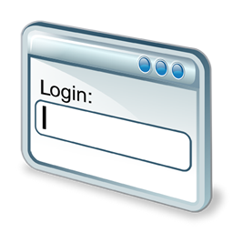

Authentication - how much assurance is “enough”?
  Security
  Experience
Authentication Strength
Multi-Factor Authentication
Public Identity Provider Federation
Authentication Delegation
Disjointed Sign-on
Global Sign-on
Reduced Sign-on
Single Sign-on

Slide 15
Demo
Multi-factor authentication via AD FS based on user’s group membership data
Related sessions:
WCA-B204 (6/5,10:15am)
WCA-B334 (6/5, 5pm)

Slide 16
Authorization - making the best access control decision possible
  Abstraction
  Type
Role-based
Attribute-based
Policy-based
Risk-based
Authorization hard-coded into the app
Abstract authorization away from the app
  Fine- / coarse-grained
Fine-grained = operation-specific
Coarse-grained = brokering access to the application as a whole

Slide 17
Demo
Multi-factor authorization via AD FS based on user group membership data
Related sessions:
WCA-B204 (6/5,10:15am)
WCA-B334 (6/5, 5pm)

Slide 18

Related content
Breakout Sessions
  WCA-B204 (6/5,10:15am)
  WCA-B334 (6/5, 5pm)
Find Me Later At: CSI booth ( or gabag@microsoft.com)

Slide 19
Resources
TechNet
msdn
  Resources for IT Professionals
  Resources for Developers
The Four Pillars of Identity - Identity Management in the Age of Hybrid IT (http://social.technet.microsoft.com/wiki/contents/articles/15530.the-four-pillars-of-identity-identity-management-in-the-age-of-hybrid-it.aspx)
Identity Infrastructure Capabilities - Managing Identity in the Age of Hybrid IT (http://social.technet.microsoft.com/wiki/contents/articles/15532.identity-infrastructure-capabilities-managing-identity-in-the-age-of-hybrid-it.aspx)
AD FS 2.0 Content Map (http://social.technet.microsoft.com/wiki/contents/articles/2735.ad-fs-2-0-content-map.aspx)
Active Directory Federation Services - www.microsoft.com/adfs
Directory integration overview - http://technet.microsoft.com/en-us/library/jj573653.aspx
Access Control Service 2.0 - http://msdn.microsoft.com/acs

Slide 20

Resources
Learning
  Sessions on Demand
  Microsoft Certification & Training Resources
http://channel9.msdn.com/Events/TechEd
www.microsoft.com/learning
TechNet
msdn
  Resources for IT Professionals
  Resources for Developers
http://microsoft.com/technet
http://microsoft.com/msdn

Slide 21




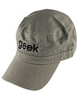

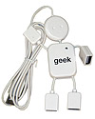
Complete an evaluation on CommNet and enter to win!

Slide 22
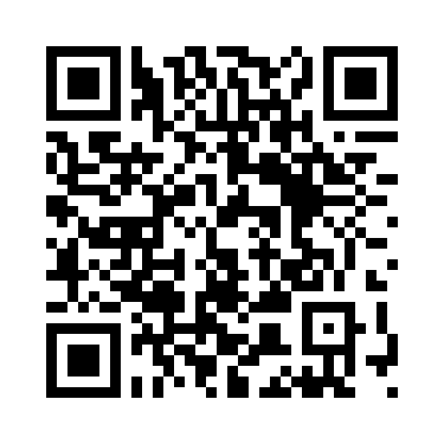


Evaluate this session
Required Slide
*delete this box when your slide is finalized
Your MS Tag will be inserted here during the final scrub.
Scan this QR code to evaluate this session and be automatically entered in a drawing to
win a prize

Slide 23

© 2013 Microsoft Corporation. All rights reserved. Microsoft, Windows and other product names are or may be registered trademarks and/or trademarks in the U.S. and/or other countries.
The information herein is for informational purposes only and represents the current view of Microsoft Corporation as of the date of this presentation. Because Microsoft must respond to changing market conditions, it should not be interpreted to be a commitment on the part of Microsoft, and Microsoft cannot guarantee the accuracy of any information provided after the date of this presentation. MICROSOFT MAKES NO WARRANTIES, EXPRESS, IMPLIED OR STATUTORY, AS TO THE INFORMATION IN THIS PRESENTATION.

