Slide 2
Patterns and Practices for the Hybrid World
ATC-B211
John Morello
Lead Architect

Slide 3
Agenda
Defining the space
What is hybrid cloud?
Hybrid app patterns
Hybrid infra patterns
Scenario walk through

Slide 4
Defining the space

Slide 5
NIST cloud attributes
Self-service
Enables automated provisioning through
a self-service portal
Broad network access
Access from anywhere on any device
Resource pooling
Enables scalability
and dynamic provisioning
Elasticity
Enables resources
to expand or contract based on demand
Measured service
Enables usage-
based resource metering

Slide 6

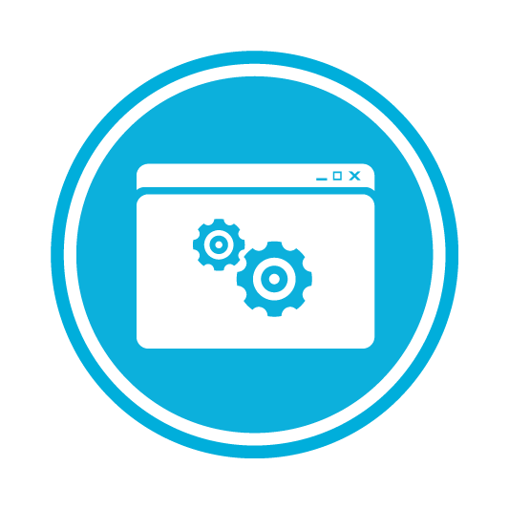
Service models
Software as a Service
Platform as a Service
Infrastructure as a Service

Slide 7



Deployment models
Private Cloud
Community Cloud
Public Cloud
Hybrid Cloud

Slide 8
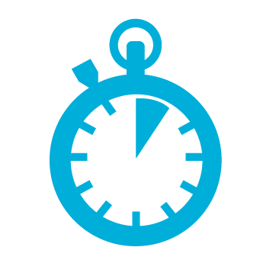




Enterprise challenges driving hybrid IT
Drive greater
IT efficiency
Reduce time
to solution
Scale
dynamically
Balance
performance
with cost
Ensure
compliance

Slide 9
What is hybrid cloud?

Slide 10
A permanent state
Gartner estimates by 2020 80% of applications will be in the cloud…
Most large enterprise customers will span across all three IT domains for the foreseeable future.
Always-on services and cloud migration are the future of IT.

Slide 11
Hybrid patterns: deployment flexibility
Deploy first on private, then move workload to public
Deploy first on public, then move workload to private

Slide 12
Hybrid patterns: composite apps
Share workloads across clouds (cloudbursting)
Run sensitive or data-intensive workloads on private, and other workloads on public

Slide 13
Hybrid patterns: resiliency
Use public cloud as a backup for private
Use private cloud as a backup for public

Slide 14
Hybrid patterns: dev flexibility
Develop on public, deploy on private
Develop on private, deploy on public

Slide 15
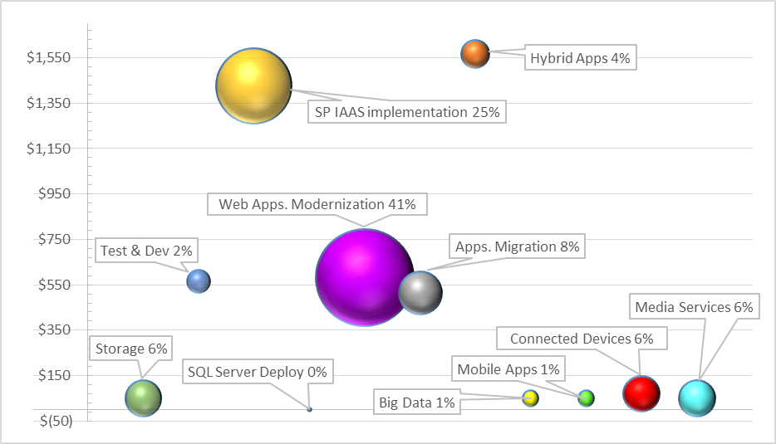
What we see in Microsoft Services

Slide 16
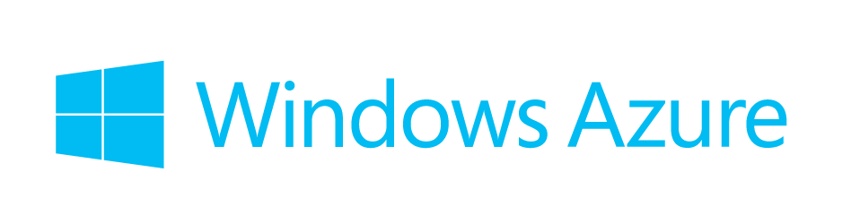


Microsoft’s hybrid cloud platform
Virtualization
Data
Identity
Development
DevOps and mgmt

Slide 17
Example apps for hybrid scenarios
Customer industry | Hybrid cloud scenario | Example apps
Financial services (USA) | Dev/test | BizTalk ESB dev /test
Government (Canada) | Disaster recovery | SQL/SP farm failover
Telecommunications (USA) | Burst to cloud | Azure Media Services and StorSimple for data archiving
Financial services (USA) | Extending to the cloud | Built cloud ESB using Azure Service Bus
Energy (Netherlands) | Extranet apps | Hybrid cloud with back-end (domain) connectivity
Telecommunications (Norway) | Dev/test | Dev / test for SharePoint
Transportation (Netherland) | Data sync | Data from on-prem is synced with the cloud
Telecommunications (Finland) | Identity federation | Identity federation for intranet apps
Energy (Denmark) | Mobile integration | Mobile apps with backend connectivity to SAP

Slide 18
Hybrid app patterns

Slide 19

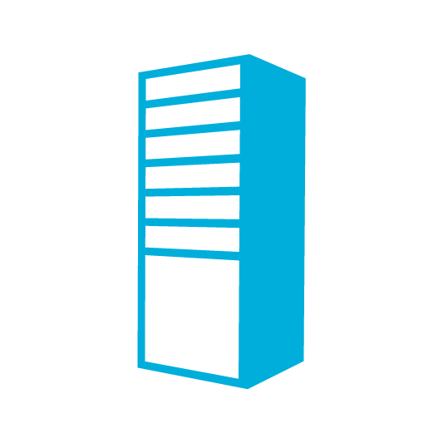

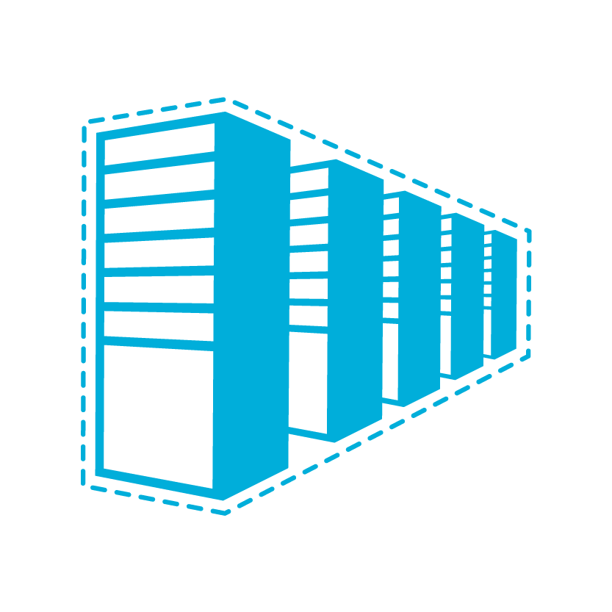

Connecting private and public
Private cloud
Public cloud
App Monitoring & Management
System Center
API
Common Framework
.NET 4.5
API
Data Synchronization
SQL Azure Data Sync
Application-Layer
Connectivity & Messaging
Service Bus
Secure Machine-to-Machine Connectivity
Windows Azure Connect
Secure Site-to-Site
Network Connectivity
Virtual Network

Slide 20
Hybrid application challenges
Deployment – refactoring code for the cloud
Identity and authentication – federation or OAuth
Cross-boundary communication and service access – how and security/policy conformance
Business logic and message routing – location and process
Data synchronization – data constraints/governance and replication
Scalability, performance and availability – managing bottlenecks and scaling up/out

Slide 21
Hybrid infra patterns

Slide 22
Hybrid IaaS definitions
Traditional
Non-virtualized
Private cloud:
On-premises
Public cloud:
off-premises
Physical servers or managing VMs and hosts individually
Non-virtualized apps
High costs, long deployment times
NIST cloud attributes
Running in your datacenter
Lower costs than traditional, higher cost than public
More flexible and customizable than public
NIST cloud attributes on shared fabric
Running in someone else’s datacenter
Lowest cost but least customizable

Slide 23









Unified management for the Cloud OS
Configure
App Controller
Orchestrator
Deploy
Self Service
Service Delivery and Automation
Virtual Machine Manager
Service Model
Operations Manager
MICROSOFT
Configuration Manager
ON
PREMISES
SERVICE
PROVIDER
Data Protection Manager
Business units
&
app owners
Service
Manager
IaaS admins
Service
Manager
Monitor
Operate
Application Management
Service Delivery and Automation
Infrastructure Management
Notes:
23

Slide 24
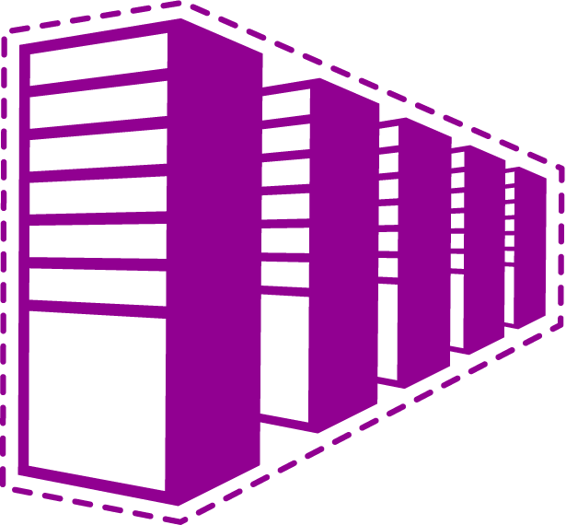
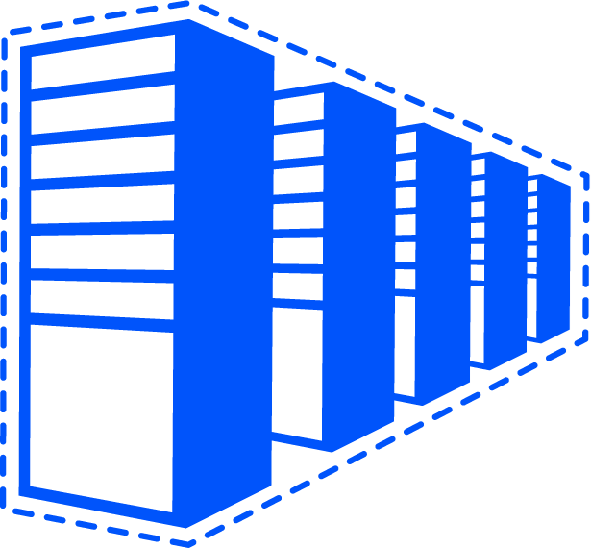
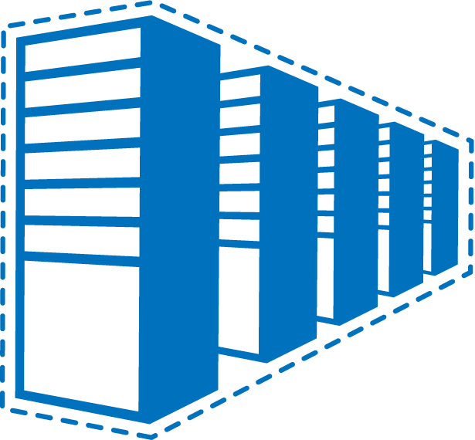
Common IaaS pattern
Contoso Production VNet in Windows Azure (10.1.0.0/16)
Contoso HQ (10.0.0.0/16)
10.1.2.0/24
10.1.3.0/24
SQL farm
IIS servers
131.57.23.120
65.52.249.22
10.1.0.4
10.1.1.4
10.0.0.10
10.0.0.11
S2S VPN tunnels
Contoso Test in Windows Azure (10.2.0.0/16)
AD / DNS
S2S VPN
Device
Exchange
BRK Gateway
10.2.2.0/24
10.2.3.0/24

Slide 25
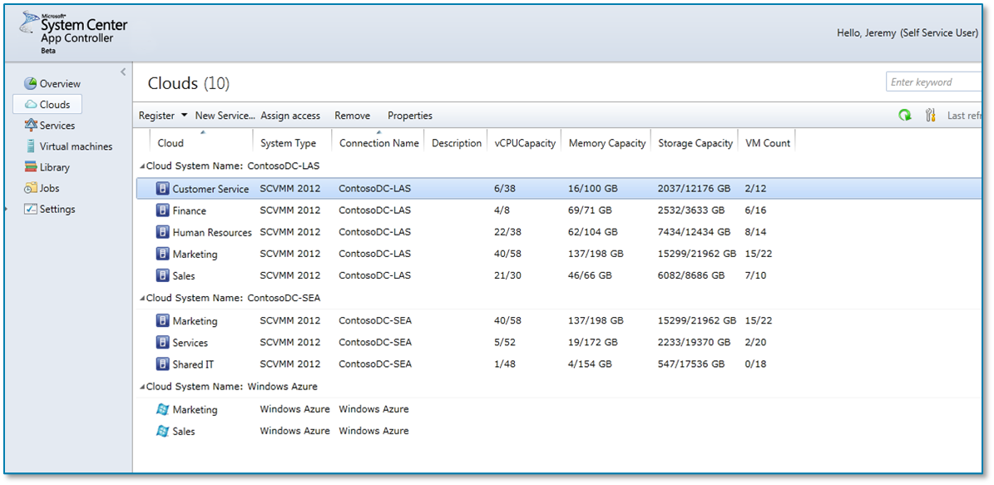


The journey
Hello, Jeremy (Self Service User)
Self-service delegation
Traditional
Virtualized
Private Cloud
Public Cloud
Clouds
Traditional
Virtualized
Private Cloud
Public Cloud
Virtual Machines
Distribution of Models Used Today
Distribution of Models Used Today
We will support your journey
on your terms
Future distribution of computing models
Future distribution of computing models
Cloud Computing is a journey
Single pane of glass visibility to your applications across your private cloud and Windows Azure
Physical, virtual & cloud management
Applications self-service across clouds
Physical, virtual & cloud management
Applications self-service across clouds

Slide 26
Scenario walk through

Slide 27
The power of “and”
It’s not a choice between PaaS or IaaS or public or private
For the rest of our careers, the future is hybrid, combining the right pieces from each
Balance cost, agility, and legacy needs to find the patterns right for you

Slide 28
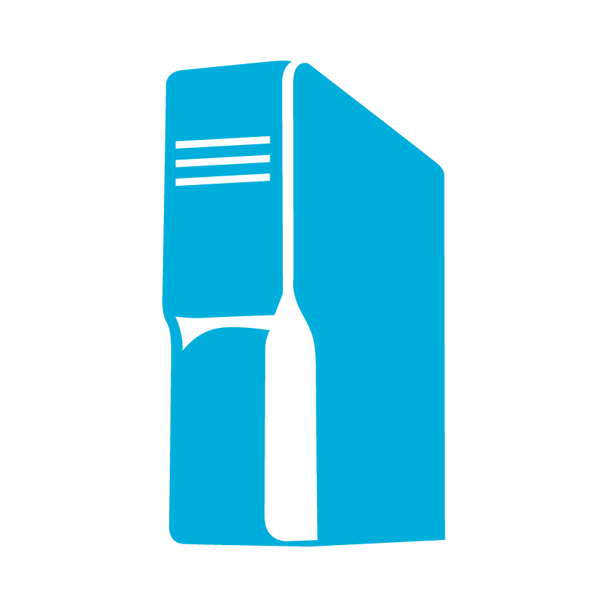








Putting it together
Satellite and cable media content distributors
Sharing information
  Distributing media to millions subscribers
  Making data accessible to more variety of devices
  Sharing analytics BI data across media providers
On-premises
Content subscribers
Storing data
  On premise Live broadcasting using cloud for reliability
  Mobile applications using cloud for accessibility
  VOD apps using cloud storage for data capacity
Mobile Apps

Slide 29
Example scenario – media broadcaster
Traditional
Private IaaS
Public IaaS
SaaS
PaaS
SP Media Library
Buy
Video On Demand
Live Streaming
“Too costly to run this myself, and I’ve made too many customizations”
Media Archiving
DRM Content
Build
Analytics
Ad Insertion

Slide 30
Example scenario - media broadcaster
Traditional
Private IaaS
Public IaaS
SaaS
PaaS
SP Media Library
Buy
Video On Demand
Live Streaming
Media Archiving
DRM Content
Build
Analytics
Ad Insertion
“Media encoding is a commodity service – it’s a compute intensive task that is cheaper for someone else to run”

Slide 31
Example scenario - media broadcaster
Traditional
Private IaaS
Public IaaS
SaaS
PaaS
SP Media Library
Buy
Video On Demand
Live Streaming
Media Archiving
DRM Content
Build
Analytics
Ad Insertion
“I wish I could use elasticity and the scalability of the cloud when broadcasting major events in live mode.”

Slide 32
Example scenario - media broadcaster
Traditional
Private IaaS
Public IaaS
SaaS
PaaS
SP Media Library
Buy
Video On Demand
Live Streaming
Media Archiving
DRM Content
Build
Analytics
Ad Insertion
“I can’t afford to keep extending and maintaining this SAN storage. I’m going to offload it to the cloud.”

Slide 33
Example scenario - media broadcaster
Traditional
Private IaaS
Public IaaS
SaaS
PaaS
SP Media Library
Buy
Video On Demand
Live Streaming
Media Archiving
DRM Content
Build
Analytics
Ad Insertion
“I want a way to securely expose DRM protected media assets to my intranet users and keep the media content heavily encrypted.”

Slide 34
Example scenario - media broadcaster
Traditional
Private IaaS
Public IaaS
SaaS
PaaS
SP Media Library
Buy
Video On Demand
Live Streaming
Media Archiving
DRM Content
Build
Analytics
Ad Insertion
“I wish I had access to analytics of media usage to better direct my Ads and channel programming.”

Slide 35
Example scenario - media broadcaster
Traditional
Private IaaS
Public IaaS
SaaS
PaaS
SP Media Library
Buy
Video On Demand
Live Streaming
Media Archiving
DRM Content
Build
Analytics
Ad Insertion
“We’re going to make the strategic decision to keep this in place right now.”

Slide 36
Summary

Slide 37
If you only remember 3 things…
Hybrid is not a temporal transition state, it is our long term reality
Power of ‘and’… combine the best of all options to balance your goals and constraints
Common app, identity, management, and virtualization across Cloud OS

Slide 38

Related content
ATC-B303: Bridging the Gap: Securely Connecting Windows Azure and Private Clouds
MDC-B318: Enabling Multi-Tenant IaaS Clouds in Microsoft System Center and Windows Server
MDC-B360: Hybrid Networking Offerings in Windows Azure
MDC-B361: Best Practices from Real Customers: Deploying to Windows Azure Infrastructure Services (IaaS)

Slide 39
Trustworthy Computing Resources
Trustworthy Computing (TwC) is a long-term, collaborative effort to deliver more secure, private,
and reliable computing experiences for everyone.
Learn more at:
http://microsoft.com/twc
Cloud Security Readiness Tool
Pass the Hash Guidance
Data, Insights and Guidance (Security Intelligence Report, volume 14)
and more…

Slide 40

Resources
Learning
  Sessions on Demand
  Microsoft Certification & Training Resources
http://channel9.msdn.com/Events/TechEd
www.microsoft.com/learning
TechNet
msdn
  Resources for IT Professionals
  Resources for Developers
http://microsoft.com/technet
http://microsoft.com/msdn

Slide 41






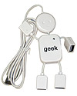
Complete an evaluation on CommNet and enter to win!

Slide 42



Evaluate this session
Required Slide
*delete this box when your slide is finalized
Your MS Tag will be inserted here during the final scrub.
Scan this QR code to evaluate this session and be automatically entered in a drawing to
win a prize

Slide 43

© 2013 Microsoft Corporation. All rights reserved. Microsoft, Windows and other product names are or may be registered trademarks and/or trademarks in the U.S. and/or other countries.
The information herein is for informational purposes only and represents the current view of Microsoft Corporation as of the date of this presentation. Because Microsoft must respond to changing market conditions, it should not be interpreted to be a commitment on the part of Microsoft, and Microsoft cannot guarantee the accuracy of any information provided after the date of this presentation. MICROSOFT MAKES NO WARRANTIES, EXPRESS, IMPLIED OR STATUTORY, AS TO THE INFORMATION IN THIS PRESENTATION.

