Slide 2
The Cloud:
Making the move to a Hybrid World!
ATC-B213
Andy Malone MVP, MCT
Quality Training (UK) Senior Instructor / Consultant
Andrew.malone@quality-training.co.uk
www.divedeeperevents.com

Slide 3

Andy Malone
Follow me on Twitter @AndyMalone
Microsoft MVP (Enterprise Security)
Founder: Cybercrime Security Forum!
Microsoft International Event Speaker
MCT (18 Years)
Winner: Microsoft Speaker Idol 2006

Slide 4
Agenda
The Changing World of Software
What is Hybrid?
The Changing World of Identity
Why Should I Go Hybrid?
How do I Get Started?
Planning for Hybrid
Implementation
Troubleshooting Hybrid!
Best Practices
Review

Slide 5
The Way we Used to Connect!
mycompany.local
The Client Access Model
Users Connect to Internal Central Network
Centralised User Management
Centralised Software Deployment
Centralised Desktop Management (GPO)
Average 5 Year Hardware Refresh
Average 4 Year Software Refresh
SMB’s Typically Use 3rd Party Consultants / Support
High Software Licensing Costs

Slide 6
Today Life is More Complex!
My Company
The Internet
Access Via an Array of Devices
Cloud Storage
International Subsidiaries
My Partner

Slide 7


Slide 8
In this New World Size Matters
The One Man Band
Small Business
Medium Size Business
Enterprise

Slide 9
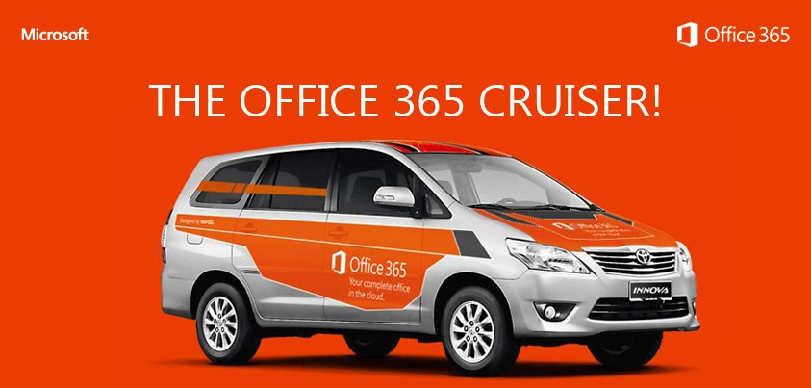
The Changing World of Software!

Slide 10

The Changing World of Software
Many vendors are changing traditional Licencing models moving to Cloud based Subscriptions.
Benefits mean that Users Always Have the Latest Version!
BYOD: Strategies Require complex Identity Solutions
Software Solutions have to Authenticate & Authorise Users on Multiple Platforms
Apps need a Set of Common Standards
Must be easily & Quickly Deployed
Data must be Secure!

Slide 11

What is Hybrid?
Provides the ability to adopt a Cloud solution whilst Maintaining on-going Application relationships with current on-prem Solutions.
Admins can manage both On Prem & In-cloud systems Simultaneously as One Entity!
Provides an Ideal Platform to Off Board certain Users, Mailboxes for Compliance reasons.

Slide 12

Why Should I Consider Hybrid?
Customer has already invested in an Exchange / Lync / SharePoint On-Site Solution
Want’s to Move to Cloud but needs to Maintain a Level of Coexistence
Needs to Manage User Accounts / Permissions Internally
Wants to Provide SSO Solution to Users in Cloud
Compliance / Legal Issues
Plus Many More…

Slide 13
Key Hybrid Features
Federation Trust
Delegated authentication for on-premises/cloud web services
Integrated Admin Experience
Manage all of your Exchange functions, whether cloud or on-premises from the same place - Exchange Administration Center (EAC)
Native Mailbox Move
Online mailbox moves
Preserve the Outlook profile and offline file (OST)
Secure Mail Flow
Authenticated and encrypted mail flow
Preserves the internal Exchange messages headers
Support for compliance mail flow scenarios (central transport)
Enables Free/Busy, calendar sharing, message tracking, online archive, and more
Leverages the Mailbox Replication Service (MRS)

Slide 14
Coexistence Feature Comparison
Feature | Simple | Hybrid
Mail routing between on-premises and cloud (recipients on either side) | ■ | ■
Mail routing with shared namespace (if desired) on both sides | ■ | ■
Unified GAL | ■ | ■
Free/Busy and calendar sharing cross-premises |  | ■
Out of Office understands that cross-premises is “internal” to the organization |  | ■
Mailtips, messaging tracking, and mailbox search work cross-premises |  | ■
OWA redirection cross-premise (single OWA URL for both on-premises and cloud) |  | ■
Single tool to manage cross-premises Exchange functions (including migrations) |  | ■
Mailbox moves support both onboarding and offboarding |  | ■
No outlook reconfiguration or OST resync required after mailbox migration |  | ■
Preserve auth header (ensure internal email is not spam, resolve against GAL, etc.) |  | ■
Centralized mail flow , ensures that all email routes inbound/outbound via on-prem |  | ■

Slide 15
Preparing to go Hybrid!

Slide 16

Hybrid Requirements!
Minimum AD 2003 Forrest Functional Role
Live DNS Name & Validation via On-line Portal
External SSL Certificate!
All Users Must have a Valid UPN
Dirsync (Write Back!)
Install ADFS 2.0 Server (High Availability Design)
Microsoft Online Services Module for Windows PowerShell
Microsoft Online Sign In Assistant
Unlike other Migration Solutions to Office 365. Hybrid Requires an On-Prem Client Access Server (CAS Exchange Server 2013 / 2010 SP3 Role) It’s FREE!!

Slide 17
Hybrid – Deployment Process
Sign up for Office 365
Register your domains with Office 365
Deploy Office 365 Directory Sync
Install Exchange 2013 CAS & MBX Servers
(Edge opt)
Publish the CAS Server
(Assign SSL certificate, firewall rules)
Run the Hybrid Wizard
General Office 365 deployment tasks
Exchange specific deployment tasks
(deep dive on next slide)
Demo

Slide 18
Demo
Planning for Hybrid!

Slide 19
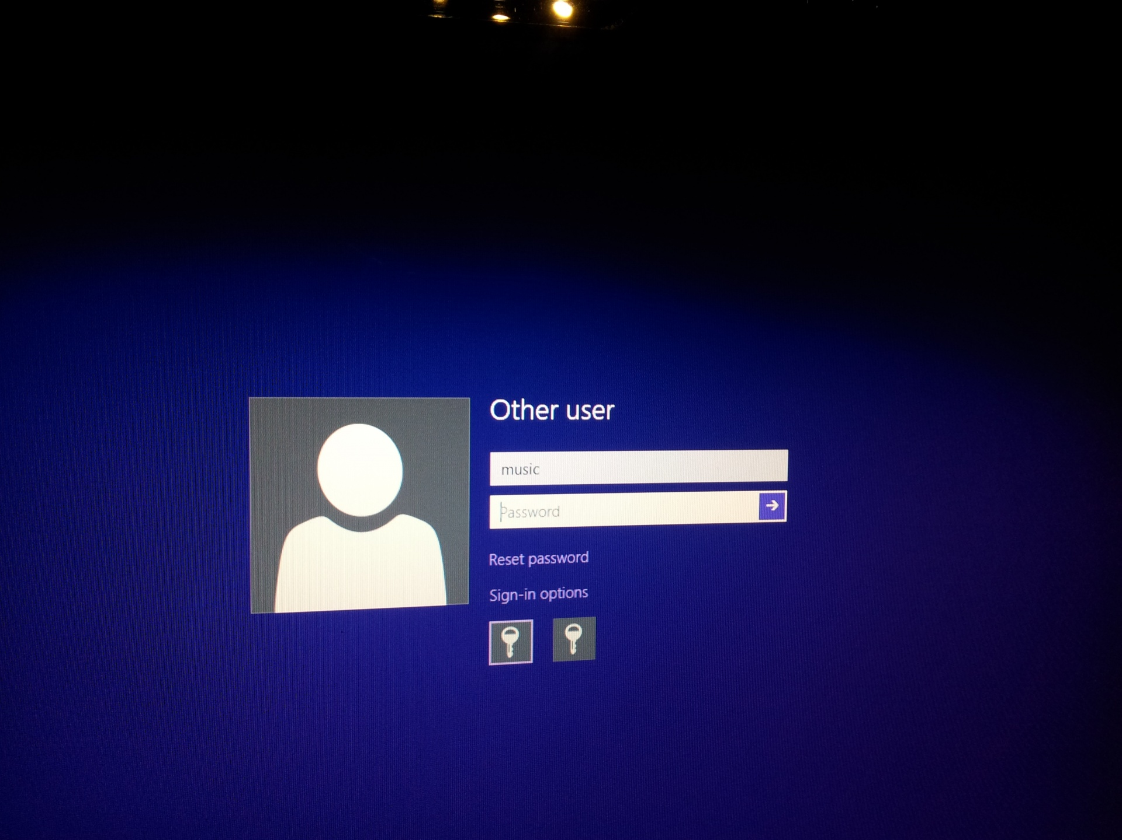
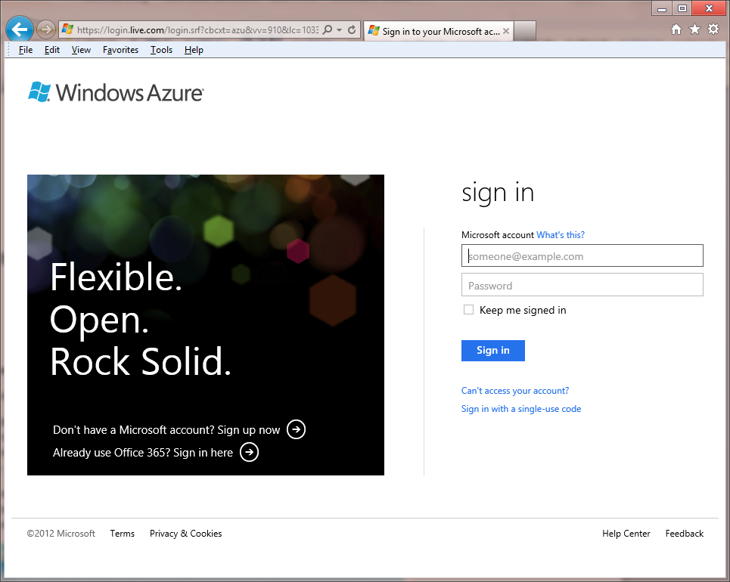
Identity Architecture and Integration Options
Cloud Identity
Federated Identity
  Separate credential from on-premises credential
  Authentication occurs via cloud directory service
  Password policy is stored in Office 365
  Does not require on-premises server deployment
  Same credential as on-premises credential
  Authentication occurs via on-premises directory service
  Password policy is stored on-premises
  Requires on-premises DirSync server
  Requires on-premises ADFS server
Single Sign On!

Slide 20


Identity Architecture and Integration Options
No Integration
Directory Data Only
Directory and Single sign-on (SSO)
Exchange
Online
Windows Azure Active Directory
Authentication platform
SharePoint
Online
Contoso customer premises
Trust
Active Directory Federation Server 2.0
Admin Portal/
PowerShell
IdP
Lync
Online
IdP
MS Online Directory Sync
Provisioning
platform
Directory
Store
AD
Office
Subscription Services
Office 365 Desktop Setup

Slide 21
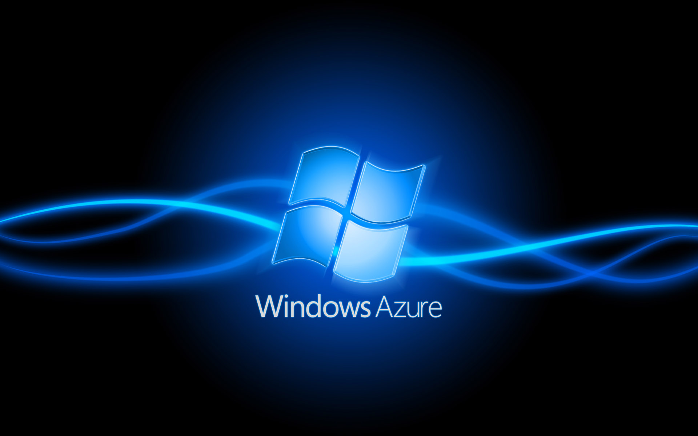
Windows Azure AD

Slide 22

Identity Challenge!
Cloud
app
Cloud
app
Cloud
app
Separate username/password sign-in
Manual or semi-automated provisioning
No direct connection to directory
AD
While enterprises work to consolidate identity system on-premises, cloud apps are fragmenting identity… again

Slide 23
What is Windows Azure Active Directory?
Cloud
app
Customized Version of ADLDS / ADAM, SQL
Every Office 365 Customer is an Azure AD Tennant
Designed primarily to meet the needs of cloud applications
Extends Customers Active Directory into the cloud
Think of it as a Fish on a Hook!
Identity as a service: essential part of Platform as a Service
Azure
AD
Cloud
app
Cloud
app
AD

Slide 24
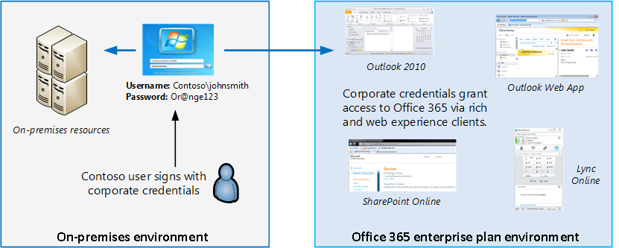
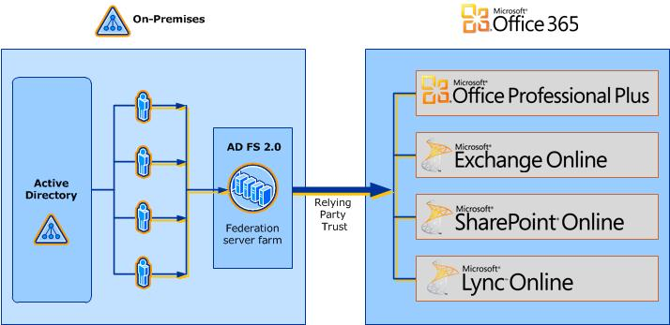
ADFS (The Nice guy in the Middle!)
Active Directory Federation Services 2.0 (2.1 in WS2012)
Enables SSO access
Provides On Premises Policy and Control
Single Active Directory forest
Requires unique third-party SSL certificate
establish a relying party trust relationship

Slide 25
Demo
Installing Active Directory Federation Services 2.0

Slide 26
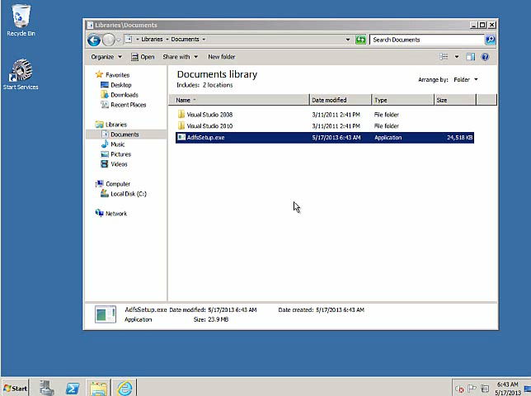

Slide 27


Authenticating Into the Cloud With SSO
Customer
Microsoft Online Services
User
Source ID
Logon (SAML 1.1) Token
UPN:user@contoso.com
Source User ID: ABC123
Auth Token
UPN:user@contoso.com
Unique ID: 254729

Slide 28
Provisioning Your Users: Options
Provisioning –
Manual
Tools
Admin Portal(s)
Provisioning - Automated
Tools
PowerShell cmdlets
GRAPH API
Synchronization
Tools
DirSync, FIM + Connector
Login:
Managed Identities Only
Login:
Managed Identities Only
Login:
Managed and Federated IDs
Services:
No Hybrid Services
Services:
No Hybrid Services
Services:
Hybrid Services Capable
Volume:
Low volume
Volume:
Low to Medium Volume
Volume:
High Volume
Complexity/Cost:
Low complexity
Complexity/Cost:
Can be high complexity
Complexity:
Varies*

Slide 29
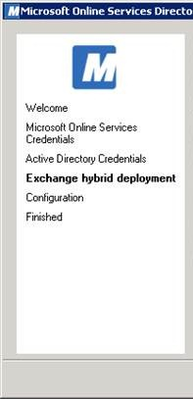
What is Dirsync?
Enables coexistence
  Provisions objects in Office 365 with same email addresses as the objects in the on-premises environment
  Provides a unified Global Address List experience between on-premises and Office 365
    Objects hidden from the GAL on-premises are also hidden from the GAL in Office 365
  Enables coexistence for Exchange
    Works in both simple and hybrid deployment scenarios
  Enabler for mail routing between on-premises and Office 365 with a shared domain namespace
  Enables coexistence for Microsoft Lync

Slide 30
Dirsync Implementation Options
1 Way Sync from AD to Cloud
  Provisions users, DLs, Security Groups and contacts
  Can move to 2 Way Sync later
  on-premises master for all objects and properties
2 Way Sync from AD to Cloud and Cloud to AD
  Required for Hybrid Deployments e.g. co-existence with Exchange online and Exchange on-premises
  Cannot move back to 1 way sync
  Cloud becomes master for certain properties (safe senders, mail co-existence, UM)

Slide 31
Dirsync: Changing the Synchronization Schedule
Default is Every 3 Hours
  “Start-OnlineCoexistenceSync” cmdlet can manually force a manual sync
Synchronization can be re-scheduled here!
  First navigate to the following directory on your DirSync Server. C:\Program Files\Microsoft Online Directory Sync\
  Locate service executable that is used to run the DirSync scheduleLocate the following lines within the Microsoft.Online.DirSync.Scheduler.exe.config file:
  <add key="SyncTimeInterval" value="3:00:0" />
  Edit the time within this file to reduce the sync schedule; for example to reduce the time to every 30 minutes use the following values: <add key="SyncTimeInterval" value="0:30:0" />
  Finally open the Services console (Start>Run>Services.msc) and restart the Microsoft Online Services Directory Synchronization Service.

Slide 32
Dirsync: Hybrid Deployment
Attribute | Feature
SafeSendersHash BlockedSendersHash SafeRecipientHash | Safelist Aggregation (a.k.a. Filtering Coexistence ) enables on-premise filtering using cloud safe/blocked sender info
msExchArchiveStatus | Cloud Archive Allows users to archive mail to the Office 365 service
ProxyAddresses (cloudLegDN) | Mailbox off-boarding Enables off-boarding of mailboxes back to on-premise
cloudmsExchUCVoiceMailSettings | Voicemail Co-Existence Used for Exchange Unified Messaging-Microsoft Lync Server 2010 integration to indicate to on-premises Lync Server that the user has voice mail in the cloud
Enables DirSync “Write Back”
  Easily move mailboxes back to on-premise (off-boarding)
  Enables Safelist Aggregation (a.k.a. Filtering Coexistence)
  Enables cloud archive
Requires on-premises Hybrid Server deployment

Slide 33
Demo
Installing & Configuring Dirsync

Slide 34


Slide 35
Hybrid: One Giant Leap for IT!

Slide 36
Migration Options to Office 365 *
IMAP Migration
  Supports wide range of email platforms
  Email only (no calendar, contacts, or tasks)
Cutover Exchange Migration (CEM)
  Good for fast, cutover migrations
  No migration tool or computer required on-premises
Staged Exchange Migration (SEM)
  No migration tool or computer required on-premises
  Requires Directory Synchronization with on-premises AD
 | IMAP migration | Cutover migration | Staged migration | 2010 Hybrid | 2013 Hybrid
Exchange 5.5 | ■
Exchange 2000 | ■
Exchange 2003 | ■ | ■ | ■ | ■
Exchange 2007 | ■ | ■ | ■ | ■ | ■
Exchange 2010 | ■ | ■ |  | ■ | ■
Exchange 2013 | ■ | ■ |  |  | ■
Notes/Domino | ■
GroupWise | ■
Other | ■
Simple Migrations
Hybrid Deployment
  Manage users on-premises and online
  Enables cross-premises calendaring, smooth migration, and easy off-boarding
Hybrid
* Additional options available with tools from migration partners

Slide 37
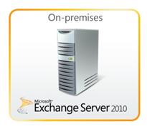
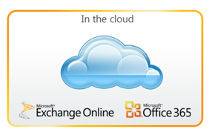




Hybrid: Migration to Office 365
Pilot Office 365
Large Migrations
Migrate users to the cloud at your own pace
Minimal or no disruption in Service

Slide 38
Hybrid: Coexist with Office 365
Maintain a hybrid Exchange environment indefinitely
Organizational Requirements
Public Folders
Legacy, email-enabled line-of-business applications
Compliance
Easy Off Boarding
Mergers and acquisitions
Mailbox
Archive
Mailbox
Mailbox

Slide 39
Hybrid: Considerations
Highly Configurable
Networks – Think about Regional Datacenter Locations
Regulatory and Compliance requirements
Manageability
  Deployment and Maintenance
  Lifecycles
Workloads not available in Exchange Online
  Outlook 2003
  Public Folders
  Limits
  Address Lists
  Permissions
  Multiple Forests

Slide 40
Hybrid – End User Experience
If configured for SSO, users login with their AD credentias. Otherwise, admin needs to distribute new passwords to users.
User’s current Outlook profile is updated with the Exchange Online server name via Autodiscover.
Offline files (OST files) do not have to be recreated.
Remember to Activate Users in Portal!

Slide 41
Decision Made.. Where do I Start
Exchange Server Deployment Assistant
  On-Premises Only
    Upgrade from Exchange Server 2003
    Upgrade from Exchange 2007
    Upgrade from mixed Exchange 2003 and Exchange Server 2007
    New installation of Exchange 2010
  Hybrid Deployment (On-Premises + Cloud)
    Exchange 2003
    Exchange 2007
    Exchange 2010
    Exchange 2013
  Cloud Only

Slide 42
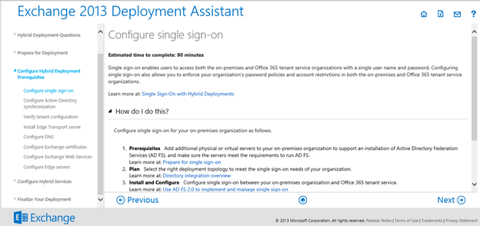
Exchange 2013 Deployment Assistant

Slide 43
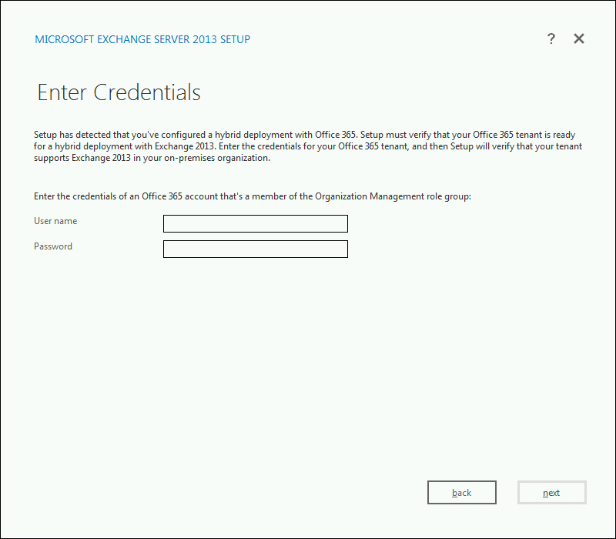
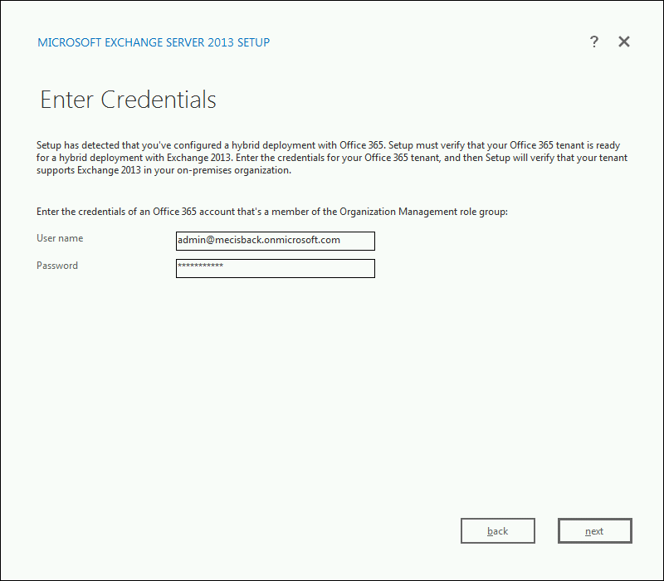
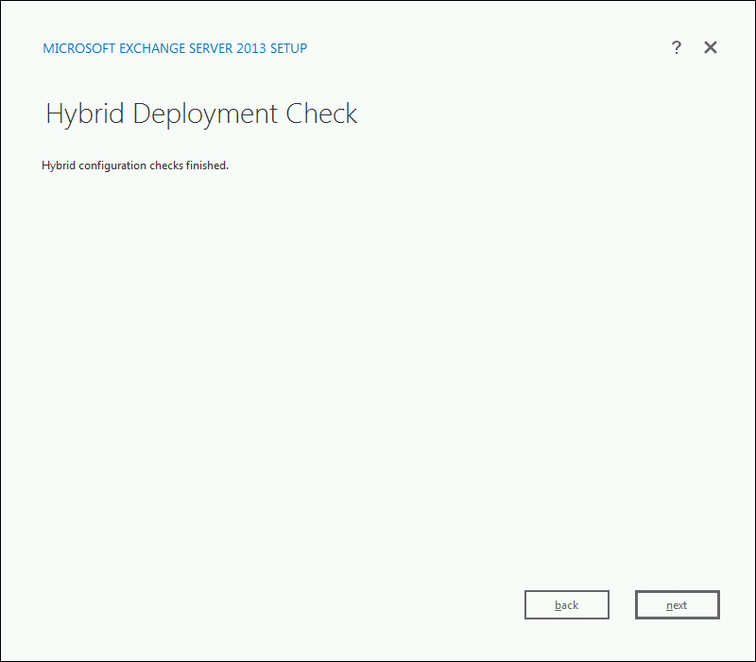
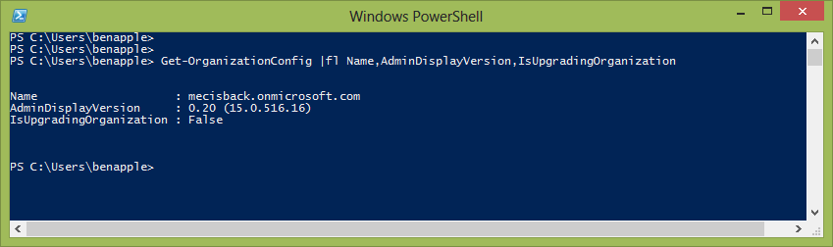

Slide 44
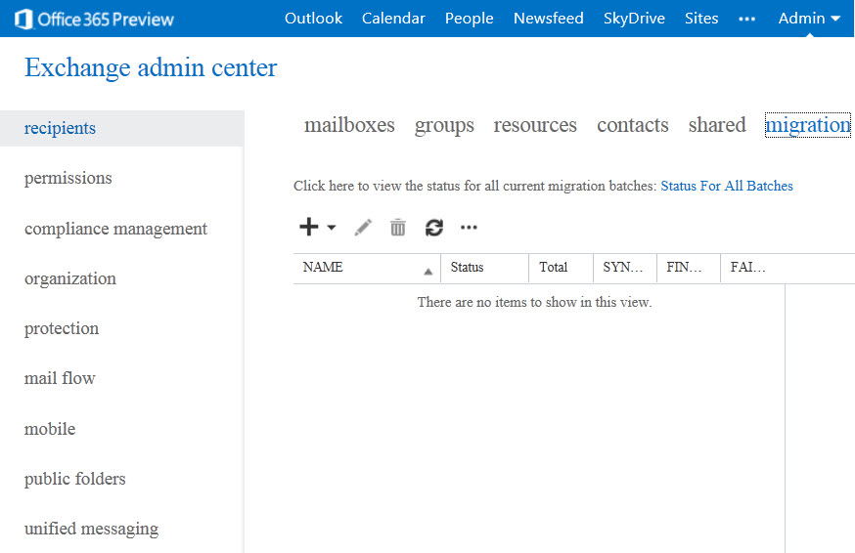
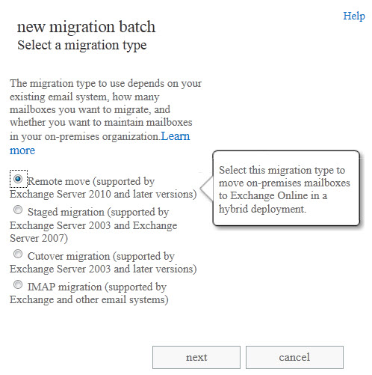
  In EAC, select
  recipients | migration
Migration Tool
launched from
Exchange Admin Center (EAC)
  Start migration wizard
  Choose hybrid remote move and follow prompts

Slide 45

  Set of Hybrid Move Cmdlets
New-MoveRequest
Get-MoveRequest
Get-MoveRequestStatistics
Suspend-MoveRequest
Resume-MoveRequest
Remove-MoveRequest
Migration Tools
also available via PowerShell

Slide 46
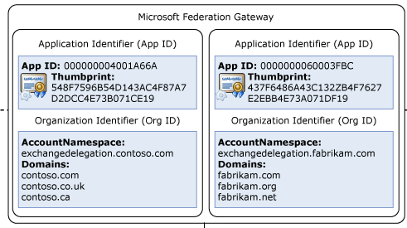
Microsoft Federation Gateway
Identity service that runs over the Internet
Uses SSL certificates and proof of domain ownership
Establish trust relationships with multiple partners
O365 Tenant automatically creates Federation Trust
Create
Auto
Org Relationship

Slide 47
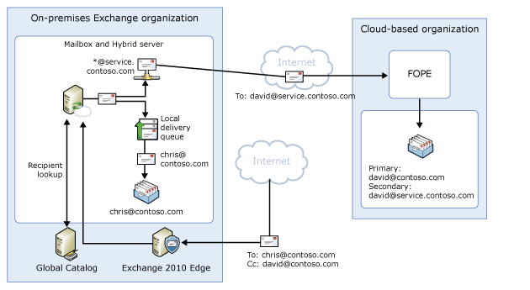
Hybrid: Mail Flow
Shared SMTP Namespaces
Secured and Authenticated Mail Flow
  Channel Privacy
  Receiver Authentication with Domain Validation
  Sender Authentication
Each organization treats the other one as an internal

Slide 48
Hybrid Considerations
Single AD Forest and Domain
20,000 Objects limit
  Contact support to increase
UPN
  Federated domain should be public (.local ?)
Set up single sign-on before AD synchronization.
High Availability
Network Security
  Inbound; 25 TCP and 443 TCP
  Outbound; 25 TCP, 80 TCP and 443 TCP
Bandwidth

Slide 49
Hybrid Considerations
Outlook 2010 / 2013 for best experience
  Outlook 2007, 2010
Unified Messaging
Mobile Devices
  Partnership should be disabled and re-enabled
Licenses
Public Folders
All Management from On Premises
No transfer of permissions
DNS Records
  Autodiscover, spf

Slide 50
Things to Consider - Certificates
Active Directory Federation Services
  Security token services(sts.contoso.com)
Exchange federation
  Self Signed can be used
Exchange services
  Autodiscover(autodiscover.contoso.com)
  OWA
  ActiveSync
  EWS
  Outlook Anywhere
Transport
  FQDN of your Exchange 2010 hybrid server

Slide 51
Hybrid Configuration
Coexistence domain
  Adds as accepted domain <domain>.mail.onmicrosoft.com
  Adds as secondary proxy domain to any e-mail address policies
Exchange federation
  Check for an existing federation trust
  Use Existing or Create a federation trust
  Create and Configure organizational relationships
  Enable free/busy sharing, Outlook Web App redirection, message tracking, and MailTips
Mailbox Moves
  Enable the Mailbox Replication Service (MRS) proxy
Mail flow
  Configure On Premises Servers and FOPE for Mail Routing

Slide 52








Exchange 2013 hybrid deployment from an existing Exchange 2007 or 2010 environment—with Edge Transport server
Clients
Office 365
1. Prepare
    Install Exchange SP and/or updates across the ORG
    Prepare AD with E2013 schema
autodiscover.contoso.com
mail.contoso.com
5
Autodiscover & EWS
SMTP
2. Deploy Exchange 2013 servers
    Install both E2013 MBX and CAS servers
    Install E2010 EDGE servers
    Set an ExternalUrl for the Exchange Web Services vdir
1
2
4
Exchange 2010 or 2007 Servers
E2010 or 2007 Hub
E2010 or 2007 CAS
E2013 CAS
E2010 EDGE
3. Obtain and Deploy Certificates
  Obtain and deploy certificates on E2013 MBX and CAS servers & E2010 EDGE servers
3
SP/RU
SP/RU
4. Publish protocols externally
    Create public DNS A records for the EWS and SMTP endpoints
    Validate using Remote Connectivity Analyzer
Intranet site
6
5. Switch autodiscover namespace to E2013 CAS
    Change the public autodiscover DNS record to resolve to E2013 CAS
E2010 or 2007 MBX
7
E2013 MBX
Internet facing site
6. Run the Hybrid Configuration Wizard
7. Move mailboxes

Slide 53
Walkthrough
Going Hybrid!

Slide 54
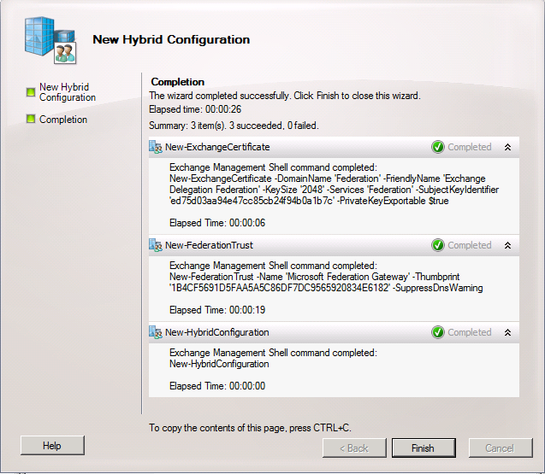
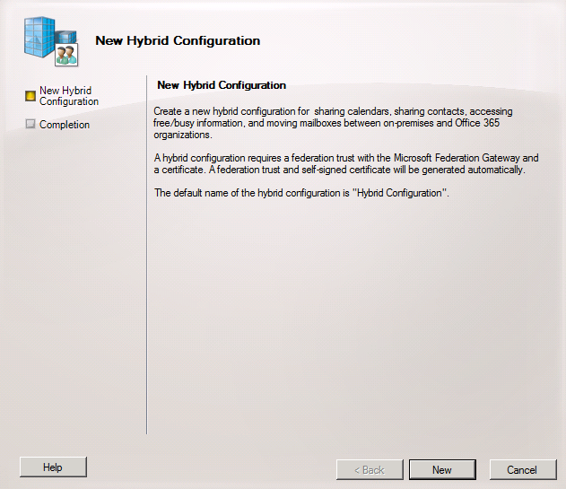
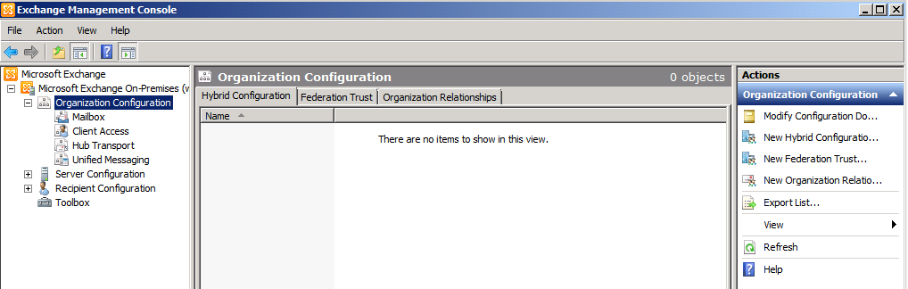
New Hybrid Configuration

Slide 55
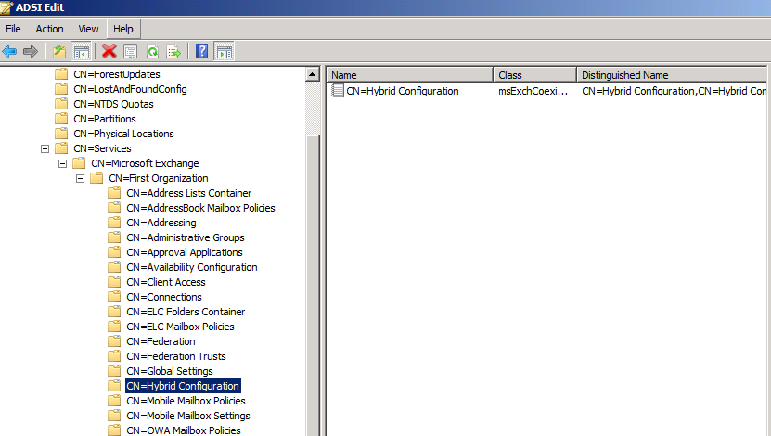
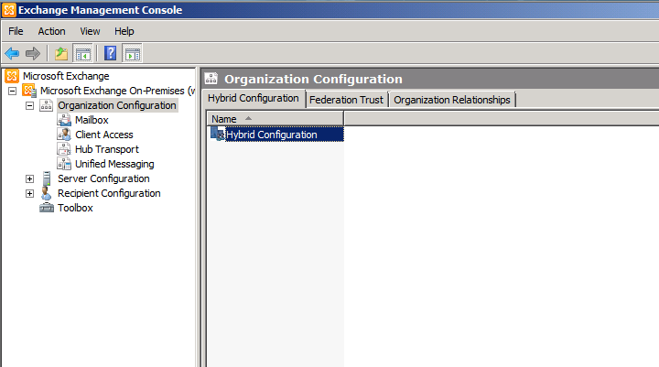
Demo

Slide 56
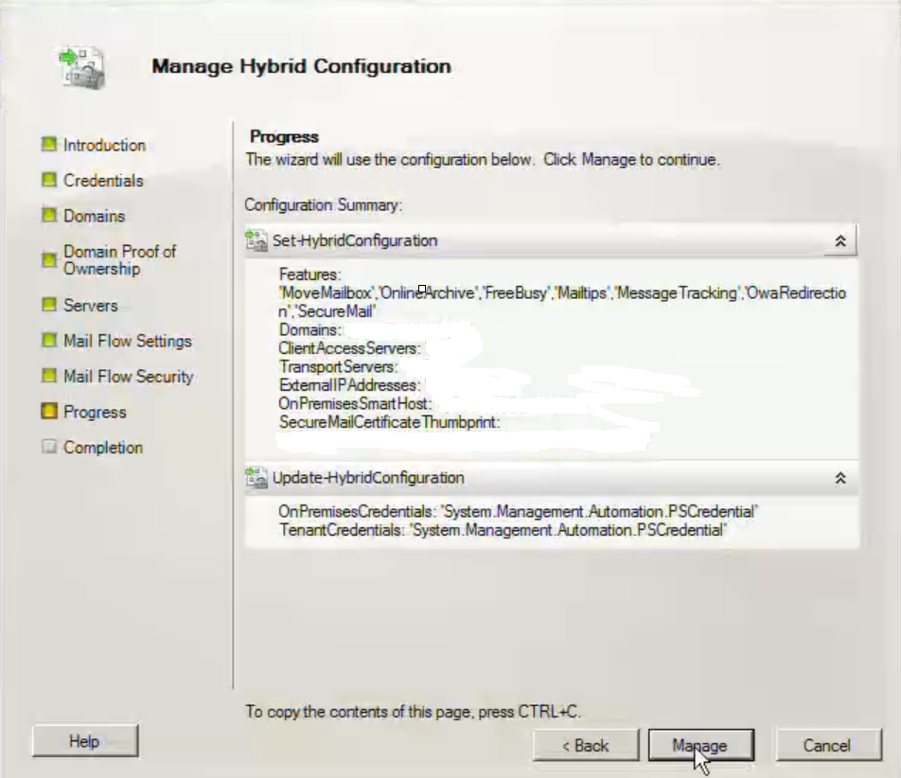
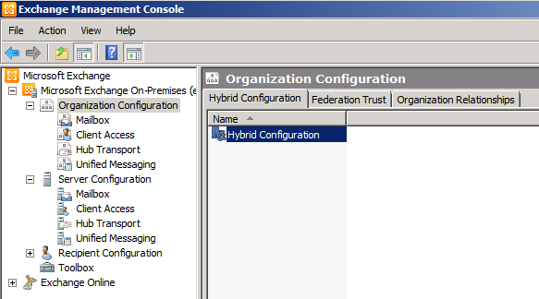
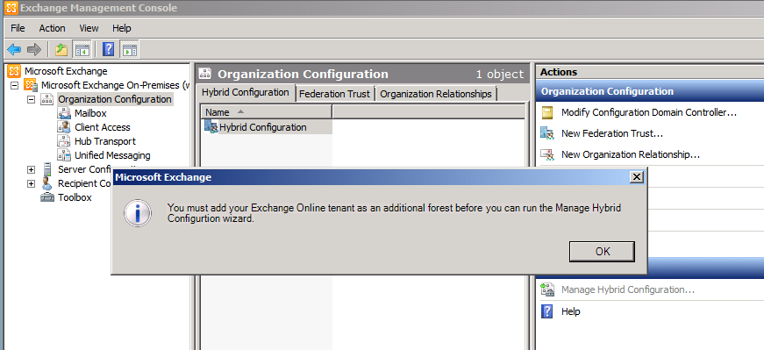
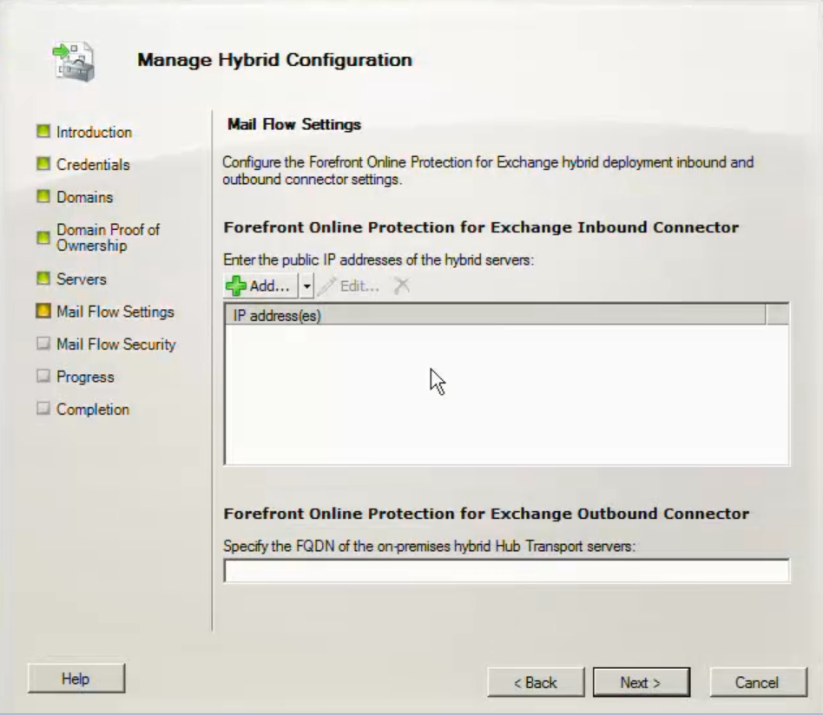
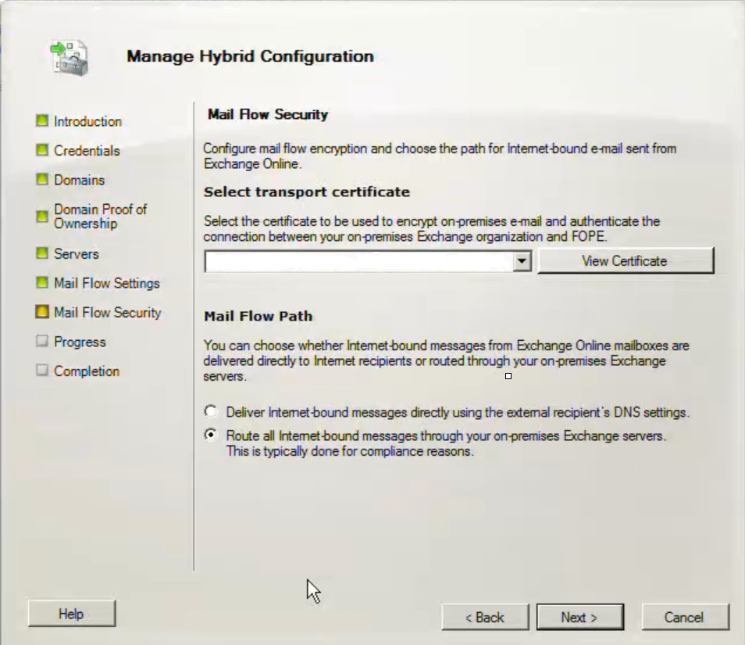
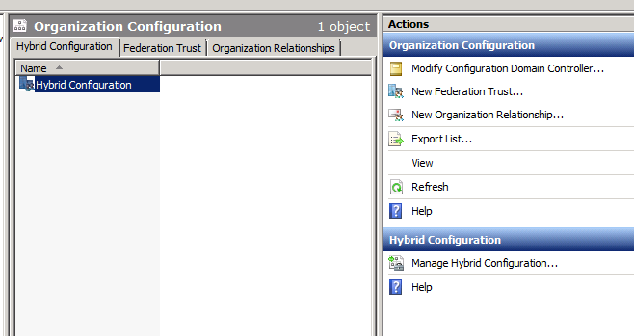
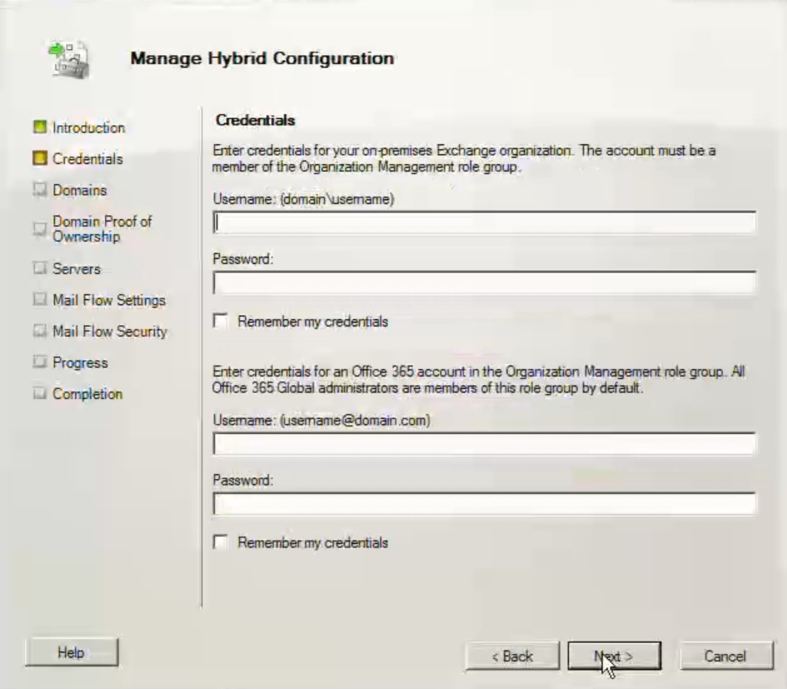
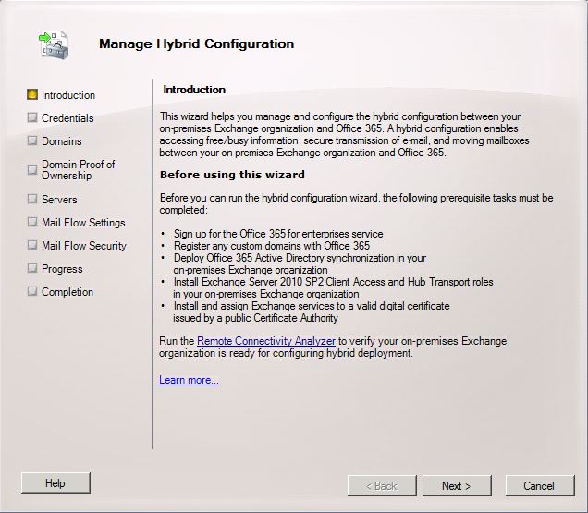
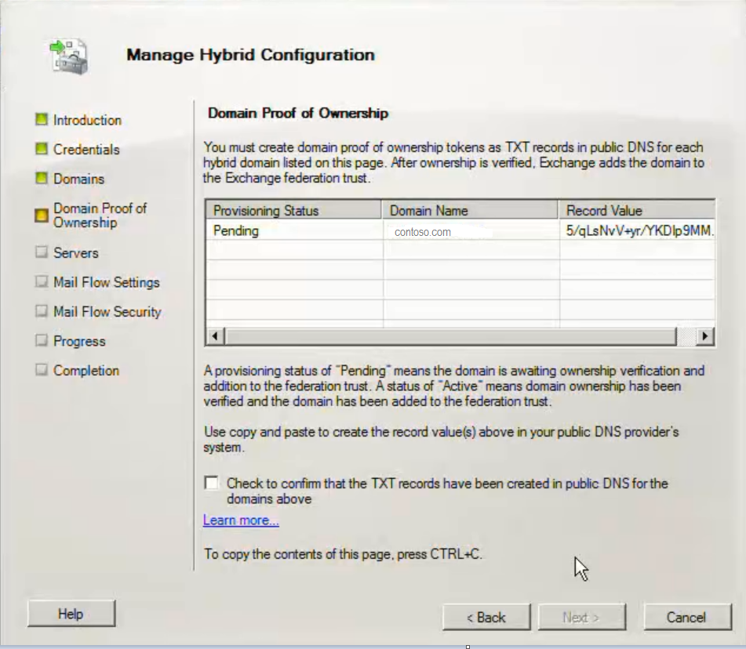
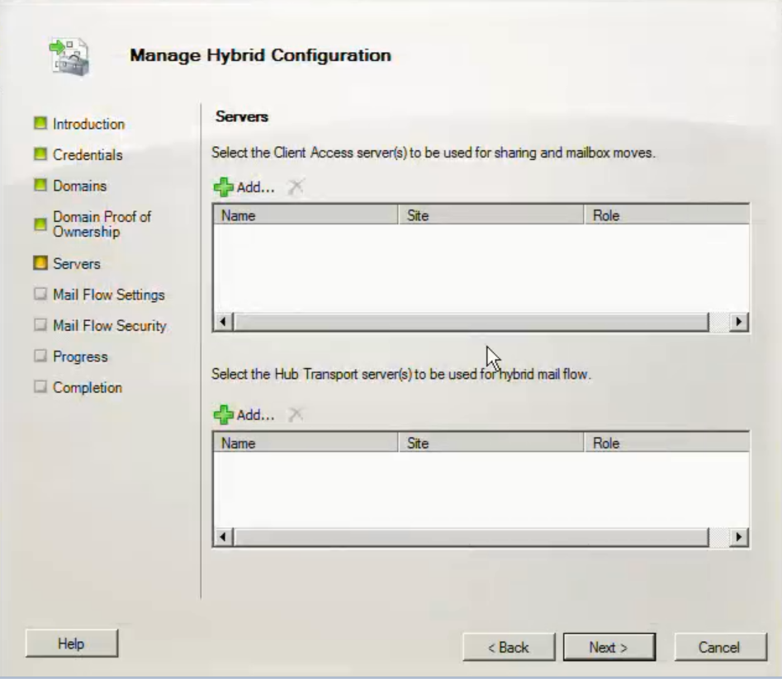
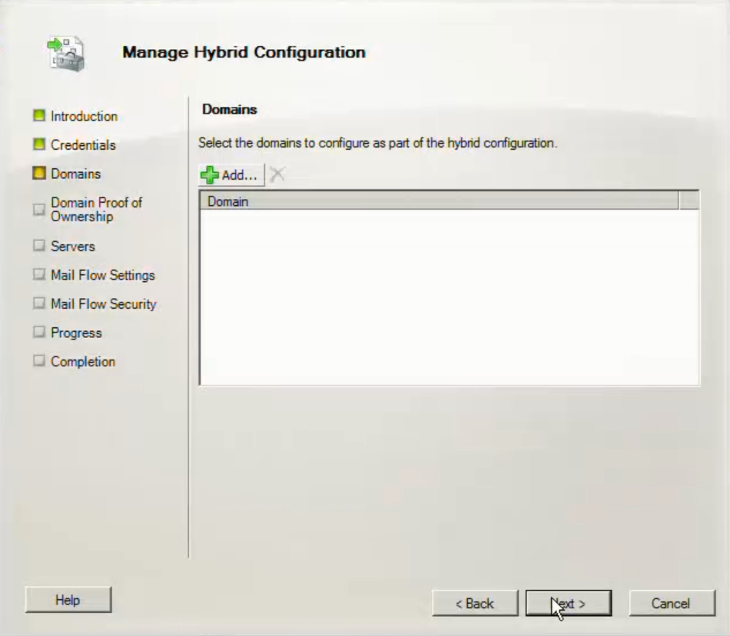
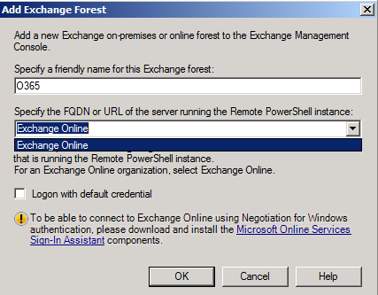
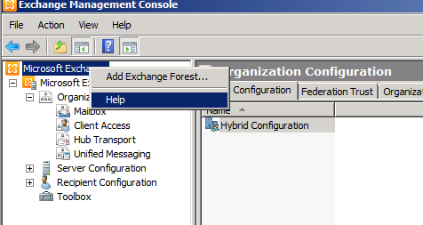
Manage

Slide 57
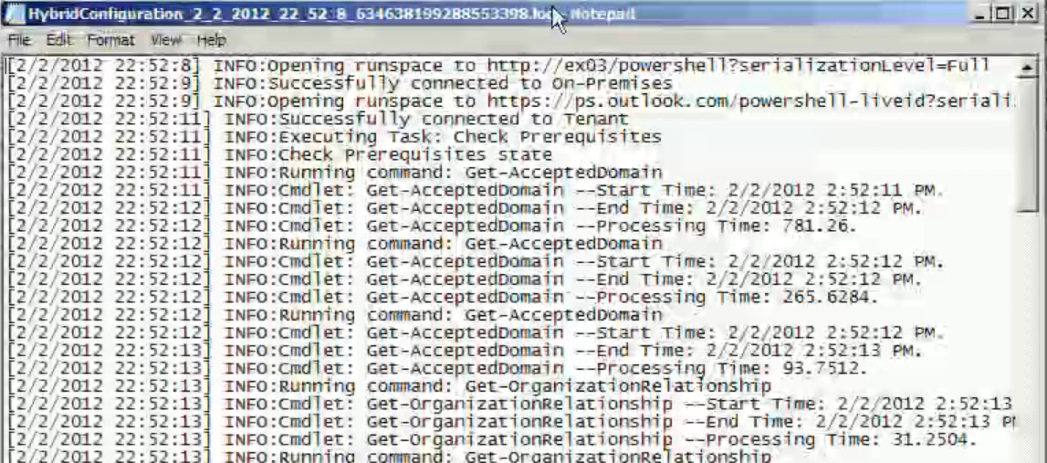
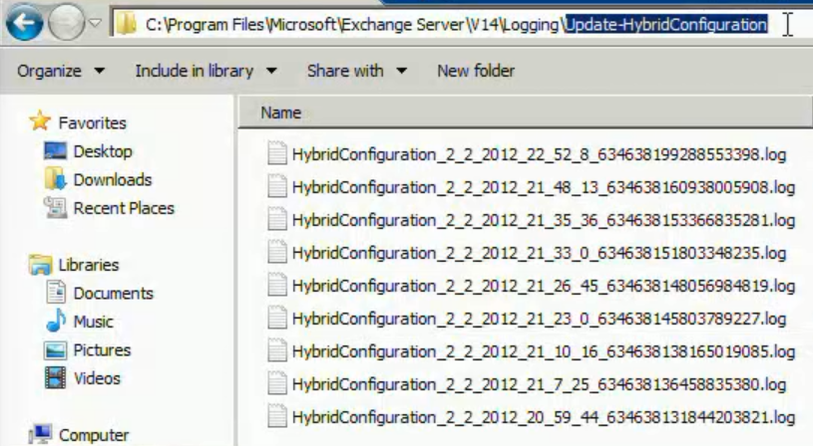
Troubleshooting

Slide 58
Demo
Life in a Hybrid World!

Slide 59
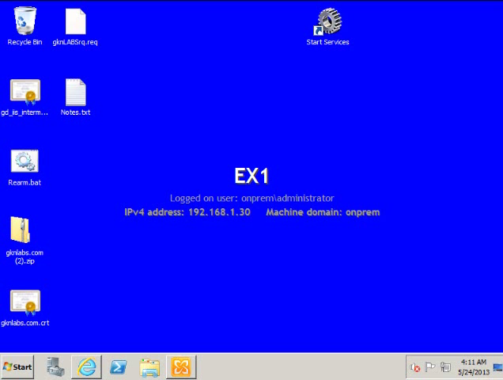

Slide 60
Hybrid Gotchas…
Plan & Prepare
Clean House
Watch out for Attachments (Limit Inbound 35Mb)
Ensure DNS Records are Correct (Inc Autodiscover)
Ensure Legacy Systems are Fully Patched and Updated before Pushing the Button!
Deploy ADFS & Dirsync
Deploy Min Exchange 2010 SP3 CAS
Never let your Digital Certificates Expire!
Domain Deletion Issue!
Drink Lots of Coffee & Red Bull ☺

Slide 61
Top Tools for Going Hybrid
Deployment Readiness Tool: Performs pre-migration checks on your Active Directory and environment
Get-ExchangeEnvironmentReport: Creates a great HTML report of your legacy Exchange system
Office 365 Speed Test: Tells you how good your connection to Office 365 is and whether you should upgrade your internet before your migration.
Exchange Connectivity Test: Many very useful tools for testing external access portions for both Exchange and Office 365
3rd Party Tools by Metalogix, MetaVis, Migration Wiz, Quest and others: Each has its strengths and weaknesses
Microsoft partners extensively with Migration Wiz, but you should evaluate which has the right pricing and features for your needs.

Slide 62
Review
The Changing World of Software
What is Hybrid?
The Changing World of Identity
Why Should I Go Hybrid?
How do I Get Started?
Planning for Hybrid
Implementation
Troubleshooting Hybrid!
Best Practices
Review

Slide 63

Related content
ATC-B306 - Cybercrime: The 2013 Ultimate Survival Guide
ATC-B312 – Security Panel Discussion
ATC-B202 – A Journey to the Dark Side of Social Networking!
ATC-B314 - The Inside Man: Surviving the Ultimate Cyber Threat
ATC-B201 - 1984: 21st Century Security Surveillance vs. the Erosion of Freedom!
ATC-B213 - The Cloud: Making the Move to a Hybrid World
SES-B307 - Office 365 Identity Solutions: Notes from the Field
Find Me Later At...Trustworthy Computing / Cloud Security Table at the Ask the Experts Session.

Slide 64
Trustworthy Computing Resources
Trustworthy Computing (TwC) is a long-term, collaborative effort to deliver more secure, private,
and reliable computing experiences for everyone.
Learn more at:
http://microsoft.com/twc
Cloud Security Readiness Tool
Pass the Hash Guidance
Data, Insights and Guidance (Security Intelligence Report, volume 14)
and more…

Slide 65

Resources
Learning
  Sessions on Demand
  Microsoft Certification & Training Resources
http://channel9.msdn.com/Events/TechEd
www.microsoft.com/learning
TechNet
msdn
  Resources for IT Professionals
  Resources for Developers
http://microsoft.com/technet
http://microsoft.com/msdn

Slide 66






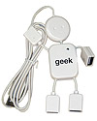
Complete an evaluation on CommNet and enter to win!

Slide 67
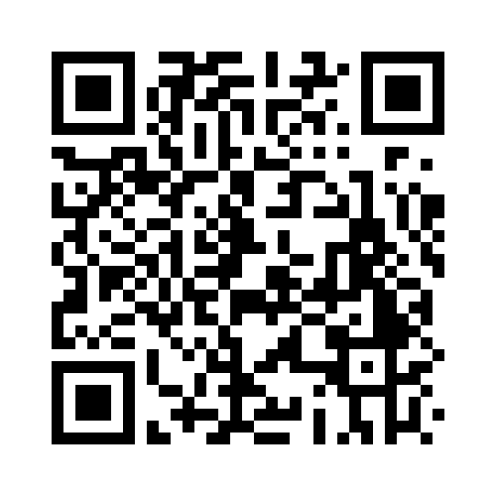


Evaluate this session
Required Slide
*delete this box when your slide is finalized
Your MS Tag will be inserted here during the final scrub.
Scan this QR code to evaluate this session and be automatically entered in a drawing to
win a prize

Slide 68

© 2013 Microsoft Corporation. All rights reserved. Microsoft, Windows and other product names are or may be registered trademarks and/or trademarks in the U.S. and/or other countries.
The information herein is for informational purposes only and represents the current view of Microsoft Corporation as of the date of this presentation. Because Microsoft must respond to changing market conditions, it should not be interpreted to be a commitment on the part of Microsoft, and Microsoft cannot guarantee the accuracy of any information provided after the date of this presentation. MICROSOFT MAKES NO WARRANTIES, EXPRESS, IMPLIED OR STATUTORY, AS TO THE INFORMATION IN THIS PRESENTATION.

