Slide 2
Win with Private Cloud: How to Drive Down TCO for Datacenter Applications
ATC-B214
Ulrich Homann
Chief Architect, WW Enterprise Services
Microsoft Corp.

Slide 3
A Typical Lifecycle
Design
Configure vs. Customize
Stand It Up
Solution Integration
Keep It Running
Admin & Service Upgrades
Use It Well
Feature Adoption & Usage

Slide 4





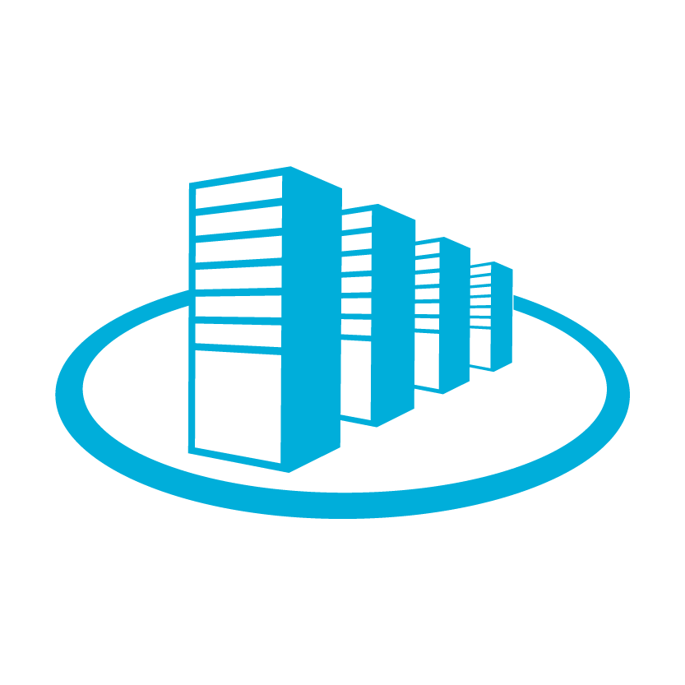
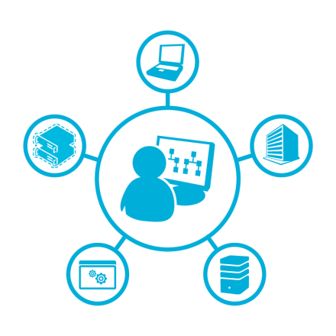

The Challenge
Lack of guidance, consistency and repeatability for deploying workloads on our Private Cloud stack which limits customers ability to realize value.
Datacenter Workloads
SharePoint 2013
Exchange 2013
Lync
2013
Missing Layer
Private Cloud
Usage Based
Self Service
Scalable and Elastic
Resource Pooling
Centralized Management

Slide 5





Current Situation
Islands of Best Practice
Public Cloud Compatibility
Mixed guidance on how to architect, plan, design, deploy, run datacentre workloads
Virtually unlimited number of configuration variations
“Islands of Best Practice” are commonplace
Long planning & deployment cycles
Various levels of public cloud compatibility across implementations
Time to Market
Complexity & Cost
We need a consistent
way to deploy…

Slide 6
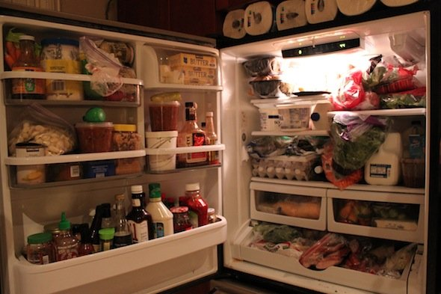
Traditional approach
Ask all your diners (users) what they would like for their
four course dinner, using any of the ingredients in the fridge

Slide 7
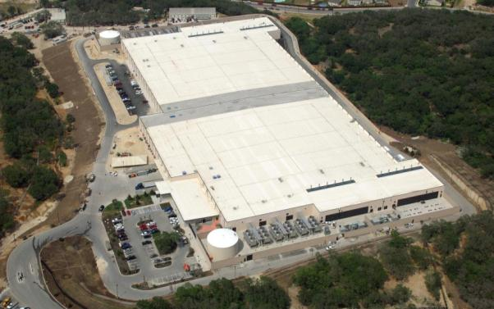
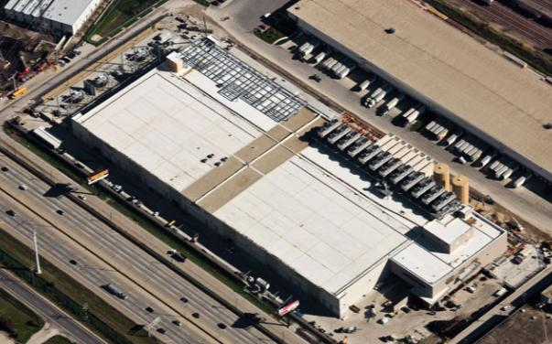
Traditional Datacenter Builds
Monolithic design and construction effort | Typical large datacenter = 11 football fields 20 to 50 Megawatts
Huge $$$ | Typical construction costs = $10M to $20M per Megawatt
Long lead time | 18 to 24 months from design to online
Microsoft Confidential

Slide 8
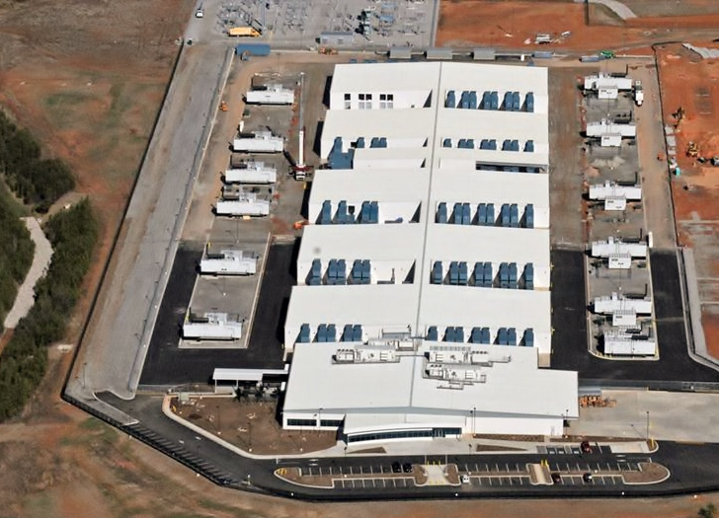
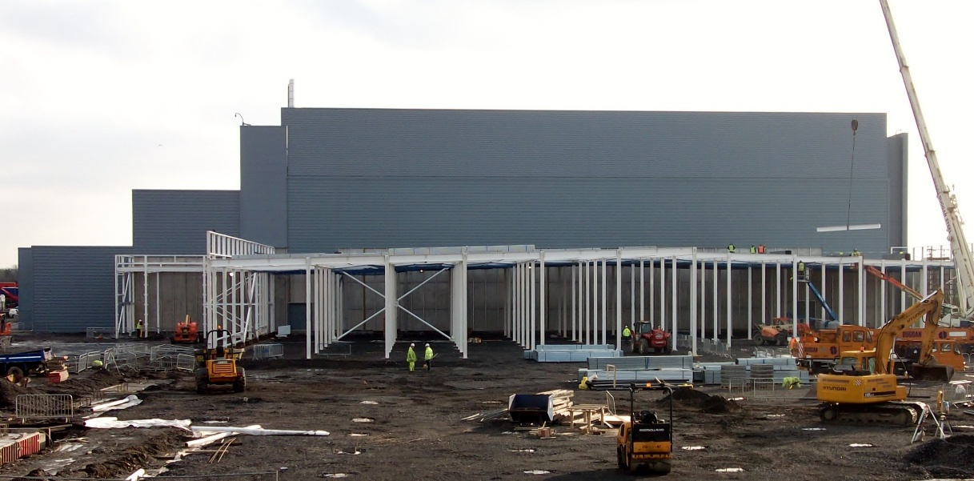

The Future Datacenter
Forget square footage—relentlessly drive down $/MW
Pre-manufacture and build your supply chain to minimize materials/waste
Enable commoditization and scale
Tailor reliability to the applications
Measure, Inform, Report, Improve
Challenge everything!
Microsoft Confidential

Slide 9

Predictability & Simplicity From Extreme Standardization

Slide 10
Industrialized Services
“implemented as standardized, automated, configurable and scalable services at a low-cost entry-level price” – Gartner Inc. 2011
Expected to reach 30% of the total IT market by 2015
Requires a real focus on standardization and automation
Source: Gartner, Inc. 2011. Gartner Says Industrialized
Low-Cost IT Services to Transform the IT Services Market.

Slide 11
Helping reach investment goals
Decrease time-to-value for capabilities such as Social, Business Intelligence, Enterprise Search and Collaboration
Build capabilities to drive predictable & mature services
Realize value in the cloud with elasticity and self-service
Provide Enterprise Scale & Governance at Commoditized Cost
Rationalized architecture foundation
Tunable configuration
Automated Deployment & Scale
Simplified Operations

Slide 12
Industrialized Delivery based upon PLA and CloudPAK
Business Productivity Workloads
SharePoint 2013
Exchange 2013
Lync
2013
Workload Product Line Architecture (PLA)
CloudPAK
SharePoint 2013 CloudPAK
Exchange 2013 CloudPAK
Lync
2013 CloudPAK
Workload X CloudPAK
Workload Y
CloudPAK
Structured guidance for developing workload CloudPAKs for Cloud deployment, leveraging workload Product Line Architectures
Private Cloud
Usage Based
Self Service
Scalable and Elastic
Resource Pooling
Centralized Management
IaaS
PLA
Datacenter
Mgmt
PLA

Slide 13
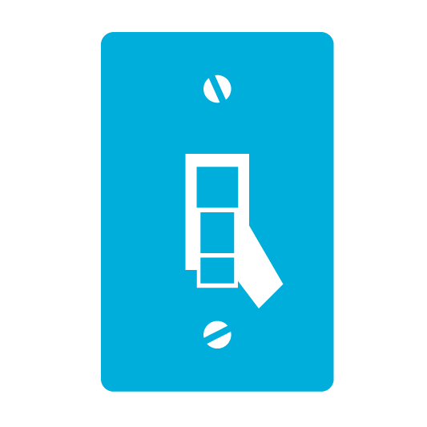



PLA - What is it?
“ ”
Microsoft, how would you do it?
Product Line Architecture (PLA)
Prescriptive
Easy to Implement
Cloud Aligned
Cost Effective
A Product Line Architecture (PLA) is a set of rules and architectural patterns that provide a method for predictable and supportable deployments

Slide 14
Key patterns learned from GFS and Public Cloud Datacenters
Packaged rule-sets optimized for performance, scale and supportability
Simplify services between public, hybrid and private
Product Line Architectures
Rationalized Guidance
6/3/2013

Slide 15


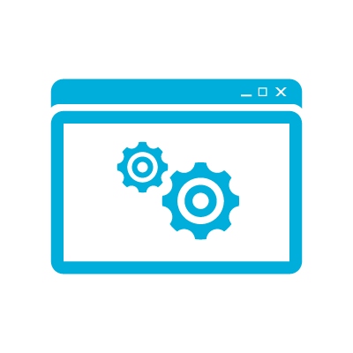
PLA - What is it?
PLA Principles
Rulebook
Support Costs
Decreased Implementation & Support Costs
Cloud
Cloud Enabled
Cloud Ready
Every Project undertaken using the PLA has rules to support the following design principles
Manage Costs
Decreased upgrade cost & complexity
Complexity
Decreased “unsupported” or un-tested deployments

Slide 16
PLA Attributes
Rulebook
Microsoft evolves the Product Line Architecture as we capture learnings from customer deployments and support incidents to continuously improve the architecture and our deployment practices.
The Benefits of using the PLA include:
  Proven deployment model
  Deployed right the first time
  Reduced time to deployment
  Predictable and achievable SLA’s
  The best user experience
  All workload capabilities realized
The PLA delivers the highest quality deployment by following design principles to support/enable …
Supportability
Quality
Performance
Disaster Recovery
Scalability
Manageability
Portability
Interoperability
Resilience

Slide 17
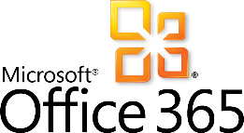
PLA - What is it?
Where does it fit?
On-Premises Custom Design
On-Premises PLA Design
On-Premises recommended practices
Supported
Recommended
Structured
Standardized

Slide 18
Introducing Cloud Packs
Cloud Packs
Right-scaled architecture developed by Microsoft for enterprise scalability and supportability
Configuration for complete control of governance, security and compliance
End-to-end extensible automation for deployment, management and maintenance of workload (SharePoint, Exchange, Lync, CRM, VDI) environments
Services for maintenance and supportability

Slide 19
Unpacking a Cloud Pack

Slide 20
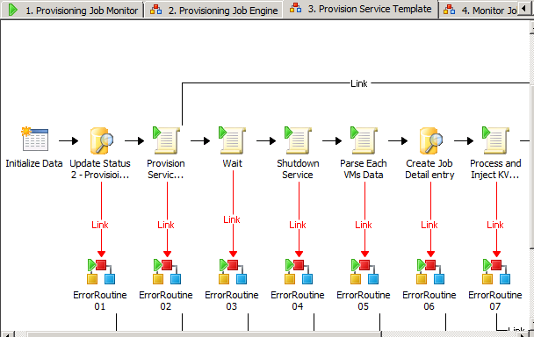
Standard deployment using System Center and Windows Server artifacts
Parallel deployment and scale-out fully automated
Sample self-service portal for integration
Cloud Pack Framework
Standardized Implementation
6/3/2013

Slide 21
Industrialized Delivery
Simplified operation and maintenance
MCS-based maintenance for Cloud Pack automation and workload
Rapid assessment using Premier Proactive Services
  Assessment tools, multiple submissions, and access to a secure online portal
  Regular updates to best practice guidance and online portal features
  Knowledge transfer of issues found
  Remediation plan
  Technical Findings report

Slide 22
SharePoint CloudPack Capabilities

Slide 23
SharePoint CloudPack Scenarios
Facilitate SharePoint App Development Lifecycle
  Enable developers to request isolated SharePoint instances as a service
  Deploy standardized Dev, Test, Production and Training environments without large support costs
Provide Enterprise Scale at Commoditized Cost
  Ensure jurisdictional, regulatory and industry compliance of all information
  Reduce deployment complexity by using architecture “stamps”
  Simplify SharePoint scale-out and disaster recovery using scale units
  Reduce cost of maintenance and change-management with pre-designed and extensible runbook automation
  Reduce infrastructure costs by measuring/metering usage and pooling infrastructure resources
Provide SharePoint Farms as a Service
  Offer standardized & right-scaled SharePoint Farm instances for Self-Service
  Manage & Support multiple consumers of SharePoint Farms with isolation
  Ensure SLAs with tuned monitoring and maintenance automation

Slide 24
Unpacking a CloudPack
Standard
Implementation
Simplified
Operation
Light-weight Design

Slide 25
From PLA to IaaS Implementation
SharePoint PLA: Sites
PCIF Toolkit (part of DCS Application Transformation Offering)
Getting Started Guide
SharePoint PLA: Search
Vision/Scope
SharePoint PLA: Collaboration
PCIF Reference Architecture
Provisioning
2
3
Service Description
Monitoring
Function “How to” Design Guides
Change Mgmt
Service Level Agreement
1
DCS Plug-ins
Backup/Recovery
Functional Specification
Usage Analysis
(charge back)
Common Interface Scripts
Cloud Pack Documentation
Cloud Pack Artifacts
Questionnaire
SharePoint Cloud Pack: Collaboration
Review PLA - Use as basis for Cloud Pack
Read PCIF RA - Describes “functions” required to deploy/manage workloads on IaaS
Develop Cloud Pack Functional Specs - Use PCIF “How To Guides” to create function designs for Provisioning, Monitoring, etc.
Build Cloud Pack Artifacts - Use PCIF “Cloud Pack Functional Spec Designs”, and “Cloud Pack Install Guide” to build VMM STs, Hydration, SCOM MPs
Build Engagement Content - Use PCIF “DCS Templates” to build Engagement Implementation and Install Guide for Cloud Pack
Monitoring Design/
Functional Spec
Runbooks
Security Model
3
4
Provisioning Design/ Functional Spec
Configuration portal
Service Templates
Cloud Pack Install Guide
SharePoint Decision Leading Workshop
Hydration
5
SharePoint Collaboration Platform
SC VMM
SC Orchestrator
SC
Operations Manager
SC Service Manager
SC App Controller
Microsoft Infrastructure-as-a-Services
(Hyper-V + System Center)

Slide 26

Trustworthy Computing Resources
Trustworthy Computing (TwC) is a long-term, collaborative effort to deliver more secure, private,
and reliable computing experiences for everyone.
Learn more at:
http://microsoft.com/twc
Cloud Security Readiness Tool
Pass the Hash Guidance
Data, Insights and Guidance (Security Intelligence Report, volume 14)
and more…

Slide 27

Resources
Learning
  Sessions on Demand
  Microsoft Certification & Training Resources
http://channel9.msdn.com/Events/TechEd
www.microsoft.com/learning
TechNet
msdn
  Resources for IT Professionals
  Resources for Developers
http://microsoft.com/technet
http://microsoft.com/msdn

Slide 28






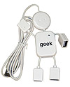
Complete an evaluation on CommNet and enter to win!

Slide 29



Evaluate this session
Required Slide
*delete this box when your slide is finalized
Your MS Tag will be inserted here during the final scrub.
Scan this QR code to evaluate this session and be automatically entered in a drawing to
win a prize

Slide 30

© 2013 Microsoft Corporation. All rights reserved. Microsoft, Windows and other product names are or may be registered trademarks and/or trademarks in the U.S. and/or other countries.
The information herein is for informational purposes only and represents the current view of Microsoft Corporation as of the date of this presentation. Because Microsoft must respond to changing market conditions, it should not be interpreted to be a commitment on the part of Microsoft, and Microsoft cannot guarantee the accuracy of any information provided after the date of this presentation. MICROSOFT MAKES NO WARRANTIES, EXPRESS, IMPLIED OR STATUTORY, AS TO THE INFORMATION IN THIS PRESENTATION.

Slide 31

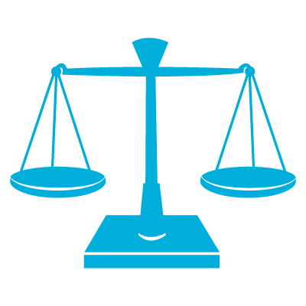
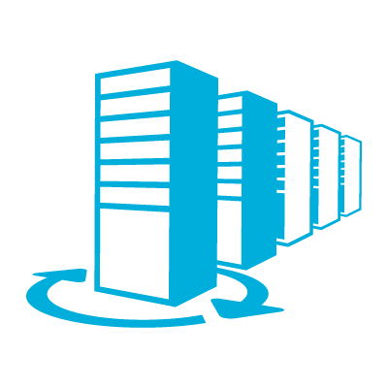

Accelerate Productivity platform deployment with Product Line Architecture
SharePoint 2013 Exchange 2013
Lync 2013
Enable a cloud-aligned platform with PLA
Potential benefits of deployment with PLA:
Scalability and Reliability
Achieve the perfect balance between scalability, reliability, and security.
Quality of Service
Efficiently deploy the infrastructure while maximizing uptime and minimizing failures.
Reduced Risk
Manage risks and complexities and reduce deployment costs and administrative overhead.
Business Value
Streamlines the deployment to focus on empowering users and meeting business needs.
To survive today’s challenging business climate, organizations must operate efficiently to maintain their competitive edge. In this setting, the quality of a company’s IT platform can resonate to every corner of the organization, encouraging innovation, growing revenue, and helping to cut costs. However it’s not an easy task to identify the most appropriate architecture that satisfies your organization's unique requirements and can be deployed predictably and quickly. Virtually an unlimited number of configuration variations exist in infrastructure deployment and various levels of cloud compatibility across implementations must be considered, often resulting in a longer and complex planning and deployment cycle.
Microsoft Services can help you accelerate the deployment of your productivity platform by reducing technical complexities and improving service levels while laying the foundation for the essential communication and collaboration capabilities needed to drive your business forward.
Get a predictable, lower risk deployment with Product Line Architecture
Microsoft Services Product Line Architecture (PLA) provides you with a set of pre-defined technical architecture and prescriptive guidance on how to architect and deploy a business productivity platform easily and cost effectively by minimizing complexity in platform design and deployment.
Build a cloud-ready platform with SharePoint, Exchange and Lync PLAs
Microsoft Services offers PLAs for the core productivity platform— SharePoint 2013, Exchange 2013 and Lync 2013—so you can build your infrastructure and provide advanced capabilities for your organization including social computing, collaboration, unified communications and content discovery and management.
The PLA framework is consistent across SharePoint, Exchange, Lync so your platform is cloud-ready and you can choose the optimal mix of public cloud, private cloud, and on-premises deployment options to meet your organizational needs.

Slide 32
Components of the PLA
A full set of tools and guidance to ensure you get a cost effective, scalable, and reliable deployment.
Deployment Scenarios
A PLA is best suited for enterprise organizations that are looking for reliability, stability and supportability in a new deployment. There are a several deployment scenarios:
Office 365
PLA Deployment
Traditional
Deployment
Service Description
Office 365 cloud deployment is the first option for SharePoint 2013, Exchange 2013 and Lync 2013
If on-premises is required, a PLA deployment is the recommended option
If the PLA Service Description and design does not meet your requirements, move ahead with a custom deployment
Provides a clear foundation for capabilities
Defines requirements for infrastructure and PLA environment
Rulebook
Solution Alignment Workshop
A Solution Alignment Workshop for SharePoint, Exchange, or Lync is the recommended next step to learn more about PLAs and determine whether they are a good fit for your organization. At the end of the workshop, you will have:
A clear understanding about PLA and the value to your organization
Confidence that key items regarding the PLA have been reviewed and discussed
An opportunity to raise questions, analyze gaps and resolve obstacles
Identification of other services that may be required
Deployment scope and an outline of the approach
A customized report based on your specific business needs captured in the workshop
Functional Specification
Detailed deployment architecture and configuration guidance
Deployment validation and recommended testing procedures
Test Plan
Service Level Target
Microsoft Services
At Microsoft Services, we have a wealth of knowledge that comes from working with thousands of customers around the world in virtually every industry. We utilize our knowledge and expertise to help our customers adopt and deploy Microsoft technologies efficiently and cost-effectively, reducing the time and risks it takes customers to realize value from their Microsoft investments.
Guidance on how to achieve the target SLT
Sizing Calculators
Sizing and
Capacity guidance
Get Started
Attend a Solution Alignment Workshop for SharePoint, Lync, or Exchange and learn about Microsoft’s approach to deploying enterprise-ready productivity platforms and how it can help your organization.
Contact your Microsoft Services representative to schedule a workshop.
Build Guide
Set-up and build guidance
Operational and maintenance guidance
Operations Guide
For more information about Consulting and Support Solutions from Microsoft, visit www.microsoft.com/services.

