Slide 2
What’s new in Hyper-V
MDC-B330
Benjamin Armstrong

Slide 3
Hyper-V in Windows Server 2012
Focused on delivering Private Cloud solutions
Incredibly well received – key highlights:
  Hyper-V Replica
  Shared Nothing Live Migration
  Support for virtual machines on SMB 3.0
  Full PowerShell Support
  And more…

Slide 4
Windows Azure IaaS
Windows Azure uses the same Hyper-V virtualization service built-into Windows Server 2012
Complete virtual machine compatibility between on premise Hyper-V and Azure IaaS

Slide 5

CUSTOMER
Common
Identity
Virtualization
Management
Development
Cloud OS
Cloud OS
WINDOWS AZURE
SERVICE PROVIDER

Slide 6
Moving Virtualization Forward

Slide 7
New Generation Of Virtual Machines
Generation 2 virtual machines
Legacy free
UEFI based
  Many emulated devices removed
  Boots from virtual SCSI or synthetic network adapters
  Enables UEFI secure boot standard
Supported guest operating systems:
  64-bit versions of Windows 8 and Windows Server 2012
  64-bit versions of Windows 8.1 and Windows Server 2012 R2

Slide 8
Enhanced VM Interaction
Remote Desktop over VMBus
Full remote desktop capabilities
  Shared clipboard
  Audio redirection
  Enhanced login
  and more….
Enabled even when the network is down
Integrated into Hyper-V Management experience

Slide 9
Automatic Activation
Zero touch activation of virtual machines
Virtual machines automatically activated according to the hosting environment
Reduces configuration for hosters / enterprises

Slide 10
Demo: Moving Virtualization Forward
Benjamin Armstrong

Slide 11
Generation 2 Virtual Machine Hardware
Legacy Devices Removed | Replacement Devices | Enhancements
IDE Controller | Virtual SCSI Controller | Boot from VHDx (64TB max size, online resize)
IDE CD-ROM | Virtual SCSI CD-ROM | Hot add/remove
Legacy BIOS | UEFI firmware | Secure Boot
Legacy NIC | Synthetic NIC | Network boot with IPv4 & IPv6
Floppy & DMA Controller | No floppy support
UART (COM Ports) | Optional UART for debugging | Faster and more reliable
i8042 keyboard controller | Software based input | No emulation – reduced resources
PS/2 keyboard | Software based keyboard | No emulation – reduced resources
PS/2 mouse | Software based mouse | No emulation – reduced resources
S3 video | Software based video | No emulation – reduced resources
PCI Bus | VMBus
Programmable Interrupt Controller (PIC) | No longer required
Programmable Interrupt Timer (PIT) | No longer required
Super I/O device | No longer required

Slide 12
Existing Virtual Machine Control
VMMS
Applications
Applications
VM Connect
Applications
VMWP
Video / Keyboard / Mouse Driver
VMBus
VMBus
Hypervisor

Slide 13
Existing Virtual Machine Control
VMMS
Applications
Applications
VM Connect
Applications
VMWP
Video / Keyboard / Mouse Driver
VMBus
VMBus
Hypervisor

Slide 14
Existing Virtual Machine Control
VMMS
Applications
Applications
VM Connect
Applications
VMWP
Video / Keyboard / Mouse Driver
VMBus
VMBus
Hypervisor

Slide 15
Existing Virtual Machine Control
VMMS
Applications
Applications
VM Connect
Applications
VMWP
Video / Keyboard / Mouse Driver
VMBus
VMBus
Hypervisor

Slide 16
Existing Virtual Machine Control
VMMS
Applications
Applications
VM Connect
Applications
VMWP
Video / Keyboard / Mouse Driver
VMBus
VMBus
Hypervisor

Slide 17
Existing Virtual Machine Control
VMMS
Applications
Applications
VM Connect
Applications
VMWP
Video / Keyboard / Mouse Driver
VMBus
VMBus
Hypervisor

Slide 18
Existing Virtual Machine Control
VMMS
Applications
Applications
VM Connect
Basic Experience
Applications
VMWP
Video / Keyboard / Mouse Driver
VMBus
VMBus
Hypervisor

Slide 19
Enhanced Virtual Machine Control
VMMS
Applications
Applications
VM Connect
Applications
VMWP
Remote Desktop Services
VMBus
VMBus
Hypervisor

Slide 20
Enhanced Virtual Machine Control
VMMS
Applications
Applications
VM Connect
Applications
VMWP
Remote Desktop Services
VMBus
VMBus
Hypervisor

Slide 21
Enhanced Virtual Machine Control
VMMS
Applications
Applications
VM Connect
Applications
VMWP
Remote Desktop Services
VMBus
VMBus
Hypervisor

Slide 22
Enhanced Virtual Machine Control
VMMS
Applications
Applications
VM Connect
Applications
VMWP
Remote Desktop Services
VMBus
VMBus
Hypervisor

Slide 23
Enhanced Virtual Machine Control
VMMS
Applications
Applications
VM Connect
Applications
VMWP
Remote Desktop Services
VMBus
VMBus
Hypervisor

Slide 24
Enhanced Virtual Machine Control
VMMS
Applications
Applications
VM Connect
Applications
VMWP
Remote Desktop Services
VMBus
VMBus
Hypervisor

Slide 25
Enhanced Virtual Machine Control
VMMS
Applications
Applications
VM Connect
Enhanced Experience
Applications
VMWP
Remote Desktop Services
VMBus
VMBus
Hypervisor

Slide 26
Private Cloud

Slide 27
Zero-downtime upgrade
Live migrate virtual machines from
Windows Server 2012 to Windows Server 2012 R2
Includes shared nothing live migration
Learn more: MDC-B331 – Upgrading Your Private Cloud

Slide 28
Faster Live Migration
Compression
  Over 2x improvement in live migration time
  No hardware changes are required
  Enabled by default
SMB Direct
  Utilizes existing and new high-end networks
  Enables super high-speed live migrations
  Supports SMB Multichannel to leverage multiple interfaces

Slide 29
Online VHDX resize
Increase and decrease the size of virtual hard disks – while the virtual machine is running

Slide 30
Live virtual machine export / clone
While the virtual machine is running…
Export a complete copy – including memory state
Export any snapshot of a virtual machine

Slide 31
Demo: Private Cloud #1
Benjamin Armstrong

Slide 32
Cross version compatibility
Compatibility In Windows Server 2012 R2 from Windows Server 2012 R2
Live migration
Saved states
Checkpoints (aka Snapshots)

Slide 33
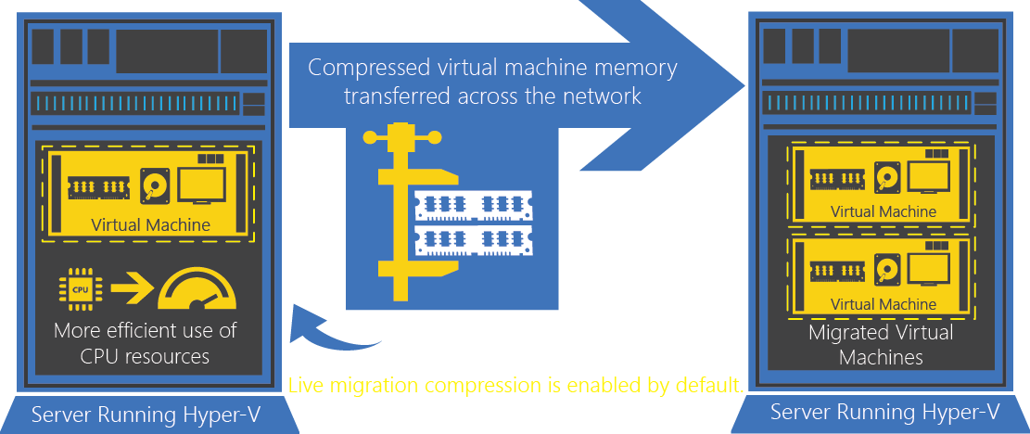

Slide 34
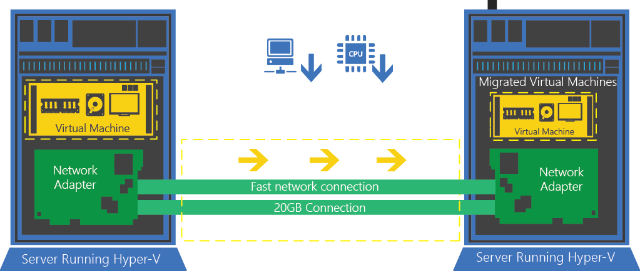

Slide 35
Faster Live Migration
Simple guidance:
If your live migration network is….
10 Gbit or less – use compression
Over 10 Gbit – use SMB / SMB Direct

Slide 36
Continuing Linux Guest Support
Full dynamic memory
Online backup
Online VHDX resize
New video driver
Learn more: MDC-B202 - Running and Managing Linux and UNIX in Hyper-V and System Center

Slide 37
Storage QoS
Enables constant SLA delivery
Dynamically configurable while the virtual machine is running
Can restrict disk throughput for overactive / disruptive virtual machines
Learn more: MDC-B345 - Windows Server 2012 Hyper-V Storage Performance

Slide 38
Guest clustering with shared virtual disks
Guest Clustering
Guest Clustering with commodity storage
Sharing VHDX files provides shared storage for Hyper-V Failover Clustering
Maintains separation between infrastructure and tenants
  Cluster Shared Volumes (CSV)
  on block storage
  Scale-Out File Server
  for file based storage
Block Storage
File Based Storage
Virtual SAS
VM presented a shared virtual SAS disk
Appears as shared SAS disk to VM
VHDX
VHDX
Learn more: MDC-B311 - Application Availability Strategies for the Private Cloud

Slide 39
Demo: Private Cloud #2
Benjamin Armstrong

Slide 40
Disaster Recovery

Slide 41
Hyper-V Replica
Extended replication
Finer grained control of replication
More…
Learn more: MDC-B373 - Understanding Hyper-V Replica: Performance, Networking and Automation

Slide 42
Demo: Hyper-V Replica
Benjamin Armstrong

Slide 43
Summary
Hyper-V for Private Cloud is just getting better
Increasing virtual machine up-time is always a priority
Listening to customers and refining features
Innovating in virtualization

Slide 44

Related content
MDC-B331 – Upgrading Your Private Cloud
MDC-B345 - Windows Server 2012 Hyper-V Storage Performance
MDC-B311 - Application Availability Strategies for the Private Cloud
MDC-B373 - Understanding Hyper-V Replica: Performance, Networking and Automation
Find Me Later At Hyper-V Booth in the MSE

Slide 45
Track resources
Learn more about Windows Server 2012 R2 Preview, download the datasheet and
evaluation bits on
http://aka.ms/WS2012R2
Learn more about System Center 2012 R2 Preview, download the datasheet and evaluation bits on
http://aka.ms/SC2012R2

Slide 46

Resources
Learning
  Sessions on Demand
  Microsoft Certification & Training Resources
http://channel9.msdn.com/Events/TechEd
www.microsoft.com/learning
TechNet
msdn
  Resources for IT Professionals
  Resources for Developers
http://microsoft.com/technet
http://microsoft.com/msdn

Slide 47






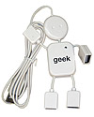
Complete an evaluation on CommNet and enter to win!

Slide 48
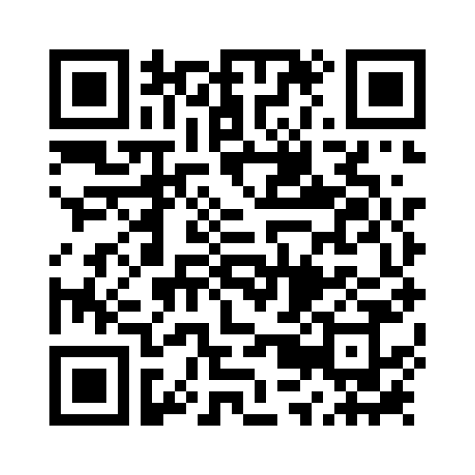
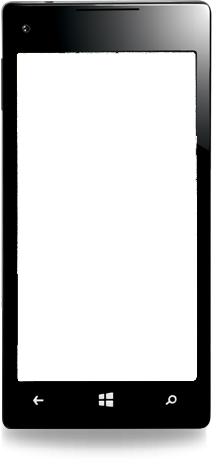

Evaluate this session
Required Slide
*delete this box when your slide is finalized
Your MS Tag will be inserted here during the final scrub.
Scan this QR code to evaluate this session and be automatically entered in a drawing to
win a prize

Slide 49

© 2013 Microsoft Corporation. All rights reserved. Microsoft, Windows and other product names are or may be registered trademarks and/or trademarks in the U.S. and/or other countries.
The information herein is for informational purposes only and represents the current view of Microsoft Corporation as of the date of this presentation. Because Microsoft must respond to changing market conditions, it should not be interpreted to be a commitment on the part of Microsoft, and Microsoft cannot guarantee the accuracy of any information provided after the date of this presentation. MICROSOFT MAKES NO WARRANTIES, EXPRESS, IMPLIED OR STATUTORY, AS TO THE INFORMATION IN THIS PRESENTATION.

