Slide 1

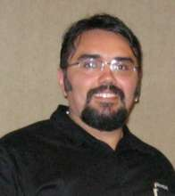
Private Cloud Security Architecture: A Solution for Private Cloud Security
AAP306
Tom Shinder
Principal Writer
Microsoft SCD iX Solutions Group
Yuri Diogenes
Senior Technical Writer
Microsoft SCD iX Foundations Group

Slide 2
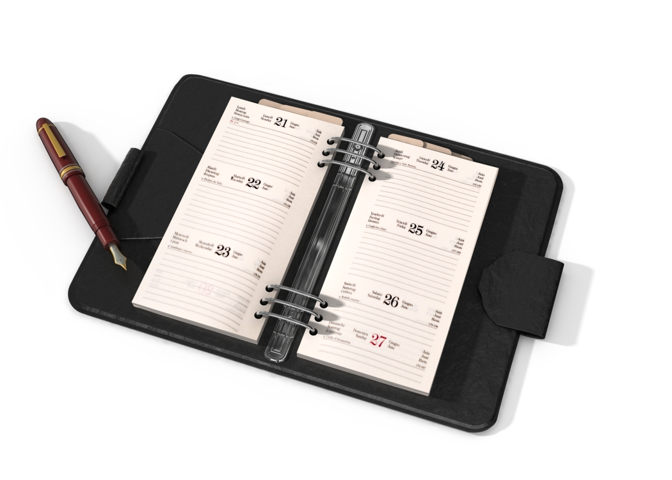
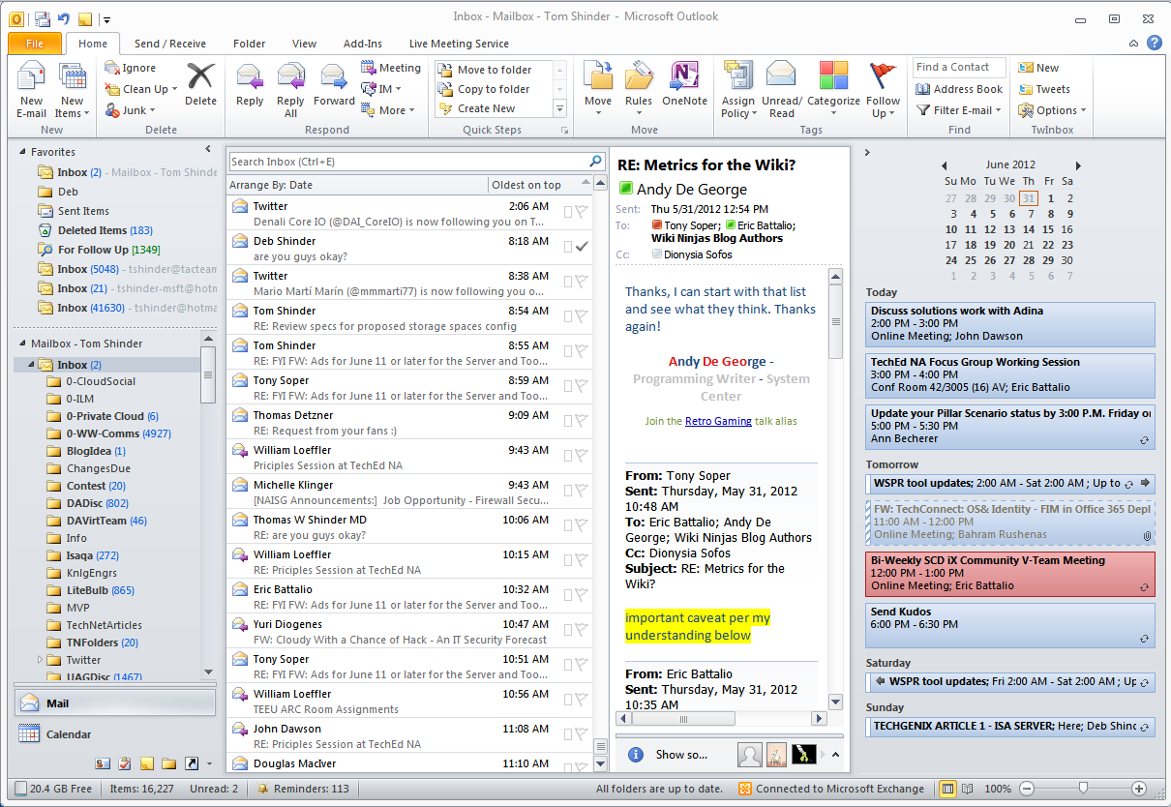

Agenda
Rebooting the Datacenter Requires a Strong Architectural Foundation
Who needs an Architect?
Cloud and Security
Key Security Differences in Private Cloud
Private Cloud Security Principles
Cloud Security Challenges Secondary to Essential Characteristics
Private Cloud Reference Model
Private Cloud Security Model

Slide 3
Who needs an Architect?
Private Cloud Security
Tom Shinder
Principal Writer
Microsoft SCD iX Solutions Group

Slide 4
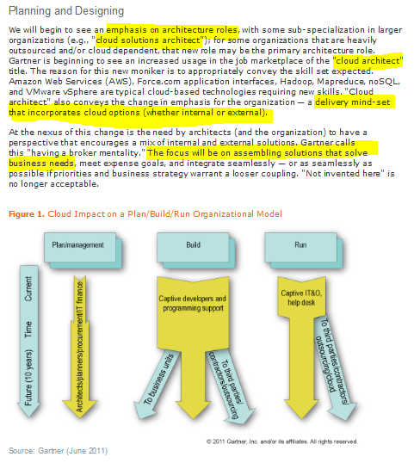
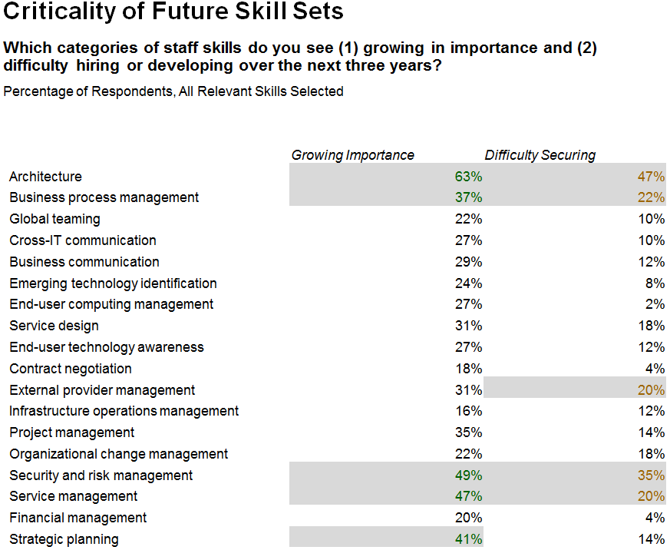
What’s in it for me?
Corporate
Executive
Board
Gartner

Slide 5
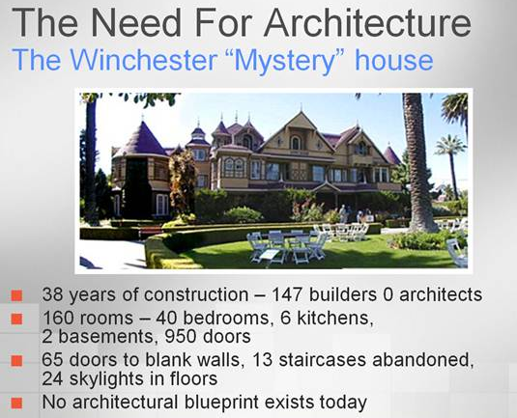

Slide 6
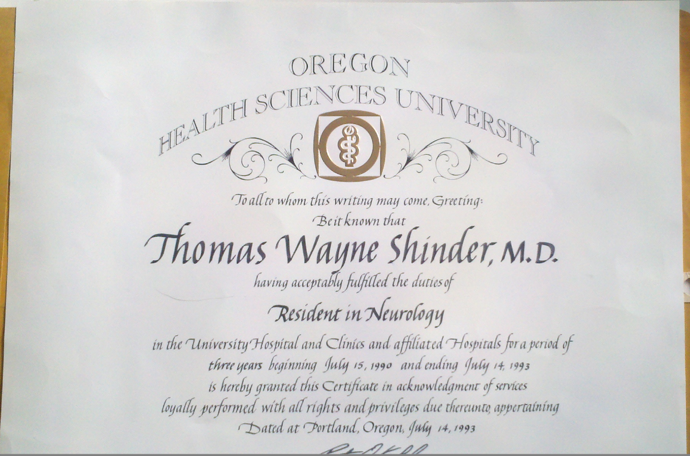

Anatomy
Physiology
Pharmacology
Biochemistry
Neuroscience
Pathology
Microbiology
Definitions
Constraints
Requirements
Decision Points

Slide 7
Cloud Security Overview
Private Cloud Security
Yuri Diogenes
Senior Technical Writer
Microsoft SCD iX Foundations Group

Slide 8

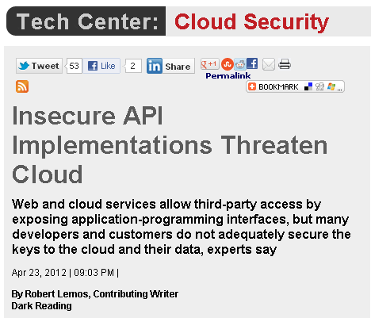
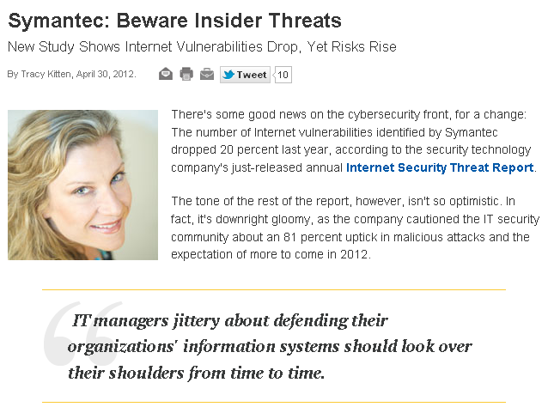
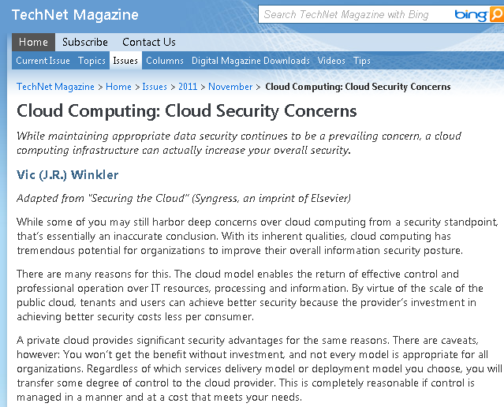

Cloud Security Challenges
Trusting Vendor’s Security Model
Obtaining Support For Investigation
Indirect Administration Accountability
Internal Threats
On-premise Security
Endpoint Protection
Loss of Physical control
Data Leakage
Traffic hijacking

Slide 9

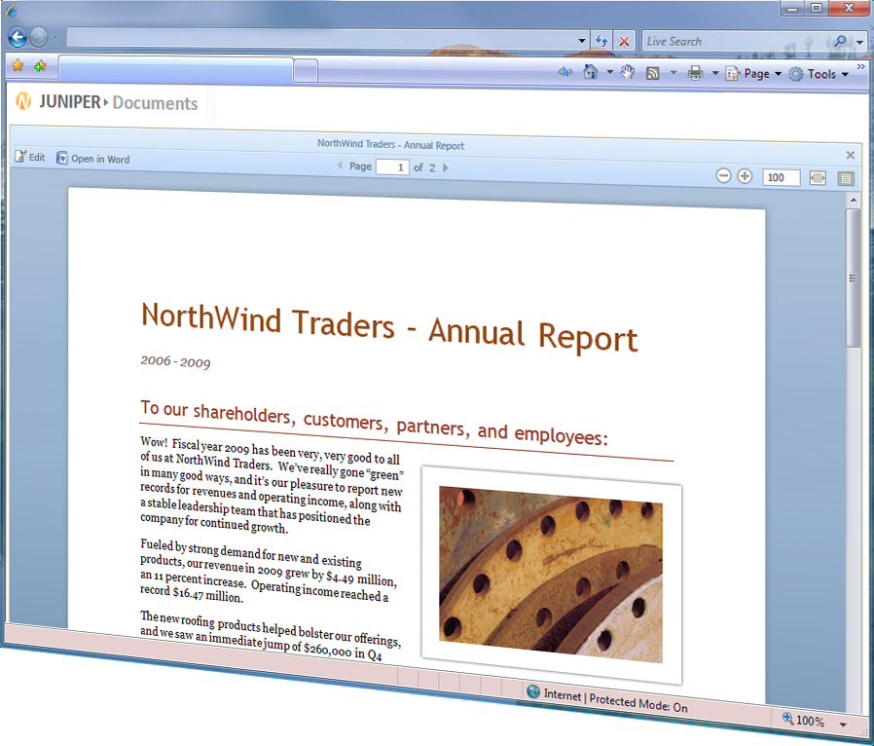
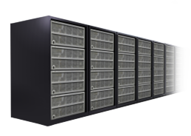
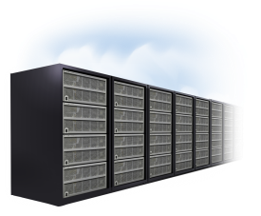
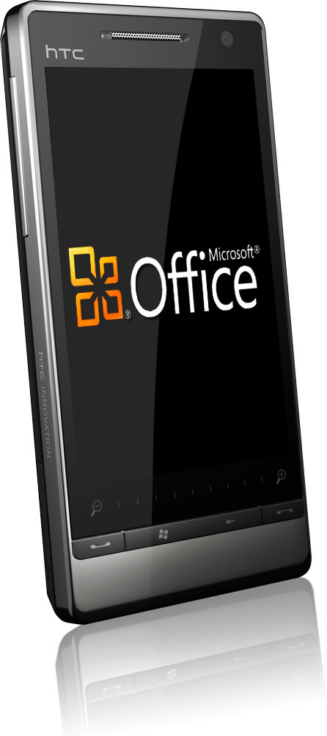
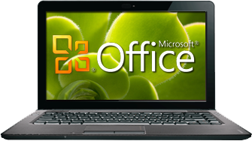


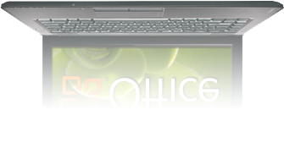
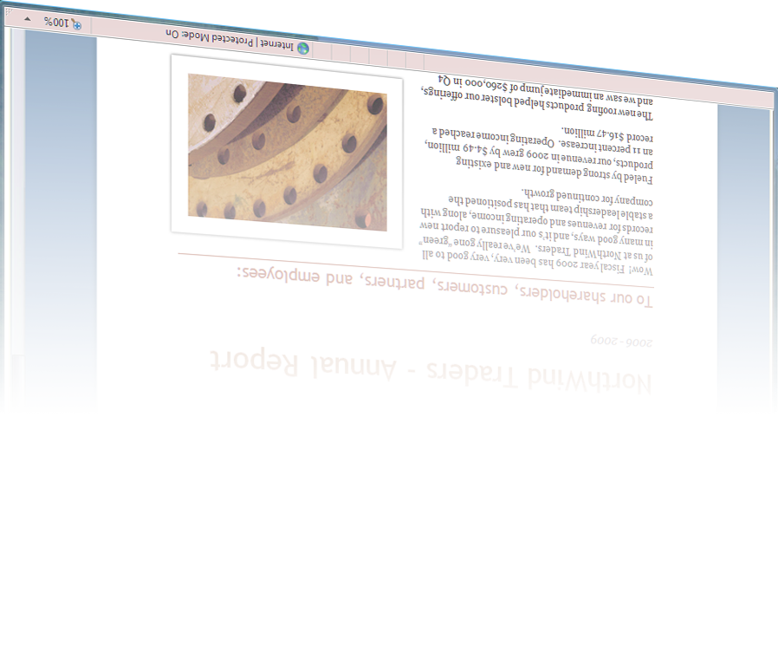



Defense in Depth Approach
On-premises
Online
Productivity with Security
Security Awareness Training
On-Premise Security
Meet Compliance and Regulatory Requirements
Cloud Vendor that has a Cloud Security Program
Security Policies

Slide 10
Key Security Differences in Private Cloud
Private Cloud Security
Tom Shinder
Principal Writer
Microsoft SCD iX Solutions Group

Slide 11
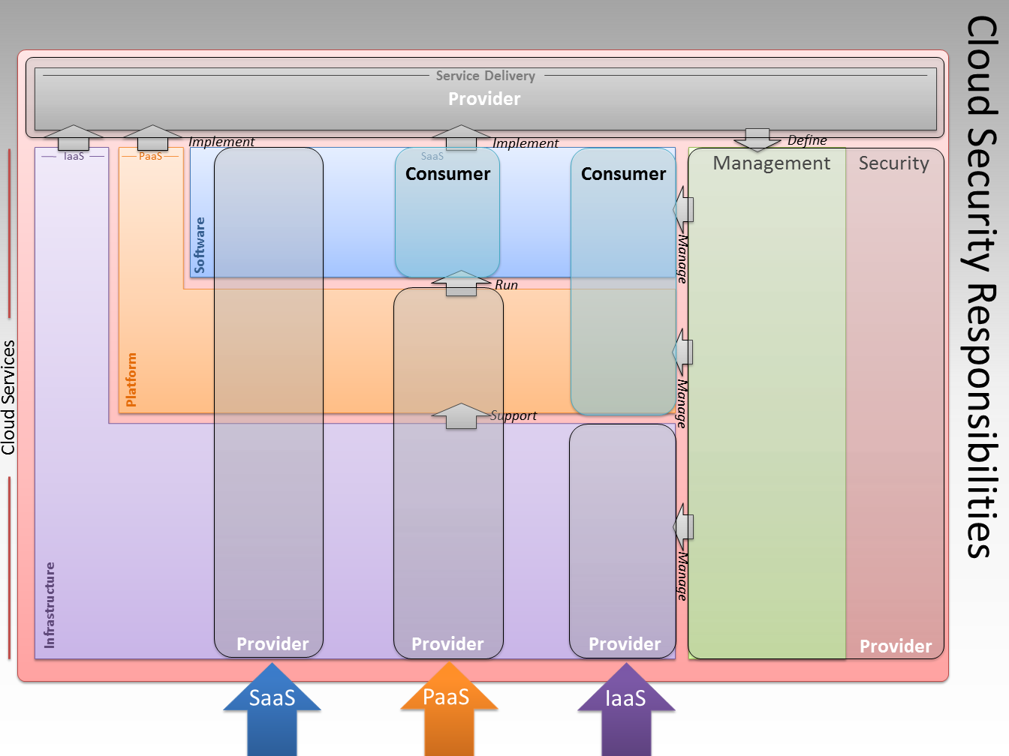
Security Responsibility

Slide 12
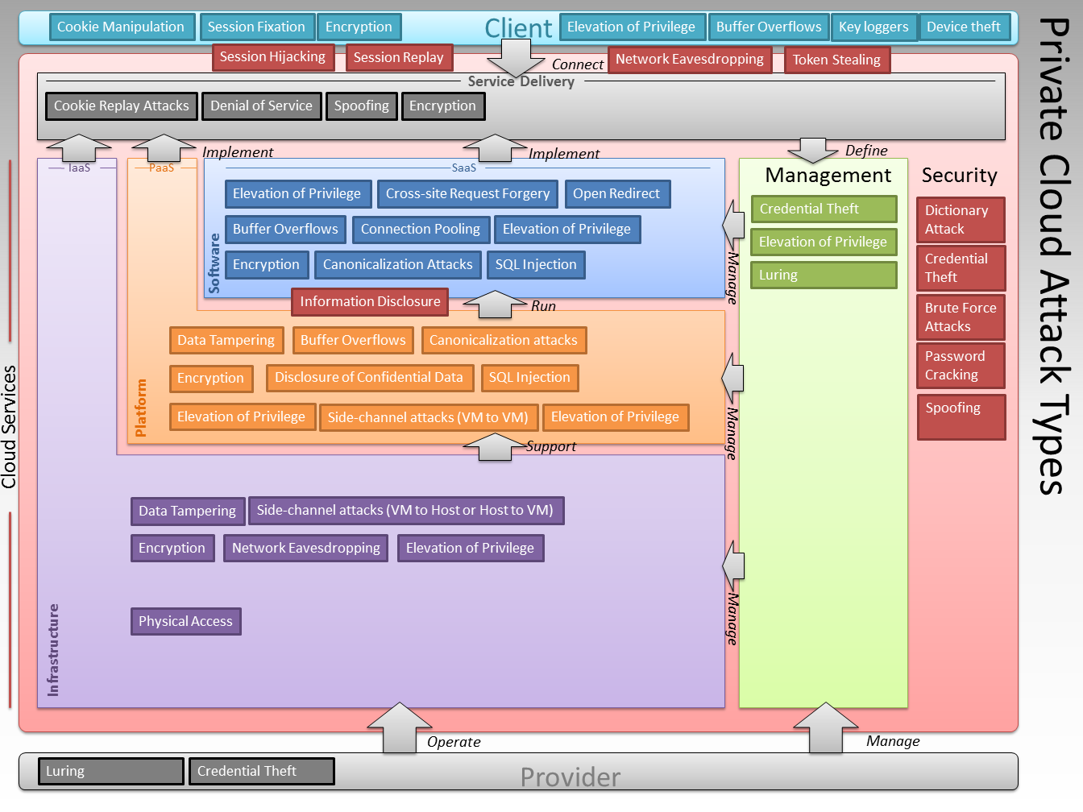
Security Attack Types
Cloud Security Threats and Countermeasures at a Glance

Slide 13
Shared Tenant Model
Multitenancy in private cloud
Multiple orgs and divisions
Requires logical separation
Authentication
Authorization
Access controls
Host A
Host B
VM
VM
VM
VM
VM
VM
VM
VM
VM
VM
VM
VM
VM
VM
VM
VM
Host C
Host D
VM
VM
VM
VM
VM
VM
VM
VM
VM
VM
VM
VM
VM
VM
VM
VM

Slide 14
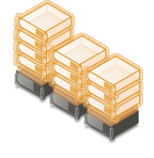
Virtualization Platform
Mobile Workloads
Automated Mobility
Unlinked from Px
Security Tools
Playing catch-up
Virtualization of Security Controls
Integrate with the private cloud fabric
Provide separate configuration interfaces
Provide programmable elastic, on-demand services
Support policies governing logical attributes
Enable trust zones separating multiple tenants
in a dynamic environment

Slide 15
Private Cloud Security Principles
Private Cloud Security
Yuri Diogenes
Senior Technical Writer
Microsoft SCD iX Foundations Group

Slide 16
The Eleven Private Cloud Security Principles
Principles provide general rules and guidelines to support the evolution of a secure cloud infrastructure. They are enduring, seldom amended, and inform and support the way you secure the private cloud. These principles form the basis on which a secure cloud infrastructure is planned, designed and created.
Apply generic security best practices
Enforce Isolation
Security is a wrapper
Attackers are AuthN and AuthZ
All data locations accessible
Use strong cryptography
Automate security operations
Minimize attack service
Limit “routing”
Audit extensively
Strong GRC

Slide 17
Cloud Security Challenges
Secondary to Essential Characteristics
Private Cloud Security
Yuri Diogenes
Senior Technical Writer
Microsoft SCD iX Foundations Group

Slide 18
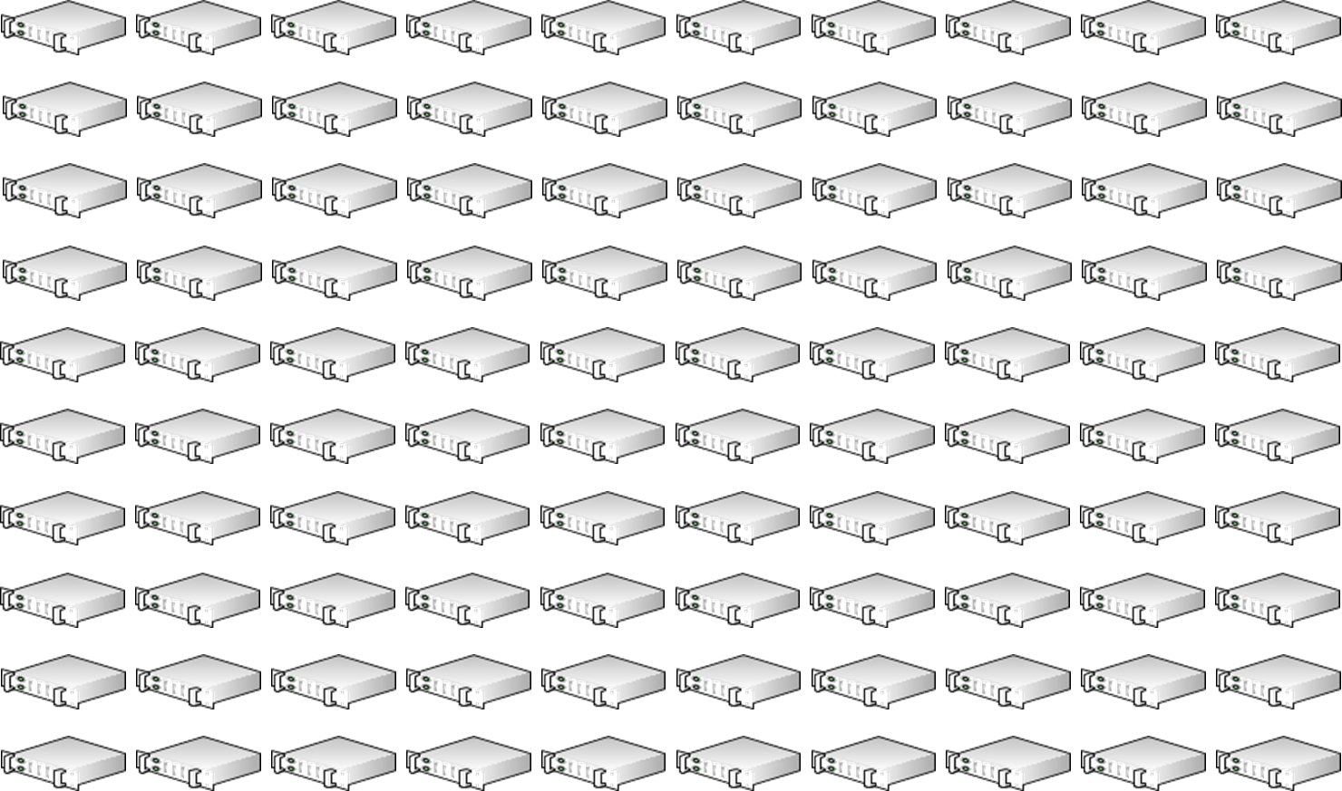




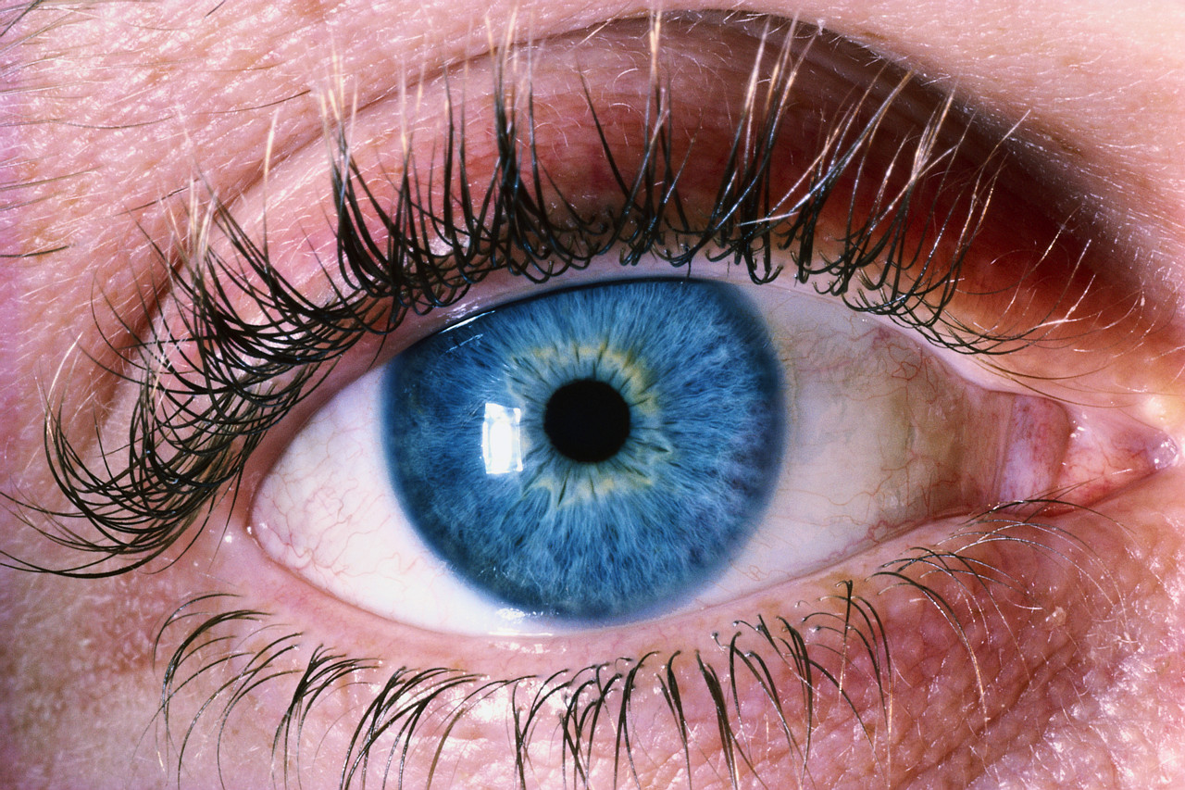




Resource Pooling
As a consumer (tenant) of the services offered by a private cloud in my enterprise, I require that application data is secure, no one else can access it, and that the data is safe if something untoward occurs
Prevent leakage between tenants
AAA
Also applies to administrators
Role Based Access Control

Slide 19

On-Demand Self-Service
Who has authority to:
Demand
Provision
Use
Release
As the architect, designer, or operator of a private cloud solution, how do I control who has access to my private cloud services and how do I monitor and audit the use of my services?
Errors in security provisioning
Clean up processes
SLA needs
to be explicit

Slide 20
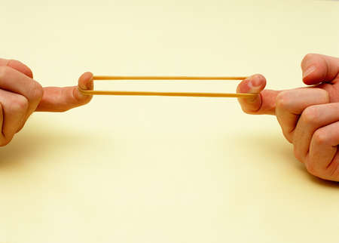
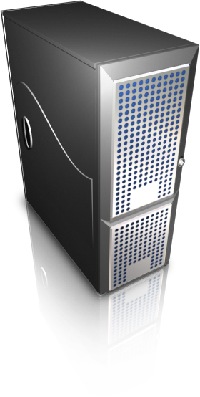

Rapid Elasticity
I am concerned that a rogue application, client, or denial of service (DoS) attack might destabilize the data center by requesting a large amount of resources. How do I reconcile the perception of infinite resources with reality?
Automation -> Resource DoS
Malicious and Inadvertent
Monitor/Manage Resources
Policy Based Quotas

Slide 21
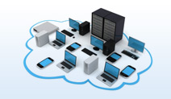






Broad Network Access
As an architect of a private cloud solution, I want to be sure that an appropriate level of security applies regardless of client location and regardless of form factor. This requirement applies to both cloud management and application security.
Bring Your Own Device
Assess device state
Application access control
Data on device
Dissociation of IT from Device Control

Slide 22
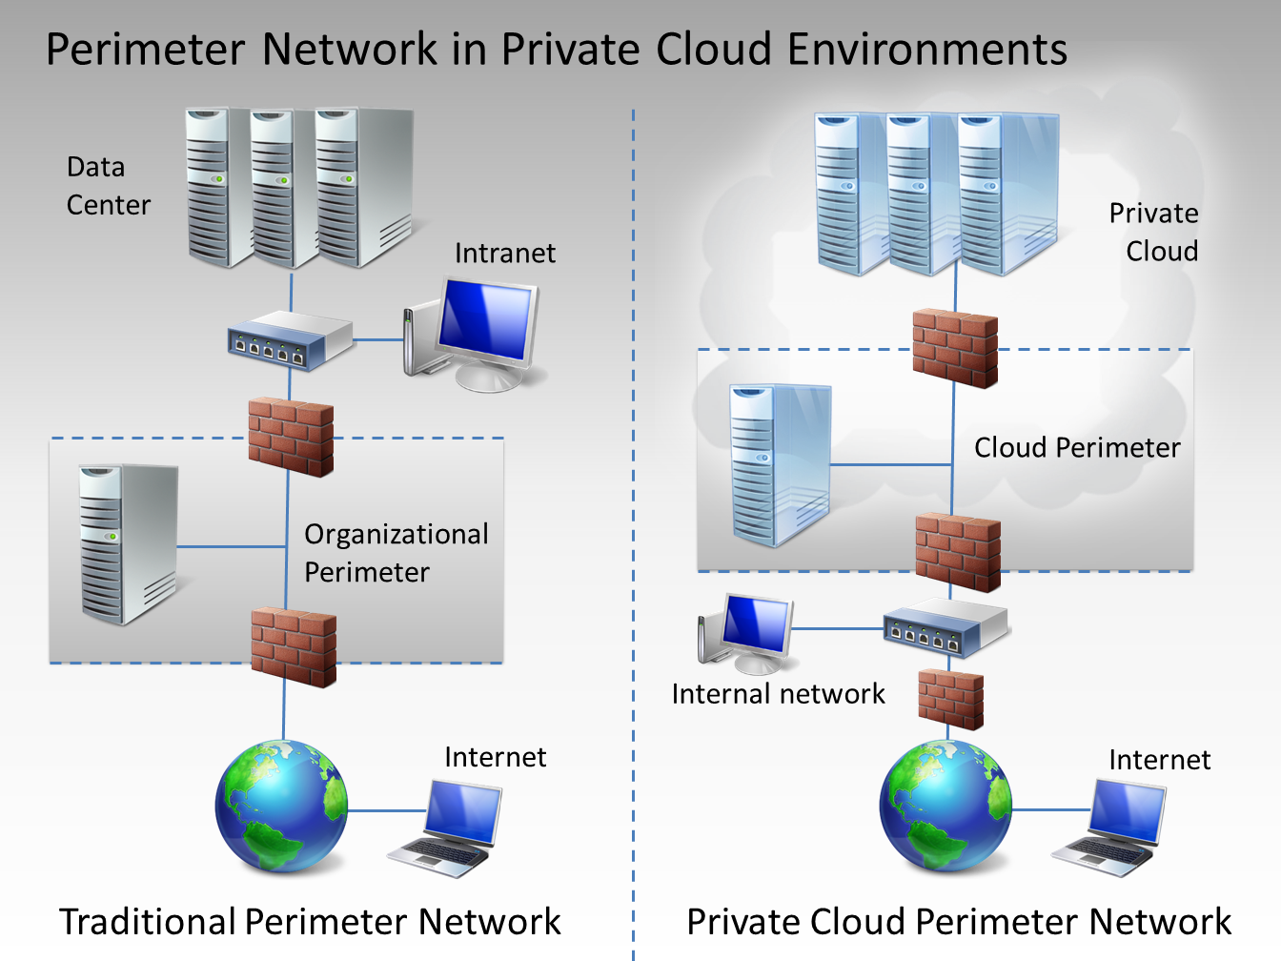
Broad Network Access - Reperimeterization
Driven By:
IPv6
Porous borders
“Tail Chasing”
Cost/benefit
Authenticated Attackers
Client Types
Defense in Depth

Slide 23
Private Cloud Reference Model
Private Cloud Security
Tom Shinder
Principal Writer
Microsoft SCD iX Solutions Group

Slide 24


What is a Reference Model?
A Reference Model is:
Abstract
Describes entities and there relationships
Defines and clarifies a problem space
Technology agnostic
A Reference Model can be used to:
Create standards for objects in the model
Break down a large problem space
Define concepts and relationships
Define and create roles and responsibilities
Compare different things (software solutions)

Slide 25
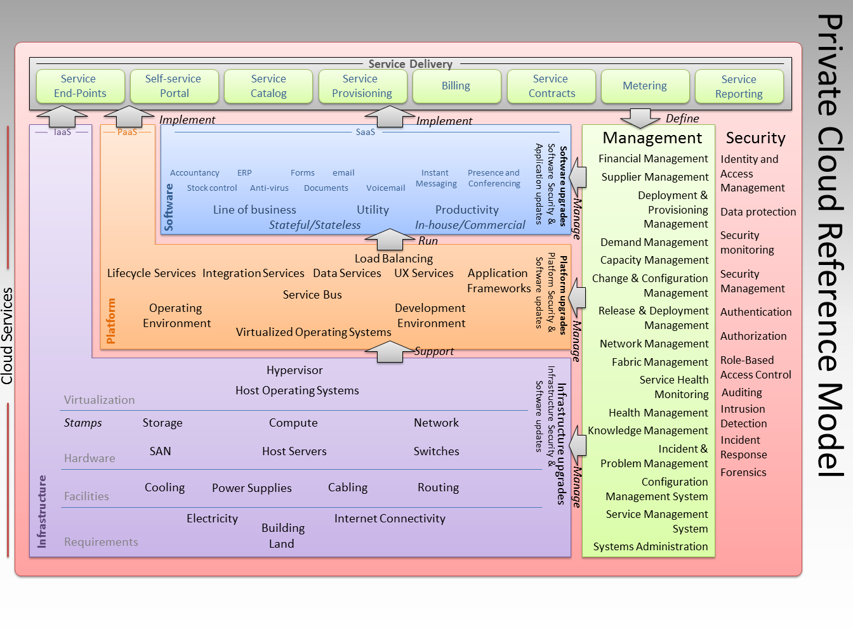
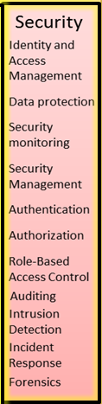
Reference Model

Slide 26
Private Cloud Security Model
Private Cloud Security
Tom Shinder
Principal Writer
Microsoft SCD iX Solutions Group

Slide 27

Private Cloud Security Model
Security Functionality
Infrastructure Security
Platform Security
Software Security
Service Delivery Security
Management Security
Client Security
Legal/Compliance
Security Domains

Slide 28
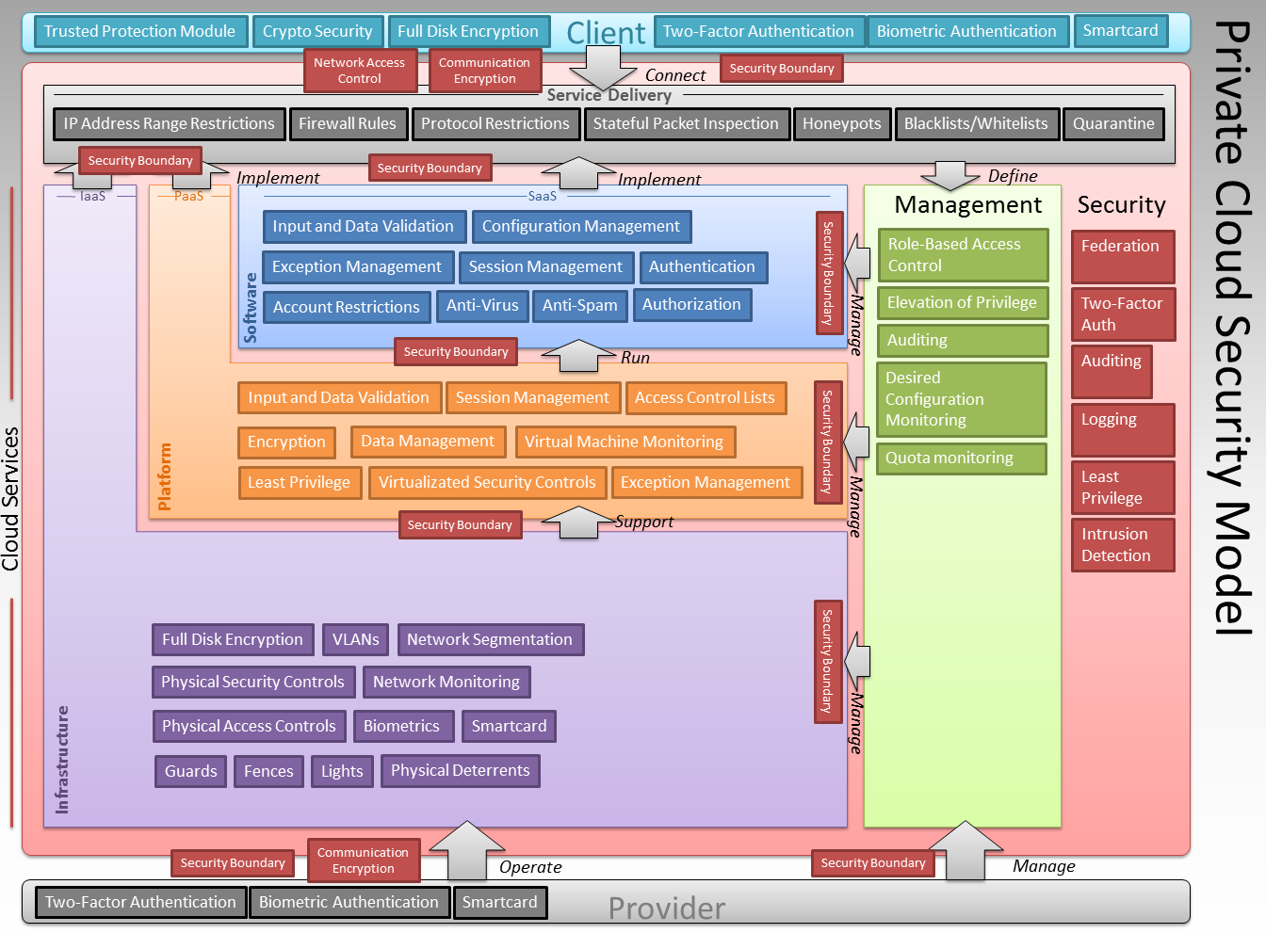
Security Model

Slide 29
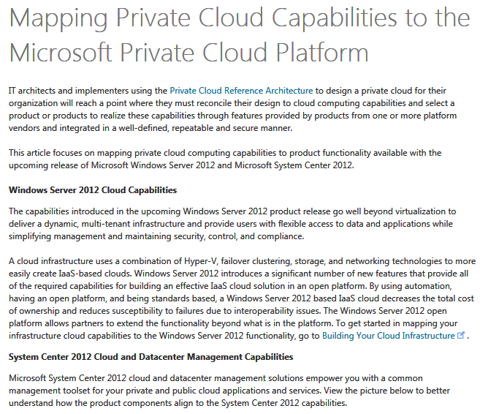
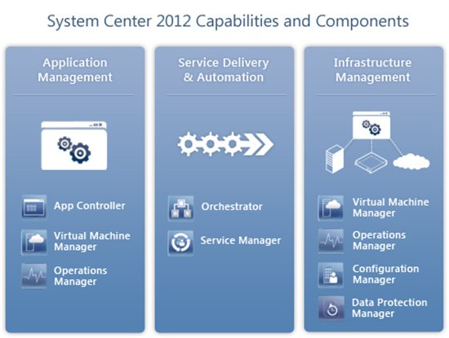
Microsoft Technology Mapping
http://aka.ms/wn5r2f

Slide 30
A Closer Look
Virtualization Platform
Physical Network Isolation
Logical Network Isolation

Slide 31

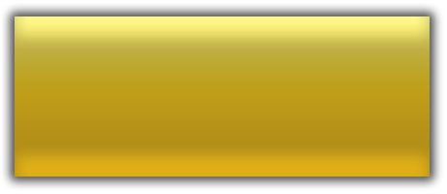


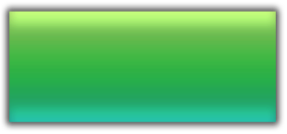
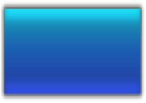




A Closer Look: Virtualization Security
Root Partition
Guest Partitions
Ring 3
Ring 3
Microkernel Hypervisor
  Isolation boundary between partitions
  Minimal TCB with no third-party drivers
Root partition
  Mediates all access to hypervisor
  Server core minimizes attack surface
    ~50% less patching required
  Guests cannot interfere with each other
    Dedicated workers processes
    Dedicated VMBus channel
Virtualization Stack
VM Worker
Processes
Guest
Applications
OS
Kernel
Server Core
Windows
Kernel
Device
Drivers
VMBus
Ring 0
Ring 0
“Ring “-1”
Windows hypervisor
Storage
NIC
CPU

Slide 32

Secure Virtualization Platform
VM 1
(Admin)
VM 2
VM 3
Monolithic Hypervisor hosts:
  Virtualization stack
  3rd party device drivers
Larger code base
  Harder to security test
  More exposure
Root
Partition
VM 1
VM 2
Guest
Partition
Guest
Partition
Virtual-
ization
Stack
Hypervisor
Virtualization Stack
Drivers
Hypervisor
Drivers
Hardware
Hardware
“The fact is, the absolute last place you want to see drivers is in the hypervisor, not only because the added abstraction layer is inevitably a big performance problem, but because hardware and drivers are by definition buggier than "generic" code that can be tested.”
Linus Torvalds, https://lists.linux-foundation.org/pipermail/desktop_architects/2007-August/002446.html

Slide 33
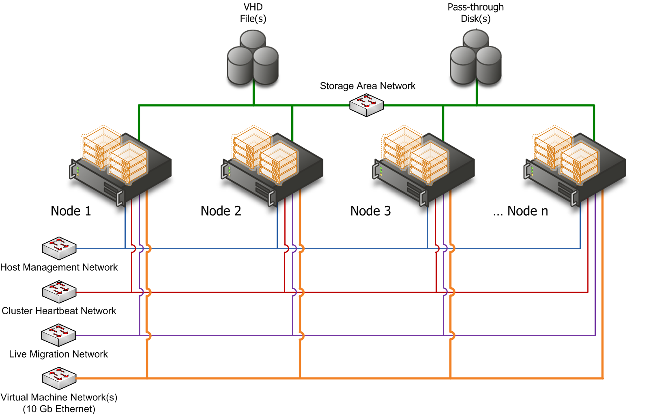
A Closer Look: Physical Network Isolation
Hosts and VMs support 802.1Q (VLAN tagging)
  Each assigned VLAN ID
  Enforced across network
  fabric
  Firewalls permit inter-VLAN traffic as per policy
Isolates:
  Host from guests
  Mgmt. traffic from guest
  traffic

Slide 34

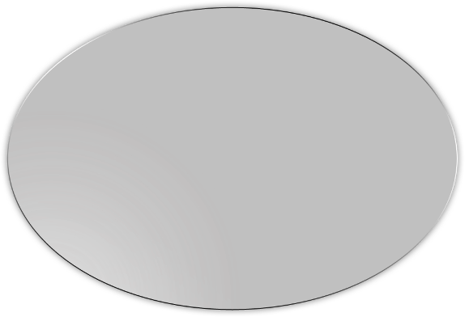

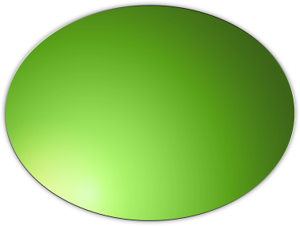
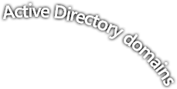


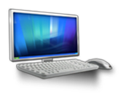

A Closer Look: Logical Network Isolation
Host-based firewall enabled
Block all inbound connections to non-essential services
  Deny guest to host / management systems
  Centrally managed firewall policy
Server and Domain Isolation using IPsec
  Non-domain hosts cannot connect
  Trusted hosts within domain must
  authenticate to connect
Data Center’s
Physical Servers
Guest OS
Network Level Authentication
AuthIP
Data-Center Network

Slide 35
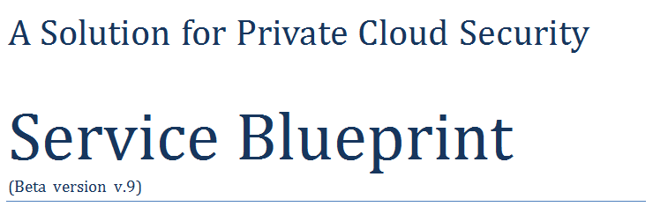
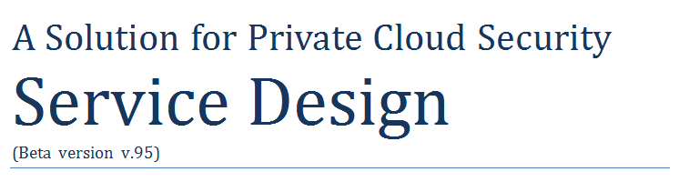
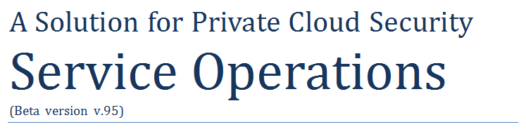
Next Steps
http://aka.ms/zaaag2

Slide 36
New Windows Server 2012 Book
announcing

Slide 37
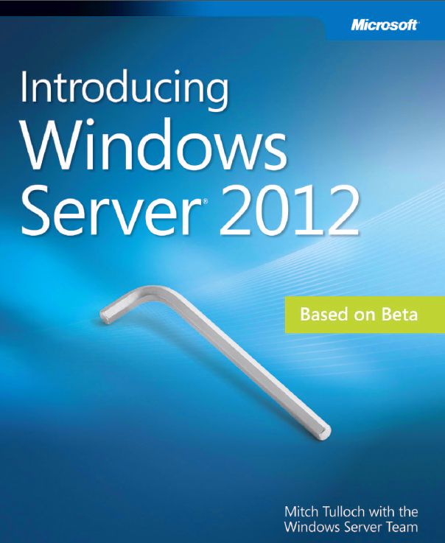
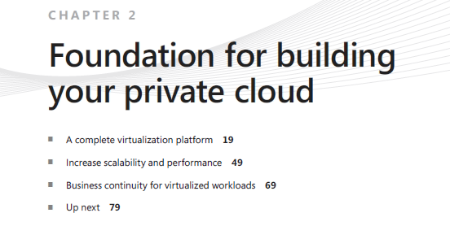
Introducing Windows Server 2012
Read it all – pay special attention to
Chapter 2!
http://aka.ms/xv5ypl

Slide 38
New Windows Server 2012 Security Book
announcing

Slide 39
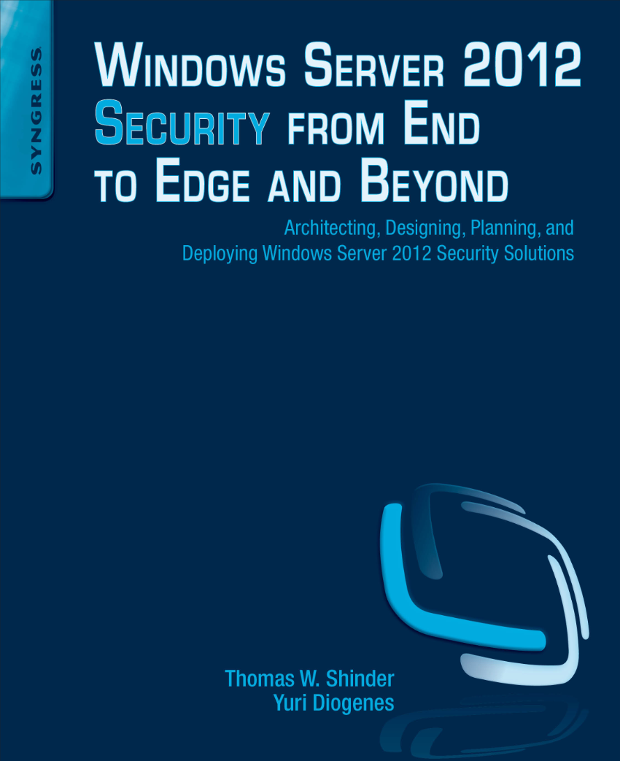
Windows Server 2012 Security from End to Edge and Beyond
Expected release date: Q1 2013

Slide 40
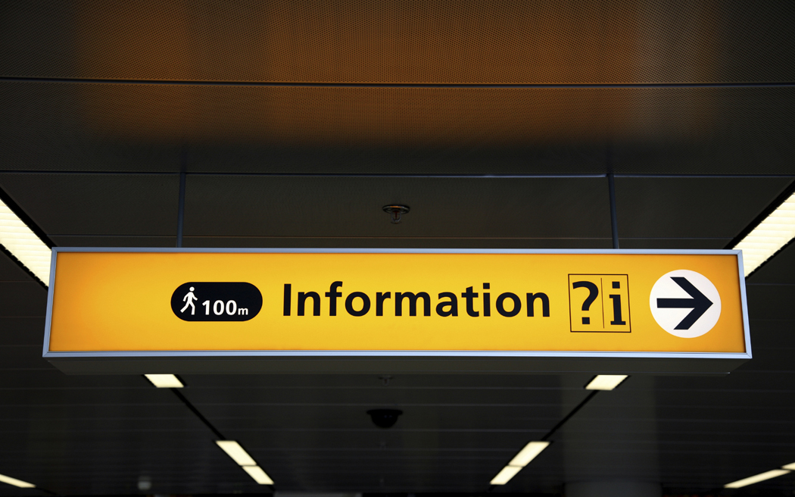
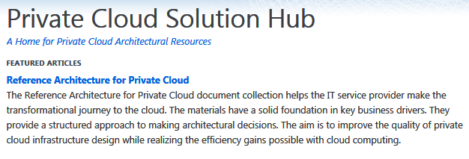

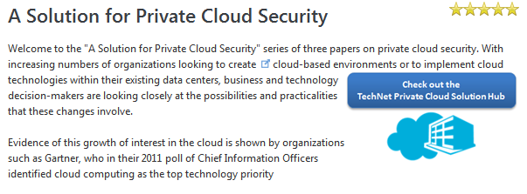
For More Information
www.technet.com/cloud/private-cloud
http://aka.ms/puptnb

Slide 41
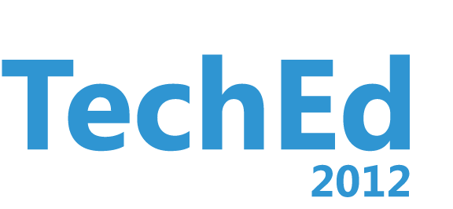
Related Content
SIA204 Cloudy Weather: How Secure is the Cloud?
OSP323 Microsoft Office 365 Security, Privacy and Trust
AAP302 The Four Pillars of Identity: A Solution for Online Success
AAP304 Private Cloud Principles, Concepts and Patterns
AAP201 Hybrid Computing is the New Net Norm

Slide 42



Resources
Learning
  Connect. Share. Discuss.
  Microsoft Certification & Training Resources
http://northamerica.msteched.com
www.microsoft.com/learning
TechNet
  Resources for IT Professionals
  Resources for Developers
http://microsoft.com/technet
http://microsoft.com/msdn

Slide 43



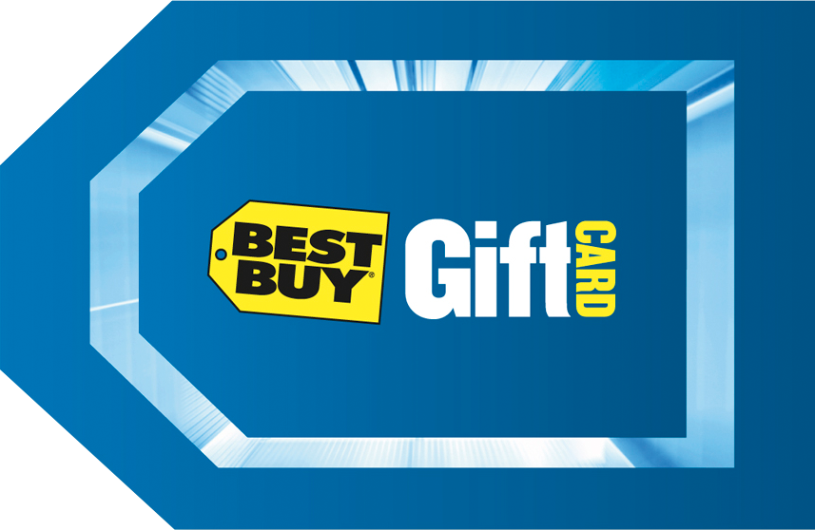



Required Slide
Complete an evaluation on CommNet and enter to win!

Slide 44


MS Tag
Scan the Tag
to evaluate this
session now on
myTechEd Mobile

Slide 45
© 2012 Microsoft Corporation. All rights reserved. Microsoft, Windows, Windows Vista and other product names are or may be registered trademarks and/or trademarks in the U.S. and/or other countries.
The information herein is for informational purposes only and represents the current view of Microsoft Corporation as of the date of this presentation. Because Microsoft must respond to changing market conditions, it should not be interpreted to be a commitment on the
part of Microsoft, and Microsoft cannot guarantee the accuracy of any information provided after the date of this presentation. MICROSOFT MAKES NO WARRANTIES, EXPRESS, IMPLIED OR STATUTORY, AS TO THE INFORMATION IN THIS PRESENTATION.

