Slide 1



Understanding and Deploying Hosted Private Cloud: Concepts and Implementation
WSV320
Josh
Adams
Senior Program Manager
Microsoft Enterprise Engineer Center (EEC)
Tom Shinder
Principal Writer
Microsoft SCD iX Solutions Group
Yuri Diogenes
Senior Technical Writer
Microsoft SCD iX Foundations Group

Slide 2
Agenda
Concepts
  Defining Cloud
  Private Cloud Reference Architecture
Scenarios
  Practical scenarios
Designing and Planning
  What’s right for me?
Implementation
  Building a Cloud Infrastructure Demo

Slide 3
Building a Cloud Infrastructure on Windows Server 2012
Concepts
Tom Shinder
Principal Writer
Microsoft SCD iX Solutions Group

Slide 4
NIST Cloud Definition
Hybrid Clouds
Deployment
Models
Private Cloud
Community
Cloud
Public Cloud
Service
Models
Infrastructure as a Service (IaaS)
Platform as a Service (PaaS)
Software as a Service (SaaS)
On Demand Self-Service
Essential
Characteristics
Broad Network Access
Rapid Elasticity
Resource Pooling
Measured Service
Massive Scale
Resilient Computing
Common
Characteristics
Homogeneity
Geographic Distribution
Virtualization
Service Orientation
Low Cost Software
Advanced Security

Slide 5
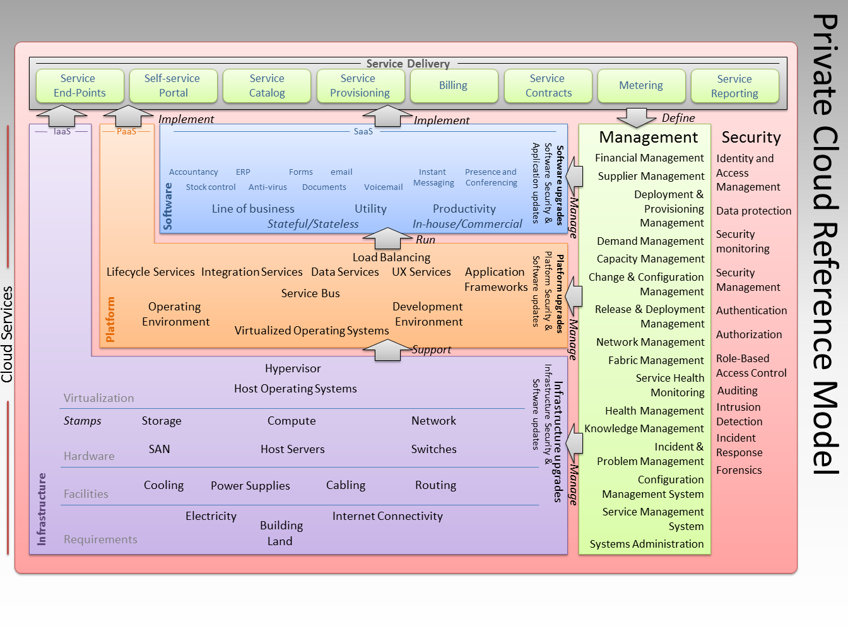
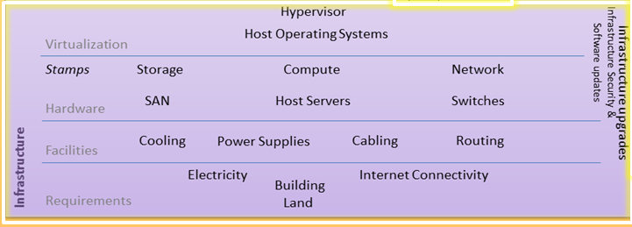
Reference Model

Slide 6
Practical scenarios
Scenarios
Yuri Diogenes
Senior Technical Writer
Microsoft SCD iX Foundations Group

Slide 7
Practical Scenarios
Building your cloud infrastructure allows you to design a Hyper-V cluster for:
  Hosting virtual machines on an IaaS cloud
  Performing operations such as on boarding of new and existing virtual machines
  Virtual machine maintenance
Proposed Cloud Infrastructure Scenarios
  Non-Converged Enterprise Configuration
  Converged Data Center with File Server Storage
  Converged Data Center without Dedicated Storage Nodes
This is the Cloud Infrastructure
Not a complete IaaS solution

Slide 8
Non-Converged Enterprise Configuration
Non-Converged Networking with SAN
Physically isolated networks
Traditional SANs
Hyper-V Server
VM 1
VM 2
Storage
Live Migration
Cluster
Manage
Hyper-V
Extensible Switch
HBA /
10GbE
1 GbE
1 GbE
1 GbE
1GbE /
10 GbE + SR-IOV
FC / iSCSI
SAN
Infrastructure Network:
Storage/Live Migration/Cluster/Management

Slide 9
Converged Datacenter Network + File Server Storage
Converged Networking and File Based Storage
Separate Infrastructure and Tenant Networks
File Server for VM storage
File Server
Hyper-V Server
VM 1
VM n
Cluster
Storage
Manage
Live Migration
Cluster / Storage
Manage
Hyper-V
Extensible Switch
HBA
(Optional)
10GbE
(RDMA)
10GbE
(RDMA)
1/10GbE
FC/SAS
Infrastructure Network
Tenant Network
iSCSI
SAN / JBODs
Infrastructure Network:
Storage/Live Migration/Cluster/Management

Slide 10
Converged Network and Storage
Converged Compute + Storage:
10GbE Network(s), fully converged
Hyper-V Server
VM 1
VM n
Live Migration
Cluster / Storage
Manage
Hyper-V
Extensible Switch
HBA
(Optional)
1/10GbE
Tenants Network
FC/SAS
SAN / JBODs

Slide 11
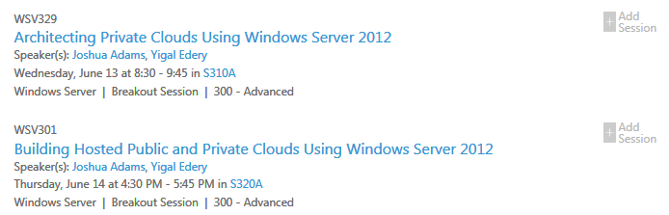
LEARN MORE!
WSV329
WSV301

Slide 12
What’s right for me?
Designing and Planning
Tom Shinder
Principal Writer
Microsoft SCD iX Solutions Group

Slide 13
Storage Options and Decisions
Single Cluster
Well-connected Storage
Spaces or SAN
10 GbE
Storage and Compute Cluster
“I need a very low cost storage solution”
“Most of my VMs are disk-bound”
“My infrastructure doesn’t yet support 10 GbE”
“I need the highest performance possible”
“I need to scale storage and compute together”
“I need a highly available solution”
CSV
Scale Unit
Scale Unit
Scale Unit
Scale Unit
Hyper-V Host
Hyper-V Host
Hyper-V Host
Hyper-V Host
Hyper-V
Host
Hyper-V
Host
Hyper-V
Host
Hyper-V
Host
Space
Space
Space
Space
Space
Space
Space
Space
Shared JBOD SAS/SAN
Shared JBOD SAS/SAN
Shared JBOD SAS/SAN
Shared JBOD SAS/SAN
…
…

Slide 14
Storage Options and Decisions
Compute Cluster
Storage Cluster
File-Based Storage
Flexible Block Options
10 GbE (RDMA/SMB3/NFS/LBFO/Multipath)
“I need to manage my compute and storage infrastructure separately (cabling and other Px infrastructure constraints)
“I need the flexibility of file-based storage for VHDs (SMB and NFS)
“My primary workloads are expected to be compute-bound”
“We need to keep the storage team and compute teams as separate as possible”
Compute Cluster
Storage Cluster
CSV
Compute Scale Unit
Compute Scale Unit
Storage Scale Unit
Storage Scale Unit
Hyper-V Host
Hyper-V Host
Hyper-V Host
Hyper-V Host
File Server
File Server
File Server
File
Server
Space
Space
Space
Space
Shared JBOD SAS/SAN
Shared JBOD SAS
…
…
…
…

Slide 15
Network Options and Decisions
“I require Px separation for all network traffic types
  One NIC each for tenant/management/Live Migration/Storage/Cluster-CSV traffic
“I require Px separation for Infrastructure and Tenant traffic
  One NIC for Infrastructure and One for Tenant
“I only have slots for a single NIC team”
  Consolidate infrastructure/tenant traffic through Hyper-V Switch
Hyper-V Server
VM 1
VM 2
Storage
Live Migration
Cluster
Manage
Hyper-V Server
VM 1
VM n
Hyper-V
Extensible Switch
Hyper-V Server
Live Migration
Cluster / Storage
Manage
VM 1
VM n
Live Migration
Cluster / Storage
Manage
Hyper-V
Extensible Switch
HBA /
10GbE
1 GbE
1 GbE
1 GbE
1GbE /
10 GbE + SR-IOV
Hyper-V
Extensible Switch
10GbE
(RDMA)
1/10GbE
1/10GbE

Slide 16
Compute/Virtualization Design
“I require compute and memory isolation for selected workloads
  Processor affinity
  NUMA support
“I want to deploy scale units that mirror fault domains
  Use Failover Clusters to define both scale unit and fault domain
“I have a completely stateless application and want to keep the compute layer simple
  Use standalone servers and fabric management with clustering
  Use both Hyper-V Replica and Live VM and Storage Migration

Slide 17

Example Requirements and Design
I require cost effective storage
I require file based VHD storage
I require Px separation of Infrastructure and Tenant Traffic
I require HA for Infrastructure and Tenant traffic
I require scale units and fault domains of the same size
I require HA for stateful applications
File Server Cluster (SMB3)
Storage Spaces
Infrastructure NIC Teams (LBFO) for Infrastructure and Tenant Traffic
Compute Cluster (Failover Clustering)
File Server
Hyper-V Server
VM 1
VM n
Cluster
Storage
Manage
Live Migration
Cluster / Storage
Manage
Hyper-V
Extensible Switch
SAS HBA
10GbE
(RDMA)
10GbE
(RDMA)
1/10GbE
SAS
Infrastructure Network
Tenant Network
JBOD
Storage Spaces

Slide 18
Building a Cloud Infrastructure Demo
Implementation
Josh
Adams
Senior Program Manager
Microsoft Enterprise Engineer Center (EEC)
Yuri Diogenes
Senior Technical Writer
Microsoft SCD iX Foundations Group

Slide 19
Implementation Steps Part 1: Storage
Initial Storage Configuration
  Connect and Prepare Shared Storage
  Install Roles and Features
Storage Cluster Setup
  Cluster Validation
  Cluster Wizard
  Clustered Storage
  CSV and Scale-Out File Server
  Shared Folders

Slide 20
Building a Cloud Infrastructure Part 1 - Storage
demo
Josh
Adams
Senior Program Manager
Microsoft Enterprise Engineer Center (EEC)

Slide 21
Implementation Steps Part 2: Hyper-V
Hyper-V Configuration
  BIOS Requirements
  Install Roles and Features
Hyper-V Cluster Configuration
  Cluster Validation
  Cluster Wizard
  Cluster Tuning
Additional Hyper-V Configuration
  Data Location
  Virtual Switch

Slide 22
Building a Cloud Infrastructure Part 2 – Hyper-V
demo
Josh
Adams
Senior Program Manager
Microsoft Enterprise Engineer Center (EEC)

Slide 23
Implementation Steps Part 3: Validation
Validate the configuration
  Create a VM
  Perform a Quick or Live Migration

Slide 24
Building a Cloud Infrastructure Part 3 – Validation
demo
Josh
Adams
Senior Program Manager
Microsoft Enterprise Engineer Center (EEC)

Slide 25
Questions?

Slide 26
New Windows Server 2012 Book
announcing

Slide 27
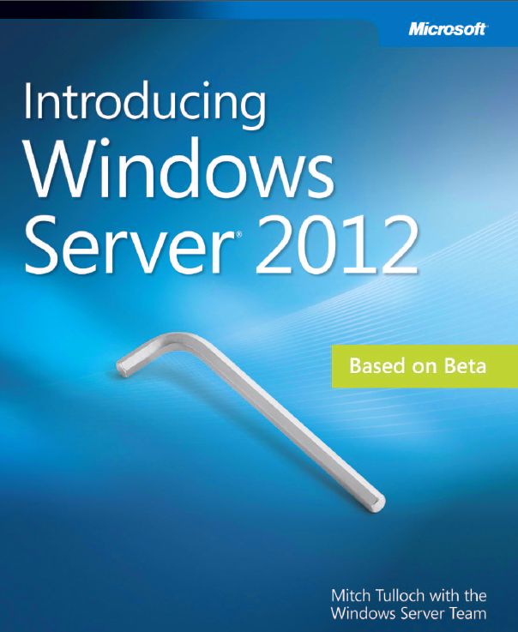
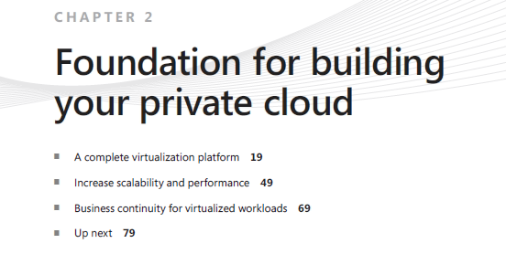
Introducing Windows Server 2012
Read it all with an extra attention to
Chapter 2!

Slide 28
New Windows Server 2012 Security Book
announcing

Slide 29
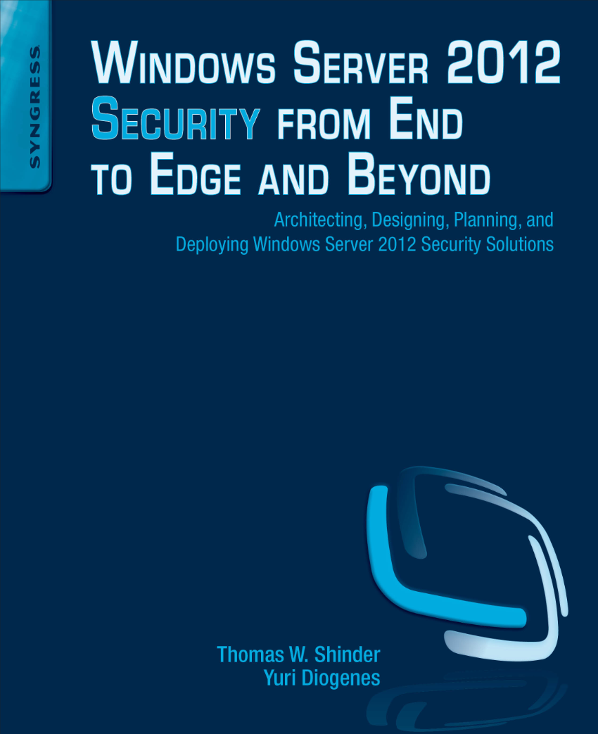
Windows Server 2012 Security from End to Edge and Beyond
Expected release date: Q1 2013

Slide 30

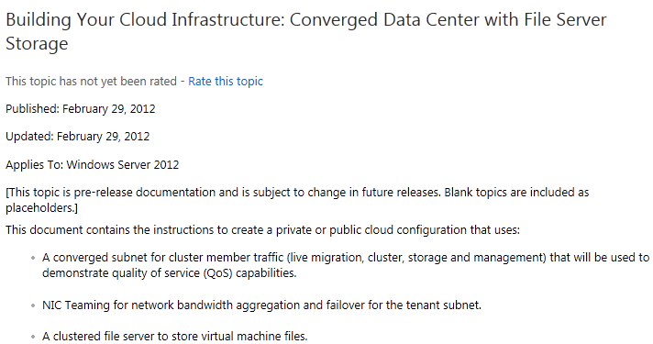
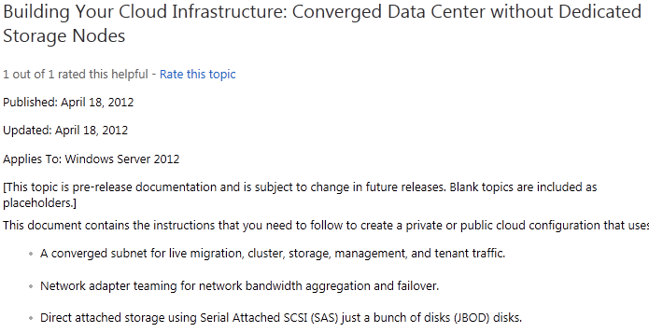

For More Information
http://aka.ms/uuxl5z
http://aka.ms/u1sirf

Slide 31


Related Content
AAP304 Private Cloud Principles, Concepts and Patterns
WSV329 Architecting Private Clouds Using Windows Server 2012
WSV301 Building Public and Private Clouds Using Windows Server 2012
VIR306 Hyper-V over SMB3: Remote File Storage Support in Hyper-V
WSV334 Windows Server 2012 File and Storage Services Management

Slide 32


SIA, WSV, and VIR Track Resources
#TE(sessioncode)
Talk to our Experts at the TLC
Hands-On Labs
DOWNLOAD Windows Server 2012 Release Candidate
microsoft.com/windowsserver
DOWNLOAD Windows Azure
Windowsazure.com/
teched

Slide 33



Resources
Learning
  Connect. Share. Discuss.
  Microsoft Certification & Training Resources
http://northamerica.msteched.com
www.microsoft.com/learning
TechNet
  Resources for IT Professionals
  Resources for Developers
http://microsoft.com/technet
http://microsoft.com/msdn

Slide 34







Required Slide
Complete an evaluation on CommNet and enter to win!

Slide 35


MS Tag
Scan the Tag
to evaluate this
session now on
myTechEd Mobile

Slide 36
© 2012 Microsoft Corporation. All rights reserved. Microsoft, Windows, Windows Vista and other product names are or may be registered trademarks and/or trademarks in the U.S. and/or other countries.
The information herein is for informational purposes only and represents the current view of Microsoft Corporation as of the date of this presentation. Because Microsoft must respond to changing market conditions, it should not be interpreted to be a commitment on the
part of Microsoft, and Microsoft cannot guarantee the accuracy of any information provided after the date of this presentation. MICROSOFT MAKES NO WARRANTIES, EXPRESS, IMPLIED OR STATUTORY, AS TO THE INFORMATION IN THIS PRESENTATION.

